Slide 1


What is an intelligent product?
Vaggelis Giannikas
Duncan McFarlane
Mark Harrison

Slide 2

Intelligent Product [Descriptive]
“A physical order or product that is linked to information and rules governing the way it is intended to be made, stored or transported that enables the product to support or influence these operations”

Slide 3
Characteristics of Intelligent Product
Possesses a unique identity
Is capable of communicating effectively with its environment
Can retain or store data about itself
Deploys a language to display its features, production requirements etc.
Is capable of participating in or making decisions relevant to its own destiny
Able to match physical goods to order information
Access to a network connection [directly or indirectly]
Linked to static and dynamic data about item – across multiple organisations
Able to respond to queries
Priority, routing, production, usage decisions can be made [on behalf of] the item
Decision
Making
Agent
network
Network
DataBase
Reader
(Wong et al., 2002, McFarlane et al, 2003)
Tag/ID

Slide 4
Levels of Product Intelligence
Level 1 Product Intelligence: which allows a product to communicate its status (form, composition, location, key features), i.e. it is information-oriented.
Level 2 Product Intelligence: which allows a product to assess and influence its function in addition to communicating its status, i.e. it is decision-oriented.
(Wong et al., 2002)

Slide 5
Levels of Product Intelligence
Level 1
Represent the (customer) needs linked to the order: e.g. goods required, quality, timing, cost agreed
Communicate with the local organisation (as well as with the customer for the order)
Monitor/track the progress of the order through the industrial supply chain
Level 2
[Using the preferences of the customer] to influence the choice between different options affecting the order when such a choice needs to be made
Adapt order management depending on conditions.

Slide 6
Application areas

Slide 7
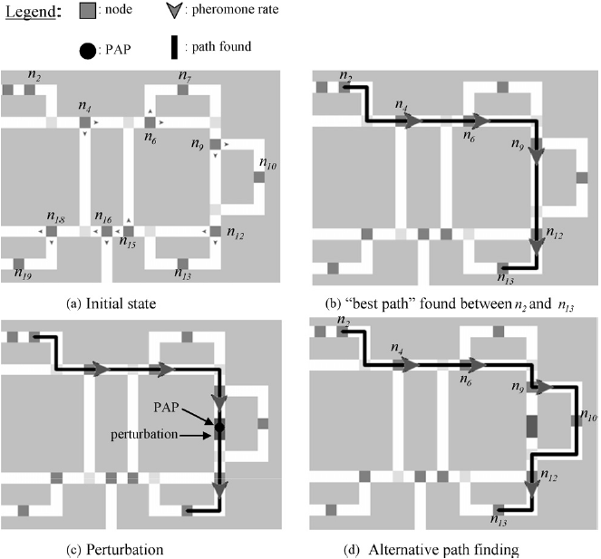
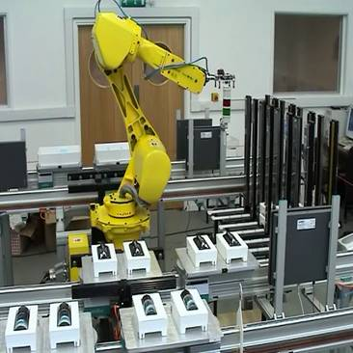
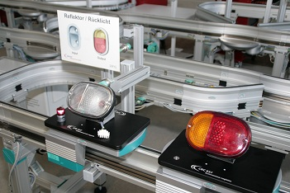
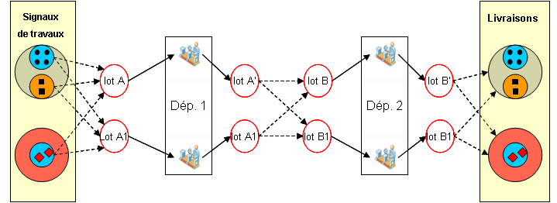
PI Developments in Manufacturing
(Chirn et al., 2002)
(Sallez et al., 2009)
(Thomas et al., 2012
(Morales-Kluge et al., 2011)

Slide 8
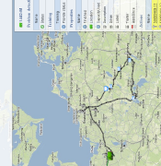
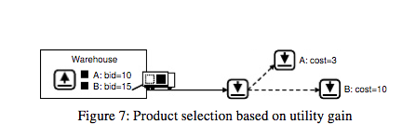
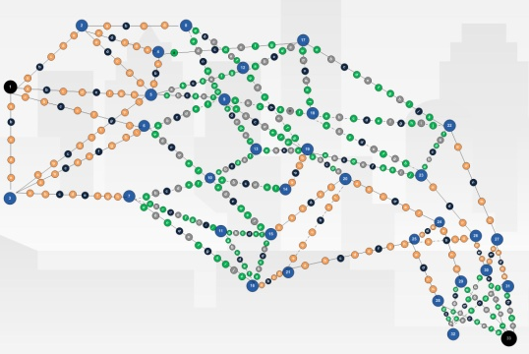
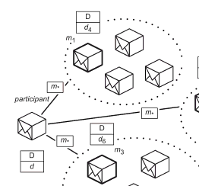
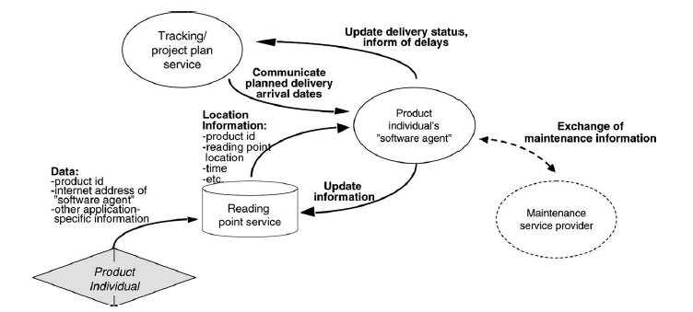
PI Developments in Logistics
(Giannikas and Kola, 2012)
(Meyer et al, 2009)
(Schuldt, 2011)
(Karkkainnen et al, 2003)

Slide 9
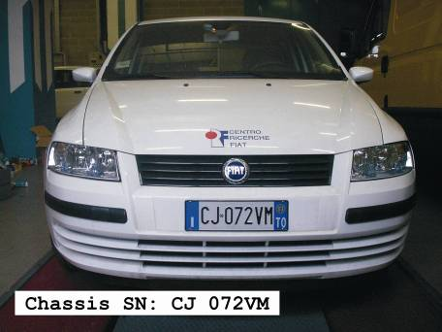
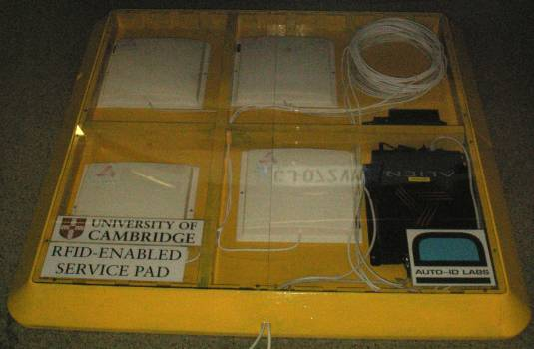
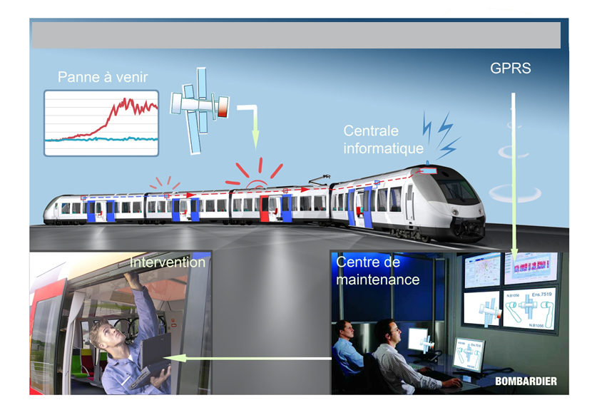
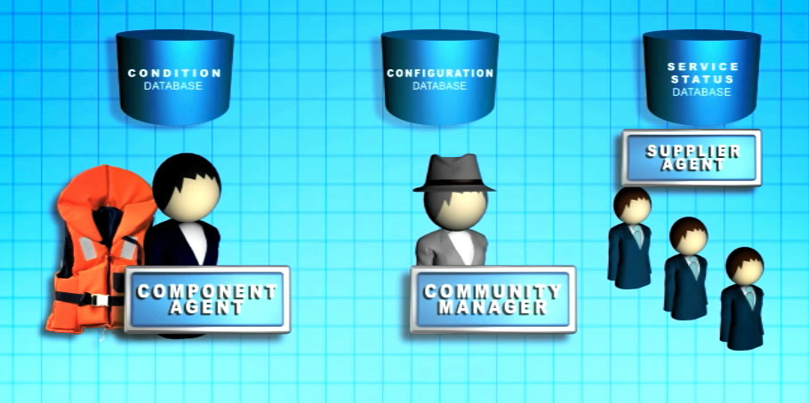
PI Developments in Services
(LeMortellec et al, 2012)
(Parlikad et al, 2008)
(Brintrup et al, 2010)

Slide 10
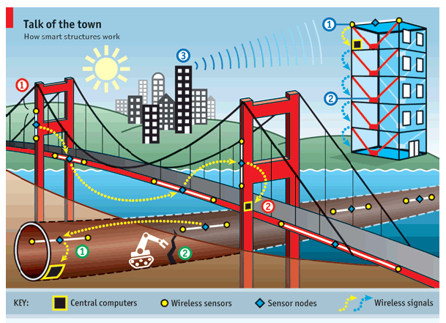
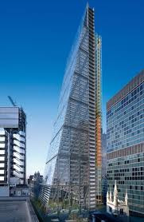
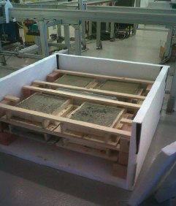


PI Developments in Construction

Slide 11
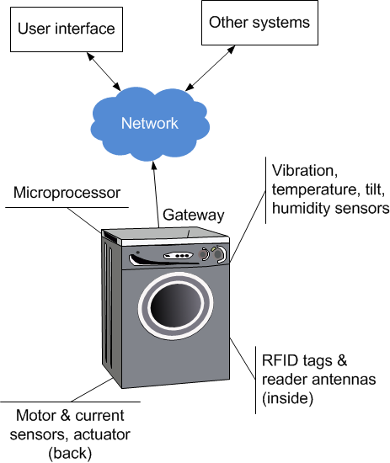
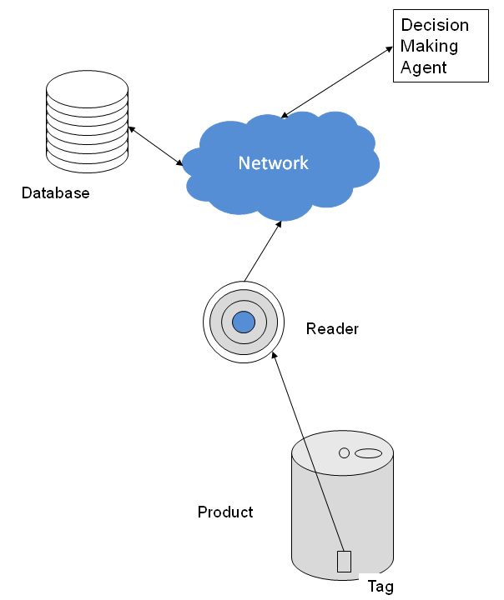
Where is the intelligence?
Local
Remote

Slide 12
Benefits – Where/When useful

Slide 13
Today’s Opportunities: Structural
Multi Organisation: When a product or order moves between organizations in its delivery
Multi Ordering: When a specific item can be part of multiple orders/ consignments for certain stages of its production/ delivery.
Customer Specific: When a customer’s specific requirements for his order is at odds with the aggregate intentions of the logistics organisation.
Distributed Orders: When an order exists in multiple segments scattered across multiple organizations.
Unique Order: When an order is irreplacable
Decision
Making
Agent
network
Network
DataBase
Reader
Tag/ID

Slide 14
Today’s Opportunities: Behavioural
Changing Environment: When options arise frequently and unpredictably for alternative routings to be considered.
Frequent Disruption: When disruptions are frequent and performance guarantees are difficult to achieve.
Dynamic Decisions: When decision making about order management requires human resources that are not available.
Customer Preference Changes: When customer’s preferences change between ordering and delivering.
Decision
Making
Agent
network
Network
DataBase
Reader
Tag/ID

Slide 15
Deployment Issues:
Drivers & Enablers
Business Drivers |  | Technological Enablers
energy price constraints |  | RFID Systems
environmental constraints |  | Object and Vehicle Location Systems
tighter traceability regulations & practices |  | Distributed Data Management Methods
supply chain disruptions |  | Order Tracking Software
internet-based consumer services |  | Web/Cloud Services

Slide 16
Our current research

Slide 17




Our Research
Focussing on event monitoring in multimodal transportation
Particular interest in dynamic rerouting decisions/actions
when there are logistics disruptions
Industrial scoping study on issues and barriers to effective
multimodal rerouting
Considering a distributed, intelligent system paradigm
[“product intelligence’] as a means of addressing problem
K
N
R
A
O
S
B
L
P
T

Slide 18
Multimodal Routing Problems
A-Priori Routing Problem: Optimal route and servicing selection in an existing multimodal network prior to shipment
complex, multi objective, optimisation
Static, non real time computation
Dynamic Re-Routing Problem: Optimal route and servicing selection revision in an existing multimodal network after shipment has been initiated.
Disruption driven changes
Real time, dynamic recalculation
Many physical limitations &
constraints

Slide 19
Multimodal Rerouting Today
Often not done
Limited data sharing between organisations
Time and labour intensive
Non optimal: first feasible option
Oriented to the needs of logistics organisation [not the end customer]
…. There are physical limitations to rerouting

Slide 20
Challenges in Multimodal Rerouting
Order-level information: High granularity data needed
Lifecycle information: routing/tracking information all along logistics path
Distributed decision making: multiple organisations involved/implicated in any revised decision
Multi-objective nature of decisions: order, consignment, vehicles, companies involved have conflicting needs
Time-critical decisions: options vary over time
Time-consuming problem solving: complex calculation, distributed data, knock on effects are time consuming
Order-level decisions: each order requires individual handling
Desirable behavior: when to co-operate? when to compete?

Slide 21
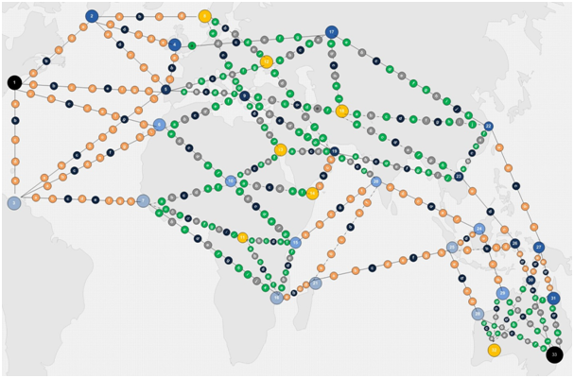
Simulation games for data capturing
Notes:
We want to study what people do in their travel scenarios and replicate their successful tactics in freight transportation

Slide 22
Interested?
Customers that want better visibility and better control of their orders
Logistics providers that want to improve event/disruption monitoring and control
Anybody else interested in the concept?
Vaggelis Giannikas
PhD Researcher
University of Cambridge
eg366@cam.ac.uk
Contact

Slide 23

Intelligent Aircraft Parts
[ SAHNE Project Video ]
http://www2.ifm.eng.cam.ac.uk/automation/videos/SAHNE_short_video.mp4
Notes:
23

