Slide 1
  Overview of the GS1 Architecture – Lunch & Learn
GS1 Global Standard Event Atlanta
26 March 2014

Slide 2



Agenda
David Buckley: Introducing the GS1 Architecture Group
Sue Schmid: GS1 System Principles & Liaison process
Ken Traub: GS1 System Architecture & GS1 System Landscape
  All Questions & Answers / Wrap up and close

Slide 3
1: Introducing the GS1 Architecture Group
David Buckley

Slide 4
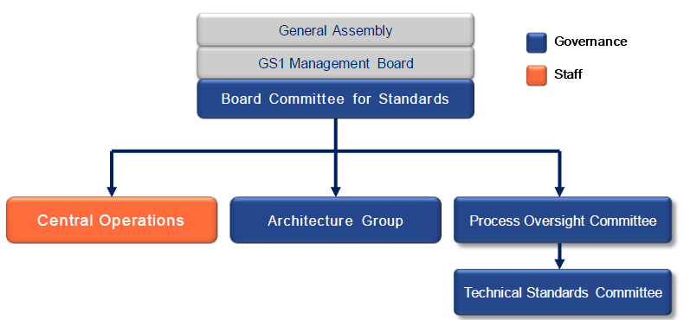

The GS1 Architecture Group
GS1 Architecture Group is an advisory body composed of end users, solution providers, and MO representatives to ensure the integrity, consistency and efficient interoperation of the GS1 System via a documented GS1 System Architecture.
Notes:
The GS1 Architecture Group is a formal part of the GS1 Governance Structure. It is important to stress that it is an advisory body.
Central Operations is a governance support entity which represents the staff function and reports to the Vice President of Global Standards.

Slide 5
Principal Responsibilities of Architecture Group
To promote and protect the integrity of the GS1 System
To ensure the GS1 System Architecture is well documented, accessible, extensible, and broadly understood
To review and provide recommendations for business standards and services development
To advise on strategic direction for the GS1 Portfolio
To respond to issues or questions submitted by members of the GS1 community regarding the GS1 System
To foster the integration of the GS1 System into commercial solutions and products

Slide 6
What the Architecture Group does not do
The Architecture Group does not change decisions regarding the content of work carried out by GSMP groups or project teams; but makes recommendations on matters that affect the technical integrity and interoperability of GS1 System.

Slide 7
AG Members: have a 3-year term
Name & organisation (Chairs in bold) | Term start | Term end |  | Term start | Term end
Robert Abate, Wal-Mart | 18 Feb 2013 | May 2016 | Staffan Olsson, GS1 Sweden | 20 May 2013 | May 2014
Xavier Barras, GS1 France | 7 Oct 2011 | May 2015 | Andrew Osborne, GS1 UK | 20 May 2013 | May 2015
Henri Barthel, GS1 GO | 20 May 2013 | May 2016 | Kunle Oye-Igbemo, GS1 Nigeria | 7 Oct 2011 | May 2015
David Buckley, GS1 GO | 20 May 2013 | May 2016 | Josef Preishuber-Pfluegl, CISC | 20 May 2013 | May 2014
Kevin Dean, GS1 Canada | 20 May 2013 | May 2015 | Pere Rosell, GS1 Spain | 20 May 2013 | May 2015
Vera Feuerstein, Nestle | 20 May 2013 | May 2016 | Sue Schmid, GS1 Australia | 20 May 2013 | May 2014
Andreas Füßler, GS1 Germany | 20 May 2013 | May 2016 | Eugen Sehorz, GS1 Austria | 20 May 2013 | May 2016
Hein Gorter de Vries, GS1 Nederland | 20 May 2013 | May 2016 | KK Suen, GS1 Hong Kong | 20 May 2013 | May 2014
Mark Harrison, Cambridge Auto-ID Lab | 20 May 2013 | May 2015 | John Terwilliger, Abbott | 7 Oct 2011 | May 2015
Fred Kempkes, Unilever | 18 Feb 2013 | May 2016 | Ken Traub, Ken Traub Consulting | 20 May 2013 | May 2015
Jens Kungl, Metro Group | 20 May 2013 | May 2016 | Junyu Wang, Fudan Auto-ID Lab | 6 Nov 2012 | May 2016
Sean Lockhead, GS1 GO | 20 May 2013 | May 2016 | Tony Zhang, FSE | 14 Feb 2012 | May 2015
Roberto Matsubayashi, GS1 Brasil | 20 May 2013 | May 2014
  Periodic call for member applications in GSMP Newsletter
Notes:
Key Point: you can apply to join AG. Want a diverse group: skills, sectors, countries, … and Must be an active participant in the standards process
The qualifications of AG members:
■ Members must have extensive knowledge of the overall GS1 System, GS1 Standards and
Guidelines, IT infrastructure/networks, and Supply Chain
■ Prior working knowledge of standards bodies is helpful, but not required
■ Must have current knowledge of architecture and input to their own system architecture of
their organisation
■ Experience in technical system design or architecture design

Slide 8




Architecture Group Deliverables:
Findings:
  Requests submitted by
  members of GSMP community
Architecture Principles:
  Sue will introduce
System Architecture:
  Ken will introduce
System Landscape:
  Ken will introduce
All deliverables are published on
http://www.gs1.org/architecture
Notes:
Speak about RFF in high-level detail
Use of GRAI in eCOM Trade Messages - GSMP team developing guidelines for Management of Reusable Transport Items (RTIs) submitted to AG as some countries used GRAI for orders and others insisted on GTIN
Compatibility of GS1 EANCOM and GS1 XML - When to use GS1 EANCOM and when to use GS1 XML and ensuring comptiblity
GTIN Allocation & Importers – major issue, partly led to GTIN on the web, when same product sold by multiple suppliers (typically on web). Source marking
Attributes Association with GS1 keys – new from the ID SMG. Can, say, a Expiry Date be on a Trade Item, A Coupon and an Asset? Same AI or different AI
External identifiers embedded in GS1 Keys for transport equipment– new from the T&L IE group. When creating GS1 ID Keys, especially GIAI, some users are embedding a BIC code or other structure. Have to balance rules for ‘issues or the number’ and ‘processer of the number’
None are easy simple questions: often balancing one principle against another.

Slide 9
2: GS1 System Principles & Liaison process
Sue Schmid

Slide 10

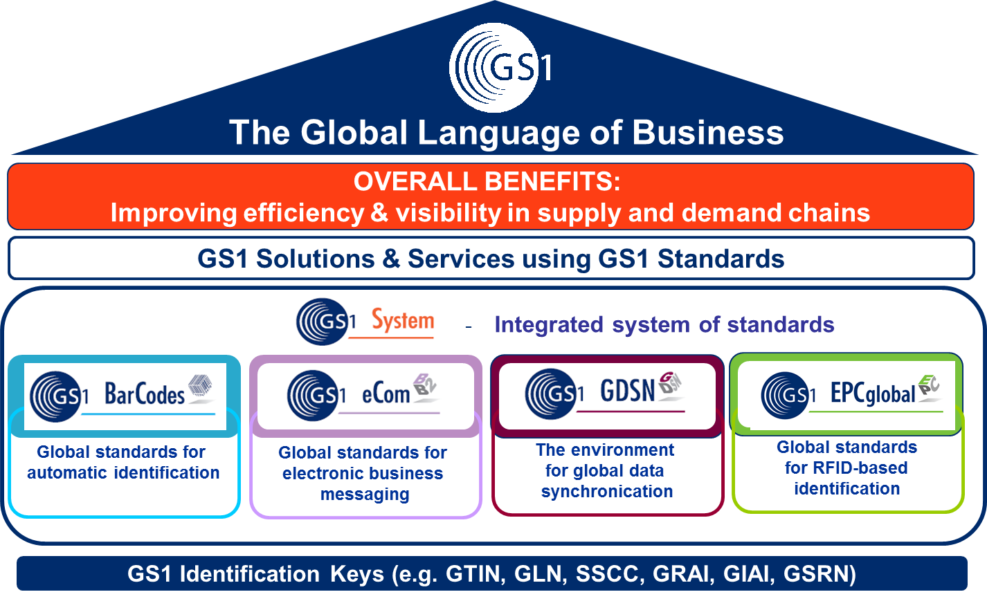
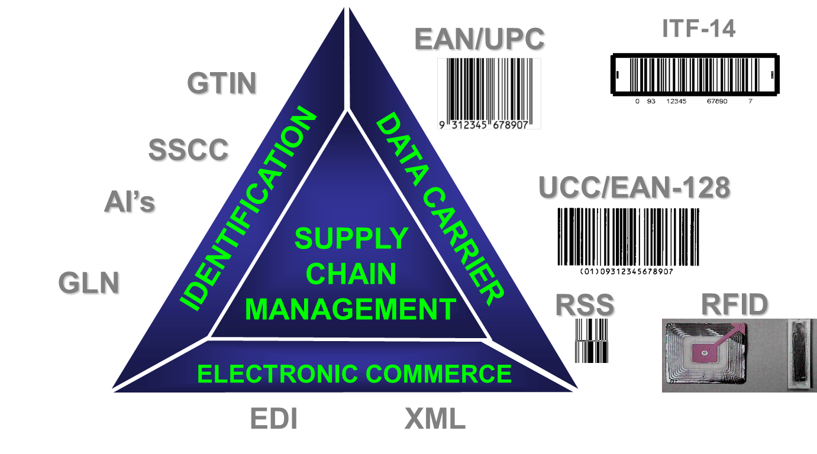
A bit of history……
1996 - 4 Principles
2008 - 19 Principles
2014 - 22 Principles
Notes:
Our System has always had principles, they may not have been identified specifically as “principles” but we have always had them. In 1996 we had four principles, by 2008 we had 19
Now after a process of rationalisation and simplification we have………22
It is also a reflection of the evolution of the GS1 System, from the humble number and bar code scanned at POS 40 years ago to standards that support the capture, storage and retrieval of events and the management of information to support consumer choice, knowledge and in many cases life saving decisions, the GS1 System provides a comprehensive set of standards that support many complex processes within supply, demand and consumer interactions.

Slide 11
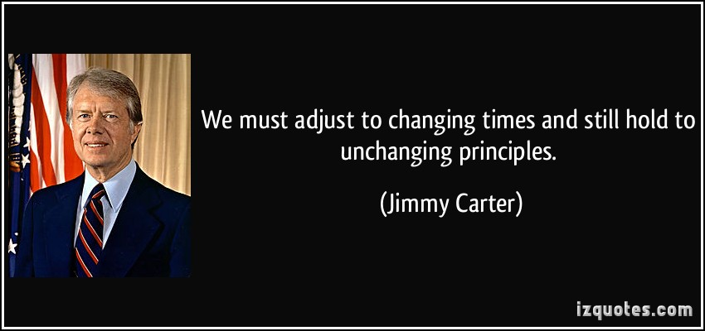

Slide 12

GS1 Architecture Principles
Revised in 2011 with the objectives:
  To add principles that were missing, to remove principles that are not adding value and to correct any principles that need correcting.
  To improve the clarity of the principles, in the light of experience of applying them, if and where necessary.
Collaborative process including community review
Approved by the Board Committee for Standards on 14th February 2012
Notes:
The principles were reviewed and enhanced under the auspices of the GS1 Architecture Group and were put into GSMP community review.
The collaborative and open approach to development does not always produce crystalline prose, but should improve clarity.
You are urged to read the principles in full and, if you are part of the standards development community, to have them in mind when you participate in GSMP groups.

Slide 13
The 22 principles
Conformance | Non-significance
Consistency | Open Supply Chains
Demonstrable Business Value | Overall Value/Overall Cost
Deprecation | Re-use of Components
Elimination of Non-conformance | Royalty free
Extensibility | Scalability
Forward Looking | Security
Global Multi-Sector Standards | Simplicity
GS1 Identification Keys | Technology Independence
Interoperability | Third Party Standards
Non-duplication | Vision and Mission
Notes:
The GS1 Architecture Group did not find a useful and accurate way to categorise the principles.
However, for the purposes of this presentation the following break-down is given to help explain usage:
These are the four new principles in 2012. There were added based upon the usage of the former 2008 version of the principles.

Slide 14


Slide 15
Life is not perfect……
The GS1 Architecture Principles are not decrees
They are:
  Ideals that we must meet, whenever possible
  Statements of good practice that will benefit our system
  The basis for architectural assessment of all proposed GS1 standards and guidelines
But reality sometimes means we have to compromise
We should compromise:
  Only after proper consideration and justification
  With the endorsement of the governance structure
  (BCS)
Notes:
If divergences remain in the final proposals, the deliverables may still be put to the Board Committee for Standards for ratification.

Slide 16
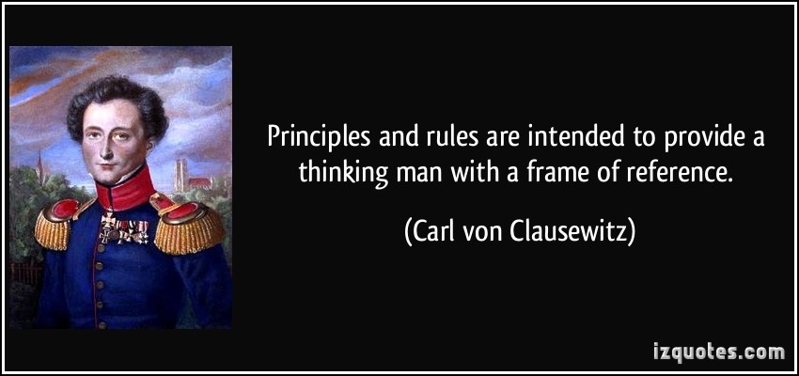

Slide 17
Principles....only as good as their use!
Get to know the principles
Apply them in your standards development work
Socialise them and seek clarification from Architecture Group members
Architecture Group appoints a liaison to each GSMP Work Group
Liaison identifies potential divergences to the principles and raises within group and in Architecture Group
All Draft deliverables are assessed against the principles as part of the GS1 System development process
Notes:
The most effective way of achieving value from the GS1 System is for all involved in its development to understand the architecture principles and how the GS1 System benefits from abiding by them.
Draft deliverables are reviewed against the principles as an integral part of the systems development processes.
Deviation from one or more of the architecture principles does not disqualify a development because other factors, commercial or geopolitical for example, may be more important. However it is the responsibility of the all to be aware of any deviations from the principles before proposing ratification.

Slide 18

Benefits of the GS1 Principles
Abiding by the principles results in
Development of high quality standards
A robust and coherent system
Consistency between all parts of the GS1 System
Ease of use for User Companies, Solution Providers and Member Organisations
The principles provide a structured framework to assess improvements and additions to the GS1 System
Notes:
The full benefits of the GS1 System can only be obtained when the GS1 standards, guidelines, solutions and services, respect the architecture and the principles. Setting the target any lower, or diluting it, diminishes the value of the system.

Slide 19


Slide 20
Architecture Group
Liaisons
Updated 12 February 2014

Slide 21
Standards Maintenance Groups
SMG Name | AG Liaison | AG Participants
GSMP BarCodes | Eugen Sehorz | Sue Schmid Vera Feuerstein
GSMP Data Accuracy | Hein Gorter de Vries
GSMP eCom | Pere Rosell | Sean Lockhead Fred Kempkes
GSMP Global Data Synchronization | Sean Lockhead | Staffan Olsson Tony Zhang
GSMP Global Product Classification | Sean Lockhead
GSMP Identification | Eugen Sehorz | Sue Schmid Vera Feuerstein Sean Lockhead
GSMP Traceability and Event Sharing | Ken Traub | Pere Rosell Mark Harrison Jens Kungl

Slide 22
Mission Specific Working Groups (1/2)
Working group name | AG Liaison | AG Participant
Healthcare AIDC Updates | Sue Schmid
B2C Trusted Source of Data (TSD) | Kevin Dean | Vera, Sue, Kevin, Sean, Ken, Staffan, Tony
eCom Logistics Standards | Henri Barthel | Pere Rosell
EPCIS 1.1 and CBV | Ken Traub | Jens Kungl
GDS-GPP Sustainability | David Buckley | Sean Lockhead Staffan Olsson

Slide 23
Mission Specific Working Groups (2/2)
Working group name | AG Liaison | AG Participant
GDSN Major release 3 | Sean Lockhead | Tony Zhang
Pedigree Security, Choreography and Checking Service a.k.a. Event based traceability | Mark Harrison | Sean Lockhead Ken Traub
HAG UHF Air Interface 1 and 2 Work Group | Ken Traub | Jens Kungl, Joe PP
GDS Key Validation | Staffan Olsson | Kevin Dean Sean Lockhead John Terwilliger
NGPI | Andrew Osborne
GS1 Digital - GTIN+ on the web Technical | Kevin Dean | Hein, Staffan, Andreas, Tony, Sean, Andrew, Junyu, Ken
GLN Allocation rules | Kevin Dean

Slide 24
Other Groups
Group Name | AG Liaison | AG Participant
GS1 Digital - GTIN+ on the web IE | Staffan Olsson | Sean, Hein, Andreas, Junyu, Tony
GEPIR TDT | Sean Lockhead | David

Slide 25
3: GS1 System Architecture & GS1 System Landscape
Ken Traub

Slide 26
GS1 Architecture
26
GS1 System Landscape – the “what”
  Written for a general audience of existing and new Members and Solution Providers
  Enumerates, summarizes, and categorizes all GS1 Standards
GS1 Architecture – the “what” + the “why”
  builds on the GS1 System Landscape to:
    Show how the standards fit together
    Articulate underlying technical principles
    Help to guide the development of future standards
Both revised annually

Slide 27

GS1 System Architecture – What’s In It for You?
Authoritative definitions for
  GS1 Standard
    Technical Standard
    Application Standard
  GS1 Guideline
  GS1 Service
  GS1 Solution
Explanation of how GS1 Standards fit together:
  Identify
  Capture
  Share
Stuff you won’t find by reading any one GS1 Standard
Notes:
27

Slide 28
GS1 Standards
GS1 Standards for identifying, capturing, and sharing information—about products, business locations, and more—make it possible for companies to speak the same language, connect with each other, and move their business forward.

Slide 29
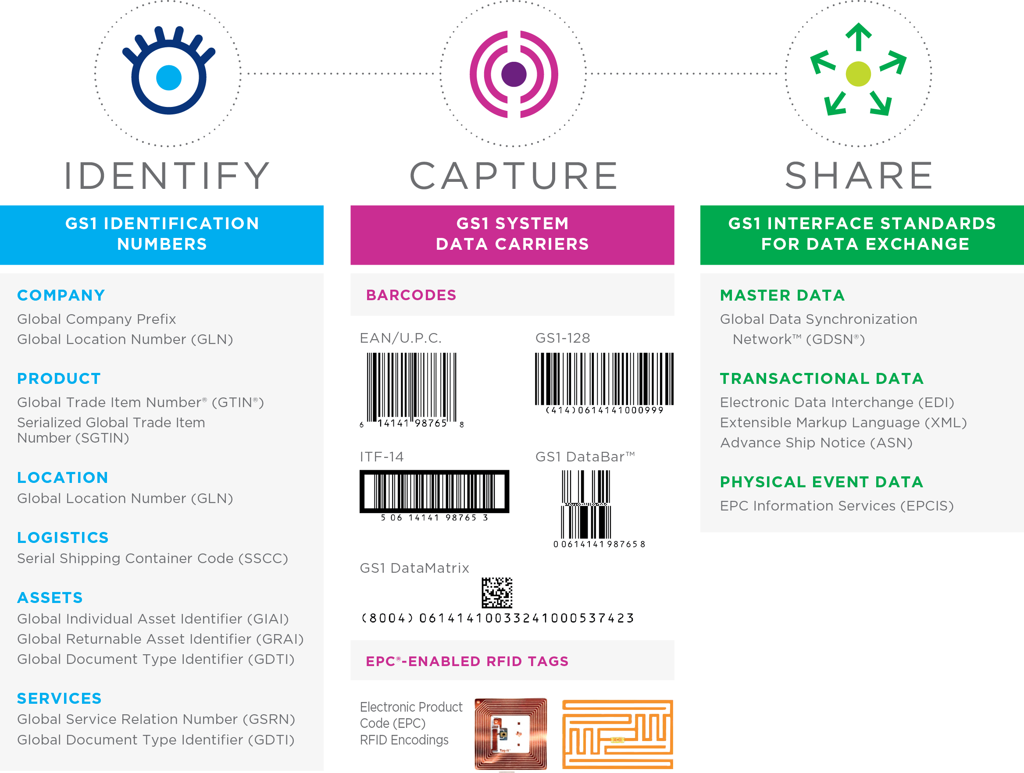
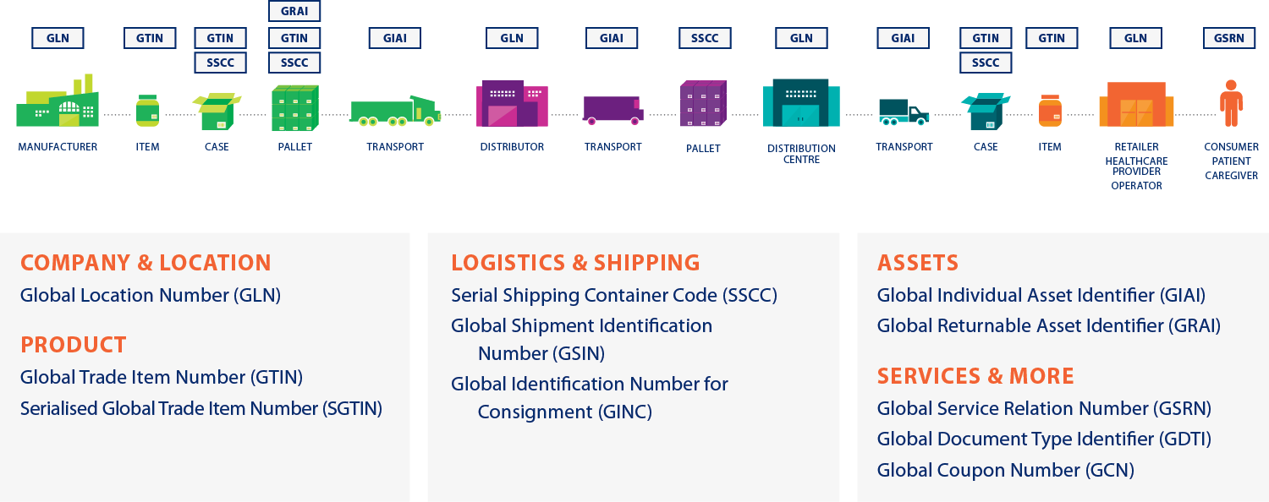
IDENTIFY: GS1 Standards for Identification
Used to uniquely distinguish all products (trade items),
logistic units, locations, assets across the supply chain from manufacturer to consumer.

Slide 30

CAPTURE: GS1 Standards for Barcodes & EPC/RFID
GS1 Barcodes and EPC/RFID are data carriers for GS1 identifiers; but can also accommodate different needs such as batch/lot information and expiry dates.

Slide 31
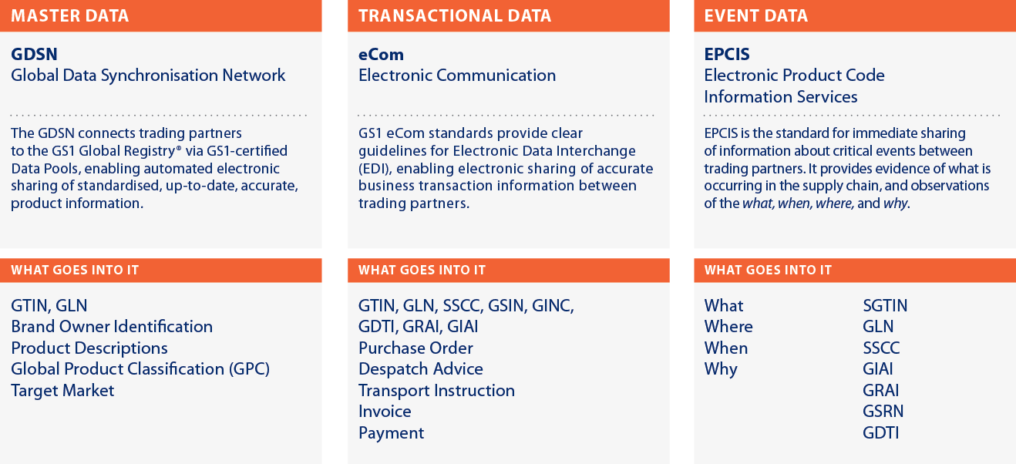
SHARE: GS1 Standards for Data Exchange
Interoperability, made possible by identification standards,
data capture standards, and interface standards for electronic communication, allows product information to flow through
the supply chain.

Slide 32
How the Layers Fit Together
Capture
Share
Identify

Slide 33


GS1 standards, guidelines, solutions and services
GS1 Services
End user interaction with GS1 Service conforms to GS1 Standard
End user external interface conforms to GS1 Standard, usage subject to GS1 Application Standard
End User 1
IT Infrastructure
End User 2
IT Infrastructure
Interface
Interface
System Component
Data exchanged between end users conforms to GS1 Data Standard, usage subject to GS1 Application Standard
System Component
Design of system component is out-of-scope for GS1 System
Interface
Interface
System Component
System Component
End user internal interface conforms to GS1 Standard
Physical objects exchanged between end users carry GS1-compliant data carriers, subject to GS1 Application Standard
Interface
Interface
GS1 Guidelines may assist end user in implementing a GS1 Standard
GS1 Solutions may suggest a combination of GS1 Standards, Guidelines, Services, and other Solutions

Slide 34


Read It Yourself!
All deliverables are published at
www.gs1.org/architecture
34
Notes:
Speak about RFF in high-level detail
Use of GRAI in eCOM Trade Messages - GSMP team developing guidelines for Management of Reusable Transport Items (RTIs) submitted to AG as some countries used GRAI for orders and others insisted on GTIN
Compatibility of GS1 EANCOM and GS1 XML - When to use GS1 EANCOM and when to use GS1 XML and ensuring comptiblity
GTIN Allocation & Importers – major issue, partly led to GTIN on the web, when same product sold by multiple suppliers (typically on web). Source marking
Attributes Association with GS1 keys – new from the ID SMG. Can, say, a Expiry Date be on a Trade Item, A Coupon and an Asset? Same AI or different AI
External identifiers embedded in GS1 Keys for transport equipment– new from the T&L IE group. When creating GS1 ID Keys, especially GIAI, some users are embedding a BIC code or other structure. Have to balance rules for ‘issues or the number’ and ‘processer of the number’
None are easy simple questions: often balancing one principle against another.
34

Slide 35
4. Questions and Answers
All

Slide 36
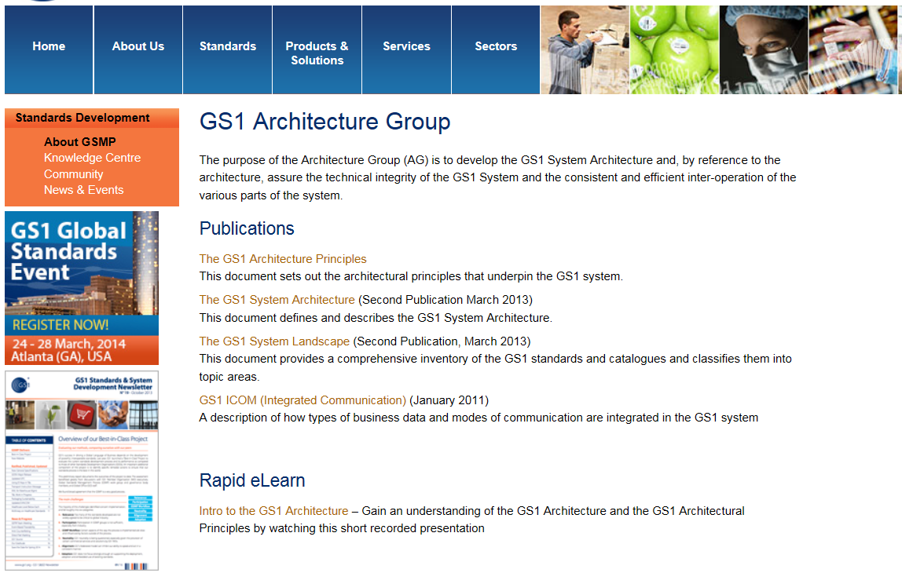
GS1 Architecture Group
http://www.gs1.org/architecture

Slide 37
Contact Details
GS1 Global Office
Avenue Louise 326, bte 10
B-1050 Brussels, Belgium
T + 32 2 788 78 00
W www.gs1.org

