Slide 1


Retail 2020
Richard McKeating, Enterprise Architect, Tesco

Slide 2
Tesco around the world
530,000+ People
12
Countries
£71bn Turnover
75 million
Shopping trips a week

Slide 3
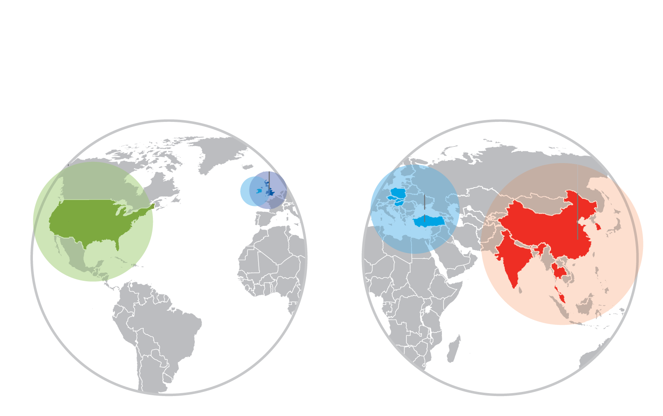

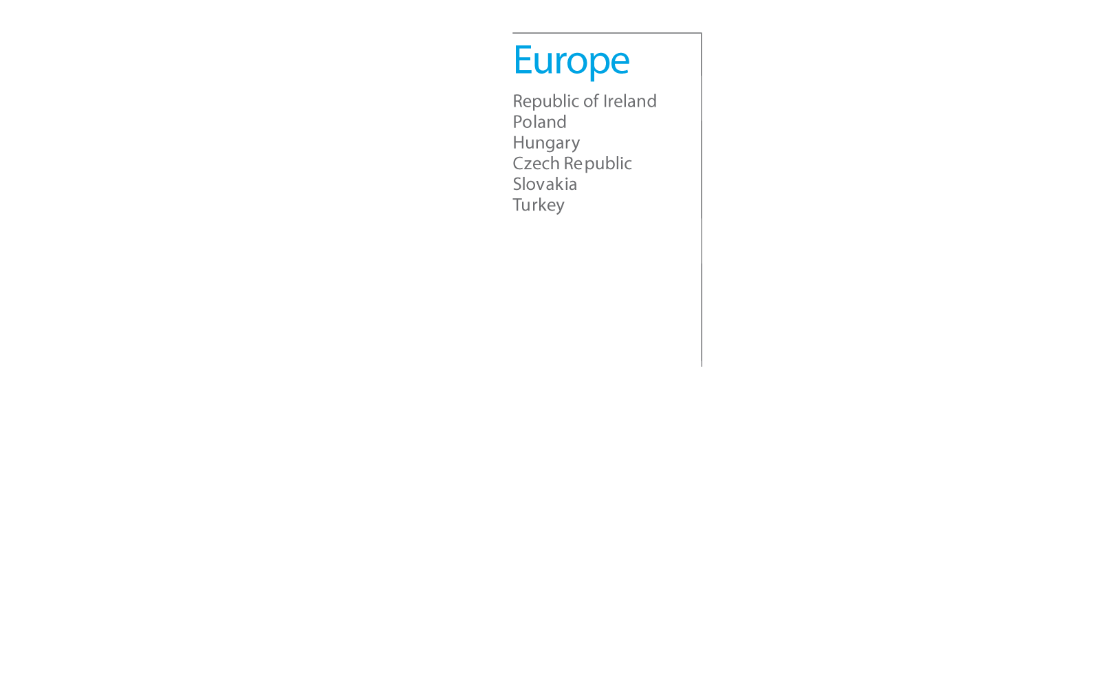

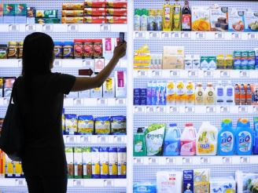
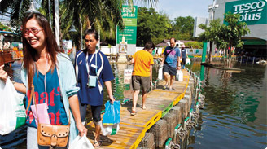

Slide 4





Not just a grocer…

Slide 5
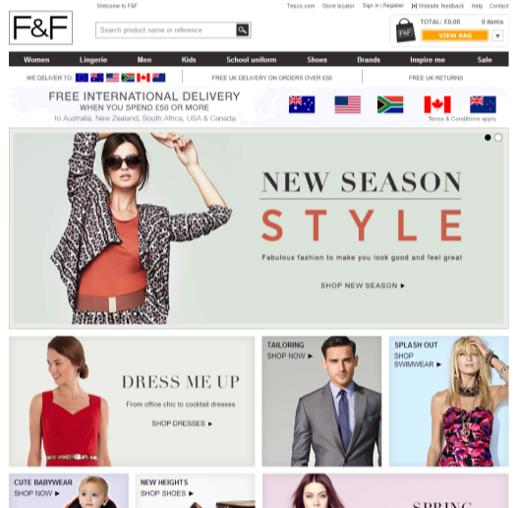
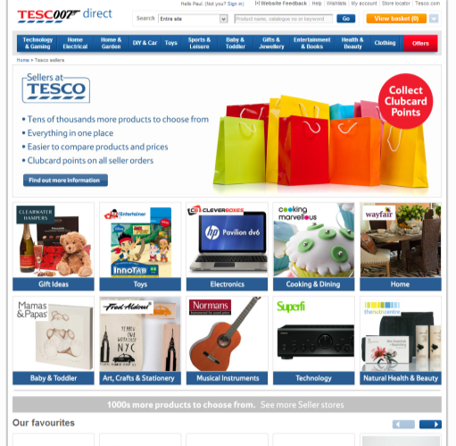
GM and Clothing too…

Slide 6
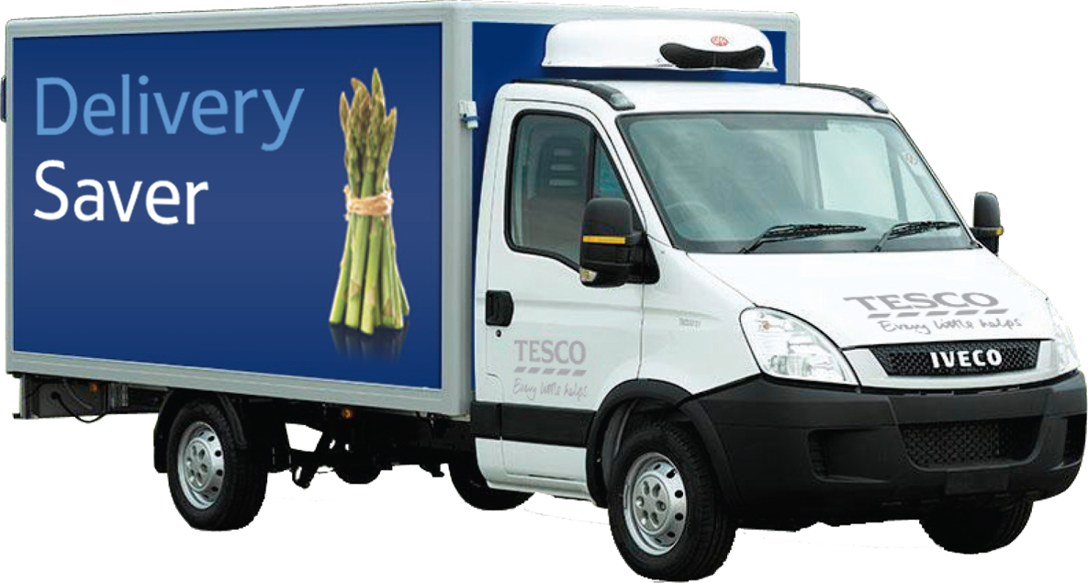
50 cities around the world
Notes:
Tesco.com grocery

Slide 7
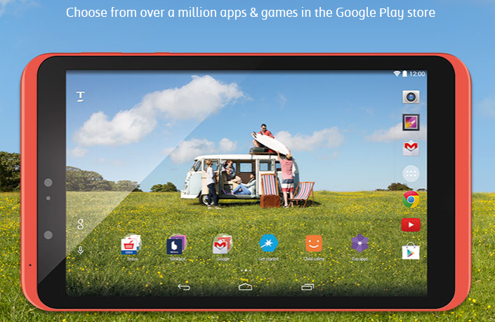
And the Hudl…

Slide 8
Retail 2020
“The future is already here – it's just not evenly distributed”
William Gibson, quoted in The Economist, December 4, 2003

Slide 9




Transformational tech

Slide 10




38 years
13 years
4 years
12 weeks
to reach 50m

Slide 11






Digital Natives
Notes:
My kids and naturally digital

Slide 12





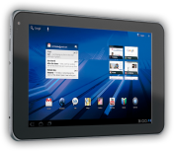
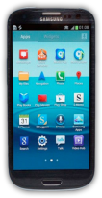
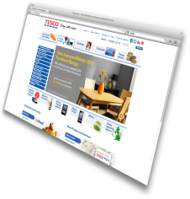
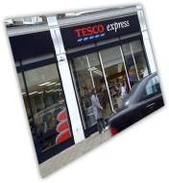
…just want to shop
Notes:
No mental anguish

Slide 13


A world powered by Clouds
Notes:
Trend one: A cloud of knowledge, powered by connected devices and people

Slide 14

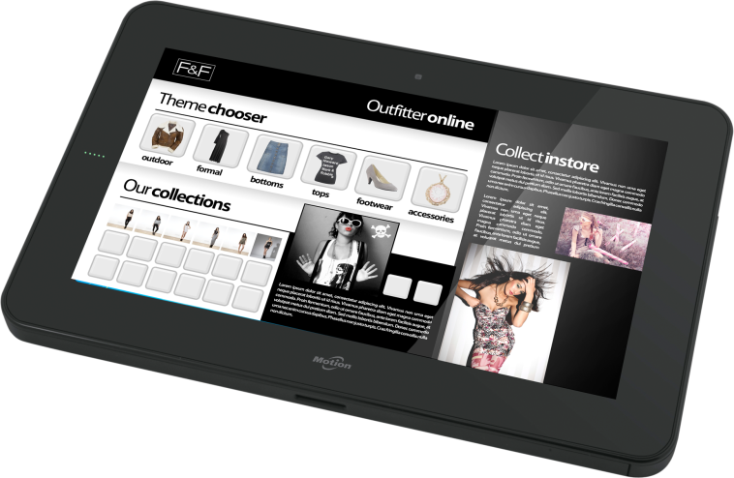
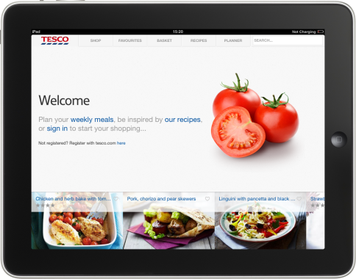


Blended reality
Notes:
The second trend is the emergence of a seamless, blended reality world
That cloud of connected devices and people I just described creates a seamless connection between the real world and the digital world.
As our customers become more digitally savvy and connected they will want to shop in many different ways from researching products in store or online, buying them on their smartphone or PC and picking them up from store or having them delivered to home or to their workplace. As retailers we have to be able to help our customers move effortlessly between the digital world and the real world.

Slide 15
Personalisation
One size
doesn’t fit all

Slide 16
Retail 2020
Plus ça change, plus c'est la même chose

Slide 17

Price

Slide 18
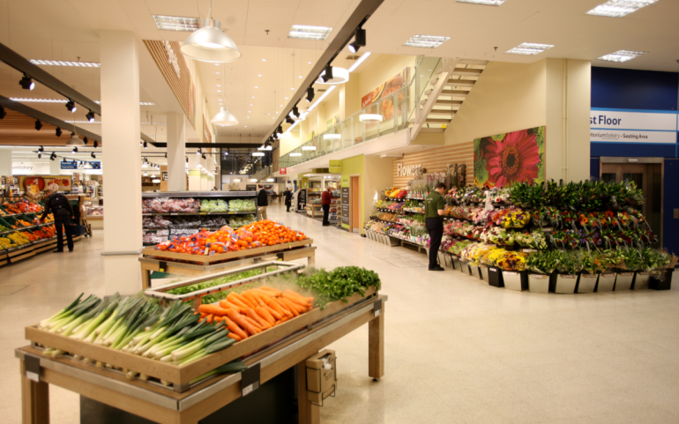
Range

Slide 19
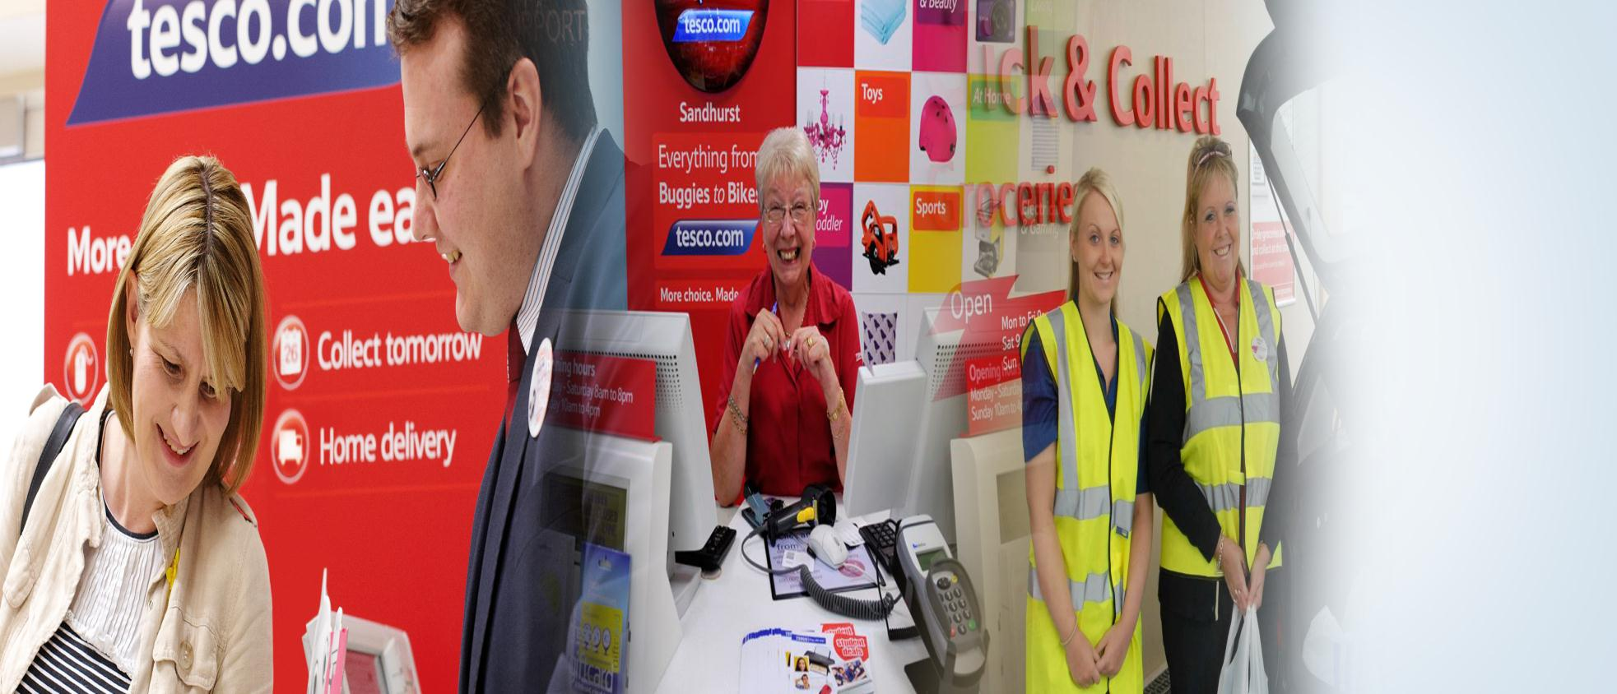
Convenience

Slide 20

Service

Slide 21
Retail 2020
A retail revolution fuelled by information

Slide 22
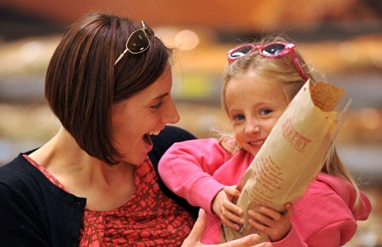
Customers and technology
Film/TV
Phone/SMS (Tesco Mobile)
Radio/Music
Digital Entertainment
Connected White Goods in the home
TV, Washing Machine, Fridge etc
EBooks
Interactive Digital Signage
Wifi
Augmented Reality
Remote Banking Advice
NFC Adverts
Payment
Apps
Self Checkout
Shopping
Banking
Manned Checkout
Social
Reserve & Collect
Scan as You Shop
Scan as You Shop Mobile
Location Services
Call Centre IVR
Web
Kiosks
Community & Education
AppStore
Shopping
Services
Information
Reviews
Digital Content
Hudl
Social Media

Slide 23
The information revolution
Events not file transfers
Open APIs not Closed
Interactive not batch
Mobile not fixed
What’s happening now not what happened yesterday
Apps not applications
Rich product data not just supply chain
Multimedia not just text
Supply chain transparency not invisibility
Unstructured data not just structured

Slide 24

Information overload

Slide 25
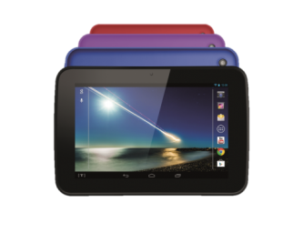
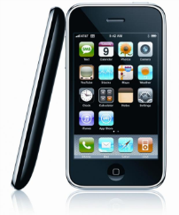

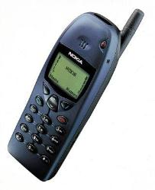
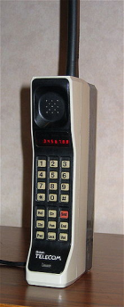
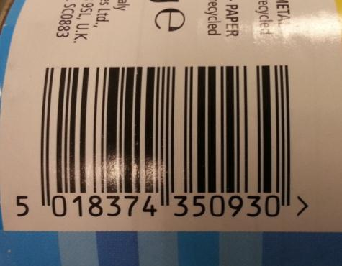
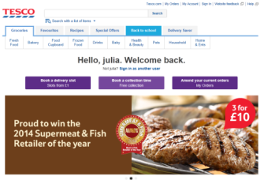
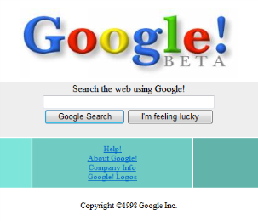
Barcode
2013
2007
2000
1998
1983
1973
First mobile phone call

Slide 26
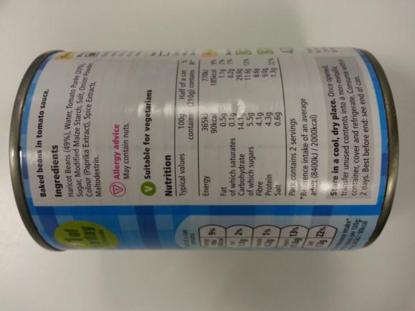
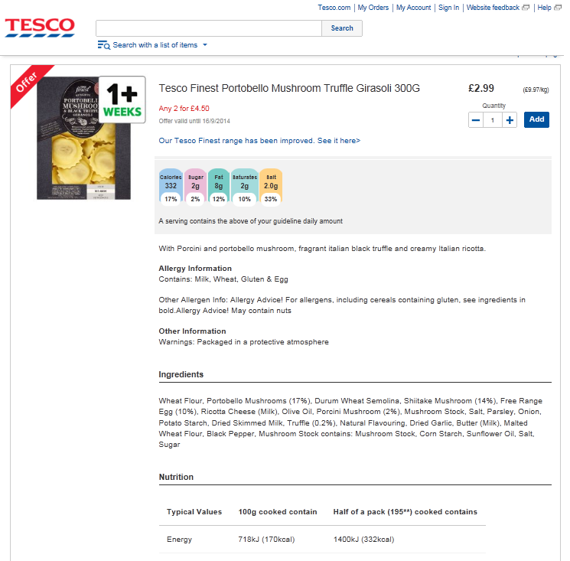
Product information
Notes:
Read the label!

Slide 27
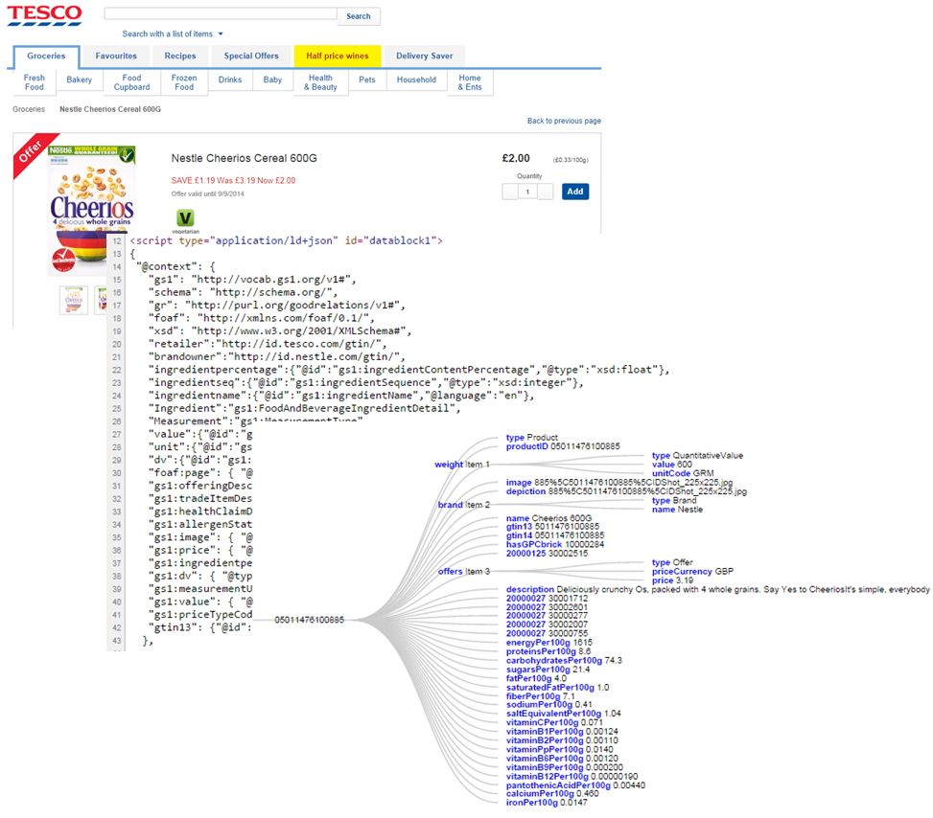
The foundations
Structured data on the web
GS1 Standards
NGPI
EU 1169
Notes:
RDFa – Mark Harrison, Cambridge Uni
Our need for digital identifiers and global data standards has never been greater.
The global language of business needs an extended vocabulary; one which encompasses ever richer product information,
and one which allows our customers to buy goods securely and confidently with the tap of phone or click of a mouse.

Slide 28
Retail 2020
….The future is already here
Thank you for listening

