Slide 1
Upstream Integration
Brooklyn NY, 25 March 2011
Regenald Kramer - GS1 Global Office, Brussels

Slide 2
Anti-Trust Caution
GS1 and the GSMP operate under the GS1 anti-trust caution. Strict compliance with anti-trust laws is and always has been the policy of GS1.
The best way to avoid problems is to remember that the purpose of the committee is to enhance the ability of all industry members to compete more efficiently.
This means:
  There shall be no discussion of prices, allocation of customers, or products, etc.
  If any participant believes the group is drifting towards an impermissible discussion, the topic shall be tabled until the opinion of counsel can be obtained.
  The full anti-trust caution is available in the Community Room if you would like to read it in its entirety

Slide 3

Meeting Etiquette
Meetings will begin promptly at designated start times
Avoid distracting behaviour:
  Place all mobile devices on silent mode
  Avoid cell phones
  Avoid sidebar conversations
Speak in turn and be respectful of others
Be collaborative in support of the meeting objectives

Slide 4

What is GS1 Upstream Supply
Chain Integration?
The GS1 solution to address the challenges in supply chain integration and collaboration between manufacturers and their suppliers
Increased efficiencies
Optimised inventory levels
Maximised production capacity
Improved trading relationships
Reduced costs
Notes:
The key point is that upstream supply chain integration addresses the specific challenges faced by manufacturers and their suppliers, i.e. upstream from retailers/foodservice operators and their manufacturers/suppliers. And by suppliers we mean suppliers of packaging, raw ingredients, chemicals, parts and so on.
If we look at the supply chain and how it operates today, we know that, for example in the retail sector, all the leading retailers and their suppliers – in other words, the CPG (or consumer packaged goods) or grocery manufacturers – have been using GS1 standards to improve the efficiency and effectiveness of their supply chains. This has been happening for many, many years. By integrating their shared processes they have gained massive benefits across the industry.
Upstream supply chain integration simply aims to bring these same benefits of integration – through the use of GS1 standards to improve supply chain processes - to the manufacturers and their suppliers, one step up the supply chain.
It does this by improving supply chain processes through consistent and reliable information sharing and improved visibility of inventories, sales forecasts and production plans. This increases responsiveness to manufacturing requirements and therefore to the retailers or foodservice operators and ultimately to the final consumers.
And upstream integration is happening today, with many thousands of manufacturers and their suppliers implementing and benefitting from improved business processes using GS1 standards. And this is what we will look at in more detail now.
The top-line benefits are listed here – and these are top-line benefits that both manufacturers and their suppliers will enjoy.

Slide 5


What is GUSI?
Global Upstream Supply Initiative
A TCGF Working Group of manufacturers from CPG/Retail and their suppliers collaborating together to develop an upstream solution based on:
  common scenarios
  common processes
  common electronic messages
Reduce complexity and implementation costs
Create a platform to allow exchanges between CPG/Retail manufacturers and their suppliers

Slide 6
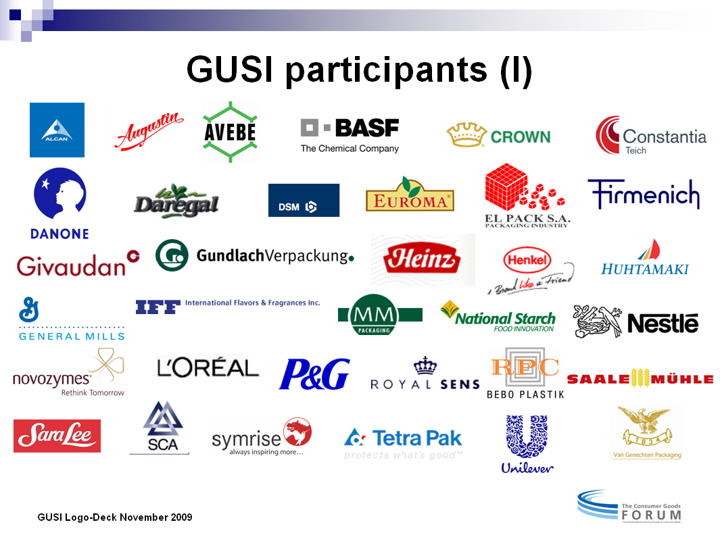
GUSI Members & Supporters (active)
Source: GUSI - November 2009
Notes:
Here we can see many of these leading retailers, manufacturers upstream suppliers – all are members and supporters of GUSI.
It’s also worth noting that many of the worlds leading global service providers – such as SAP, Accenture, GXS and so on – as well as many trade associations, such as GS1 of course, are also supporters of GCI and GUSI. In fact, GS1 collaborates closely with GCI on many supply chain projects, not just GUSI.
[Note, the companies listed here are all members of GCI and are all directly involved in the development of GUSI. Although they may not yet have implemented GUSI, they plan to in the future]

Slide 7
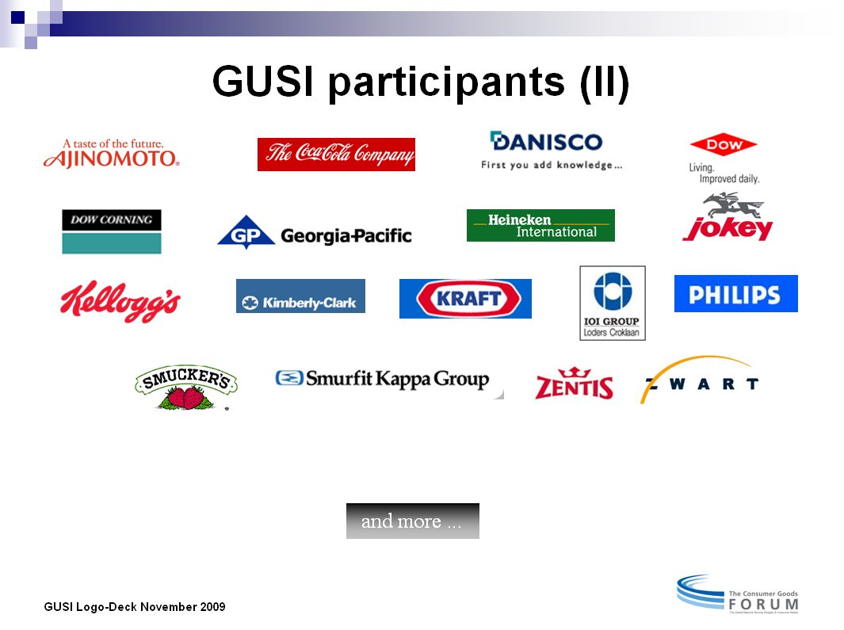
GUSI Members & Supporters
Source: GUSI - November 2009
Notes:
Here we can see many of these leading retailers, manufacturers upstream suppliers – all are members and supporters of GUSI.
It’s also worth noting that many of the worlds leading global service providers – such as SAP, Accenture, GXS and so on – as well as many trade associations, such as GS1 of course, are also supporters of GCI and GUSI. In fact, GS1 collaborates closely with GCI on many supply chain projects, not just GUSI.
[Note, the companies listed here are all members of GCI and are all directly involved in the development of GUSI. Although they may not yet have implemented GUSI, they plan to in the future]

Slide 8
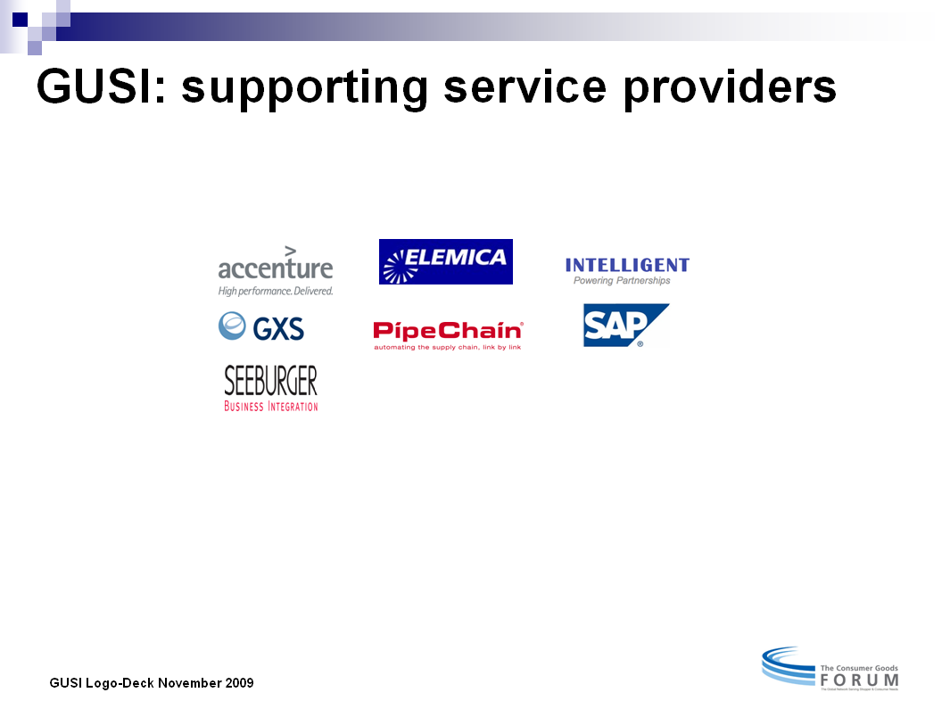
GUSI Members & Supporters
Source: GUSI - November 2009
Notes:
Here we can see many of these leading retailers, manufacturers upstream suppliers – all are members and supporters of GUSI.
It’s also worth noting that many of the worlds leading global service providers – such as SAP, Accenture, GXS and so on – as well as many trade associations, such as GS1 of course, are also supporters of GCI and GUSI. In fact, GS1 collaborates closely with GCI on many supply chain projects, not just GUSI.
[Note, the companies listed here are all members of GCI and are all directly involved in the development of GUSI. Although they may not yet have implemented GUSI, they plan to in the future]

Slide 9
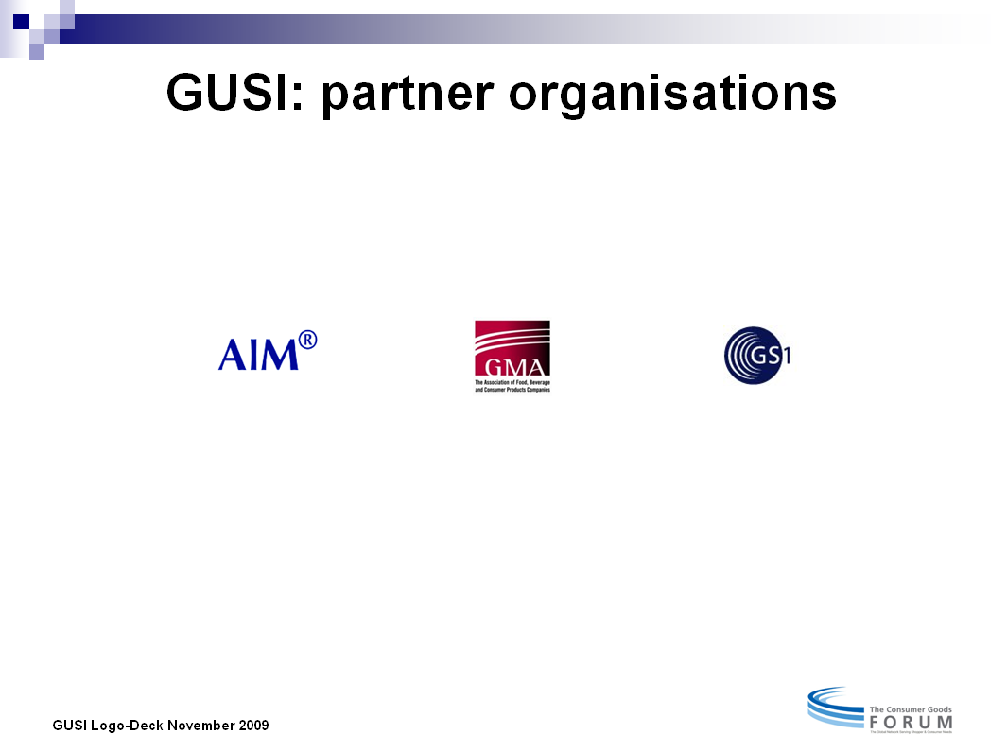
GUSI Members & Supporters
Source: GUSI - November 2009
Notes:
Here we can see many of these leading retailers, manufacturers upstream suppliers – all are members and supporters of GUSI.
It’s also worth noting that many of the worlds leading global service providers – such as SAP, Accenture, GXS and so on – as well as many trade associations, such as GS1 of course, are also supporters of GCI and GUSI. In fact, GS1 collaborates closely with GCI on many supply chain projects, not just GUSI.
[Note, the companies listed here are all members of GCI and are all directly involved in the development of GUSI. Although they may not yet have implemented GUSI, they plan to in the future]

Slide 10




Implementation Status
Number of trading partner pairs having implemented GUSI:
  approx. 150 pairs in 2006
  approx. +500 pairs in 2007
  approx. +800 pairs in 2008
  GCI GUSI was initiated in 2004

Slide 11
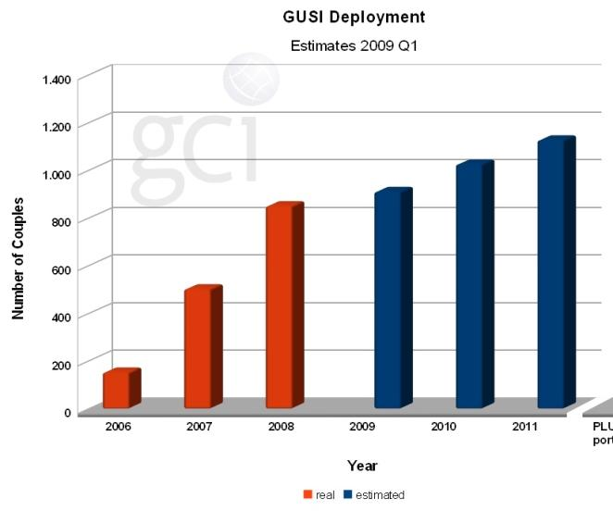
GUSI implementation growth
Notes:
[This slide simply shows the growth in GUSI implementations by the number of ‘trading partner couples’ – i.e. a manufacturer and a supplier implementing any GUSI upstream supply chain process is one trading partner couple. It can be useful to show the growth in GUSI implementations in recent years and the predicted steady growth.]

Slide 12
GUSI Deployment 2010/11
Status Update FY2010/11
12 MOs in Europe
  +5 MOs in FY2010/11
4 MOs outside of Europe:
  Australia, Canada, Mexico, US
: +5 European MOs in 2010/11
: 7 European MOs before 2010/11
: Not deployed yet
KPI 2010-2011 | FY 09/10 Results | FY 10/11 Actual | FY 10/11 Target | Status
# of MOs in deployment | 11 | +30% (16) | +20% (13) | Above Target

Slide 13
GUSI Benefits
Faster integration
  Up to 75% reduction in the time taken to connect to new trading partners
Reduced costs
  Reduced set-up costs through lower development and training costs
  Reduced maintenance costs through fewer non-standard interfaces
Larger scope
  Increased ROI by being able to implement across a larger scope of factories and suppliers, both large and small
Notes:
[This slide gives specific benefits from implementing GUSI, but the benefits are covered elsewhere so should not be needed]
So what are the real benefits of following this standardised model and approach? Well, once a manufacturer or supplier adopts the GUSI approach, connecting to trading partners is quicker, cheaper and easier.
The process can be 75% faster than following an ad-hoc approach because a proven, tried and tested approach is used.
It is also cheaper. The costs, particularly IT, in terms of set-up and maintenance are vastly reduced.
Because the same processes are being used consistently, so the development and training costs are lower
Maintenance costs are lower because multiple non-standard interfaces are phased out
And the scope for implementation is wider – a higher return on investment, because it’s cheaper and faster to implement, means more – and smaller - suppliers can be bought on board.

Slide 14
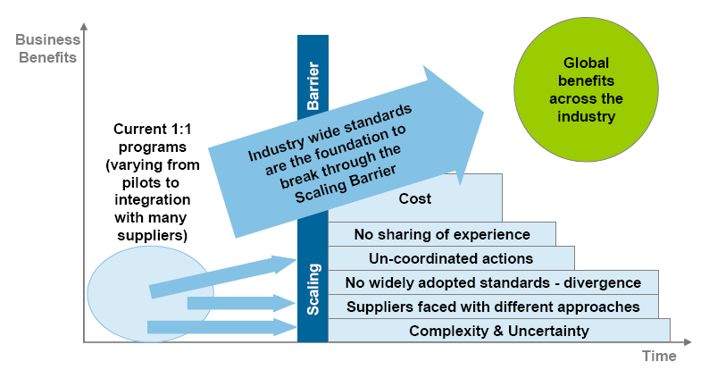
Scaling Barrier

Slide 15
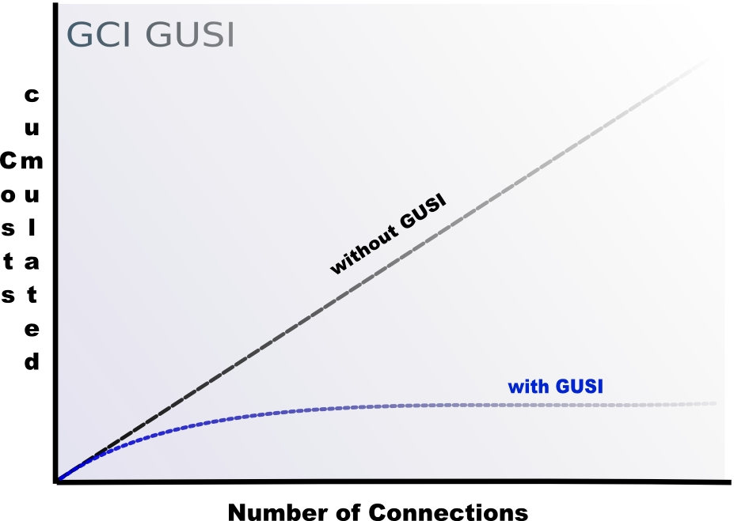
Implementation Costs Development

Slide 16
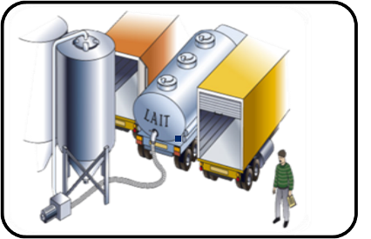
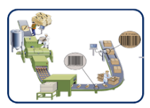

Benefits for Suppliers
Suppliers Manufacturers Retailers/
Foodservice
UPSTREAM
INTEGRATION
Greater visibility of forecasting and planning
Optimised inventory levels
Greater efficiencies
Better customer service levels
Easier and faster reconciliation of payments
Reduced costs
Notes:
So what are the real benefits that manufacturers and their suppliers can expect when implementing upstream integration?
Well, the direct benefits they enjoy come from improved information sharing and more efficient processes between them.
For manufacturers this brings benefits such as
Greater and earlier visibility of manufacturer requirements and supply and demand forecasts
Reduced or optimised inventory levels in the production process through shorter lead times
Increased efficiencies through optimised supply chain processes
Improved customer responsiveness and service levels
Improved and faster reconciliation of payments due to sharing of information, better processes, greater visibility and so on
And ultimately, reduced costs due to overall improved processes
In today’s difficult economic climate these benefits are of course more important than ever.
16

Slide 17
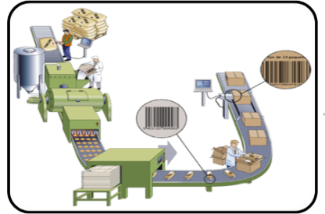
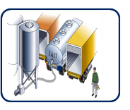
Benefits for Manufacturers
Suppliers Manufacturers Retailers/
Foodservice
UPSTREAM
INTEGRATION
Increased responsiveness
Maximised production capacities
Optimised inventory levels
Greater efficiencies
Improved trading relationships
Increased visibility and traceability
Reduced costs
Notes:
However, the benefits from the upstream supply chain don’t stop there.
Because with better upstream processes, manufacturers benefit from:
Increased responsiveness to retailer and other customer demands
More efficient production planning resulting in maximised production capacities
Reduced or optimised inventory levels through shorter lead times, leading to better use of capital
Increased efficiencies through optimised supply chain processes
Improved trading relationships with both customers and suppliers
Increased visibility and traceability of goods and their ingredients and materials
And again, ultimately, reduced costs through greater efficiencies, processes and so on
17

Slide 18

Benefits for Retailers/Food Service
Suppliers Manufacturers Retailers/Food Service
UPSTREAM
INTEGRATION
Increased on-shelf availability
Reduced time to market
Notes:
And naturally, this improved responsiveness to retailer or foodservice operator’s requirements also delivers improved on-shelf availability and reduced time to market for new product introductions – benefiting everyone in the supply chain as well as, ultimately, the consumer.
18

Slide 19
Bottlenecks…
Key Success Factors
Business driven with IT support
Trust between parties in the beginning is very crucial
Thorough agreement of the business rules - partnership
Different mindset for planners at SU (process is “out of your hands” ) and for customer care at suppliers
A solid IT structure
Don’t change specs too often
Poor forecast accuracy
Multiple deliveries per day
Vendor splits
Suppliers without business case for SMI

Slide 20
What’s in UIM?
A collaborative approach based on two main purchase
orders scenarios:
    The Traditional Order Management (TOM): purchase order initiated by the manufacturer
    The Supplier Managed Inventory (SMI): purchase order initiated by the supplier
Based on 6 building blocks

Slide 21
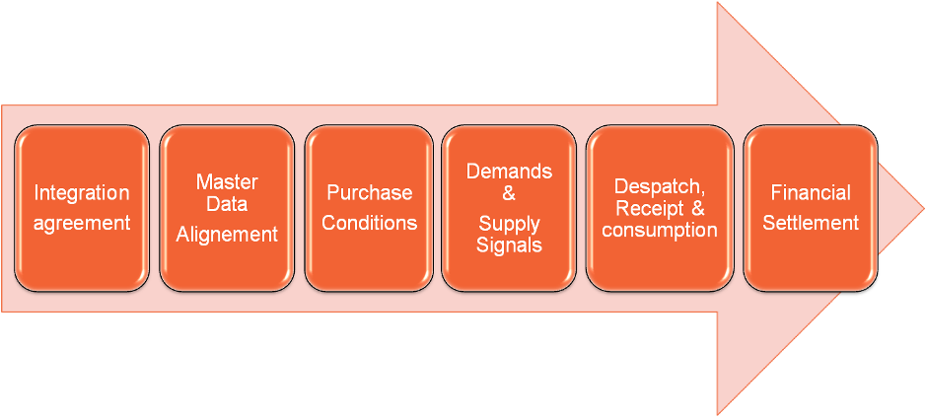
The six building blocks

Slide 22
The Upstream Integration Model (UIM)
Building Blocks
Manufacturer Process
Transactions
Supplier Process
Integration Agreement
Agree on Business Rules
Integration Agreement
Agree on Business Rules
Data Alignment
Maintain Master Data
Item Master Data
Maintain Master Data
Purchasing Conditions
Agree Purchasing Conditions
Purchase Conditions
Agree Purchasing Conditions
Inventory
Report Inventory
Purchase Order
Report Inventory
Net Requirements
Consumption Forecast
Demand and Supply Signals
Gather Material Requirements
Replenishment Forecast
Plan Production & Supply
Integrate Information
PO/Net Requirements Confirmation
Confirm Delivery
Delivery Plan
Await Shipment
Despatch Notification
Pick & Pack Goods
Despatch, Receipt & Consumption
Receipt of Goods
Physical Shipment of Goods
Shipment
Check Goods
Receipt Notification
Goods Receipt Notification
Consume Goods
Consumption Report
Consumption Notification
Invoice Receipt
Invoice
Create Invoice
Create Self-Billing Invoice
Self-Billing Invoice
Invoice Receipt
Financial Settlement
Invoice Confirmation
Invoice Confirmation
Invoice Confirmation
Create Remittance Advice
Remittance Notification
Payment Notification
Initiate Payment
Physical Payment
Payment Receipt
Notes:
GUSI’s aim is to enable manufacturers to cost effectively develop more efficient and effective supply chains with their suppliers. And they have achieved this by developing a solution called the Upstream Integration Model, or UIM. And yes, it’s another acronym.
The UIM is simply a standardised business process model that defines common business scenarios and processes covering areas such as procurement, material forecasting, inventory management, despatch, receipt and consumption of materials, and financial settlement between trading partners.
Importantly, the UIM is fully based on the use of existing GS1 global supply chain standards – and uses GS1 XML message standards to exchange information between trading partners in support of the supply chain processes highlighted here.
OK, let’s take a look at the UIM – we won’t go into it any great depth as the detail is not important today, just an overview of how it is modelled, as this will help us understand how upstream supply chain integration works.
[click] First, we can see that the concept of the model is based on six building blocks:
Integration agreement
Data alignment
Purchasing conditions
Demand and supply signals
Despatch, receipt and consumption of materials
Financial settlement
[click] Then we can see how these relate to manufacturer processes
[click] And supplier processes
[click] and the business transactions between the manufacturer and the supplier
We can take a look at one building block to show how this works – the despatch, receipt and consumption of goods. So this is to go with the delivery and usage of goods – packaging materials, raw ingredients, chemicals and so on. The process starts with the supplier, picking and packing goods, they then send a despatch notification message to the manufacturer, who is awaiting the goods. The supplier then sends the goods themselves and the manufacturer receives them and checks them, sending a notification back to the supplier acknowledging the fact that the goods have been received or, if it is the case, noting any discrepancies from the expected delivery. The manufacturer then ‘consumes’ the goods, i.e. uses them in the manufacturing process, and informs the supplier of this.
You can see how the other building blocks work in similar ways. And you can see how the UIM has simply mapped out typical supply chain processes between the manufacturer and their suppliers.
An important point to note here is that the UIM is totally modular. You can choose to implement any individual block, or even any individual message, totally depending on your individual business requirements and priorities.
As I have said, GUSI fully endorse the use of GS1 standards in upstream supply chain processes, as we will see next.

Slide 23
The Upstream Integration Model (UIM)
Implemented with GS1 standards: GS1 XML messages
Building Blocks
Manufacturer Process
Transactions
Supplier Process
GS1 XML messages
Integration Agreement
Agree on Business Rules
Integration Agreement
Agree on Business Rules
Data Alignment
Maintain Master Data
Item Master Data
Maintain Master Data
Item Data Notification
Purchasing Conditions
Agree Purchasing Conditions
Purchase Conditions
Agree Purchasing Conditions
Purchase Conditions
Inventory
Inventory Activity or Inventory Status
Report Inventory
Purchase Order
Report Inventory
Multi-shipment Order
Net Requirements
Order Response
Consumption Forecast
Goods Requirement
Demand and Supply Signals
Gather Material Requirements
Replenishment Forecast
Plan Production & Supply
Goods Requirement Response
Replenishment Request
Replenishment Proposal
Integrate Information
PO/Net Requirements Confirmation
Confirm Delivery
Delivery Plan
Await Shipment
Despatch Notification
Pick & Pack Goods
Despatch Advice
Despatch, Receipt & Consumption
Receipt of Goods
Physical Shipment of Goods
Shipment
Check Goods
Receipt Notification
Goods Receipt Notification
Receipt Advice
Consume Goods
Consumption Report
Consumption Notification
Consumption Report
Invoice Receipt
Invoice
Create Invoice
Invoice
Create Self-Billing Invoice
Self-Billing Invoice
Invoice Receipt
Financial Settlement
Invoice Confirmation
Invoice Confirmation
Invoice Confirmation
Invoice Response
Create Remittance Advice
Remittance Notification
Payment Notification
Initiate Payment
Physical Payment
Payment Receipt
Settlement
Notes:
[click] As here we can see the specific GS1 XML electronic messages that address the business processes covered by each building block.
So again, if we look at the despatch, receipt and consumption building block we can see which messages are used.
[click] The despatch advice message is sent by the suppler to the manufacturer to inform the manufacturer the details of the goods that are about to be shipped to them. This may be in response to a specific order or because the manufacturer’s stock needs replenishing, and the supplier knows this due to the improved sharing of forecasts and orders between the two trading partners. The despatch advice message, incidentally, is commonly known as an ASN – or Advanced Shipping Notice.
The receipt advice message is then sent back from the manufacturer to the supplier once the goods have been received and checked against the despatch advice message, or ASN. As I mentioned, any discrepancies – for example, under or over deliveries – can also be indicated in this message.
Finally, the consumption report message is sent from the manufacturer to supplier as and when the goods are consumed, that is used in the manufacturing process.

Slide 24
The Upstream Integration Model (UIM)
Implemented with GS1 standards: GS1 Identification Keys
Building Blocks
Manufacturer Process
Transactions
Supplier Process
GS1 XML messages
Integration Agreement
Agree on Business Rules
Integration Agreement
Agree on Business Rules
Maintain Master Data
GTIN, GLN
Data Alignment
Item Master Data
Maintain Master Data
Item Data Notification
Purchasing Conditions
Agree Purchasing Conditions
Purchase Conditions
Agree Purchasing Conditions
Purchase Conditions
Inventory
Inventory Activity or Inventory Status
Report Inventory
GTIN, GLN
Purchase Order
Report Inventory
Multi-shipment Order
GTIN, GLN
Net Requirements
Order Response
GTIN, GLN
Consumption Forecast
Goods Requirement
Gather Material Requirements
GTIN, GLN
Demand and Supply Signals
Replenishment Forecast
Plan Production & Supply
Goods Requirement Response
Replenishment Request
Replenishment Proposal
Integrate Information
PO/Net Requirements Confirmation
Confirm Delivery
Delivery Plan
Await Shipment
GTIN, GLN, SSCC
Despatch Notification
Pick & Pack Goods
Despatch Advice
Despatch, Receipt & Consumption
Receipt of Goods
Physical Shipment of Goods
Shipment
GS1 Logistics Label
Check Goods
Receipt Notification
Goods Receipt Notification
Receipt Advice
Consume Goods
GTIN, GLN
GTIN, GLN, SSCC
Consumption Report
Consumption Notification
Consumption Report
Invoice Receipt
Invoice
Create Invoice
Invoice
GTIN, GLN
Create Self-Billing Invoice
Self-Billing Invoice
Invoice Receipt
Invoice Confirmation
GTIN, GLN
Financial Settlement
Invoice Confirmation
Invoice Confirmation
Invoice Response
Create Remittance Advice
Remittance Notification
Payment Notification
Initiate Payment
Physical Payment
Payment Receipt
Settlement
Notes:
And finally we can see that the GS1 Identification Keys – the GTIN, GLN and SSCC that we talked about earlier - are used throughout the process.
[click] As you can see, the GLN, or Global Location Number, and GTIN, or Global Trade Item Number, are totally integrated throughout the process, as they are used to ensure the correct companies, locations and goods are always being identified – using an identification and numbering system that all parties in the supply chain use, thereby eliminating costly and potentially confusing proprietary systems.
[click] And again, if we take a more detailed look at the despatch, receipt and consumption building block, we can see where and when the keys are used as part of the GS1 XML electronic messages. For example, the despatch advice and receipt advice messages both include GLNs to indicate the two companies who are trading, as well the locations of the sites that’s the goods are being despatched to and from. They also include the GTINs of all the products that are being shipped, and also the SSCCs of all the pallets that make up the order.
[click] Also, when the goods are physically shipped between the two trading partners the GS1 Logistics Label is applied to every pallet in the order so they can be uniquely identified by the SSCC which is encoded in a GS1-128 bar code on the label.

Slide 25
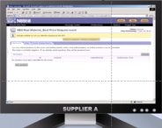
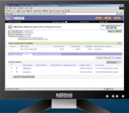

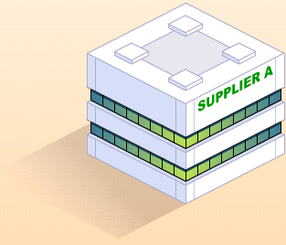



Upstream Integration Model Example: SMI
Supplier
Manufacturer
Automatically update
Production Plans
& send ......
Prepare Delivery
& advise Customer
via ....
Replenishment Forecast
Confirm Production
plans based on
Inventory Availability
Delivery Plan
Send automated receipt
notification
Prepare Warehouse
for receipting &
re-confirm production
Dispatch Notification
Physical shipment of goods
Auto. reconcile
Invoices to Receipts
&
initiate Payment
Automatically reconcile
despatched vs. receipted
data & send .....
Receipt Notification
Invoice
Remittance Notification
Physical Payment

Slide 26
Benefits
Collaborative planning:
    Optimisation production run length + combining
    Working Capital reduction
    Reduction # rush orders
    Improved asset utilisation
SMI:
    Reduction # rush deliveries
    Optimisation truckloads
General:
    Improved service levels
    Benefits of automation information exchange
    More time for SC improvement
    1 way of working for suppliers and sourcing units

Slide 27

2020 The Future Value Chain
What do you want to achieve in 2020? Are you focused on making your business more sustainable, optimizing a new shared supply chain, engaging with technology-enabled consumers or helping consumers improve their health and wellbeing? Do you expect to achieve all this by yourself, or will you look for collaboration?
Our world is changing:
  Globalisation
  Speed of Technology
  Volatile Energy Costs and Dwindling Supplies
What do we need to do?
  Develop new ways of working – sustainable changes in culture and collaborative business planning, synchronised production
  Freely share information – manage increasing complexity through transparency
  Redefine the value chain – sustainability

Slide 28






The GUSI Movie

Slide 29


Q&A
(Questions & Answers)

Slide 30


Plan 2011/2012
GUSI Deployment

Slide 31
  Plan 2011/12

Slide 32
Any Other Business
GUSI Deployment

Slide 33
Any Other Business

Slide 34
Contact Details
Regenald Kramer
GS1 Global Office, Brussels
regenald.kramer@gs1.org
T + 32 2 788 78 40

