Slide 1
GS1 Standards Spring Event 18-22 March 2013 – Dallas Building Standards to Deliver Business Value
Technical Publications – How it happens
Friday Morning Session
Who May Attend: Everyone
Charlotte Michaels, Technical Publications Manager

Slide 2
Effective meetings
Avoid distracting behaviour:
Avoid checking e-mail or answering calls
Effective listening and participation
Write notes if looking to offer feedback
Be respectful of others, speak in turn
Save questions for the end
Notes:
Subscribe to

Slide 3
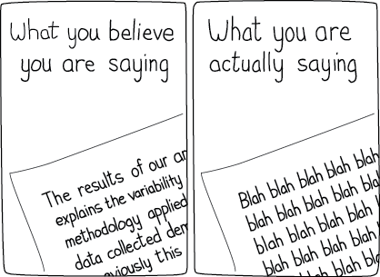
On Writing Well
On Writing Well, Mar 2013
Notes:
Subscribe to

Slide 4
Improvement Strategy
1. Introductions
2. Overview of technical publications
3. Needs Analysis
4. Feedback
4. Improvements to date
5. Actions to date
6. Future goals

Slide 5
Overview
Technical publications are a GS1 product deliverable
produced under a life-cycle process
designed with specific features and functions
coherent source and reference documents
published and posted in the Knowledge Centre

Slide 6
Needs Analysis
QUESTION: what do users need and want?
compiled inventory of current documentation
user surveys carried out by Marketing
focus groups with staff and users
benchmarked against other standards organisation’s style guide standards (ISO, IEEE, W3C, IEC, CEU
conducted usability study to understand user Web behavior

Slide 7
What is a Usability Study?
How does it work?
Usability studies site functionality.
Gauge how users interface with web site content.
Removes design elements to determine site effectiveness.
What was done?
1. financed online software
2. hierarchy tree created (1200+ links)
3. test script (10 tasks)
3. response record
4. analyse data

Slide 8
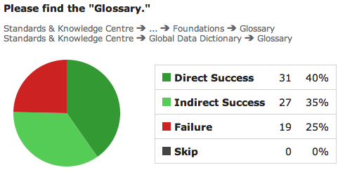
Usability Study Results
Task by task results #1

Slide 9
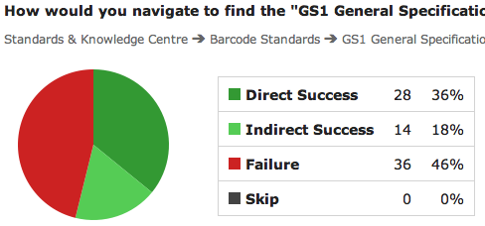
Usability Study Results
Task by task results #2

Slide 10
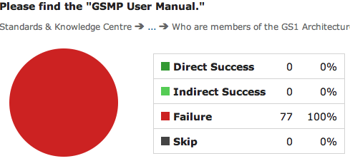
Usability Study Results
Task by task results #3

Slide 11
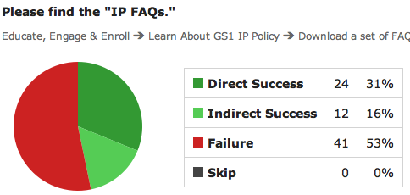
Usability Study Results
Task by task results #4

Slide 12
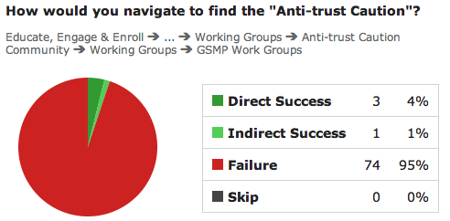
Usability Study Results
Task by task results #5

Slide 13
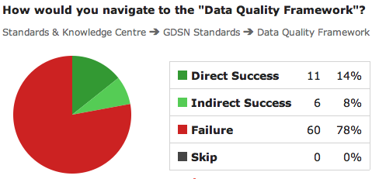
Usability Study Results
Task by task results #6

Slide 14
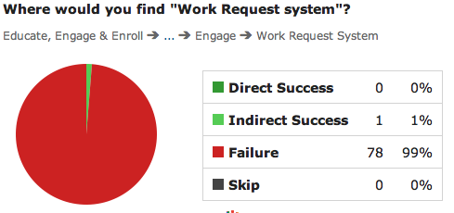
Usability Study Results
Task by task results #7

Slide 15
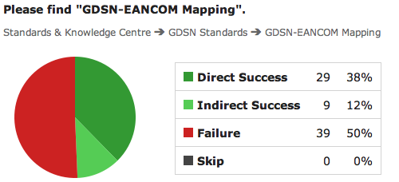
Usability Study Results
Task by task results #8

Slide 16
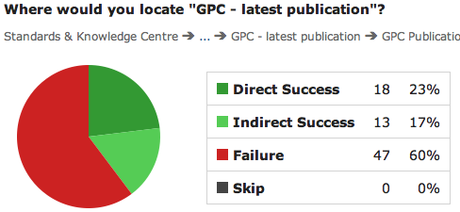
Usability Study Results
Task by task results #9

Slide 17
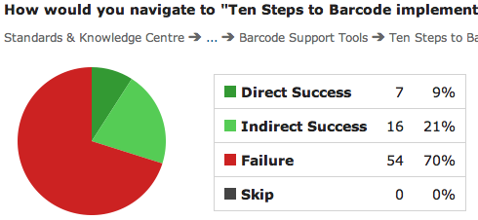
Usability Study Results
Task by task results #10

Slide 18
Analyzed usability data results
Participation
91 people participated, 77 (84% completion rate)
Overall directness 57% (no backtracking)
Overall success rate 31% (ended up with correct link)
Average time to complete 9.6 minutes
This means we can:
Track how many clicks people went outside known links
Consider improvements for Knowledge Centre functionality
Discuss future search capabilities improve

Slide 19
Overall feedback
Standards visibility
difficulty finding “standards” on GS1 web site
Standards accessibility
not all standards available on web site (GenSpec)
Documentation improvement and review
conformity to branding
inconsistent look and feel
dense content, terminology, sentence structure, bad references

Slide 20
Overall feedback
Search capabilities
search engine does not return specific content
difficult to determine latest version

Slide 21
Recommendations
Proposed user recommendations:
make standards easier to find
place all standards in the Knowledge Centre
remove wrinkles in document development
add publications support to life cycle development
improve document author’s writing skills
repair search engine capabilities

Slide 22
Six point improvement plan
Technical Publications
1
2
Standards visibility
Standards access
3
4
Doc improvement
Documentation Review
5
6
Improve writing skills
Search engine

Slide 23
Actions to date
Standards visibility
placed “Standards” on GO web site (Mar 2013)

Slide 24
Actions to date
Standards access
posted the GenSpec in Knowledge Centre (Mar 2013)

Slide 25
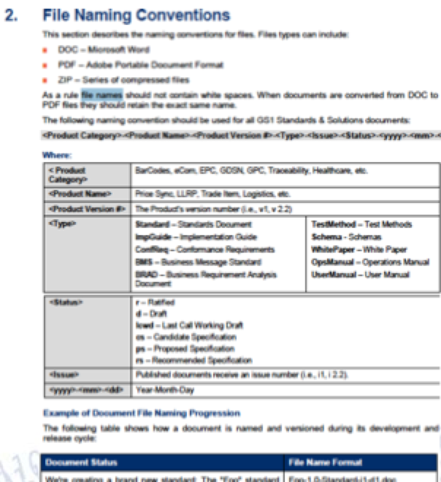
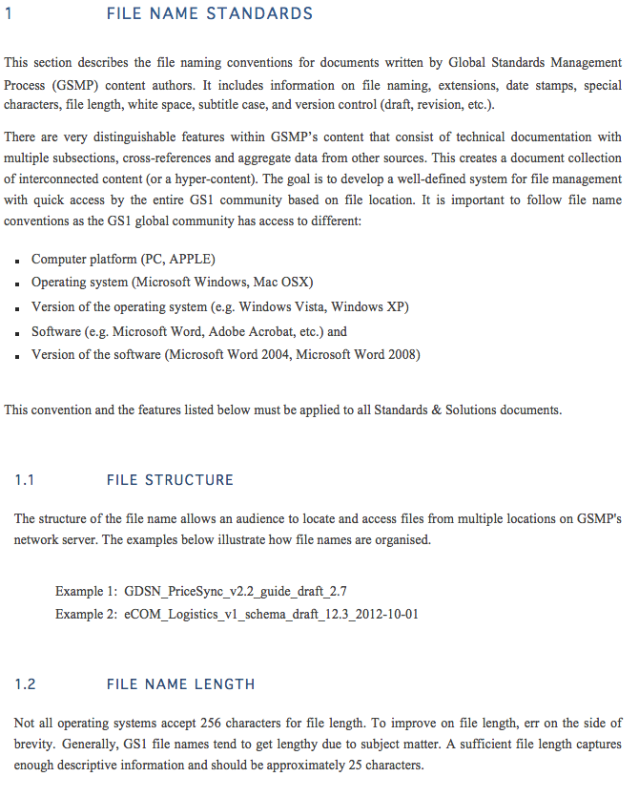
Actions to date
Documentation improvement
applied standards organisation’s best practices
refresh GS1 Style Guide (peer, team, and group review)
*Orange signifies current review status

Slide 26
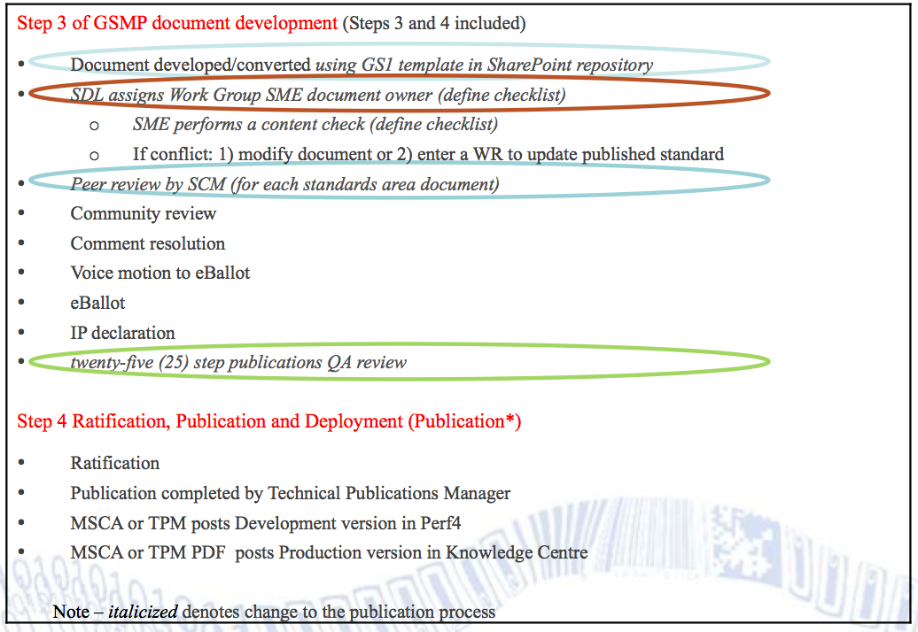
Actions to date
Documentation review
incorporated a Technical Publications QA Review (Feb 2013)

Slide 27
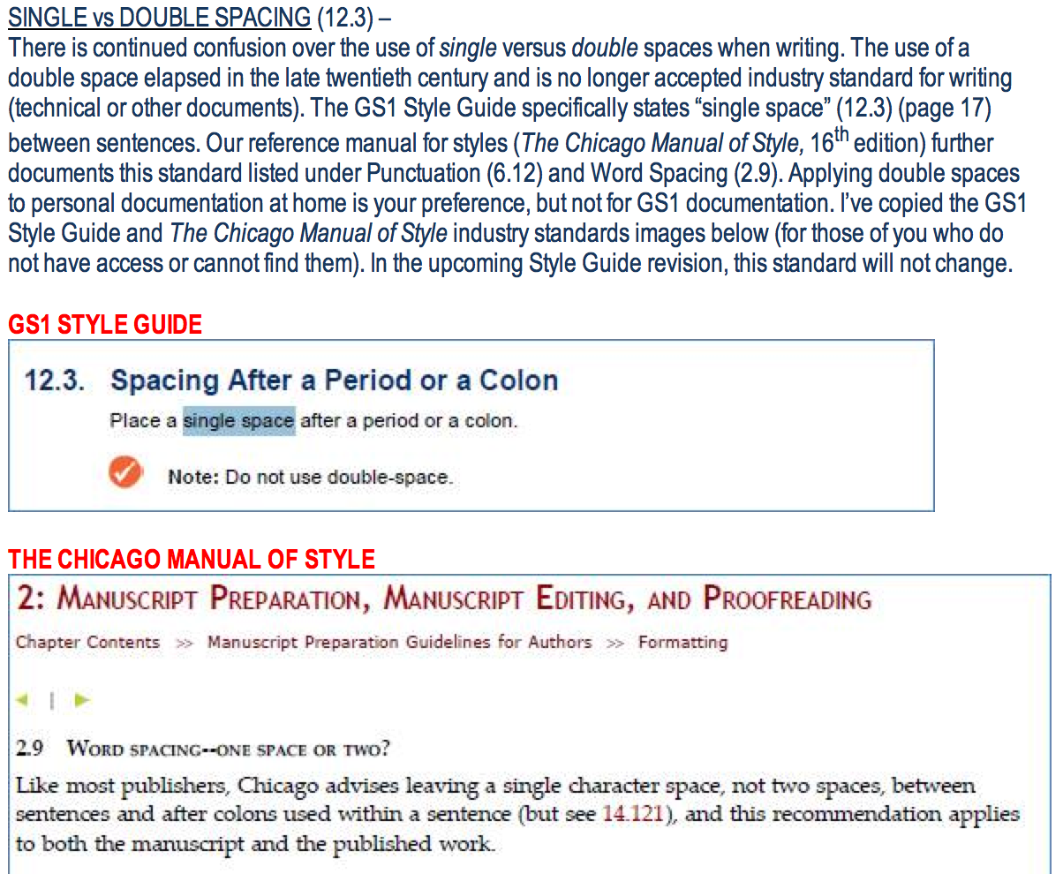
Actions to date
Improve writing skills
created quarterly On Writing Well in GSMP Weekly (Jul 2012)

Slide 28
Actions to date
Ten tips on writing Well “Not all documents are created equal”
Tip #1: Start documents in an approved GS1 template.
Tip #2: Limit lengthy sentences. Simple sentence structure: 10-15 words.
Tip #3: Summarize points with subheadings to break up heavy content.
Tip #4: Define difficult words (in parenthesis).
Tip #5: Use lists and bullets for sequential information.
Tip #6: It’s not necessary to bullet a heading in a slide or document.
Tip #7: Add illustrations and graphs to increase retention.
Tip #8: Include white space: absence of text increases comprehension.
Tip #9: Test your documentation to ensure accuracy.
Tip #10: Highlight (bold) only important terms.

Slide 29
Future actions
Search capabilities
work with Marketing to improve search engine results
incorporate metadata into documentation
GenSpec
makeGenSpec smaller document
create a GenSpec Wiki
Standards documents
other standards as Wiki
standards in Knowledge Centre for other languages
Resource library
templates to be added in Knowledge Centre

Slide 30
Event survey
There are 2 types surveys:
1. Individual Session Surveys - Please complete the hard copy satisfaction survey at the end of each working group session. Your group leader will provide it to you.
2. Overall Event Survey – All attendees will receive an email on Friday to rate your overall satisfaction of the event.
You might win an iPod Nano!
30

Slide 31
Save the date for the next GS1 Standards Event!
7-11 October 2013
Lisbon, Portugal
Corinthia Hotel
Hosted by
Sponsored by

Slide 32
Contact Details
GS1 Global Office
Avenue Louise 326, bte 10
B-1050 Brussels, Belgium
T + 32 2 788 78 00
W www.gs1.org

