Slide 1
GS1 US Initiatives update
March 18, 2013

Slide 2
Gs1 standards makes it possible
To increase availability of accurate data
To accurately answer the what, when, where, and why of a specific product’s movement
To apply standards to business processes
To achieve interoperability between trading partners
VISIBILITY
EFFICIENCY
COLLABORATION
To help industry meet their respective regulatory requirements
To share precise recall information between trading partners
To improve patient safety through pedigree standards for pharmaceuticals
To combat counterfeiting through standardized identification and authentication
SAFETY
SECURITY

Slide 3
Solving industry needs
INDUSTRY
PROBLEM / OPPORTUNITY
ADOPTION
& USAGE
REQUIREMENTS
SOLUTIONS
Helps industry identify a problem or opportunity and organize to solve it
Helps industry define the needs /goals and create adoption plans
Facilitates the development of:
Standards
Guidelines
Tools
Readiness Programs
Education & Training
Measures how industry adopts and uses standardized technology

Slide 4
GS1 US Focus areas and key industries
FOCUS AREAS
B2B2C
Data Quality and Data Management
Inventory Efficiency
Product and Location Identification
Traceability and Safety
KEY INDUSTRIES
Apparel / General Merchandise
CPG / Grocery
Foodservice
Fresh Foods
Hardlines
Healthcare

Slide 5
Apparel and general merchandise
Focus areas
After decades of using GS1 Standards, the apparel and general merchandise industries are moving beyond the barcode toward global implementation of EPC-enabled RFID technology to identify, capture, and share information about individual items.
In 2011, industry leaders began the drive toward item- level tagging at the point of manufacture—known as "source-to-store tagging"—and are beginning to reap the benefits of true inventory visibility.
100 active members in the Item Level RFID Initiative
Notes:
GS1 US® EPC Item Level Readiness Program Provides the education, tools, and community support necessary to move businesses forward as they prepare for EPC-enabled RFID adoption
The Item Level RFID Initiative (ILRI) Establishes a course of action for the adoption of EPC-enabled RFID technology throughout the retail supply chain

Slide 6
healthcare
Focus areas
GS1 US is working together with healthcare leaders to adopt and use standards that will help organizations share data, promote accuracy, and work more efficiently to improve patient safety and lower healthcare costs.
Industry-wide efforts are focused on increased use of Global Location Numbers (GLNs), adoption of Global Trade Item Numbers (GTINs), and advancements in readiness for serialization and drug pedigree requirements.
Add metrics
Notes:
GS1 Healthcare US
Driving the adoption and implementation of GS1 Standards to improve patient safety and supply chain efficiency since 2008
Bringing together members from all segments of the U.S. healthcare industry to address the most pressing supply chain issues
2010 and 2012 Sunrise Dates To accelerate wide-scale adoption of GS1 Standards, "sunrise" dates were established by the industry:
2010 for location identification (Global Location Number – GLN)
2012 for product identification (Global Trade Item Number – GTIN)
2015 Readiness and FDA Track and Trace Initiatives
GS1 Healthcare US works with members of the U.S. pharmaceutical industry to help prepare companies for product serialization, 2015 state drug pedigree requirements, and FDA track and trace initiatives using GS1 Standards.
FDA Unique Device Identification (UDI) for Medical Devices
The proposed FDA UDI regulation aims to transform disparate medical identification methods into a standardized system.
The GS1 GTIN provides the foundation for companies to meet these requirements.

Slide 7
hardlines
Focus areas
The hardlines industry is focused on leveraging clean and accurate data throughout the supply chain. GS1 Standards are at the heart of this effort, helping the industry electronically exchange information through data synchronization and manage their data with 1SYNC's Product Data Management Platform.
EPC-enabled RFID is also improving efficiencies in inventory management for hardlines.
Add metrics

Slide 8
foodservice
Focus areas
The Foodservice GS1 US Standards Initiative is working to adopt and implement GS1 Standards for location identification using Global Location Numbers (GLNs), product identification using Global Trade Item Numbers (GTINs), and product descriptions through the electronic transfer of information in the Global Data Synchronization Network (GDSN) throughout the foodservice supply chain. Widespread adoption of these and other GS1 Standards in the foodservice industry will greatly improve efficiency, product information, and safety.
128 Initiative members; 2,331 GDSN Data Pool subscribers, 267,000 GTINS, and 2,340 GDSN connections
Notes:
Foodservice GS1 US Standards Initiative Driving the adoption and implementation of GS1 Standards within the foodservice supply chain since 2009, with the goal of 75 percent of the industry (measured by revenue) using GS1 Standards by 2015
FDA Food Safety Modernization Act (FSMA) Focuses on the creation of a new food safety system with broad preventative measures and accountability

Slide 9
CPg/grocery
Focus areas
Industry-wide efforts for improvements in fresh food identification, the increased use of the GS1 DataBar™ for produce and coupons, and the growing emphasis on data quality are all driving improvements in product traceability and safety.
The improved supply chain visibility made possible by GS1 Standards is a critical component of delivering the brand experience consumers expect and the accurate information they increasingly demand.
Over 20 organizations represented to create a case label guideline for the use of GS1-128
Notes:
FDA Food Safety Modernization Act (FSMA) Focuses on the creation of a new food safety system with broad preventative measures and accountability
Produce Traceability Initiative (PTI) A voluntary, wide-reaching industry initiative recommending supply chain-wide adoption of electronic traceability for every case of produce by the year 2012
GS1 DataBar for Produce GS1 US recommends that retailers selling loose produce begin implementing point-of-sale hardware and software systems to scan and process GS1 DataBar barcodes and 14-digit Global Trade Item Numbers.
Business-to-Consumer (B2C) Alliance Brings together leading consumer brands, technology providers, and retailers to find effective solutions for sharing accurate and authentic product information
GS1 DataBar for Coupons The Grocery Manufacturers Association Joint Industry Coupon Committee and GS1 US recommend that manufacturers’ coupons carry a GS1 DataBar barcode aligning more granular and more accurate information, as well as increasing efficiency at point-of-sale.
Rapid Recall Exchange™ An online solution that applies industry expertise and best practices to standardize product recall notifications
The Global Data Synchronization Network™ (GDSN®)

Slide 10
Fresh foods
Focus areas
GS1 Standards are at the center of the fresh foods industry's efforts to address product traceability and safety while also streamlining business processes.
To improve traceability in the fresh foods industry, companies are moving from commodity identification to product identification linking Critical Tracking Events to Key Data Elements as recommended by the Institute of Food Technologists.
Over 85 organizations represented in the GS1 US-IFT Traceability Work Group
Notes:
Produce Traceability Initiative (PTI) A voluntary, wide-reaching industry initiative recommending supply chain-wide adoption of electronic traceability for every case of produce by the year 2012
GS1 DataBar for Produce GS1 US recommends that retailers selling loose produce begin implementing point-of-sale hardware and software systems to scan and process GS1 DataBar barcodes and 14-digit Global Trade Item Numbers.
GS1 DataBar 2014 Sunrise for Other Fresh Food Categories GS1 US recommends all other retailers consider preparing point-of-sale hardware and software systems to scan and process GS1 DataBar barcodes and 14-digit Global Trade Item Numbers by January 1, 2014.
Food Safety Modernization Act (FSMA) Focuses on the creation of a new food safety system with broad preventative measures and accountability
Traceability for Seafood Developed by the National Fisheries Institute, GS1 US and U.S. seafood industry stakeholders, the U.S. Seafood Traceability Implementation Guide provides practical guidance for industry-wide seafood traceability.
Traceability for Meat and Poultry US Implementation Guide This guide provides the best practices for managing product traceability at the shipment, pallet, case, and consumer level, and is the tangible result of industry collaboration.

Slide 11
Main Themes of the Legislation update
FSMA
Prevention
Comprehensive preventive controls for food* and feed facilities
Produce safety standards*
Intentional adulteration standards
Transportation
Inspection, Compliance, and Response
Mandated inspection frequency
Expanded records access
Enhanced product tracing*
Third party laboratory testing
Imported Food Safety
Certification of Imported Food
Foreign Supplier Verification
Authority to deny entry
Enhanced Partnerships
State and local capacity building
Foreign capacity building
Inspection Agencies
Prevention: 2 proposed rules released February
Inspection, Compliance, and Response: IFT Trace Recommendations

Slide 12
Enabling Industry to Respond to the Food Safety Modernization Act (FSMA)
Food Safety Modernization Act (FSMA)
Food & Drug Administration (FDA)
Institute of Food Technologists (IFT)
Conducted pilots for FDA:
Produce and Processed Food
- P1: Current systems used to identify, capture, store and share data
- P2: Supply chain data used to determine if interfaces between existing systems are sufficient for product tracing
Partners with Government, Associations and Academia
Preventive Controls, Inspections, Compliance and Response, Imported Food Safety, Enhanced Partnerships
50 new rules, guidance documents, reports in 3 years
Pilots conducted Spring 2012
Actively watching industry initiatives
Final report due to Congress July 2012
GS1 Standards and GS1 US Community

Slide 13
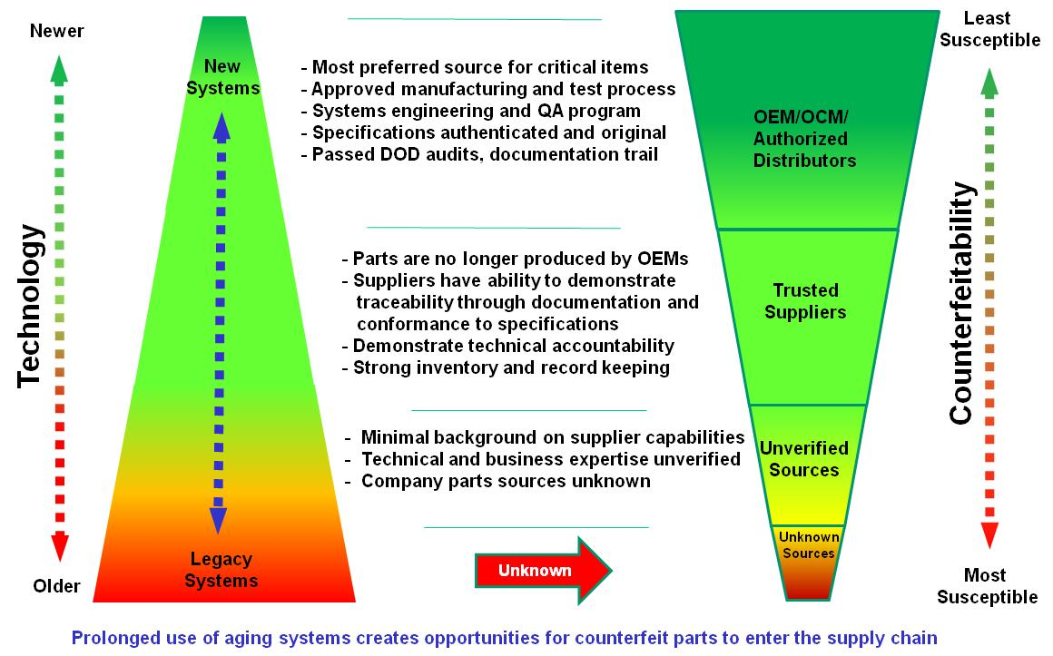
US DOD -- Current State of Identification
Figure 1: Profile of Counterfeit Risk¹
^{[1]} Peters, Paul Mr. “DoD Anti-counterfeiting Strategy.” 7 March 2012.

Slide 14
US DoD Anti-Counterfeit Initiative
National Defense Authorization Act - FY2010 Section 818
Focus on Detection and Avoidance of Counterfeit Electronic Parts
GS1 US has been asked to develop an item identification and authentication strategy to uniquely identify any product, part, or component in the supply chain and determine the authenticity of such product, part, or component.
Each alternative will be assessed on how it addresses the business needs and mitigates risk as defined by key stakeholders throughout the supply chain.
The recommendation will aim to meet three criteria: easy to implement, cost effective to introduce and maintain, and effectiveness in authenticating products, parts, and components.
GS1 US recommendation to be completed April 2013

