Slide 1
Dynamic Packaging Artwork Solution
Brieann Beckner – Solution Architect

Slide 2
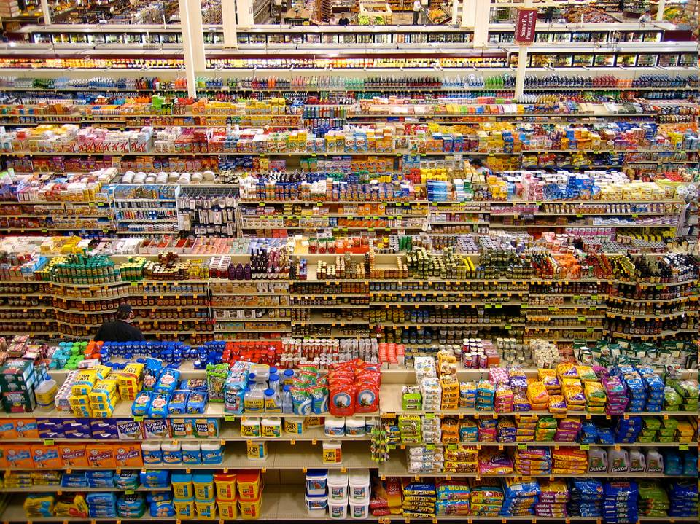
5
70%
80%
seconds
Decisions made at shelf*
Decision time in
front of shelf
Don’t know why they make these choices**
Marketing collateral
Commercial Print / Signs & Displays
Notes:
This is a helicopter view of a supermarket these days. Many products that are all packed in a nice looking packaging that scream: “Take me!!!” 70% of purchase decisions are now made at the shelf.
Consumers usually spend 5 seconds to make decision
After decision, 80% don’t know why…

Slide 3
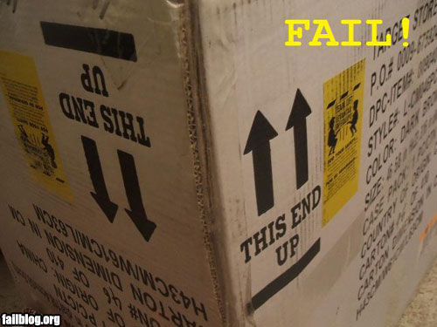
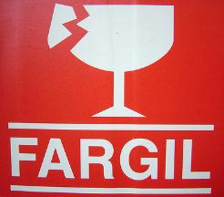
Notes:
Unfortunately, not all packaging will result in extra sales!

Slide 4
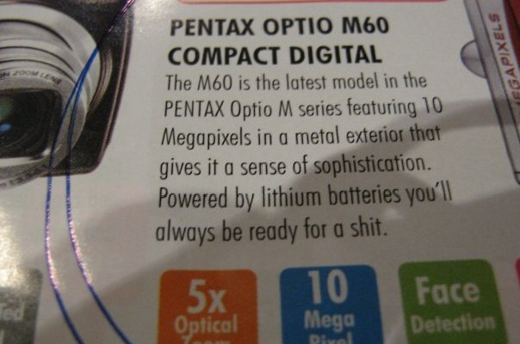
Notes:
Or just stupid typo’s

Slide 5
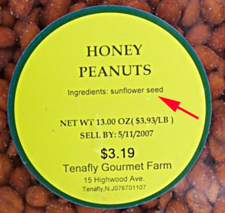
Notes:
Sometimes the packing can just lead to confusion

Slide 6
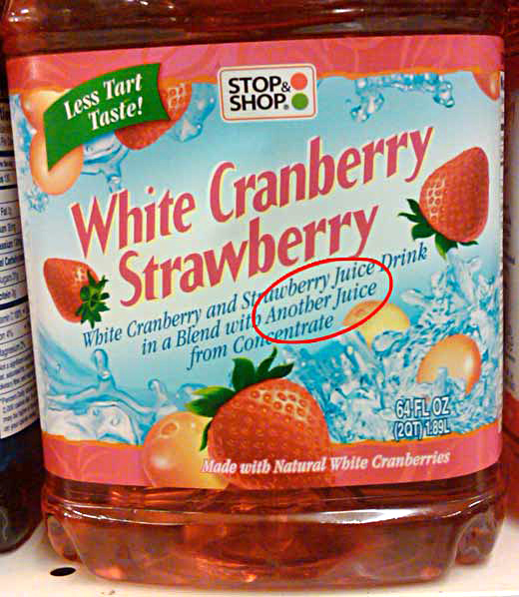
Notes:
Forgotten content

Slide 7
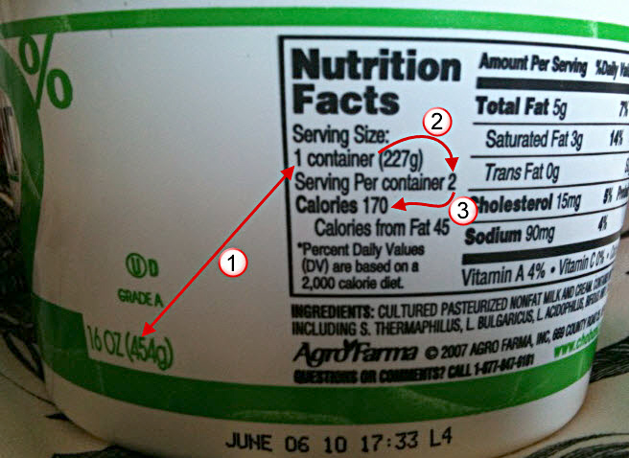

Slide 8
Where do the errors occur on packaging?
Technical Drawings
Graphics
Copy
Tech Specs
Artwork Execution
5%
16%
58%
2%
19%
The quick smart packaging expert jumped over the lazy competition. The quick smart packaging expert jumped over the lazy competition. The quick smart packaging expert jumped over the lazy competition. The quick smart packaging expert jumped over the lazy competition.
Codabar
Code 128
Code 39
Code 93
Data Matrix
EAN 13
GS1 DataBar
ITF-14
Pharmacode
QR Code
UPC
The quick smart packaging expert jumped over the lazy competition.
b a r c o d e

Slide 9
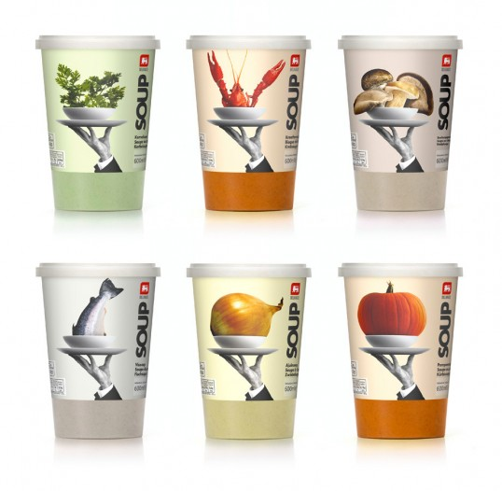




Packaging is Complex
x Number of Languages
x Number of Flavors
1 Master Design
Notes:
Reason for all the Errors is - Packaging is complex. Even relatively basic packaging designs like this become more complex…

Slide 10

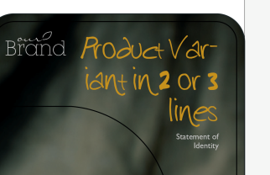





Getting Content on to the Packaging is Complex
Brand
Owner
Artwork
Studio
Notes:
Secondly – getting content to the packaging is complex

Slide 11

Why do all these content errors occur?
1. Lack of global standard to communicate content

Slide 12


Why do all these content errors occur?
2. Lack of global process standard to manage content

Slide 13
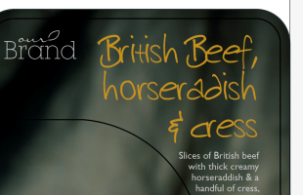


Why do all these content errors occur?
3. Lack of tools to update packaging artwork

Slide 14
Solution offered by GS1 and Esko:
Collaborative Packaging Artwork

Slide 15



1. GS1 XML Intelligent Packaging
Speak the SAME LANGUAGE

Slide 16


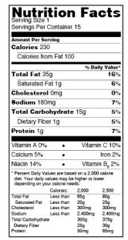

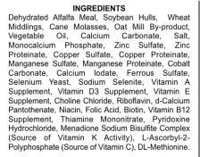


1. GS1 XML Intelligent Packaging
Notes:
Any form of content can be structured via the standard. Content includes graphics, logos, barcodes and textual information.

Slide 17

2. Standard Process Enabled by GS1
Use ONE Trusted Source of Data
Notes:
The same XML file can be used to update packaging artwork, marketing information, and digital publication

Slide 18
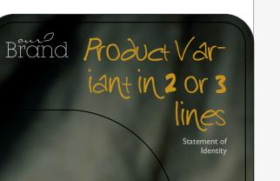
3. Esko Tools to Update Packaging Artwork
Artwork is LINKED to the GS1 Content
Notes:
The 3rd gap were proper tools to place the structured content into the packaging artwork. This solution has been developed by Esko and is called Dynamic Content.

Slide 19

Testimonial from an Early Adopter
Situation: 75,000 Pieces of Art (POA) per year
Benefits:
Nr. of approval cycles per POA went down from
2.5 to 1.5
Total amount of ‘human touches’ was reduced with 50%

Slide 20
Packaging is Constantly Changing
How often do you change your packaging?
Sources: “Innovations in Packaging” Pan-European Survey 2012, easyFairs®, “Reinventing innovation at consumer goods companies”, McKinsey Quarterly, 2006
Notes:
The reduction in approval cycles becomes especially important when you consider how often packages are changing.
The Pan-European Survey from 2012 shows that 19% of brands are changing their packaging at least every 6 months

Slide 21
Why Change?
“Which of the following are currently driving your packaging decisions?”
Source: “Innovations in Packaging” Pan-European Survey 2012, easyFairs®
Notes:
Cost Reduction, Enhanced brand image, Environmental impact

Slide 22
Esko Shares Common Goals with our Customers
1
2
Protect Brand Equity
Manage
Copy &
Content
3
4
Brand
Color Consistency
Drive Packaging Innovation
Notes:
WebCenter is 1 piece in in an integrated brand management offering. Other elements:
- Content Management (DCE)
- 3D Design, (Studio, Visualizer, Store Visualizer)
- Color Management (Pantone LIVE)

Slide 23
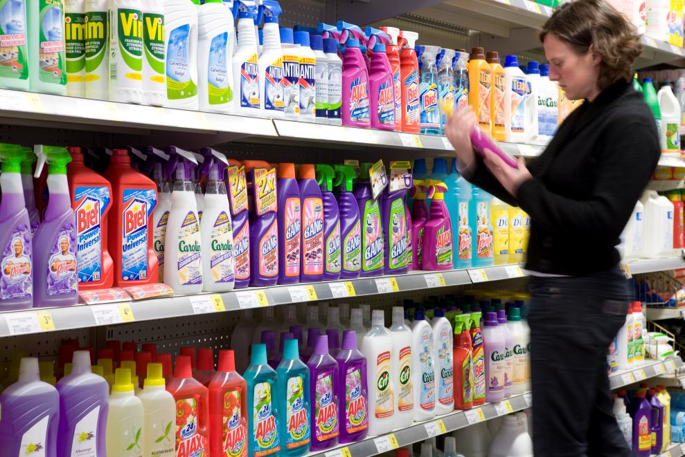
…Did you know?
9 of 10
70%
100%
Brands
Or more
Independent focus
Packaging is produced with Esko software
Market share within the packaging supply chain
Creating innovative packaging software
Notes:
Also used by over 1300 brand owners & retailers

