Slide 1
Standards = success
Welcome to gsmp in dallas
Siobhan o’bara, SVP, Industry Engagement, GS1 US

Slide 2
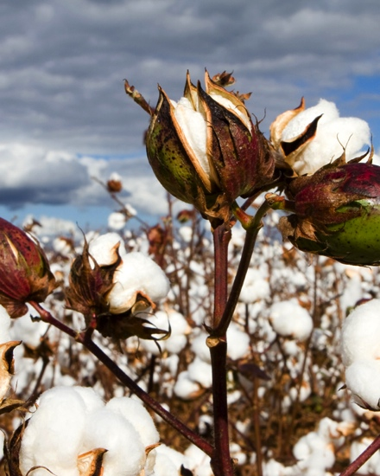
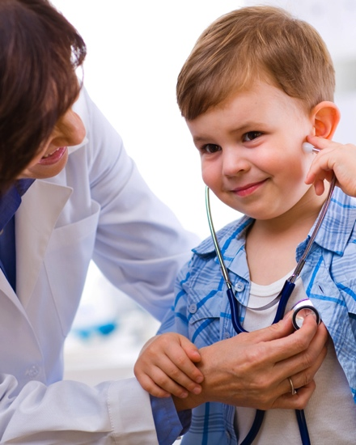
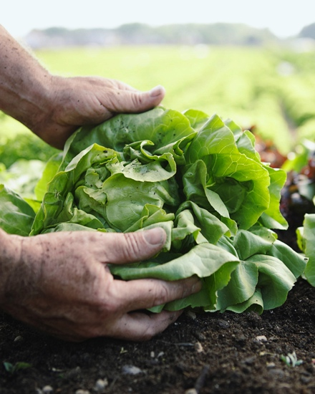

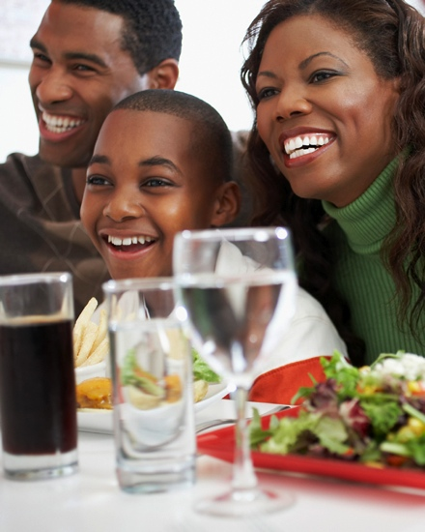
The global language of business
GS1 makes it possible for industries and companies of all kinds to move their business forward by adopting GS1 Standards as the foundation of their business processes.

Slide 3


110+ member organizations serving business around the world

Slide 4
gs1 By the numbers
2 million companies around the world
use GS1 Standards
More than 5 billion GS1 barcodes
are scanned every day
6 million products are assigned U.P.C.s
in the GS1 Data Driver® item management tool
10 million products are registered by brand owners in the GS1 Global Data Synchronization Network™ (GDSN®)

Slide 5
The power of industry moving as one
The application of GS1 Standards is ever-evolving, driven by ongoing engagement with industry leaders working together to forge new paths and create better ways of doing business.
Industry Collaboration
& Innovation
Mass Adoption

Slide 6
Gs1 Standards make it possible
To increase availability of accurate data
To accurately answer the what, when, where, and why of a specific product’s movement
To apply standards to business processes
To achieve interoperability between trading partners
VISIBILITY
EFFICIENCY
COLLABORATION
To help industry meet the requirements of the Food Safety Modernization Act
To share precise
recall information between trading partners
To improve patient safety through pedigree standards for pharmaceuticals
To combat counterfeiting through standardized identification and authentication
SAFETY
SECURITY

Slide 7
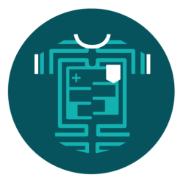
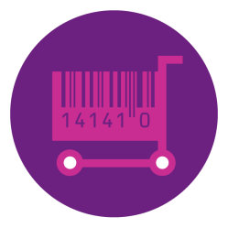




GS1 US Focus areas and key industries
FOCUS AREAS
B2B2C
Data Quality and
Data Management
Inventory Efficiency
Product and Location Identification
Traceability and
Safety
KEY INDUSTRIES
Apparel / General Merchandise
CPG / Grocery
Foodservice
Fresh Foods
Hardlines
Healthcare

Slide 8
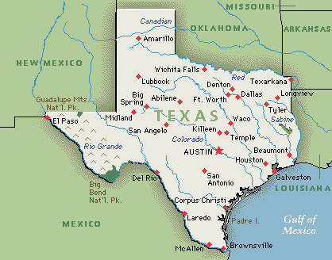

Slide 10
Local laws – odd but true
It is illegal to raise alligators in your home.
If you sit on the sidewalk – you could be fined $200.
It is illegal to drive without windshield wipers. Of course, you don’t need a windshield but you must have the wipers.
It is illegal to take more than 3 sips of beer while standing.
The Encyclopedia Britannica is banned in Texas because it contains a formula for making beer at home.
You are unable to tuck your pants in one boot unless you own ten or more cattle.
If you are released from jail, you must be given a horse and a shotgun, if you request them.
Dallas city ordinance states that a person cannot go barefoot without first obtaining a permit….

Slide 11
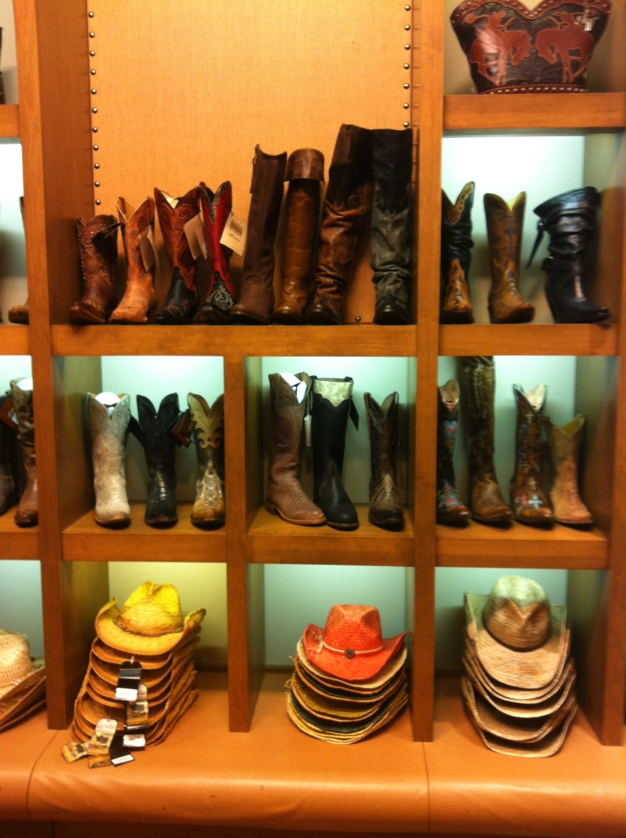
Welcome to texas--

Slide 12



Contact information
Siobhan O’Bara
Senior Vice President, Industry Engagement
GS1 US
TEL +1 609 620 8046
EMAIL sobara@GS1US.org
WEB www.GS1US.org/healthcare
Connect with the GS1 US community on

