Slide 1
GS1 Industry Engagement
Paul Voordeckers
GS1 President Industry Engagement & EPCglobal

Slide 2





CPG / Retail
Emerging Trends
Sustain-ability
Safety &
Health
Operational Excellence
Knowledge
Sharing & People Development
Future Value Chain
Climate Change Initiatives
Global Food Safety Initiative
Health & Wellness Initiative
Marketing
(Shopper & Consumer insights)
IT
(Connected Businesses for Consumers)
Supply Chain
(Delighting the Consumer – acting as One)
People Initiatives
B2B2C
Sustainability Measurement
- CO2 footprint
Global Manufacturing
Aging
Cloud Computing
Future SC
People Development
Global Primary
Trading Partners Performance Measure
(TPPM)
SC Hot Spots
- Deforestation
- Refrigeration (GHG)
Auditor Competence
Global Summit
Storage & Distribution
Future Leaders
Global Social Compliance Program
Guidance Docs
Global
Scorecard
Regulatory
Knowledge Navigator
Communication
Business
Information Needs Group
(BING)
Next Generation Product Identification (NGPI)
Global Upstream Initiative (GUSI)
Common Language
- Global Packaging Project (GPP)
Linked to Traceability
Prepare our People
KEY: Black = GS1 Engagement (existing)

Slide 3


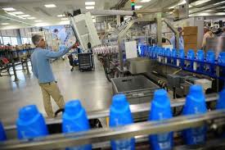
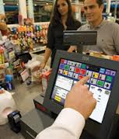





Next Generation Product Identification (NGPI)
More consumer information
Accurate data; mobile/on-line
Strive towards minimal disruption to supply chain
Strive towards minimal disruption to POS

Slide 4




IE in Foodservice
Coordinated MO engagement
  Share best practices and experiences
  MO Interest Group for Foodservice with GO coordination
    Quarterly calls to learn and leverage
    Foodservice Engagement Starter Kit
Our approach
  Lay the foundation
  Begin product information sharing
  Establish e-commerce business transactions

Slide 5





IE in Fresh Foods
Global Industry User Group
  Addressing Business Process Guides
  Working to Reduce Food Waste
  Leveraging best practices and experiences
Industry Group Progress
  Fresh Foods Integrated Guide available by June 2013
  Fruit & Vegetable Master Data Guideline by June 2013
  Fresh Foods Roadmap – Establishing 2013-2014 Priorities this Wednesday at the Industry Group Session

Slide 6

Healthcare – regulatory bodies momentum
To date, regulatory bodies have endorsed GS1 Standards in 65 countries – more traction ongoing
McKinsey report “Strength in unity: The promise of global standards in healthcare”
  disseminated by GS1 Global Office,GS1 Member Organisations and McKinsey
  23 MOs actively promoting and using the report
GS1 Position Paper endorsed by 22 global and local users

Slide 7

23rd GS1 Healthcare Conference
Buenos Aires, Argentina – 23-25 April
2nd time in LATAM since the inception of GS1 Healthcare
Simultaneous translation confirmed
Also confirmed as speakers:
  McKinsey & Company
  Representatives from regulatory bodies: USFDA, Argentina, Colombia, Netherlands,
  Global manufacturers: Bayer, GSK, Pfizer
  Distributors, wholesalers: Mc Kesson, Premier
  Hospitals from Argentina, Brazil, France

Slide 8
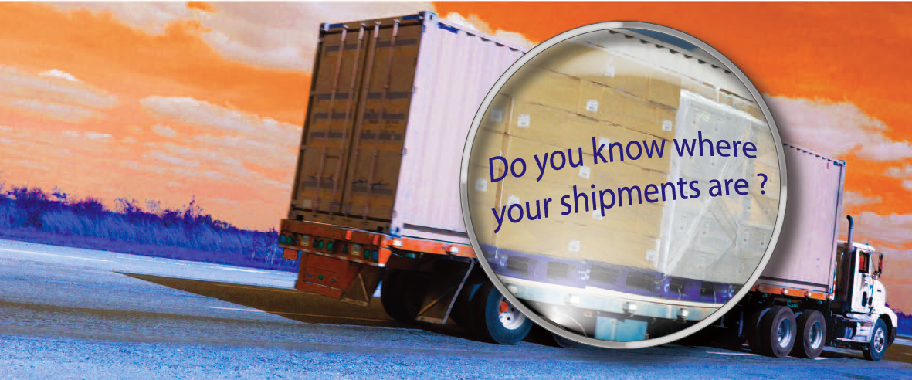
Transport & Logistics
Shippers and Logistic Service Providers need to know exactly where their shipments are at any given time
GS1 provides value…
The GS1 System of Standards provides a standarised way to identity items and locations…
to capture details about supply chain movements … and to share that information both internally and with authorised business partners
Notes:
Shippers and Logistic Service Providers need to be able to determine exactly where their shipments are at any given time so they can make good business decisions and take appropriate action based on accurate up-to-date information.
GS1 can help!
------------------------------ Challenge : a Business need --------------------------------
Shippers and Logistic Service Providers need to be able to determine exactly where their shipments are at any given time so they can make good business decisions and take appropriate action based on accurate up-to-date information
---------------------------- GS1 provides value -----------------------------
GS1 System of Standards will allow companies to Identify, Capture and Share accurate information enabling visibility in the supply chain
-------------------------------- Benefits ----------------------------------
Shippers and Logistic Service Providers will act and take good business decisions for accurate forecasting, planning, and production
real-world implementations I will give you a copy of the brochure that I shipped to Dallas that you can show saying: In this brochure you will discover
real-world implementations of GS1 Standards providing visibility into the T&L processes of Tesco, Unilever, DHL Supply Chain, Stena Line, DSV Road, the U.S. International Trade Data System Product Information Committee, Kibun Japan…

Slide 9

Apparel, Fashion & Footware
SPEAKERS
VDC Research, Macy’s, VF Jeanswear, GS1 US, GS1 DE, GS1 HK
Macy’s Store visit – see the use of EPC-RFID in store operations
TOPICS
Latest implementations of EPC in Apparel
New trends : Omni-/Multichannel
Downstream & Upstream supply chain & business models and collaborative planning
PARTICIPATION
50+ participants : 17 companies & 11 MO’s

Slide 10
New Initiatives
Financial Services
GS1 to play a key role in “standing up” the Legal Entity Identifier (LEI).
Decision on role GS1 pending from now till June 2013
Components/Parts ID
CPID ready
Draft Guideline currently in development
Ratification in May’13 at GA
eTailers
Understand and quantify global business needs that are unique to eTailers.
Develop global MO and user community involvement.
GDSN & GLN Registries
Continue GDSN deployment in Healthcare (e.g. UDI)
Determine data sharing needs for other sectors
Global deployment of the GLN Registries Framework

Slide 11
Who does What in IE?
Lynda
Retail Value Chain
Greg
Fresh Food
Foodservice
Enzo
Apparel
Defense
Robert
eTailers
Automotive/Component Parts
Audrey
Transport & Logistics
Ulrike
Healthcare
Pete
GDSN & GLN Registries

Slide 12






Welcome Greg, Robert and Pete
Greg Rowe
Robert Beideman
Pete Alvarez
Director IE, Retail and Foodservices
Senior Director IE, New Sectors
Senior Director IE, GDSN & GLN Reg

Slide 13

Welcome Robert
Robert Beideman
15 year veteran of the Logistics Automation industry
Expertise in Business Intelligence, Systems Engineering, Supply Chain Automation, Consultative Sales
Define global industry needs of New Sectors that can drive the development of GS1 standards, solutions & services
Current focus on CPID and eTailers
Engage MO community in the development of New Sectors for GS1
Senior Director-Industry Engagement, New Sectors

Slide 14
Contact Details
GS1 Global Office
Avenue Louise 326, bte 10
B-1050 Brussels, Belgium
T + 32 2 788 78 00
W www.gs1.org

