Slide 1
GS1 Global Standards Event
24-28 March 2014 – Atlanta
Building Standards to Deliver Business Value
Session: GS1 Digital, Industry Engagement
Time: Monday, 1:30pm-5:30pm
Who May Attend: Everyone

Slide 2
Anti-Trust Caution
GS1 and the GSMP operate under the GS1 anti-trust caution. Strict compliance with anti-trust laws is and always has been the policy of GS1.
The best way to avoid problems is to remember that the purpose of the committee is to enhance the ability of all industry members to compete more efficiently.
This means:
  There shall be no discussion of prices, allocation of customers, or products, etc.
  If any participant believes the group is drifting towards an impermissible discussion, the topic shall be tabled until the opinion of counsel can be obtained.
  The full anti-trust caution is available in the Community Room if you would like to read it in its entirety.

Slide 3

Meeting Etiquette
Meetings will begin promptly at designated start times
Avoid distracting behaviour:
  Place all mobile devices on silent mode
  Avoid cell phones
  Avoid sidebar conversations
Speak in turn and be respectful of others
Be collaborative in support of the meeting objectives

Slide 4

WiFi internet access is complimentary!
Please connect …
Connect to: WESTIN-MEETING
Password: GS1WB

Slide 5
The discussion today
  Introduction – GS1 Digital
    Steve Bratt, GS1
  Market Perspective
    GS1 UK
      David Smith, GS1 UK
    GS1 Germany
      Andreas Fuessler, GS1 Germany
    GS1 Japan
      Hideki Ichihara, GS1 Japan
    GS1 US
      Rich Richardson, GS1 US
  GS1 Digital – Background, Strategy, and Current Work
    Robert Beideman, GS1
  GTIN+ on the Web - Technical Aspects
    Mark Harrison, Auto-ID Labs, Cambridge
  Discussions
    GTIN+ on the Web MSWG – Get Involved!
    Digital Media work underway
    GTIN Validation work underway
    Next Priorities

Slide 6
The discussion today
  Introduction – GS1 Digital
    Steve Bratt, GS1
  Market Perspective
    GS1 UK
      David Smith, GS1 UK
    GS1 Germany
      Andreas Fuessler, GS1 Germany
    GS1 Japan
      Hideki Ichihara, GS1 Japan
    GS1 US
      Rich Richardson, GS1 US
  GS1 Digital – Background, Strategy, and Current Work
    Robert Beideman, GS1
  GTIN+ on the Web - Technical Aspects
    Mark Harrison, Auto-ID Labs, Cambridge
  Discussions
    GTIN+ on the Web MSWG – Get Involved!
    Digital Media work underway
    GTIN Validation work underway
    Next Priorities

Slide 7






GS1 Global Strategy – our strategic priorities
1
Mission/vision
  Common mission/vision
  Common brand visual identity
2
3
4
5
Execution Quality
Sector Focus
Digital
Innovation
  Standards Implementation
  Data Quality
  Adoption of GS1 standards in Core and Emerging Sectors
  Global Classification of sectors and business processes to
  GS1 Digital Strategy with emphasis on GS1 Strategy for Omni-channel
  Key Projects
    GS1 Source
    GTIN+ on the Web
  Global Business Technology Innovation
  Local entrepreneurship
  and MO-MO sharing
6
  Common KPIs
  MO Clustering supported by GO Cluster Managers
  Common Trademark Agreement
  Review Advisory Council
  GS1 Organizational Culture
Organisation
Notes:
7

Slide 8
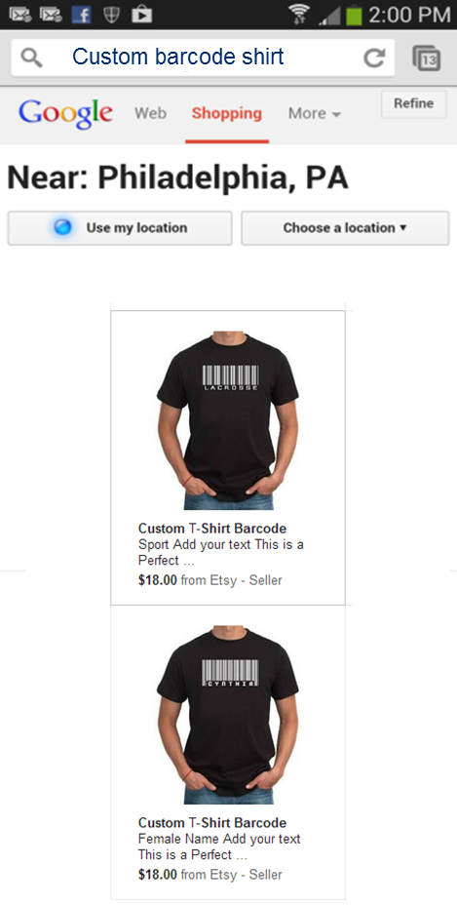
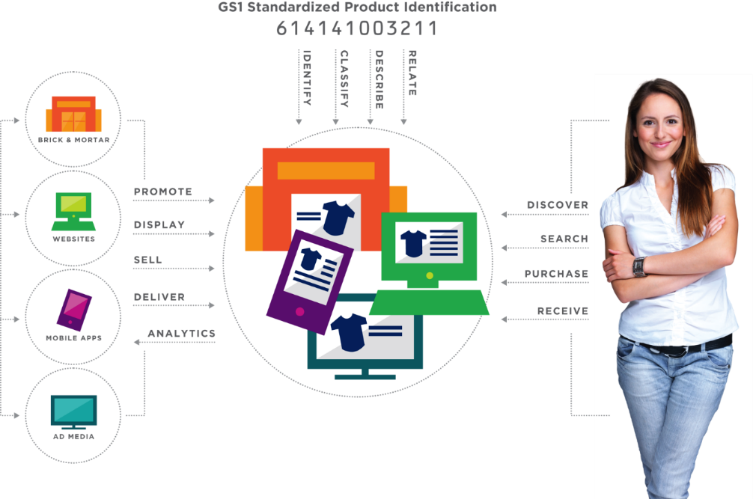


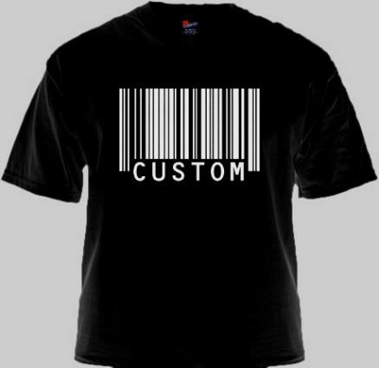



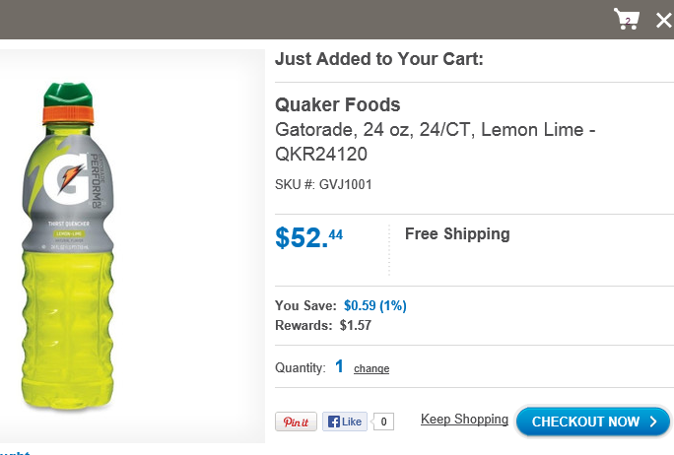




A “Demand-Chain Story” …
Etsy
Custom Barcode tshirt
UPC: 052000241204
$18.00

Slide 9
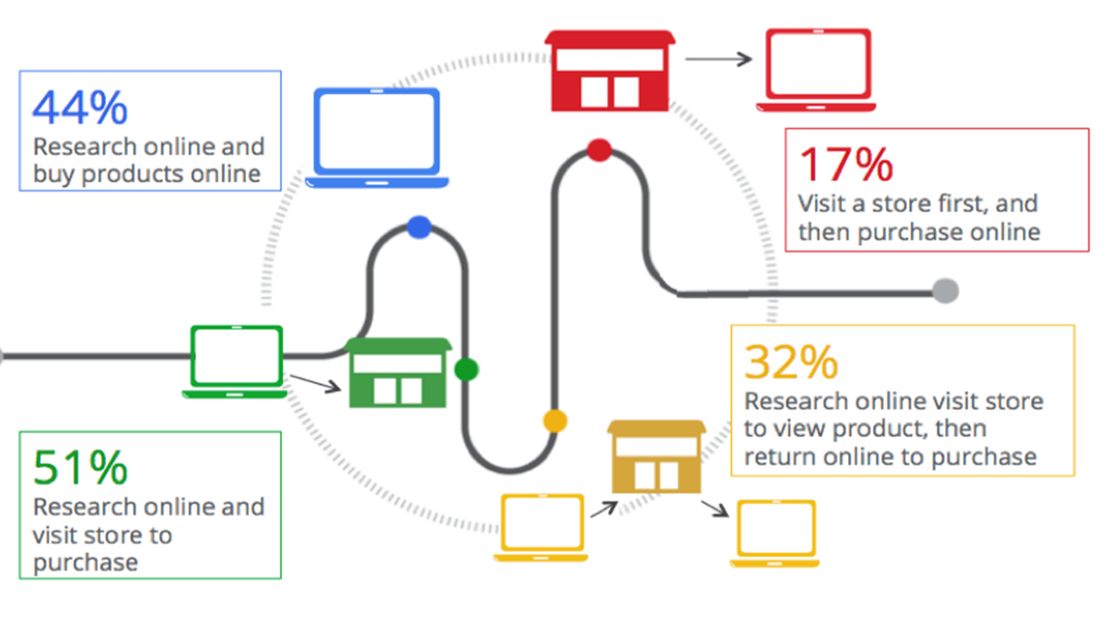
Smarter Shoppers
Google Retail Advertising Blog: October 2012

Slide 10
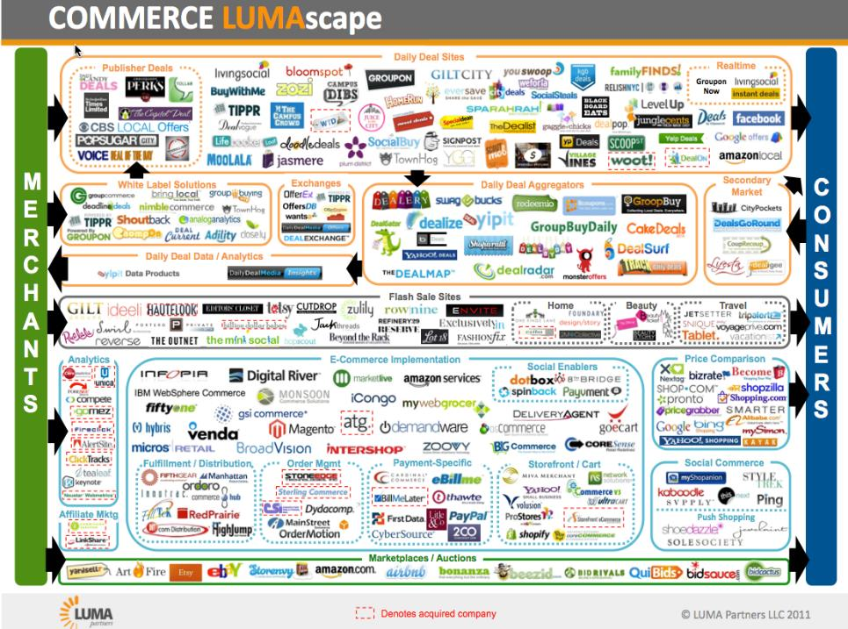
Daily Deal Sites
White Label Solutions
Exchanges
Daily Deal Aggregators
2ndary
Market
Daily Deal Data/Analytics
Flash Sale Sites
Analytics
E-Commerce
Implementation
Price
Comparison
Social
Commerce
Affil-
iates
Market Places / Auctions
Luma Partners, 2011

Slide 11

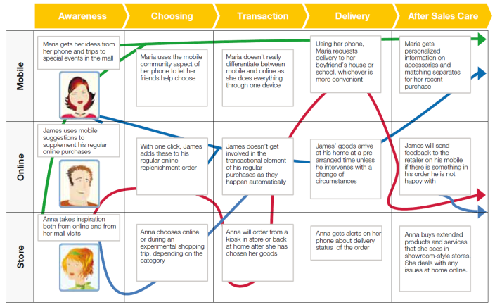
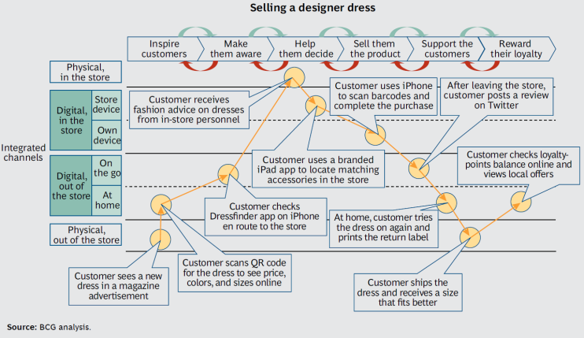
Growing number of industry and analyst reports validate importance of omni-channel and the pain points that GS1 could help to address
“We should engage the customer in however he or she chooses to shop with us. I want to break those silos down internally in my own organization and make sure that we are doing one thing and that is putting the customer at the center of all of our decisions.”
- Terry Lundgren, Chairman, President, and CEO of Macy’s, December, 2013
Macy’s
Google
Boston Consulting Group
CapGemini
See references and Backgrounder for more on these omni-channel reports

Slide 12
Vision/Mission:
Our Winning Aspiration
Make the GS1 System as important in the digital world as it is today across traditional supply chains
Empower industry to more efficiently connect with consumers across physical and digital paths to purchase
Expand GS1 standards to enable the trusted identification, classification, description, relationship, and sharing of data about things in the digital world

Slide 13
GS1 Digital: Empowering Omni-channel
614141999996

Slide 14
Why an omni-channel perspective?
Omni-channel …
.. is a disruptive evolution in our core sector of retail
.. about connecting all aspects of a company’s business processes with a constant focus on a seamless consumer experience
.. requires an (natural) extension of GS1 standards to empower supply-side and demand-side business processes (plus some new standards)
See the separate Backgrounder for a more in-depth explanation of our choice of an initial retail omni-channel focus

Slide 15












Areas of Potential Involvement? *
Enabling Technologies in GS1 Digital
  GTIN+ on the Web
  Digital Media
  Web Data Authenticity
  Category hierarchy
  Mobile ID
Related Enabling Technologies
  Next Generation Product Identification**
  Allocation Rules**
Application of GS1 System to address Business Needs
  GS1 Source
  ePayments
  updated eCoupon standard
  eReceipt standard
  Store-based e-fulfillment
  Connection of Products to Social Media Touchpoints
  Inventory visibility
  RFID inventory
  Consumer Privacy
  Guidelines for use of GS1 System on the Web
** Outside of GS1 Digital / a dependency
* Compiled from McKinsey, AC, MO’s, Digital Interest Group

Slide 16
The discussion today
  Introduction – GS1 Digital
    Steve Bratt, GS1
  Market Perspective
    GS1 UK
      David Smith, GS1 UK
    GS1 Germany
      Andreas Fuessler, GS1 Germany
    GS1 Japan
      Hideki Ichihara, GS1 Japan
    GS1 US
      Rich Richardson, GS1 US
  GS1 Digital – Background, Strategy, and Current Work
    Robert Beideman, GS1
  GTIN+ on the Web - Technical Aspects
    Mark Harrison, Auto-ID Labs, Cambridge
  Discussions
    GTIN+ on the Web MSWG – Get Involved!
    Digital Media work underway
    GTIN Validation work underway
    Next Priorities

Slide 17

UK retail market update
We are all shopping online!
Online sales of non-food grew by nearly one fifth in December 2013 the fastest rate since 2010
In grocery, 15% of UK sales, worth £900m booked online between Dec 20 – 23. Yearly average 5.5% in 2013
Source BRC/KPMG

Slide 18
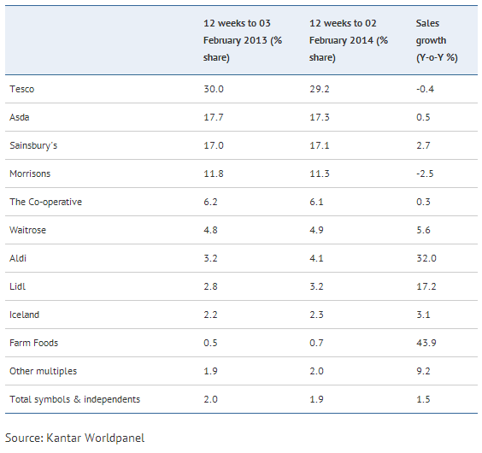
Latest Grocery Sector Performances Net growth ONLY in Premium & Discount sectors. Excluding Aldi & Lidl, grocery sector growth is just +1.0% … a net decrease! (Market +2.4%, vs +2.9% last time; inflation +2.1% YoY)
“Hot off the press”: 12-week data to Feb. 2nd
Total UK Retail grew by +5.4%, driven by categories like furniture (being boosted by increased activity in the housing market).
Food spend is in only marginal growth, in a price-driven market – source: BRC

Slide 19

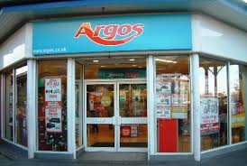


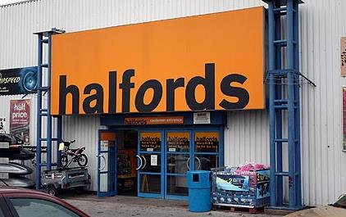
UK retail market update
6.9%
23%(online)
5 weeks to Dec 28
46% via internet
20% over Christmas from tablets and phones
3.8%)
18 weeks to Jan 14
12.0%
8 weeks to Dec 24
5.2%
14%(online)
15 weeks to Jan 10

Slide 20
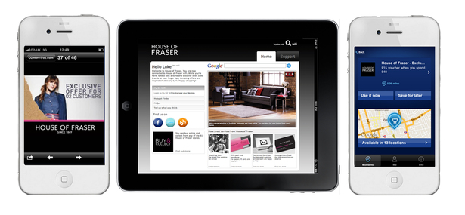
UK retail market update
mobile devices accounted for 27% of online sales in Q3 of 2013
50% of traffic to House of Fraser via mobile devices

Slide 21



UK retail market update
Click and collect grew from 11% in Q1 of 2013 to 19% by Q3 for multichannel retailers

Slide 22












UK retail market update

Slide 23
The discussion today
  Introduction – GS1 Digital
    Steve Bratt, GS1
  Market Perspective
    GS1 UK
      David Smith, GS1 UK
    GS1 Germany
      Andreas Fuessler, GS1 Germany
    GS1 Japan
      Hideki Ichihara, GS1 Japan
    GS1 US
      Rich Richardson, GS1 US
  GS1 Digital – Background, Strategy, and Current Work
    Robert Beideman, GS1
  GTIN+ on the Web - Technical Aspects
    Mark Harrison, Auto-ID Labs, Cambridge
  Discussions
    GTIN+ on the Web MSWG – Get Involved!
    Digital Media work underway
    GTIN Validation work underway
    Next Priorities

Slide 24
GS1 Digital Industry Engagement – Market View Germany
Shopper Approach within eCommerce/
Cross-Channel Environment

Slide 25
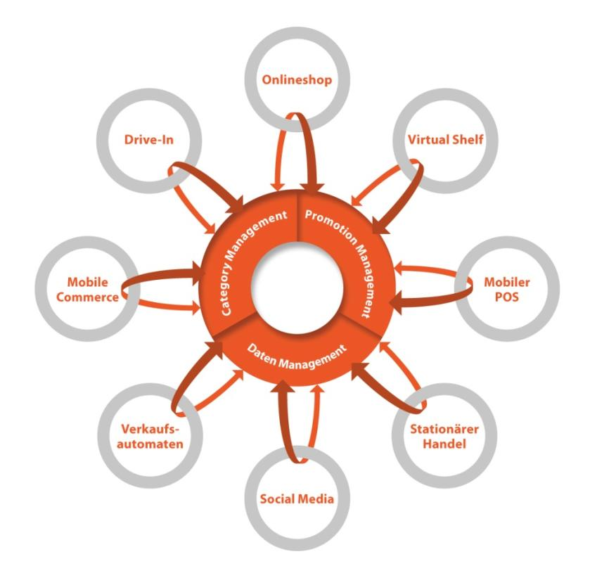
Background:
Online & Offline Conglomerate
Vending
Machines
Brick & Mortar
Source: Survey “The Future Value Chain 2025”, GS1 Germany 2013

Slide 26
GS1 Cross-Channel House
Cross-Channel
Supply Chain
Content Management
Identification on the Web
Category Management
Shopper Marketing
GS1 Enabling Technologies
Organizational
and Operational Structure

Slide 27


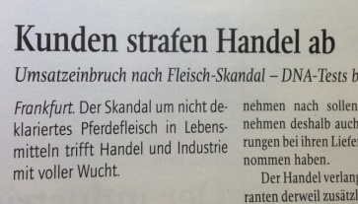
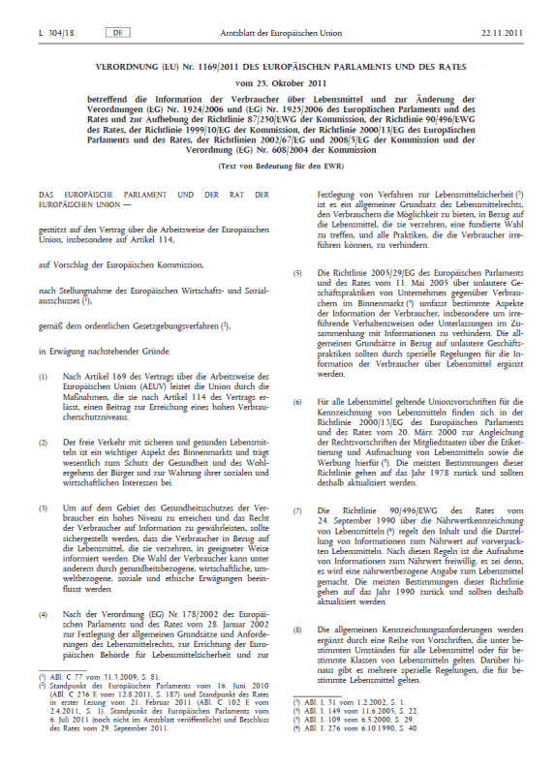
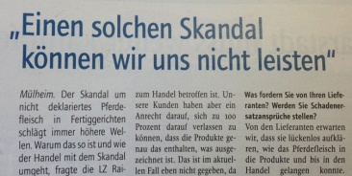
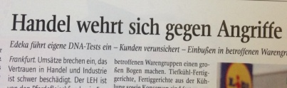
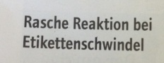
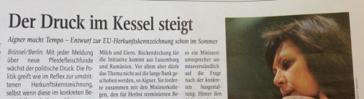
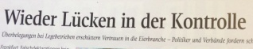
Hot Topic in Content Management:
EU Regulation 1169/2011
Cause
Law
Aim
1169/2011
dioxin in eggs,
EHEC in soy sprouts, horse meat in lasagna,
could be continued…
more transparency for consumers e.g. regarding ingredients and source of food

Slide 28


Critical: Identification of Products with Different Declarations
Production/Warehouse
Brick & Mortar Retail
consumer can read package texts before buying the product and thus knows what the product contains
GTIN
40 08400 40102 7
Food A
GTIN
40 08400 40102 7
Lebensmittel A
Distance Selling
food A with small change in recipe (e.g. 0,1 % less fat with accordingly changed nutrition facts)
consumer cannot read the package texts before buying the product to know what the product contains
consumer orders
GTIN
40 08400 40102 7
EU 1169/2011
food A
retailer supplies
GTIN
40 08400 40102 7
food A with small change in recipe (e.g. 0,1 % less fat with accordingly changed nutrition facts)

Slide 29
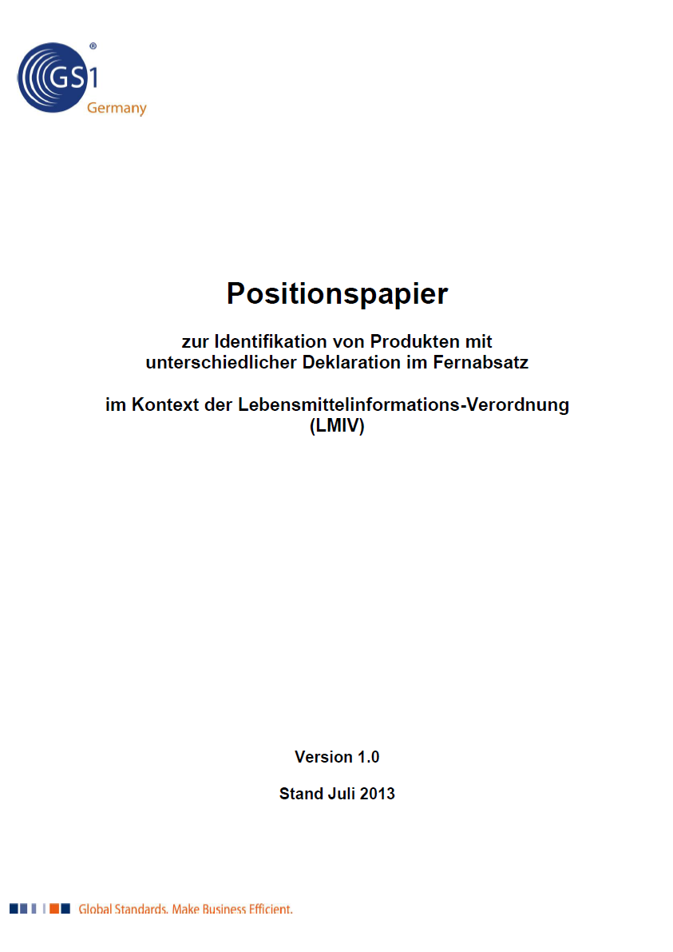
Position Paper on GTIN Allocation Rules for Compliance with EU 1169/2011
Short-term
Allocation of new GTINs at change of declarations in accordance with
EU 1169/2011
Middle- to long-term
Implementation of GTIN+X
Condition
Analysis and practical experiences to evaluate the process and investment costs

Slide 30




Service of
Certification –
Service
Retailer
Supplier
1. Direct data delivery
Quality Gate - Certification
PDM Platform
Portal / M2M
PDM Platform
Data pool
Quality Assurance
Certification –
Service
Capturing and
Content Service
2. Data Completion
3. Outsourcing
Quality Gate - Services
Quality Gate -Today

Slide 31

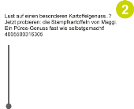

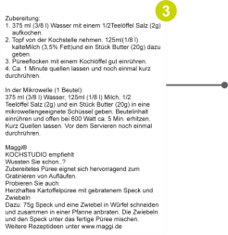
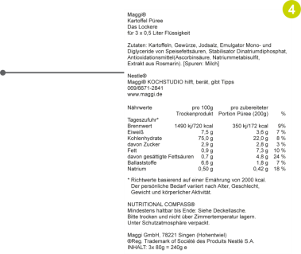
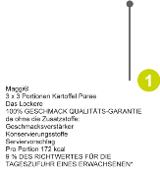

Service for Digital Content

Slide 32
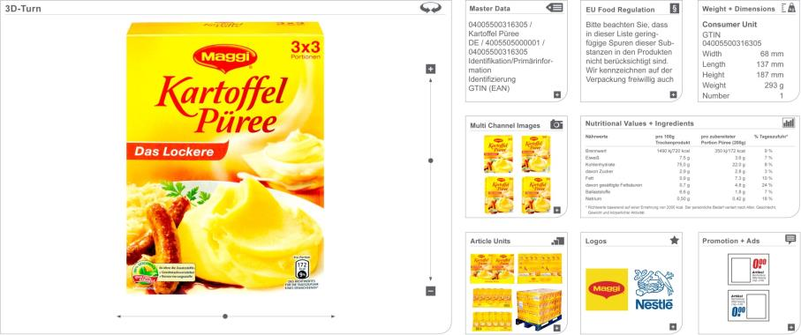

Service for Digital Content –
Example 3D Turn
Video

Slide 33
GS1 Cross-Channel House
Cross-Channel
Supply Chain
Content Management
Identification on the Web
Category Management
Shopper Marketing
GS1 Enabling Technologies
Organizational
and Operational Structure

Slide 34
Hot Topic in Category Management:
Does the CM Process for Brick & Mortar works Online as well?
Strategic Setup
  CM is about
Adequate assortments …
… at the right time
… in the right amount
… at the right place
1
Category Definition
8
2
Category Role
3
Category Assessment
4
Category Review
Category Goals
5
Category Strategies
  Proposition
  No new CM process as strategically questions are the same, but: at some process steps content needs to be enlarged
6
Category Tactics
7
Category Implementation
  8 Step CM Process

Slide 35
Additional Content for
Online/Cross-Channel CM Process
0a. Positioning: analyze new competition environment, understand customer and his/her behavior
→ define target customer / shopper segmentation
0b. Strategic setup
Define categories per channel and possibly per target customer (Product<>Category – not always one-to-one relationship anymore! Market research: consider special market research for online)
Assign roles per category and channel
Categories and their potential are to be evaluated per channel (same KPIs for offline and online, but special additional KPIs have to be considered for online)
Define goals per channel
Design strategies accordingly
Modulate tactics per channel accordingly
(offline tactics remain the same, for online: communication and diverse services to be added)
Implementation per channel
Review of implemented tactics per channel
Strategic Setup
1
Category Definition
8
2
Category Role
3
Category Assessment
4
Category Review
Category Goals
5
Category Strategies
6
Category Tactics
7
Category Implementation
  8 Step CM Process

Slide 36
GS1 Cross-Channel House
Cross-Channel
Supply Chain
Content Management
Identification on the Web
Category Management
Shopper Marketing
GS1 Enabling Technologies
Organizational
and Operational Structure

Slide 37
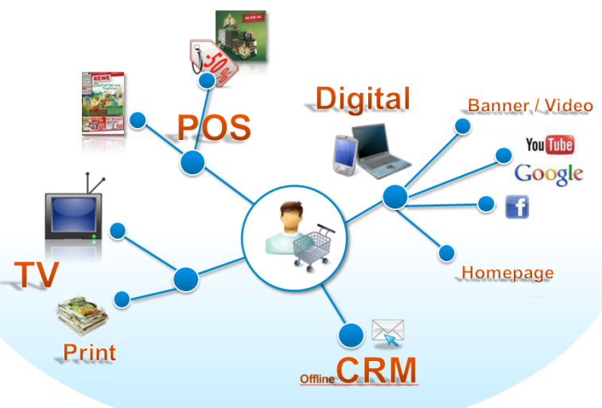
Hot Topic in Shopper Marketing:
Consumer & Shopper Journey
channels increase
customer does not think
in channel categories

Slide 38
Channel Overarching
Shopper Behavior
Consumer & Shopper Journey
Pre Sales Info, Influence &
Creation of Shopping Mission
Decision
about
distribution
channel
Consultancy, Information
gathering
Delivery
to customer
Con-
sumption,
Rating of
purchase
After
Sales
Service
Product
availability
Buying
decision
Payment
Returns, complains
Channels
Commerce is ubiquitous and omni-present
All touch points are seamlessly integrated
Dependent upon industries, different channels are used by the customer (different decision pattern)
Print (ad,
leaflet)
Out-of-Home
(e.g.. poster)
TV/Radio
Stationary
Website/
Online-Shop
Social Media
email/fax
Phone
Mobile/Tablet
SMS/MMS
Source: Following among others Haderlein 2012 and Accenture 2010

Slide 39
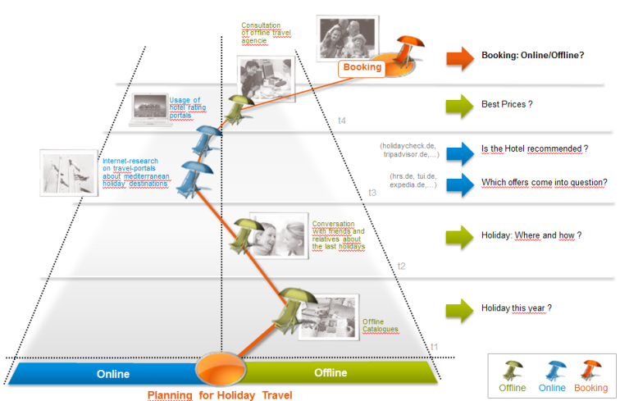
Example: Booking of Holiday Journey
consultation of offline travel agency
booking: online/offline?
usage of hotel rating portals
best prices?
internet research on travel portals about holiday destinations
is the hotel recommended?
which offers come into question?
conversation with friends and relatives about the last holidays
holiday – where and how?
offline catalogues
holiday this year?

Slide 40
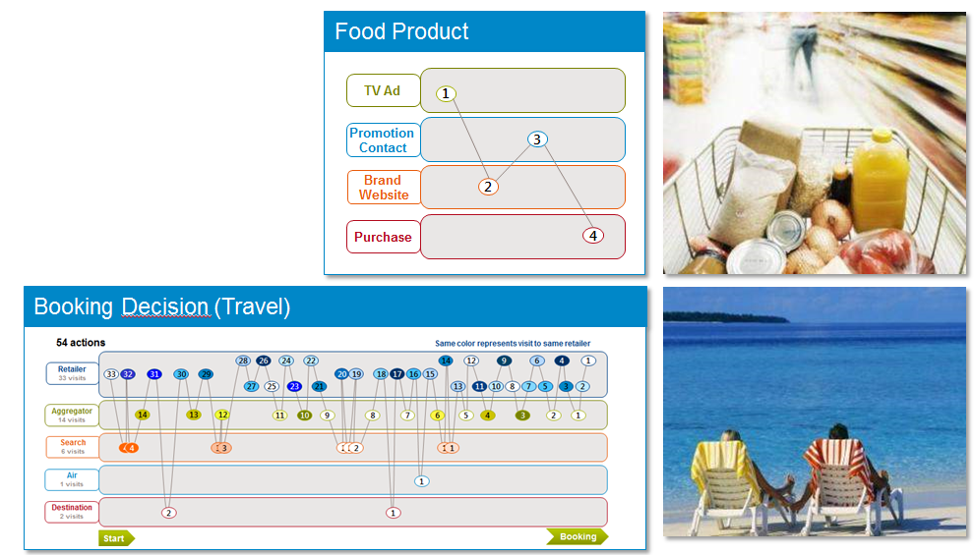
Channel Overarching
Decision Process per Mission

Slide 41
User Priorities
Cross-Channel
Supply Chain
Content Management
Identification on the Web
Category Management
Shopper Marketing
Priority 1
Priority 2
Priority 3
GS1 Enabling Technologies
Organizational
and Operational Structure

Slide 42
The discussion today
  Introduction – GS1 Digital
    Steve Bratt, GS1
  Market Perspective
    GS1 UK
      David Smith, GS1 UK
    GS1 Germany
      Andreas Fuessler, GS1 Germany
    GS1 Japan
      Hideki Ichihara, GS1 Japan
    GS1 US
      Rich Richardson, GS1 US
  GS1 Digital – Background, Strategy, and Current Work
    Robert Beideman, GS1
  GTIN+ on the Web - Technical Aspects
    Mark Harrison, Auto-ID Labs, Cambridge
  Discussions
    GTIN+ on the Web MSWG – Get Involved!
    Digital Media work underway
    GTIN Validation work underway
    Next Priorities

Slide 43
Current status in Japanese mobile market.
How is digital world in Japan.
2014.03.24
Final version

Slide 44
Agenda
Market Trends in Japan
Business cases for mobile
GS1 Japan’s actions

Slide 45





Market trends in Japan
1.E-commerce
Annual sales ranking on Direct Marketing company. (2012)
(Million Yen)
Rank | Company name | Annual sales
1 |  | 620,000
2 |  | 244,709
3 |  | 226,610
4 | Nissen Holdings Co., Ltd | 170,532
5 | MISUMI GROUP Inc. | 134,844
6 |  | 130,456
7 | SHOP CHANNEL | 127,161
8 |  | 117,381
9 | JAPANET HOLDINGS Co.,Ltd. | 117,094
10 | Belluna Co., Ltd. | 102,165
Note : each annual sales are consist of mail order system and e-commerce.
(Source; Tsuhanshinbunsya Co.,Ltd.)

Slide 46
Market trends in Japan
1.E-commerce
Trading partner of Amazon Japan and RAKUTEN registers numbers of GS1 Company Prefix in Japan.
For example, over 1000 trading partners of Amazon Japan registered GS1 Company Prefix per year.
RAKUTEN is also one of leading e-tailer in Japan, their trading partners came to register GS1 Company Prefix.

Slide 47






Market trends in Japan
2.Electronic Money
Value of transactions 20,582(JPY billions)
Volume of transactions 2,342(millions)
Value per transaction 879(JPY) (Fiscal 2011)
Number of electronic money instruments issued 17,497 (millions)
Of which: mobile phones 2,080 (millions)
Number of terminals 1.07(millions) (Mar. 2012)
(Source ; Recent Developments in Electronic Money in Japan (2012)
Payment and Settlement Systems Department, Bank of Japan)
Major electronic money cards
Card Brand note : ( ) shows issuer. | card in force (thousand) | Volume of transactions per month(thousand) | Number of available stores
Edy (RAKUTEN) | 74,500 | 30,000 | 3,500,000
Suica (rail) | 39,510 | 57,920 | 1,946,700
WAON (AEON) | 30,500 | 61,600 | 1,570,000
PASMO (rail) | 21,860 | 17,450 | 1,400,000
nanaco (7&i) | 21,210 | 69,000 | 1,200,000
ICOCA (rail) | 7,610 | 3,050 | 1,643,500
(Source ; Nikkei MJ (13TH March 2013)

Slide 48
Market trends in Japan
3.Mobile phone’s subscribers.
Total Numbers of Phone subscribers; 136,040,000 (Dec.2012)
Percentage of 3G Service; 85% (8.1％ down)
Percentage of LTE Service; 15%
(source; Ministry of Internal Affairs and Communication.)
Total number of smartphone subscribers;
estimated 42,170,000 (Dec. 2012) (source; Mobile Computing Promotion Consortium )
Rate of smartphone’s subscribers is about 30%.
What kinds of faction smartphone user are choosing ? (multiple answers allowed)
call feature 96.5%
mail and message exchange 96.5%
internet 87.8%
application 82.0%
photo 81.8%
GPS 63.0%
Sample Survey; Respondent =1,707 (source; Impress R&D/ Mobile Content Forum,2012)

Slide 49
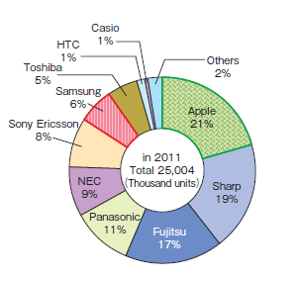
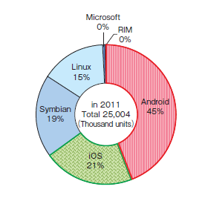
Market trends in Japan
4. Trends in smartphone‘s Unit-shares in Japan
unit-sales-share of smartphones in Japan by OSs
unit-sales-share of smartphones in Japan by Manufacturers
Android has large market share in Japan.
It would be similar trend other countries.
Apple has large market share.
Japanese people love to use iPone.
Samsung is incresing market share.
(Source) 2013 WHITE PAPER Information and Technology in Japan

Slide 50
Market trends in Japan
5. EC service per mobile device.
 | smartphone | Feature phone
Online shopping | 32.6% | 19.6%
Air line booking | 12.7% | 8.0%
Hotel booking | 13.8% | 8.3%
Event ticket booking | 8.1% | 6.3%
Net auction | 15.8% | 10.6%
Coupon | 18.3% | 13.9%
Net Banking | 15.4% | 10.2%
No use | 47.4% | 62.0%
(source; Impress R&D/ Mobile Content Forum,2012)
Smart phone users more active in the internet than feature phone users.

Slide 51
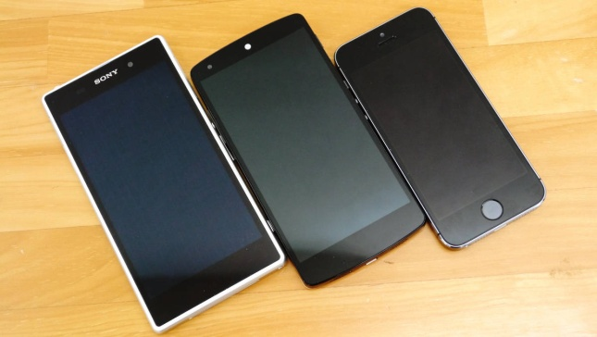
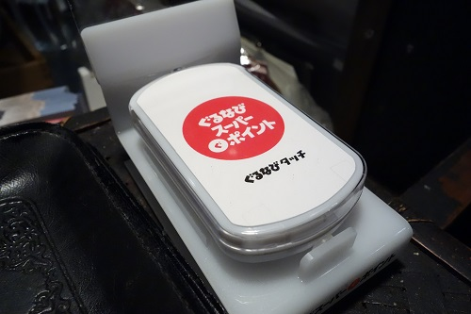
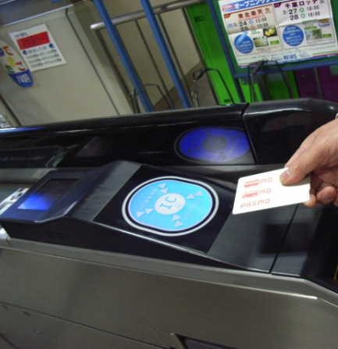

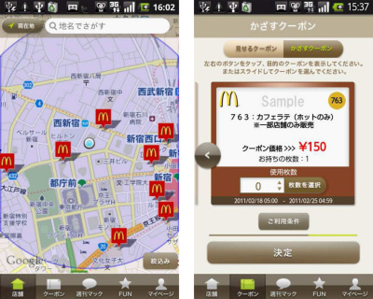
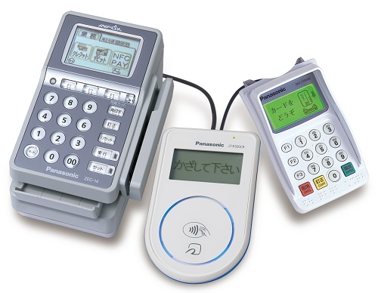
Market trends in Japan
Reward and coupon
terminal at restaurant.
Smartphone
Entrance gate
at a train station.
Many kinds of smartphone are used.
Consumer touches the terminal with mobile phone, they can get electronic coupon or rewards.
Ticket with electronic wallet.
Smartphone with application or IC
Card ticket allows you to enter entrance gates at a station.
Mobile coupon.
Payment terminal.
.The card can be used for ticket and payment at retail stores.
Consumer download application to their own phone in advance, and they can get electronic coupon.
The terminal can accept payment by credit card, mobile phone and smartphone.

Slide 52
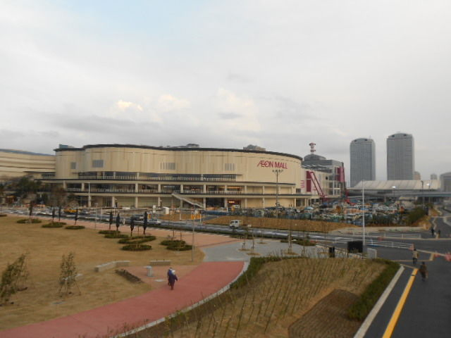
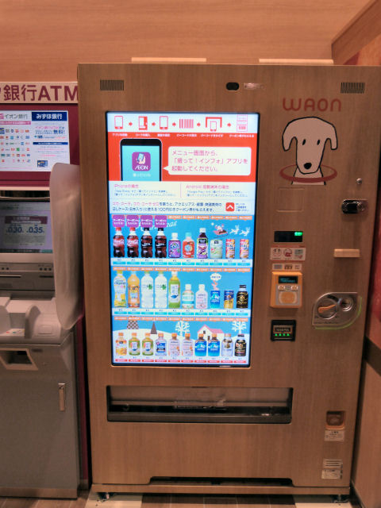
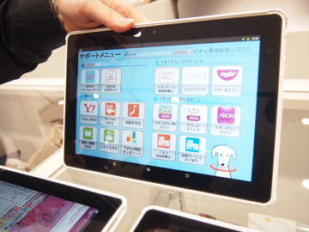
Market trends in Japan
AEON opened a new shopping center last December in Chiba pref., Japan.
Designed for “Omni channel” experience.
Appearance of new shopping center.
The automatic vending machine with Digital Signage.
Consumer can pay by electronic money and cash.
In store tablet to access product and service information.

Slide 53
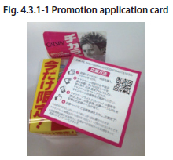
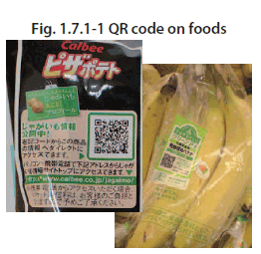
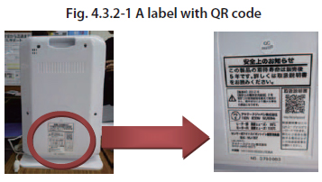
Business Cases
There are many kinds of business cases by using mobile devices.
QR code is one key feature to expand mobile market in Japan.
Product promotion using QR Code .
Product information by using QR Code .
Product safety information by using QR Code.

Slide 54







Promotion activity with drug store chain and cosmetic company
Business Case 1
Promotion was started on 11th June 2012.
Target product : 7 kinds of Hair wax, all Styling Forms items.
Process:
A cosmetic company prepared a card with QR code encording “URL”/product “GTIN”. the company use “native” QR Code. Promotion’s Applicants read QR code to access the web site that prepared for each product.
Merit:
consumer : easy participation.
cosmetic company : Analysis of promotion participants per point-of-sale.

Slide 55
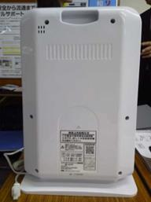
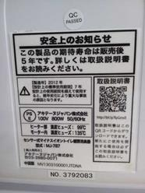
Product safety
Business Case 2
JTDNA is a non-profit organization for product safety.
They are testing trial system. The organization asks manufacturers to mark
Product label. The label shows QR code encording “URL + product ID” to access product’s instruction manual.
label on space heater.
Close-up of label showing QR code.

Slide 56
GS1 Japan’s actions for mobile
Information sharing with user companies.
Mobile sector In Japan unfamiliar with GS1 standardization’s activities.
GS1 Japan held seminars for user companies three times to share GS1’s activities.
14th June, 2011
12th March,2013
14th March,2014
Promotion activities for GS1 2D symbols.
We are promoting 2D barcode in Japanese mobile industry. DENSOWAVE developed demo software to decode GS1 QR symbol. We showed it at trade show . And we published flyer to show GS1’s mobile.
New study group.
We asked some manufacturers, retailers, Information providers to form study group to discuss standardization activities. The study group started this past January.

Slide 57
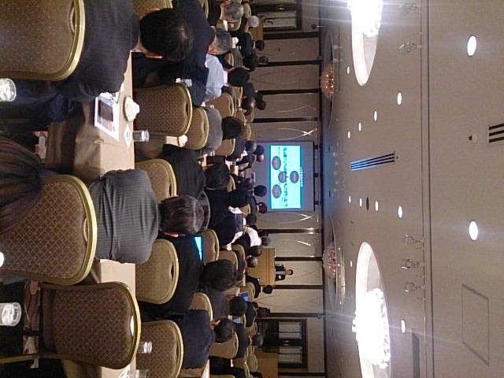
GS1 Japan’s actions for mobile
Mobile seminar in Tokyo was held on 14th March,2014.
Final number of participants ware around 120.

Slide 58
GS1 Japan’s challenge for mobile
GTIN value promotion with user companies.
We share GTIN value with potential users. We will encourage e-tailers to use GTIN.
Promotion for GS1 2D symbols.
We’ll discuss user companies to find the way to use GS1’s 2D barcode for mobile.
We’ll need to discuss how product information sharing would be in Japan.
As GS1 Source will be started this year, we share the status on GS1 Source for user companies. We intend to increase our study group’s member companies to discuss.

Slide 59
Contact
Hideki Ichihara
GS1 Japan
Tel
+81-3-5414-8520
E-mail
ichihara@gs1jp.org
Web site
GS1 Japan www.gs1jp.org/
Notes:
59

Slide 60
The discussion today
  Introduction – GS1 Digital
    Steve Bratt, GS1
  Market Perspective
    GS1 UK
      David Smith, GS1 UK
    GS1 Germany
      Andreas Fuessler, GS1 Germany
    GS1 Japan
      Hideki Ichihara, GS1 Japan
    GS1 US
      Rich Richardson, GS1 US
  GS1 Digital – Background, Strategy, and Current Work
    Robert Beideman, GS1
  GTIN+ on the Web - Technical Aspects
    Mark Harrison, Auto-ID Labs, Cambridge
  Discussions
    GTIN+ on the Web MSWG – Get Involved!
    Digital Media work underway
    GTIN Validation work underway
    Next Priorities

Slide 61
GS1 Digital Session
GS1 Global Standards Event
March 2014

Slide 62


The New Retail Ecosystem
Consumers are demanding a seamless, simple shopping experience.
With expectations of:
Infinite choices in assortment,
price and fulfillment
Increased amounts of accurate product data for decision making
Access to any product,
anywhere, anytime from any device

Slide 63
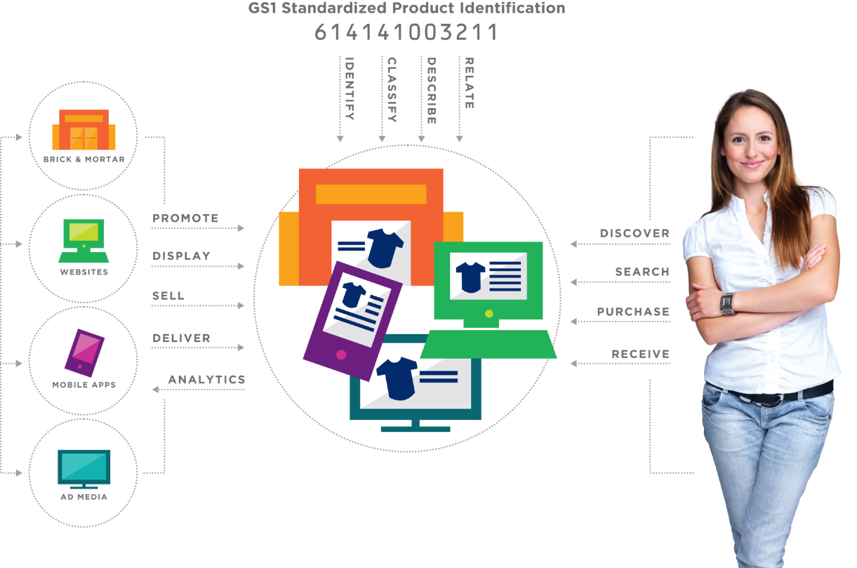
Extending and Leveraging your standards investment

Slide 64
Apparel and general merchandise imperatives
Network-wide inventory visibility and accuracy
  The ability to see to “the last item” within the enterprise and consumer-direct supplier partners
  Delivering on the promise to the consumer
Web-ready products
  Improving speed to web for both product attributes and images
  Meeting consumer demand for rich product information
Optimized fulfillment strategies
  Ensuring that processes, infrastructure and systems are streamlined and integrated to meet desired service levels and delivery commitments

Slide 65
Current digital initiatives
Identification Integrity
  Helping industry determine if an identifier is valid and correctly assigned according to GS1 Standards
Unique Online Product Identification
  Using GS1 standardized identifiers to improve search, visibility, and sharing trusted product data with consumers.
Consumer Friendly Product Classification
  An industry wide reference model that improves seller efficiency, product exposure, shopping, data handling and interoperability
Trusted Source of Data
  Providing standardized product data and images through GS1 Source.
  Helping improve product search and data integrity

Slide 66
Some initial Learnings
Consumer is driving the agenda like never before
This is all about helping companies to grow their business
Technology is moving at an incredible pace
Stakeholder is very different than our traditional partners
Our message and value proposition needs to be clear and simple
  http://www.gs1us.org/industries/apparel-general-merchandise/tools-and-resources/videos-and-demos/omni-channel-video
GS1 must reestablish its leadership position

Slide 67




The world is changing, key external forces are at play…
Force
Why it matters
  Loss of relevance as fewer items go over Point-of-Sale
  Possible emergence of other standards
  Pace of change eclipsing traditional commerce change, e.g. use of QR codes jumped 28% to 62% in 1 year
Digital tipping point
Omni channel – anytime, any-where commerce
  Consumers engage across channels - online, mobile, in-store - and suffer from less-than-optimal experiences across search, discovery, purchase, delivery, use, and returns business processes
  Demand for standards to support new omni-channel inventory and fulfillment models
  Emphasize need for accuracy of data pools
  GS1 identifiers act as key data element across platforms to enable 360 product views for big data analytics
Data Quality
Value the “new normal”
  Growth of vertical/private label focused value retailers reduces need for GS1
  Potential to leverage omni-channel growth to bring them into GS1
From McKinsey GS1 Global Strategy deck, 2013

Slide 68
The Challenge and Opportunity
“As technology blurs the distinctions between physical and online retailing, retailers and their supply-chain partners will need to rethink their competitive strategies.”
MIT Sloan Management Review, May 2013

Slide 69
Vision/Mission:
Our Winning Aspiration
Make the GS1 System as important in the digital world as it is today across traditional supply chains
Empower industry to more efficiently connect with consumers across physical and digital paths to purchase
Expand GS1 standards to enable the trusted identification, classification, description, relationship, and sharing of data about things in the digital world

Slide 70





















Expanding Relevance of GS1
PRODUCTS
INFORMATION
3PL’s
Market
places
Online
Pureplays
Brick/Mortar
Webpages

Slide 71














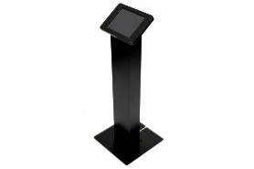
Data Sharing in an omni-channel world
Better Data = GS1’s Focus on Data Quality
Smarter Data = GTIN+ on the Web
Marketplaces
Digital Assets
Agencies
Ad Copy
PDF / Ad Copy
Promotions
Videos
Search / SEO
Catalog and Print
Images
Product Data Mgmt.
Promotions
Items
Wording
Supply Chain
Collections
Pricing
T
ERP
Systems
Text
Collections
01010010
Advertising, Marketing
Identification
Attributes
Master Data
Digital Assets
Search Engines
Identification
Data Pools
Faster Data = Better Data + Smarter Data =
Focus on Frictionless Flow of Data and Process Interoperability
Store Kiosks

Slide 72
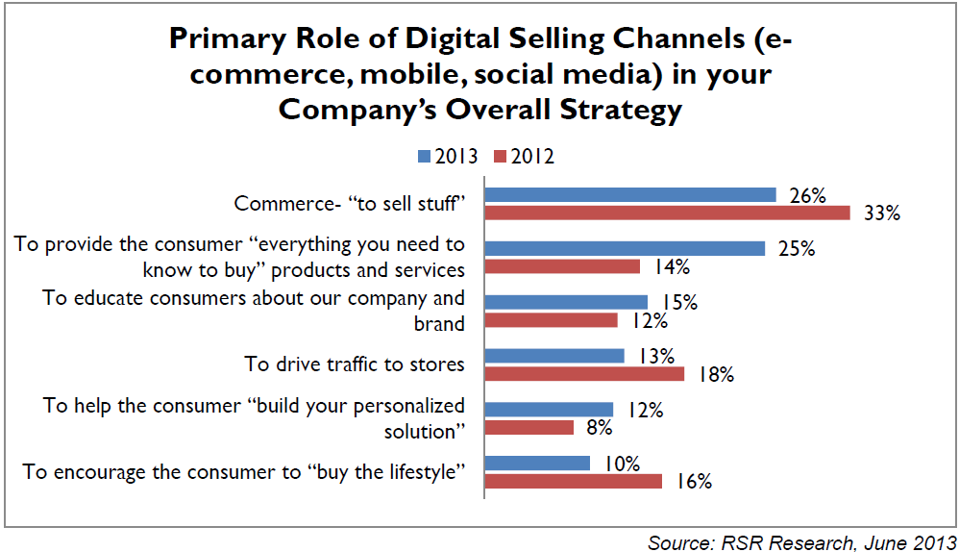
Why Digital?
RSR Research: June 2013

Slide 73
Why an Omni-channel Perspective?
“Omni-channel presence is delivering a much more seamless experience all across the board in one clear message”
- Karen Katz, CEO of Neiman Marcus Group, 2011
“I can’t overstate how mobile is changing how we interact with our consumers, we have to embrace these changes”
– Joel Anderson, CEO of Walmart
“We will continue to see a convergence of the digital and physical world. Those who conquer that trend will be market leaders.”
- John Phillips, SVP Customer Supply Chain and Logistics, Pepsico, Inc.
“The world’s largest store in every pocket” - McKinsey
“Digital has been a catalyst for everything in the company”
- Angela Ahrendts, CEO of Burberry, now with Apple
“Starting with the Internet and moving into today’s connected mobile devices, people have more information and purchasing choices than ever before. Customers use technology in every facet of their lives, including in how they shop. This is increasingly disruptive to retailers.”
- Mike McNamara, CIO, Tesco

Slide 74
Why an omni-channel perspective?
Omni-channel …
.. is a disruptive evolution in our core sector of retail
.. about connecting all aspects of a company’s business processes with a constant focus on a seamless consumer experience
.. requires an (natural) extension of GS1 standards to empower supply-side and demand-side business processes (plus some new standards)

Slide 75
Relevant business needs
Consistent ID: Lack of consistent and unique identification of a trade item across omni-channel ecosystem resulting in less-than-optimal web traffic and search results
Consistent Attribute Info: Lack of consistent and robust product attribute information across omni-channel ecosystem creating inefficiencies on the business side and consumer confusion and lowered trust
Identification Granularity: Retailers and Consumers need increased identification granularity for certain trade items that cause current omni-channel fulfillment challenges
Search Visibility: Lower than desired visibility of trade items in search and on social media resulting in lower brand penetration and reduced searchability

Slide 76
Relevant business needs
Trusted Open Data: Brand Owners, Retailers, and Consumers wish to distinguish/identify authentic or trusted product data on the open Web
Local Availability: Consumers want accurate information on local availability of products that they desire
Inventory Visibility: Retailers must improve inventory visibility across organizational silos
Returns Complexity: Online retailers increasingly inviting other merchants to sell through their sites, creating potential for delivery/returns complexity and challenges

Slide 77
Relevant business needs
Asset Duplication: Duplication of Product Image creation across trading partners causing wasted time and money and creating inconsistency in product representation
Post Sale: Consumers desire support for their product purchases (manuals, recipes, user forums, etc)
Social Media: Consumers want to provide feedback about their products and share experiences on social media

Slide 78
Areas of Potential Involvement? *
Enabling Technologies in GS1 Digital
  GTIN+ on the Web
  Digital Media
  Web Data Authenticity
  Category hierarchy
  Mobile ID
Related Enabling Technologies
  Next Generation Product Identification**
  Allocation Rules**
Application of GS1 System to address Business Needs
  GS1 Source
  ePayments
  updated eCoupon standard
  eReceipt standard
  Store-based e-fulfillment
  Connection of Products to Social Media Touchpoints
  Inventory visibility
  RFID inventory
  Consumer Privacy
  Guidelines for use of GS1 System on the Web
** Outside of GS1 Digital / a dependency
* Compiled from McKinsey, AC, MO’s, Digital Interest Group

Slide 79
Priorities – 2014/2015
GS1 Digital:
  GTIN+ on the Web: Unique online product identification and associated attribute representation
  GS1 Source: Trusted Master Data Exchange
  Digital Media (Images, Video, etc)
  Guidelines for use of GS1 System on the Web
  Other Initiatives outside GS1 Digital
    NGPI
    Allocation Rules

Slide 80

GTIN+ on the Web relevance in an omni-channel ecosystem
Notes:
Leveraging this familiar graphic, here are the touchpoints for GTIN+ on the Web standards

Slide 81
GTIN+ on the Web - foundational
Enabling
Omni-channel Transformation
Consumer-centric business model
Sharing accurate data across organization
Enabling re-use of data across channels
Supply Chain Efficiency
Consistency
Accuracy
Control
Flexibility
Visibility
In Barcodes and Tags
In Business Messaging
For Event Data Sharing
On the Web
Unique Identification
Product Description
Product Classification
Methods for Data Sharing
Standards

Slide 82
GTIN+ on the Web relevance
Business Needs Relevance
Search Visibility
Consistent ID
Consistent Attribute Info
Trusted Open Data
Local Availability
Inventory Visibility
Post Sale needs
Returns Complexity
GTIN+ on the Web is a foundational expansion of the GS1 System intended to drive relevance of our System across business processes that are focused on search, discovery, purchase, receipt, and use in the digital world.

Slide 83

Benefits of GTIN+ on the Web
Across the business system…
Consumers
More relevant, complete search results they can trust from Brand Owners and Retailers; easier to compare products. Ease of product discovery.
Improved accuracy and completeness of online search, resulting in higher traffic, fewer missed items, higher conversion rates, sell more product, lower SEO costs, more accurately targeted ads
Better integration along supply & demand chains based on consistent use of GS1 identifiers, e.g. pooled inventory
Retailers
Sell more
Improved data quality, accuracy and brand equity
Single point of contact for uploading product attributes, reducing time to shelf and content creation costs
Actionable consumer insights, better ability to target ads
Brand
owners
Search
engines
Optimize search algorithms by leveraging structured data model and machine readable content
Notes:
Benefits for all constituents.

Slide 84
GTIN+ on the Web – 4 deliverables
URI structures/syntax for representation of GS1 Keys and Attributes on the Web (also relevant to NGPI and OMA…see next slide)
Semantic Web representations of Attributes and Attribute values for webpage markup
RDF representation of GPC (already created) for use as a resource on the open Web
Guideline for best practices for Semantic markup for Product webpages for manufacturers, retailers, and solution providers

Slide 85
Interactions between GTIN+ on the Web, NGPI, OMA
Group | Business Needs | Technical Standards | Application Standards
GS1 Retail: TCGF/GS1 NGPI | What
GS1 Healthcare | What
GS1 Digital | What
GSMP WG: GTIN + on the Web |  | How
Open Mobile Alliance |  | How
GSMP WG: NGPI |  |  | Where
Communication across work efforts designed to avoid all duplication

Slide 86
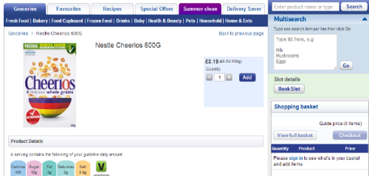
Global standards for Web page layout = YES
For product data on Web page = NO
Search engines see global web standards for links, fonts, images, page layout …
There are no global standards for embedding product IDs and attributed are in the code of a web page.
Search engines can only infer meaning.
The web
page
that you
see…
<div typeof="schema:Product" id="contentMain" about="gtin:05011476100885">
…
<span property="schema:brand" typeof="schema:Brand">
<span property="schema:name">Nestle</span> </span>
<span property="schema:name">Cheerios 600G</span>
…
<td property="food:sugarsPer100g" content="21.4" datatype="xsd:float">21.4g</td>
What computers see in the underlying Web code

Slide 87

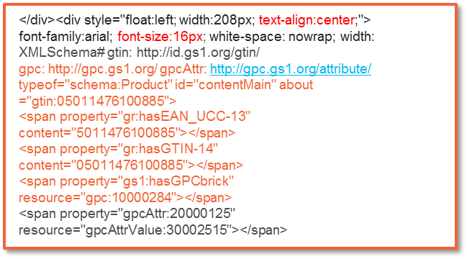


Global standards for Web page layout = YES
For product data on Web page = WHAT IF?
If these were real standards, search engines could better understand product data
…
The web
page
that you
see…
What computers see in the underlying Web code

Slide 88
The discussion today
  Introduction – GS1 Digital
    Steve Bratt, GS1
  Market Perspective
    GS1 UK
      David Smith, GS1 UK
    GS1 Germany
      Andreas Fuessler, GS1 Germany
    GS1 Japan
      Hideki Ichihara, GS1 Japan
    GS1 US
      Rich Richardson, GS1 US
  GS1 Digital – Background, Strategy, and Current Work
    Robert Beideman, GS1
  GTIN+ on the Web - Technical Aspects
    Mark Harrison, Auto-ID Labs, Cambridge
  Discussions
    GTIN+ on the Web MSWG – Get Involved!
    Digital Media work underway
    GTIN Validation work underway
    Next Priorities

Slide 89



GTIN+ on the Web
whole grain breakfast cereal
http://id.example.com/gtin/05011476100885

Slide 90

Location-centric Information & Services

Slide 91



Product-centric Information & Services

Slide 92



Product-centric Information & Services
Technical Specifications
Warranty Registration
Instruction Manual (PDF)
Software Downloads
Firmware Updates
User Forum
(advice, troubleshooting)
Spares & Accessories

Slide 93

Building on our existing data models
GDSN

Slide 94




Product Classification & Contextual Search

Slide 95

URLs vs URIs
Uniform Resource Identifiers (URIs) are the general term including:
Uniform Resource Locators (URLs) – e.g. web addresses
Uniform Resource Names (URNs) – e.g. pure identity EPCs

Slide 96
HTTP URIs
HTTP URIs can function both as names and as locators
They’re globally unambiguous (point to just one resource)
They’re also self-resolving on the web (‘clickable’) – unlike URNs
They’re widely used for semantic web markup / linked data

Slide 97
Linked Data uses URIs
http://dbpedia.org/resource/Brussels
http://data.ordnancesurvey.co.uk/id/postcodeunit/CB30FS
http://www.w3.org/2003/01/geo/wgs84_pos#lat
http://dbpedia.org/ontology/populationMetro
http://schema.org/gtin14
http://schema.org/weight

Slide 98


HTTP URIs – just click for more info!

Slide 99

HTTP URIs – just click for more info!

Slide 100


Using HTTP URIs to write facts

Slide 101
HTTP URIs & Semantic Web / Linked Data
Linked Data / Semantic Web technology uses HTTP URIs to identify anything (cities, people, places, properties, relationships, etc.)
e.g. http://dbpedia.org/resource/London identifies London
http://sws.geonames.org/2643743/ identifies London
To obtain information about a resource, (e.g. London), you can make a web request for it (HTTP GET) – just using a web browser
Because your web browser cannot deliver London to you, the website is configured to suggest a redirect to an information representation of London. This is an HTTP 303 ‘See Other’ redirect.
http://dbpedia.org/resource/London redirects to http://dbpedia.org/page/London
http://dbpedia.org/data/London

Slide 102

Machine-readable facts in your web pages
<p>Nestle Cheerios 600G </p>
<p about="gtin:05011476100885">Nestle Cheerios
<span rel="schema:weight" typeof="schema:QuantitativeValue">
<span property="schema:value" datatype="xsd:float">600</span>
<span property="schema:unitCode" content="GRM" datatype="xsd:string">G</span>
</span>
</p>

Slide 103
GTIN+ on the Web – supporting users
Pilot activities
Share experiences
Best practice guidelines
Toolkits & Prototypes

Slide 104



Accurate product data online
EU 1169/2011

Slide 105

Beyond compliance, gain benefits
http://id.example.com/gtin/05011476100885
GTIN+
on
the Web
Benefits!
Improved search results
Improved visibility in web / apps
Enable product-centric services
Some extra
effort
Compliance

Slide 106




Learn how to update your web templates!
Internal Database
of
Product Master Data
GDSN
Add semantic markup
to web page templates

Slide 107
The discussion today
  Introduction – GS1 Digital
    Steve Bratt, GS1
  Market Perspective
    GS1 UK
      David Smith, GS1 UK
    GS1 Germany
      Andreas Fuessler, GS1 Germany
    GS1 Japan
      Hideki Ichihara, GS1 Japan
    GS1 US
      Rich Richardson, GS1 US
  GS1 Digital – Background, Strategy, and Current Work
    Robert Beideman, GS1
  GTIN+ on the Web - Technical Aspects
    Mark Harrison, Auto-ID Labs, Cambridge
  Discussions
    GTIN+ on the Web MSWG – Get Involved!
    Digital Media work underway
    GTIN Validation work underway
    Next Priorities

Slide 108
Resources
www.gs1.org/digital/
  HTTP URI Papers
  Connection to Work Groups
  One-Pagers – GTIN+ on the Web
  Plenary Session Transcript
  Links to relevant videos
  Presentations
Thursday, 9:00am – 12:30pm

Slide 109
Resources
www.gs1.org/digital/
  HTTP URI Papers
  Connection to Work Groups
  One-Pagers – GTIN+ on the Web
  Plenary Session Transcript
  Links to relevant videos
  Presentations

Slide 110






Resources on Omni-channel
Tough Choices for Consumer Goods Companies
  McKinsey, December 2013
  http://www.mckinsey.com/insights/consumer_and_retail/tough_choices_for_consumer_goods_companies
Omnichannel Alchemy
  Boston Consulting Group, October 2013
  https://www.bcgperspectives.com/content/articles/retail_digital_economy_omnichannel_alchemy_turning_online_grocery_sales_gold/
Integrated MultiChannel Retail
  CapGemini, 2008
  http://www.capgemini-consulting.com/resource-file-access/resource/pdf/Integrated_Multi-Channel_Retailing.pdf
Digital Disruption and retailer opportunities
  Bain and Company, Nov 2012
  http://www.bain.com/Images/BAIN_BRIEF_Retail_holiday_newsletter_%232_2012-2013NEW.pdf
Digital Shopper Relevancy Report
  CapGemini, July 2012
  http://www.capgemini.com/thought-leadership/digital-shopper-relevancy
E-Commerce nad Consumer Goods
  Booz and Company, November 2012
  http://www.booz.com/media/file/BoozCo_E-Commerce-and-Consumer-Goods.pdf
The Reciprocity Principle
  Boston Consulting Group, 2014
  https://www.bcgperspectives.com/content/articles/marketing_center_consumer_customer_insight_how_millennials_changing_marketing_forever/
The New Omni-Channel Approach to Serving Customers
  Accenture, 2013
  http://www.accenture.com/SiteCollectionDocuments/communications/accenture-new-omni-channel-approach-serving-customers.pdf
Digital’s Disruption of Consumer Goods and Retail
  Boston Consulting Group, November 2012
  http://www.bcg.com/expertise_impact/industries/retail/publicationdetails.aspx?id=tcm:12-121740&mid=tcm:12-121734
Omni-channel Customer Experience
  Webcredible, Nov 2012
  http://www.webcredible.co.uk/user-friendly-resources/white-papers/omni-channel-report-2012.pdf
Your Customer’s All-channel Experience
  CapGemini, May 2013
  http://www.capgemini.com/resources/its-all-about-them-your-customers-all-channel-experience

Slide 111
Resources
  Public GS1 Digital Page
    www.gs1.org/digital/
  GS1 Digital Industry Engagement Interest Group
    http://community.gs1.org/apps/org/workgroup/gs1ie_digital_ig/
  GTIN+ on the Web MSWG
    http://community.gs1.org/apps/org/workgroup/gsmp_gtin_otw_mswg/
  Contact Robert Beideman
    robert.beideman@gs1.org

Slide 112

Your feedback drives our continual improvement
There are 2 types surveys:
1. Individual Session Surveys - Please complete the hard copy satisfaction survey at the end of each work group session. Your group leader will provide it to you.
2. Overall Event Survey – All attendees will receive an email on Friday to rate overall satisfaction of the event.
You might win an Amazon Gift Card!

Slide 113

Save the date! GS1 Global Standards Event!
Rome, Italy
6 – 10 October 2014

Slide 114
Contact Details
GS1 Global Office
Avenue Louise 326, bte 10
B-1050 Brussels, Belgium
T + 32 2 788 78 00
W www.gs1.org

