Slide 1
GS1 Global Standards Event
Melanie F. Nuce, VP Retail Apparel and General Merchandise
25 March 2014

Slide 2
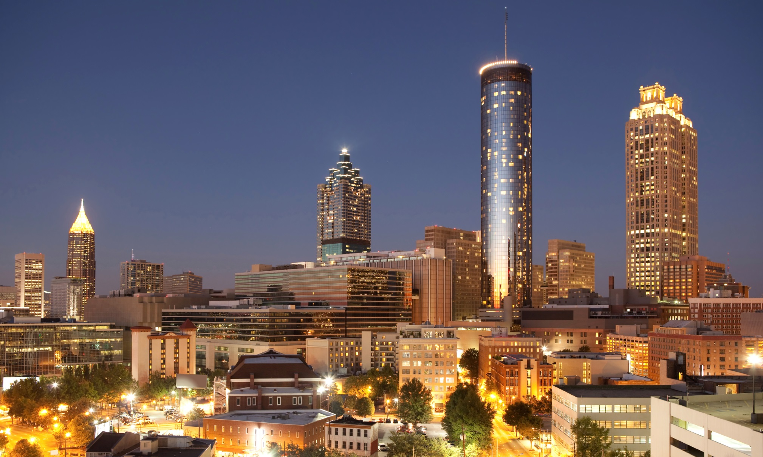
WELCOME TO THE A-T-L
Ya’ll

Slide 3
GS1 Standards are the global language of business —
a language for identifying, capturing, and sharing information automatically and accurately,
so that anyone who wants that information can understand it, no matter who or where they are.

Slide 4
The global language of business
Providing:
visibility efficiency security collaboration
convenience value safety satisfaction
for business
for consumers

Slide 5
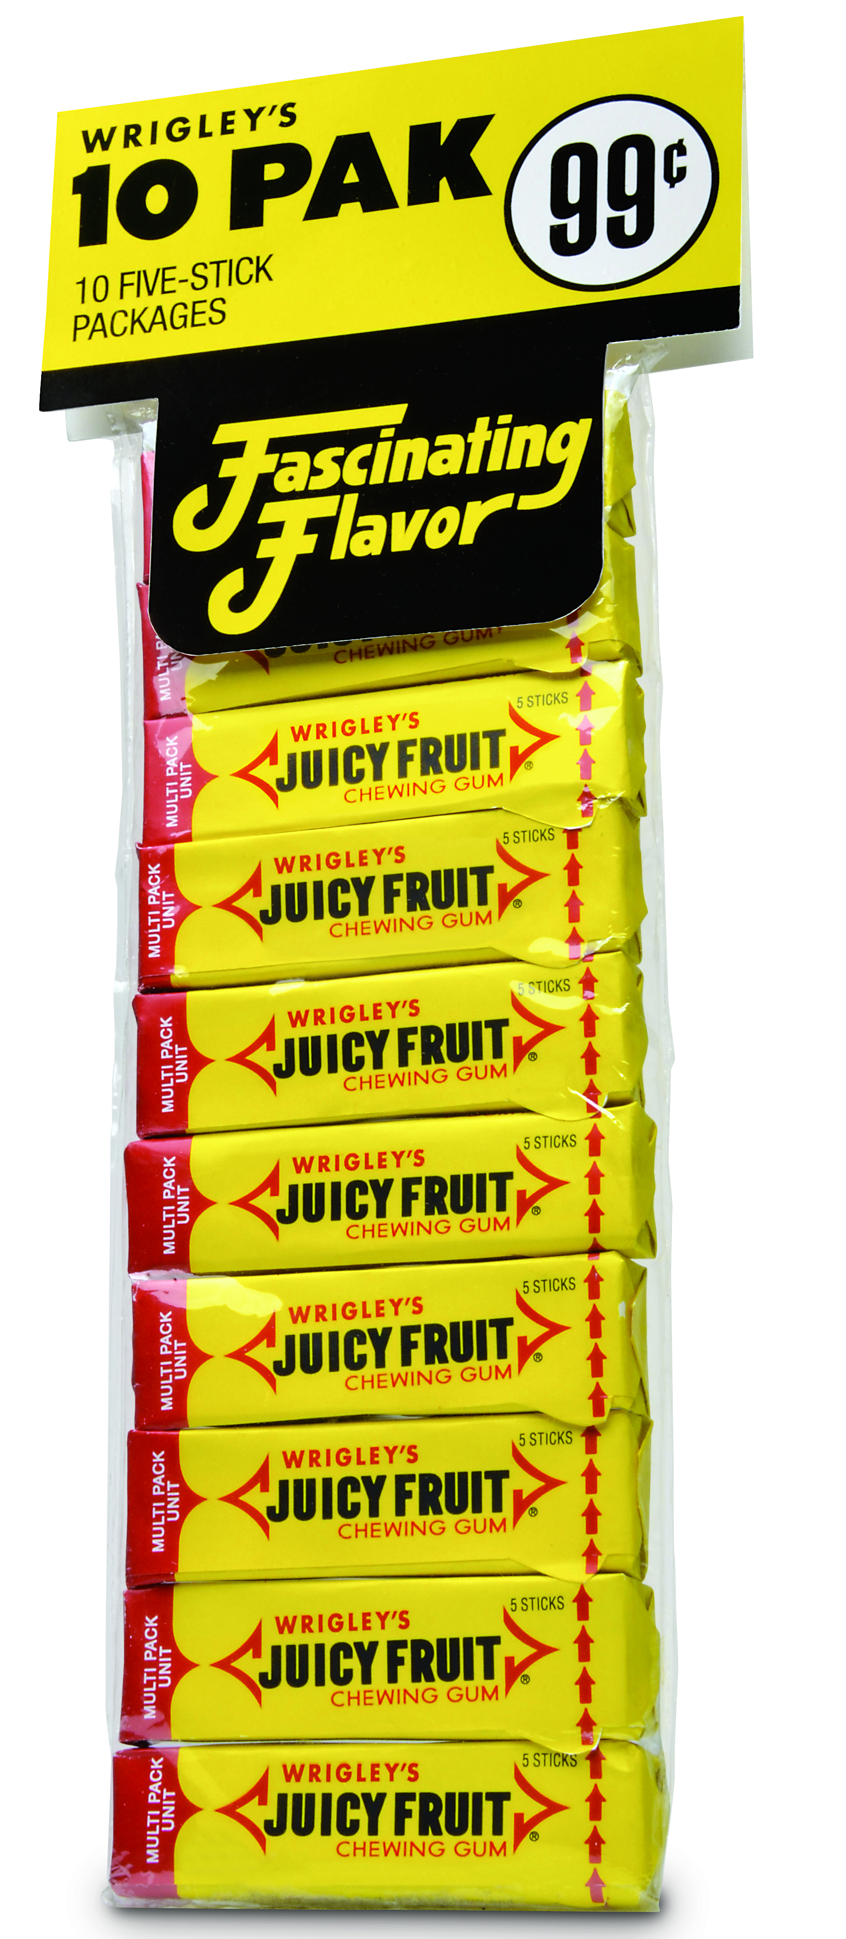
From 1974 to 2014
On June 26th, a pack of Wrigley’s gum becomes the first product to be scanned with a GS1 barcode in a Marsh supermarket in Ohio, United States.
"Mock up of the original product that was created with permission of Wrigley”.

Slide 6
GS1: Solving industry needs
Industry
Problem / Opportunity
Requirements
Solutions
Adoption
& Usage
GS1 helps industry identify a problem or opportunity and organize to solve it
GS1 helps industry and government define their needs /goals and create adoption plans
GS1 develops:
Standards
Guidelines
Tools
Readiness Programs
Education & Training
GS1 measures how industry adopts and uses standardized technology

Slide 7
gs1 By the numbers
2 million companies around the world use GS1 Standards
More than 5 billion GS1 barcodes are scanned every day
6 million products are assigned U.P.C.s in the GS1 US Data Driver® tool
13+ million products are registered by brand owners in the GS1 Global Data Synchronization Network™ (GDSN®)

Slide 8
GS1 US 2014–2016 strategy – Foundation
Using GS1 Standards as a key component of business processes will deliver lower costs and higher revenue for industry
TARGET SECTORS
Retail/Grocery
Healthcare
Foodservice
Apparel/
General Merchandise
BUSINESS NEEDS*
Efficiency
Growth
Risk Management
STRATEGY
Customer Experience
Leveraging Partners
Data Quality
B2B2C
Culture & Capabilities
*17 Key Business Processes Identified

Slide 9
LOCAL FLAVOR

Slide 10
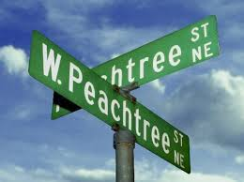
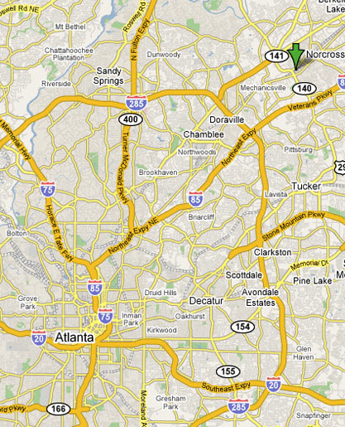
71 streets with Peachtree in the name
Notes:
Peachtree Street is not named for a peach tree of any sort. Many of Atlanta's corridors follow the paths created by the Creek and Cherokee Indian nations who inhabited the area until the early 19th Century. A large Creek settlement was called Standing Pitch Tree after a tall lone tree. Over time, the "pitch tree" became "peach tree."

Slide 11
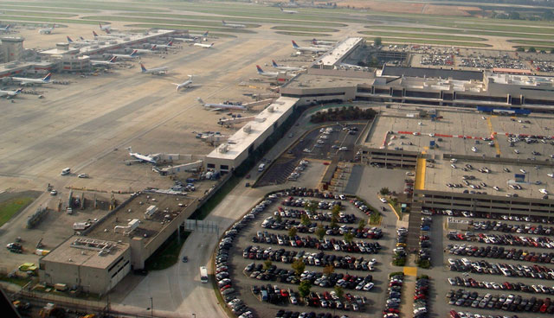
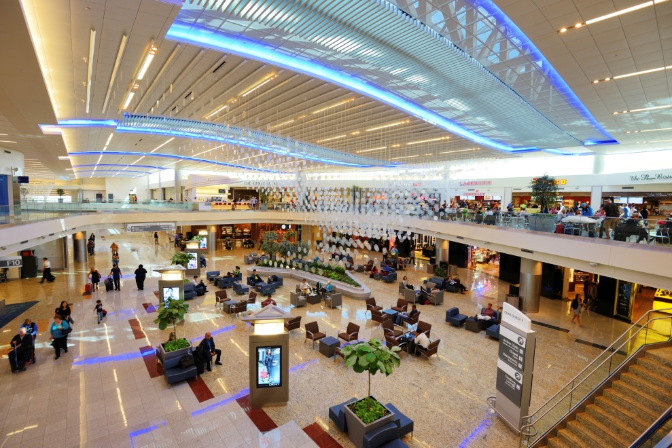
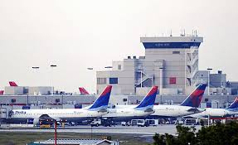
World’s Busiest Airport
Notes:
With a passenger terminal complex equivalent to more than 45 football fields, Hartsfield-Jackson Atlanta International Airport is the world's busiest passenger airport. Atlanta is an ideal location for carriers like hometown Delta Air Lines, as the city is a 2-hour flight away from 83 percent of U.S. cities.

Slide 12
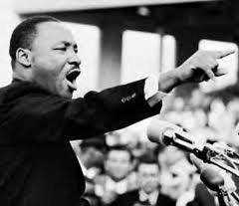
The ATL’S VIPs
Leader of the Civil Rights Movement
39th President of the United States
One of two cities with two Nobel Peace Prize Winners

Slide 13
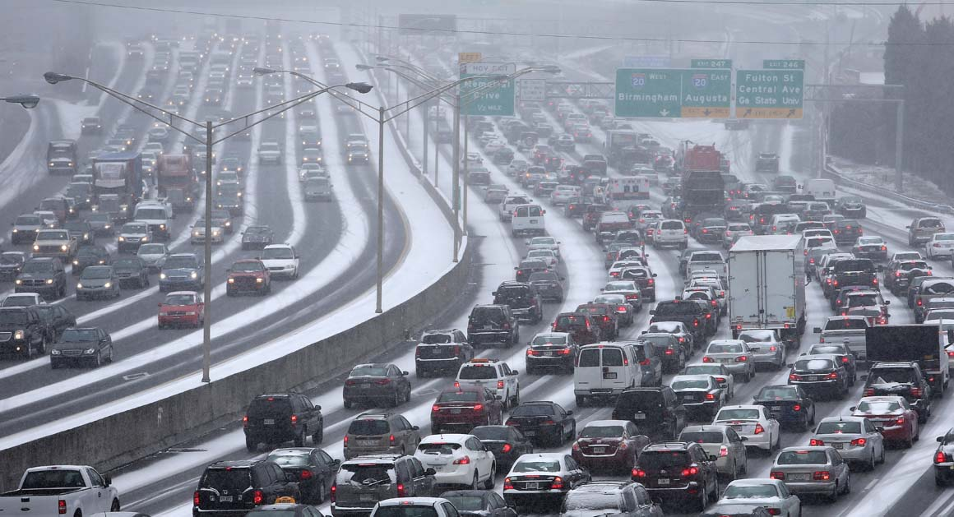
SNOW + TRAFFIC in the ATL = Snowpocolypse 2014
Notes:
After three inches of snow in the middle of the day (but more importantly ice…) and a town of 4 million deciding to go home at the same time, Snowpocolypse 2014 was seen in ATL. People slept in their cars on 1-85 and in hotels on their commute home…which for some lasted 18 hours.

Slide 14
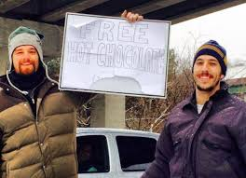
You can always count on Southern Hospitality
Notes:
But no bother…..those who weren’t stranded practiced what we are most famous for…our sweet Southern Hospitality. And order and faith in humanity were restored.

Slide 15
Melanie F. Nuce, VP Retail Apparel and General Merchandise

