Slide 1
GS1 Global Standards Event 24-28 March 2014 – Atlanta Building Standards to Deliver Business Value
Session: Technical Publications
Time: Tues 25 Mar 2014 @ 11am
Who May Attend: Anyone interested in Publications
Speaker(s): Charlotte Michaels

Slide 2
technical publications workshop
^{Anti-trust caution}
GS1 and the GSMP operate under the GS1 anti-trust caution. Strict compliance with anti-trust laws is and always has been the policy of GS1.
The best way to avoid problems is to remember that the purpose of the committee is to enhance the ability of all industry members to compete more efficiently.
This means:
there shall be no discussion of prices, allocation of customers, or products, etc.
if any participant believes the group is drifting towards an impermissible discussion, the topic shall be tabled until the opinion of counsel can be obtained.
the full anti-trust caution is available in the Community Room if you would like to read it in its entirety.

Slide 3
technical publications workshop
^{Meeting etiquette}
Meetings will begin promptly at designated start time
To improve session:
avoid distracting behaviour
place mobile devices on silent
avoid cell phones
avoid sidebar conversations
Speak in turn
Be respectful of others
Be collaborative in support of the meeting objectives

Slide 4
technical publications workshop
^{Wi-fi Internet}
Wi-fi Internet access is complimentary!
Please connect only ONE device
Connect to: WESTIN-MEETING
Password: GS1WB

Slide 5
Welcome m introductions Agenda m change management in technical publications and on the Knowledge Centre Session goal and success factor improve quality of technical publications
technical publications workshop
^{agenda and goal}

Slide 6
technical publications workshop
^{types of publications}
Different types of publications
M general created by read by books and magazines journalists general public brochures marketing consumers
training manuals, FAQs, help HR/cust support employees, sales teams
end user software manuals sw/hw companies users
technical created by read by
operating instructions aviation pilots
laws legal profession citizens, judicial system
medical records healthcare Drs, nurses, Rx technical manuals/documents SMEs industry technicians
technical publications requires specialised knowledge

Slide 7
technical publications workshop
^{problems in documentation}
Problems in documentation occur because …
M
documentation is/has … this is due to …
difficult to find missing metadata/search engine optimisation (SEO)
dense to read lengthy sentence structure different word spellings GS1 subscription to GBR versus Am. English version control issues source document not updated
errors, inconsistencies incorrect branding, not acc. GS1 style guide
To improve upon the above issues, quality control and assurance check points
were installed at the Technical Publications level in 2013. The following slide shows what has been done to date to improve technical documentation.
.

Slide 8
technical publications workshop
^{quality} ^{control and assurance}
Quality control and assurance in technical documentation m level role resource(s) for each level individual content authors templates SDLs customer support notification SMEs content author resources
team GSMP and SD quality assurance installed
quality control check points
Tech Pubs included in Community Review quality assurance check points after eBallot, tech pubs review
update legacy documents branding: logo and copyright
SDL/WG approve PDF
after action report to SDL
organisation GO and MOs recent updates Knowledge Centre GS1 U.S. link to SD and GSMP
posted GS1 NL PMR video
Web site update
monthly On writing well articles

Slide 9
technical publications workshop
^{behavior on the Web}
Behavior on the Web
Why pay attention to how people read?
79% scan content* while 16% read word for word* (the rest unk.)
Reading behavior
Real-life page views on how people read show the average person spends 10-20 seconds searching for content. After that, they bounce.
Bounce rate
These are users who visit one page then … bounce (leave the site)
HIGH bounce rate could be due to:
incorrect key word on the site
poor navigation and design
*Acc. Nielson/Norman Group, 1997

Slide 10
technical publications workshop
^{reading behavior on the Web}
Reading behavior: how we read
the eye constantly polls information coordinating activities with the brain.
perception occurs in the first 50 ms of fixation
we determine what will be fixated upon in the first 25-100 ms*
we are only interested in information during the first 200ms*
fewer elements on a page means less distractions.
increased white space increases comprehension*
Numbered and bulleted lists provide high skim value.
To improve our site Marketing and Publications conducted a usability study.
*Acc. Irwin, Carlson-Radvansky, 1996
*Acc. Sperling, 1960
*Acc. White space layout, 2004

Slide 11
technical publications workshop
GS1 2012 Dublin Usability Study
GS1 2012 Dublin Usability Study
What is usability testing?
usability studies site functionality.
Why study it?
we gauge how users interface with web site content (Knowledge Centre)
How does it work?
remove design elements (logo, colors) to determine site effectiveness
1. utilised online software
2. hierarchy tree created (1200+ links)
3. test script created (10 tasks – 5 basic and 5 advanced)
4. screen, record and log behaviors
5. analyse data

Slide 12
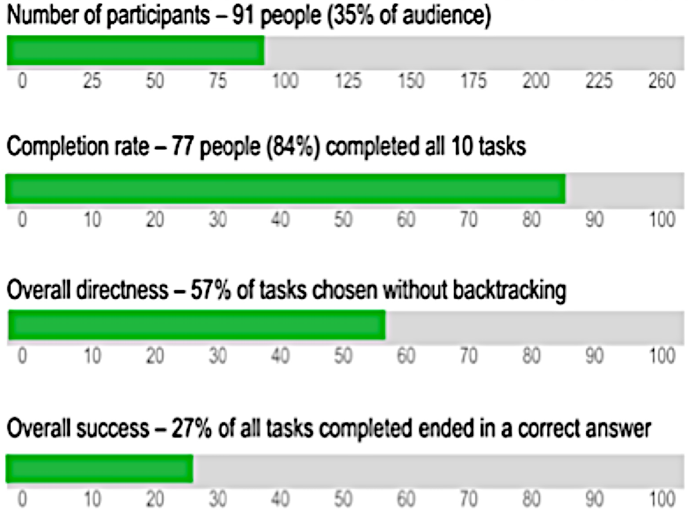
technical publications workshop
GS1 2012 Dublin Usability Study
GS1 2012 Dublin Usability Study
The study tested how well users performed tasks.

Slide 13
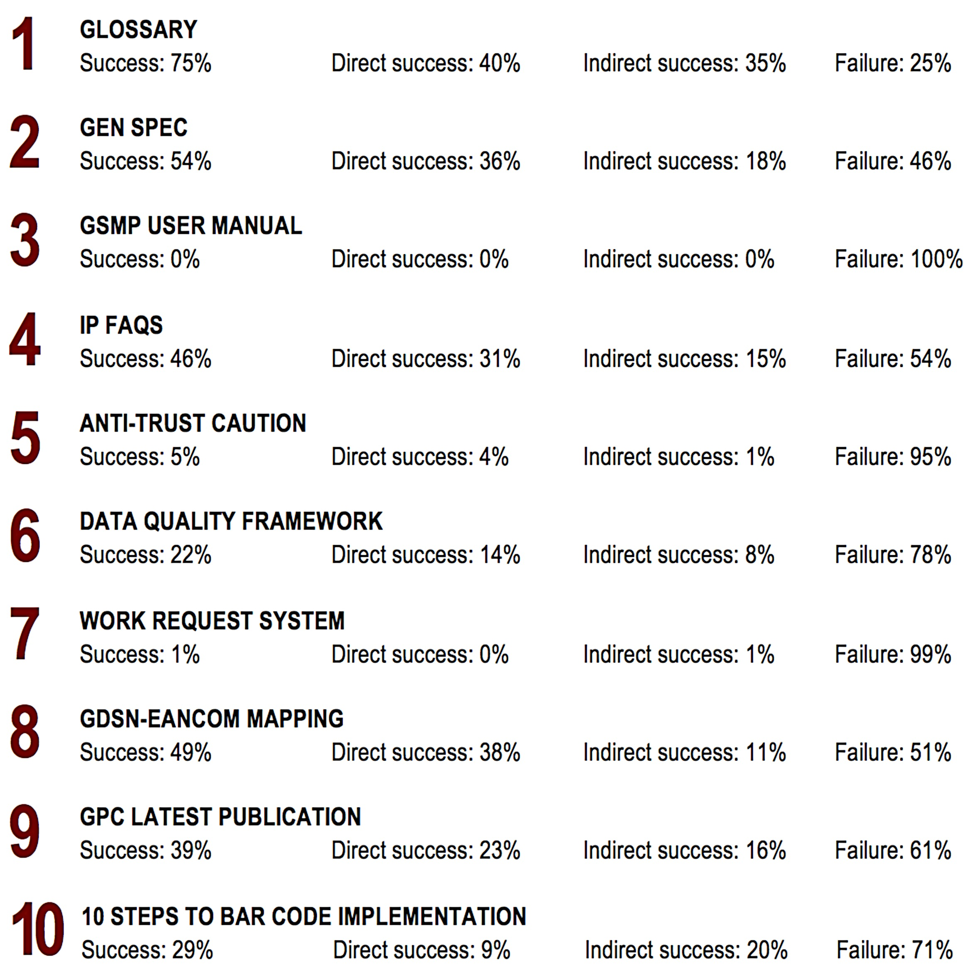
technical publications workshop
^{task by task statistics}
GS1 2012 Usability Study, task by task statistics

Slide 14
technical publications workshop
^{usability study results}
Usability study results
of those who participated 41.9% visit the Knowledge Centre monthly.
more than 75.6% were GO or MO and were familiar with content.
other participants worked for an organisation outside of GS1 9.3%
How do GS1 users compare to other users?
the average person spends 10-20 seconds searching for content.
GS1 2012 Usability Study : users spend 21.98s finding content.
*Acc. Nielson/Norman Group, 1997

Slide 15
Global Web site m Create a global brand identity Common template for all MOs Refresh current site to support MOs User centric (less is more) Improved SEO and interface No change in URLs Simpler structure From this to this About Us About Us Standards Standards Products & Solutions Industries Services News and Events Sectors
technical publications workshop
^{global Web site project update}

Slide 16
Q/A m Do we want or need HTML5? Discuss other MOs single repository. Other topics … ?
technical publications workshop
^{Q/A}

Slide 17
Complete session survey
technical publications workshop
^{survey}

Slide 18
Your feedback drives our continual improvement
There are 2 types surveys:
1. Individual Session Surveys - Please complete the hard copy satisfaction survey at the end of each work group session. Your group leader will provide it to you.
2. Overall Event Survey – All attendees will receive an email on Friday to rate overall satisfaction of the event.
You might win an Amazon Gift Card!

Slide 19
Save the date! GS1 Global Standards Event!
Rome, Italy
6 – 10 October 2014

Slide 20
Contact Details
GS1 Global Office
Avenue Louise 326, bte 10
B-1050 Brussels, Belgium
T + 32 2 788 78 00
W www.gs1.org

Slide 21
technical publications workshop
^{change management}
Glossary of terms in this presentation m abbreviation definition GO global office
GSMP global standards management process
MO member organisation
PMR package measurement rules
QA quality assurance
QC quality control
Rx derives from Latin word “prescription” (to take)
SD standards development
SDLs standards development leader
SEO search engine optimization
SMEs subject matter expert
TPR technical publications review
unk unknown
WG work group

