Slide 1
SSCC in Airfreight – Pilot project

Slide 2
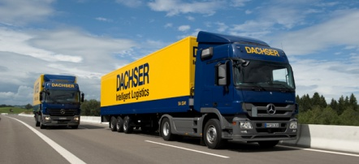
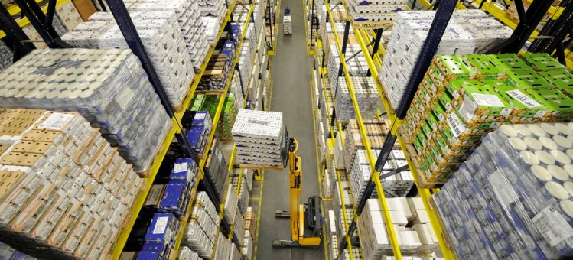
Corporate figures 2013
Revenue: bn € 4,99
Employees: 24.900
Own locations: 471
Transport equipment in units: 10.008

Slide 3
Homogeneity of IT systems
Homogeneity
DACHSER infrastructure
Wide range of customer applications
Warehouse management
system (WMS)
Transport management
system road (TMS)
Transport management
system air & sea (TMS)
Communication via the EDI center

Slide 4
A high degree of innovation
Weekly program updates
Proactive approach (PGM change)
Continuous improvement process
New functions
Prompt troubleshooting
Rapid response time
time
Conventional approach (release changes)

Slide 6
Barcode - SSCC
00
123456789
3
4012345
5
Europe network
Only with SSCC
Created by
Customer via ERP and transferred via EDI
Customer via DACHSER application “transport order”

Slide 7
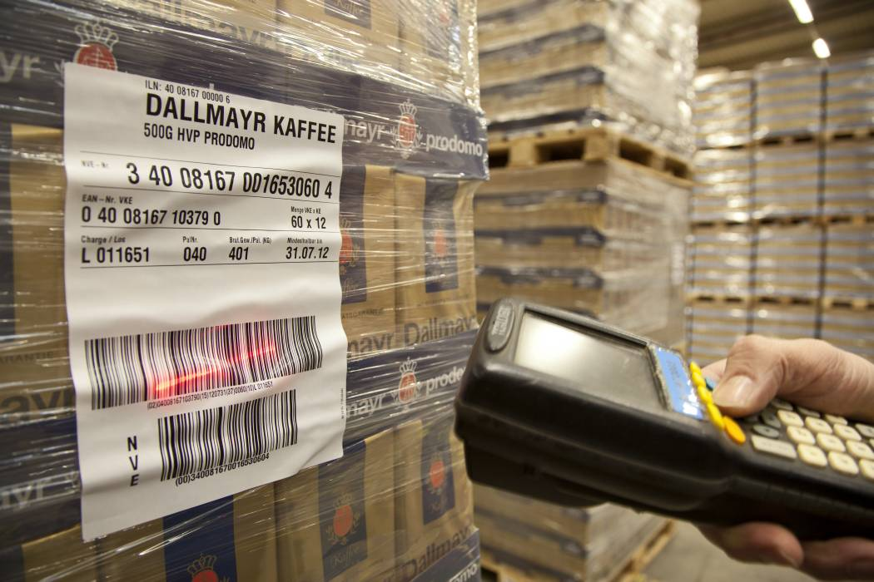
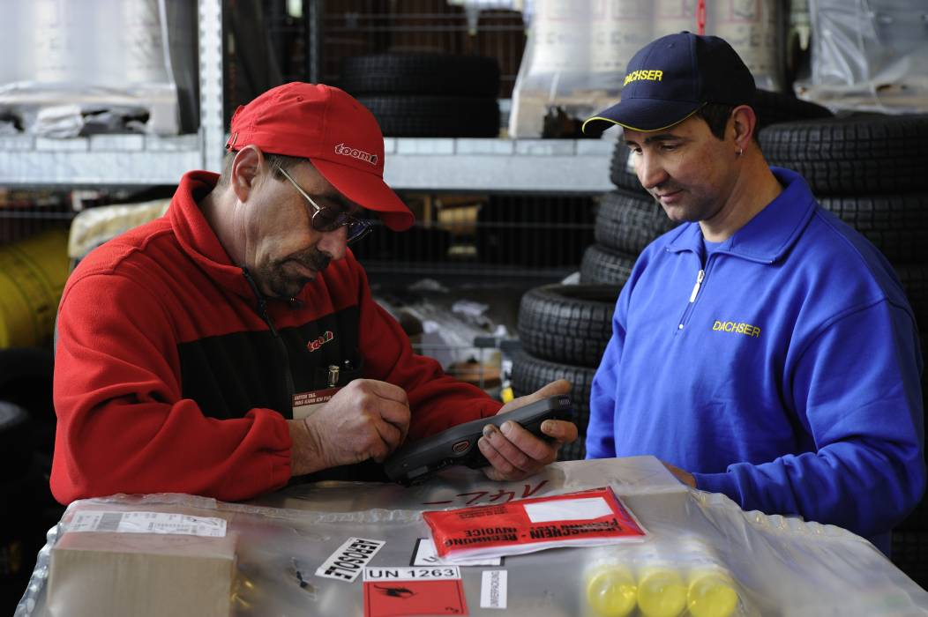
Work-flow
Scanning
in the Warehouse
Delifery with
ST-Online

Slide 8
eLogistics – many applications – one solution

Slide 9
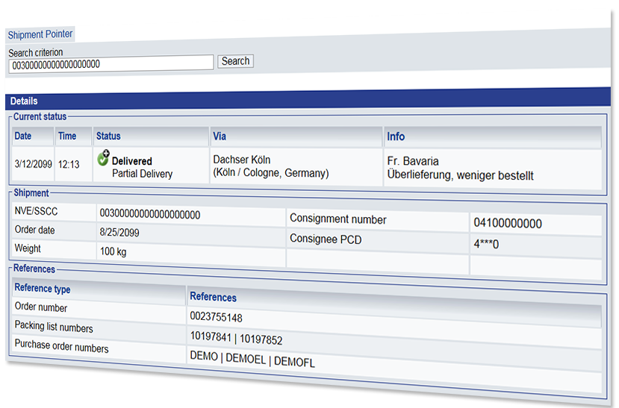
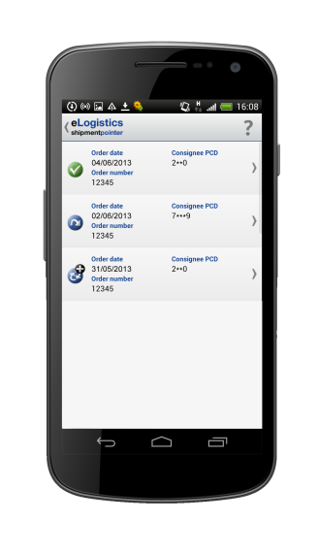
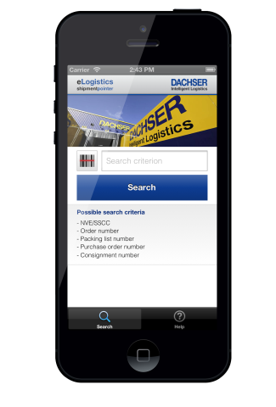
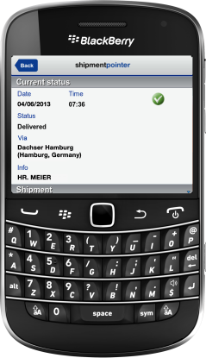
–
Tracking and tracing made easy
Possible search criteria: SSCC, order number, delivery note number, PO number or shipment number
Shipment pointer app available for Apple iOS, Android and Blackberry OS
Available in 13 languages, on the web and as an app

Slide 10
modules
Send (distribution)
Collect (procurement)
Extend (special delivery scenarios)
Forwarding orders (shipper view)
Collection orders
Neutralization (cover address)
Forwarding orders (consignee view)
Special projects

Slide 11
Supply chain event management (SCEM)
Proactive quality monitoring
CUSTOMER
Status information
Z
A
Z
A
Z
E
E
E
Z
A
Z
Z
A
Z
A
as individual e-mail
as e-mail with Excel overview
Z
E
Z
R
E
A
Z
E
Z
R
Z
A
E
Z
R
Report
A
Z
K
K
Z
Z
Shipments with discrepancies
A
E
Shipments without discrepancies
OK
R
E
A
Constant comparison of target shipment process with actual shipment process

Slide 12
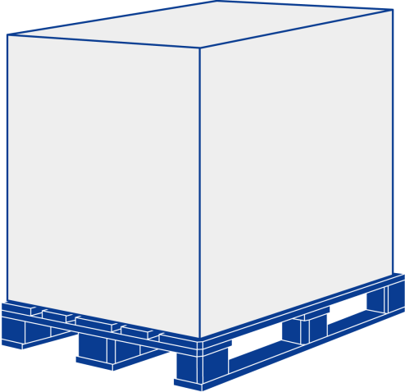
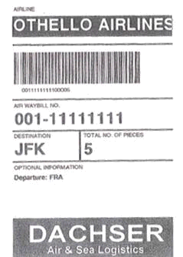
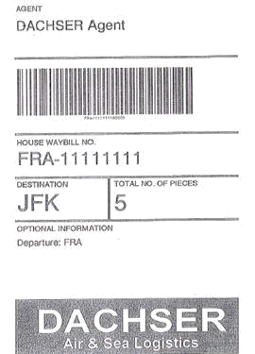
Identifiers along the Supply Chain (Airfreight)
Marks & Addresses
Consignee
Shipper

Slide 13
Current challenges Piece-Level-Tracking (Airfreight)

Slide 14
SSCC along the Supply Chain (Airfreight)
Consignee
Shipper

Slide 15
SSCC in Airfreight – Pilot project with Germany
Timeline
2009 Kickoff together with Germany
2010 Argumentation Paper
2014 Launching of pilot project (definition of showcase, etc.) together with an airline
Goal
Sharing information on piece level (by using SSCC)
Approach
SSCC(s) linked to corresponding MAWB-No. within both (Airline & Dachser) IT-systems

Slide 16
Let´s find more players joining us to make it happen!

