Slide 1
New Member Session
Intro to GS1
Intro to Standards Development
Notes:
Welcome to the world of Standards Development. I hope you enjoyed the session so far.
Please welcome Justin Childs and Greg Rowe as they provide into to GS1, GSMP and Industry Engagement for you!

Slide 2
GS1 Overview Organization structure
David Buckley & Justin Childs

Slide 3
GS1: The Global Language of Business
GS1 Overview
GS1 is a neutral not-for-profit organisation driven by its users, that facilitates collaboration amongst trading partners, to create more efficient, safer and sustainable value chains through global standards.
Notes:
For the last 30 years, we at GS1 have dedicated ourselves to the design and implementation of global standards for use in the supply chain. GS1 standards provide a framework that allows products, services, and information about them to move efficiently and securely for the benefit of businesses and the improvement of people’s lives, everyday, everywhere. Our standards ensure effective exchanges between companies, and act as basic guidelines that facilitate interoperability and provide structure to many industries.

Slide 4
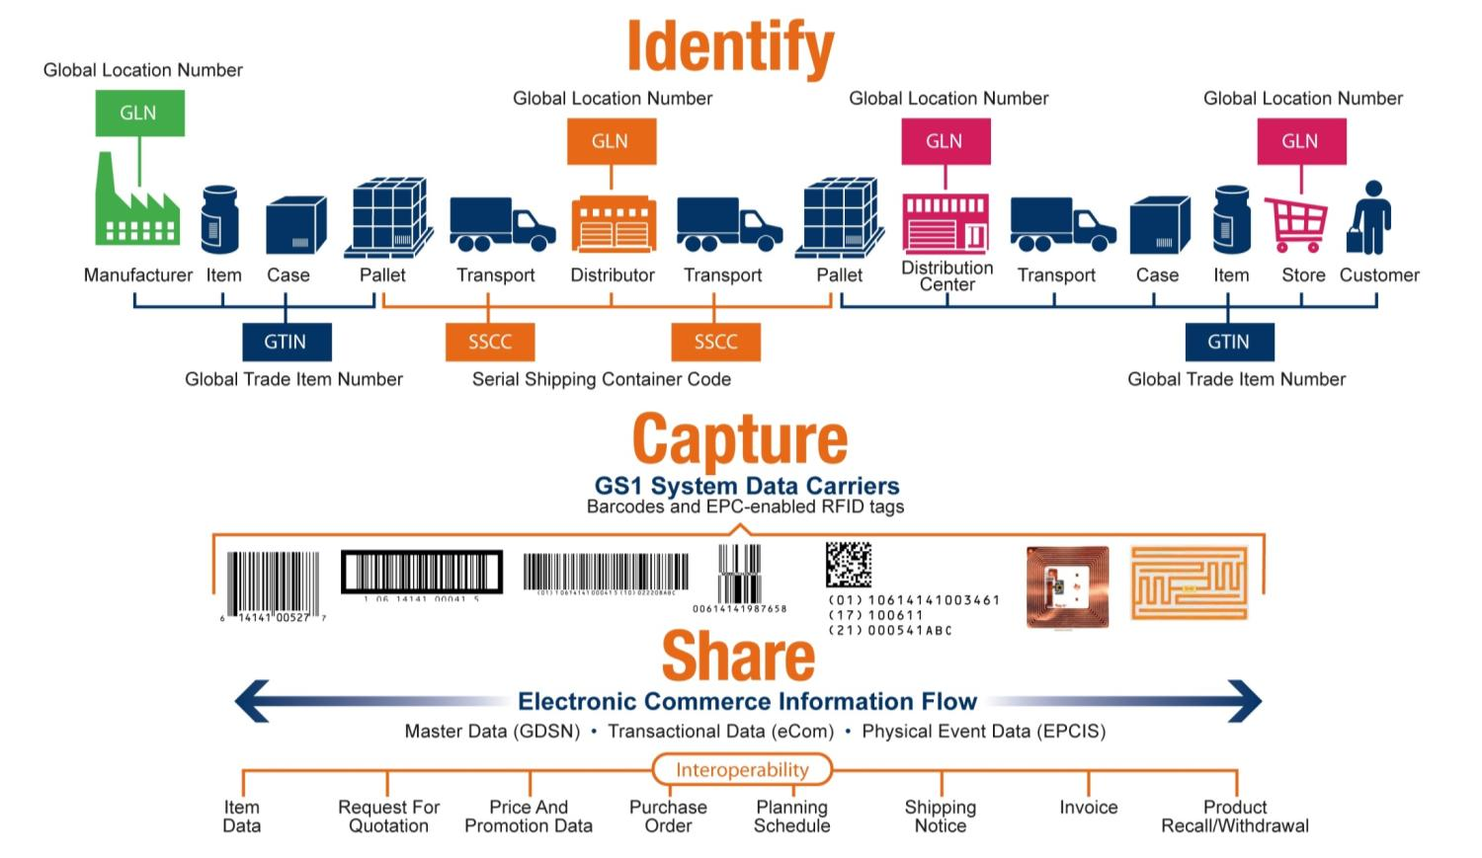
GS1 Overview
GS1: A global system of standards

Slide 5
GS1 Overview
GS1 – Bringing companies together
GS1 brings together companies representing all parts of the supply chain
Manufacturers, distributors, retailers, hospitals, transporters, customs organisations, software developers, local and international regulatory authorities, and more work together under our leadership to create, implement and use standards
Notes:
GS1 standards bring together companies representing all parts of the supply chain – manufacturers, distributors, retailers, hospitals, transporters, customs organisations, software developers, local and international regulatory authorities, and more.

Slide 6
GS1 Overview
GS1 Vision and Mission
Our vision is a world where goods and related information move efficiently and securely for the benefit of businesses and people’s lives
Our mission is to be the neutral leader enabling communities to develop and implement open global standards

Slide 7
GS1 Overview
Global reach … local presence
111 Member Organisations
Close to 1.4 million member companies
150 countries served
2,500 people helping us

Slide 8
Global Office Organization

Slide 9
GS1 Global Office Organisation
Leadership Team
Miguel Lopera
President & CEO
Marianne Timmons President
Industry Engagement
Steve Bratt
CTO & President,
Standards
Development and EPCglobal
Malcolm Bowden
President
Global Solutions & GDSN
Inc.
Patrick Vanlombeek
Chief Marketing Officer
Philippe Wéry
Chief Financial and
Administration
Officer

Slide 11
Your Global Office IE Team
Ulrike Kreysa
Greg Rowe
Marianne Timmons
Jim Bracken
Agathe Daskalides
Enzo Blonk
Robert Beideman
Agathe Daskalides
Audrey Kremer
Audrey Kremer
Pete Alvarez
Diane Tailard

Slide 17
What GS1 Offers
GS1 Standards for identify, capture, and share information—about products, business locations, and more—make it possible for companies to speak the same language, connect with each other, and move their business forward.
GS1 provides a system of standards and supporting services and solutions to help companies in our key sectors solve together business challenges in the value-chain

Slide 18
GS1 Business
GS1 meets the needs of multiple industries
Retail & Consumer Goods
Healthcare
Customs, transport & logistics

Slide 19
GS1 Business
GS1 meets sub-sectors needs in the retail value chain
Consumer Packaged Goods
DIY
Apparel & Footwear
And more…
Consumer Electronics
Fresh Foods
Notes:
The Retail Value Chain encompasses all products that can be sold through a retail channel : online or offline, B2C or even B2B…
It’s not only about Fast-moving Consumer Goods, it’s also about Fresh Foods, Apparel & Footware, Consumer Electronics, Hardline or DIY…
We have common needs in terms of supply chain processes and exchanging information where we need to collaborate.
But also specific issues like fresh food spoilage, consumer electronic recycling, clothing theft or luxury counterfeiting. Yet all of these require a holistic retail value chain approach to better resolve them

Slide 20
GS1 Business
Standards in action within the Healthcare supply chain
Transport provider
Manufacturer
Distributor, wholesaler, GPO, …
Healthcare provider
Patient
Improved production, packaging & supply processes
Simplification and accuracy improvement in distribution processes
Automatic verification in dispensing & administration processes
reducing medical errors
More accurate and efficient supply chain management
Enabling traceability & authentication (counterfeiting, product recalls, etc.)
Enabling regulatory compliance
Improving patient safety and supply chain efficiency
Notes:
Problem / Opportunity Statement:
Need to expand infrastructure used to share data among trading partners
No consistent data standards throughout supply chain
Inaccurate or bad data at many points in the supply chain
Everyone pays the ultimate price for bad data – unnecessary interruptions and costs
Each participant in the Healthcare Supply Chain has a different product number for the same product. Makes ordering, recalls, and proper identification to the patient difficult.

Slide 21
GS1 Business
GS1 Objective in Transport and Logistics (T&L)
Improve the efficiency and visibility of the T&L operations of supply chain stakeholders through the use of GS1 Global Standards
No transport and logistics company can be efficient without robust information technology and data systems.
GS1 standards are now well recognized in the Transport and Logistics sector.

Slide 22
GS1 Organisation Summary
Next Slide: How GS1 is structured

Slide 23
How GS1 are Structured

Slide 24
Participation in Standards Development
Justin Childs

Slide 25
Participation in Standards Development
Agenda
Submit Work Requests for standards changes
Join work groups
Attend work group meetings and events
Vote on community review and ballots
(MOs) Represent members

Slide 26
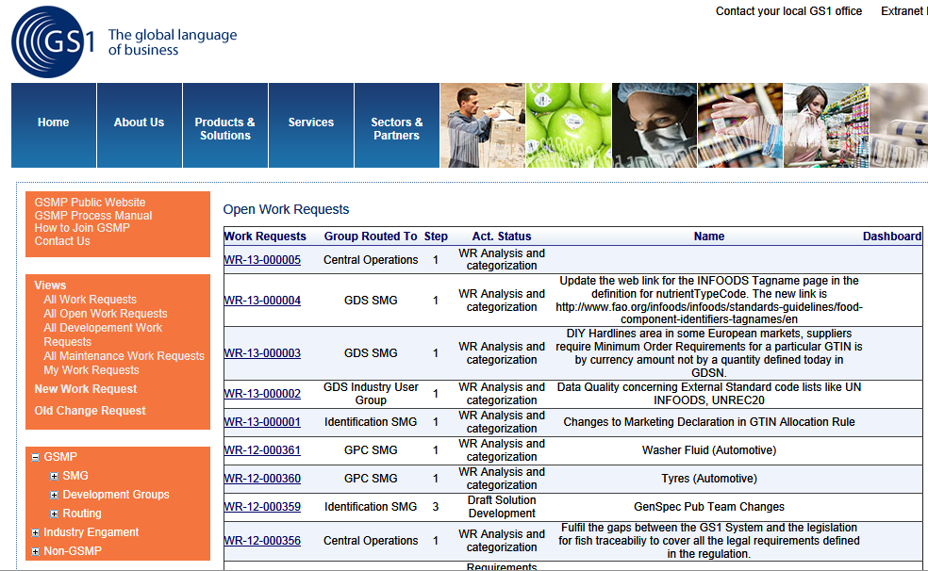
Participation in Standards Development
It all starts with a Work Request
Access the Work Request System portal
http://wr.gs1.org

Slide 27
Joining a GSMP Work Group
Participation in Standards Development
Sign GS1 Intellectual Property Policy
Sign Work Group Opt-In Agreement
Join Group in GS1 Community Room
Visit http://www.gs1.org/gsmp/participation to learn more about this process
Notes:
This slide shows the 4 steps to participate in a working group.
Our website includes a list of all active working groups. Once you decide where you want to participate, ask your company to sign the IP Policy and the desired Working Group Opt-In Agreement. There is an Opt-In agreement for each working group.
After the IP Policy and Opt-in Agreement are signed, any employee of your company may participate in the working group your company has opted-in to participate. The person who intends to participate in the working group must then join the online GS1 Community room and the Working Group in GS1 Community room.
Visit our website www.gs1.org/gsmp/participation to step through this process.

Slide 28
New Join Assistance Website
Participation in Standards Development

Slide 29
Active Work Groups on GSMP Website
Participation in Standards Development
http://www.gs1.org/gsmp/community/working_groups/

Slide 30
My Groups Workspace – New!
Participation in Standards Development

Slide 31
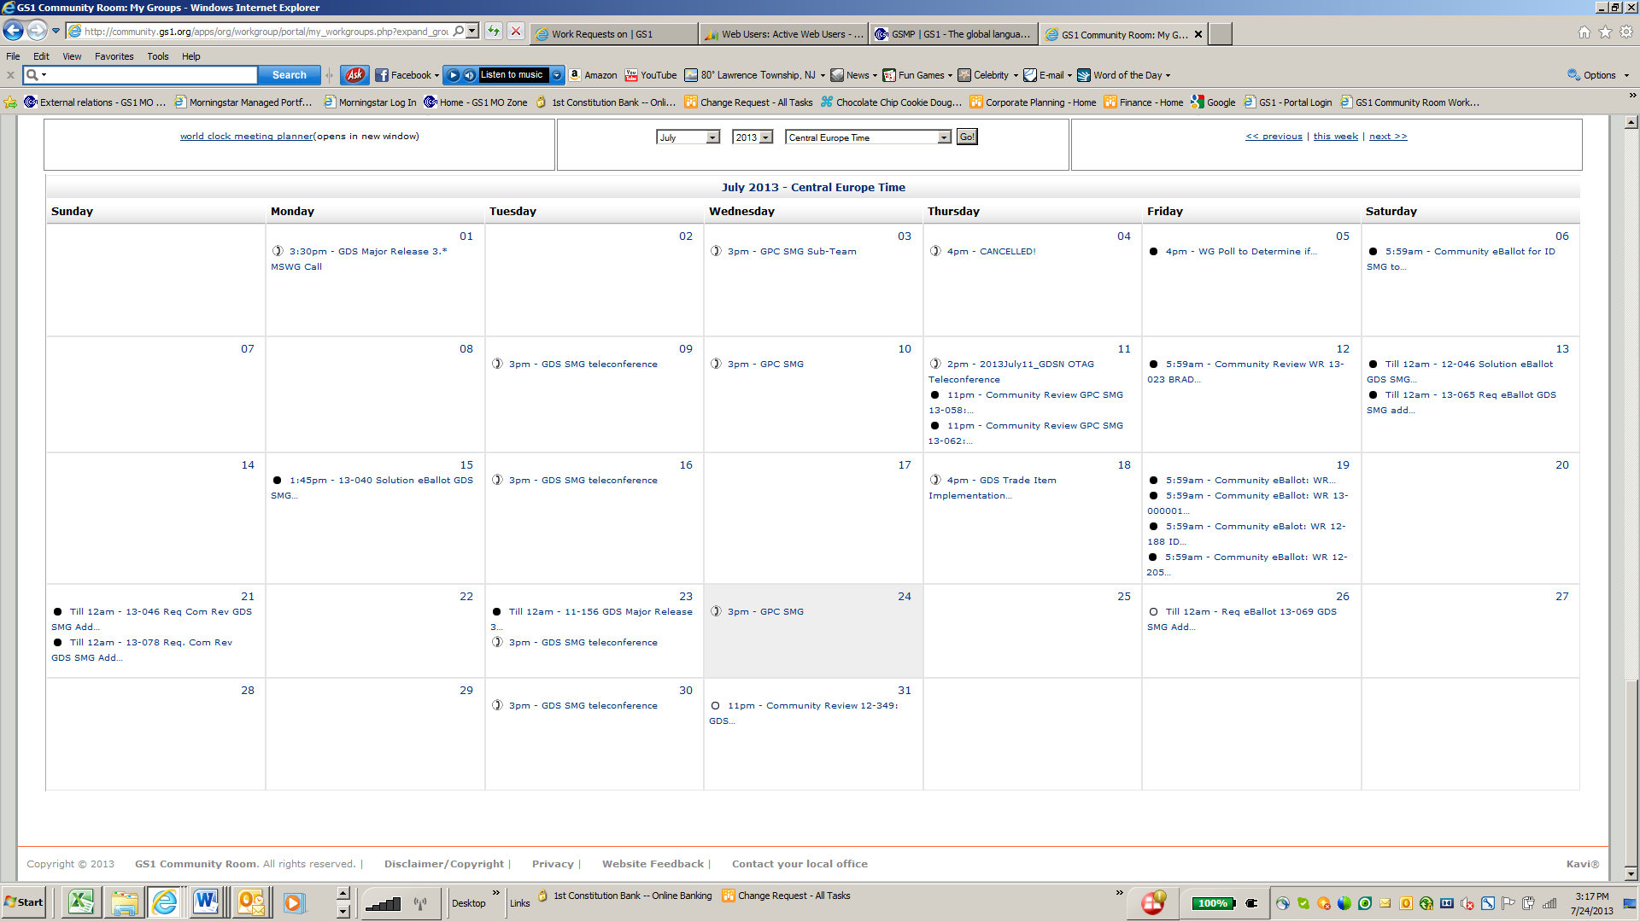
Participation in Standards Development
Monthly calendar for all work groups

Slide 32
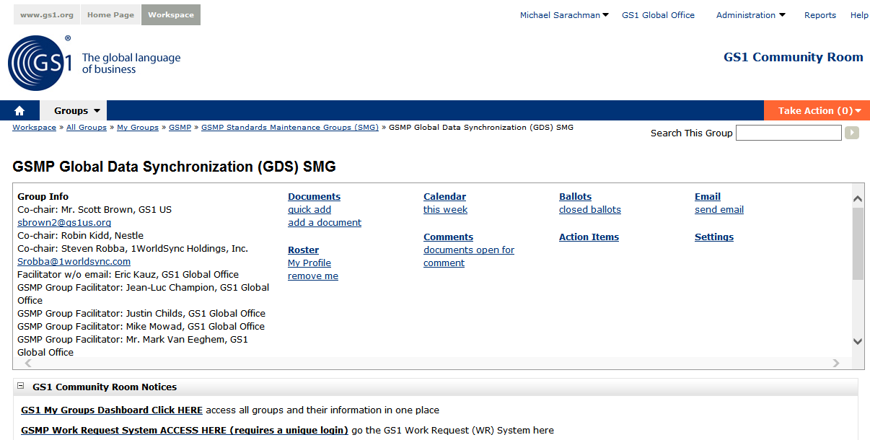
Group Community Room
Participation in Standards Development

Slide 33
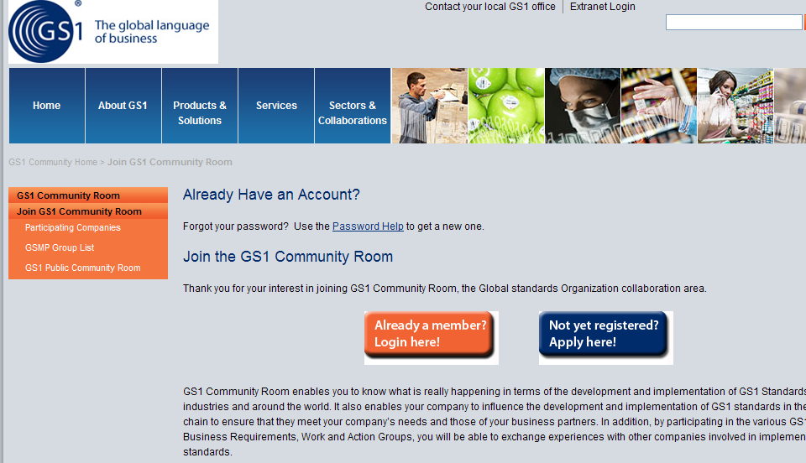
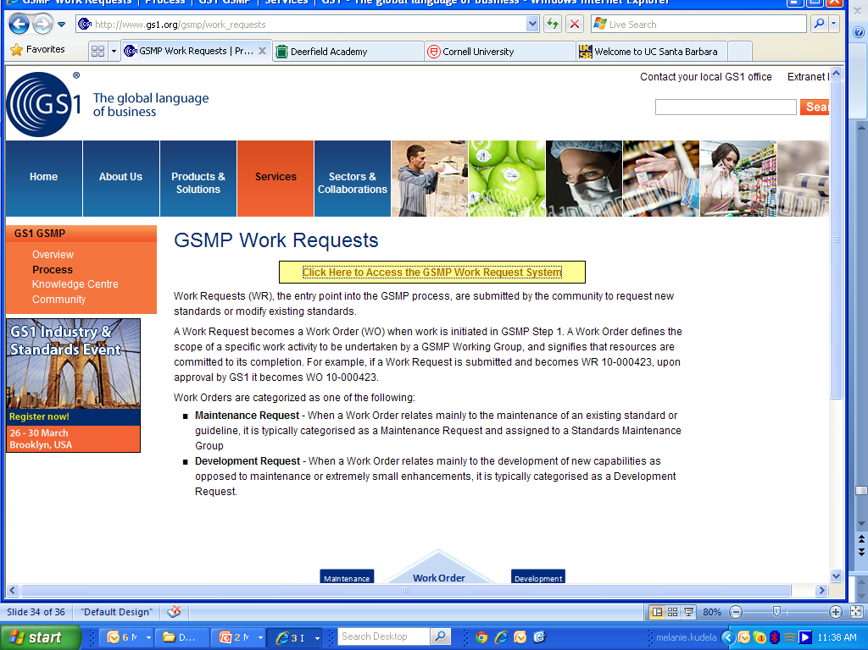
GSMP Resources
Participation in Standards Development
www.gs1.org/gsmp
GS1 Community Room
http://community.gs1.org/join
GSMP Work Request System wr.gs1.org

Slide 34
GS1 Global Marketing
Global Office Website and MO Zone
PUBLIC
MO/USERS
MO
http://www.gs1.org
http://community.gs1.org
http://mozone.gs1.org
Global Office website
Community Room
MO Zone
http://learn.gs1.org
Learn

Slide 35
Technical Publications
Global Office Website
Global Office Website
www.gs1.org

Slide 36
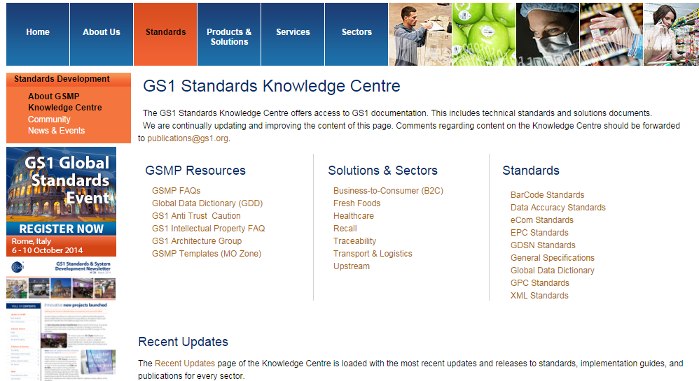
Technical Publications
Published Standards Website
All GS1 standards published on public website
http://www.gs1.org/gsmp

Slide 37
Resources – lots of information on web
Global Standards Management Process (GSMP)
Global Standards Management Process (GSMP)
http://www.gs1.org/gsmp/process

Slide 38
Participation in Standards Development
GSMP reporting measurement of progress
What’s in development?
What’s the rate of membership growth?
How is GSMP performing?
What’s the status of a work group?
Visit our website “GSMP Reporting” to find current information
www.gs1.org/gsmp/insight

Slide 39
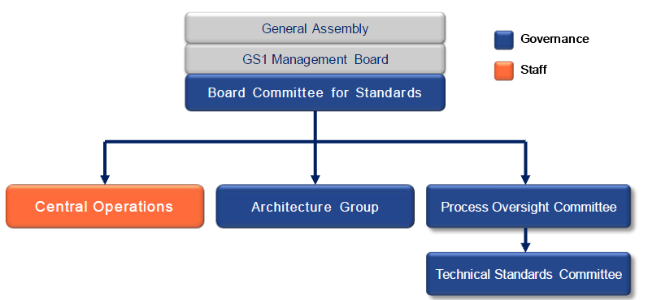
The GS1 Architecture Group
The GS1 Architecture Group is an advisory body composed of end users, solution providers, and MO representatives to ensure the integrity, consistency and efficient interoperation of the GS1 System via a documented GS1 System Architecture.
Notes:
The GS1 Architecture Group is a formal part of the GS1 Governance Structure. It is important to stress that it is an advisory body.
Central Operations is a governance support entity which represents the staff function and reports to the Vice President of Global Standards.

Slide 40
Principal Responsibilities
To promote and protect the integrity of the GS1 System
To ensure the GS1 System Architecture is well documented, accessible, extensible, and broadly understood
To review and provide recommendations for business standards and services development
To advise on strategic direction for the GS1 Portfolio
To respond to issues or questions submitted by members of the GS1 community regarding the GS1 System
To foster the integration of the GS1 System into commercial solutions and products

Slide 41
AG Deliverables
Findings
Requests submitted by
members of GSMP community
Architecture Principles
Ideals to be met where possible
System Landscape
The ‘what’ of the GS1 System
System Architecture
The ‘what and the why’ of the GS1 System
All deliverables are published on: http://www.gs1.org/architecture
Notes:
Speak about RFF in high-level detail
Use of GRAI in eCOM Trade Messages - GSMP team developing guidelines for Management of Reusable Transport Items (RTIs) submitted to AG as some countries used GRAI for orders and others insisted on GTIN
Compatibility of GS1 EANCOM and GS1 XML - When to use GS1 EANCOM and when to use GS1 XML and ensuring comptiblity
GTIN Allocation & Importers – major issue, partly led to GTIN on the web, when same product sold by multiple suppliers (typically on web). Source marking
Attributes Association with GS1 keys – new from the ID SMG. Can, say, a Expiry Date be on a Trade Item, A Coupon and an Asset? Same AI or different AI
External identifiers embedded in GS1 Keys for transport equipment– new from the T&L IE group. When creating GS1 ID Keys, especially GIAI, some users are embedding a BIC code or other structure. Have to balance rules for ‘issues or the number’ and ‘processer of the number’
None are easy simple questions: often balancing one principle against another.

Slide 42
Participation in Standards Development
Learn More: events
Any questions on
GS1 Organisation or GSMP?
www.gs1.org/gsmp/news

