Slide 1
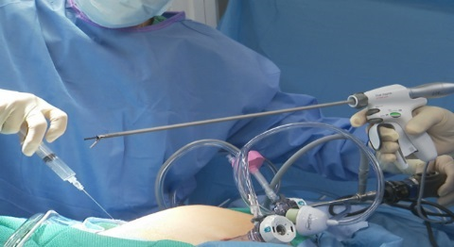
The Journey of Serialization and Traceability Brazil Market Deployment
Leandro Oliveira
Johnson & Johnson Supply Chain
Sr. Manager, Supply Chain Visibility

Slide 2
Agenda
Johnson & Johnson Quick Overview
Brazilian Deployment
J&J Pilot RDC-54/2013
Market Deployment RDC-157/2017
Deployment Next Steps
Q&A

Slide 3
Johnson & Johnson
Global science & technology company focused solely on healthcare
More than 275 operating companies in 60 countries
Selling products in more than 175 countries
More than 130,000 employees worldwide

Slide 4
Johnson & Johnson Portfolio
Consumer
Baby Care • Body Care • Facial Skin Care • Sun Care • Feminine Personal Care • Allergy Care • Compromised Skin Care • Cough and Cold Care • Digestive Health • Oral Care • Pain Care
Medical Devices
Wound Closure & Surgical Devices • Minimally Invasive Surgery • Joint Replacement • Sterilization • Eye Health • Diabetes Care
Pharmaceuticals
Oncology • Infectious Diseases & Vaccines • Immunology • Cardiovascular & Metabolism • Neuroscience & Pain • Pulmonary Hypertension

Slide 6
Johnson & Johnson and GS1 Partnership
J&J worldwide supply chain leader on GS1 Executive Board
Global supply chain Strategy & Deployment VP on the US GS1 Executive Board
Strong connection with external working groups promoting best practices and GS1 standards
GS1 standards embedded into all J&J efforts
Supply chain players and regulators
in need of a common language!

Slide 7
Brazilian Laws & Regulations
Federal Law 11.903/2009
Anvisa Regulatory Act (RDC 59/2009)
Anvisa Regulatory Act (RDC 54/2013)
Anvisa Regulatory Act (RDC 157/2017)
2009
2013
Federal Law 13.410/2016
2016
2017

Slide 8
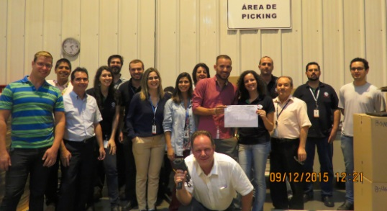
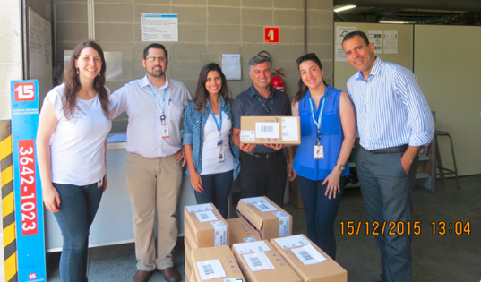
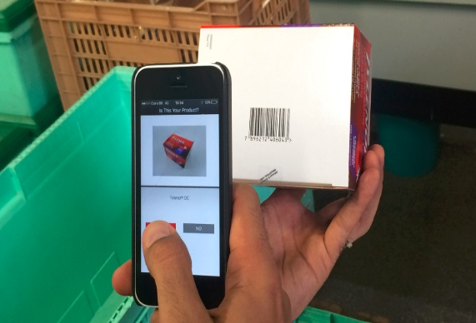
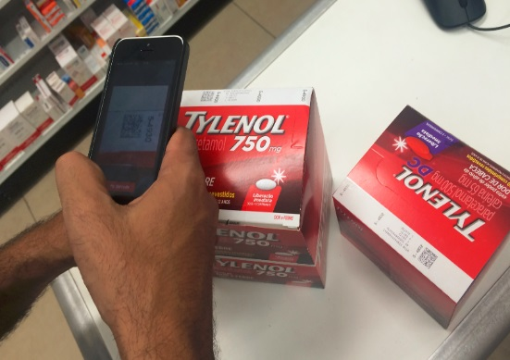
Brazilian End-2-End Pilot 2015 (RDC-54)
Pharmacy chain founded in 1962
42 Branches in 8 cities at “Vale do Paraiba” Region
720 employees, potentially 2MM customers
Partnered with Consumer and Janssen batches
Operations, Comercial and IT areas involved
8

Slide 9
Brazilian Serialization and T&T High-Level Timeline
Most Probable Scenario
Players Definition
Technical Pilot
Technical Adjustments
Full Market Implementation
2017 2018 2019 ....... 2022
Start Experimental
Phase Aug/17
Finish Experimental
Phase Aug/18
Finish Experimental
Phase Evaluation Apr/19
Final deadline, all products
and all supply chain Apr/22
9

Slide 10
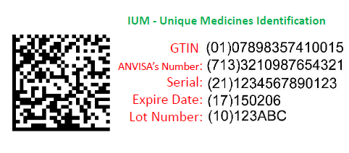
License Plate – Secondary Packaging
The RDC 157/2017 states that the GS1 DataMatrix bar code symbol should encode the following data that makes up the IUM (Unique Medicine Identification), in the following order:
GTIN – Global Trade Item Number
ANVISA Registration Number
Serial Number
Expiration Date
Lot / Batch Number

Slide 11
Brazilian Serialization and T&T High-Level Overview/Requirements
GS1 standard license plate + Anvisa registration number (AI 713)
Full T&T, not mandatory pre-importation movements
Bonded warehouse, custom processes and freight companies out of scope
Centralized T&T data repository – Sistema Nacional de Controle de Medicamentos (SNCM)
Supply chain players to define how the horizontal
communication will function
11

Slide 12
Brazilian Serialization and T&T Scope & What Has Been Done
14+ participants (5 manufacturers, 2 distributors, 2 hospitals, 5 pharmacies and
public entities TBD)
Overall regulatory milestones were defined by Anvisa
All manufacturers with at least a couple of lines, serialization and T&T systems ready
SNCM technical guideline drafted and shared with the experimental phase participants
Technical meetings with Anvisa IT started, as well as interactions with all participants
“Support the regulator to mature SNCM for a bigger scale implementation”
12

Slide 13
Brazilian Serialization and T&T Next Steps
Project governance to be established in both Anvisa and private market levels
Validate the business processes and connectivity requirements with Anvisa
Adjust and fine tune the technical requirements as the participants progress throughout the experimental phase
Cascade down the SNCM connectivity to the rest of the supply chain
13

