Slide 1
GS1 Global Data Model - Market Stages Guideline
Mark Van Eeghem & Markus Mueller
July 2023

Slide 2
The GS1 Global Data Model helps leverage product content for a seamless shopping experience across every channel.
By simplifying and harmonising the exchange of product data around the world, the GS1 Global Data Model standard increases operational efficiency for brand owners and retailers and improves data accuracy and completeness for consumers.
One product. One experience. Every channel.
Contact: Markus Mueller
https://www.gs1.org/standards/gs1-global-data-model
© GS1 2023

Slide 3
Global Data Model
WHAT
Attribute Definitions for Business (ADB) standard
HOW
GDM Attribute Implementation Guideline
WHEN
GDM Market Stages
Further simplifies product data exchange with timeliness guidelines
© GS1 2023
Notes:
The Global Data Model standard is surrounded and elevated by three complimentary standards, ADB and the Implementation Guide, that significantly simplify product data exchange. And now a third, Market Stages - which simplifies timeliness of exchange.
The three of these supporting standards provide the What, How and When answers to the Global Data Model Standard. What: Attribute Definitions for Business (ADB) How: GDM Attribute Implementation Guide When: GDM Market Stages
The new THIRD standard that further simplifies product data exchange with timeliness guidelines

Slide 4
Attribute Definitions for Business (ADB) standard and GDM Attribute Implementation Guideline
The GS1 Attribute Definitions for Business (ADB) and the GDM Attribute Implementation Guideline provide additional clarity to existing technical standards.
These standards were created, by request from the Consumer Goods Forum (CGF), to support the business processes:
list/order
move/store
sell product digitally and physically
Attribute Definitions for Business Standard
GS1 Global Data Model Attribute Implementation Guide
Business-friendly names, definitions, examples and usage statements simplify meaning and usage of standard attributes for business users and communities.
© GS1 2023
Notes:
The message in slides 3 and 4 is that the Global Data Model standard is surrounded and elevated by 3 complimentary standards, ADB and the Implementation Guide, that significantly simplify product data exchange. And now a 3rd…Market Stages…which simplifies timeliness of exchange.

Slide 5
GDM Market Stages – The Business Case
WHY
Current Situation
Data recipients may require, but not use, all of the data at once.
Manufacturers challenged to deliver a full set of data when data points may not be fully known
Goal
Enable manufacturers to provide product data only as needed by recipients to perform key business functions, e.g., verify the product, cut POs, transport items.
Expected Outcome
Better business processes and more accurate information at the time that it’s needed/required
Achieve greater process efficiency, improved data quality and timeliness
© GS1 2023

Slide 6
Market Stages Example
GDM Attribute Gross Weight
At which Lifecycle Stage does the recipient first need the data?
List/Order
Needed to create PO
At which Lifecycle Stage does the recipient need the data to be final?
Move/Store
Needed to support transportation and warehouse storage practices
© GS1 2023

Slide 7
Product Data Lifecycle – Improved Data Delivery
Rather than a 1-time delivery, by manufacturer of all data...share data in phases when most needed
Phases defined by market stage
Ready
to Buy
Ready
to Move
Ready
to Sell
LIST/ORDER - relevant attributes
Supplier
Retailer
+
MOVE/STORE - relevant attributes
SELL - relevant attributes
+
© GS1 2023

Slide 8
Product Data Lifecycle – Market Stages Example
Attribute Stacking Factor (how many units of a trade item can be safely stacked)
Data requirement by market stage as follows:
Ready
to Buy
Ready
to Move
Ready
to Sell
LIST/ORDER – Prelimary (support PO creation)
Supplier
Retailer
+
MOVE/STORE – Final (support transportation and warehouse storage practices)
SELL – Final (support display and shelving decisions)
+
© GS1 2023

Slide 9
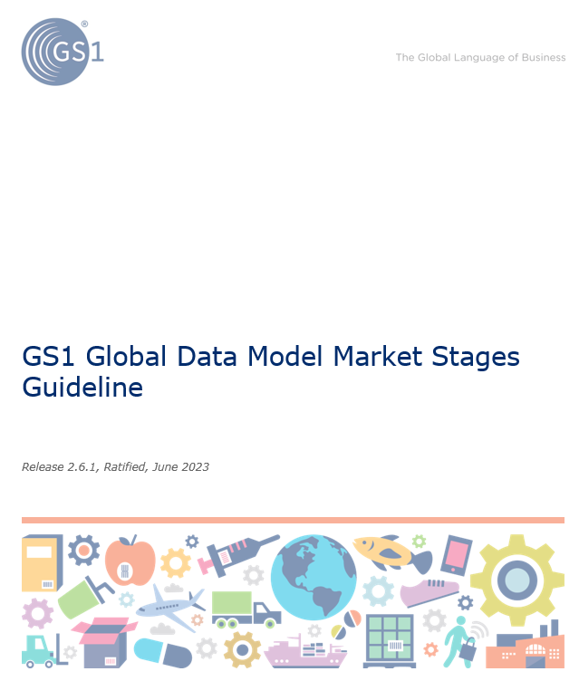
Market Stages Guideline Word Document
© GS1 2023

Slide 10
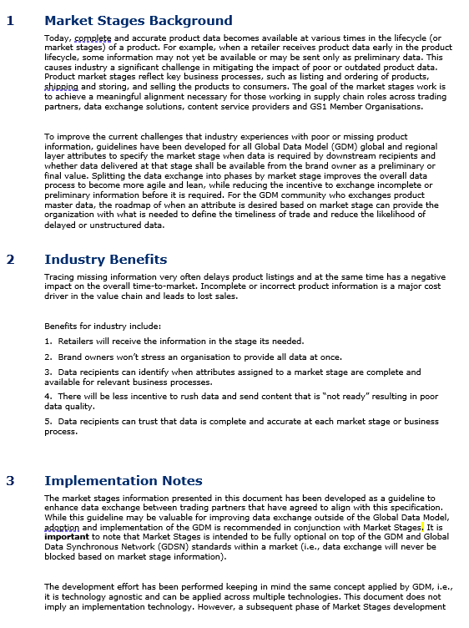
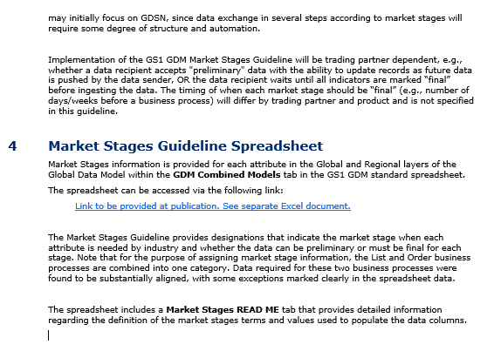
Market Stages Guideline Word Document
© GS1 2023
Notes:
The Guideline explains:
- the value proposition of GDM Market Stages
- the benefits, to any organisation, of timely sharing of product data
- the structure of the technical standard

Slide 11
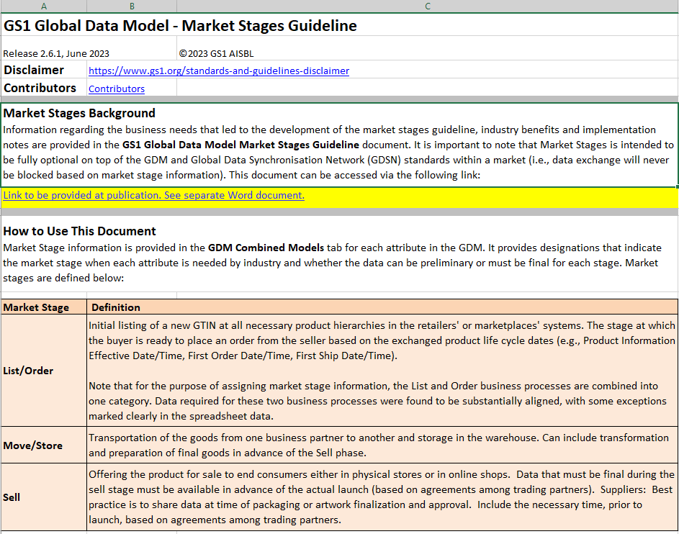
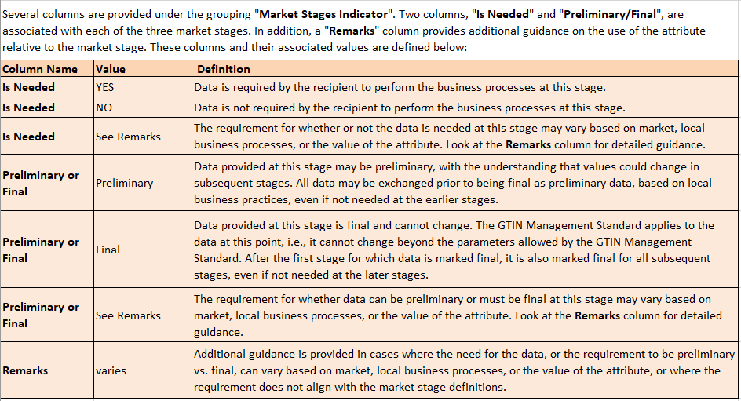
Market Stages Excel Spreadsheet – ReadMe Embedded in GDM standard
© GS1 2023
Notes:
The Market Stages Guideline provides:
definitions of the values that are used to indicate WHEN a recipient needs an attribute, and if the attributes need to be preliminary or final
indicators for every Global Data Model attribute on timeliness

Slide 12
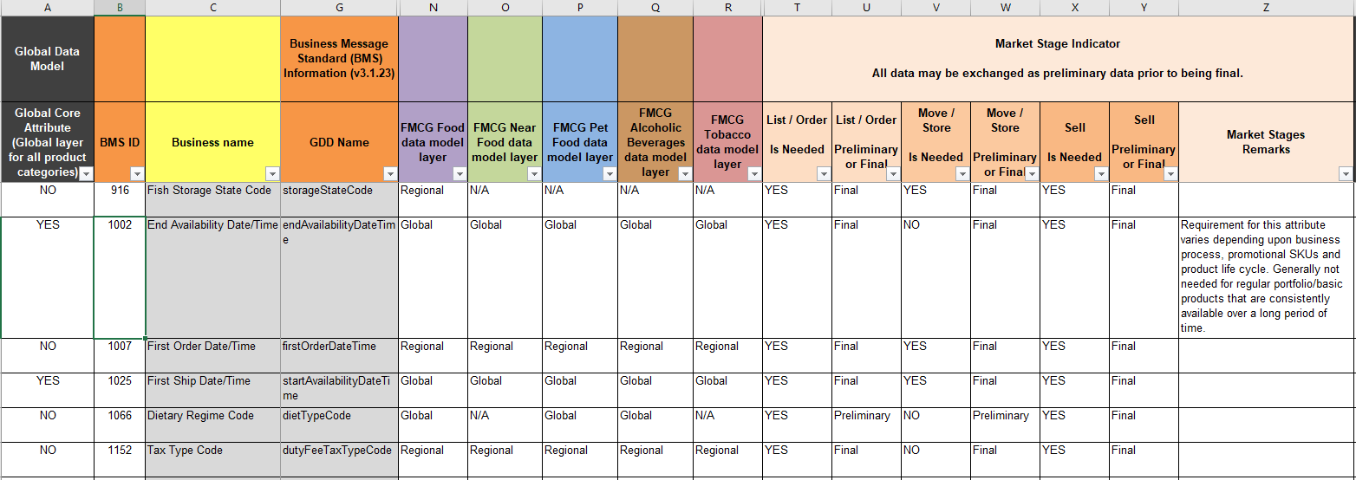
Market Stages Excel Spreadsheet - Embedded in GDM standard
© GS1 2023

Slide 13
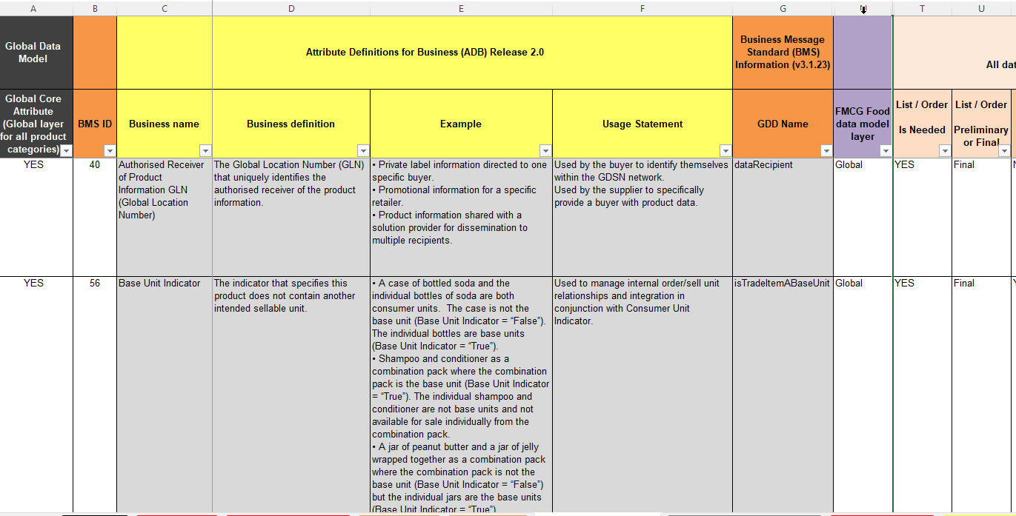
Use Case: Create a Standardised Listing Sheet
2. ADB helps business owners understand what is being requested
1. Filter List/Order to “YES” - identifies data needed to list and order a product

Slide 14
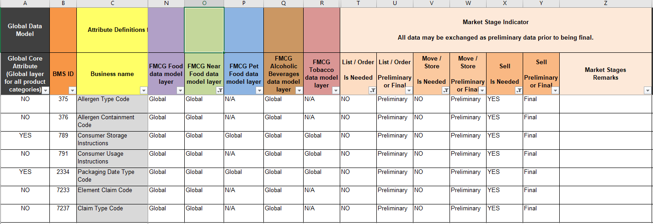
Use Case: Prioritising data creation Example: highlight attributes not needed until the last stage of trade – SELL the item
3. Additional option: filter Near Food model on “Global” to limit list to attributes by product category and GDM layer
1. Filter Sell to “YES” - indicates what is needed to Sell a product
2. Filter List/Order and Move/Store to “NO” – Highlights attributes not needed prior to Sell stage

