Slide 1
GS1 standards within the context of traceable construction and installation
Frits van den Bos, innovation manager GS1 Netherlands
20 December 2021

Slide 2

Traceable Construction and installation
Report October 2021

Slide 3
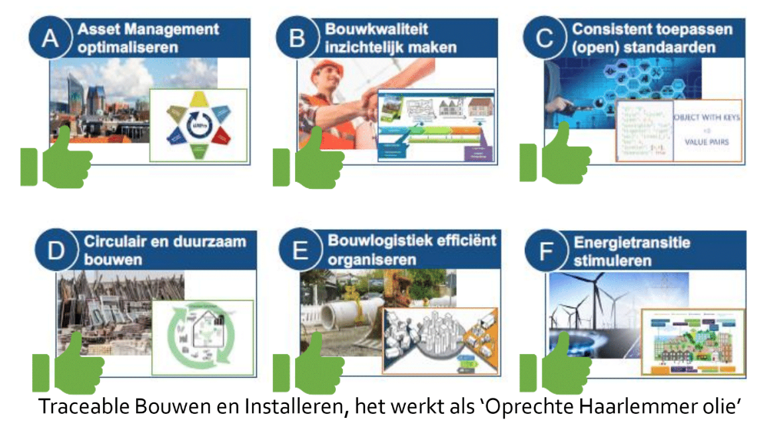
Traceable construction and installation

Slide 4
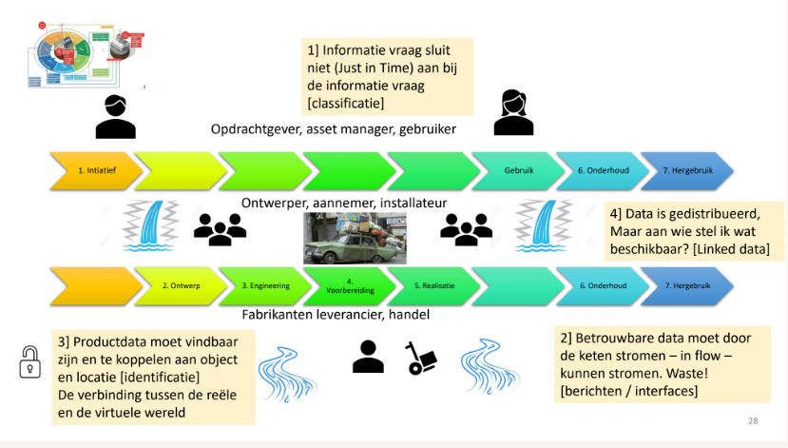

Slide 5
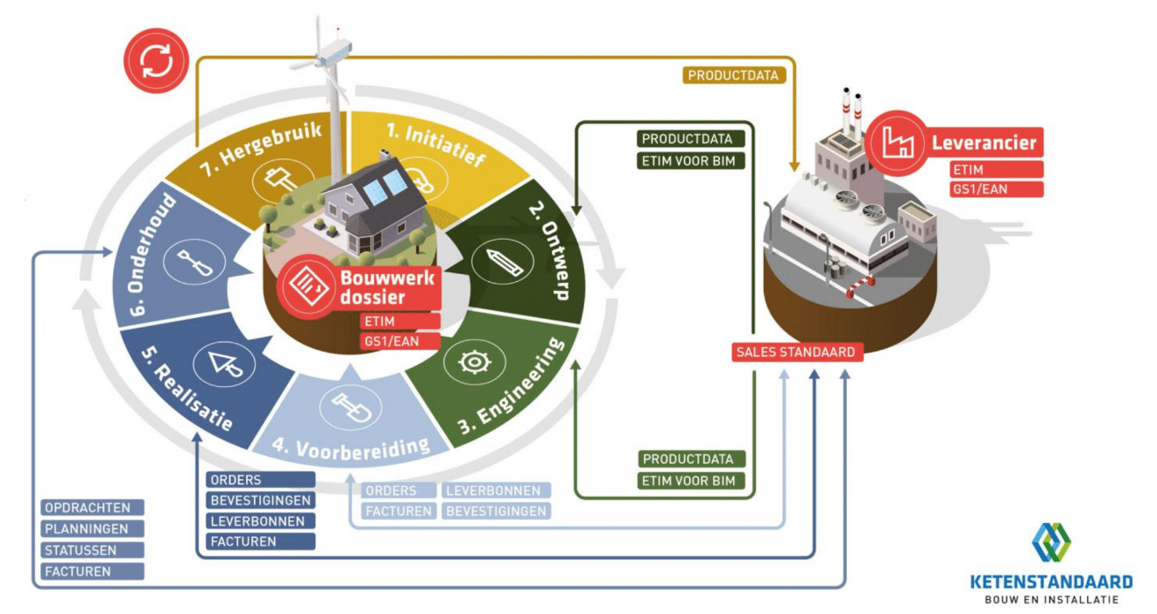

Slide 6
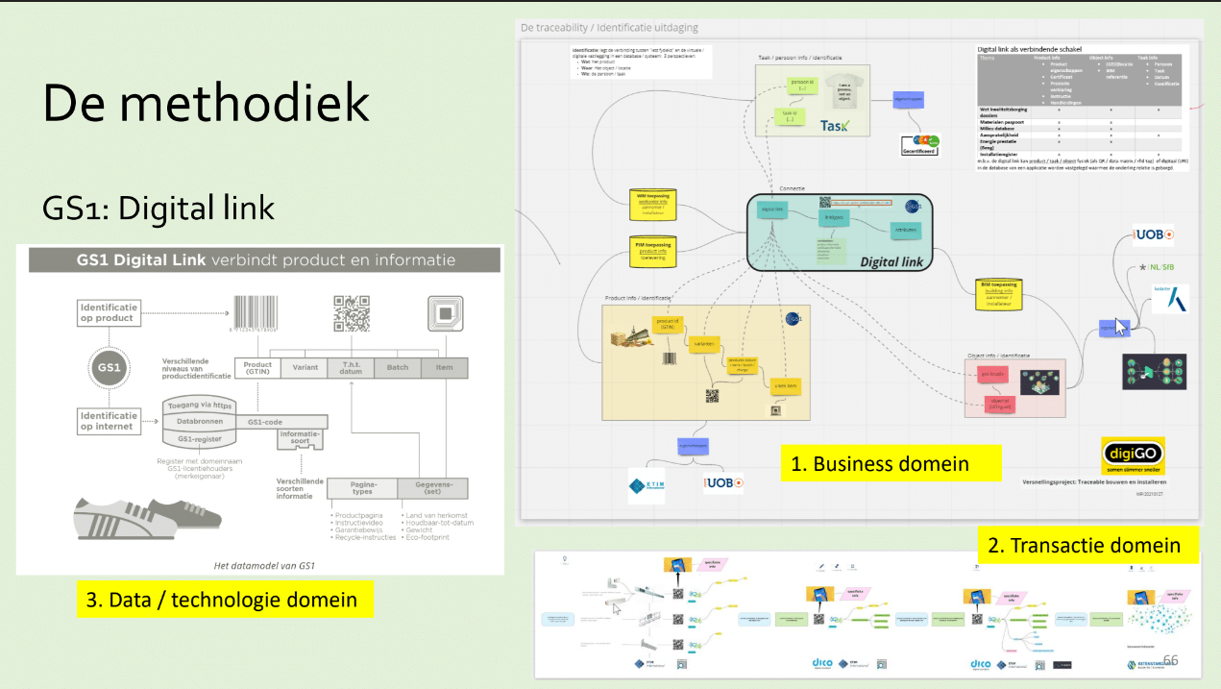

Slide 7

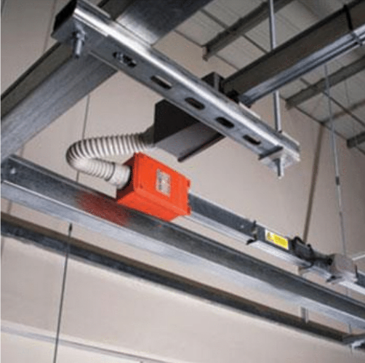


Different types of products

Slide 8
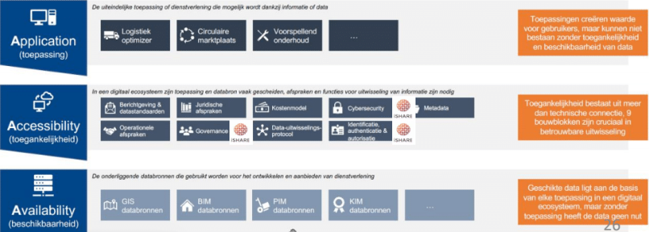
Managing the information sharing

Slide 9
Identification for a Circular Economy
Considerations for GS1

Slide 10
Circular Economy
refurbish
return
resell
produce
stock
sell
use
share
maintain
recycle
Brand owner
Wholesaler
Retailer
Marketplace
Consumer
Service providers
LSP
Point of Sale
A product goes beyond the POS and continues it own individual life cycle

Slide 11
Circular Economy
refurbish
return
resell
produce
stock
sell
use
share
maintain
recycle
Brand owner
Wholesaler
Retailer
Marketplace
Consumer
Service providers
LSP
model
Point of Sale
product
Batch
item
asset
Needs more granular identification that persist during the whole product life cycle

Slide 12
Circular Economy
refurbish
return
resell
produce
stock
sell
use
share
maintain
recycle
Brand owner
Wholesaler
Retailer
Marketplace
Consumer
Service providers
LSP
model
Point of Sale
product
Batch
item
Needs data that can be linked to the products at different levels of granularity

Slide 13
Circular Economy
refurbish
return
resell
produce
stock
sell
use
share
maintain
recycle
Brand owner
Wholesaler
Retailer
Marketplace
Consumer
Service providers
LSP
Point of Sale
item
Or needs data that can be linked to the most granular level of identity

Slide 14
Circular Economy
Digital Product Passport
refurbish
return
resell
produce
stock
sell
use
share
maintain
recycle
Brand owner
Wholesaler
Retailer
Marketplace
Consumer
Service providers
LSP
model
Point of Sale
product
Batch
item
Needs data that to be aggregated at item level at any time during the product life cycle

Slide 15
Made to order
refurbish
return
resell
produce
stock
sell
use
share
maintain
recycle
Brand owner
Wholesaler
Retailer
Marketplace
Consumer
Service providers
LSP
model
Point of Sale
Specifications by customer
#ordered by customer
(Bilateral) Order and/or project number
product
#repeated order
Batch
item
Should fit the identification and data scheme of the Circular Economy

Slide 16
Made to order
refurbish
return
resell
produce
stock
sell
use
share
maintain
recycle
Brand owner
Wholesaler
Retailer
Marketplace
Consumer
Service providers
LSP
model
Point of Sale
Specifications by customer
#ordered by customer
(Bilateral) Order and/or project number
product
#repeated order
Batch
item
  How to identify at different levels? Generic, batch, item?

Slide 17
Made to order
refurbish
return
resell
produce
stock
sell
use
share
maintain
recycle
Brand owner
Wholesaler
Retailer
Marketplace
Consumer
Service providers
LSP
model
Point of Sale
Specifications by customer
#ordered by customer
(Bilateral) Order and/or project number
product
#repeated order
Batch
item
  How to we differentiate before and after Point of Sale (use, maintenance)?

Slide 18
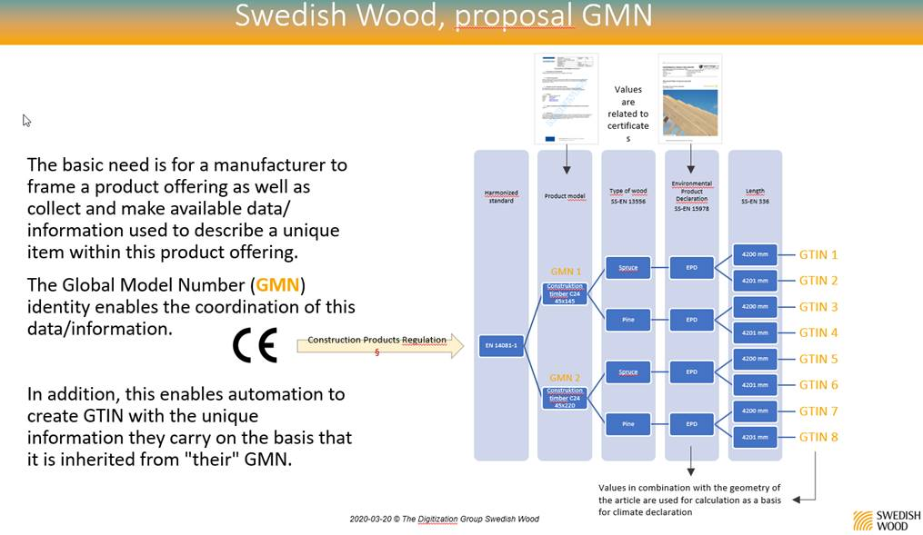
Point of Sale

Slide 19
Circular Economy upstream
produce
stock
sell
Brand owner
Wholesaler
Retailer
Marketplace
LSP
refurbish
return
resell
produce
stock
sell
produce
stock
sell
use
share
maintain
recycle
Brand owner
Wholesaler
Retailer
Marketplace
Brand owner
Wholesaler
Retailer
Marketplace
Consumer
Service providers
LSP
LSP
produce
stock
sell
Brand owner
Wholesaler
Retailer
Marketplace
LSP
Parts
Product
Item
Point of Sale
Point of Sale

Slide 20
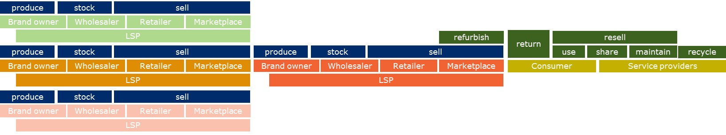

Can we close the loop?
Products / packaging
Life of the instance
Parts/components

