Slide 1
GS1 Industry & Standards Event 2017
11 October 2017 – Brussels, Belgium
Transforming business together
Session: Barcode Identification Futures
Time: 1300 to 1700 CET
Speaker(s): Pete Alvarez, Karen Arkesteyn, Robert Beideman, Ray Delnicki, Scott Gray, Andrew Hearn, Naoko Mori, Dan Mullen

Slide 2
Anti-trust caution
GS1 operates under the GS1 anti-trust caution. Strict compliance with anti-trust laws is and always has been the policy of GS1.
The best way to avoid problems is to remember that the purpose of the group is to enhance the ability of all industry members to compete more efficiently.
This means:
  There shall be no discussion of prices, allocation of customers, or products, boycotts, refusals to deal, or market share.
  If any participant believes the group is drifting toward impermissible discussion, the topic shall be tabled until the opinion of counsel can be obtained.
The full anti-trust caution is available via the link below, if you would like to read it in its entirety: http://www.gs1.org/gs1-anti-trust-caution.

Slide 3
Meeting etiquette
Avoid distracting behaviour:
  Place mobile devices on silent mode
  Avoid sidebar conversations
Be considerate
  Avoid monologues
  Keep comments concise

Slide 4


GS1 Standards Event App – How to get it
Get the App by searching your App store for "GS1 Global Events"
(If you already have the Global App due to attendance at the Global Forum or Standards Event, you do not need to do this)
Once you have the Global App on your mobile device, the Industry & Standards Event module will automatically show up. Please click the orange (+) to activate the event within your application.
1
2
Login with the email address you used to register for the event:
Username: (your registered email)
Password: 2017
2017
3

Slide 5
WiFi internet access
Select “Crowne-Plaza-Free-Internet” and connect
Password:2017

Slide 6
Exploring the Future of GS1 Identification
Robert Beideman, VP, Retail
11 OCT 1305 to 1320

Slide 7

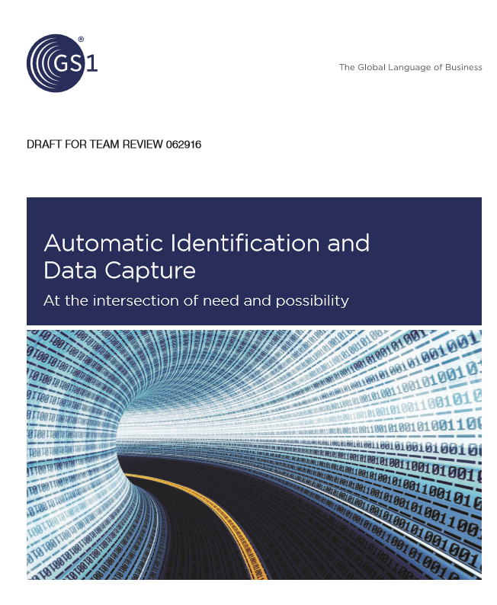
A cross-sector perspective of the road ahead for AIDC-related industry priorities

Slide 8
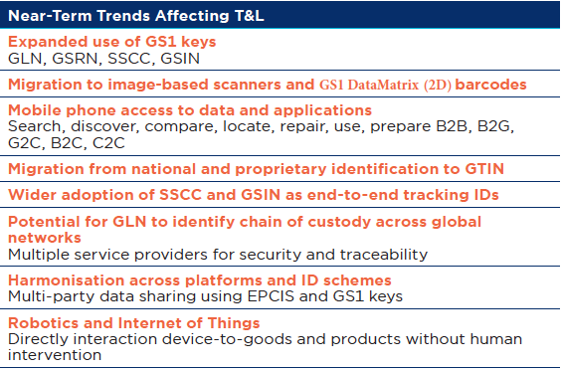
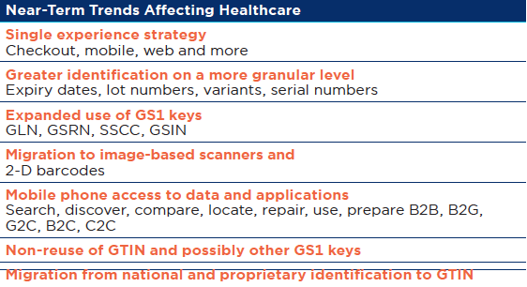
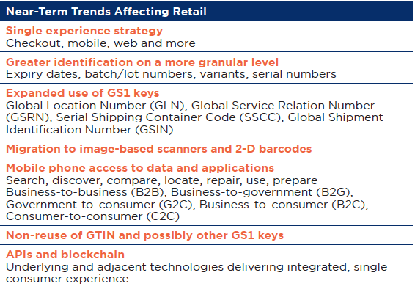
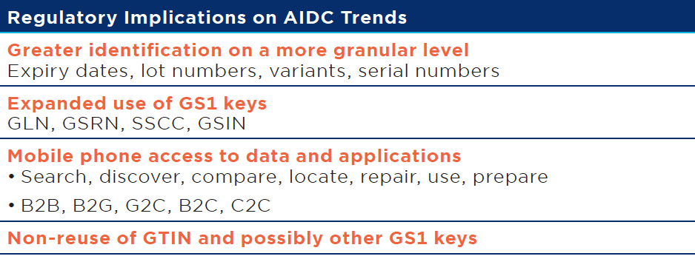
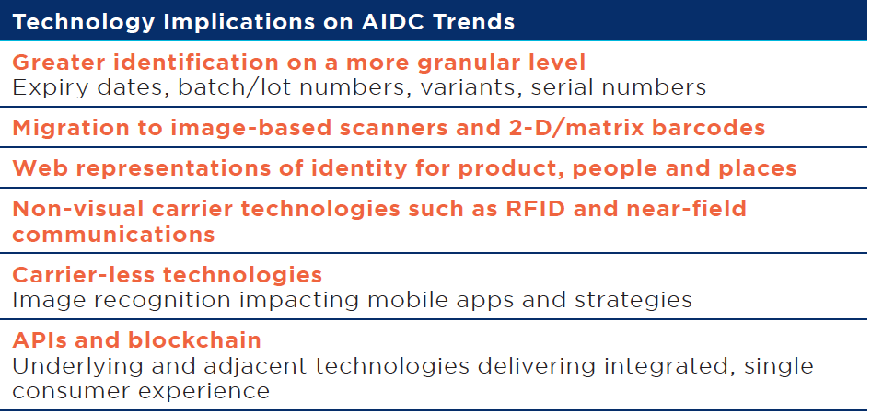
Identifying common challenges
Priorities that span industries, regulation, and technology
Retail
Regulation
Technology
Healthcare
T&L
Common AIDC-related Challenges
=

Slide 9
Two actionable projects identified:
Digital Bridge / Mobile Bridge
  Build an industry-led vision for a “1Barcode” future across the business landscape and enable supply chain, web and smartphone identification solutions
GS1 Key Capacity Management
  Monitor and understand the rate of allocation of GS1’s identification keys, and ensure keys can be issued forever.
The report also identifies more long-term AIDC opportunities, sometimes outside of GS1’s core, being discussed in the Innovation Network and Auto-ID Labs

Slide 10
GS1 Key Capacity Management
  Monitor and manage the allocation of GS1’s identification keys, and ensure keys can be issued for years to come.
Produce a methodology to monitor and manage GS1 Key Capacity that accurately forecasts consumption, while considering variables that could significantly impact rates in the future. Variables include:
    More rigid non-reuse policies
    Success in engaging new industries
    Assignment of GTINs for new categories of trade items, especially those not subject to physical-world limits
    Time and effort needed for industry to react
Consider approaches to expand key capacity
Develop an approach to estimate future demand for ALL GS1 keys, that includes contingency plans should capacity become a forecasted issue

Slide 11
Contact Information
Robert M Beideman
VP, Retail
GS1
1009 Lenox Drive, Suite 202
Lawrenceville, NY 08648 USA
+1 609 902 0859
robert.beideman@gs1.org

Slide 12
AIDC Applications Advances
15 minutes
Scott Gray, Senior Director, Technology Strategy
11 OCT 1320 to 1335 CET

Slide 13

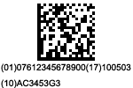
Hmmm….
What would happen if a brand manager replaced this…
With this on a consumer product, case, logistics unit…

Slide 14
The Answer Depends
Private Label? | If a retailer is ready, why not?
Fresh foods | For products marked with RCNs, could we migrate country by country to GTIN and 2D?
Regulated healthcare | The migration is already occurring across the world
Coupons | Some have already moved to GS1 DataBar. How did they do it?
General Merchandise | “You’re fired!”
Mobile | The “migration” began without us (QR Code)
T&L | If internal okay, but what about open supply chain?

Slide 15
The Answer Depends
Fresh foods | Karen and Scott
Regulated healthcare | Pete
Coupons | Ray
General Merchandise | Robert
Mobile | Naoko, Robert, Scott, and Pete
T&L | Dan

Slide 16
Scott “Nadi” Gray
Senior Director, Technology Strategy
+ 1 (609) 439 3975
scott.gray@gs1.org
Princeton - Brussels

Slide 17
GS1 Barcode and Extended Packaging
Naoko Mori GS1 Japan
11 October 2017

Slide 18
1.1 Extended packaging
“Decoded & Processed Data” Pilot
1.2 Extended Packaging
GS1 AI version use case
1.3 Reading GS1 Barcode in action in Japan

Slide 19








Extended Packaging Pilot
- Encoding the “Decoded & Processed Data”
Product: Hair Wax for men
URL/GTIN (in Conventional QR Code) to go to promotion application website

Slide 20







PILOT by A Beauty Care Product Company
The Brand Owner happy to know promotion application by product GTIN
Capability to manage purpose-focused URL with GTIN (by product) is a plus
Comparison with the sale figures and promotion application rates per GTIN

Slide 21
“Decoded/Processed Data” approach
Brand Owner’s View
Pros
-No Special App required
(1. To Read GS1 QR Code and
2. To process AI (01) and (8200) to make ”URL/GTIN”)
-Easier and Quicker deployment
-URL+GTIN can be handy for specific purpose solution such as campain
Cons
- Non-Standards way
(but not a big problem within a company)

Slide 22

Extended Packaging GS1 AI version Use Case
-User manual storage platform
Platform to store User Manual/safety Instruction Documents
GTIN and URL for the common URL platform (Scodt.jp)
Different companies participate in the platform
Hardware Company-A
Document
Platform
(01)GTIN-A1(8200)scodt.jp
Cosmetics company-B
(01)GTIN-B1(8200)scodt.jp
Furniture company -C
(01)GTIN-c1(8200)scodt.jp

Slide 23
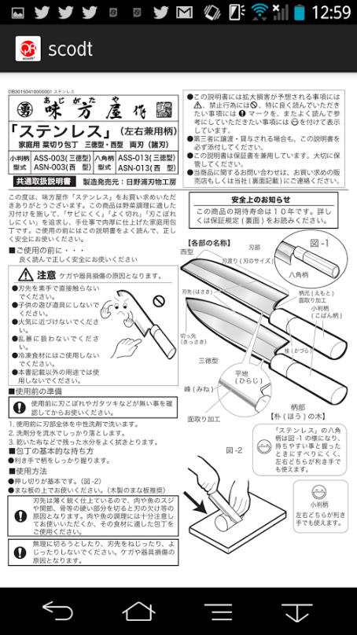
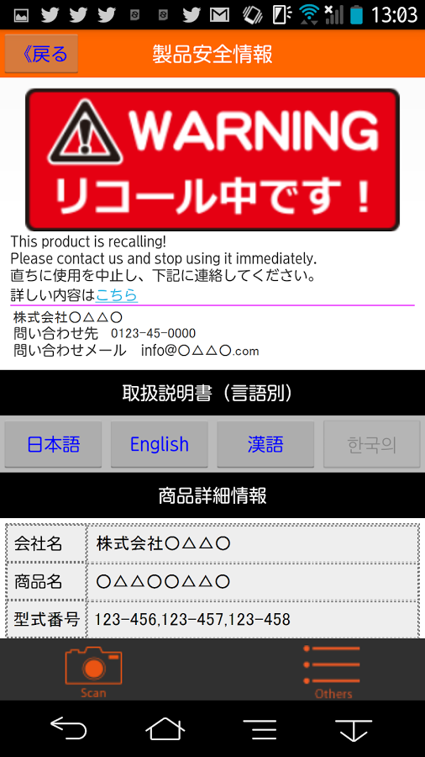
Sample

Slide 24
Extended Packaging AI approach
Platform Operator’s View on the “Decoded/Processed Data” approach
- Pros
-Standardized way of encoding data to all users on board
-Easier to extend the “landing page” data set
(lot number, etc – for example, (01), (10), (8200) )
- Cons
-Need to develop a specialized App. (time and resource)

Slide 25

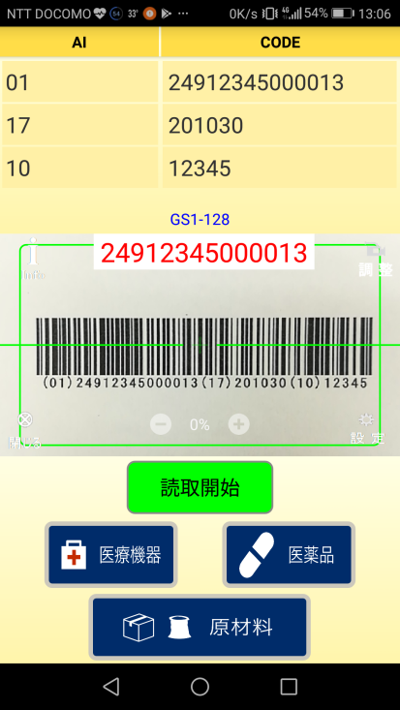
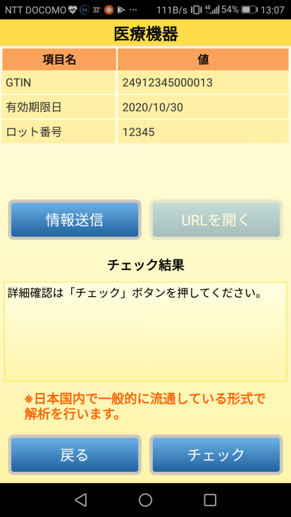
FYI: GS1 Japan Standard Barcode in Action
Decoder/syntax checker App(under development)
Enter
Read, check FNC1 and decode
Interpretation & Syntax check, etc.
FNC1 check
Capability to
send data in cvs,
URL access
Go to Syntax
check
(by product
Category*)
* Extended Packaging basic process function will be added late in FY 2018

Slide 26
Thank you!
Naoko Mori
General Manager, Solutions Service
GS1 Japan
Place Canada, 7-3-37, Akasaka
Minato-ku, Tokyo JAPAN
+81-3-5414-8501

Slide 27
Mobile Bridge for Retail
10 minutes
Robert Beideman and Scott Gray
11 OCT 1350 to 1400

Slide 28
Retail Perspective: If we do nothing
PAST
PRESENT
FUTURE
Marketing
Marketing
Supply Chain/ POS
Transparency?
Supply Chain/ POS
Other Need?
Supply Chain/ POS

Slide 29
Retail Perspective: First Step
PAST
PRESENT
FUTURE
Marketing
Marketing
Supply Chain/ POS
Transparency?
Supply Chain/ POS
Other Need?
Supply Chain/ POS
POS &
Supply Chain +
Marketing+
Transparency+
Future Need?
Supply Chain/ POS

Slide 30
Retail Perspective: Long Term
PAST
PRESENT
FUTURE
Marketing
Marketing
Supply Chain/ POS
Transparency?
Supply Chain/ POS
Other Need?
Supply Chain/ POS
POS &
Supply Chain +
Marketing+
Transparency+
Future Need?

Slide 31




Retail Perspective: How?
This can be made possible by accommodating all of this…
  Marketing URL and
  Transparency URL and
  and
  GTIN for Supply Chain/POS
  Other GS1 attributes
Into something
more like this:
  Which contains everything needed to support Supply Chain/POS, Transparency, Brand and Retailer marketing and regulations

Slide 32
Retail Perspective: How? (Technical version)
This can be made possible by accommodating all of this…
  http://www.company.com/random_words.html and
Consumer Product Variant
  http://www.transparencysolution.org/random_words.html and
Consumer Product Variant
0614141012336
  (01)061414101233(xx)a435D1br
Into something
more like this:
  http://www.company.com/gtin/0614141012336/CPV/a435D1br
Into something
more like this:
  http://www.company.com/gtin/0614141012336/var/a435D1br
  AND (01)0614141012336(xx)a435D1br

Slide 33


Mobile Digital Bridge (OGSM)
15 minutes
Pete Alvarez
11 October, 1400 to 1415

Slide 34
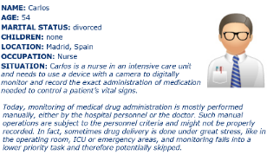

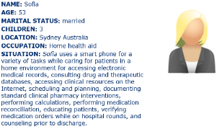

Focus on the end user (i.e. personas)
nurse
pharmacist
at home heath aid
at home patient

Slide 35








Digital disruption
What are they
looking for?
Who is providing
the data?

Slide 36
GS1 Healthcare Mobile Bridge project
The healthcare community has identified two areas where GS1 has an important role.
  A GS1 barcode to be scanned by a mobile device
  The device to be directed to the appropriate and correct source of product information
At the request of the user community, the first phase of the project is to rapidly develop a strategy and roadmap to address the points above.
Any subsequent standard and solution must allow for future development in other sectors.

Slide 37





Ecosystem vision
The digital information returned can vary (if required) between users. In this example the product code a device location information allows a patient to be given information on the product based on the pack and where they are physically located. The healthcare professional is supplied different information based on the pack and their profession (doctor).
Data Carrier
Product Code
Product Variant
Batch
Expiry
Serial Number
Other
Digital Bridge
Service
Digital Information
Device
Location
Time
Language
User persona
Other
Digital Information
Source: Grant Courtney, GSK

Slide 38
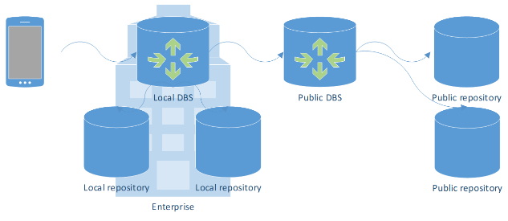
Possible architecture (illustration)
Scenario: A client connecting to a local Digital Bridge Service to retrieve local and public data
Source: Kevin Dean

Slide 39

Pete Alvarez
GS1 Global Office
Senior Director, Identification and Data Strategy, Healthcare
+1 609 557 4547
peter.alvarez@gs1.org

Slide 40
Belgilux initiative: variable measure items at POS
15 minutes
Karen Arkesteyn
11 OCT 1415 to 1430

Slide 41



Variable measure items at POS
GS1 Belgilux use of RCN in EAN-13
Packaged/labelled by supplier → national article number assigned by GS1
Packaged/labelled by retailer → internal number by retailer
GTIN (and other dynamic info) in GS1 data carrier by end of 2019
National/internal solution
No dynamic info
Exhaustible range
Administrative burden
“Administrative GTIN” in GDSN
Different solution per retailer
International solution
Use of GS1 company prefixes
Dynamic info
International data exchange
E-commerce
Notes:
We assumed GS1 DataBar would be the chosen carrier

Slide 42
Variable measure items at POS
Work Group with major retailers in Belgilux (Carrefour, Colruyt, Delhaize, Makro) and suppliers
Unanimous decision: GS1 DataMatrix as data carrier
Procedural, technical and financial feasibility
Overview of supply chain and involvement other stakeholders (e.g. food banks)
But…
GS1 DM not an approved GS1 symbology at POS in retail
Information | AI
GTIN-13 with leading zero | 01
Net weight | 310X
Price to be paid | 392X
Other (e.g. best before date, lot number)
and/or

Slide 43
Variable measure items at POS
Work Group with major retailers in Belgilux
August ‘17: launch of pilots with migration period
Phase of creating the barcodes on labels
Structural errors: use of Datamatrix instead of GS1 DataMatrix, encoding RCN after AI (01), wrong encoding of FNC1, encoding GTIN with indicator 9, no HRI with GTIN
Miscommunication between retailer, supplier and labeler/printer
Next meeting 28th of November for status update of pilots
Retailer: Carrefour
Suppliers: Viangro, Equinox, Westvlees, Vandenbogaerde
Migration: GS1 DM + EAN-13
Retailer: Makro
Supplier: Sopraco
Migration: GS1 DM
Retailer: Colruyt
Supplier: Lammens Poultry (tbc)
Migration: GS1 DM (+ GS1 DataBar)

Slide 44
Contact information
Karen Arkesteyn
HR & Training Manager, Project Manager Barcodes
Koningsstraat 76B1/Rue Royale 76B1
1000 Brussels
Belgium
D
+32 2 229 18 85
E
karkesteyn@gs1belu.org
www.gs1belu.org

Slide 45
RCN→GTIN Opportunity for 2D Adption
15 minutes
Scott Gray, Senior Director, Technology Strategy
11 Oct 1430 to 1445

Slide 46
So what happens when we have?
Retailers A, B, and C still using EAN/UPC with Restricted Circulation Numbers
Retailers X, Y, and Z using GS1 DataBar or GS1 2D with GTIN (perhaps with attributes) to realize the new benefits
And A, B, C’s scanners scan 2D before EAN/UPC and get a item not on file error?
What is X, Y, Z’s scanners scan EAN/UPC before 2D and get the same error?

Slide 47
Smart Retail PoS needed to support RCN migration best: Need for a “POS Flag”
Retail PoS systems need to be enabled to process a GS1 data carrier based on the GS1 key encoded (POS flag, which matches the GTIN plus attribute(s) flag to some extend)
  If the RCN is captured while the item is selected by the retailer for GS1 DataMatrix processing, the scanning environment needs to discard the RCN and look for the GS1 DataMatrix carrying the GTIN instead
This approach facilities the migration for suppliers, but is demanding PoS systems to select data to be processed based on access to master data
Notes:
You may mention chapter “4.15.1 Multiple barcode management practices for consumer trade items (all sectors)” here,
The term GTIN plus attribute(s) is described there but does not match the POS flag (I just named it like that, this is no « official term ») a 100% from my point of view (I could be wrong..!), because:
The chapter 4.15.1 is based on the fact the different data carriers addressed will carry the same number (GTIN),
which makes it much easier to process the right data carrier (and data) at the Retail PoS.
If you face a RCN in an EAN.UPC Symbol (with no connection to be made to the GTIN used without accessing master data)
and a GS1 DM with a GTIN, this may get a bit more complex – and I’m quite sure that the solution providers are even that aware about chapter 4.15.1 to begin with..
I’m not sure f the parties who had worked on this chapter are aware of that, but this is al least what major players like NCR or Datalogic told me..!

Slide 48
Conclusions
To resolve the Dilemma, GS1 Belgilux pilots play a vital part to learn about the influence on PoS performance when adopting the order of process GS1 data carriers at the PoS
  The results of the pilot are expected to be available soon
In general, the following conclusions are expected:
    Replacing the EAN-13 barcode with the GS1 DataMatrix is the safest approach for both the retailer and the consumer, but challenging for the supplier
    Adopting the order of processing at Retail PoS (GS1 DataBar – GS1 DataMatrix – EAN.UPC) is less disruptive to the whole supply chain, while the impact on performance has to be checked
    Use both EAN-13 (RCN) and GS1 DataMatrix (GTIN) at the same time asks for a smart Retail PoS, which is not available today, but should be targeted
Notes:
GS1 Belgilux pilots: Next meeting 28th of November for status update of pilots, point out to Karen (limited to her presentation or as a person)
Replacing the EAN-13 barcode with the GS1 DataMatrix
Challenge supplier: if this would be agreed, the supplier most likely would need to double his storage for a product which is “the same” for him.
One storage for the products with the RCN an EAN.UPC symbol
One storage for the products with the GTIN+ weight/price and optional data in the GS1 DataMatrix
And make sure never to deliver a GS1 DM Product X to a Retailer not capable to read it…!
Retailers wont’ care, some retailers will for sure ask for that – The Retailer will be able to have both concept activated at the PoS
If the product X comes with RCN and EAN.UPC (even if intended for GS1 DM)
processed, because this is concept is already implemented and will still work
If product X comes with GS1 DM carrying no EAN.UPC
processed, as there is only one GS1 data carrier on the product X, no issues
Adopting the order of processing at Retail PoS
Great approach if performance is not affected (..too much), would resolve the dilemma for sure, but we need more data to secure this (=> pilot results)
Use both EAN-13 (RCN) and GS1 DataMatrix (GTIN) at the same time
Some may ask (for example GS1 DE) “where’s the issue, we just have published a chapter on multiple barcodes” – does not apply, because it ‘s not the SAME identification number in this approach here, therefore the concepts multiple barcode won’t be applicable to their full extend (parts of it yes) – if you go for 100% secured process and not “oh let’s see, whatever the Retail PoS picks up first will be processed” (again, that’s what the supplier of PoS Scanners told me)

Slide 49
New PoS operative scanning environment?
1973 to 2010 – one operative scanning environment (general retail items with EAN/UPC)
2010 to present – new environment (regulated healthcare items distributed under control)
Could items marked with RCNs be next?
Can we state that use of GS1 DataBar/2D could be determined by each market as the migration stage is set by the Member Organization and industry in each country?
If retailers in a country agreed to move from RCN in EAN/UPC to GTIN+ in GS1 DataBar/2D, would there be an impact on other countries?
If not, why not? Isn’t this exactly the same thing we are doing in healthcare?
Before you form your opinion, listen to speakers Pete and Ray later in the session…

Slide 50
Scott “Nadi” Gray
Michel Ottiker
Senior Director, Technology Strategy
GS1 System Consultant
GS1 Switzerland GS1 Global
Monbijoustrasse 68 Princeton - Brussels
3007 Bern
+41 58 800 72 00 +1 609 439 3975
+41 58 800 72 32
scott.gray@gs1.org
m.ottiker@gs1.ch
www.gs1.ch
www.gs1.org
50

Slide 51
Retail Use Case for Consumer Product Variant
15 minutes
Robert Beideman
11 OCT 1445 to 1500

Slide 52
Healthcare Adoption of GTIN and GS1 2D
10 minutes
Pete Alvarez
11 October, 1500 to 1510

Slide 53
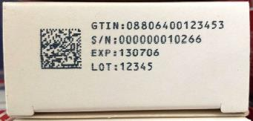
Data Elements on which regulatory bodies agree
Product Identifier (GTIN)
Serial Number
Expiry date
Lot/Batch number

Slide 54
The driver: Serialisation of pharmaceuticals
= country developing requirement or requiring serial number

Slide 55
GS1 DataMatrix on pharmaceuticals
country developing requirements or requiring DataMatrix and/or using DataMatrix in pilots

Slide 56








Requirements for medical device identification
Russia
Canada
EU
S.Korea
Japan
U.S.A.
Turkey
China
Qatar
Chinese Taipei
Saudi
Arabia
India
Brazil
Australia
Argentina
And more coming…
Notes:
Unique Device Identification continues to progress for the benefits of patients safety
Over 500,000 devices have been registered to the U.S. FDA Global UDI Database (GUDID) by 2016
More than 90% of products in the US FDA GUDID carry GS1 as UDI primary device identifier
GS1 was the first accredited UDI Issuing Agency of the US FDA and is now in the process of re-accreditation for the next 7 years.
GS1 is UDI Assigning Agency for the EU

Slide 57
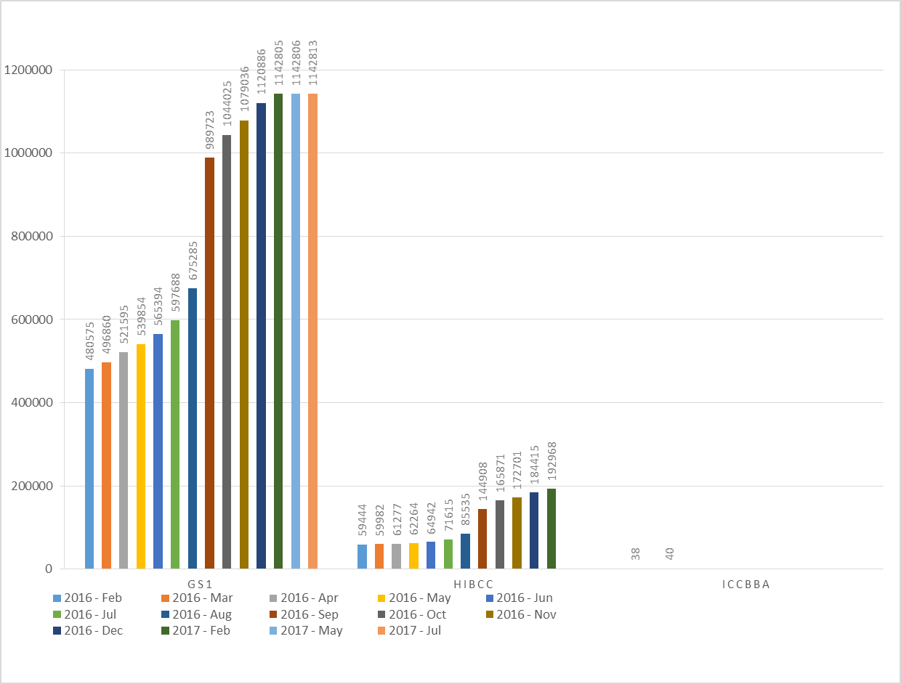
More than 85% of products in US FDA Global Unique Device Identifier Database (GUDID) carry GS1 as UDI primary Device Identifier
85%+

Slide 58
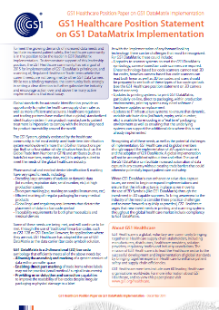
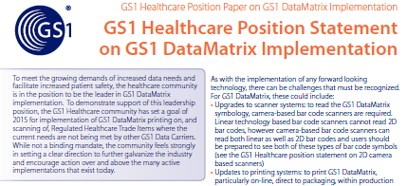

Position – GS1 DataMatrix adoption…
Preparing members, solutions providers and end users for the future thru global positions…
Get your copy at:
http://www.gs1.org/docs/healthcare/GS1_Data_Matrix_Position_Paper.pdf

Slide 59






GS1 DataMatrix & unique product ID…
GS1
DataMatrix
As we see more AIDC marking on small Pharmaceutical and Medical Device products (and/or on their packaging) we will see more GS1 DataMatrix due to its ability to efficiently and securely carry more data in smaller areas, and also due to its promotion for use by the GS1 Healthcare global members.
Becoming familiar with the available support materials is advised...
CHECK OUT: http://www.gs1.org/healthcare/library
http://www.gs1.org/docs/barcodes/GS1_DataMatrix_Introduction_and_technical_overview.pdf

Slide 60
Pete Alvarez
GS1 Global Office
Senior Director, Identification and Data Strategy, Healthcare
+1 609 557 4547
peter.alvarez@gs1.org

Slide 61
Old to New Barcode Migration Success Story
15 minutes
Ray Delnicki

Slide 62


U.S. Coupon History
1985: UPC-A
Steps:
Replace first digit of U.P.C. Company Prefix with “5”
Use balance of the 6 digit company prefix
Family Code; 3 digit number assigned by MFG
Cents off
Check Digit

Slide 63

U.S. Coupon History
1997: Coupon Extended Code – UPC-A & GS1-128
Steps:
UPC-A
Replace first digit of U.P.C. Company Prefix with “5”
Use next 5 digits of U.P.C. Company Prefix; discard any remaining
Family Code; 3 digit number assigned by MFG
Value Code
Check Digit
GS1-128
AI (8100)
First digit of U.P.C. Company Prefix
5 digit offer code assigned by MFG
AI (21) Serial Number; used as Household ID

Slide 64
Challenges
Unable to handle variable length Company Prefixes
Value code structure limited
Validation with a single Company Prefix and Family Code only
No systemic expiration date checking
Cashier intervention required to handle complex offers
Use of bypass code (992) inhibits appropriate offer validation

Slide 65
Coupon Re-engineering Committee- 2002
The Joint Industry Coupon Committee (JICC)
  Association of Coupon Professionals (ACP)
  Food Marketing Institute (FMI)
  Grocery Manufacturers of America (GMA)
  Retailers and suppliers
  GS1 US
Work continued 5 years
  Motivation was maintained because of the challenges mentioned on the previous slide

Slide 66

Coupon Re-engineering Committee- 2007
Published its work in 2007
  Interim code announced to begin 2007 (upon publication) until 2011
  Announced in 2011 remove U.P.C
  2015- U.P.C. Coupon Code removed from guideline and Gen Spec

Slide 67


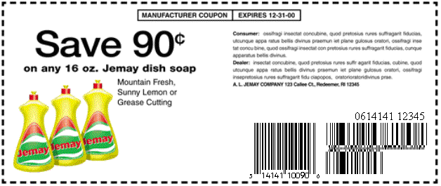

Transition
1985 UPC-A Coupon “5”
1997 Coupon Extended Code
(UPC-A plus GS1-128)
2007 INTERIM
UPC-A & GS1DataBar Expanded
2011 FINAL
GS1 DataBar Expanded Only

Slide 68









Coupon Implementation Timeline
GS1 US Coupon Code & GS1 DataBar Expanded Coupon Code (INTERIM)
2007
GS1 US Coupon Code
January 1985
Work Request to remove UPC Coupon Code from GS1 General Specifications 2014 complete retirement from US market July 1 2015
GS1 US Coupon Code & GS1-128 Extended Coupon Code
January 1997
GS1 DataBar Expanded Coupon Code (FINAL)
2011
  Total migration period- 12 years- 2002 – 2015
  Migration implementation period- 4 years- 2011- 2015
  Roughly 98% migrated (instore coupons, serving small retailers etc.)

Slide 69
Ray Delnicki
Global Standards Director
1009 Lenox Drive
Suite 202
Lawrenceville, New Jersey
08648
+1 609-620-4569
+1 609-658-0025
rdelnicki@gs1us.org

Slide 70
Retail Position on 2D Scanner Investment
20 minutes
Robert Beideman
11 OCT 1510 to 1530

Slide 71
2D Position Paper
Scope of the Recommendation
Limitation of Recommendation
Next Steps and Action

Slide 72
2D Position Paper - Background
Consumers are demanding access to more information online and on product labels.
In retail systems, including point-of-sale, fully addressing these consumer needs will require more granular identification in addition to the Global Trade Item Number (GTIN), such as batch or serial number.
To support more granular identification across all product categories, barcode scanners that exclusively read one-dimensional (1D) barcodes may not be adequate in many situations. Two-dimensional (2D) barcodes will be required and imaging-based barcode scanners will be required to scan them.

Slide 73
2D Position Paper - Background
As 2D barcodes begin to address the broad needs of manufacturers, retailers, consumers and regulators, there will be many years where 1D and 2D codes may coexist on products.
Since it will take years to replace retail POS equipment, the time is now to consider these trends when making near-term decisions that may limit future capabilities.
The need to increase consumer engagement and connection to extended information about products will drive the move to 2D barcodes because they can enable supply chain, POS, and applications on smart devices.

Slide 74
2D Position Paper - Recommendation
Retailers should consider investing in imaging-based scanning capability to be prepared for the future. 2D capable scanners will enable them to unlock the value and benefit of data-rich 2D barcodes and maximize opportunities to meet consumer and/or regulatory demands.
It should be noted that, as of today, only the latest imaging-based systems can claim to match the throughput levels of the implemented laser-based systems on 1D barcodes. Investment decisions should always be based on balanced considerations of throughput, cost and back-end systems capabilities.

Slide 75
2D Position Paper - Recommendation
In terms of barcode scanner system investment, GS1 recommends all parties who scan trade items at any level, anywhere:
  Consider introducing a minimum level of imaging-based scanner capability, for example by installing imaging-based hand-held scanners or hybrid slot capability at POS to take advantage of the speed of 1D and the additional functionality of 2D symbols.
  Enable processing of more granular identification/ information in addition to GTIN in all systems.
  Encourage solution providers to develop imaging-based, high-volume scanner systems that can scan both GS1 1D and 2D symbols with more granular identification/information at equal or higher throughput levels than current laser-based systems for 1D symbols.

Slide 76
Contact Information
Robert M Beideman
VP, Retail
GS1
1009 Lenox Drive, Suite 202
Lawrenceville, NY 08648 USA
+1 609 902 0859
robert.beideman@gs1.org

Slide 77
2D on Logistics Label
Dan Mullen

Slide 78
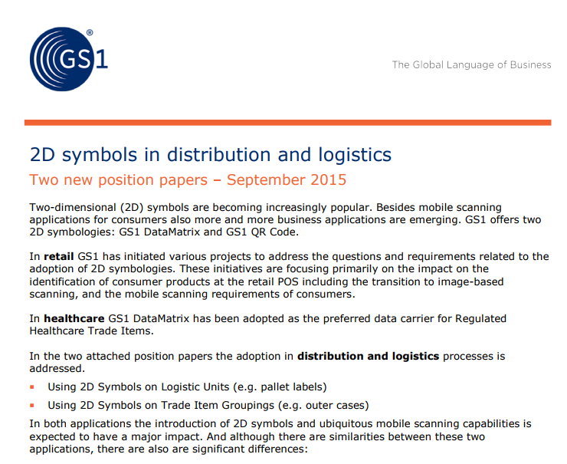
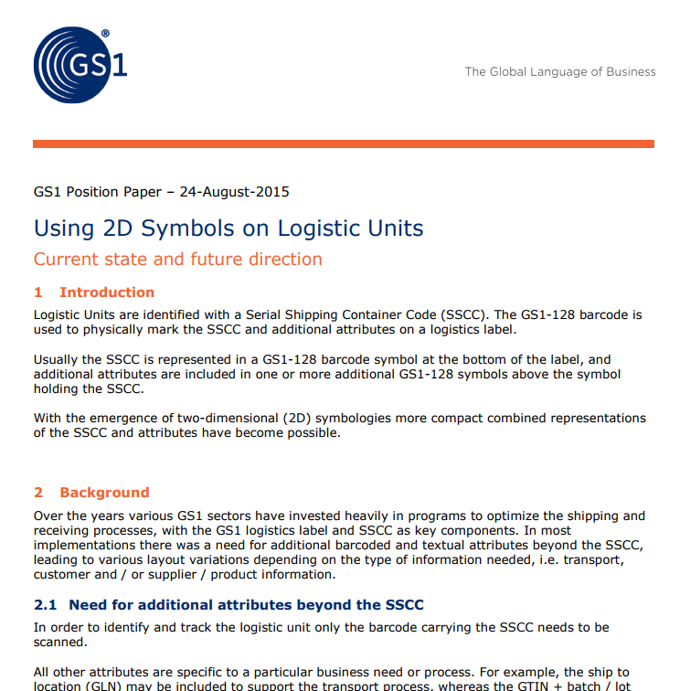
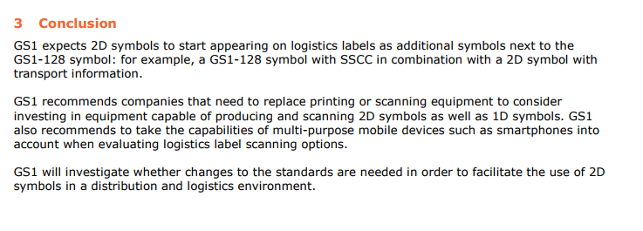
Background

Slide 79
Background
Recommending new or replacement equipment is capable of printing and reading both 1D and 2D barcode symbols
Logistic units may require SSCC plus information such as expiry date, batch/lot, or ship to location.
  Multiple GS1-128 barcodes are required to accommodate this information
  Typical label sizes can be “crowded” with barcode and HRI
  2D barcodes such as GS1-QR Code and GS1-DataMatrix
GS1 to investigate changes to the General Specification in order to facilitate

Slide 80
Why is there such keen interest?
2D barcodes are already being used in various ways in logistics.
Consider some examples of logistics labels with 2D symbols

Slide 81

GS1 Australia
(00)093123450000000012
(421)0362770
(401)931234518430GR
(403)MEL

Slide 82
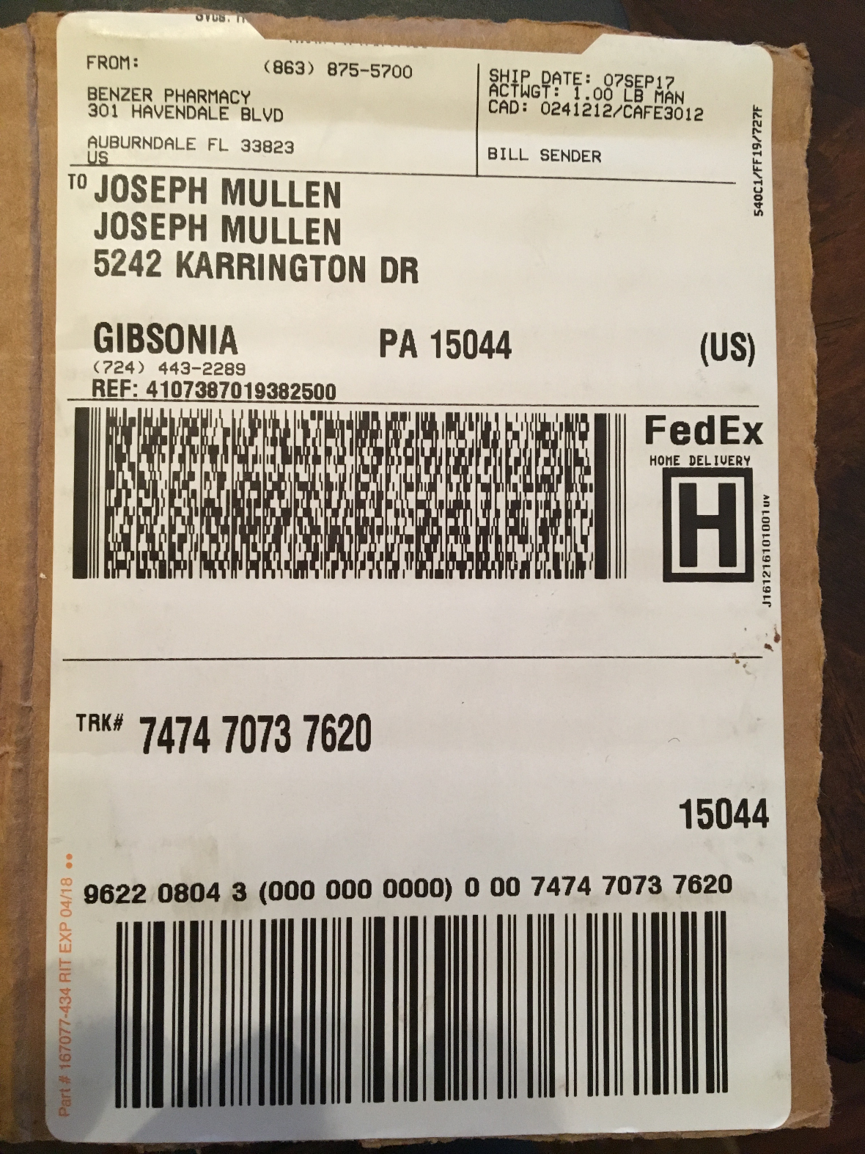
FedEx (parcel)
[)>010215044840804747470737620FDEG63921972501/11.00LBN5242 KARRINGTON DR GIBSONIA PAJOSEPH MULLEN 0610ZGH00711ZJOSEPH MULLEN 12Z724443228920Z031Z96220804300063921979007474707376209K4107387019382500

Slide 83
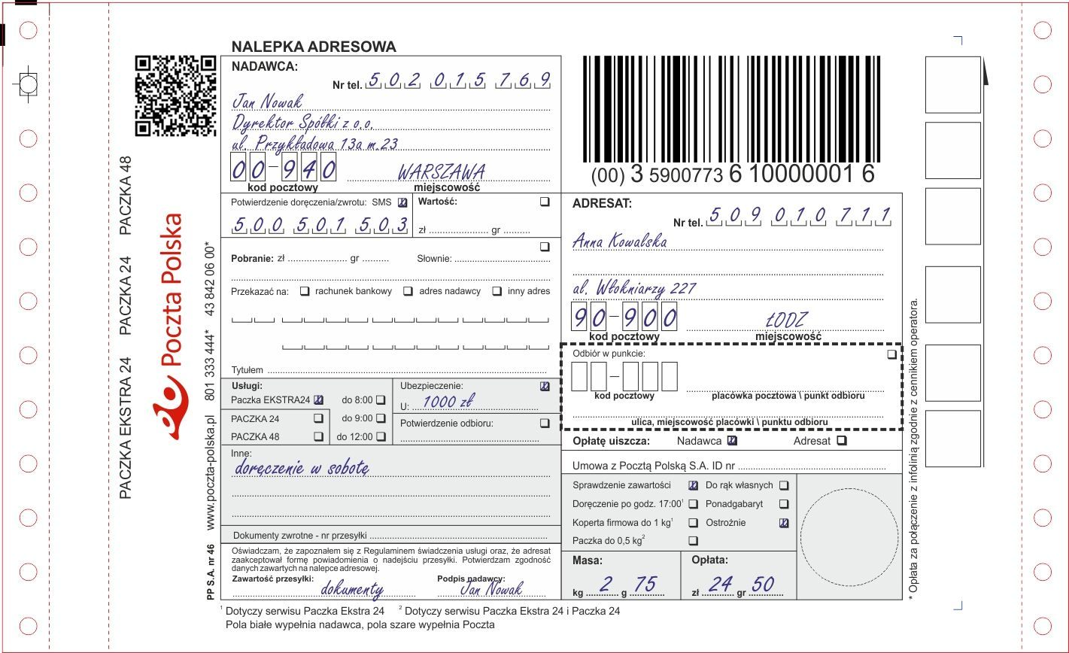
Poczta Polska (Postal)
http://sledzenie.poczta-polska.pl/?numer=00359007736100000016

Slide 84
Work has begun to consider how 2D for logistics labels could be introduced to the General Specification
Sub team met 25 September 2017
  General agreement that 2D option would be valuable option for logistics labels
  Agreement that one linear code with SSCC would be needed
  Agreement that 2D barcode would repeat SSCC and offer opportunity to encode additional AIs
  General direction for first work request would only consider existing AIs, not discussing new data at this point
  HRI will be needed – SSCC at least once, discussing what other information should be available as HRI

Slide 85
Next Steps
Draft update to General Specification
Review by sub team in mid October
Draft update to GS1 Logistics Label Guideline
Review in November
Submit work to GSMP (ID SMG) – end of November

Slide 86
Afternoon Coffee Break
1530 to 1600 CET

Slide 87
Consumer Product Variant

Slide 88
Consumer Product Variant
Goal: Increasing transparency between trading partners through the accurate sharing of data about product variations that do not require a new GTIN.
Develop a standard means of sharing information about product variations to replace existing “non-standard” data exchange that is occurring today
Definition: A variation of a trade item which does not require a new GTIN per the GTIN Management Standard, but where communication related to the change may be required.
Notes:
These practices are occurring today. Brand owners are making slight variations to products- a new GTIN is not required – and they are communicating in a non-standard, “out of band” manner to their partners. It’s all very trading partner specific - creating cost.

Slide 89
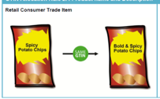
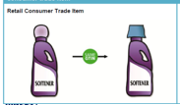
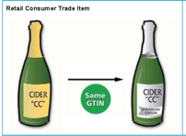

Making smaller changes transparent ….to all
Notes:
We formed a discussion group, and we met in Brussels where we spent a full day examining use cases, product variation types and discussed some general requirements with respect to Consumer Product Variant.
The focus of our discussions was specifically on unique identification of variations or versions where it was important to be transparent about the changes…but where a new GTIN was NOT required.
We concluded that CPV needed to be a defined identifier and there were certain pieces of information that would assist in data consumer’s workflow to manage these changes.
From there- we socialized the findings with a number of stakeholders that were unable to attend. In those discussions…as well as in the face to face meeting…we learned….
NEXT SLIDE
Products with smaller changes that may not require a “new” GTIN, need to be distinguished in some manner, in order to be able to make the information available to trading partners and consumers, especially online.
eCommerce/Digital introduces new challenges to presentation of products and product variations to the consumer.
Disclosure of these variations is especially important in a digital commerce world, for full transparency to be realized.
Fully transparent product information, at a “version” level is increasingly becoming an important component to consumer satisfaction.

Slide 90
Who supported this work?
1WorldSync Holdings, Inc. | GS1 Germany
Aeon | GS1 Hungary
Ahold (USA) | GS1 Italy
Alcon Labs | GS1 Japan
Alibaba | GS1 Netherlands
Bar Code Graphics, Inc. | GS1 Poland
Bayer Pharma AG | GS1 Portugal
Beijing REN JU ZHI HUI Technology Co. Ltd. | GS1 Spain
Bonduelle | GS1 Sweden
Carrefour | GS1 Switzerland
Coca-Cola Company (The) | GS1 UK
Coles | GS1 US
Colgate-Pamolive | Johnson & Johnson
Detailresult | Mars, Inc.
eBay Inc | Nestle
Ecolab | PepsiCo, Inc.
Google Switzerland GmbH | Procter & Gamble Co.
GS1 Australia | REWE Group
GS1 Austria | Target Corporation
GS1 Belgium & Luxembourg | Tesco Stores Ltd.
GS1 Brasil | The Consumer Goods Forum
GS1 Canada | The J.M. Smucker Company
GS1 China | Unilever UK
GS1 Chinese Taipei (formally known as GS1 Taiwan) | USDM
GS1 Colombia | Wakefern Food Corporation
GS1 Finland | Walmart/Sam's Club
GS1 France | Wegmans Food Markets

Slide 91

Unique ID Project: Industry Glidepath
Follow the New Rules
Technical Standards changed to GTIN Reuse at end of 2018
GDSN Data Exchange at Variant Level
Enable CPV marking on Case and Consumer Package
Communicate Consumer Product Variant Data CPV – Associated Data defined in Gen Spec/GDD
This is the work that has been completed.
Getting Identification and Data Right
Work has been initiated
2012
2016
2017
2018
?
?

Slide 92

Consumer Product Variant in GDSN
Industry Call to Action has been met with enthusiasm.
Incorporation of Consumer Product Variant in GDSN is high-priority of the Data Excellence Board.
Final ‘enabler’ to transparency of product versions and sets the stage for the future.

Slide 93
Contact Information
Robert M Beideman
VP, Retail
GS1
1009 Lenox Drive, Suite 202
Lawrenceville, NY 08648 USA
+1 609 902 0859
robert.beideman@gs1.org

Slide 94
GTIN Capacity Study: Phase 2
What’s Next?
Andrew Hearn; Senior Director, AIDC
October 2017

Slide 95
Agenda – GTIN capacity
Where it all started
GTIN Capacity Phase 1
  Understanding supply
GTIN Capacity Phase 2
  Monitor
  Evaluate
  Educate & Update
  Estimate

Slide 96
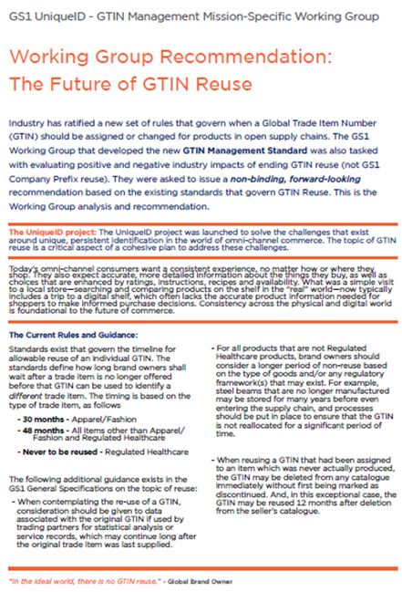
GTIN Capacity Study: Where it all started
GS1 UniqueID - GTIN Management Recommendation: The Future of GTIN Reuse
  Highlighted the need to understand GS1’s GTIN Capacity
GS1 understands that the current capacity is only part
of the picture, we need a plan for the future

Slide 97
GTIN Capacity Study Phase 1: Executive summary
51 MOs representing 86% of the world’s GDP responded to survey.
GS1 System is nowhere close to exhausting capacity after 40+ years.
  13% of GTIN capacity used (including GS1 Prefixes reserved by GO).
GS1 MO growth rates have remained steady:
  Historical average growth rate: 7% - 9%.
  Projected average growth rate: 6% - 7%.
Assuming an aggressive, future growth rate of 12%:
  At least 33 years before there is any issue with GTIN capacity.

Slide 98
GTIN Capacity Study Phase 2
To ensure that we are actively managing any potential future risk, GS1 is working to actively monitor and predict the future demand for GTINs. This work includes:
Monitor: Establish capacity monitoring / reporting for GTIN.
Evaluate: Potential options to expand GTIN Capacity, including impact.
Educate & Update: GS1’s current policies / procedures on GCP assignment.
Estimate: A framework to ‘predict’ the future demand for GTINs.

Slide 99
GTIN Capacity Study Phase 2: Monitor
Create capacity monitoring / reporting for Global Company Prefixes (GCPs).
Establish a schedule (e.g., Quarterly) where trend analysis is conducted to look for anomalies and understand GS1’s overall position.
  Take regular ‘snapshots’ of the data.
  Create an ongoing ‘status’ report that can show:
    High level trends.
    MO specific analysis of GCP capacity utilization.

Slide 100
GTIN Capacity Study Phase 2: Evaluate
Research options to expand GTIN Capacity, including their impact:
    Internal GO team to start to list possible alternatives.
    Expand the team to discuss implications to existing systems: Users, MOs, data carriers, software, standards, etc.
    Create an alternatives list with potential impacts. These impacts include potential changes to: labelling, database structures, methods of data exchange, etc.

Slide 101
GTIN Capacity Study Phase 2: Educate & Update
Assess the current policies & procedures, such as:
  Review GS1 Policy for clarity & impact on capacity.
  Work with MOs with high GCP utilisation to understand the situation – what factors led to this situation and how to change it.
Recommend Best Practices and training options.

Slide 102
GTIN Capacity Study Phase 2: Estimate
Develop a framework to estimate the future demand for GTINs, such as:
  Investigate possible new markets and their GTIN capacity requirements.
  Identify global megatrends that could impact the rate of key issuance and quantify potential capacity impacts of each, such as:
    mass personalisation
    device identification
    In-app purchases
    the cessation of use of Restricted Circulation Numbers (RCNs)

Slide 103
Contact Information
Andrew Hearn
Senior Director, AIDC Team
1009 Lenox Drive
Suite 202
Lawrenceville, NJ 08648
+01 609 557 4586
+01 609 658 0367
+01 609 658 0367
Andrew.Hearn@GS1.org
www.gs1.org

Slide 104
AIDC Technical Team
October 2017
Andrew Hearn, Senior Director, AIDC Team

Slide 105
AIDC Technical Team: What is it
It is a vibrant community of AIDC technical experts who:
  share their experiences.
  rely on each other to help solve technical issues of their members.
  grow a network of expertise that will raise the skill of all involved.
  share new AIDC initiatives, best practices no matter where they are happening.
It is the place where GS1 AIDC technical topics are discussed and the MO – AIDC community can circulate questions, foster discussions and be updated on the latest initiatives from around the world.

Slide 106
AIDC Technical Team: The Numbers!
Kicked off in March!
1 Dedicated Community Room
1 Chair: Michel Ottiker, GS1 Switzerland
1 piece of Barcode Verification Services marketing collateral created
2 Industry speakers: Glenn Spitz, Cognex; Rick Fox, FOX IV Technologies
2 Industry White Papers shared
2 sets of AIDC Test Lab results reviewed
5 Work Requests consulted on
35+ MOs involved in Barcode Conformance Testing Program
41+ MO members on the roster
Numerous questions answered by peers becoming official FAQs
  * Sharing the knowledge to make everyone better

Slide 107
Contact Information
Andrew Hearn
Senior Director, AIDC Team
1009 Lenox Drive
Suite 202
Lawrenceville, NJ 08648
+01 609 557 4586
+01 609 658 0367
+01 609 658 0367
Andrew.Hearn@GS1.org
www.gs1.org

Slide 108
DotCode Update

Slide 109


DotCode Specification
DotCode is a public domain 2D barcode designed to be reliably readable when printed with high-speed inkjet or laser dot technologies. Real time, serialized data can be encoded on products in a machine-readable form at production speeds.
DotCode v2 published in July 2012
  Specification originated at AIM Global and their Technical Symbology Committee (TSC)
Interesting GS1 fact about DotCode symbology:
    “Opening data of at least two digits and with no FNC1 in the 1st or 2nd positions identifies a carrier for GS1-formatted data”
The specification is currently being revised to identify and mitigate hard to decode symbol patterns as the dot patterns are created.

Slide 110






DotCode Fun!
The specification is currently being revised to identify and mitigate hard to decode symbol patterns as the dot patterns are created.
Four possible patterns or “masks” are considered (not printed) and the best one is selected for printing. How? Which one is the best symbol?
Mask = 0
Mask = 1
ò
ò
Score: 398
Score: 421
Mask = 2
Mask = 3
ò
ò
Score: 388
Score: 416

Slide 111




DotCode Specification Update
Latest reviews focus on the encodation “masking” schemes to detect and minimize dot patterns that may be harder to read. (Annex A)
The latest specification completed a second public review in September with GS1 providing comments.
Some systemic issues have been found with certain strings of data using the new “masking” technique(example):
*NOTE: Yellow shading is used to show the barcode rectangle
TSC has discussed several ways to address this issue, but some testing will be needed

Slide 112
Summary the future
All products
All scanners capable of scanning 2D at EAN/UPC throughput
All symbols
All applications – all syntax
All together

Slide 113
Session Close
Please give us feedback on the session!

