Slide 1
GS1 Standards Event
20 – 24 March 2017 – Jersey City, NJ USA
Building standards to deliver business value
Session: MO to MO Sharing
Mark Holmes & Greg Rowe, GS1 Global Office
23 March 2017

Slide 2
Anti-trust caution
GS1 operates under the GS1 anti-trust caution. Strict compliance with anti-trust laws is and always has been the policy of GS1.
The best way to avoid problems is to remember that the purpose of the group is to enhance the ability of all industry members to compete more efficiently.
This means:
  There shall be no discussion of prices, allocation of customers, or products, boycotts, refusals to deal, or market share.
  If any participant believes the group is drifting toward impermissible discussion, the topic shall be tabled until the opinion of counsel can be obtained.
The full anti-trust caution is available via the link below, if you would like to read it in its entirety: http://www.gs1.org/gs1-anti-trust-caution.

Slide 3
Statement & reminder for seeking intellectual property information
Relevant to the features of the specification that are being developed in this work group, if anyone has knowledge or information about intellectual property rights, such as, patents or patent applications; please promptly convey this information to the work group facilitator.
The intellectual property rights can either be in development or owned by persons, companies or third parties within this work group or outside this work group.
We do this under the guidance of the GS1 Intellectual Property Policy, so that GS1 can seek to avoid the uncertainty regarding intellectual property claims against the Specification.

Slide 4
Agenda
13:30–13:40 Welcome & Standards Journey update Mark Holmes
GS1 GO
13:40–14:00 GS1 UK’s approach to GTIN Management Paul Reid
deployment GS1 UK
14:00–14:20 GS1 Brasil engagement with small to Luiz Costa
medium companies GS1 Brasil
14:20-14:30 Measuring standards deployment Eileen Harpell

Slide 5
Welcome and Standards Journey update
Mark Holmes
GS1, VP of Standards Development

Slide 6
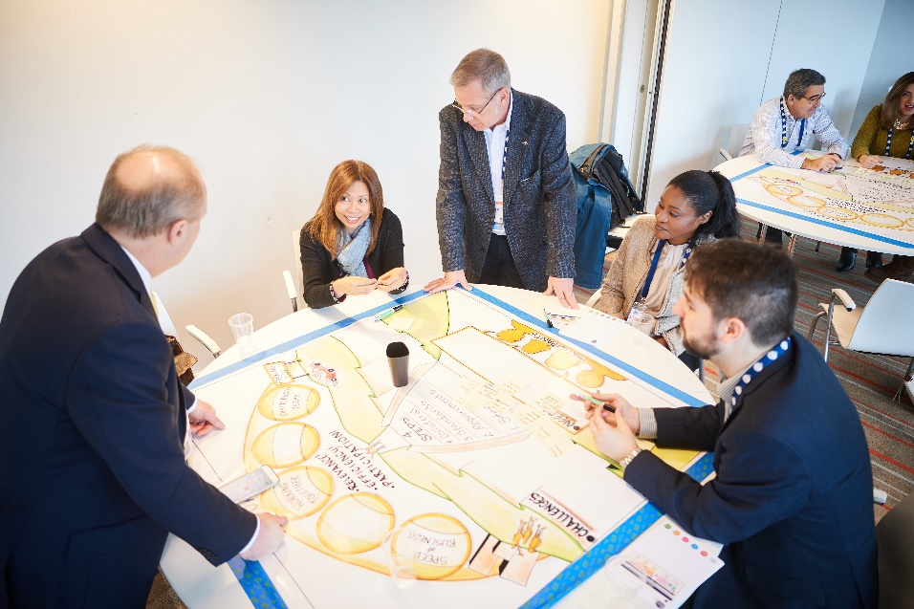


GS1 Forum – Standards Journey continues

Slide 7
Standards Journey – Worldwide input
2017 - 26 countries represented
2017 - 15 new countries
2016 - 21 countries represented
Total of 36 countries providing input

Slide 8
Standards Journey feedback from 2017 Global Forum
  Actions
  a) GSMP implemented new facilitation
  techniques and F2F meetings;
  will continue to improve
  b) Request participation of right skill
  set at right time
  c) New Xchange program coming;
  work with GS1 Marketing
  d) Current GSMP value statement;
  need to review and update
  e) Standards Development Certification
  Programme
  f-g) Excellent points; needs to be
  addressed
Challenges / Needs
a) Complicated process which
takes a long time / make the
pace of changes faster
b) Time constraints to get involved
c) Promotion of GS1 Standards/
brand awareness
d) Simplify communication to attract
more adoption
e) Lack of training / increase
knowledge of GSMP
f) Low demand of GSMP in small
Member Organisations
g) Flexibility of adoption

Slide 9
GS1 UK’s approach to GTIN Management deployment
Paul Reid
Head of Standards & Consulting, GS1 UK

Slide 10
GTIN Management Standard
GS1 UK Deployment Approach
Paul Reid
Head of Standards & Consulting, GS1 UK
March 2017

Slide 11

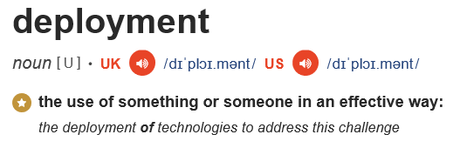
Deployment – what is it?

Slide 12
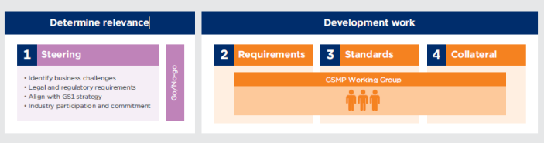

Deployment – in the context of GS1
MO
Member
Deployment?

Slide 13
Deployment
Good
Updates to GS1 GO & MO websites
Low level marketing to members
Update training materials

Slide 14
Deployment
Better
GTIN Management approach
Good

Slide 15
Deployment
Best
Better
?
Good

Slide 16
Deployment
Better
GTIN Management approach
Good

Slide 17
GS1 UK approach for GTIN Management
The usual:
Updates to GS1 GO & MO websites
Low level marketing to members
Update training materials
In addition:
Relentless communication within GS1 UK
Targeted marketing to ‘strategic members’
Updates to GS1 UK Boards
Presentation at GS1 UK Annual General Meeting with Unilever
GTIN Management Survey
Plus…
Notes:
This was the old allocation rule for product description, no GTIN change
But not good examples, these are more tweaks to adjectives relating to the product, rather than changes to the description of the product itself
…but it might explain why we are still getting queries through on this subject

Slide 18

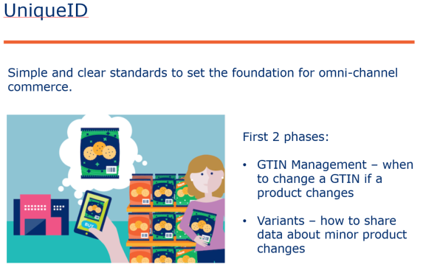

Bringing the GTIN Management to life
GS1 UK Annual General Meeting
Notes:
This was the old allocation rule for product description, no GTIN change
But not good examples, these are more tweaks to adjectives relating to the product, rather than changes to the description of the product itself
…but it might explain why we are still getting queries through on this subject

Slide 19
Bringing the GTIN Management to life
Notes:
This was the old allocation rule for product description, no GTIN change
But not good examples, these are more tweaks to adjectives relating to the product, rather than changes to the description of the product itself
…but it might explain why we are still getting queries through on this subject

Slide 20
Deployment
Best
Better
?
Good

Slide 21
Deployment – in the context of GS1
MO
Member
Deployment?

Slide 22
Deployment – in the context of GS1
GTIN
Management
Deployment?
MO
Member

Slide 23
Deployment – in the context of GS1
MO
Member
Start early!

Slide 24
Deployment – in the context of GS1
MO
Member
Start early!
Define what we mean by ‘deployment’
Agree the roles of GS1 (GO & MO) and Industry in deployment
Get commitment from Industry to play their part in deployment, not just GSMP
Set relevant deployment KPIs

Slide 25

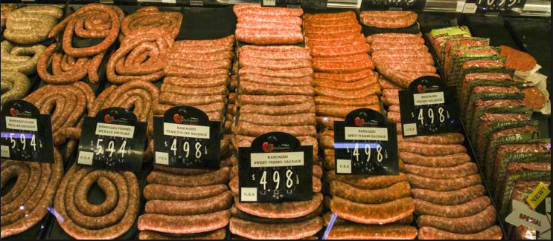

GSMP and Sausages
Key Message
Key Message
?
Who is eating our sausages and are they any good?
GSMP
GS1 local websites
Who is eating our sausages and are they any good?
GSMP
GS1 local websites
The Opportunity
The Opportunity
GSMP stops here!
Current KPIs feel like:
How many sausages have we made?
How quickly did we make them?
But:
What do our sausages taste like?
Who’s eating them?
How do we know we’ve made good sausages? ….etc. etc.
GSMP stops here!
Current KPIs feel like:
How many sausages have we made?
How quickly did we make them?
But:
What do our sausages taste like?
Who’s eating them?
How do we know we’ve made good sausages? ….etc. etc.
S
T
O
P
!
S
T
O
P
!
Solutions?
Solutions?
Set good success criteria e.g. adoption metrics
Ensure we gain commitment to deploy (users/MOs)
Improve communications through the process
Produce better collateral to help MOs deliver a consistent message across our members e.g. templates, best practice tips
Ensure content is both tech/non tech and for large and small users
Set good success criteria e.g. adoption metrics
Ensure we gain commitment to deploy (users/MOs)
Improve communications through the process
Produce better collateral to help MOs deliver a consistent message across our members e.g. templates, best practice tips
Ensure content is both tech/non tech and for large and small users

Slide 26
GS1 Brasil
Luiz Renato Martins Costa
GS1 Brasil - Associação Brasileira de Automação

Slide 27
SME´s GS1 Brazil
Luiz Costa, Training and Education
March, 2017

Slide 28
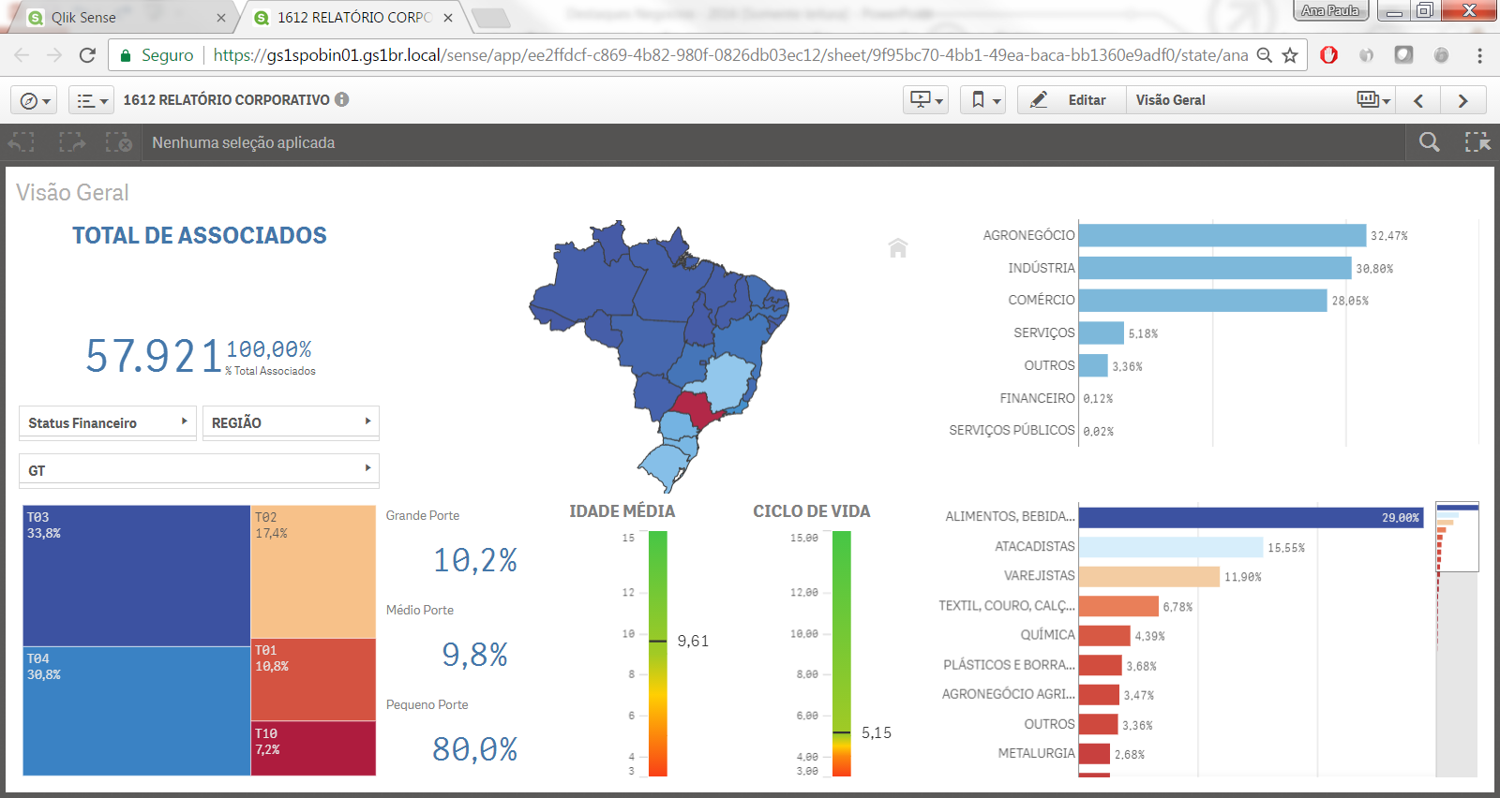
GS1 Brazil – Member Profile until Dec/2016
Members
57,921
Notes:
Brazil, is a country with continental dimensions. Divided into 5 regions.
Within these regions, GS1 Brazil currently has approximately 58 thousand GS1 members.

Slide 29

















Overview – GS1 Brasil Industry Engagement Team
)
Footwear & Technical Industry (Defesa, IoT)
Industry Engagement Manager
Footwear & E-commerce
SME e Apparel
E-commerce
& Healthcare
Fresh Food
Food Services & Influencers
29
Notes:
To meet this size, GS1 Brazil's industry engagement team is divided by business executives for each industry sector

Slide 30
Overview – GS1 Brasil Industry Engagement Team
)
Footwaer & Technical Industry (Defesa, IoT)
Industry Engagement Manager
Footwear & E-commerce
SME e Apparel
E-commerce
& Healthcare
Fresh Food
Food Services & Influencers
30
Notes:
As the focus of this presentation is to show the initiatives to disseminate GS1 standards in Brazil for SMEs. We have an exclusive business executive for this sector, Claudilena Murro

Slide 31
GS1 Brazil – Member Profile until Dec/2016
Members
GS1 Brazil
57,921
Notes:
Looking at the range of almost 58,000 associates (reference of December / 16), 80% of our members are SME (Approximately 46 thousand members), located mostly of them, In the south and southeast regions of Brazil.
GS1 Brazil office is located in São Paulo, in the center of this main region.

Slide 32
Economic scenario in Brazil
Uncertainties and lack of clarity about the direction of the economy.
Hope for a better year.
Notes:
Brazil is in a moment of recovery of its economy, which has been weakened in the last years due to a series of economic and political factors, so this directly affects the SMEs

Slide 33
GS1 Brazil Actions for SMEs
Notes:
Thinking about the quality of services for our associates and the Brazilian Economic scenario, now we will see the actions that GS1 Brazil promotes with SMEs to minimize the impact of this factor to our members.

Slide 34


Actions for SMEs
“GS1 BRASIL HAS THE RESPONSIBILITY OF HELPING SMES COMPANIES TO SURVIVE IN THE MIDST OF SO MANY ADVICES FOUND IN THE BRAZILIAN MARKET*
Notes:
“GS1 BRASIL HAS THE RESPONSIBILITY OF HELPING SMES COMPANIES TO SURVIVE IN THE MIDST OF SO MANY ADVICES FOUND IN THE BRAZILIAN MARKET*
To minimize the number of companies closing due to the Brazilian economic instability, we will now show how GS1 helps our members.

Slide 35

Working with SME
RELATIONSHIP
TECHNOLOGY
CAPACITATION
BUSINESS
Notes:
SME Sector in GS1 Brazil has 4 pillars:
- Relationship
- technology
- capacitation
- Business

Slide 36
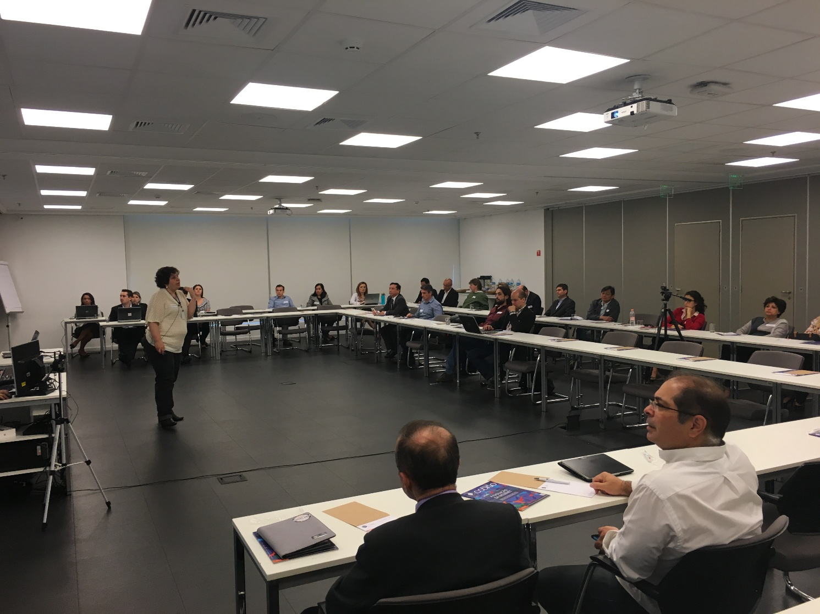
Actions for SMEs RELATIONSHIP
MEETINGS TO DISCUSS GOOD PRACTICES AND EXPERIENCES
EXCHANGE
Notes:
When we speak of "relationship"
We have a bimonthly committee open to SMEs which are received within the GS1, to listen to their needs and doubts regarding the standards and correct application of them.
This practice instructs SMEs to stay on the market and sell their products to the big retailers in Brazil.

Slide 37

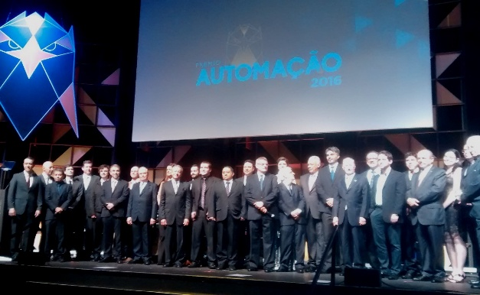

2016 AUTOMATION AWARD
Actions for SMEs RELATIONSHIP
Notes:
Also when talking about "relationship", GS1 Brazil has in its biggest event, the "automation award", known as the "oscar of Brazilian automation", a specific category for companies that want to register their GS1 application cases inside Of their small and medium enterprises.
This award serves as recognition and incentive to SMEs to apply the gs1 standards.

Slide 38
Actions for SMEs RELATIONSHIP
Notes:
Here we will see the video, unfortunately in Portuguese, of the winner of the award in 2016.
The company called "panks" that sells masses of pancakes and joined GS1 in order to be able to sell to the big retailers of são paulo and all Brazil, significantly increasing its sales after joining gs1.

Slide 39
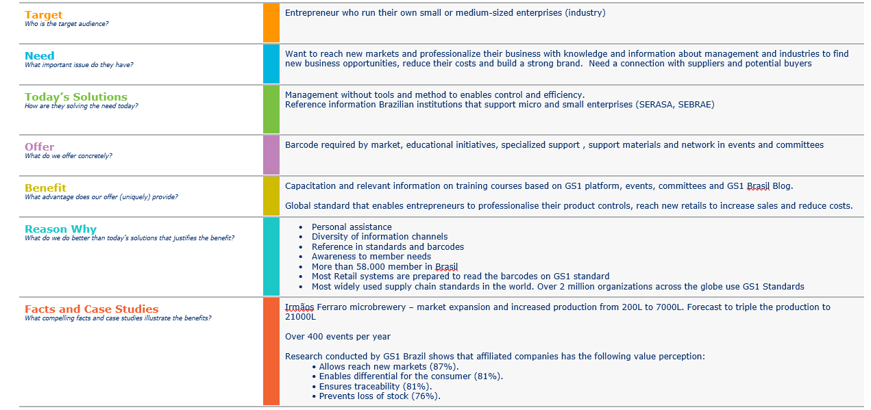
SME´s Value proposition
Actions for SMEs RELATIONSHIP
Notes:
Following the principles of GS1 Global Office and its processes, we received training at the end of last year of value proposition, and it was replicated to evaluate our associates.
So that we could raise the amount of companies that can be applied into micro and small companies in the Brazilian market.

Slide 40
Insights from Value Proposition´s exercise
Actions for SMEs RELATIONSHIP
What we have learned?
Represent 80% of our members
Seek more control and organization
Search for basic management information
Need someone they can count on
Want to professionalize and expand their business
Dream of having a well-known brand
Notes:
What we have learned?
Represent 80% of our members - Approximately 46,300 SMP members
Seek more control and organization
Search for basic management information
Need someone they can count on
Want to professionalize and expand their business
Dream of having a well-known brand
Due to the large number of members, this is the importance of always listening to the industry through our committees, their needs

Slide 41



Actions for SMEs TRAINING & EXPERIENCE
BLOG
SEARCH
TRAINING
Notes:
Actions involving training and capacity building
We have an annual calendar of training sessions, which instruct the associated partners to use GTINs correctly, as well as the correct measurement and data quality of their products.
All GS1 training is already updated according to the new GTIN management rules.
Gs1 also has a national system of product registration, the CNP. A platform to which SMEs can create and manage their GTINs and data records through this platform.
Other actions such as blog and publicity materials are also offered for free to our members.

Slide 42
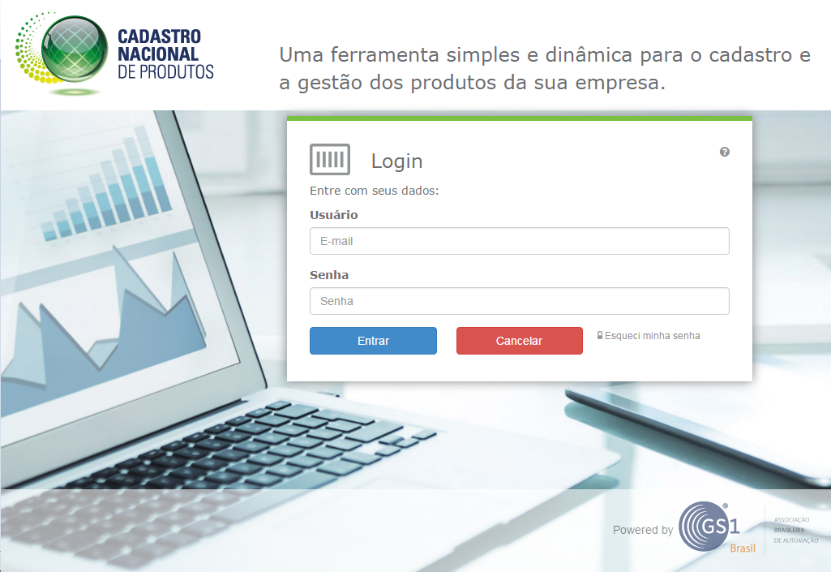
Cadastro Nacional de Produtos 2.0
Notes:
O CNP 2.0, a partir dos próximos meses, começará a ter como campos obrigatórios “Pesos e Medidas”. De forma a antecipar possíveis dúvidas dos associados, iremos fornecer esse treinamento de pesos e medidas.
https://cnp.gs1br.org/

Slide 43

















Actions for SMEs TRAINING & EXPERIENCE
Notes:
Training in universities: GS1 Brazil has a strong presence within the largest Brazilian universities, to instruct future businessmen about the correct performance and use of the GS1 system.
GS1 Brazil also invests in the training of future entrepreneurs, last year was made 22 actions in different educational institutions (college, technical courses and universities).

Slide 44
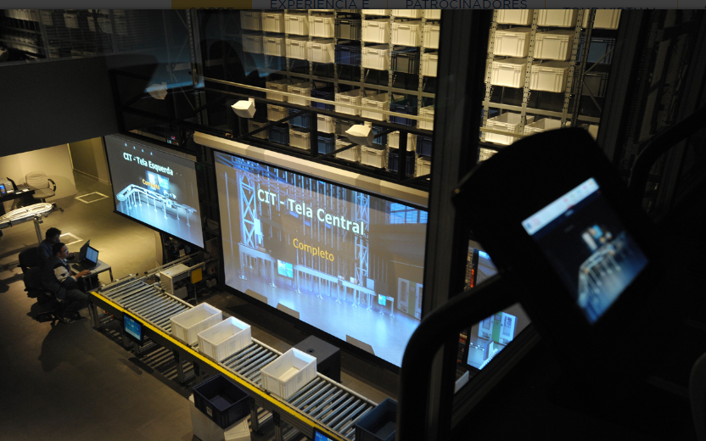

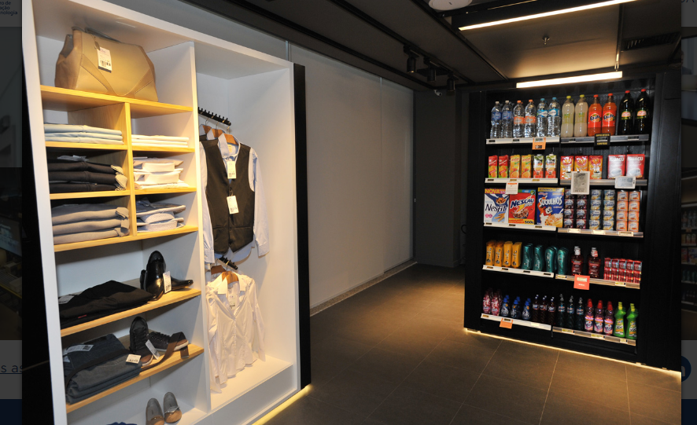
Actions for SMEs TRAINING & EXPERIENCE
Notes:
GS1 Brazil also has a center for innovation and technology, CIT, which members can see in practice as our standards are applied in practice, adding value to their specific applications.
Visits are free and open to any community in Brazil, including non-members.

Slide 45
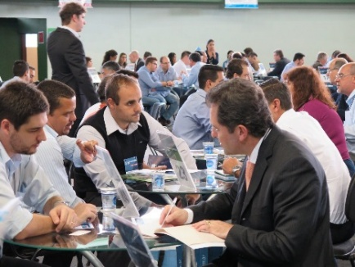
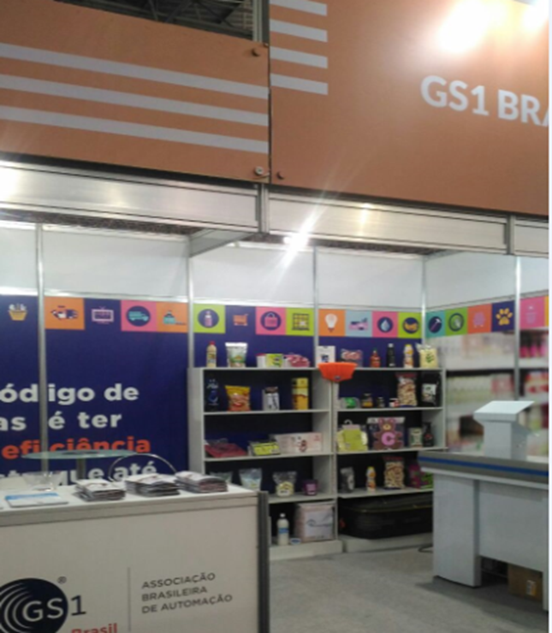
Actions for SMEs SUPORT FOR BUSINESS
BUSINESS ROUNDTABLE
FAIR
Notes:
With regard to business support, we also promote monthly business roundtables and also strong presence in fairs and congresses and also Brazilian local support agencies for SMEs

Slide 46

Actions for SMEs SUPORT TO BUSINESS
ENTREPRENEUR'S FAIR SEBRAE SP 2017
4 Days
+140.000 VISITORS
BUSINESS EXPECTATIONS OVER usd$5,5 Mi
1.749 VISITORS ON GS1 STAND
Notes:
Sebrae is a non-profit private entity with the mission of promoting the sustainable and competitive development of small businesses.
This year, the entrepreneurs fair had the following data:
4 Days
+140.000 VISITORS
BUSINESS EXPECTATIONS OVER usd$5,5 Mi
1.749 VISITORS ON GS1 STAND

Slide 47
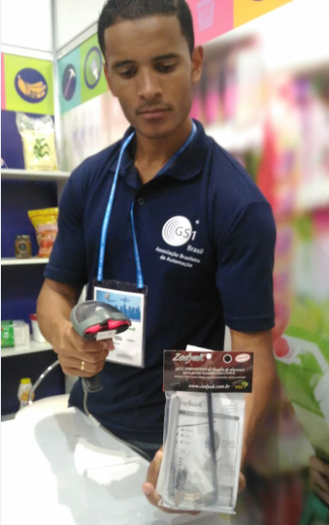
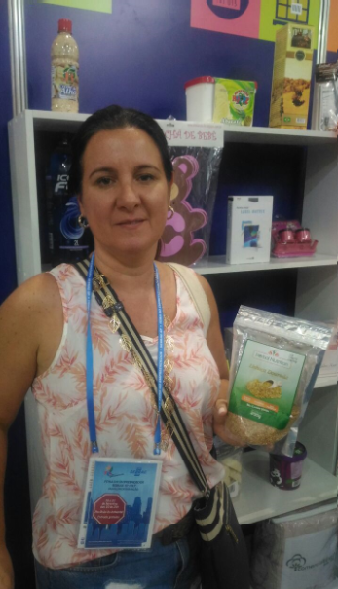
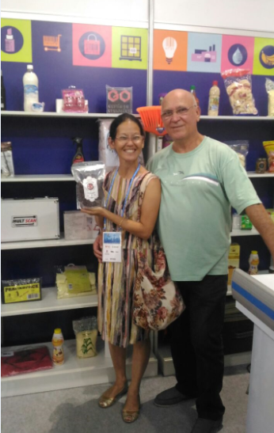
Actions for SMEs SUPORT TO BUSINESS
Notes:
This is the profile of small and medium businessmen in Brazil.
Are simple people, often from rural areas, who need support to keep their businesses active.
And GS1 Brasil gives full support through the actions seen in this presentation, so that the 46 mill small and medium entrepreneurs can have tools to survive this scenario of instability in Brazil.

Slide 48
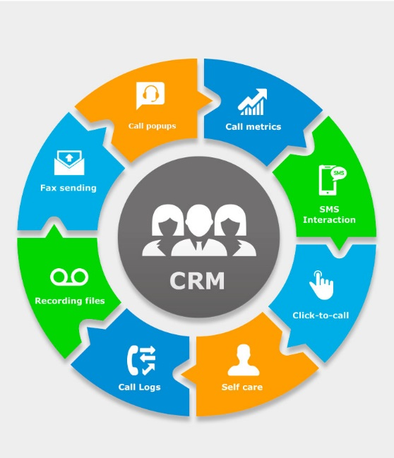
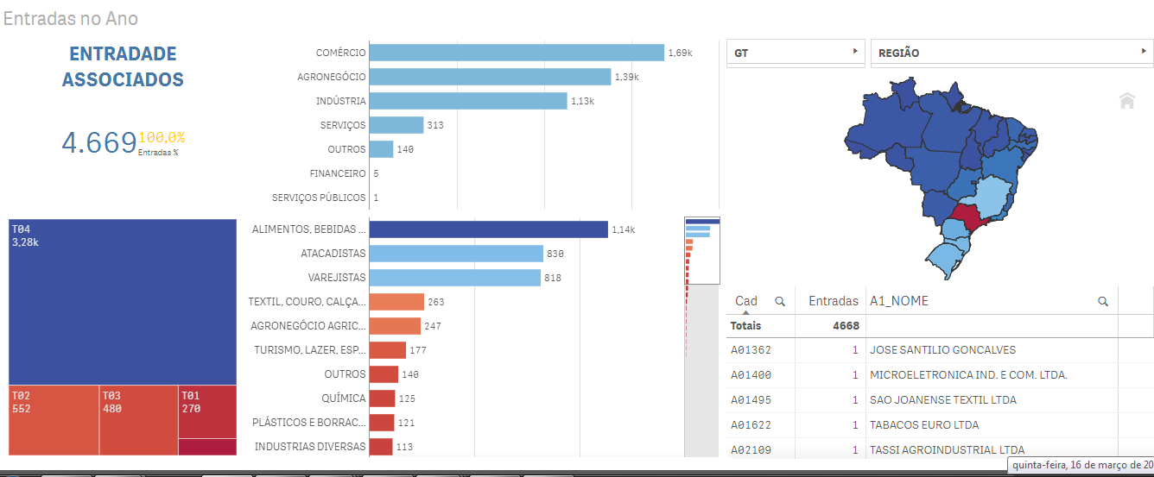

Actions for SMEs TECHNOLOGY
WE’RE READY TO HELP OUR MEMBERS
Notes:
To meet this demand, we have a call center to meet our associates, with approximately 40 people trained and able to direct and serve SME in the best possible way.
We also have a BI service and CRM for internal management of all information and re-orders received from our associates.

Slide 49
Next steps - 2017
BUSINESS ROUNDTABLE
ITINERANT MEETING
DATA QUALITY PROMOTION
SME STRATEGIC COMMITTEE
SME SEMINAR
SME WEEK
ACTIONS WITH PARTNERS:
  SEBRAE, SME MINISTRY, CIESP, FIESP
Notes:
These are the next actions for 2017 next to the SMEs. Remembering that the focus of GS1 Brazil this year is the correct identification and data quality.
SEBRAE, SME MINISTRY, CIESP, FIESP - Brazilian associations to support micro and small enterprises

Slide 50





Thanks ;)
Luiz Costa
Training & Education
GS1 Brazil
Rua Henrique Monteiro, 79
Pinheiros, São Paulo
CEP: 05423-020
T
+55 (11) 3068 6249
D
+55 (11) 3068 6231
E
Luiz.costa@gs1br.org
www.gs1.org

Slide 51
GS1 Global Standard Adoption Metric
Eileen Harpell, GSMP Operations

Slide 52


Don’t let this happen to Standards!

Slide 53





Contact Information
Mark Holmes
Vice President, GS1 Standards Development
GS1 Global Office
Princeton Pike Corporate Center, 1009 Lenox Drive, Suite 202
Lawrenceville, NJ-08648, USA
D
+16095574583
M
+15085087133606
E
mark.holmes@gs1.org
www.gs1.org

