Slide 1
GS1 Industry & Standards Event 2017
09-13 October 2017 – Brussels, Belgium
Transforming business together
Session: Distributed Working Groups
Time: 12:30 -13:30
Who may attend: All
Speaker(s): Greg Rowe, Director, Standards Development

Slide 2
Anti-trust caution
GS1 operates under the GS1 anti-trust caution. Strict compliance with anti-trust laws is and always has been the policy of GS1.
The best way to avoid problems is to remember that the purpose of the group is to enhance the ability of all industry members to compete more efficiently.
This means:
  There shall be no discussion of prices, allocation of customers, or products, boycotts, refusals to deal, or market share.
  If any participant believes the group is drifting toward impermissible discussion, the topic shall be tabled until the opinion of counsel can be obtained.
The full anti-trust caution is available via the link below, if you would like to read it in its entirety: http://www.gs1.org/gs1-anti-trust-caution.

Slide 3
Statement & reminder for seeking intellectual property information
Relevant to the features of the specification that are being developed in this work group, if anyone has knowledge or information about intellectual property rights, such as, patents or patent applications; please promptly convey this information to the work group facilitator.
The intellectual property rights can either be in development or owned by persons, companies or third parties within this work group or outside this work group.
We do this under the guidance of the GS1 Intellectual Property Policy, so that GS1 can seek to avoid the uncertainty regarding intellectual property claims against the Specification.

Slide 4



GS1 Standards Event App – How to get it
Get the App by searching your App store for "GS1 Global Events" (If you already have the Global App due to attendance at the Global Forum or Standards Event, you do not need to do this)
Once you have the Global App on your mobile device, type GS1IS17 in the search box. Please click the orange (+) to activate the event within your application.
1
2
Login with the email address you used to register for the event:
Username: (your registered email)
Password: 2017
2017
3

Slide 5
Today’s objective
At the end of the session, you come and say to me:
“I would like to start a Distributed Working Group in my country!”

Slide 6
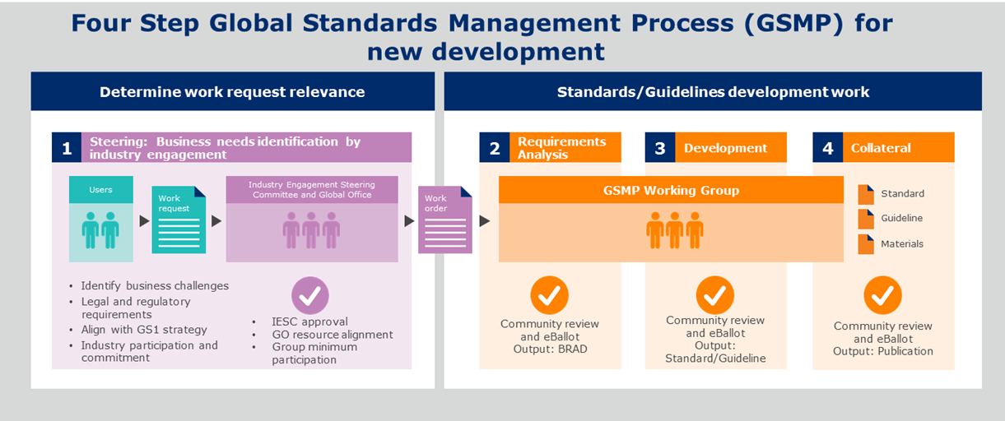
What is the Global Standards Management Process (GSMP)?
A community-based process for creating GS1 standards and GS1 guidelines

Slide 7
GSMP guiding principles
1
Openness & Transparency
5
Standards Protection
  Standards development process is open to all.
  Protected by the GS1 Intellectual Property Policy.
2
User Driven Standards
6
GOVERNANCE
  Only created in response to business needs.
  The GSMP is accountable to the Governance Groups.
3
CONSISTENCY
7
Consensus and Voting
  Drives interoperability between the stakeholders who adopt them.
  Strives for consensus of all stakeholders.
4
Stakeholder Participation
8
Global Applicability
  Includes End Users and Solution Providers.
  Strive for global applicability across multiple industries.

Slide 8


GSMP Policies
All companies and MOs involved in GSMP:
  must sign the Intellectual Property Policy
  must sign an Opt-In agreement
  conduct all meetings under Antitrust caution
GS1 requires all participants to operate under the same agreement

Slide 9

Participation is the “Key” to Success
Participate globally
    Standard Maintenance Groups
    Mission-specific Working Groups (MSWGs)
Participate locally
    Your local GS1 Member Organisation work group
    Distributed Working Group
Notes:
There are two ways to participate:
Participate in your local GS1 Member Organisation (MO) work group. To locate your local GS1 MO office, simply click on the link - http://www.gs1.org/contact/overview#Europe
Participate globally. GSMP has two ways to be involved in the standards development process:
Standard Maintenance Groups, which works to improve existing standards
Mission-specific Working Groups (MSWGs) which works to develop new standards
To see all current SMGs and MSWGs click on the following link - http://www.gs1.org/standards-development/workgroups

Slide 10


Distributed Working Groups (DWG)
Engages your local industry members
Creates a comfortable local working environment
Expands participation in GSMP work groups
Broadens MO and Standards Development collaboration
Allows you to participate locally under GSMP

Slide 11

Where DWG participates in the GSMP
Distributed Working Group
Notes:
We will now look into detail at each step of the four steps of the GSMP process

Slide 12

Role of the GS1 Member Organisation
Form, manage & facilitate your DWG
Attends global group meetings
Conveys global work to local DWG
Gather local input and convey to global group
Ensure all members sign GS1 IP & Opt In forms

Slide 13
Local influences Global
Your members participate and contribute to each working group
GS1 MO lead works directly with GS1 Standards Development Leader
Regular communication between the two leads
DWG members participate in Community Review and eballots
Global feedback
Input into Global group
Global Standard
MO Local work group
GSMP work group

Slide 14


Benefits of Distributed Working Groups
Brings true global participation into the GSMP development process
Creates true global standards
Eliminates barriers of:
  Language
  Geographical Time zones

Slide 15
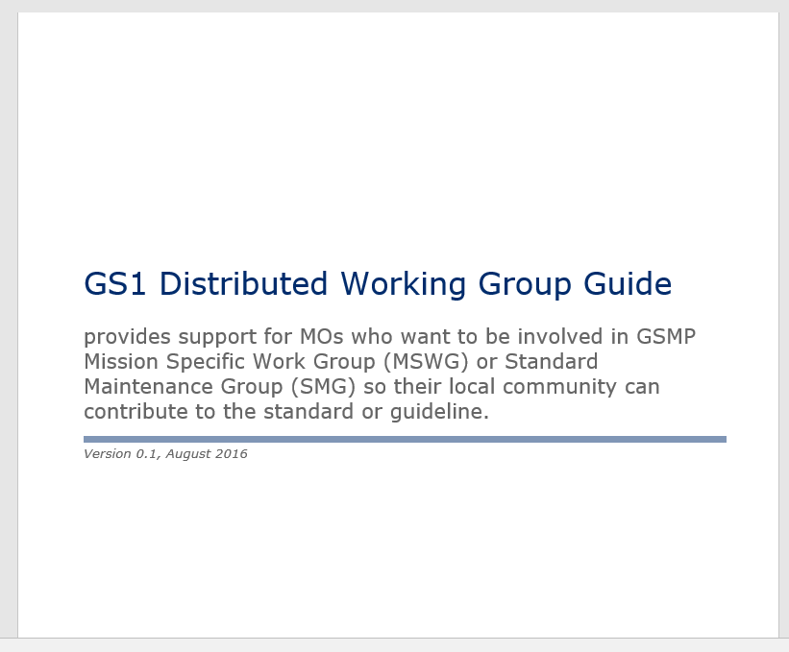

Distributed Working Group Guideline – MO Zone
Download in the MO Zone- http://mozone.gs1.org/gsmp

Slide 16

Get involved today!

Slide 17
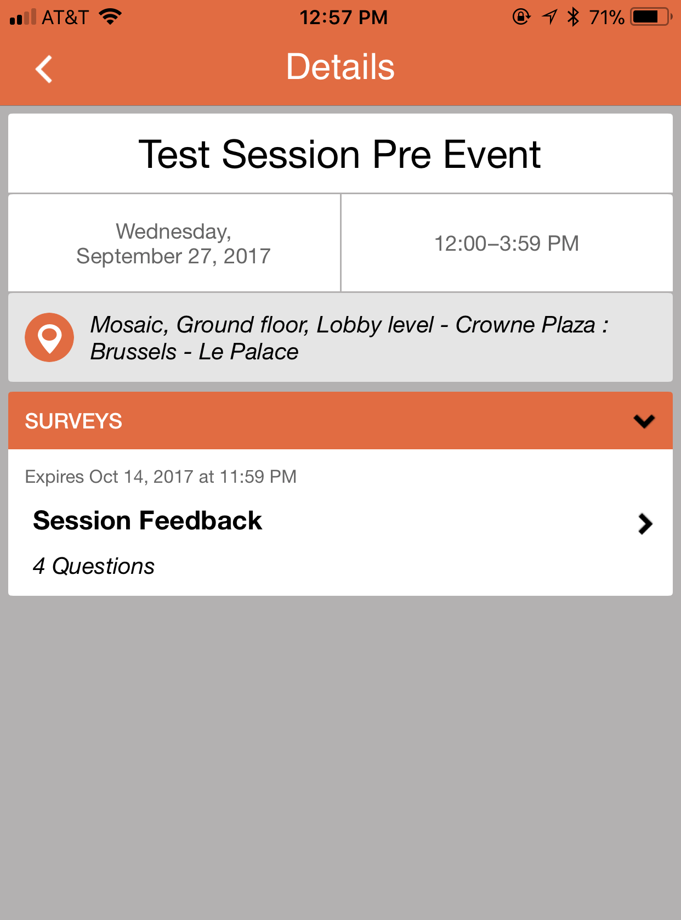
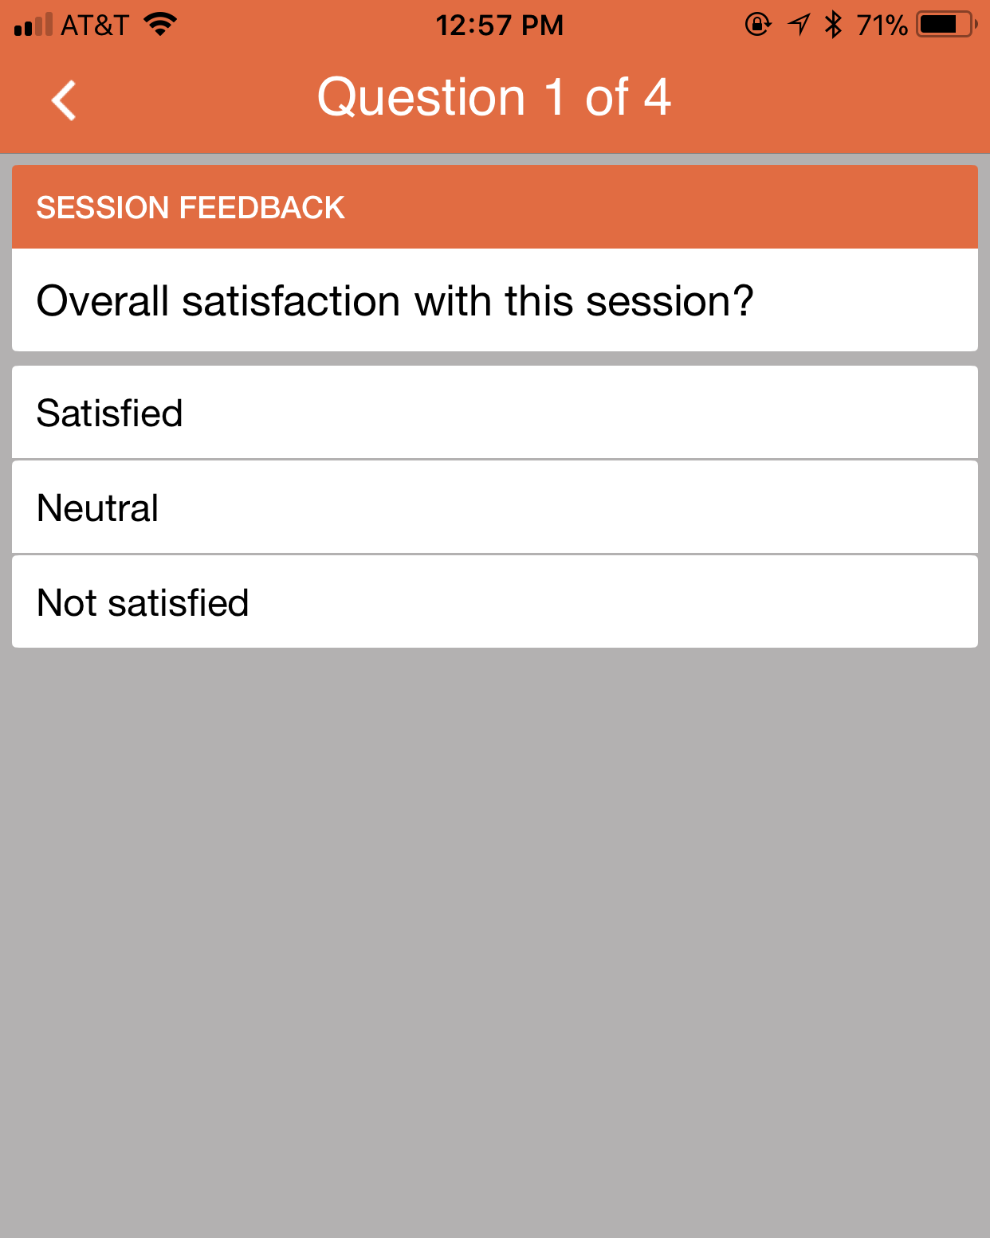
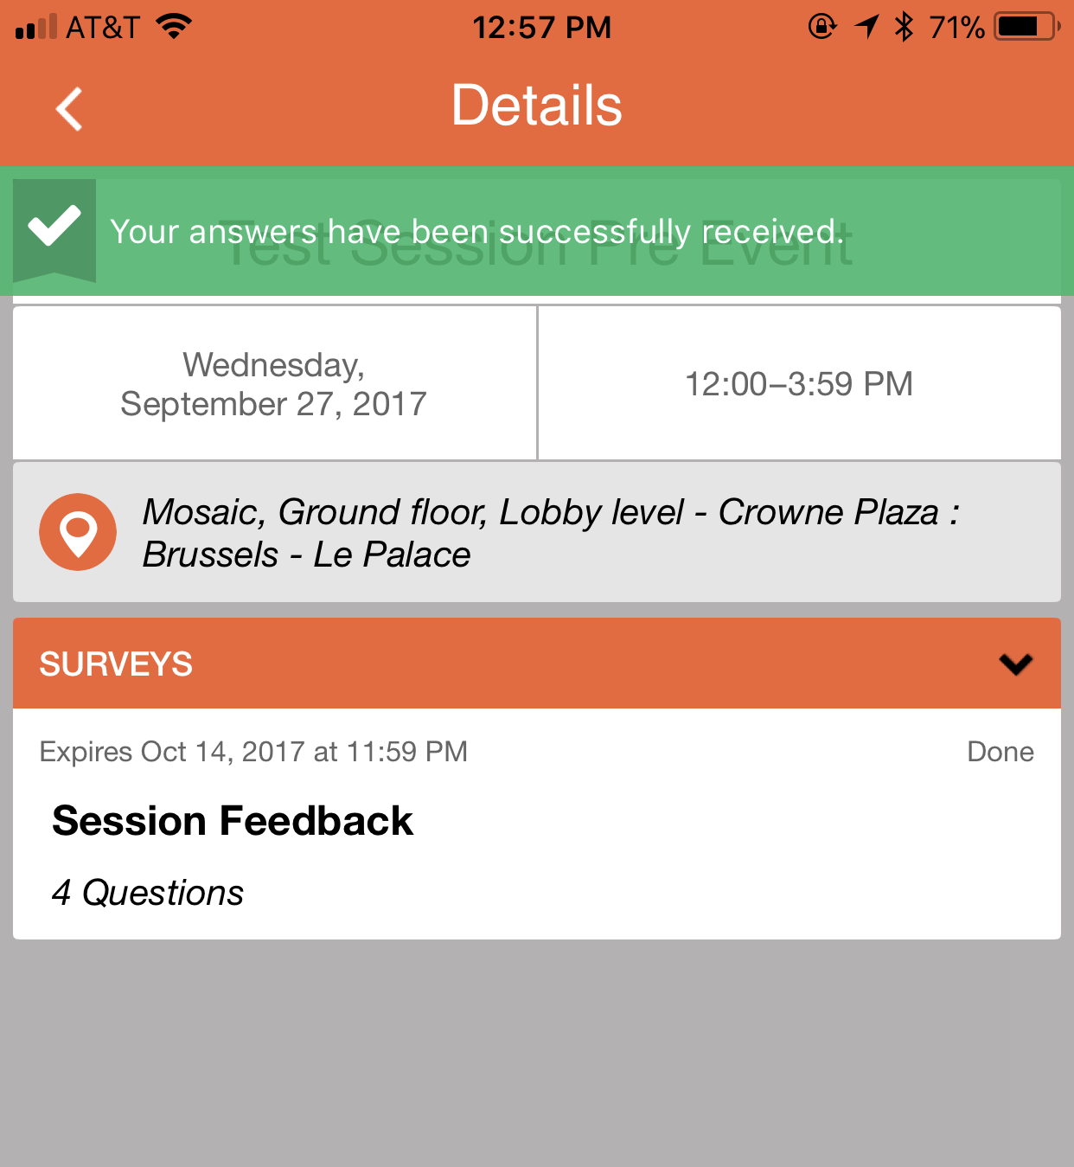
Event App – How to rate sessions
1
  Select your rating and enter comments
  A confirmation appears
  Within each session, you will see “surveys” listed at the bottom
2
3
✓
✓
✓

Slide 18
Contact Information
Greg Rowe
Director, Standards Development
1009 Lenox Drive
Lawrenceville, NJ 08648
M: +16096582309
E: greg.rowe@gs1.org

