Slide 1
Use of GS1 Standards and Blockchain in Supply Chain Management
Žiga Drev Co-Founder & Managing Director
origintrail.io
Notes:
Intro Deck - OriginTrail - Use of GS1 Standards and Blockchain in Supply Chain Management

Slide 2
Agenda
Opacity of supply chains
OriginTrail development - from centralized solution to decentralization
Is Blockchain a Silver Bullet for Supply Chain related Challenges
OriginTrail Protocol - enabling companies to speak the same language, with integrity
Yimishiji usecase - GS1 EPCIS and blockchain adoption
What’s next?
Trace Alliance - empowering businesses through blockchain technology and data standards
Notes:
Agenda
Opacity of supply chains
OriginTrail development - from centralized solution to decentralization
Is Blockchain a Silver Bullet for Supply Chain related Challeges
OriginTrail Protocol - enabling companies to speak the same language, with integrity
Yimishiji usecase - GS1 EPCIS and blockchain adoption
Feature showcase - alert system
Trace Alliance - empowering businesses through blockchain technology and data standards

Slide 3
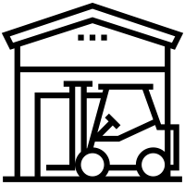
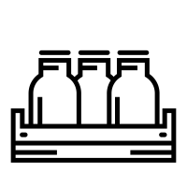
Notes:
Plate

Slide 4
Complexity of Supply Chains
32% of manufacturers say they are unable to guarantee the ingredients they use aren’t fraudulent.
2017 Lockton Food & Beverage Report
Notes:
Lockton Research

Slide 5
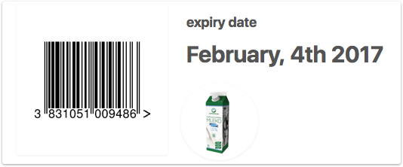
OriginTrail v1.0 (Before Blockchain)
Download App
App commercial
Scan barcode and input expiry date

Slide 6
Most common question:
How can we trust the information you’re providing us?
Notes:
Question “how can we trust…”

Slide 7
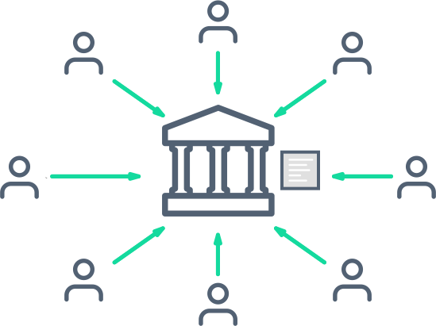
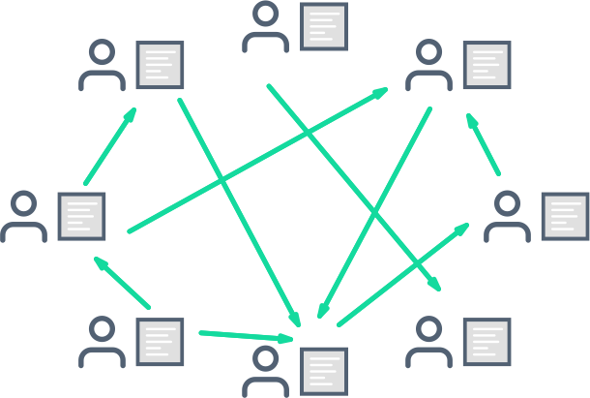
Ways of record keeping
Centralised ledger
Decentralised ledger
Ledger stored and updated by the central body (middle-man)
Trust in the middle-man
Ledger easy to change & manipulate
“Single point of failure”
Ledger stored and updated by all participants, no middle-man
Trust in the network mechanisms (math & cryptography)
Ledger is immutable
System can survive catastrophic events
Notes:
Ways of record keeping

Slide 8
Is a Silver Bullet?

Slide 9
Cost & Lack of Database Properties
Platform
Ethereum
Hyperledger Fabric
IPFS/Filecoin/Storj
BigchainDB
SYSTEM TYPE
Public
Permissioned
Public
Permissioned
General purpose virtual machine, Smart contracts
Customizable blockchain framework for closed environments
Decentralized document database
INTENDED USE
Decentralized file storage
DATA STORAGE COST
High
N/A
Low
Low
DATABASE FUNCTIONALITIES
No
No
No
Yes
SUITABLE FOR HIGHLY INTERCONNECTED DATA
No
No
No
No
Notes:
Table of decentral- solutions

Slide 10
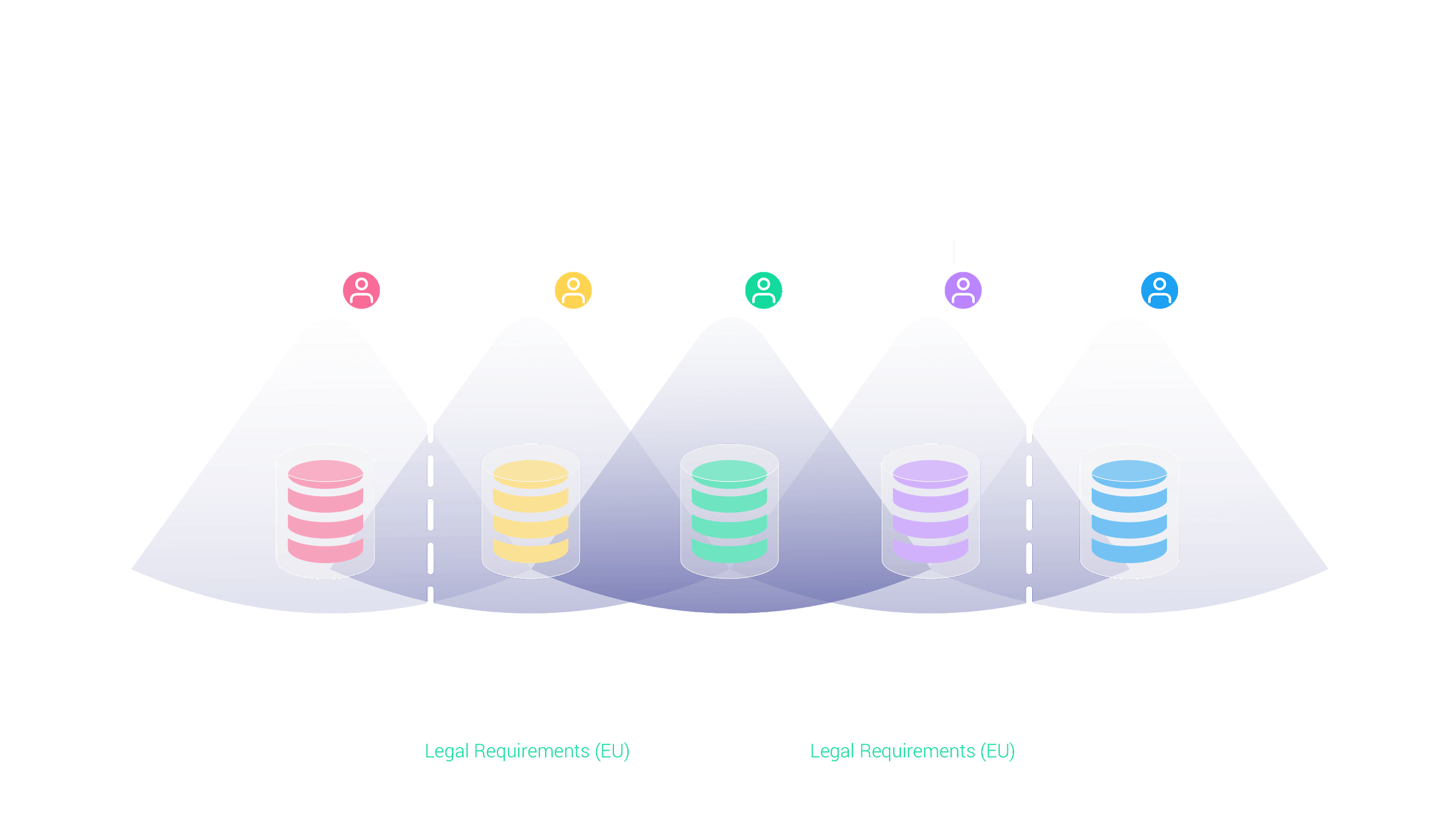
Data Fragmentation
Notes:
Data siloes slide

Slide 11
OT protocol technology stack
Application layer
Network layer
Data layer
Blockchain layer
Notes:
OriginTrail Protocol (layered Architecture)

Slide 12
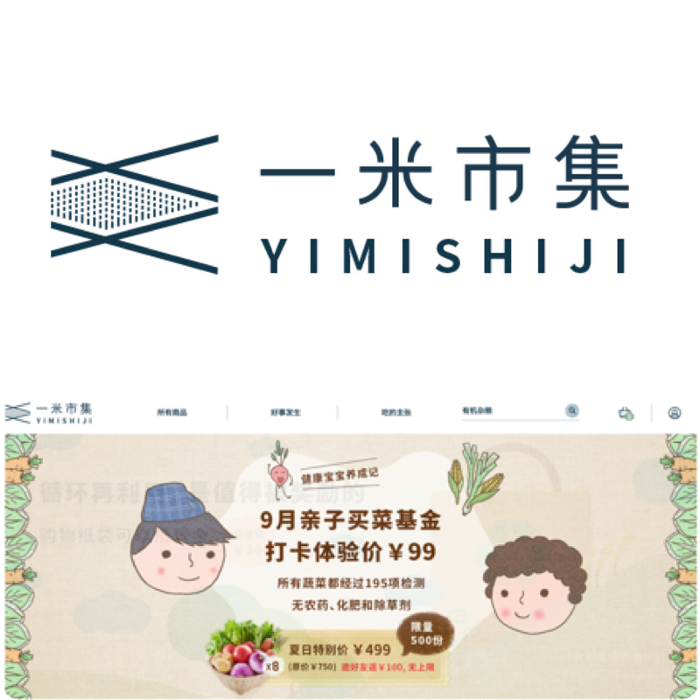
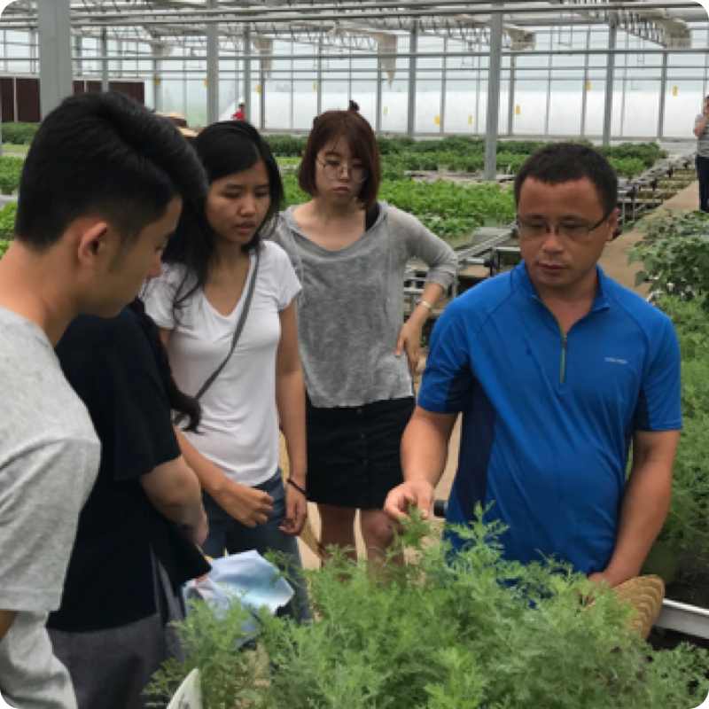
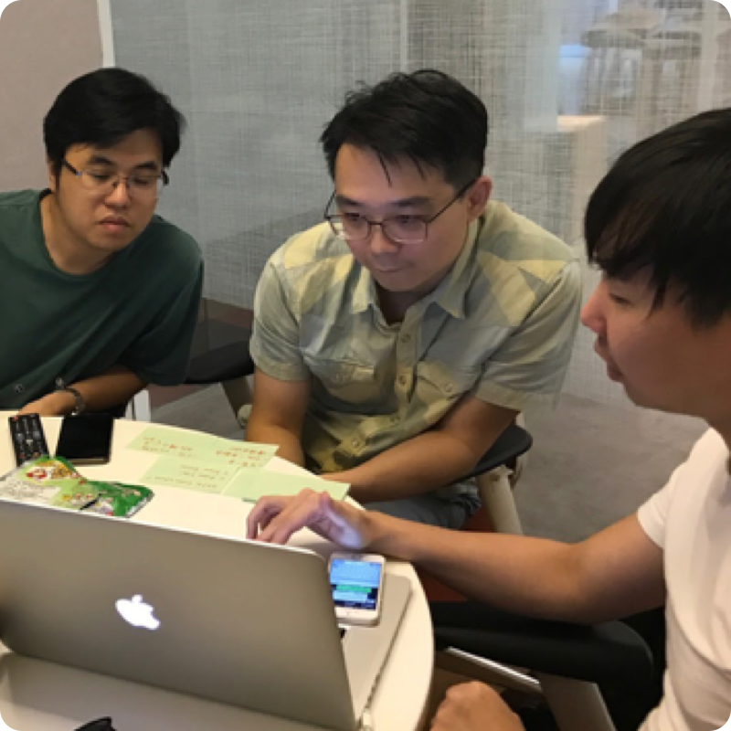
OriginTrail implementation case
Yimishiji e-commerce platform
Product journey from farm to table
Establishing accountability within the supply chain
Product safety (looking at ways to use sensor data)
Notes:
YimiShiji slide (standard one)

Slide 13
Integration steps
STEP 1
Supply Chain Mapping and Data Preparation
STEP 2
Data structuring following the GS1 EPCIS standard with every participant in the observed supply chain
STEP 3
Integration with the OriginTrail network to enable data sharing

Slide 14
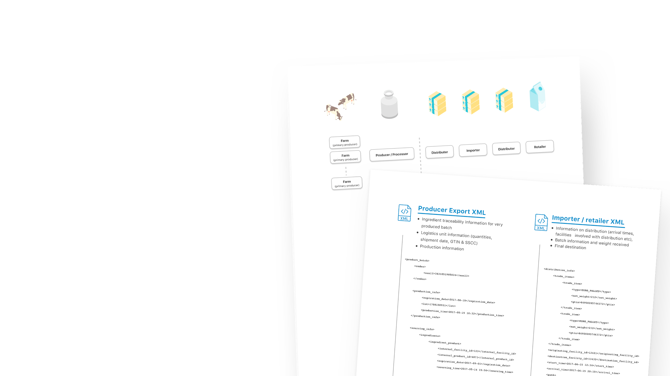
STEP 1
Supply Chain Mapping and Data Preparation

Slide 15
STEP 2
Data structuring following the GS1 EPCIS standard with every participant in the observed supply chain
Step 2 - Data structuring following the GS1 EPCIS standard with every participant in the observed supply chain
Data structuring by supply chain partners in GS1 EPCIS XMLs
Validation of GS1 structured data

Slide 16
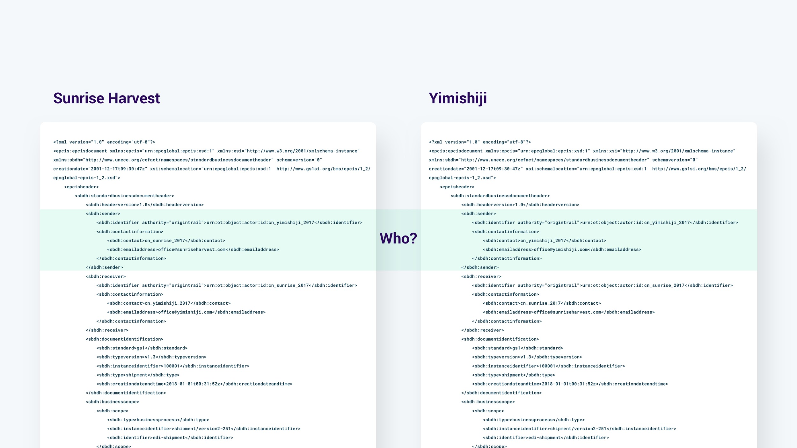
GS1 structured XMLs after validation
Notes:
Step 1 (, SC mapping, data structuring, XML GS1 EPCIS) for all 3 steps

Slide 17
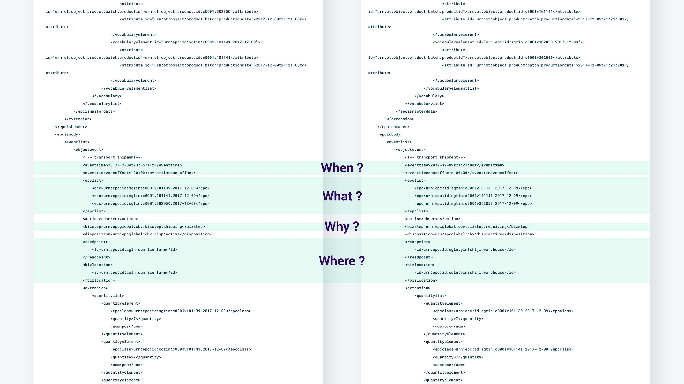
Notes:
Step 1 (, SC mapping, data structuring, XML GS1 EPCIS) for all 3 steps

Slide 18
STEP 3
Integration with the OriginTrail network to enable data sharing
Step 2 - Data structuring following the GS1 EPCIS standard with every participant in the observed supply chain
Setting up and OriginTrail nodes
Establishing automated data transfer to OriginTrail nodes (once a day)
Validating the data matching in the setup process
Observing the data through the visual interface
Detection of discrepancies

Slide 19
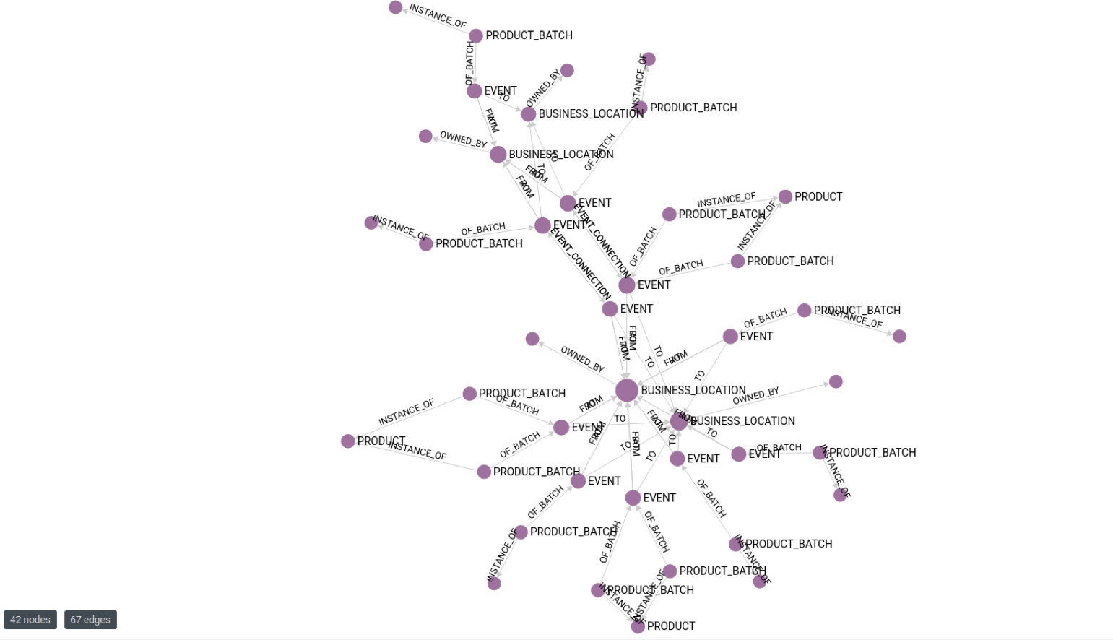
Resulting interconnected data graph
Notes:
Step 1 (, SC mapping, data structuring, XML GS1 EPCIS) for all 3 steps

Slide 20
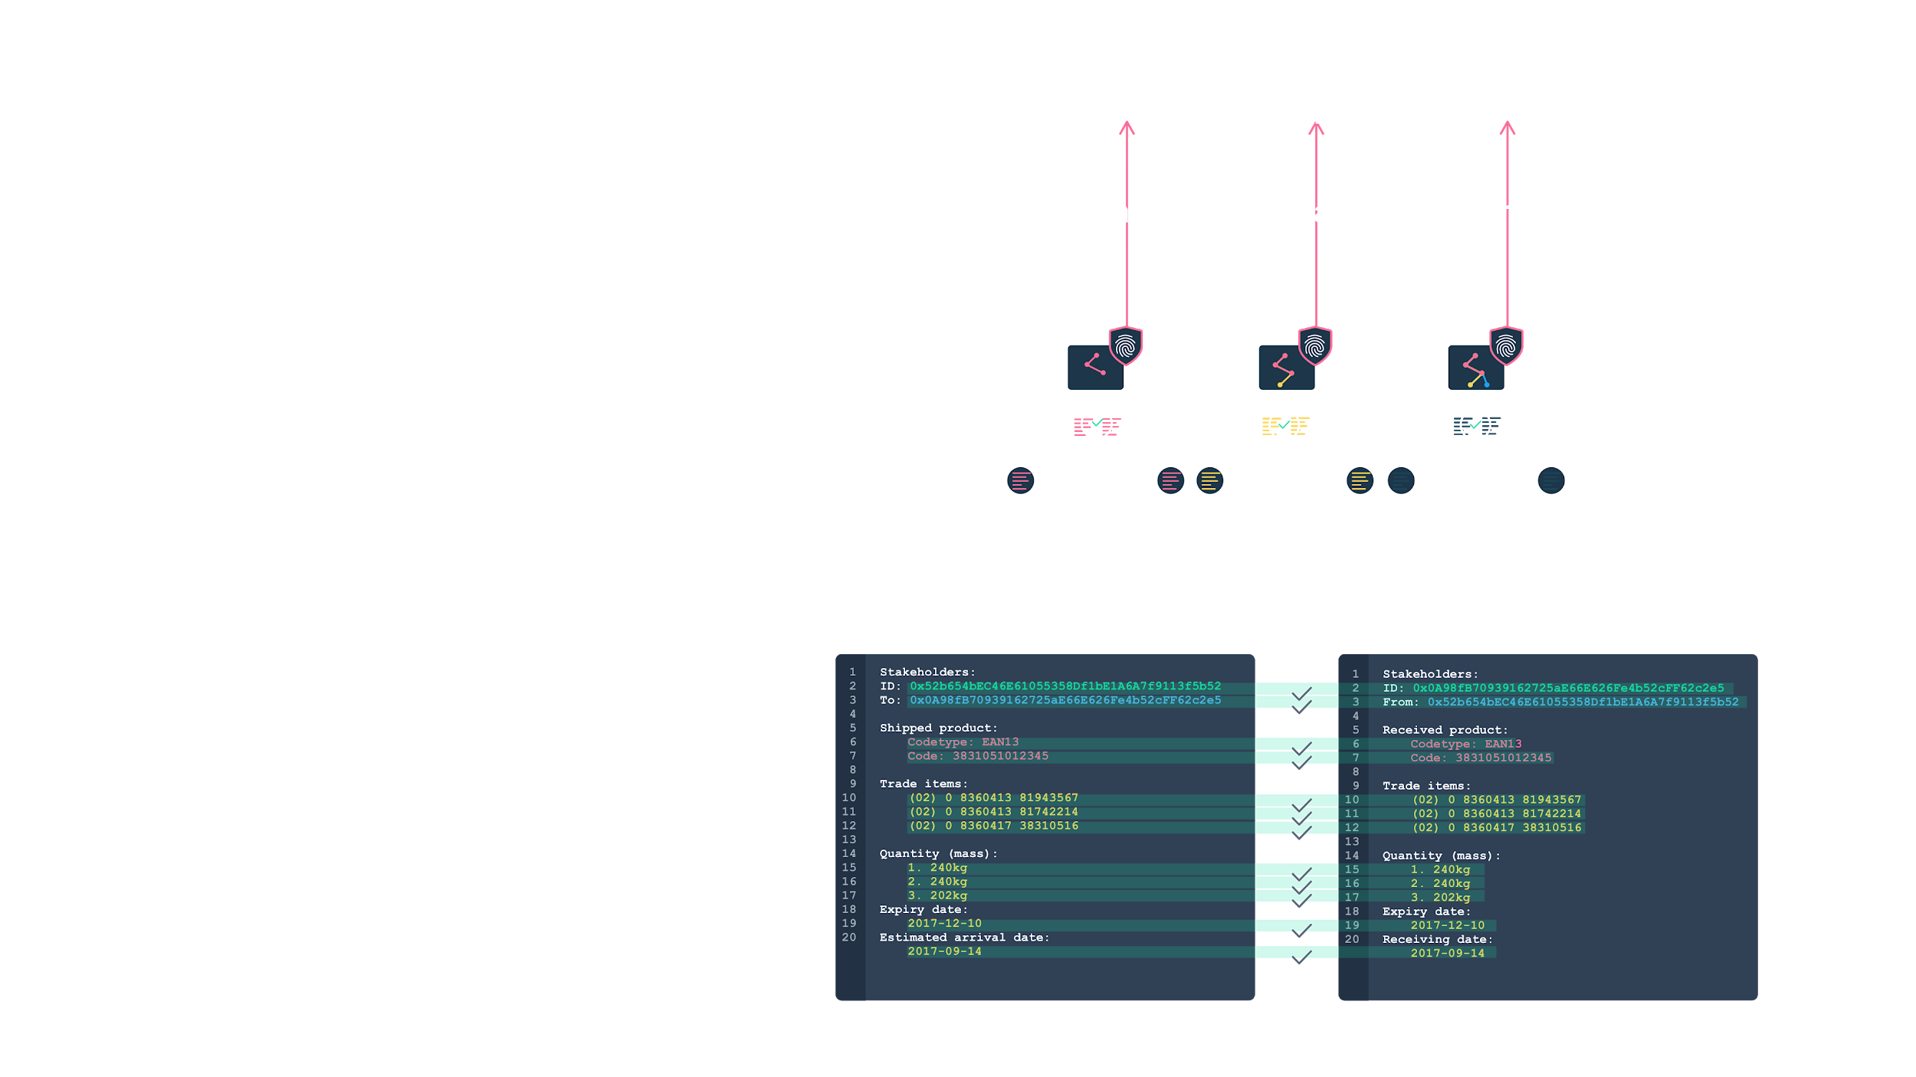
Real world data validation with the Consensus check
Validation of matching data sets
public information
encrypted data
encrypted with validation properties (zk-SNARKs) over entire chain

Slide 22
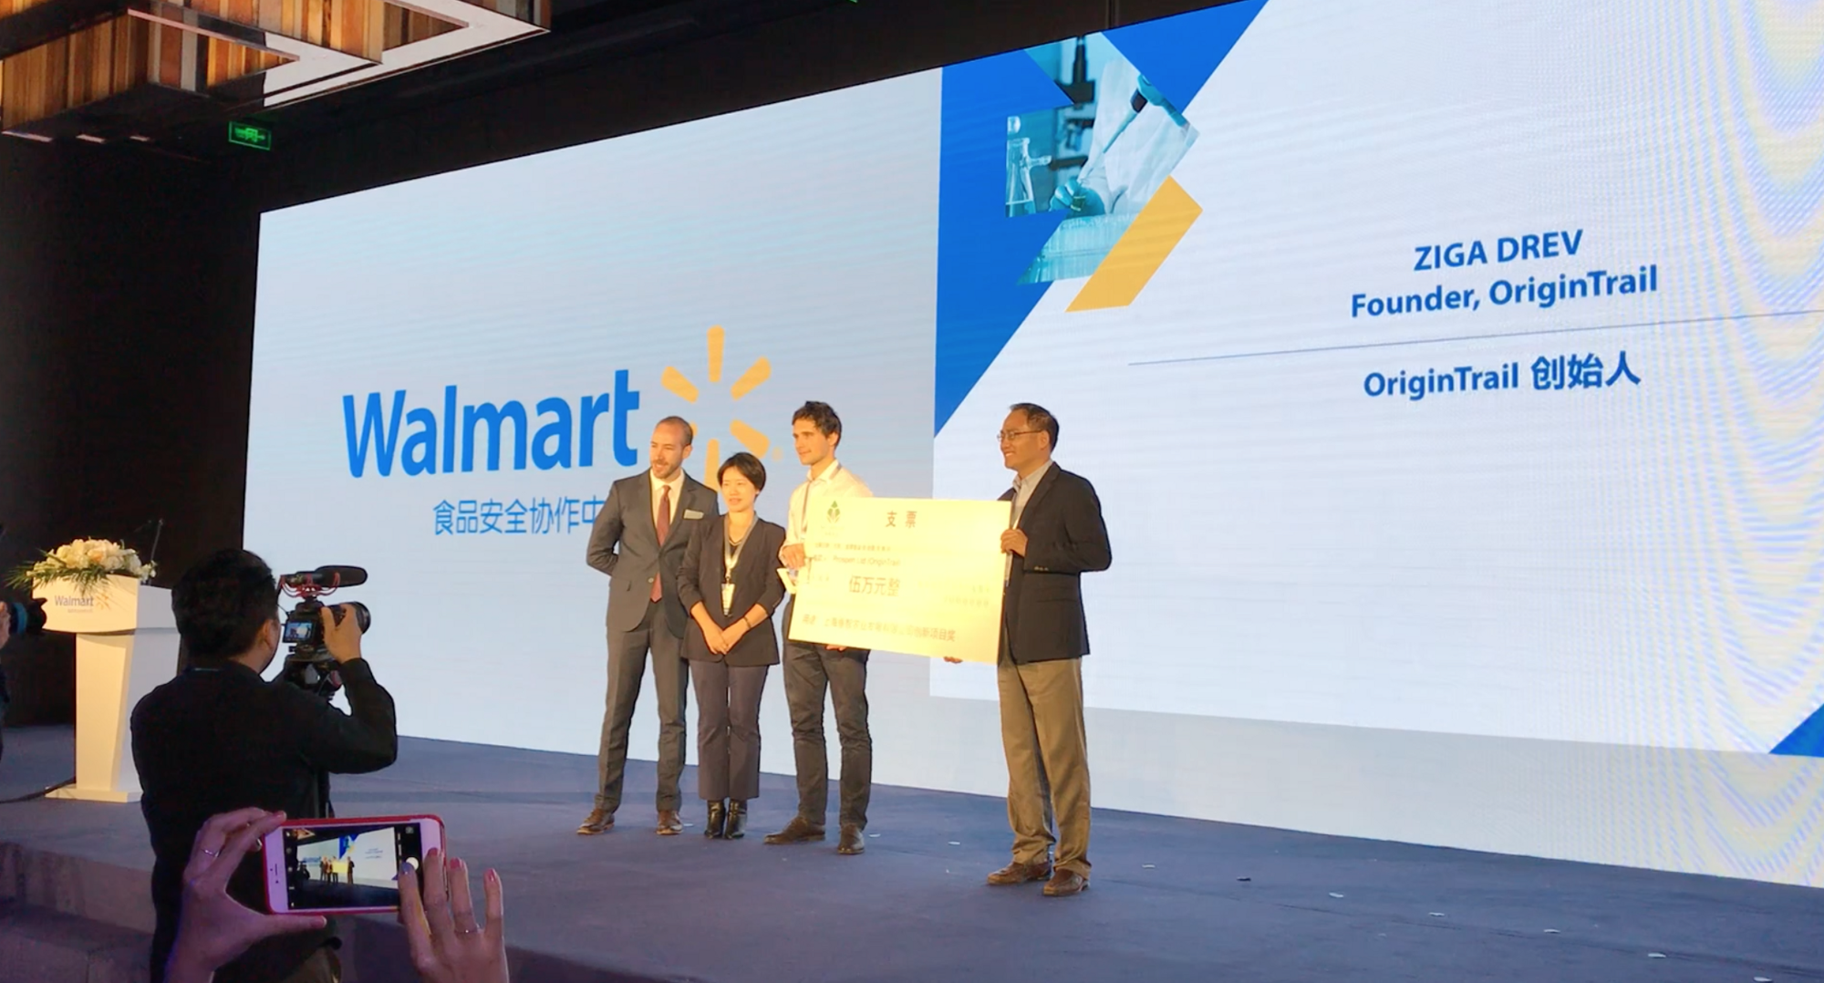
Notes:
YimiShiji slide (steps)

Slide 23
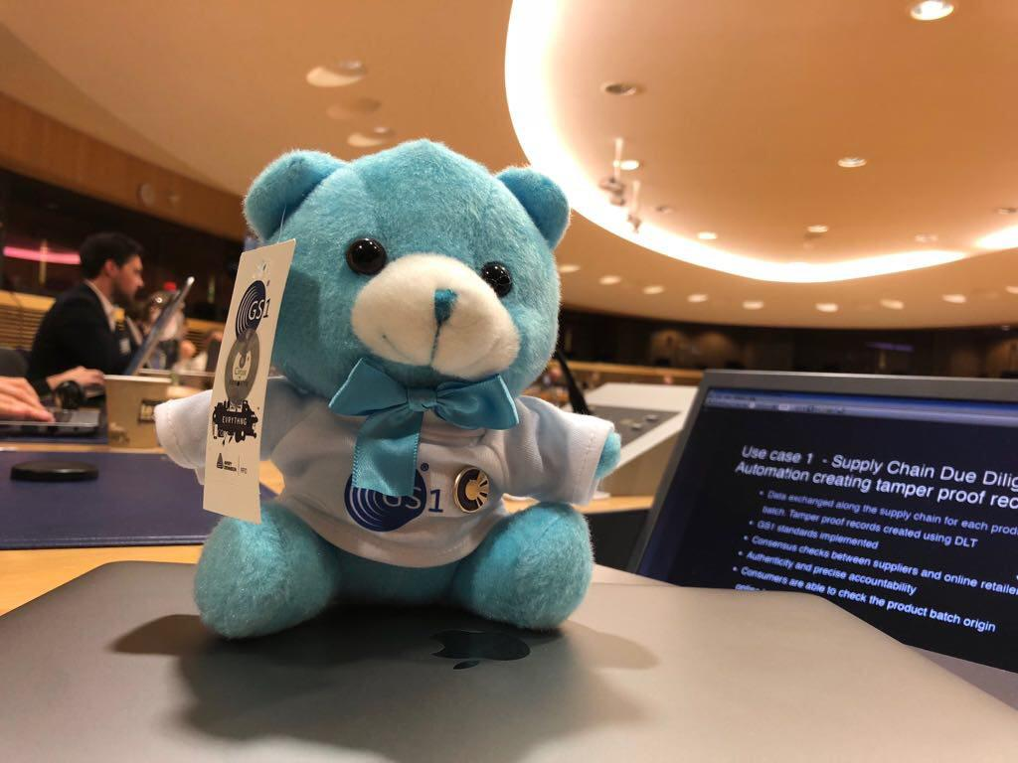
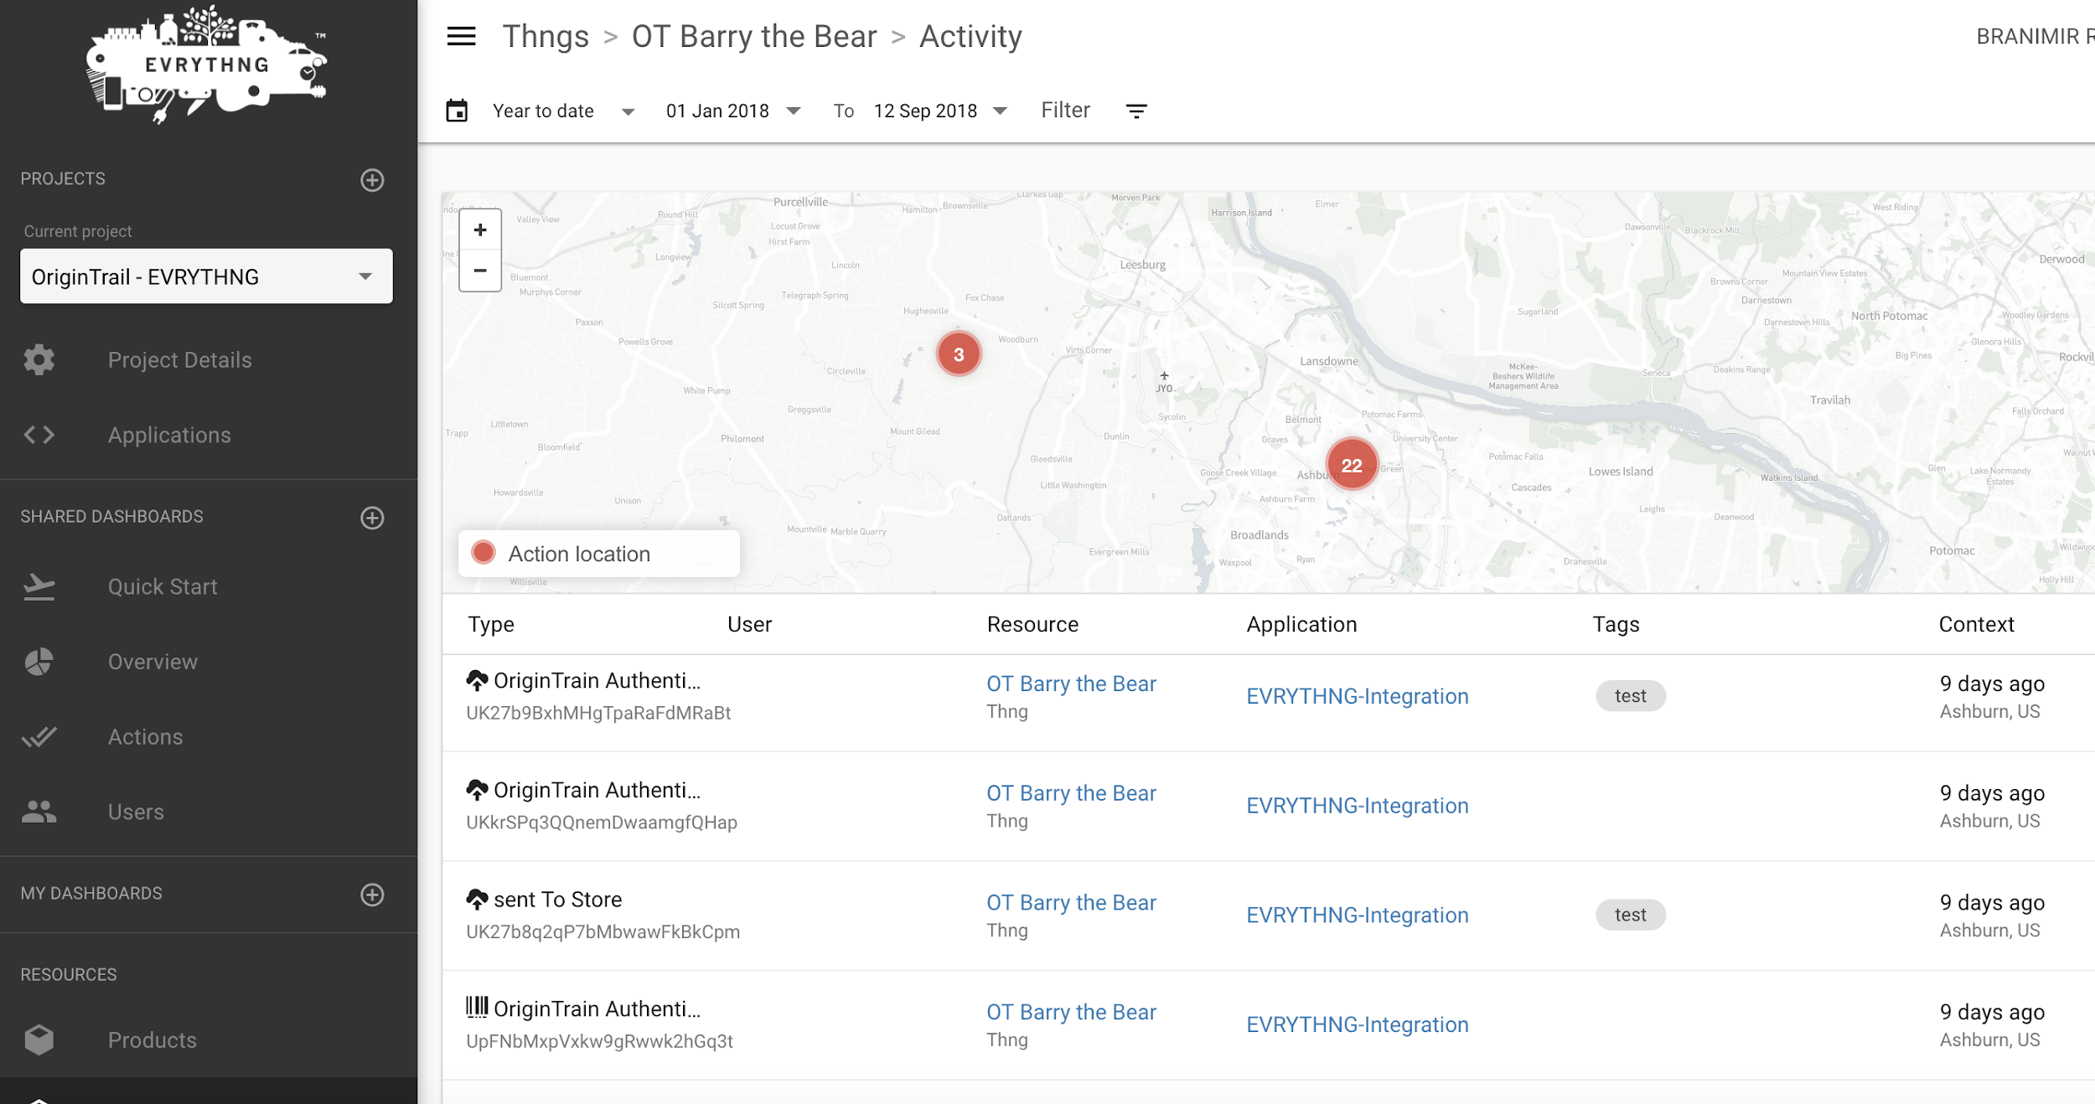
What’s next? Digital link
GS1 Digital Link

Slide 24
Notes:
Trace Alliance slide

Slide 25
Thank You for Your Attention!
origintrail.io
origintrail
OriginTrail
@origin_trail
OriginTrail
OriginTrail
OriginTrail

Slide 26
Presentation of prototype
Demo
Notes:
Yimi
Feature Showcase (P&G demo with imaginary names)

Slide 27
Awards and Recognitions

Slide 28
Partnerships

