Slide 1
The next four slides are the templates to be completed for GSMP Work Requests on EDI
A worked example follows to provide guidance

Slide 2
Work Request Number: title & submitter
(1 mandatory)
Description and background:
Submitter:

Slide 3
Work Request Number: Business need / Requirement / Process description (2 mandatory)
Requirement:
Business Need:

Slide 4
Work Request Number: Possible new/EDIFACT code? Possible technical solution (3 mandatory)
Possible new codes:
Possible technical solution:

Slide 5
Work Request Number: attachments
(4 optional)
Use this space for any attachments that might help further understanding. For example:
  Link to regulation
  Images
  etc/.

Slide 6
The following slides are for guidance on how to complete an EDI Work Request

Slide 7
23-0xx: [Work request title/topic] Add new Code
Description:
Requirement: A detailed technical statement of the requirement. For example
Addition of Freight Charge
- transportInstructionMessage in GS1 XML 3.6
- EANCOM IFTMIN message in EANCOM 2002
Business Need: A detailed statement on why the change is needed, where it will be used and who are the supporters. For example:
In the logistic process it sometimes necessary to indicate a “Freight Charge” for a specific item between the logistic service provider and consignee. This can be done in both GS1 XML and in EANCOM.

Slide 8
23-0xx: Submitters (if space permits, the submitter can appear on the first slide too)
Industry
Nestlé Deutschland AG
Unilever Deutschland GmbH
Dr. August Oetker Nahrungsmittel KG
Henkel AG & Co. KGaA
August Storck KG
Coca-Cola Erfrischungsgetränke AG
Osram GmbH
Philips
Mondelez
Retail
Rewe Zentral AG
dm-drogerie markt GmbH & Co.KG
Schwarz IT KG
METRO SYSTEMS GmbH
MARKANT Handels und Service GmbH
OBI Smart Technologies GmbH
Amazon
Lekkerland
EDEKA AG
Others
EDIMEDIEN
Kraftverkehr Nagel GmbH & Co. KG

Slide 9
23-0xx: Process Description with Process Picture / Graphic
Example for Business Need / Requirement / Benefit:
see next slide
Process Flow
see next slide

Slide 10
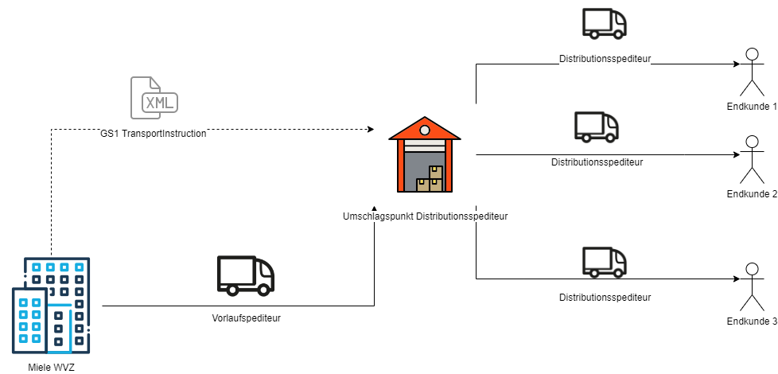
23-0xx: Process Flow Transport Instruction

Slide 11
23-0xx: Process, Business Need & Benefit
Process description:
The sender of products has to inform the Logistic Service Provider with all details regarding Dangerous Goods Information in the transportInstructionMessage on item level.
Business Need:
To fulfill shortly the requirements regarding Dangerous Goods Information for transports in the supply chain.
Benefit:
The new qualifiers enables a complete specification of Dangerous Goods in the transportInstructionMessage.

Slide 12
23-0xx: Possible place for new codes / EDIFACT code? Possible technical solution with details
Proposal for adding an existing EDIFACT code: (dependent – if an idea exists)
Possible place for new codes: (dependent – if an idea exists)
see next slide
Possible technical solution with details: (mandatory – for new codes)
IFTMIN, MOA, SG, DE 5025 – New code: 64 (Freight Charge)
- Code name (value)
- Code description
- Code definition

Slide 13
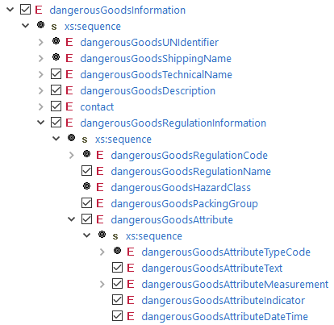
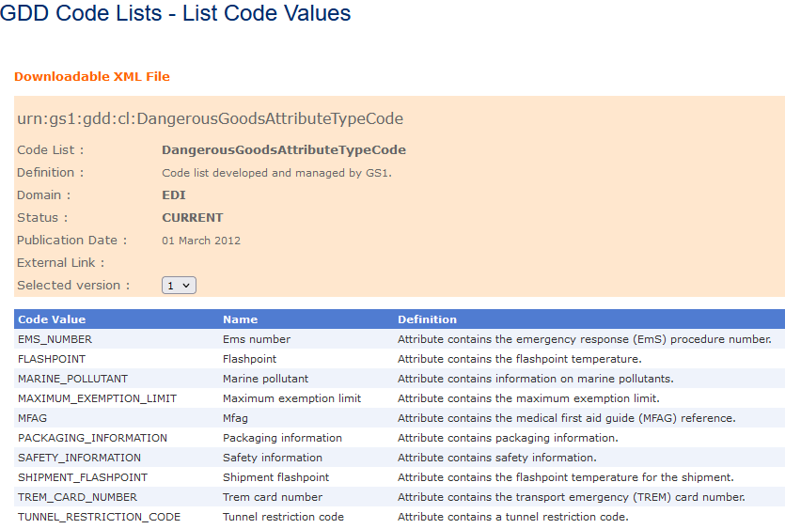
23-0xx: Possible place for new codes:
DangerousGoodsAttributeTypeCode

Slide 14
23-0xx: Attachments
Use this space for any attachments that might help further understanding. For example:
  Screen shots
  Link to regulation
  Link to EDI requirement documents

