Slide 1
Preparing a Code work request template – Quick Guide
Steve Robba, Director of Standards Development, GS1 Global Office
February 2021

Slide 2
Preliminary
This guide is only to help prepare the Code template
Quick download of template can be found:
https://www.gs1.org/sites/default/files/docs/gsmp/codes_gmd_template_feb_21.xlsx
The full guide with more examples and details can be found:
https://www.gs1.org/sites/default/files/docs/gsmp/how_to_fill_out_codes_templates_i1-0_a_2021-02-25_0.docx
To learn how to fill out a GS1 work request, please refer to “Work Request Form Guidance” https://www.gs1.org/sites/default/files/docs/gsmp/work_request_blank_question_template.docx
All entries in the document shall be made in English UK. There are instances for formal names (Company names, Brands, etc.), when the original language may be used.

Slide 3
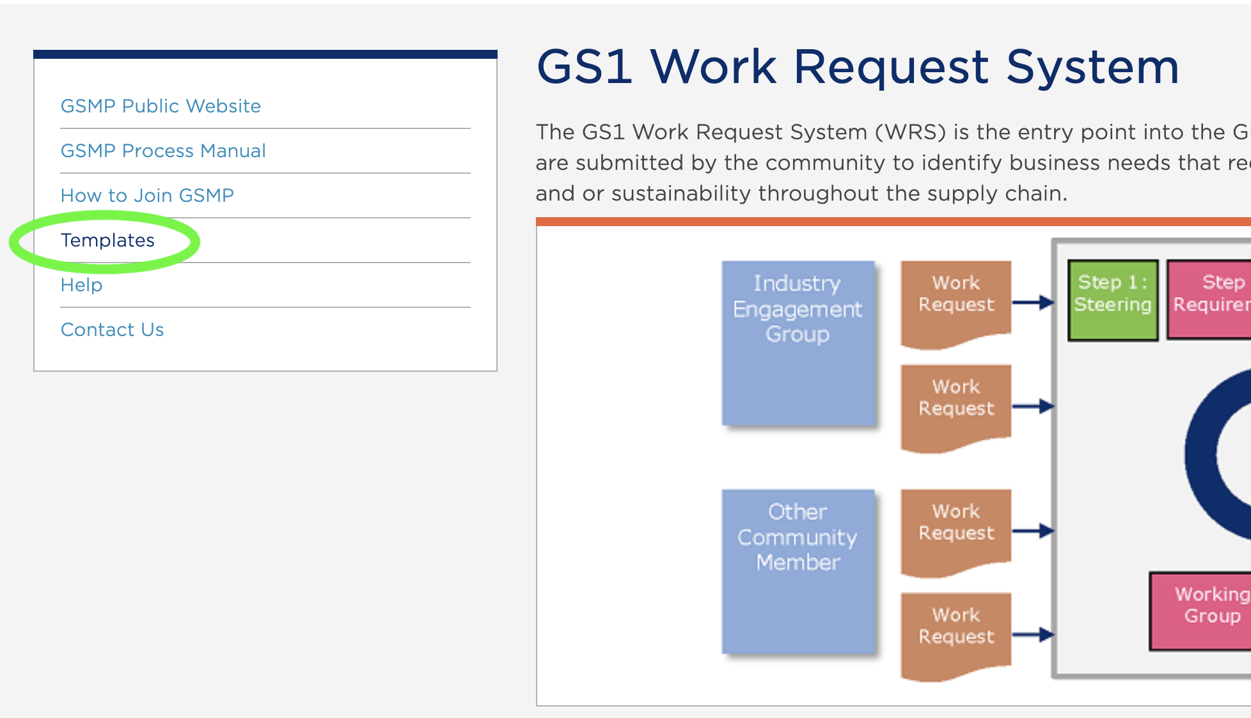
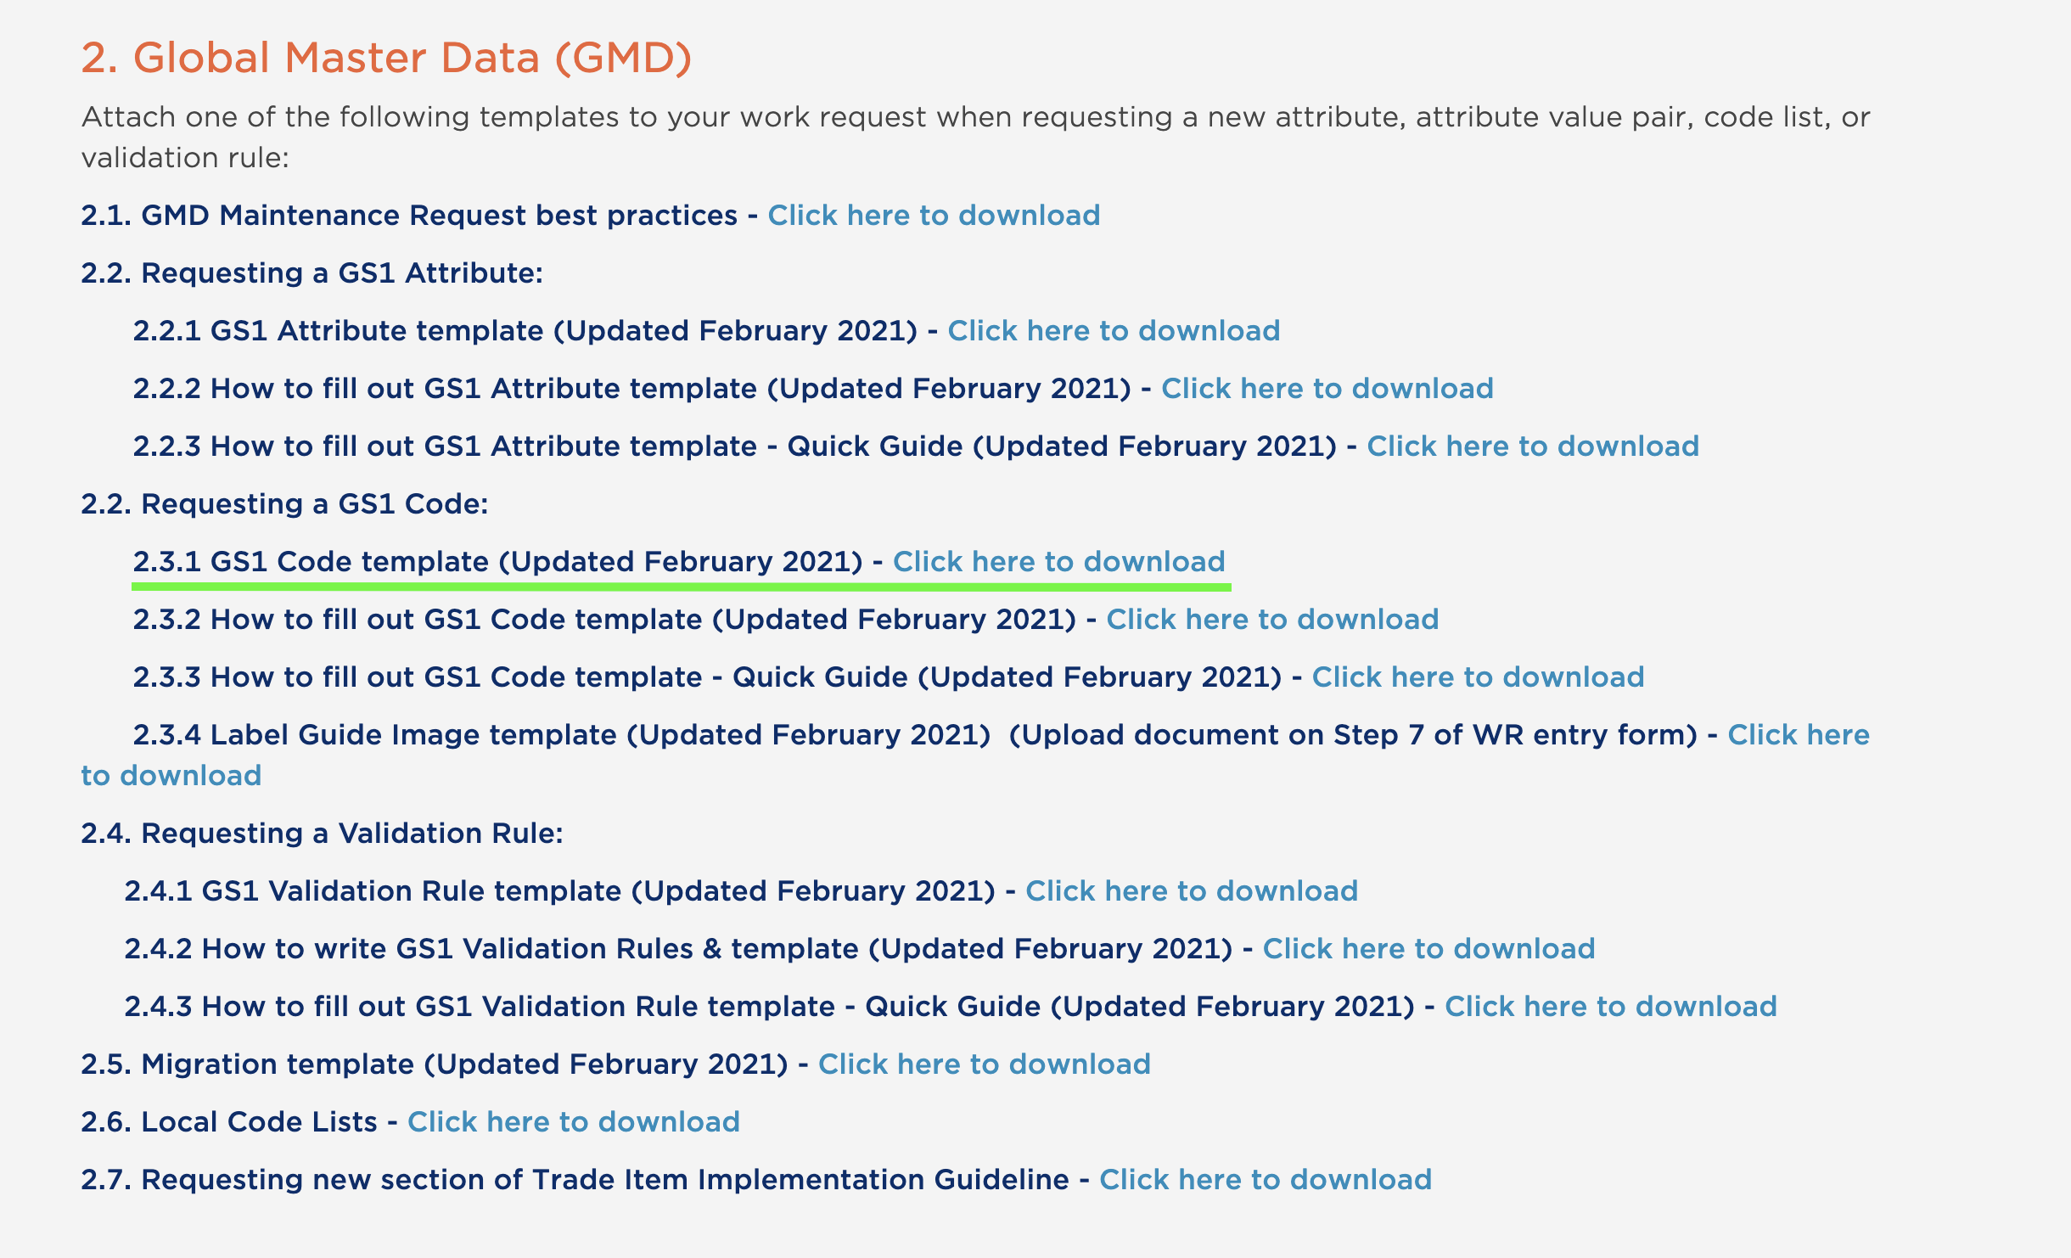
Download the Code template
Go to http://wr.gs1.org
Select “Templates”
Requesting a GS1 Code
Click or Right click link for 2.3.1

Slide 4
Code Template
Always begin entering at line 5
Never delete rows 1 through 4.
Row 1 the work request system uses to populate the proper fields in the system.
Row 2 & 3 are provided as examples and quick directions.
Row 4 is the line to notify user to start at row 5.

Slide 5
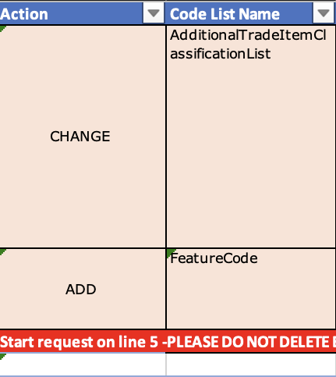
Code Template
Action & Code List Name
Action: Simply select from the drop down:
ADD for a new code
CHANGE for a change to an existing code
DELETE to remove an existing code
Code List Name: A drop-down to select the code list name.
Note: there are some extra codes at the end of the list not in alphabetical order.
If this is a new code list select “New”
If you cannot find a code list select “Code not listed”

Slide 6
Code Template
Action general template instructions
Action:
ADD - Fill out all columns to the best of ability.
CHANGE – Fill out code list name and Code
And then what changed only. All columns do not need to be filled out. Do not use colour fonts or strikethroughs to demonstrate changes.
DELETE – A delete must come with a Change for the definition stating the code is being deprecated and instruction on what to use.
A migration form must be submitted for all deletions.

Slide 7
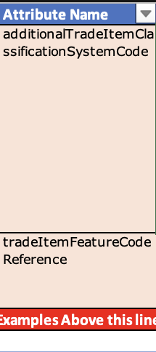
Code Template
Attribute name
Enter the attribute name that the code is going to be used for
If this is a new code list, then the attribute may be new. Enter the attribute name from the attribute template being requested.
Requests for productCharacteristicsValueCodes are no longer accepted due to the Global Data Model recommendation that they did not help B2C attribution.

Slide 8
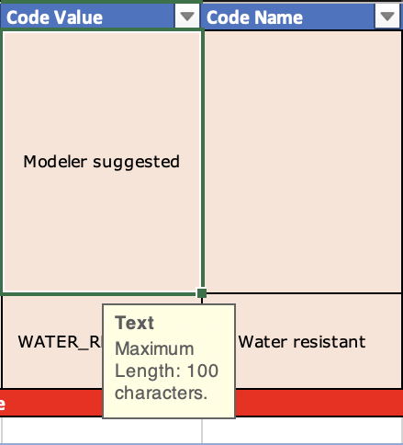
Code Template
Code Value & Code Name
Code Value: The code value format is all uppercase letters with an underscore between words.
Use Modeler suggested when not sure or want recommendation.
Code Name: The format of a code name should follow typical use of capitalization of a name. Upper case should only be used to start a code name or if it is a formal name of something.
For Units of measure, we are using the following systems in this order:
Unified Codes – best to put Modeler suggested
UN Rec 20
GS1

Slide 9
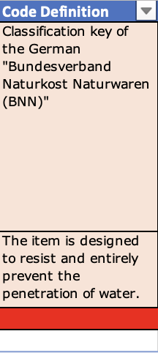
Code Template
Code Definition
All new Code requests SHALL have a business friendly and succinct definition.
All definitions SHALL have proper punctuation. Make sure you end sentences with a period “.”.
All acronyms SHALL be in parenthesis after the full text of the acronym has been stated.
All acronyms SHALL be extended to the full text in a definition.
A definition should be able to give a visual representation of the code is a characteristic of a product.
Continue next slide

Slide 10
Code Template
Code Definition
Definitions SHALL NOT just repeat the code, except in special circumstances when there is a global understanding of the name. (This is very rare).
A definition SHALL be able to be understood globally. Avoid using colloquial or local sayings.
A change to a definition SHALL NOT use font colours nor strikethroughs to represent changes.

Slide 11
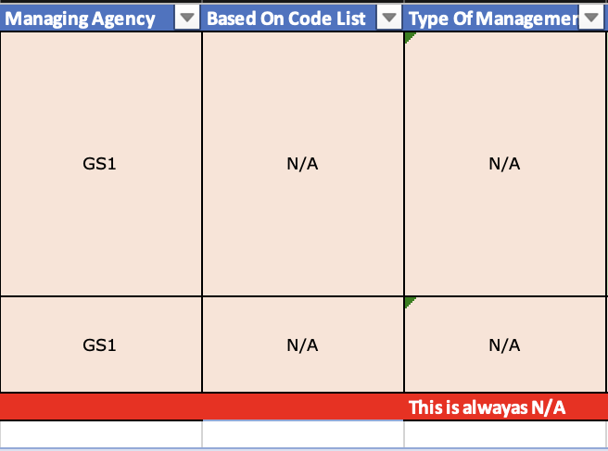
Code Template
Managing Agency, Based on Code List, Type of Management
Managing Agency - Unless this is a code list managed by another agency, please use “GS1”. Others ISO, Unified Code, UN Rec 20
Based on Code List – Please use “N/A”, unless for another agency code list.
Type of Management – Always use “N/A” from drop-down. We are no longer using this, so leaving blank is ok also.

Slide 12
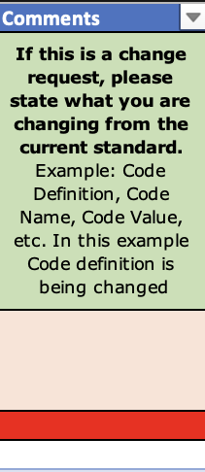
Code Template
Comments
This is mainly used to express the changed “from” the current standard and “to” the request.
The main changes only occur for
Code definitions
Code name
Code Value – needs a migration if changing.

Slide 13
Any questions please contact GSMP@gs1.org

