Slide 1
Preparing a Validation work request template – Quick Guide
Steve Robba, Director of Standards Development, GS1 Global Office
February 2021, Version 1.3

Slide 2
Preliminary
This guide is only to help prepare the template
Validation work request template
https://www.gs1.org/sites/default/files/docs/gsmp/validation_rules_gmd_template_feb_21.xlsx
To learn how to create a proper validation, please refer to “How to write GDSN Validation Rules” document.
https://www.gs1.org/sites/default/files/docs/gsmp/how_to_write_gdsn_validation_rules_i1-3_a_2021-02-10.docx
To learn how to fill out a GS1 work request, please refer to “Work Request Form Guidance” https://www.gs1.org/sites/default/files/docs/gsmp/work_request_blank_question_template.docx

Slide 3
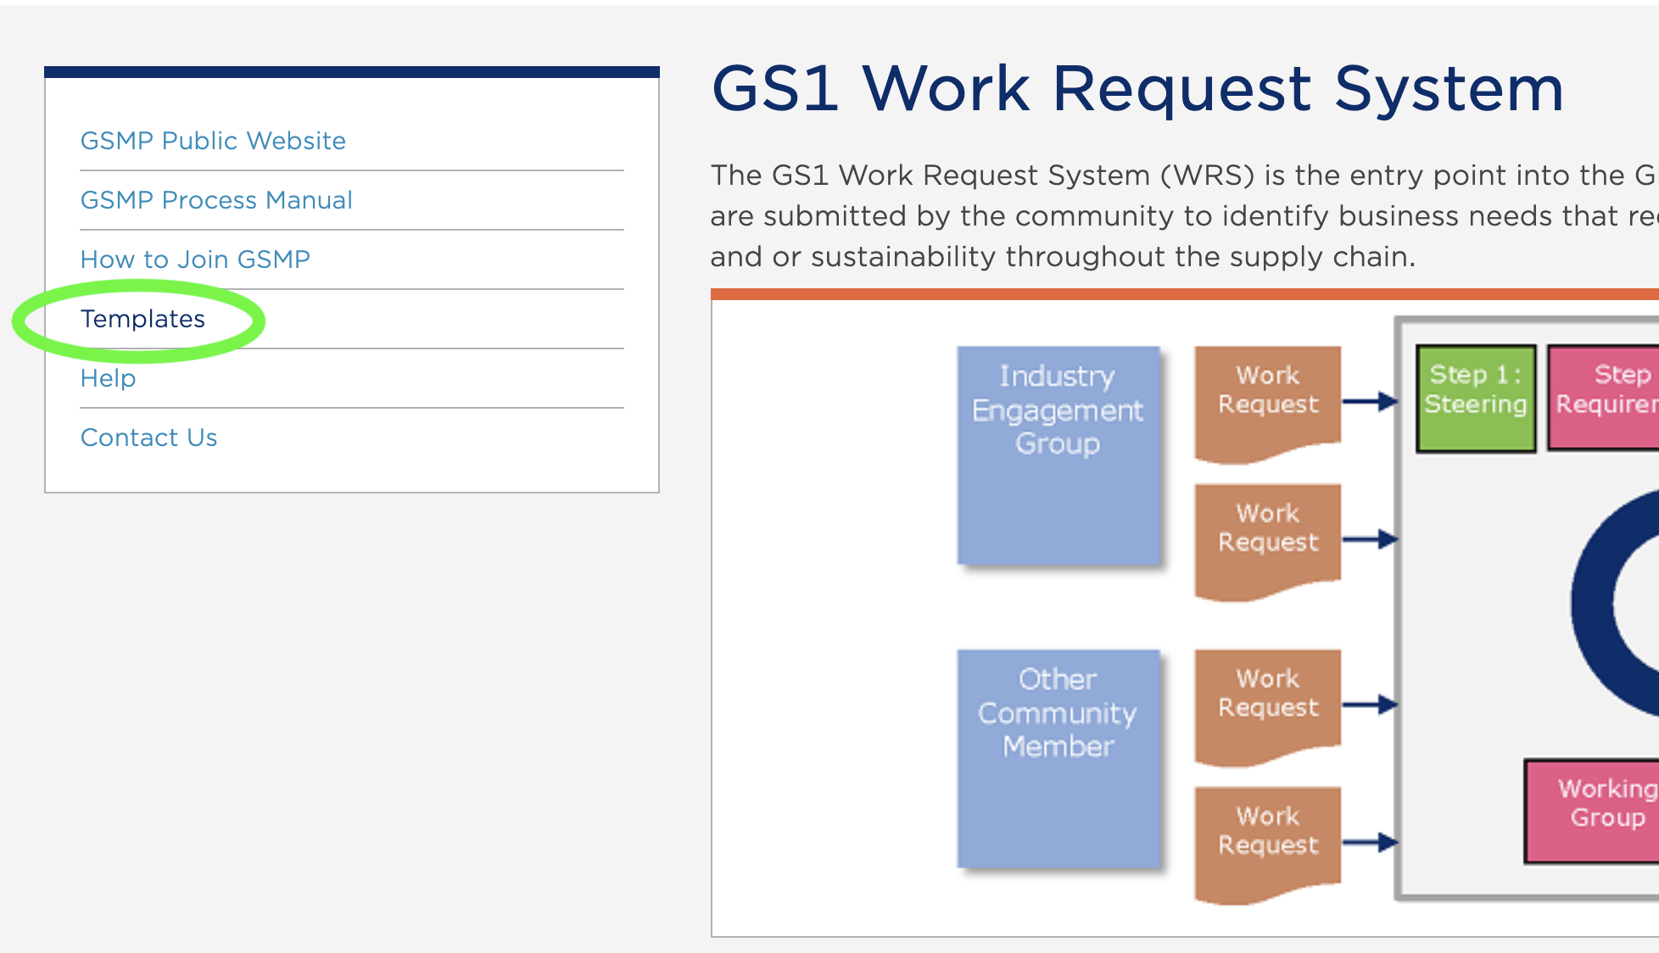
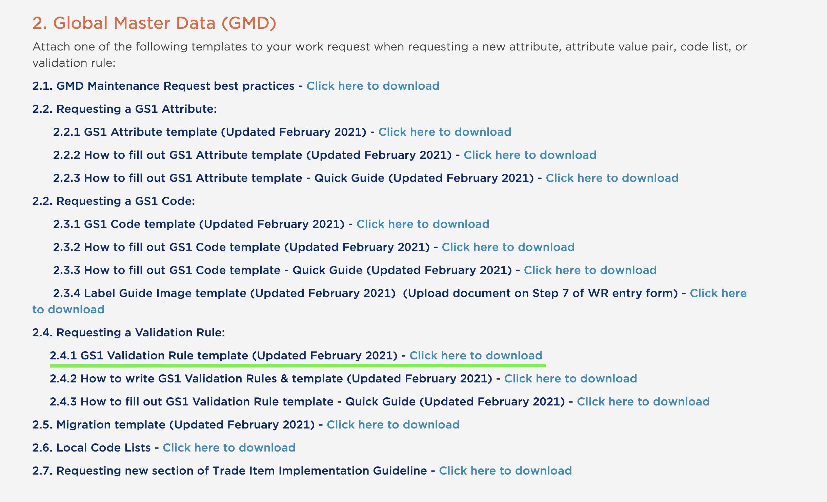
Download the Validation template
Go to http://wr.gs1.org
Select “Templates”
2.4 Requesting a Validation Rule
Click or Right click link for 2.4.1

Slide 4
Validation Template
Always begin entering at line 5
Never delete rows 1 through 4.
Row 1 the work request system uses to populate the proper fields in the system.
Row 2 & 3 are provided as examples and quick directions.
Row 4 is the line to notify user to start at row 5.

Slide 5
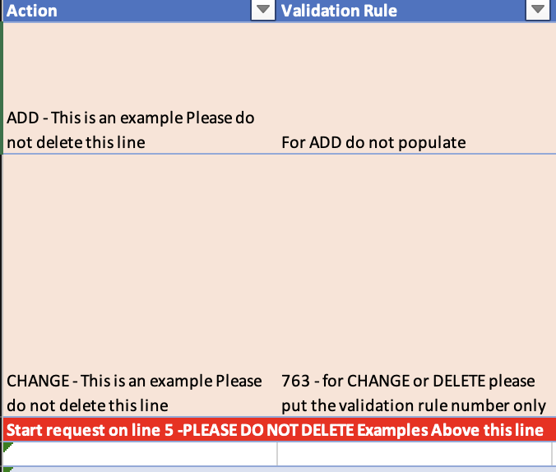
Validation Template
Action & Validation Rule
Action: Simply select from the drop down ADD for a new validation, CHANGE for a change to an existing validation, DELETE to delete an existing validation.
Validation Rule: This is for Validation Rule numbers.
ADD – do not use
CHANGE, DELETE please supply the current Validation rule ID.

Slide 6
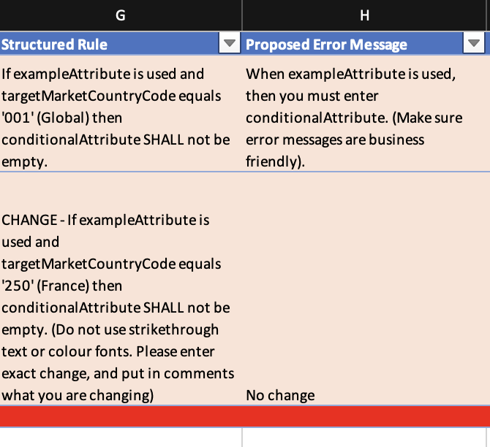
Validation Template
Structured Rule & Proposed Error message
General Comments:
CHANGES
Do not use colour fonts nor strikethrough text to explain the change or delete in the template.
These types of visual changes do not upload to the work request system.
Use “Comments” column to provide change details.
Refer to the “How to write GDSN Validation Rules” document. https://www.gs1.org/docs/gdsn/How_to_Write_GDSN_Validation_Rules.pdf

Slide 7
Validation Template
Structured Rule &
Proposed Error Message
Structured Rule: Follow in detail “How to write GDSN Validation Rules” document. https://www.gs1.org/docs/gdsn/How_to_Write_GDSN_Validation_Rules.pdf
Proposed Error Message: Please make sure the error message is business friendly. When there is a need to state a “value entered” back to user, use the <attribute value or Code value code name> approach. See guide for details.

Slide 8
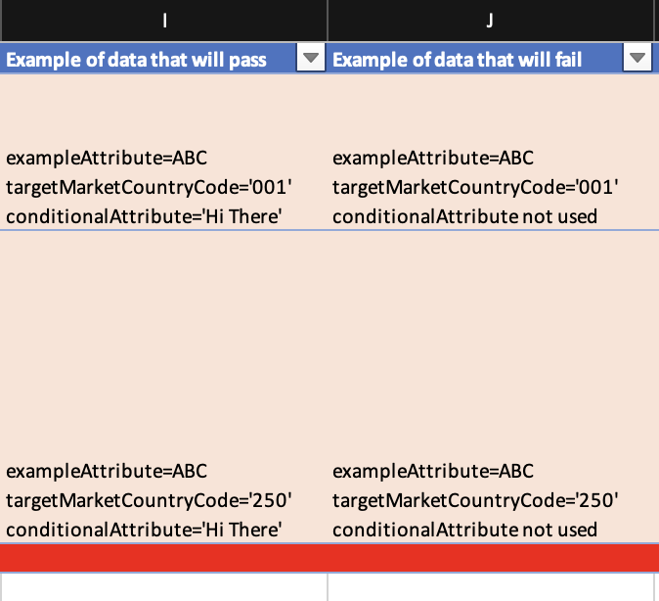
Validation Template
Example of data pass/fail
Example of data that will pass/fail: Include as many examples as necessary. When stating that an attribute is “empty” use the term “not used”. The reason is XML does not pass empty data.

Slide 9
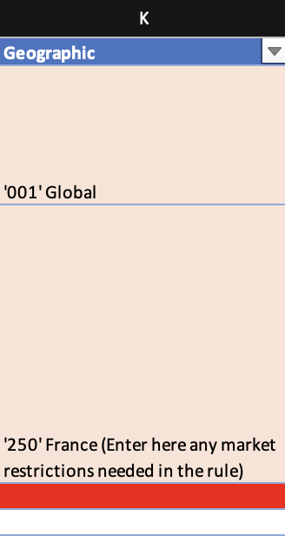
Validation Template
Geographic
If this is a Global rule and applies to all markets enter “Global”.
If this applies to the Global target market and no other market use ‘001’ Global.
If the geography is specific to target market(s) include both the ISO 3 digit code and country name.
It is a default that this statement is exclusive to this (these) market(s).
If it excludes the market(s) explicitly state “Excludes ‘???’ Country name”.

Slide 10
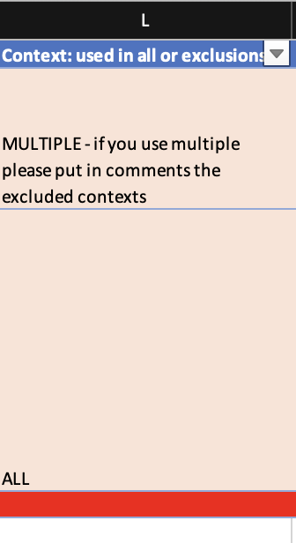
Validation Template
Context & Comments
Contexts: This is a drop down
ALL – means applicable to all contexts (Products).
MULTIPLE – means multiple product contexts are excluded from the rule.
“Individual” – means an individual context is excluded.
Note: The default is to exclude Medical devices and Pharmaceuticals. You must provide a business case to Healthcare to include those products in a rule.
See next page about comments.

Slide 11
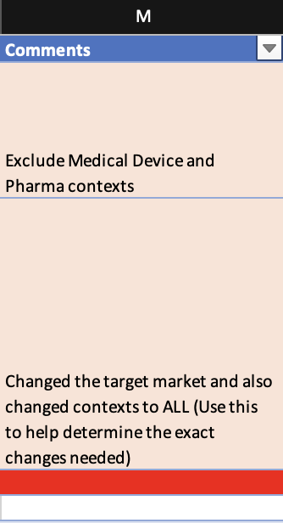
Validation Template
Context & Comments
Comments: This serves for 2 purposes.
Specify the changes made to rules or proposed error messages.
Explain the detail of excluded contexts. Since the tool does not allow multiple selections, this field is used to help explain.

Slide 12
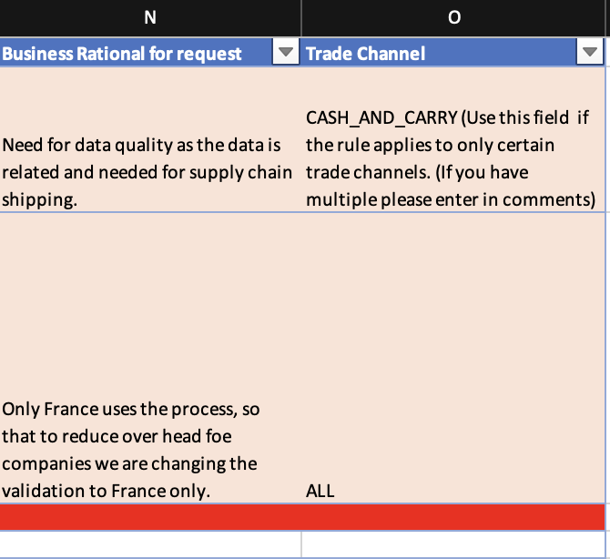
Validation Template
Business Rational & Trade Channel
Business Rational: Include the business case for the request. It is not because the validation exists already. Please explain why the need for this particular validation rule.
Trade Channel: Not widely used currently, this would explain which trade channels the rule would be applicable to. Note this is a drop down, so multiple trade channels must be included in comments field.

Slide 13
Any questions please contact GSMP@gs1.org

