Slide 1
GS1 Standards Event 2018
19-23 March – Jersey City, NJ USA
Building standards to deliver business value
Session: GDSN User Group and OTAG Meeting
Time: Monday 19 March and Tuesday 20 March 2018
Who may attend: The GDSN User Group and OTAG meeting is open to all attendees.
Speaker(s):

Slide 2
Anti-trust caution
GS1 operates under the GS1 anti-trust caution. Strict compliance with anti-trust laws is and always has been the policy of GS1.
The best way to avoid problems is to remember that the purpose of the group is to enhance the ability of all industry members to compete more efficiently.
This means:
  There shall be no discussion of prices, allocation of customers, or products, boycotts, refusals to deal, or market share.
  If any participant believes the group is drifting toward impermissible discussion, the topic shall be tabled until the opinion of counsel can be obtained.
The full anti-trust caution is available via the link below, if you would like to read it in its entirety: http://www.gs1.org/gs1-anti-trust-caution.

Slide 3
Statement & reminder for seeking intellectual property information
Relevant to the features of the specification that are being developed in this work group, if anyone has knowledge or information about intellectual property rights, such as, patents or patent applications; please promptly convey this information to the work group facilitator.
The intellectual property rights can either be in development or owned by persons, companies or third parties within this work group or outside this work group.
We do this under the guidance of the GS1 Intellectual Property Policy, so that GS1 can seek to avoid the uncertainty regarding intellectual property claims against the Specification.

Slide 4
Meeting etiquette
Meetings will begin promptly as scheduled
Be present – avoid multi-tasking
Avoid distracting behaviour:
  Place mobile devices on silent mode
  Avoid sidebar conversations
Be considerate
  Avoid monologues
  Keep comments concise
Respect work group decisions
  Avoid re-opening decisions unless there is a significant quality impact
Collaborate in support of meeting objectives
  Ask questions
  Be open to alternatives
Be representative
  Avoid personal remarks
  Do not speak for your company or community if you do not clearly understand their needs
  Votes should reflect the needs of your company or community

Slide 5


GS1 Standards Event App – How to get it
Get the App by searching your App store for "GS1 Global Events" (If you already have the Global App due to attendance at the Global Forum or Standards Event, you do not need to do this)
Once you have the Global App on your mobile device, type GS1NJ18 in the search box. Please click the orange (+) to activate the event within your application.
1
2
Login with the email address you used to register for the event:
Username: (your registered email)
Password: GS1events
2017
ar
2018
3

Slide 6
WiFi internet access
Select “GS1” and connect
Password: GS1events

Slide 7
Introduction - GS1 User Group
Introductions
  Anti-Trust Caution
  Meeting Expectations
  Agenda Review and Update

Slide 8
GDSN Healthcare update
Pete Alvarez

Slide 9
Topics
GDSN and Pharma
Attribute Guidance for healthcare (TIIG)
USAID GDSN Implementation Rollout

Slide 10

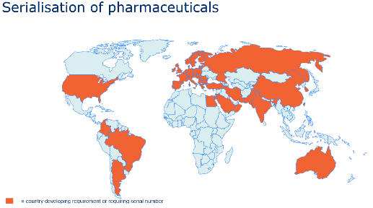
GDSN Pharma Use Case
Objective: Enable Pharmaceutical manufacturers to share master data, required by serialisation and traceability regulation, via GDSN with their customers (hospitals, distributors and pharmacies, etc.).
Available soon on the GS1 Healthcare website

Slide 11
Attribute Guidance for Healthcare

Slide 12

Business Need
The healthcare industry is asking for guidance and examples on how to populate and use GDSN attributes in various use cases and contexts
The GS1 Healthcare Leadership Team supports the development of guidance which helps manufacturers, distributors and hospitals

Slide 13

GDSN Attribute Guidance for Healthcare
Action: Provide healthcare similar guidance on how to use GDSN attributes as we do for other sectors
Sponsored by GS1 US, with support from the global healthcare community
Work Request pending

Slide 14
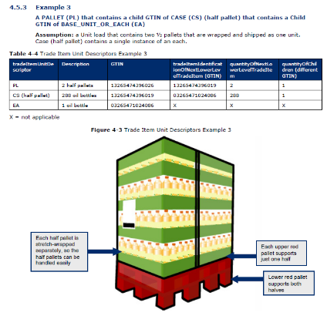
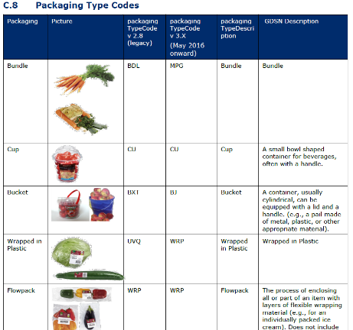
Trade Item Implementation Guide
Provides general guidance on how to use and populate GDSN attributes
Sector specific guidance:
Food & Beverage
Fresh Foods
Fruit & Vegetables
Next: Healthcare (Pharma & Medical Devices)

Slide 15
USAID GDSN Implementation Rollout

Slide 16

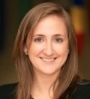
USAID GDSN Implementation Rollout
In January 2018, the USAID Global Health Supply Chain – Procurement and Supply Management (GHSC-PSM) project launched an implementation programme across all of their pharmaceutical and medical device suppliers from all over the world.
Kaitlyn Roche
Manager, Global Standards
GHSC-PSM

Slide 17

USAID GHSC-PSM Statistics
Approximately 300 suppliers
Offices in 30 countries, ship to more than 50 countries
Approximately $1.1 billion in annual spend on global health commodities - mainly pharmaceuticals & medical devices

Slide 18
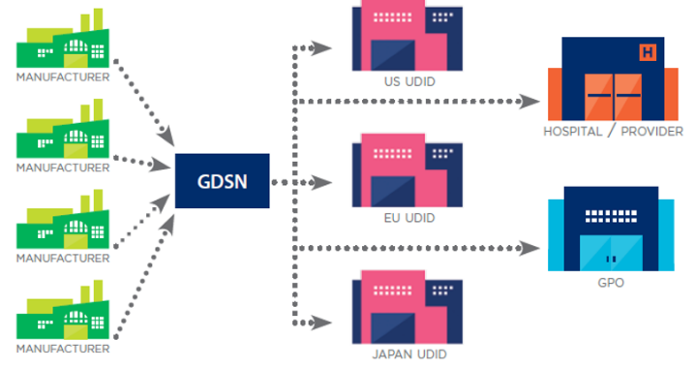
GDSN Vision for Global Health
Align master data among global procurement agencies through a single connection
Over time as supply chains mature, extend capabilities into supported countries
GHSC-PSM
National Drug Regulatory Authority
UNFPA
Central Medical Store
Global Fund
EXAMPLE ONLY

Slide 19
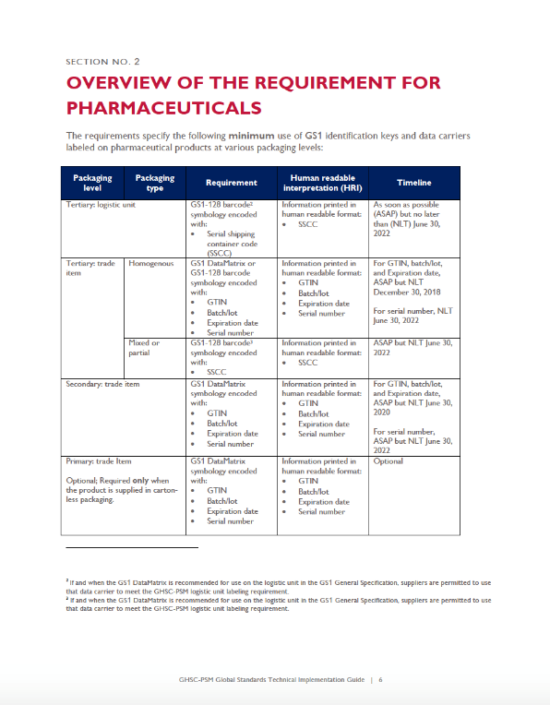
USAID GHSC-PSM Requirements
Identification (GTINs & GLNs) within 6 months of new contracts
Labeling requirements for pharmaceuticals, medical devices, laboratory reagents, and sterile test kits phased in between Dec 2018 – Jun 2022
Master data exchange via the GDSN required by Dec 2019
  For more information contact the USAID GHSC-PSM Data Sync Team at datasync@ghsc-psm.org
  Visit http://ghsupplychain.org/globalstandards

Slide 20

Pete Alvarez
GS1 Global Office
Senior Director, Identification & Data Strategy, Healthcare
peter.alvarez@gs1.org

Slide 21
Global Product Classification Update (GPC)
Mike Mowad

Slide 22
GS1 Industry & Standards Event 2018
Global Product Classification (GPC)
GDS User Group Update
Building standards to deliver business value
Mike Mowad, GS1 Global Office

Slide 23

The Role of GPC in GDSN
The Global Product Classification (GPC) standard gives buyers and sellers a common language to group products the same way globally
Ensures effective data synchronisation in GDSN and enables:
  Item Publication
  Registration
  Subscription

Slide 24

GPC Releases
GPC uses a “Consolidated Release” strategy to publish twice per year, (every June and December)
Approximately 5 months after a new GPC is published
it is incorporated into the latest GDS release

Slide 25
GPC deployment into GDS
May/Jun
2017
Nov/Dec
2017
May/Jun
2018
Nov/Dec
2018
May/Jun
2019
Nov/Dec
2019
GPC Jun-2017 Publication
GPC Dec-2017 Publication
GPC Jun-2018 Publication
GPC Dec 2016 Deployed
into GDSN
GPC Dec-2018 Publication
GPC Jun 2017 Deployed
into GDSN
GPC Jun-2019 Publication
GPC Dec 2017 Deployed
into GDSN
GPC Dec-2019 Publication
GPC Jun 2018 Deployed
into GDSN
GPC Dec 2018 Deployed
into GDSN
GPC Jun 2019 Deployed
into GDSN

Slide 26
GPC June 2018 Publication Schedule
April 2018
May 2018
June 2018
Motion Final WRs to Public Review
11-Apr
Motion to eBallot
23-May
Publish June 2018 Release By 30-Jun
Community Review
Final WRs
16-Apr to 7-May
Prep
eBallot
24-May to 7-Jun
(2 Weeks)
IP Review
24-May to 21-Jun
(4 Weeks)
Prep

Slide 27
GPC Brick Code Adoption in GDSN

Slide 28
% of Temporary GPC Brick Codes Passed through GDSN

Slide 29























GPC Translations
GPC is officially published in Oxford English and is translated to 22 other languages
 | Arabic |  |  | French |  |  | Korean |  |  | Russian
 | Chinese |  |  | German |  |  | Latvian |  |  | Serbian
 | Czech |  |  | Greek |  |  | Macedonian |  |  | Spanish
 | Danish |  |  | Hungarian |  |  | Norwegian |  |  | Swedish
 | Dutch |  |  | Italian |  |  | Persian
 | Finnish |  |  | Japanese |  |  | Portuguese
* Languages in Orange are coming soon

Slide 30



Core Attribute in the GS1 Cloud
Attributes | Check | View | Explore
1. GTIN
2. Brand
3. Label Description
4. Medium Resolution Image
5. Target Market
6. Company Name
7. Product Classification
GPC
Required for service
Service enhanced as a result

Slide 31





Contact Information
Mike Mowad
Director, Global Product Classification
michael.mowad@gs1.org
Jeanette McVeigh
GPC SMG Manager & Service Provider
jeanette.mcveigh@gs1.org
www.gs1.org

Slide 32
GSMP Process
Eileen Harpell

Slide 33
Consumer Product Variants Update
Eric Kauz

Slide 34
Update on GS1 Cloud
Birgit Mahler

Slide 35
Coffee Break
1530 – 1600 EST

Slide 36
GDSN Discussion Topics
GDSN Discussion Topics Discussion of management of external code lists
  External Code Lists - Request to input all code lists in GDD
  Healthcare network release – Review results

Slide 37
WR-17-000349 – Mirva Alatyppo
WR-17-000349 – Handling instructions
  Ethylene is colorless and sweet smelling gas, which is formed by plant breathing. The production of ethylene is the normal function of the plant. Ethylene accelerates the ripening of fruit (and aging) and affects both taste and aroma.
  Items that produce plenty of Ethylene and Items suffering from Ethylene should be stored separately in distribution centers and stores. With Ethylene information trade item can be directed into right section in e.g. distribution centers
  How this is implemented by recipients?

Slide 38
GDSN Discussion Topics cont’d..
  WR- 17-000249 - proposition is to have a different directory and schemas location for all new GDSN release. e.g., if the release is 3.1.3, new URL with http://www.gs1globalregistry.net/3.1.3/schemas/ for production environment and http://www.gdsregistry.org/3.1.3/schemas/ for preproduction environment.
  Discussion on process and assumptions on subscribe, publishing and registering items with target market D_A (Development Assistance)”.

Slide 39
WR- 18-00025 – Steve Robba
The problem for Duty Free Shopping at Airports is the recipients support many markets. Many of them are not in GDS and the recipients need languages for all markets they serve. In addition, the markets that do have GDS, the Travel Retail data model itself is different than the market models hence causing additional issues.
Add a country code for T_R Travel Retail.

Slide 40
GDSN releases and roadmap
GDSN releases and roadmap
  Release planning
  Documentation
  Release dates
  Status update and future outlook/direction from the sectors - Neil Gray
  Definition for each level of GDSN release - Nordine

Slide 41
Lunch
1230 – 1330 EST

Slide 42
Piloting move to HTML publication
David Buckley & Eric Kauz

Slide 43

Moving beyond PDF
Standards and guidelines:
Which publishing
format?
Initiative underway looking publishing GS1 standards & guidelines:
In formats other than PDF:
  HTML
  Machine-readable format
Leveraging GS1 Smart Search concepts and meta data

Slide 44
Eric to demo
Eric to demo HTML

Slide 45
National initiative
Sylvia Rubio / Staffan Olsson

Slide 46
Improve Subscription Process
Tony Zhang

Slide 47







We capture, manage, and share product information with the world.
GLOBAL FOOTPRINT
CROSS-INDUSTRY EXPERIENCE
20 YEAR HISTORY
UNMATCHED CUSTOMER DEDICATION
DATA
CAPTURE
DATA
INTEGRATION
DATA
VALIDATION
DATA
SYNDICATION
DATA
ANALYTICS
B2B
B2C

Slide 48
What Makes FSEnet⁺ Different?
01
02
03
04
PEOPLE
SOFTWARE
EXPERIENCE
REACH
Dedicated Account Managers
In-House Development
Team
Unlimited Support
Our own Code/Program
Not-Outsourced
Everything Under One
Roof
Saas Based
20 years of Data
Management Experience
Pioneers of GDSN
Global Footprint
Explosive Growth
Continued Expansion
Modularized Application for Satisfying:
  Schema
  Attributes
  Message Choreography
  Defined Validations

Slide 49
Current Subscription Process
Create subscription
Send subscription to Global Registry
Global Registry to match subscription with suppliers
Subscription is forwarded to supplier data pool

Slide 50
Problem
The recipient data pool does not know when the subscription is sent to source data pool
We received many requests to trace where subscriptions are
We just delete subscriptions and resend

Slide 51
Proposal
Could Global Registry sends a subscriptions to recipient data pool?
Could Global Registry inform recipient data pool when subscription is forwarded?
Could Global Registry allow source data pools to check whether a subscription is available (only query its source data pool)?

Slide 52
Discuss WR – 18000023
Nordine Eddaoudi

Slide 53
WR number 18-000023
Nordine.eddaoudi@gs1fr.org
20/03/2018

Slide 54
French regulation on spare parts ‘Décret n°2014-1482 du 9 décembre 2014’
Contents :
According to the French regulation, before purchasing an electrical / electronic product, the end consumer must know if he can buy spare parts to repair this product in case of breakdown.
If yes, the retailer must also provide the delay for buying those spare parts and the date from which this deadline will begun.
Complete regulation is described in this link https://www.legifrance.gouv.fr/affichTexte.do?cidTexte=JORFTEXT000029881868&dateTexte=20180122

Slide 55
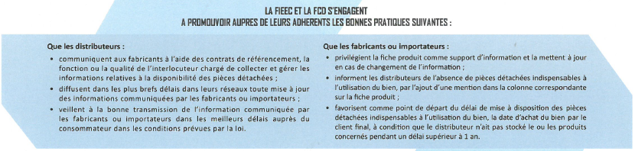
Resume of the regulation by the Retail and Trade Federation
For the retailer :
  Provide information about availability of spare parts to the end consumer (website, store shelf, …) ➔ Global business need
For the supplier :
  Use product description to provide information related to spare parts
  Inform retailers about the availability of spare parts ➔ 1st part of the business need
  Use the date of purchasing by consumer as a reference for the deadline (Eg : 5 years of availability that will began when the consumer purchase the product) ➔ 2nd part of the business need

Slide 56
GS1 France’s proposal (technical solutions)
The proposed change is to define 3 new attributes :
1st part of the business need : isTradeItemSparePartsAvailable “Boolean that indicates if ‘yes’ or ‘no’ the spare parts are available for the product”
2nd part of the business need : sparePartsAvailabilityPeriod “number of years for the availiability” and sparePartsAvailabilityEffectiveDateType “referenced date from which the period will begin”
Why do we need a Boolean? To make sure that the product is really not concerned by spare parts if supplier has not provided the both other attributes.
  With isTradeItemSparePartsAvailable = false, it will be sufficient.

Slide 57
GDSN Simplification Initiative Update
Alan Hyler / Susie McIntosh-Hinson

Slide 58
Coffee Break
1530 – 1600 EST

Slide 59
GS1 in Europe Update
Tomas Tlchor

Slide 60
GDSN User Group & OTAG
Update on GS1 in Europe activities related to GDSN
GS1 Standards Event 2018, Jersey City
20th March 2018

Slide 61

Introducing Europe
24 official languages
28 EU member states, 47 GS1 in Europe MOs
EU legislation (Regulations), transposed legislation (Directives), national legislation
Different level of GDSN maturity in EU states (from none to mature)
GS1 in Europe as legal entity exists for only 5 years
Different national data models (GDSN subsets) and harmonization challenges
Big users push for regional rather than local approach

Slide 62
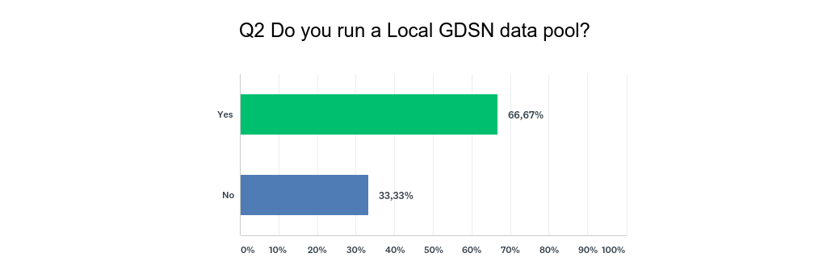
2017 GS1iEU Survey:
Do you run a local GDSN data pool?
Notes:
25 out of 47 GS1iEU MOs responded in the survey

Slide 63
GS1iEU B2B2C working group
GS1iEU Board
GS1iEU REC
GS1iEU Data Excellence Steering Committee
GS1iEU Data Excellence User Board
Data Excellence Sponsor
Jan Somers, GS1 Belgilux
B2B2C WG Project Manager
Tomas Tluchor, GS1 Czech Rep.
GS1iEU B2B2C Working Group

Slide 64

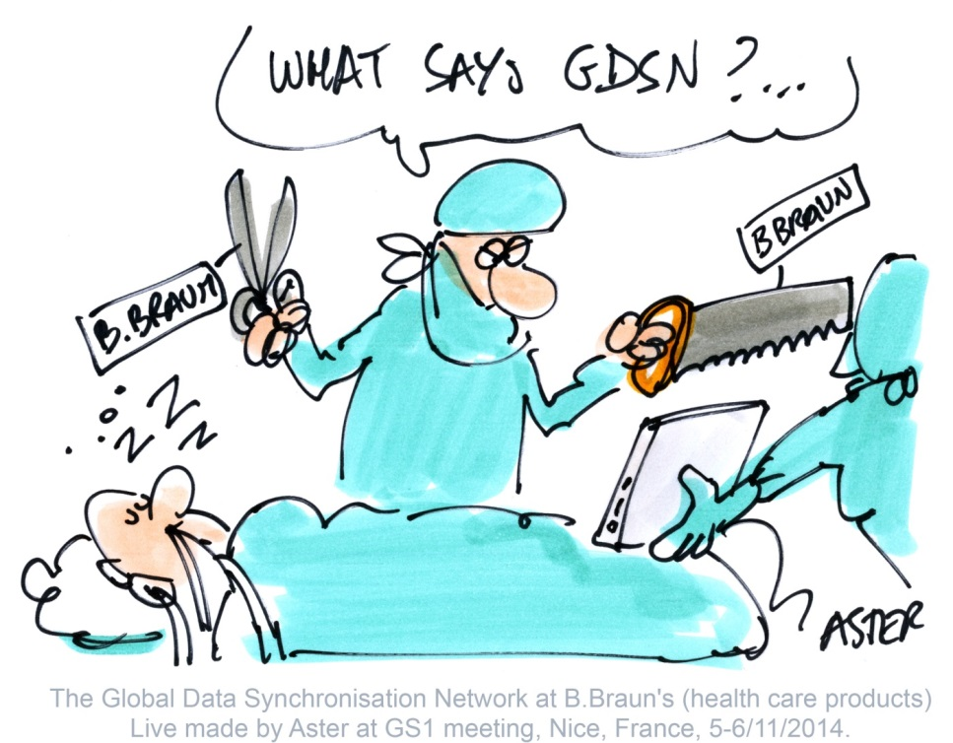
ECHO Project
The ECHO initiative focuses on harmonising market strategies and data requirements across borders in order to maximise the benefits of using the GDSN
Collaboration of GS1 MOs with healthcare stakeholders
Data model covering regulation requirements for medical devices (FDA, NHS, MDR) – ready
Data model for pharmaceuticals – to be developed

Slide 65
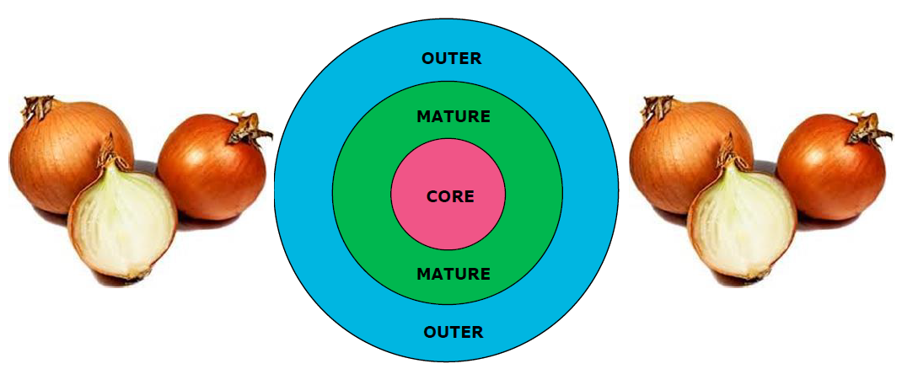
EU Mature Data Model (EU MDM) – Onion model

Slide 66
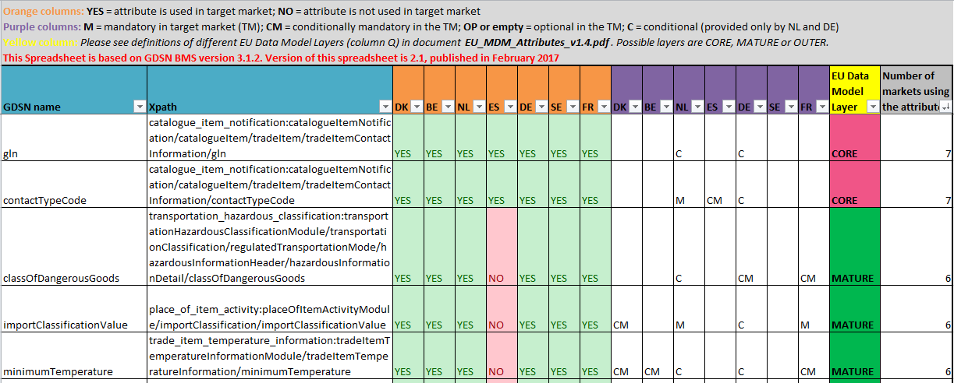
EU MDM – list of attributes

Slide 67

EU MDM - Plans for 2018
Submit validation rules to GSMP
1 new VR and 2 changes of existing VRs submitted last week
25 will be submitted in second half of April
Start updating the Data Model
It is already old – published in February 2017
Plan to update twice a year
Data in Global Attribute Explorer needed
Use it

Slide 68
Summary of the 25 VRs to be submitted in April
6 rules for logic rules around nutrients
  e.g. there are no more sugars than carbohydrates in a trade item (CHOAVL >= SUGAR-)
6 rules to ensure correct use GTIN vs nonGTIN pallet attributes
  e.g. If tradeItemUnitDescriptorCode equals 'PALLET', then quantityOfTradeItemsPerPallet SHALL NOT be used.
7 rules to prevent duplications
  If multiple iterations of packagingMarkedDietAllergenCode are used, no two iterations SHALL be equal.
7 other rules
GS1 in Europe MOs can opt-in until 16th of April

Slide 69
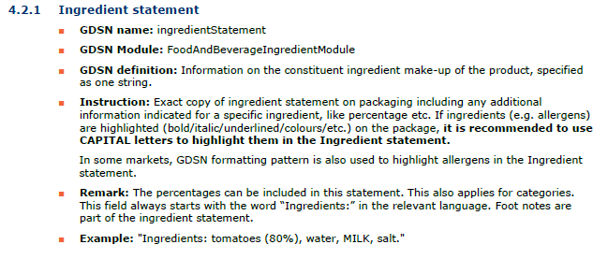
GS1 in Europe GDSN Guidelines
Published: Food Information Regulation (1169); Pet Food
Input to TIIG: Dangerous Goods
All guidelines have same structure:
list of relevant GDSN attributes with guidance.

Slide 70

GS1iEU GDSN Guideline on Pet Food
Based on requirements of EU Regulation 767/2009
Harmonized implementation of pet food in GDSN across Europe
Developed in 2017 together with the industry (MOs, suppliers, retailers, associations)
25 attributes – 4 are new in 3.1.6 release
Available on GS1iEU website: http://www.gs1.eu/news/gdsn-implementation-guidelines-for-pet-food

Slide 71










Dangerous Goods and Hazardous Substances
Provide better guidance on how to exchange required information via GDSN
Avoid different GDSN implementations of the same EU legislation in different markets
European input into work on new section in Trade Item Implementation Guideline (TIIG)

Slide 72

Dangerous Goods Guidance: challenges
Differences in existing implementations
Huge and often updated official documentation (e.g. ADR)
  GDSN „topics“ seem stable (2009 = 2017)
  One version should be chosen and used as a reference
Code lists
  Most of code lists are externally managed and can change frequently
  Guidance not on the codes but on the method to create the codes
Complex subject – expertise needed

Slide 73

Contact Information
Tomáš Tlučhoř
Project Manager
GS1 in Europe
Rue Royale 76, mailbox 1
Brussels 1000, Belgium
T
+420 227 031 165
M
+420 725 096 098
E
tluchor@gs1cz.org
www.gs1.eu

Slide 74
Update: Trade Item Implantation Guideline (TIIG)
David Buckley

Slide 75
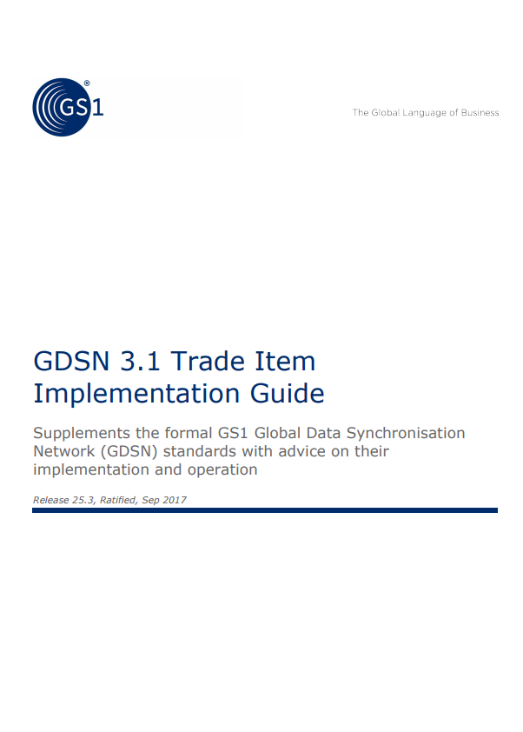
Update: Trade Item Implantation Guideline (TIIG)
https://www.gs1.org/gdsn/trade_implementation_guide
David’s simplified understanding:
Major overhaul and update in 2016 to support GDSN MjR:
  Today structurally sound and generally up-to-date
TIIG sub-team last met in 2016
David Buckley took GO responsibility for TIIG from Mike Mowad in 2017
  TIIG cRoom exists and is used for initial discussions
  All Work Requests formally processed by GMD-SMG
Following slides recent Work Requests

Slide 76
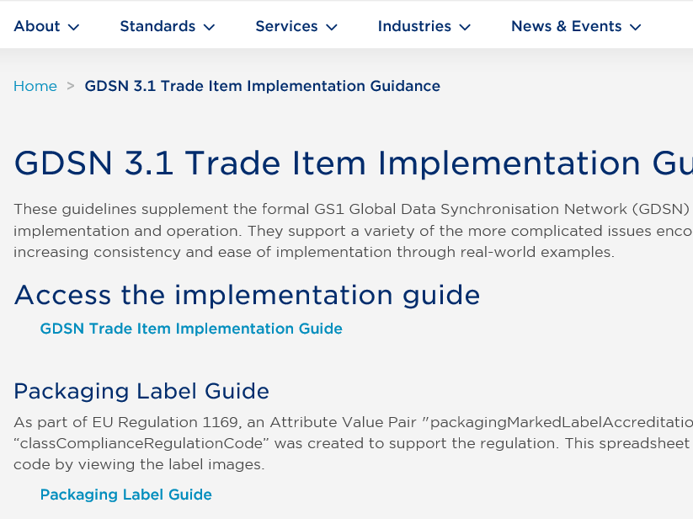
Update Trade Item Implementation Guide (TIIG)
https://www.gs1.org/gdsn/trade_implementation_guide
GDSN Trade Item Implementation Guide
Packaging Label Guide
[Possible in the future] Leveraging GDSN for the FDA Global Unique Device Identifier Database (GUDID) Implementation Guideline

Slide 77
Work in progress: updates to TIIG (summary)
In ratification:
  17-000331, Update section 3.6, example 6 for Unit of Measure
  18-000020, Update section 35.4.1 on use of components
  Errata fix (highlighted by Staffan)
Ad hoc sub group:
  18-000016, new section xxx on “Transportation, Dangerous and Hazardous Information”
Expected from Tony Zhang:
  Work Requests 17-172 & 17-320 are withdraw but expecting a new item to help clarify certification and accreditation

Slide 78

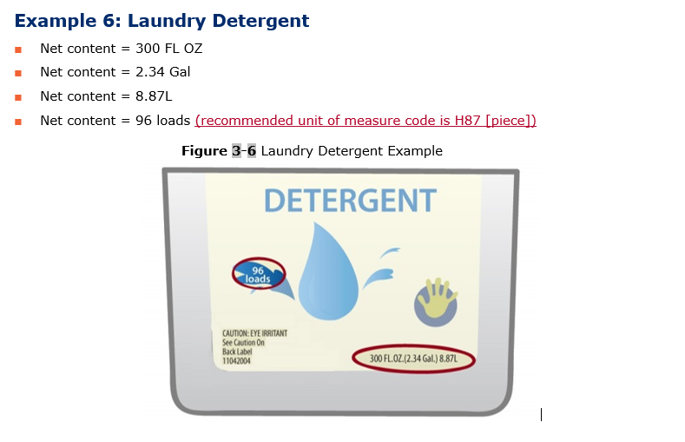
17-331: Update the Trade Item Implementation Guideline (TIIG), Example 6 in section 3.6 to provide recommendation for the actual Unit of Measure (UoM) code

Slide 79
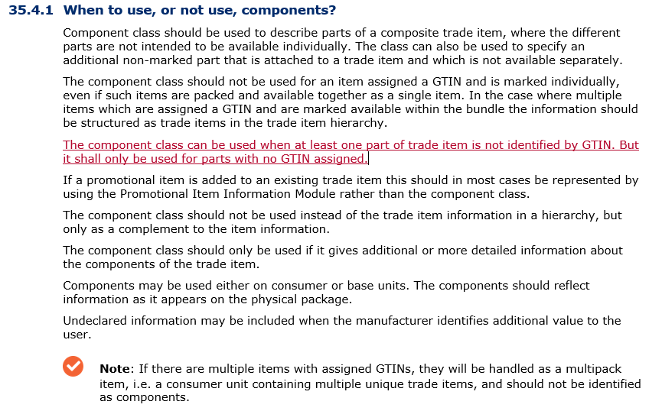
18-00020:Update Trade Item Implementation Guide (TIIG) to clarify implementation of components

Slide 80
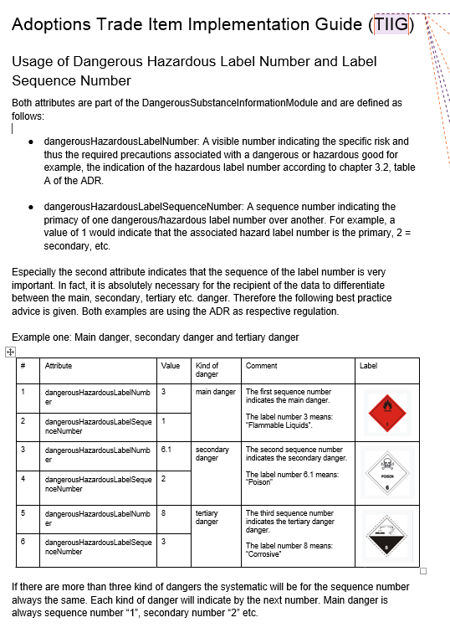
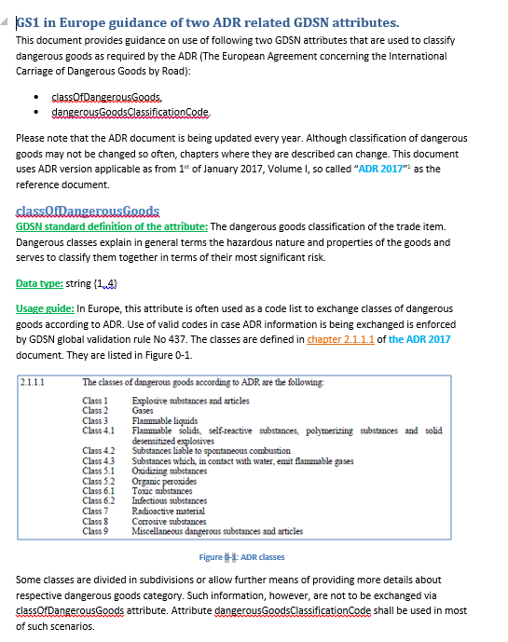

18-016:Update Trade Item Implementation Guide (TIIG) for Transportation, Dangerous and Hazardous Information
Input from 18-016
GS1 Canada
GS1 in Europe

Slide 81
Ad hoc group of GMD-SMG volunteers
Agreed at GMD-SMG NOT to reestablish the TIIG subteam (dormant since 2017) but progress individual topics:
  Small or maintaince requests, directly to GMD-SMG
  Larger or more complex requests, via Ad hoc group of volunteers to prepare proposal for GMD-SMG
    NOTE: Only GMD-SMG can move to Community Review or eBallot
Ad hoc team for Transportation, Dangerous and Hazardous Information update:
  Steven Robba (1WSync), Rita Laur (GS1 Canada), Zubair Nazir (GS1 Canada), Tomáš Tlučhoř (GS1 Czech), Reinier Prenger (GS1 Nederland), David Buckley (GS1 Global Office) – open to others volunteers

Slide 82
Open discussion
Tony: possible upcoming Work Request on certification
Packaging Label Guide: after major clean-up now in maintaince mode
David: possible quality check on TIIG attribute names
One document or break up into smaller parts?
Any other discussion items?

Slide 83
WR - 18-000063 - Tomas Tlchor
GDS is a complex standard with well over 1,000 defined attributes. Currently, the only unique identification of each attribute is xpath. But xpath is too long and not used in several GDSN related documents such as for example GDSN Trade Item Module Library BMS. Attribute names are therefore often used by readers to search for information but these names are not unique.
Following 2 main problems have been identified:
  conducting analysis of GDSN attributes in MS Excel (e.g. comparing different data models) is difficult because attribute names are not unique and xpaths are sometimes too long for Excel functions used to compare/analyse data,
  searching attribute information in pdf documents (BMS, TIIG), GDD etc. is slow as attribute names are not unique and sometimes also quite long. Possible solution is to add this to Attribute Explorer - Tomas Tlchor

Slide 84
WR - 18-000063 - Tomas Tlchor cont’d…
We would like to propose that GS1 Global Office assigns short ID to every GDSN attribute. This will allow MOs to re-use such IDs instead of creating their own. It will be also easier for international users to cross reference. If included into global GDSN documentation (e.g. BMS pdf), it will make it more efficient to work with.

Slide 85
GDSN Discussion Topics cont’d…
Process to request access to the Data Pool GS1 Cloud website – Susie McIntosh-Hinson

Slide 86
Code Value
Animal ID
Zsolt Jasco

Slide 87
Hero Image Discussion
Paris Meeting
CPV
Yolande Diaz

Slide 88
Recap/Open Items
Future User Group Meetings – Alan Hyler (30 minutes)
  Recap/Open Items List
Adjourn

