Slide 1
GS1 Industry & Standards Event 2017
09-13 October 2017 – Brussels, Belgium
Transforming business together
Session: GDSN USER GROUP
Who may attend: All Attendees

Slide 2
Anti-trust caution
GS1 operates under the GS1 anti-trust caution. Strict compliance with anti-trust laws is and always has been the policy of GS1.
The best way to avoid problems is to remember that the purpose of the group is to enhance the ability of all industry members to compete more efficiently.
This means:
  There shall be no discussion of prices, allocation of customers, or products, boycotts, refusals to deal, or market share.
  If any participant believes the group is drifting toward impermissible discussion, the topic shall be tabled until the opinion of counsel can be obtained.
The full anti-trust caution is available via the link below, if you would like to read it in its entirety: http://www.gs1.org/gs1-anti-trust-caution.

Slide 3
Statement & reminder for seeking intellectual property information
Relevant to the features of the specification that are being developed in this work group, if anyone has knowledge or information about intellectual property rights, such as, patents or patent applications; please promptly convey this information to the work group facilitator.
The intellectual property rights can either be in development or owned by persons, companies or third parties within this work group or outside this work group.
We do this under the guidance of the GS1 Intellectual Property Policy, so that GS1 can seek to avoid the uncertainty regarding intellectual property claims against the Specification.

Slide 4
Meeting etiquette
Meetings will begin promptly as scheduled
Be present – avoid multi-tasking
Avoid distracting behaviour:
  Place mobile devices on silent mode
  Avoid sidebar conversations
Be considerate
  Avoid monologues
  Keep comments concise
Respect work group decisions
  Avoid re-opening decisions unless there is a significant quality impact
Collaborate in support of meeting objectives
  Ask questions
  Be open to alternatives
Be representative
  Avoid personal remarks
  Do not speak for your company or community if you do not clearly understand their needs
  Votes should reflect the needs of your company or community

Slide 5


GS1 Standards Event App – How to get it
Get the App by searching your App store for "GS1 Global Events"
(If you already have the Global App due to attendance at the Global Forum or Standards Event, you do not need to do this)
Once you have the Global App on your mobile device, the Industry & Standards Event module will automatically show up. Please click the orange (+) to activate the event within your application.
Login with the email address you used to register for the event:
Username: (your registered email)
Password: 2017
1
2
3
2017

Slide 6
WiFi internet access
Select “Crowne-Plaza-Free-Internet” and connect
Password: 2017

Slide 7
Agenda Review
Introductions
Anti-Trust
Switch to Agenda

Slide 8
GS1 Industry & Standards Event 2017
09-13 October 2017 – Brussels, Belgium
Transforming business together
Session: Global Product Classification (GPC),
GDS User Group Update
Speakers: Mike Mowad, GS1 Global Office

Slide 9

The Role of GPC in GDSN
The Global Product Classification (GPC) standard gives buyers and sellers a common language to group products the same way globally
Ensures effective data synchronisation in GDSN and enables:
  Item Publication
  Registration
  Subscription

Slide 10
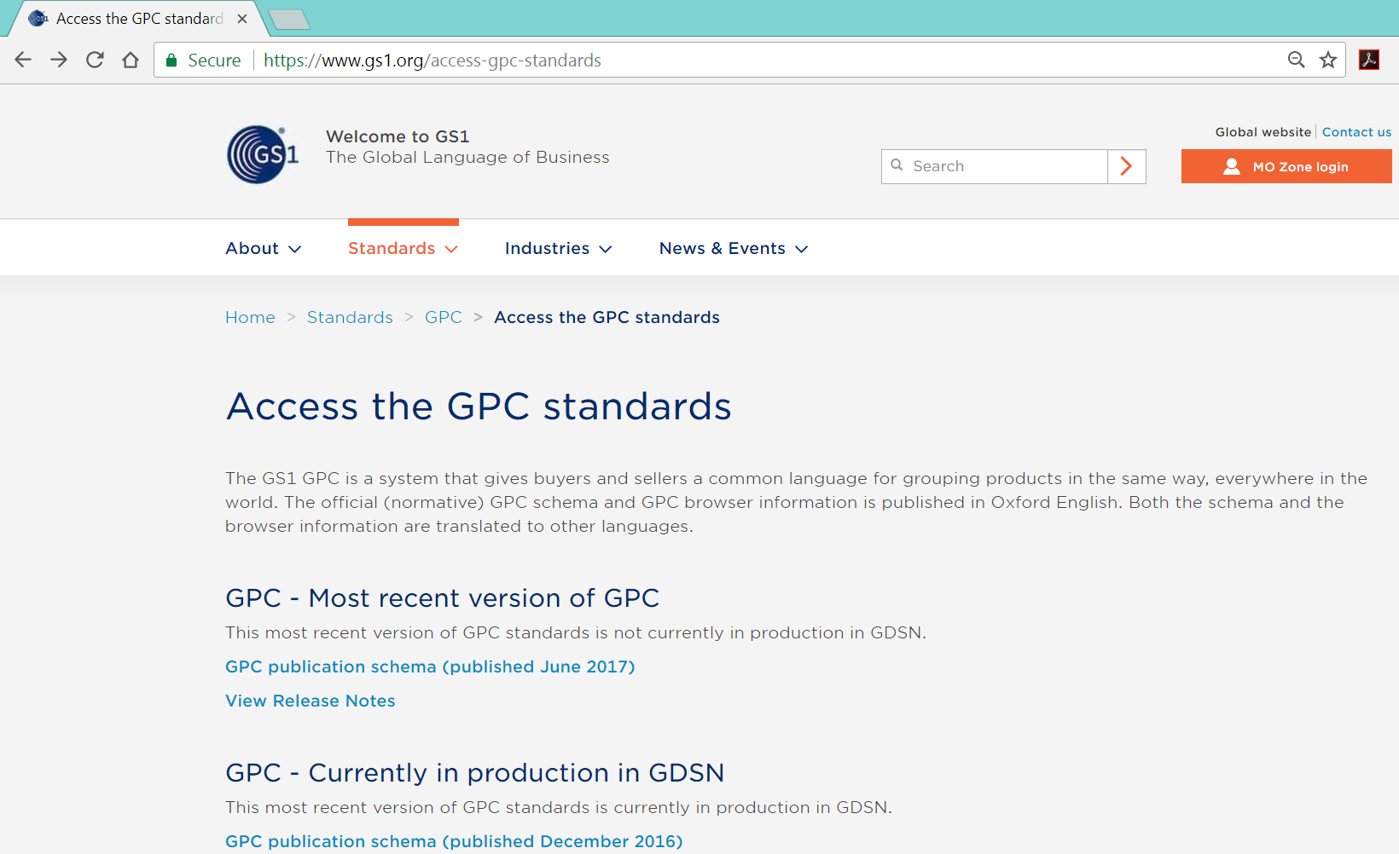
GPC Standards Website

Slide 11
GPC Delta Reports
Additions - The introduction of a new code.
Deletions - The absence of a code that was previously published.
Modifications - When the code has NOT changed but the textual description HAS changed AND the definition has NOT changed. GPC Codes are NEVER modified and once deleted can never be re-used. If the Brick impacted has a significant definition change the normal process is to Add new codes and Delete old codes.
Replacements - When a code has been Replaced by another code in a 1:1 relationship.
Splits - When a code has been Split into other codes in a 1:many relationship.
Moves - When a code has changed its hierarchy in a 1:1 relationship

Slide 12

GPC Releases
GPC uses a “Consolidated Release” strategy to publish twice per year, (every June and December)
Approximately 5 months after a new GPC is published it is incorporated into the latest GDS release

Slide 13






Previous Publications
Jun-2017 Publication:
New Bricks to expand Cosmetics, Photography, Hormonal Contraception, DIY Products, and Crops
Processed 26 WRs
Dec-2016 Publication:
New Bricks to expand classification in Crops, Fruits/Vegetables,
Travel Cases/Bags, Books, Textiles, and Cosmetics
Processed 47 WRs

Slide 14
GPC Dec-2017 Publication
(Updated Oct-2017)
Dec 2017 Publication:
Oct-2017
Nov-2017
Dec-2017
Publish Dec-2017 Release to Website
By 20-Dec
Motion Final WRs to Public Review
11-Oct
Physical Meeting
Motion to eBallot
15-Nov
Community Review Final WRs
16-Oct to 31-Oct
Prep
eBallot
16-Nov to 30-Nov
(2 Weeks)
IP Review
16-Nov to 14-Dec
(4 Weeks)
Prep

Slide 15
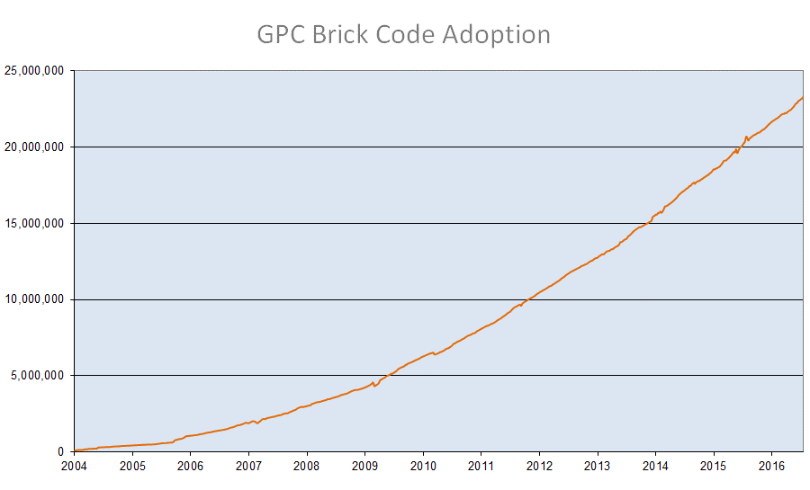
GPC Adoption in GDSN
(as of June 2017)

Slide 16



















GPC Translations
GPC is officially published in Oxford English and is translated to 18* other languages
Arabic
Chinese
Czech
Danish
Dutch
Finnish
French
German
Hungarian
Italian
Japanese
Macedonian
Persian
Portuguese (Brazil)
Russian
Serbian
Spanish (Mexico)
Swedish
* Three more languages in the queue

Slide 17
Dairy Products
Segment
Family
Class
Bricks (Old)
Bricks (New)
Milk
(Frozen)
Milk/Milk Substitutes (Frozen)
Food
Beverage
Tobacco
Milk / Butter
Cream / Yogurts
Cheese / Eggs
Substitutes
Milk and Milk Substitutes
Milk Substitutes
(Frozen)
Milk
(Perishable)
Milk/Milk Substitutes (Perishable)
Milk Substitutes
(Perishable)
Milk/Milk Substitutes (Shelf Stable)
Milk
(Shelf Stable)
Milk Substitutes
(Shelf Stable)

Slide 18
GPC Sustainability (Crops)
Updated Oct 2017
 |  | Q3/Q4 2017 | Q1/Q2 2018 | 2018
Segment: Crops WR: 17-000081 Family: Crops for Food Production Family: Crops not for Food or Feed | Completed: Dec-2016
Segment: Crops WR-17-000235 Family: Crops for Food Production |  | Dec-2017 Pub
Segment: Crops Family: Crops for Food Production Family: Crops not for Food or Feed Family: Grasses for propagation & Feed Family: Crops for feed and forage |  |  | Scheduled: Jun-2018 Pub
Commodities (Harvested Products) |  |  |  | TBD
Livestock |  |  |  | TBD

Slide 19

WR 17-195 Clothing
Combines several “clothing” related WRs to update Children’s Wear, Accessories, Outerwear, and Occupational Working Clothes
With the assistance of Industry Experts we are reorganizing the hierarchy (Family & Class) to better reflect the Apparel industry
Minimum impact to existing Brick and Brick Codes
Target: GPC June 2018 Publication

Slide 20
Contacts
Mike Mowad
Director, Global Product Classification
michael.mowad@gs1.org
Jeanette McVeigh
GPC SMG Manager & Service Provider
jeanette.mcveigh@gs1.org

Slide 21
Eileen Harpell, Global Standards Management Process
Previously…

Slide 22
Agenda
Review changes
Opportunities
Automation project

Slide 23

Improved Work Request input
A clear business need in work requests
SMG minutes and agenda's will report work request activity in a table (system driven, Automation Project)
Clear and concise requirements’ output from SMG’s

Slide 24
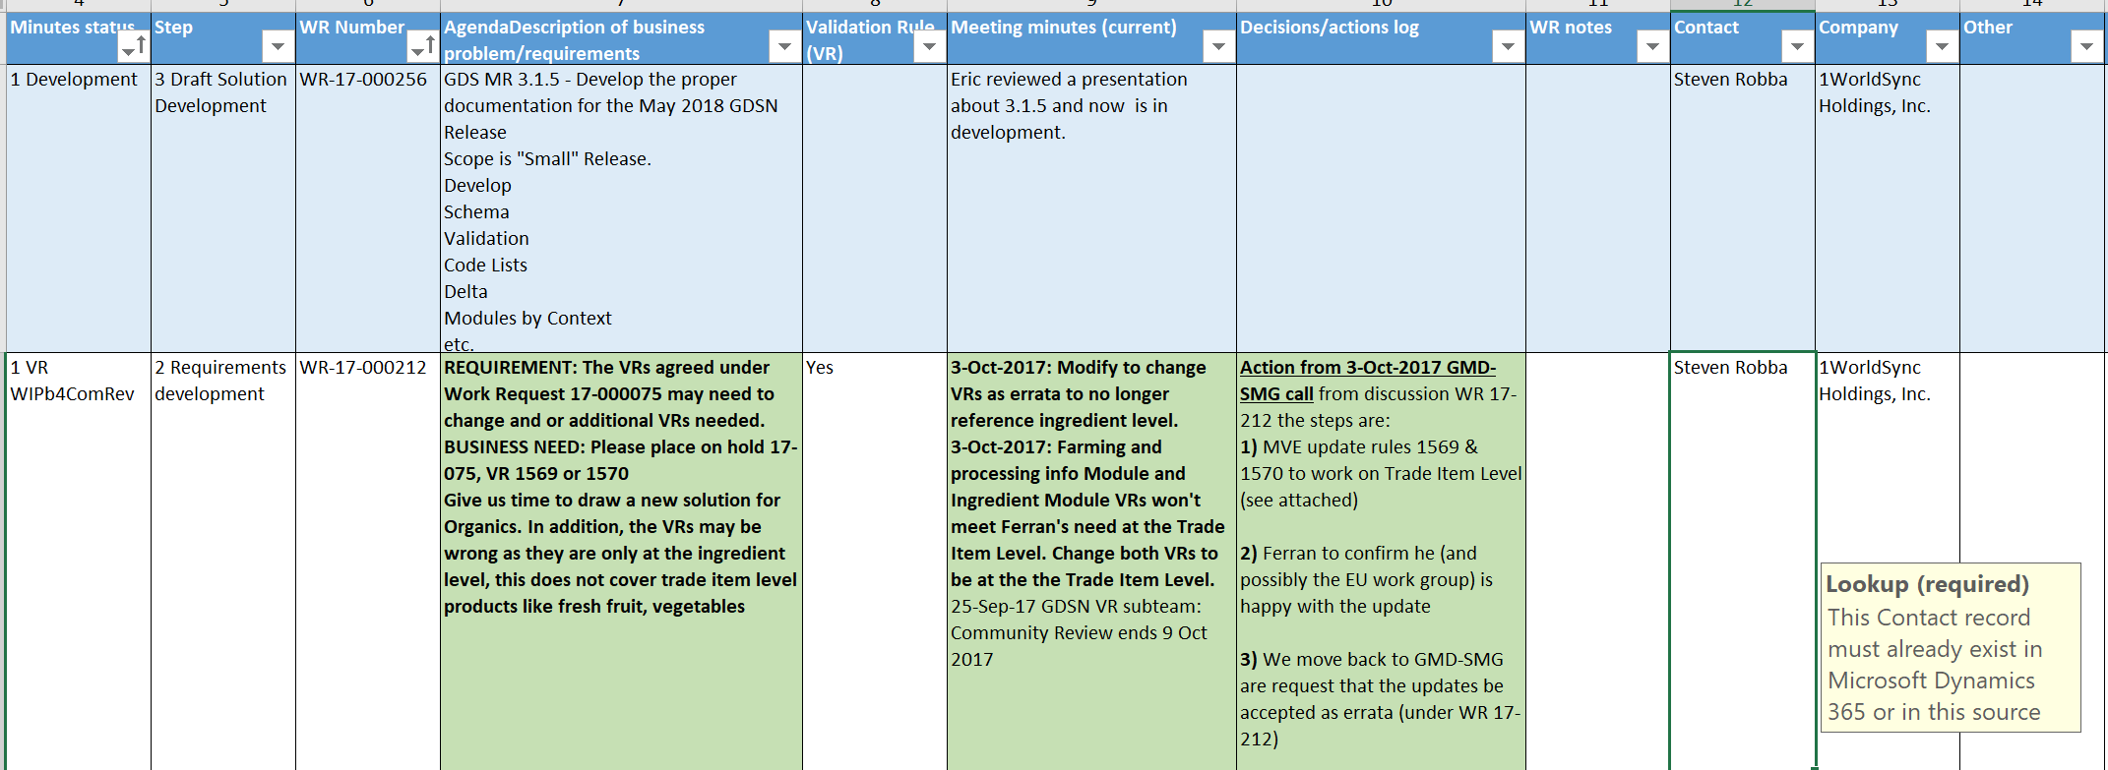
Minutes and agenda's Work Request activity reviewed in a table

Slide 25
Opportunity

Slide 26
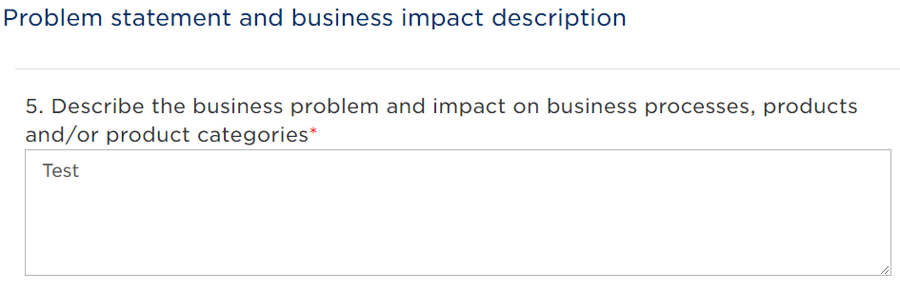
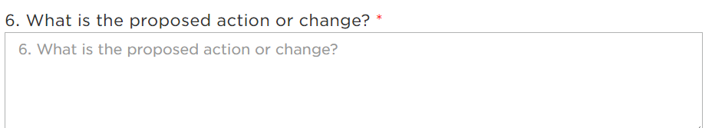
User Stories
A User Story describes a desired feature (functional requirement) in narrative form. User Stories are usually written by the Product Owner, and are broken down into two part the User story and an acceptance criteria
Work Request Form
Syntax for a User story:
As a <type of user>, I want <some goal> so that <some reason>.
Acceptance criteria:
Acceptance criteria is the story specific requirements that must be met for the story to be completed. They are a technique for adding functional detail to user stories.

Slide 27
Example User Stories
Current requirement example:
“It shall be possible to add picture to each code. For example a logo for each code from PackagingMarkedLabelAccreditationCode.”
Preferred requirement example in user story form:
As a system user (type of user), I would like the ability to view a logo for every code value (business goal), so that I can more easily identify the appropriate code (business reason).
Acceptance criteria
System shall provide GO Admin the ability to maintain a logo to each code value
Icon shall be displayed next to the record in the administrative and end user screens, where applicable

Slide 28
We want to tweak the status of a WR to reflect the way we work
GSMP
Solutions
Other
COPS review
Modeler review
Chair review
SMG review
Requirements development
Community Review
eBallot
Approved requirement
In a release queue
Published
Withdrawn/solution exits/bundled/Not approved by industry
Incomplete - returned to submitter
On hold

Slide 29
The Automation Project

Slide 30
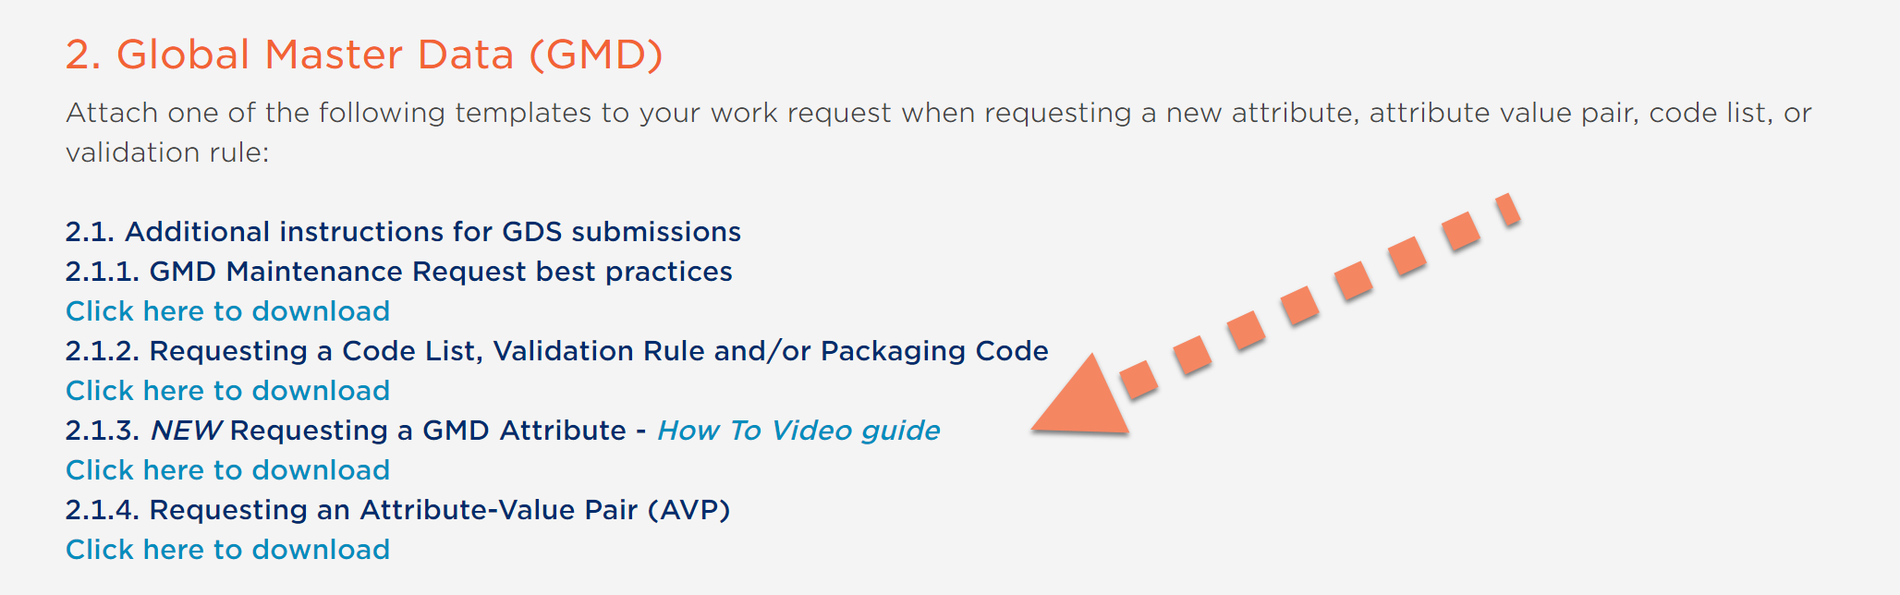
Attributes upload into a database – NEW TEMPLATE

Slide 31
The Automation Project
Phase 1 – GSMP
Replace the Excel attachment to a WR with an automated upload
Phase 2 – GSMP
Create new procedures for GSMP to process line item requirements (1 to many) online during calls and in the system
Phase 3 – Solutions
1. Create new procedures for modelers to process line item requirements
2. Create customer visibility to all work queues (release and published)

Slide 32
How to enter a new Work Request
Work Requests will be processed in batches, just like they are today, therefore:
A Work Requests will move forward with all requirements or not at all, all or none (a line item can be excluded by exception)
Discussion:
How should WR be submitted

Slide 33
Coming soon
Code Lists and Validation Rules uploads
Complete the “Requirements database” delta, add all requirements for WR entered prior to the Attribute upload
Provide visibility to the “Requirements Database” in the Work Request system for submitters

Slide 34
Network Release Schedule
Alan Hyler

Slide 35
GDSN Releases
  Communication and planning for all stakeholders
  Validation of release types
  Pre-Production and Production Date
  Alignment on the 4 Release schedules per year

Slide 36
Lunch!

Slide 37
GS1 Cloud
Buidling the largest source of trusted product information
in the world
GS1 industry & Standards Event, Brussels
October 2017

Slide 38












GS1 Cloud Core Team
Dipan Anarkat
GS1 Technical Product Director, GS1 Cloud
Christine Carina
Product Marketing Consultant, GS1 Cloud
Milena Boghossian
Manager Training & Education, Customer Service
Donna DiPietro
Analyst, Services and Solutions
Cameron Green
Senior Director B2C, Industry Solutions
Audrey Kremer
Director Industry Engagement, GS1 Cloud & Emerging Services
Sean Lockhead
Senior Director,
Data Systems
Birgit Mahler
Product Manager,
GS1 Cloud
Marie Petre
General Counsel, Corporate Services
Lisa Sandberg
Senior Director,
Global Marketing
Mike Wehrs
Head of Data Products
& Services, Solutions
Silvia Venturini
Customer Service & Knowledge Transfer Manager, Customer Service

Slide 39

Consumers
Retailers, e-tailers,
& marketplaces
App developers &
solution providers
GS1 Cloud
The largest source of trusted product information in the world
Healthcare
Brand owners
Regulators
GS1 MOs
Notes:
The GS1 Cloud will benefit everyone in the product information ecosystem, from data owners putting the data in — the brand owners and manufacturers, to all the different kinds of data users — the retailers, e-tailers, online marketplaces, app developers and solution providers, healthcare providers, regulators and the ultimate data user — the consumer.
And GS1 itself benefits by being better able to deliver on its purpose to transform the way we work and live through the power of standards.

Slide 40


GS1 Cloud
Benefits for consumers
Confidence in product information
Connected, seamless experiences
Notes:
Trusted product information has never been more important than it is for today’s companies working to build connected, enriching consumer experiences that drive satisfaction, loyalty and growth.
Consumers want to feel confident in the information they are relying on to make a purchase decision. To be sure that a product is what it says it is.
They expect more product information than ever before to make an informed purchase decision. And they expect the content to be accurate, complete and consistent across all channels.
With the GS1 Cloud, any company can access brand-sourced product data and deliver more confidence to their consumers.

Slide 41


GS1 Cloud
Benefits for brand owners
Ease of data management
Activation of products globally
Global reach for their B2C data
Notes:
For Brand Owners, GS1 Activate and the GS1 Cloud combine ease of data management with global visibility for their products.
GS1 Activate helps them identify their products correctly and manage their data easily.
They’ll have control of their data and can put it to work for their business — getting products to market faster and trading more efficiently.
With successful implementation of GS1 standards they’ll be able to achieve:
Faster time to market
Optimised business processes, including efficient trading partner transactions
Reduced labour and costs
Improved risk management
Increased ease of compliance
The GS1 Cloud gives brand owners activation of their products globally and global reach for their consumer-facing data.
New products are instantly seen by potential customers anywhere in the world.
All data users — from retailers, e-tailers and marketplaces to app developers and solution providers — can be confident that they are accessing the right information.
Consumers will get brand-sourced information about their products, leading to greater consumer confidence, satisfaction and loyalty.

Slide 42


GS1 Cloud
Benefits for retailers, e-tailers and marketplaces
Simplified data access
Easier data quality
Product exploration
Confident consumers
Notes:
For retailers, e-tailers and marketplaces, the GS1 Cloud provides faster, simplified access to brand-sourced and consistent product data.
By moving to this trusted, foundational data set, the time and cost associated with gathering and verifying data is significantly reduced.
They’ll have increased access to brands and brand-sourced product data and be able to explore products to sell in their store from any target market around the world.
Most importantly, delivering this trusted product data to consumers will help drive confidence, satisfaction, loyalty and ultimately improved competitiveness and growth for their business.

Slide 43


GS1 Cloud
Benefits for app developers
and solution providers
One source of authoritative data
Great data
Global community
Notes:
App developers and solution providers are working at the cutting edge of consumer experience — dreaming, inventing and building new ways to bring value to the lives of consumers.
New apps are being launched all the time, providing information and connection, automation and convenience, entertainment and community — all at our fingertips.
Access to brand-sourced product data has remained elusive, with developers assembling data from multiple, questionable sources.
Until now.
With the GS1 Cloud, app developers and solution providers can now rely on one source of brand-originated product data to fuel their connected consumer experiences.

Slide 44


GS1 Cloud
Benefits for regulators
Easier data access and data quality
Easier compliance by brands and retailers
Easier security and border risk management
Notes:
For regulators, the global data visibility made possible by the GS1 Cloud will make it easier for everyone to do their part in protecting the safety of consumers.
By making brand-originated data simpler to share and access, regulators will have an easier time:
Driving compliance by brands and retailers to provide required data attributes
Driving security to keep harmful products off of shelves and out of hospitals and pharmacies, thus avoiding costly recalls
Managing risk at our borders efficiently so that focus can be given to high-risk products, releasing low-risk products to get to their destinations on time
Feeding product data into government initiatives such as humanitarian efforts and health metrics

Slide 45

GS1 Cloud: How it works
Data collection
Data uploaded from
various sources
Data storage
Data stored in a modern, scalable cloud database
Data access
Data distributed to various value-creating applications
GS1 Activate
GTIN Issuance and Activation
Retailers,
e-tailers
GDSN Data Pools
App developers, solution providers
Data aggregators
GS1 Cloud
Manufacturers
Local/other
catalogues
GS1 MOs
GS1 MOs
Brand owner
internal systems
Regulators
Customer/Member Management
Access management, business relationship,
support (tier 1 technical and customer),
value-add services
Notes:
The GS1 Cloud has three primary functions: data collection, data storage and data exchange.
Data collection will take place through the sharing of data from existing databases plus a new global key issuance and management service — GS1 Activate — offered by every MO.
Data storage will ultimately include more than 100 million products, along with seven core product attributes that will deliver the trusted product information that consumers demand.
Data exchange will take place through MOs to retailers, e-tailers, manufacturers, app developers, etc. — opening up a door to entirely new categories of potential member customers.

Slide 46
GS1 Cloud Phase 1 – Use cases
Key Authentication – Verify if a specific GTIN is in the GS1 Cloud and therefore the GCP was licensed properly - CHECK
Product Validation – provides limited product label information and product image (if available) to help an end consumer know if the product they are looking at is indeed what the Brand says it is - VIEW
Basic Product Search – With an entered GPC and target market, a list of products is displayed that matches those search parameters – EXPLORE

Slide 47



GS1 Cloud
Check
Formerly known as
GTIN Authentication
View
Formerly known as
Product Validation
Explore
Formerly known as
Search
Notes:
The GS1 Cloud is launching with three powerful features that will help companies access and use trusted data.
With Check — formerly known as GTIN Authentication — an online marketplace can confirm that the products in their system are properly identified with valid GTINs.
With View — the new name for Product Validation — mobile apps and e-commerce sites will no longer have to struggle to source product information from unverified sources and worry about its quality. They can now easily serve consumers with core, consumer-facing information that has been provided by the brand owner.
And now retailers looking for new products to carry in their physical or online store can use Explore — formerly known as Search — to discover new products by Global Product Classification (GPC) and target market.

Slide 48



GS1 Cloud: Core attributes and features
Attributes | Check | View | Explore
1. GTIN
2. Brand
3. Label Description
4. Medium Resolution Image
5. Target Market
6. Company Name
7. Product Classification
Check
View
Explore
Required for service
Service enhanced as a result
Notes:
To enable the first three data-exchange features of the GS1 Cloud, all MOs will be asked to provide 7 attributes:
GTIN
Brand
Label description
Medium resolution image URL
Target market
Company name
Product classification
The required data is geared towards consumer-facing applications so only consumer units are needed, along with the attributes that have been deemed essential for consumers.
If you have questions about why these attributes are important, how they are used, what the best practices are if you don’t have them in your system or how to address data quality, please see the GS1 Cloud FAQ document that is currently available.
And let’s review the three features that will be using these attributes:
For companies that want to ensure proper identification of products within their system, GS1 Check confirms that the Global Trade Item Number (GTIN) uses a GS1-assigned Company Prefix.
For mobile apps and e-commerce sites that want to provide accurate product information, GS1 View provides all available attributes for a product identified by a GTIN.
For companies looking for new products to carry in their physical or online store, GS1 Explore gives them the ability to discover new products by Global Product Classification (GPC) and target market.

Slide 49





GS1 Activate and GS1 Cloud
Consumer product
data collection
Data uploaded from various sources
Consumer product data storage
Data stored in a modern, scalable cloud database
Consumer product data access
Data distributed to various value-creating applications
Member Customer Systems
GS1 Activate
GTIN Issuance and Activation
Data Users
Check
GS1 Cloud
MO CRM/ERP Systems
View
Explore
Data Quality & Policy Validations
Other sources
GDSN Data Pools
Data aggregators
Local/other catalogues
Brand owner internal database
Global Company
Prefix (GCP)
GTIN non-reuse
Consumer Product Variant (CPV)
Data Permanence
Rules
Global Data Dictionary Validation Rules

Slide 50
GS1 Cloud Phase 1 – Performance improvements
GS1 CLOUD BENCHMARKS
10K records | OLD | NEW | CHANGE
upload | 0:03 | 0:03
validate & verify | 1:11 | 0:10
Commit | 2:14 | 0:05
TOTAL | 3:28 | 0:18 | 11x faster
500K records | OLD | NEW | CHANGE
upload |  | 0:32
validate & verify |  | 6:54
commit |  | 1:05
TOTAL |  | 8:31
100K records
upload | 0:10 | 0:10
validate & verify | 8:20 + 14:20 | 0:42
commit | 24:31 | 0:15
TOTAL | 47:21 | 1:07 | 42x faster
250K records
1M records
upload |  | 1:09
validate & verify |  | 14:54
commit |  | 2:22
TOTAL |  | 18:25
Upload | 0:19 | 0:15
validate & verify | 46:02 + 1:00:00 | 3:54
commit | 1:13:11 | 0:26
TOTAL | 2:59:11 | 4:35 | 40x faster

Slide 51


Confidence starts with trusted data.
GS1 Cloud
https://www.gs1.org/gs1-cloud
GS1CloudSupport@gs1.org
Notes:
The first step in transforming the value of membership is the GS1 Cloud.
The vision of the GS1 Cloud is to become the largest source of trusted product information in the world, making it possible for businesses to meet the expectations of today’s digital consumer.
The product data in the GS1 Cloud is “trusted” because it is supplied by brand owners and submitted for certain data quality checks.
For companies working to build connected, enriching consumer experiences that drive satisfaction, loyalty and growth — trusted product information is mission critical.
Today’s consumers want to feel confident that the product information is brand-sourced and consistent no matter where they look.
They want to feel confident that a product is what it says it is.
Now, with the GS1 Cloud, any company (including healthcare) can access brand-sourced product data and deliver confidence to their consumers.
In addition to satisfying their consumers, all companies will benefit operationally as the distribution of trusted product data becomes more efficient and seamless.
CREATIVE CONCEPT:
The creative concept for the GS1 Cloud includes headline messaging and a series of key visuals directed at the users of the Cloud and focusing on what retailers and e-tailers, app developers and solution providers, and the brand owners themselves care about most — creating a positive experience for the consumer that leads to satisfaction, loyalty and repeat purchases.
Confidence in the product information is the critical factor in a positive consumer experience that the GS1 Cloud contributes to. This is what we want the GS1 Cloud to stand for in the minds of its users.

Slide 52
GDSN Simplification

Slide 53
Project Origin
February 2017 GS1 Data Excellence Board Meeting Discussion
  GDSN Roadmap Review discussion
  Backwards Compatibility
  Data Pool Interoperability discussion
    Mandatory vs. Optional certifications
    Trade Item (Mandatory)
    Price (Optional)
    Dashboard of DP Connections
Question: What would be required to increase GDSN usage by 2 to 3x over the next 3 – 5 years?
  Answer: Form a Board sub-committee to investigate and make a proposal

Slide 54
Project Schedule
Launch
  24 May Kickoff call
    Weekly working teleconferences
Deliverables
  7 September review Draft proposals that will be developed into formal 2 year plan for Board approval
      Continue teleconferences
  February 2018 Final recommendation for Board approval
    2 year action plan with supporting documentation

Slide 55
Group Charter
The objective is to increase the number of business partners using GDSN as the tool to communicate product data. This will be achieved by developing a two year plan to reduce complexity with high data quality and optimised speed to Market.
This work effort is focused on:
Interoperability
Certification and Conformance
Data Quality
Barriers to growth and adoption
Release Management
Marketing and Communication

Slide 56
Simplification – Why is it important?
GDSN is complex and growth has leveled out.
Network flexibility introduces operational and configuration complexities
What is message choreography???
Who can I send my data to? Who can send their data to me?
How many attributes are required???
Who checks my data?
How many companies do I have to work with to make GDSN work in my environment?
What is a CIC response?
How many attributes does my trading partner need?
Who agreed to theses validations?

Slide 57
Simplification – Who is participating?
Voice of our Users
GDSN users committed to sharing their experiences, and ideas on how to simplify and grow GDSN
Volunteering time and expertise to deliver proposals on key topics that will change the GDSN
1Worldsync
Carrefour
Commport Communications
Delhaize Group
FSEnet
GS1 Australia
GS1 Belgium & Luxembourg
GS1 Canada
GS1 Colombia
GS1 EU
GS1 France
GS1 Germany
GS1 Netherlands
GS1 US
IPC/Subway
Medtronic
Metro
Mondelez
Nestle
PepsiCo
Viagenie
WalMart
Representation is missing from a large majority of potential network growth (SMEs)

Slide 58
Simplification Summary
Interoperability
Certification & Conformance
Data Quality
Barriers
Release Management
Solution Partners
Make Price Mandatory
Expand MDS Certification
Develop new KPI’s
Meet the needs of the customer
Message Choreography
Audit DP’s on MDS qualifications
Understand landscape
Meet the needs of the market
Update Certification testing
Connect with all DP’s
Develop Data Quality Scorecards
Allow Data Pools to assign GTINs/GLNs
Improve visibility to releases
Visibility to Attributes & Validations
Increase DP annual Growth metrics
Enable GS1 Trustmark
Marketing & Communication
Focus on the charter (increase growth and reduce complexity)
Identify common themes (proposals cross several topics)
Proposals will become projects

Slide 59
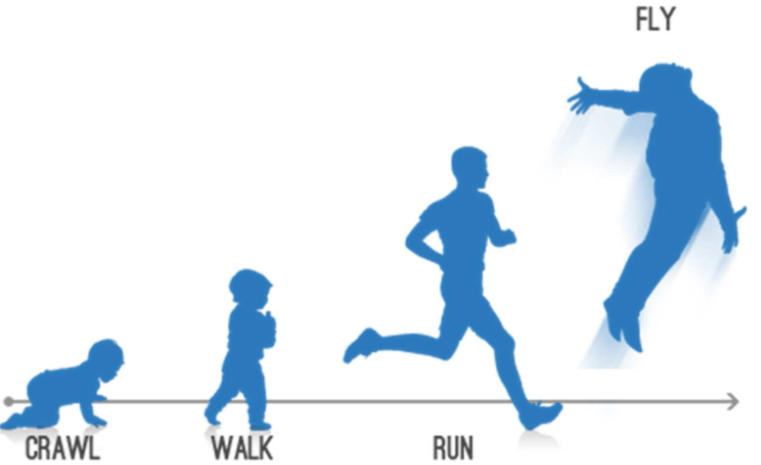
Proposals
Over 30 proposals identified across the 5 areas
      Marketing and communication plans required to support approved proposals
Proposal Impact levels vary
      Modified “Low”, “Medium”, “High” risk/reward assessments

Slide 60
Recommendations:
Safest, least risk, lowest impact
Interoperability:
  Develop an outreach programme to Identify and engage GDSN Solution Provider Community (compliance programme)
Certification & Conformance:
  Update Data Pool transfer policy and develop new supporting processes and procedures
  Develop common solution (best practice for handling local VR’s as part of Operations Manual
Data Quality:
  Require DQ training for all GDSN Certified Data Pools
Barriers:
  Highlight ‘local’ implementations of GDSN
  Highlight GDSN Data that is used outside of supply chain

Slide 61
Recommendations:
Medium Risk, medium Impact
Interoperability:
  Develop Data Pool warning messages
  Require all Data Pools to maintain a network connection with all other Data Pools
Certification & Conformance:
  Technical certifications of Duplicate Data Pools (DDP)
  Change DP Audit requirements for Implementation and Operational Performance
Data Quality:
  Promote GDSN as an enabler of GS1 Trustmark
Barriers,
  Develop new KPI’s to monitor growth and adoption
  Develop online education and training materials/courses offered by GS1
  Improve GDSN documentation

Slide 62
Recommendations:
Medium Risk, medium Impact, cont.
Barriers continued:
  Enhance communications to GDSN customers
  Perform market research to understand customer demographics/challenges and increase usage of GDSN (internal/external)
  Develop plan to increase GDSN resources i.e. ‘employee on loan’, succession planning
  Leverage initiatives such as SmartSearch and SmartLabel to improve visibility of GDSN data (GDSN must become a primary source of trusted product data)
Release Management:
  Develop and promote a network release methodology

Slide 63
Recommendations:
Highest Risk, greatest results
Interoperability:
  Improve visibility of ‘Local’ data models and validation rules*
Certification & Conformance:
  Require all DPs certify on Price
  Strengthen requirements to ensure technical competence. Include fuller set of attributes in Certification test.
  Random certification compliance testing and on-site assessment of Data Pools
  Leverage KATO to support random standards testing for, Formal complaints and Annual DP audit
Data Quality:
  Create a framework to develop regional/local differences on Core and Mature attributes and associated validations rules* (GS1 in Europe framework)
  Enhance Master Data Services (include Data Pools) and Brand Owner Certification

Slide 64
Recommendations:
Highest Risk, greatest results
Data Quality continued:
  Deploy DQ technology solution to enhance DQ levels
  Develop DQ Scorecard for GDSN data
Barriers:
  Allow Data Pools to assign company prefixes/GTINs/GLNS
  Investigate alternative GDSN Business models. i.e. incentivise growth with discounted Data Pool fees
  Investigate alternative ‘game changers’ that support the charter
Release Management:
  Develop a plan to support 4 or more network releases a year for industries that can support that pace

Slide 65
GDSN Components
Peter Jonsson
Sylvia Rubio Alegren

Slide 66
Components
The solution in GDSN and the Implementation in Sweden
  Sylvia Rubio Alegren, ICA
  Peter Jönsson, GS1 Sweden

Slide 67
History of components in GDSN
Originally a Extension for “Office Supplies” or “Align Office Supplies” but since 3.1.1 a part of todays schema in Core Item with possibility to use attributes from certain modules
Some MOs still using The Extension e.g GS1 Australia

Slide 68

What is a component?
It is a part of an trade item with unique information
It is not a new level in the hierarchy it is a kind of ”magnifier” to show product information for components in a trade item.

Slide 69
Why components?
Enables a structured way to show unique information for each component included in some trade items and make the system understand that certain information belongs to a certain component as stated on the package.
To fulfill the EU-regulation 2011/1169 for trade items with components.

Slide 70
The introduction of components in Sweden
The class trade item components and class component were implemented in in the specifications in Sweden in May 2016 (MJR)
The Swedish user group for trade item information decided that the class initially should be used for heterogeneous, food and beverage products to illustrate the components that are included in a trade item on the base level.
In principle it is possible to use information from all "modules“ on a component, but in Sweden the users initially decided to populate e.g. nutritional information, ingredient information and net content on components to fulfill the EU-regulation 2011/1169
In November 2017 we also start physical quality assurances of components

Slide 71
Peter Jönsson
Solution Manager
GS1Sweden
+46850101000
peter.jonsson@gs1.se
www.gs1.se

Slide 72
Use cases from ICA

Slide 73

ICA Sweden
Components
GDSN User Group, October 2017

Slide 74
Presenting ICA Gruppen
ICA Gruppen is a leading retail company with a focus on food and health
1,718 own and retailer-owned grocery stores in Sweden and the Baltic countries and 385 pharmacies in Sweden
Core business is grocery retail
Operations in Sweden and the Baltic countries.
Net sales SEK 104 billion
EBIT SEK 4,7 billion
Approx. 30,000 employees
Listed on NASDAQ OMX

Slide 75
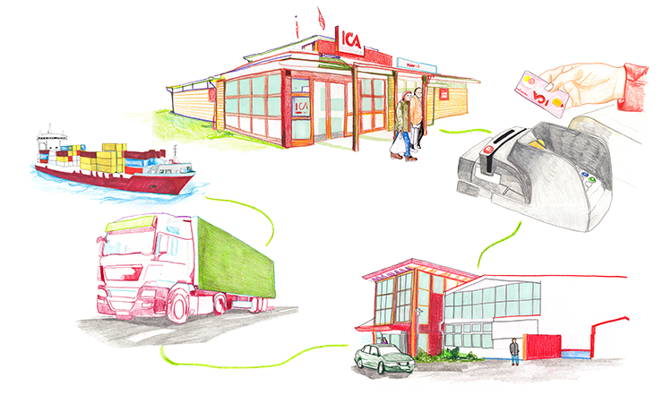
Revenue from several sources
Stores, pharmacies and online trading
Bank
Goods and services supply
Properties

Slide 76

GS1 standard solves our need of cost efficient solutions in the Supply Chain
Good harmonized master data quality by use of GDSN is the basis for:
  Efficient transport and logistics
  Traceability
  Highly automated warehouses
  Corporate audit and responsibility work
  Purchasing of goods all over the world
  Pricing, Category planning, Space
  E- Commerce and marketing material
  Electronic Data Interchange (eCom) with automatic invoice matching
A collaborative approach between trading partners across the industry, has been key to our successful GS1 implementation in Sweden

Slide 77
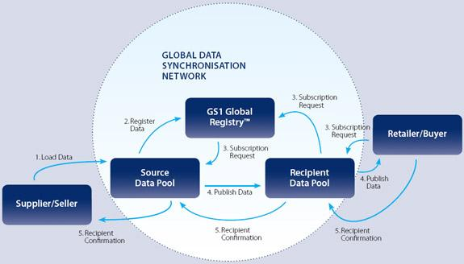

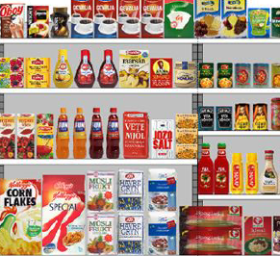
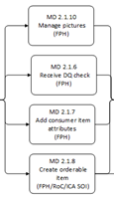



Solution Overview – Validoo - powered by GS1 Sweden
Master Data
Hub
Validoo DataEntry
Validoo Item
Validoo MediaStore
Consumer Item Information and
Product Images
Validoo Q-lab
Automated validations of electronic Trade Item Information
Own Brands/ Private label assortment
Physical product sample validation against Electronic Trade Item Information
Notes:
Before activation of trade item information, all data quality checks needs to be executed:
1 Manage Pictures
2 Receive DQ check
3 Add Consumer Item attributes
4 Create Orderable Item

Slide 78
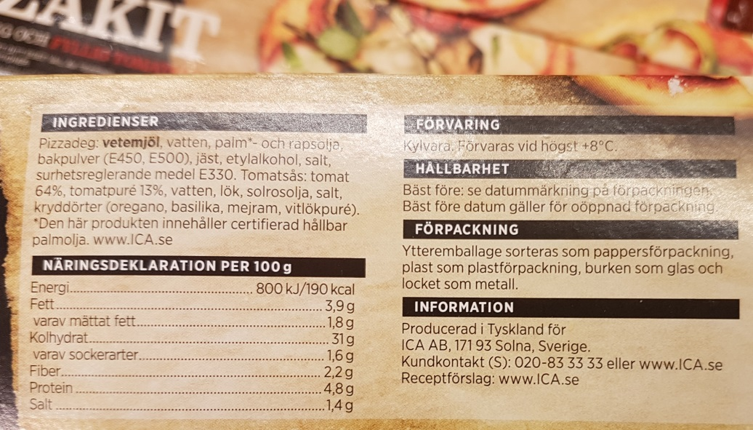
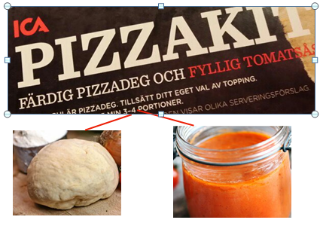
Online Challenge – Component products
EU Regulation holds the retailer responsible for information published Online
  Origin, Allergens, Nutrition, Markings
  We can not receive and publish information about respective components ingredients and nutrition, even though it is described separately on the package
  For nutrients our suppliers are forced to provide a merged nutrient information of all components
Notes:
We solve the ingredients challenge by use of the free text ingredient Statement solution, but we would prefer to use the structured Ingredient solution
For nutrients our suppliers are forced to provide a merged nutrient information of all components
We are dependent on receiving structured nutrient information since before EU/1169 (Store Produced)

Slide 79
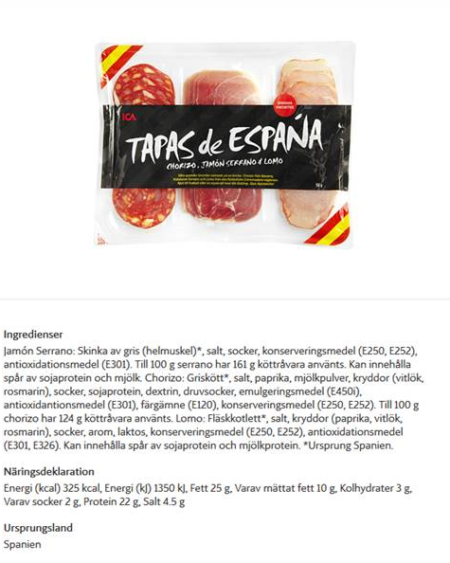
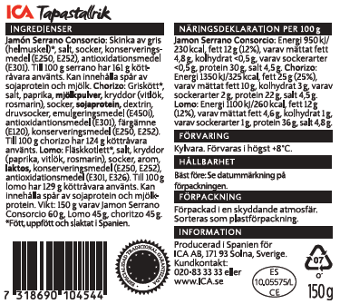
Online Presentation vs. Packaging Information
EU Regulation holds the retailer responsible for information published Online
  Origin, Allergens, Nutrition, Markings
  We can not receive and publish information about respective components ingredients and nutrition, even though it is described separately on the package
Notes:
We solve the ingredients challenge by use of the free text ingredient Statement solution, but we would prefer to use the structured Ingredient solution
For nutrients our suppliers are forced to provide a merged nutrient information of all components
We are dependent on receiving structured nutrient information since before EU/1169 (Store Produced)

Slide 80
Online Presentation vs. Packaging Information
We solve the ingredients challenge by use of the free text ingredient Statement solution, but we would prefer to use the structured Ingredient solution
We are dependent on the structured nutrient information since before EU/1169 (Store Produced)
For nutrients our suppliers are forced to provide a merged nutrient information of all components
EU Regulation holds the retailer responsible for information published Online
  Origin, Allergens, Nutrition, Markings
  We can not receive and publish information about respective components ingredients and nutrition, even though it is described separately on the package
Notes:
We solve the ingredients challenge by use of the free text ingredient Statement solution, but we would prefer to use the structured Ingredient solution
For nutrients our suppliers are forced to provide a merged nutrient information of all components
We are dependent on receiving structured nutrient information since before EU/1169 (Store Produced)

Slide 81
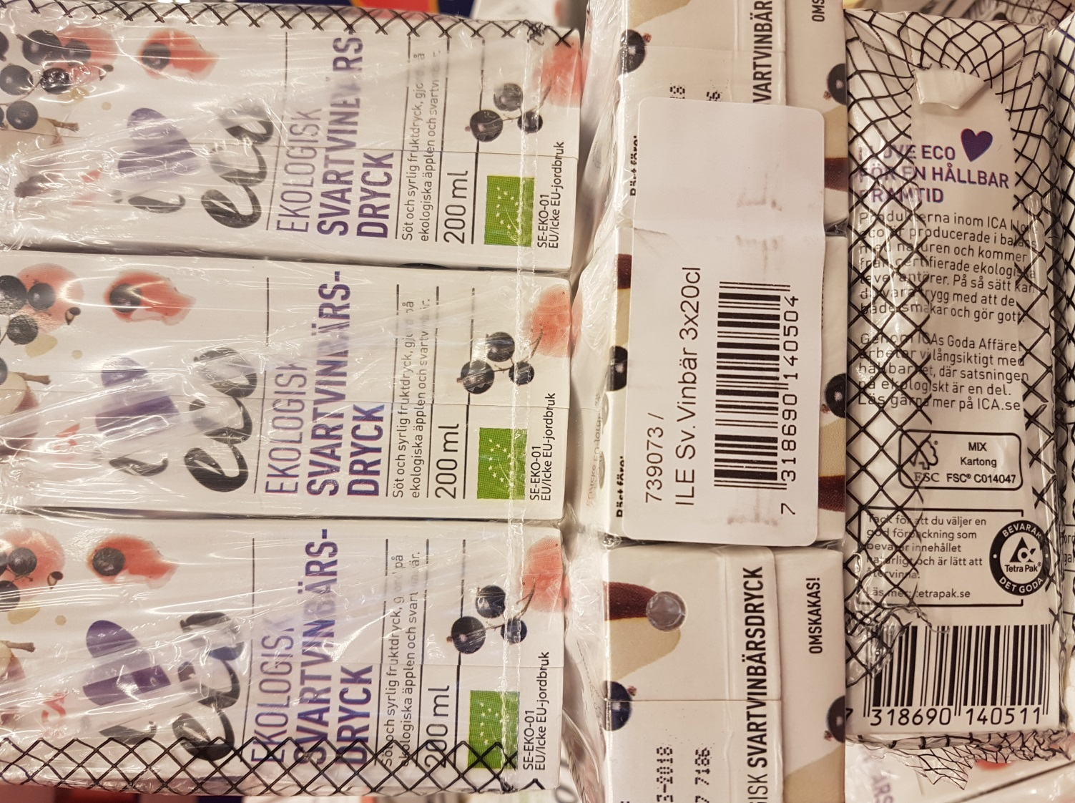
What is a Component Product and what is not?
NOT a Component Product
rather a Composite Product
All necessary information is already tied to its respective consumer GTIN
Notes:
Not a Component Product rather a Multipack or Composite Product when different tastes (imagine these are)! This is not in need of Conponent information, since all necessary information more easily can be tied to the respective Consumer GTIN, and already is! Calling this a component product would add unecessary complexity and demand migration.

Slide 82
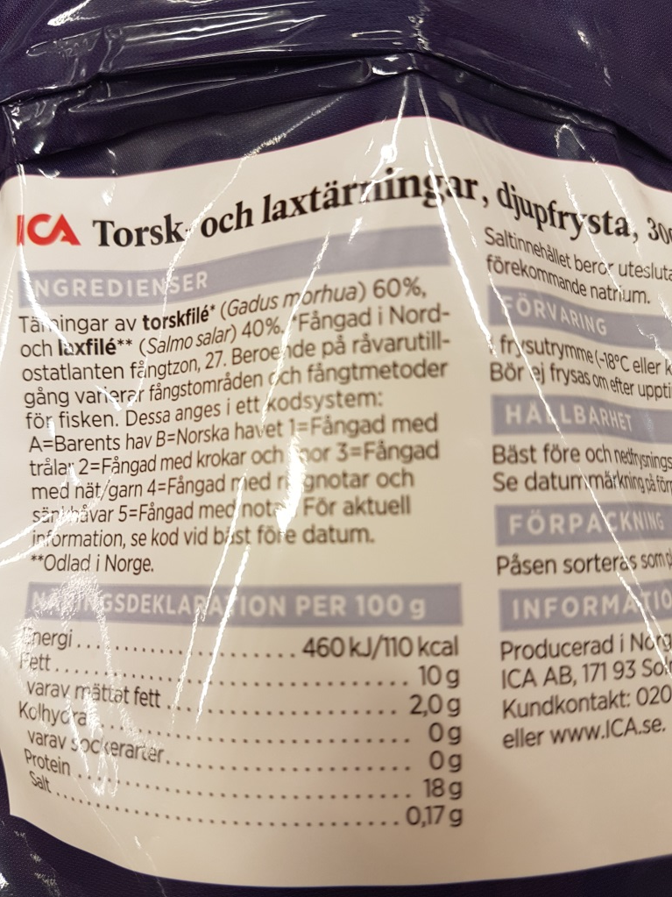
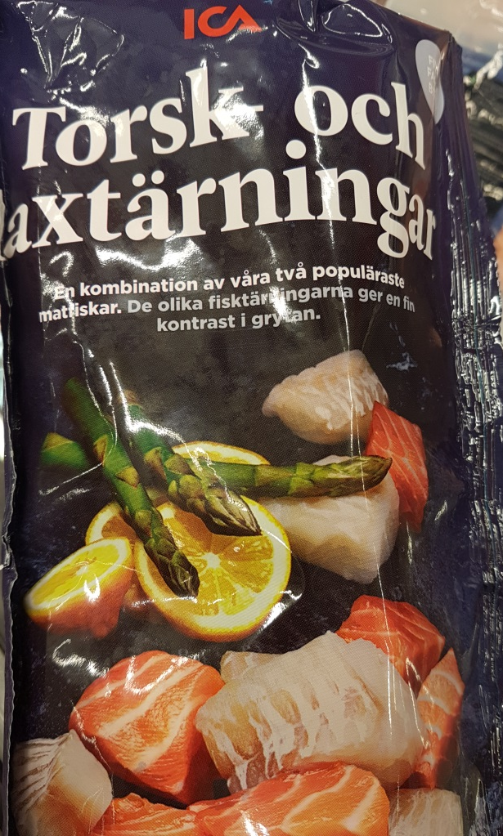
What is a Component Product and what is not?
The pieces of cod and salmon are mixed to be eaten together like in a dish, thus one set of nutrients declaration is enough
NOT a Component Product
rather a dish

Slide 83
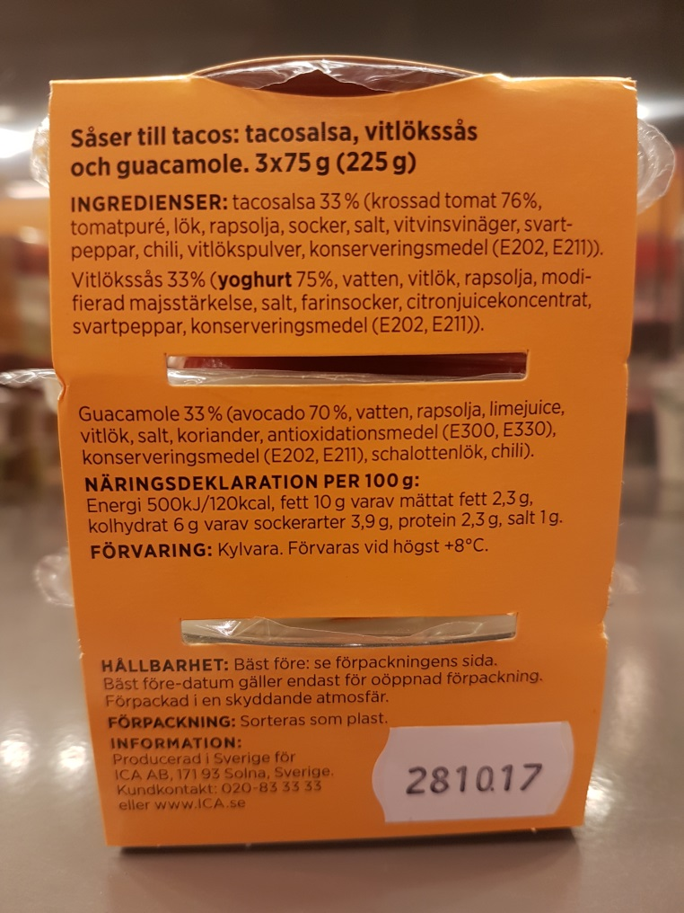
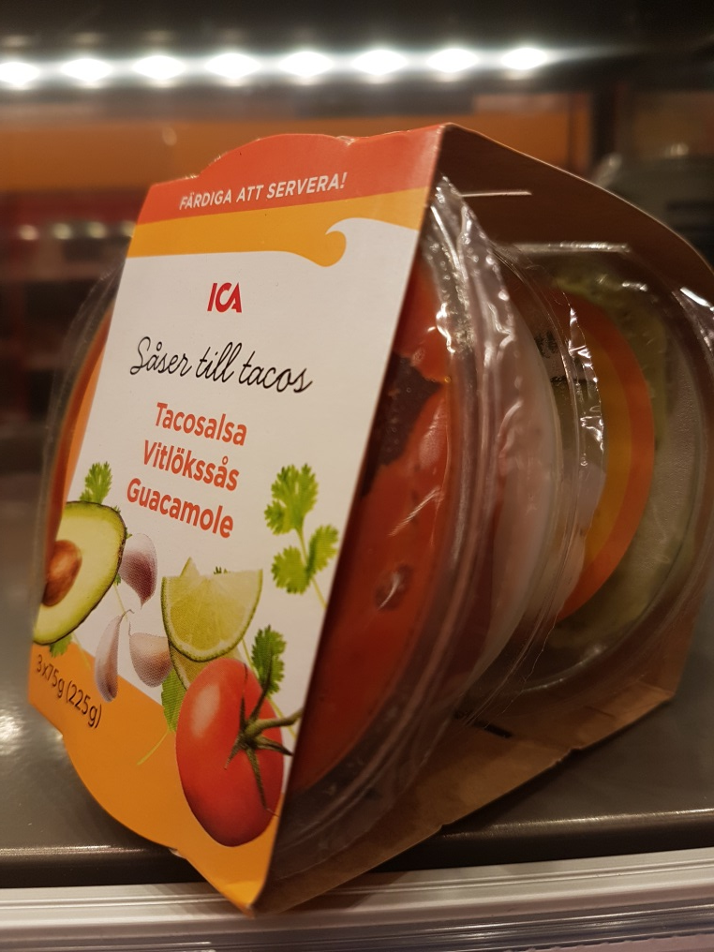
What is a Component Product and what is not?
This is a Component Product
Three different sauces. Each sauce within the consumer item wrap is indivdually packed without GTIN

Slide 84
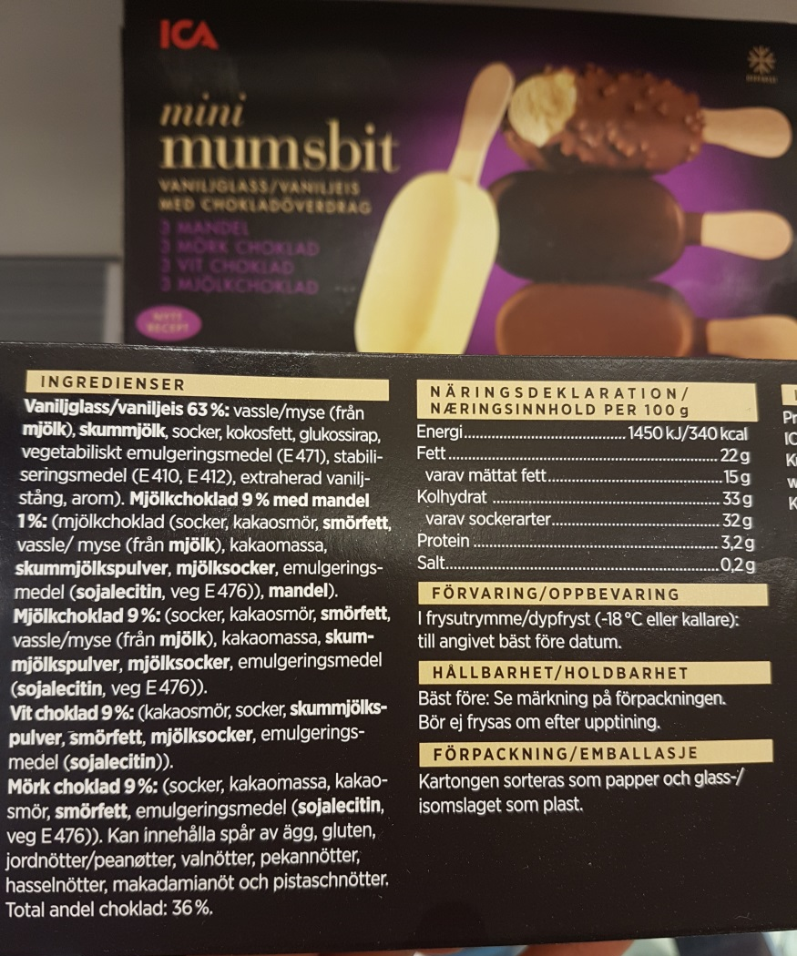
What is a Component Product and what is not?
This is a Component Product
Three different ice creams. Each ice cream in the consumer item box is indivdually wrapped without GTIN

Slide 85
Start Simple - Use a Component Solution only when Absolutely Required!
Proceed from Packaging design
Let legal Requirements be the driver
Lack of GTIN gives no other option
Unecessary use of components will force migration and drive complexity
Components should not carry information that is necessary for logistics
Don’t forget the necessity for Validation and Quality Assurance rules
Notes:
To use

Slide 86


Slide 87
GS1 Industry & Standards Event 2017
09-13 October 2017 – Brussels, Belgium
Transforming business together
Session: GDSN Update the Packaging Label Guide
Speakers: David Buckley, GS1 Global Office
Reinier Prenger, GS1 Global Office

Slide 88
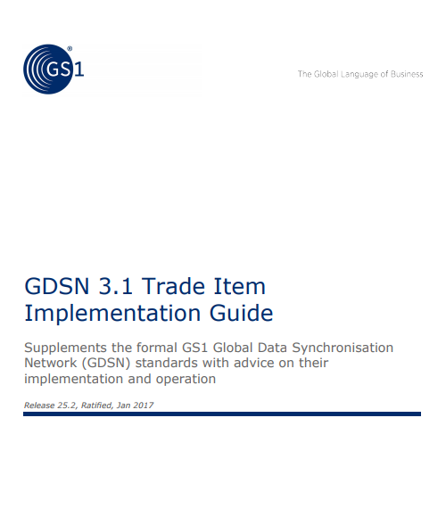
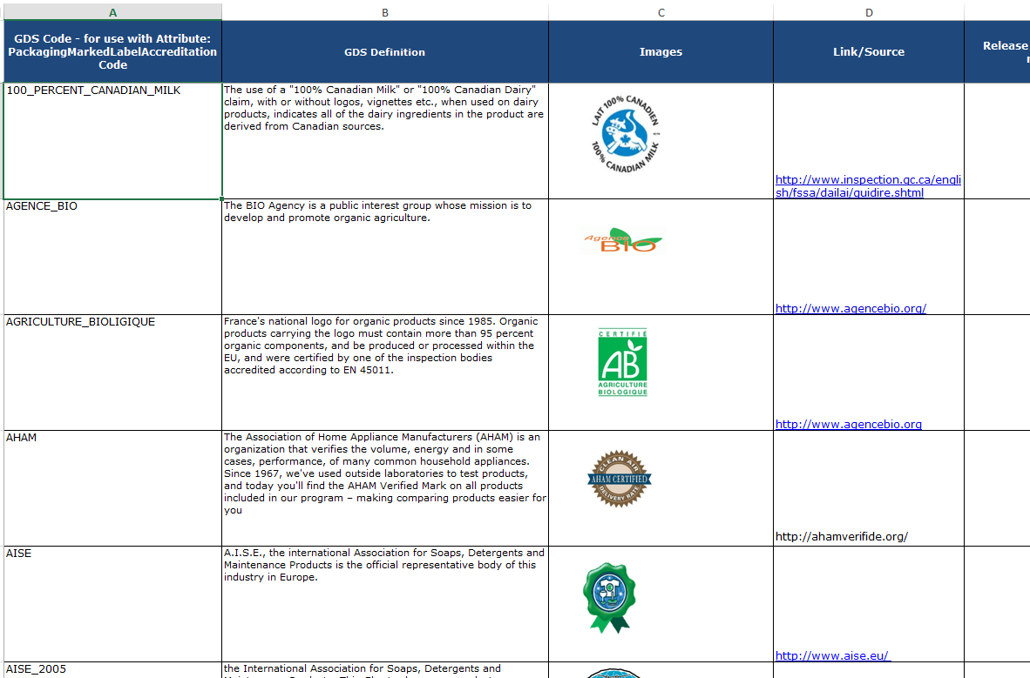
Trade Item Implementation Guide (TIIG) https://www.gs1.org/gdsn/trade_implementation_guide
TIGG
Packaging Label Guide

Slide 89
WR 17-102 (simplify navigation of the Packaging Label Guide) ComRev closed 9 Oct
27 June GMD-SMG set up a small group to look at the GS1 Nederland’s Work Request 17-000102 which requested “classify the packaging marks” to simplifying the navigation of the Packaging Label Guide
THANK YOU for participating in the three teleconferences :
Mirva Alatyppo, GS1 Finland
David Buckley, GS1 Global
Eric Kauz, GS1 Global
Rita Laur, GS1 Canada
Zubair Nazir, GS1 Canada
Steven Robba, 1WorldSync
Frederieke Vlieg, GS1 Nederland

Slide 90
Considerations
Goal:
Make it easier to find the right packaging mark
Solutions considered:
Using another tool, e.g. website → not enough resources, not sure whether effort is worth the benefit
Improving excel sheet → not the best functionalities, but all data is already in there
Proposal:
Working on improving excel sheet
  Structure may be reused in a future concept

Slide 91
Proposed solution
Added three new ‘informative’ columns:
Country of origin (global, region, national)
Product type (Food, Textile, Electrical. etc.)
Functionality (Organic, Sustainable, Recyclable, etc.)
Consideration:
Not helpful to introduce many columns because people have to scroll to the right of the Excel (and probably they will miss things then)
A ‘How to’ Worksheet has been added to explain filtering and the informative nature of the data

Slide 92
Some intangibles, cost/benefits
  Organic: this can apply to both Food and Non-food items:
    E.g., some Organic labels are clearly for food or for textile (e.g., T-shirts) but some are very generic
  Sustainability vs Environmental – not always easy to distinguish:
    E.g., AISE_2005 “… Charter Sustainability Procedures … professional users who see this logo … assured ..[of] .. environmental friendliness”
  Easy search feature must be ‘informative’ as external data and definitions can cahnge
  If we use another publication tool, why not just amend the GDD?
  During ComRev, GS1 Member Organisations are asked to review data for labels originating from their country/region

Slide 93
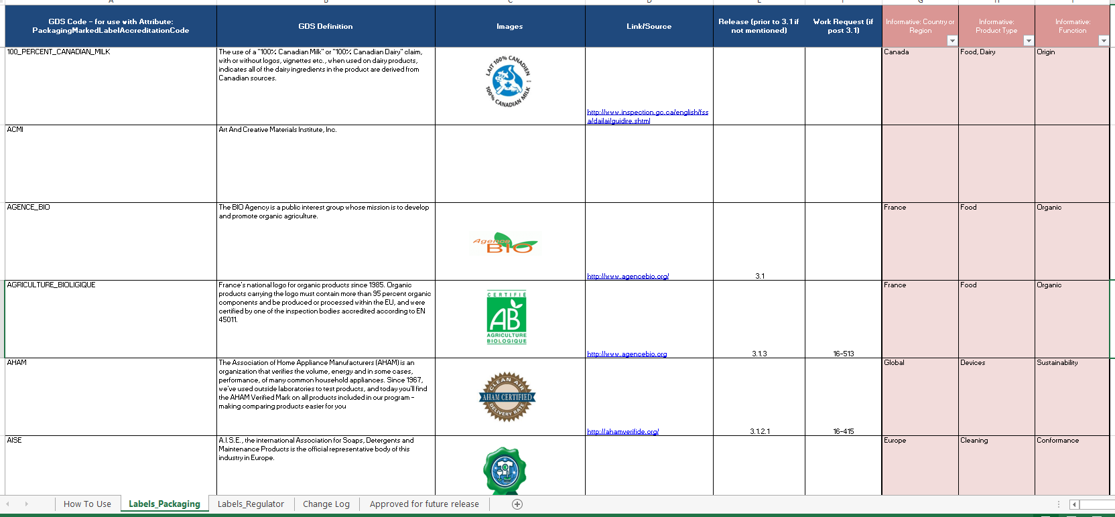
Live Demonstration

Slide 94
For Information: GDSN Release 2.8 documentation will be removed from www.gs1.org
Input to GDSN User Group & OTAG 10 October 2017, Brussels, Belgium
David Buckley

Slide 95
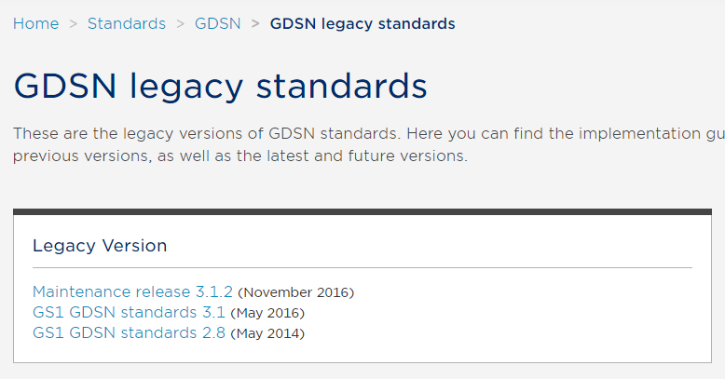
GDSN Release 2.8 to be removed. In future keep online two legacy versions
All documents kept in archive (offline)

Slide 96
Coffee Break!

Slide 97
1WorldSync
Target Market & Development Assistance
Steven Robba, Director of Global Standards
srobba@1worldsync,com

Slide 98

Think Out Side of the Box!
Forget for a few minutes about what we do in GDSN today!

Slide 99
Business Requirement
Business Driver
  Development Agencies like USAID, UNFPA, and Global Fund - and their implementing partners like Chemonics - provide foreign assistance to countries in the form of commodities and services to support development programs, including but not limited to global health, infrastructure, and food aid.
  Commodities procured in these instances may not be explicitly designated for the markets to which they are donated. Often, a generic “developing market” packaging is procured to ship to multiple markets in regions across the globe to provide flexibility in responding to cross-market demand.
  These agencies want to use the GDSN to improve speed and accuracy in data management, but the Pub/Sub model by Target Market country does align with their business model.

Slide 100
2 New Business Areas & Target Market is NOT important
EUDAMED EU Commission Med Device data base & Development Assistance Agencies
  1 Record will contain information regardless of where the product is sold
  The 1 record will contain all various required attributes in various languages.
The only way to get this information today in GDS
  Subscribe to all markets
  Gather language information from each GTIN Record and combine all data into 1 record
    EU Commission will not do this!!!!!
    This leads to potential data issues as how does these agencies process discrepancies?
38

Slide 101
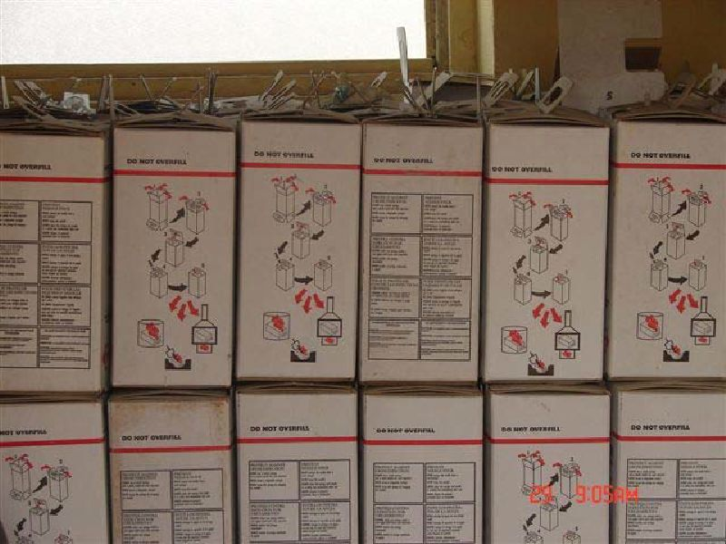
Example
8 Language Specific Usage Instructions
To gather today in GDS a recipient would need to subscribe to 5-8 different target markets
Reconcile the data into 1 record
Which record is the master record?
  Change vs data quality issues?
  Same language, different data, different market?
The need is 1 master data record per GTIN
39

Slide 102
GDSN Today – Issue managing from Global or Union of Nations
GTIN 1
NL
GTIN 1
DE
GTIN 1
BE
GTIN 1
FR
GTIN 1
CH
GTIN 1
ES
GTIN 1
PT
GTIN 1
IT
GTIN 1
AT
Dutch
German
French
Dutch
French
German
French
Italian
Spanish
Portuguese
Italian
German
2 – Dutch, 3- French, 3 – German, 2-Italian, 1-Spanish, 1-Portuguese
Which is correct????
40

Slide 103
GDSN – What is needed for EUDAMED & Development Assistance
GTIN 1
EU or DA
Dutch
French
German
Italian
Portuguese
Spanish
41

Slide 104
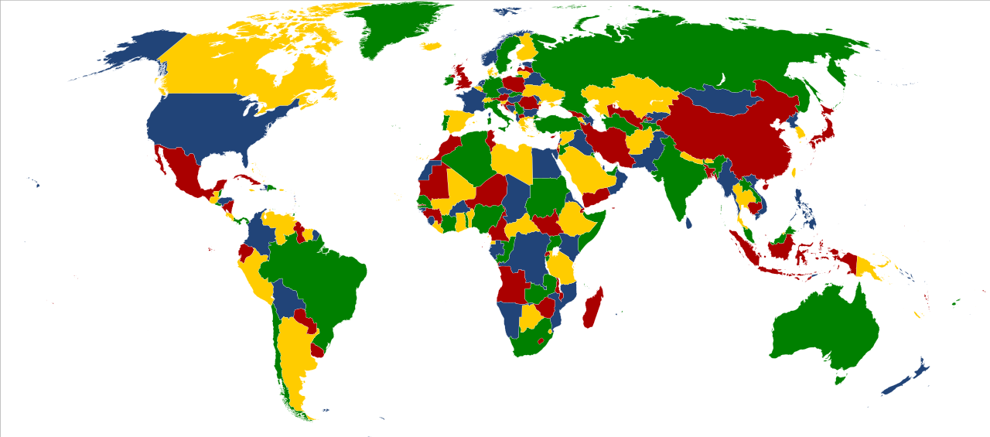
GDSN works this way a GTIN is published by Market

Slide 105
What these recipients need

Slide 106
Need
A Generic Target Market to Publish too
  Country Code DA Development Assistance
Data in records
  Regulatory Information and Import Classification for markets
  Languages primarily English, French, Spanish, Portuguese, & any other
Target Market Model becomes difficult to manage as
  They would need to subscribe to 80 or more markets
  Duplicated records to try to gather and sort just the regulatory and import information, other data is irrelevant
  GDS Target Market Model is too complex, need simpler model
44

Slide 107
Phases & Rules
These Companies are planning to use Kenya Country code
  While not optimal, they will initially use Kenya to gather information.
  Could be problematic for suppliers to manage if they do business in Kenya.
    Supplier may need Sales Market, Kenya and New DA mapped to Kenya in GDS
New Target Market
  New code could only be used for Pub/Sub as it would not make sense otherwise
Registry
  Impact to Registry?
  EU Commission UDI database may need similar TM function
    This would prove can be done before EU UDI go-live
45

Slide 108
Thank you.

Slide 109
GDSN Governance Structure
Alan Hyler

Slide 110
Governance Structure
Update

Slide 111
GDSN Delivery Process – High Level
Data Pools & GR
Users, DPs, GR
Business Needs
Standards Development
GR & DP Software Development
Users, DPs, GR
Simple WRs
& BCDs
BMS
Development
BETA/Pilot/
Testing
Certification*
Production
GSMP
All
GDSN
GDSN Business Operations
GDSN Technical Operations
GMD SMG
GDSN Advisory CMTE
GDSN User Group
GMD SMG & Work Groups
Operations and Technology Group
Certification Agent
*Note: May be optional

Slide 112
Roles and Responsibilities
GDSN Delivery Process

Slide 113
 | Manage Process & Network
GS1 Global Office | Management of the GS1 system(GDSN,DQF, GPC, eCom) and GSMP
GDSN | Global Data Synchronisation Network GS1 Global RegistryTM and KATO Test Bed platform GDSN Delivery Process (functionality, certification) Community management (trading partners, data pools) Business operations related to the GDSN
GSMP Operations | BCS governance support entity which ensures effective day to day operations of the GSMP. (resourcing, feasibility, scheduling).
Operations & Technology Advisory Committee (GDSN OTAG) | Provides recommendations and guidance to GDSN industry Engagement User Group, GDSN Inc. and GSMP on technical design and implementation, timelines and operations associated with Business requirements submitted by the GDSN User Community AND operations of the existing network. Provides specific guidance with regards to Development WR Work Requests assessment and implementation planning Recommends deployment dates
GMD SMG | Standards Maintenance Groups (SMG) Processes maintenance Work Request for the GDSN standards. Creates the business requirements (BRAD) based on business needs and develop the solution/standard Tests solution via an application based pilot (optional) Formally approve the final standard

Slide 114
 | Governance
GS1 Data Excellence Board | Sets strategic direction for the GDSN and the GS1 Global Registry™ (GR) Approval and oversight of annual budget (includes allocations for projects in flight, network releases, certifications, new projects, software development of GR and KATO and operational expenses of GDSN) Determines and approves the financial model to support annual budget
GS1 Data Excellence Board Committees | Finance – researches and recommends budget and funding model for GDSN Certification – Oversee GDSN Certification Strategy and adherence to Requirements defined by the Certification Criteria Document. Includes Annual Data Pool Audit and escalation point for non compliant DPs. Reviews and recommends actions related to the certification status of GDSN certified data pools. Nominating – Reviews and recommends candidates for GS1 Data Excellence Board membership Ad Hoc Board Committees– Chartered by the GS1 Data Excellence Board on an as needed basis.

Slide 115
 | Governance
GS1 Management Board | Ratifies GS1 Standards or GS1 Guidelines, upon recommendation of the Board Committee for Standards
GS1 Advisory Council | Selected MO CEO’s that advise the CEO of GS1 GO in global strategic matters including key projects and initiatives.
Board Committee of Standards (BCS) | Governing body of GSMP and is comprised of the following advisory groups; POC, COPS, GS1 Architecture
GS1 Architecture Group | Advisory body of the GS1 GO and BCS that promotes and protects the technical integrity of the GS1 System.
GS1 Leadership Team (LT) | Comprised of the CEO GS1, GS1 CFO, GS1 CMO, President Industry Engagement and the President Standards and System Development. Approves GS1 development priorities as part of the GS1 1 and 3 year plans as approved by the GS1 Management board.
GS1 GO LT/IEAC | Approves and prioritises work undertaken for industries and to assess the viability and impact to the GS1 system of expanding into new industries

Slide 116
 | Implementation
Member Companies | GDSN Trading partners responsible for implementation Helps to define needs by participating in Industry User Groups Helps to define standards requirements
MOs and Data Pools | Customer implementation and CRM Supports Local community engagement and management
Solution Providers | Companies and other organisations that offer products and services to user companies that help end users implement components of the GS1 System (especially GS1 Standards). e.g. GDSN Certified Data Pools

Slide 117
GS1 Industry & Standards Event 2017
09-13 October 2017 – Brussels, Belgium
Transforming business together
Session: OTAG Topics
Speakers: Ewa Iwicka, GS1 Global Office

Slide 118
OTAG Agenda
Release migration cut-overs – discussion
Dates for 3.1.5
Validation Rules cutoff dates and release management – Mark Van Eeghem
New definition of Consumer Trade Item (WR 17-089)
Best practice for reporting failure in validation
Add a new country code for Target Market for Development Assistance & a VR restricting the usage (WR 17-238)
Change schema hosting in GR (WR 17-249)

Slide 119
GDS Validation Rule Release Planning Issues
OTAG
Mark Van Eeghem, GS1 Global Office
10 Oct 2017 – GS1 Standards And Industry Engagement Event

Slide 120
Current GDS Release Schedule
Rel. | Type | Date | Cut-Off Date
3.1.4 | New Attributes and Supporting Codes | 10 Feb 18 | 10 May 17
3.1.5 | New Attributes with Supporting codes and GPC/ECL | May 18 | 25 Jul 17
TBD | New Attributes Only | Aug 18 | 9 Jan 18
TBD | GPC/ECL | Nov 18 | ??????
TBD | New Attributes Only | Feb 19 | ??????
TBD | Large | May 19 | ??????
TBD | New Attributes Only | Aug 19 | ??????
TBD | GPC/ECL | Nov 19 | ??????
TBD | New Attributes Only | Feb 20 | ??????
TBD | Large | May 20 | ??????

Slide 121
Issues around VR Release Planning
No official rules around when we can publish new or updated BUSINESS VRs.
  Result: confusion, errors, changes, more changes. Errata. A mess.
Cut-off dates are only defined 6-9 months in advance, and only for attributes.
  What about the “Ready Queue“ for VRs? What do we tell community as to what release a VR goes in?
What are the rules for deleting a business VR?
  If rule doesn’t work-> ERRATA?
  If community wants to be removed from or remove VR -> wait 18 months?
What are the rules for modifying a business VR?
  Wait? How long is acceptable?

Slide 122
Suggestions to resolve issues
Only add/change business VRs in large releases
  Add VRs to GDS Release schedule page
  1/year
  Assign targeted release date to VR in Ready Queue
  (Requires creation of rolling VR Ready Queue)
  Publish rolling VR Ready Queue to GS1 xChange (C-Room)
Allow delete of business VR to go in with next attribute only release
  Only for deletion of business VRs that are not “not working”.
  Deletion of VRs that are “not working via errata on current release.
VR Cut-Off Dates are the same as for Attributes.
  To be made visible on GDS Release schedule page.

Slide 123

Save for posterity…
Where do we write down these decisions, so we can refer to them later?

Slide 124





Contact Information
Mark Van Eeghem
Sr Manager Data Systems
GS1
Avenue Louise 326b10
1050 Brussels
+32 (0)2 788 78 27
M
+32 (0)496 123 923
E
mark.vaneeghem@gs1.org
www.gs1.org

Slide 125
Definition of Consumer Trade Item (WR 17-089)
Proposed new definition for GS1 Gen. Specs. GDSN, GDD, etc:
Retail Consumer Trade Item:
The trade item intended to be sold to the end consumer at retail point-of-sale. It is identified with a unique GTIN.
  NOTE: This does not imply every GTIN is expected to be scanned at the retail point-of-sale.
Question to OTAG:
Would changing the definition cause issues for any Data Pool?
  For Food Service items (where, in the example of Chicken sold in bulk, there is no Consumer Unit in the Hierarchy)
  For Healthcare items (is there any logic, outside the network, which might impact FDA / GoodId implementation)

Slide 126
WR 17-089 – discussion point
If the change affects isTradeItemAConsumerUnit attribute, the current data will be impacted as many foodservices products are already set true (input from FSE Net)
Response: if these items do not follow the proposed definition, they will need to be updated. Some consumer items (in the sense of the proposed definition) are sold in food service. It is difficult to assess the impact
Any thoughts?

Slide 127
Best practice for reporting failure in validation
Objective: develop best practice how to report validation failure
The following scenarios have been identified:
Errors resulting from XML Schema validation, report technical issues; the message sender needs to take corrective action
Response in case of error: GS1 Response message and the responseStatusCode value ‘REJECTED’

Slide 128
Best practice for reporting failure in validation
Errors resulting from GSMP approved Validation Rules, including the target market specific rules; the message sender needs to investigate the problem and decide what corrective action needs to be taken.
Response in case of error may be reported in two ways, depending which party needs to take the corrective action:
  QGS1 Response message and the responseStatusCode value ‘REJECTED’ should be sent when the error is to be solved by the sender Data Pool
  QGS1 Response message and the responseStatusCode value ‘ACCEPTED’, followed by the Catalogue Item Confirmation and catalogueItemConfirmationStateCode value ‘REVIEW’
  2 DPs use scenario 2b (FSE Net & Validoo)

Slide 129
Best practice for reporting failure in validation
Errors resulting from local Validation Rules these are rules not GSMP approved; the message sender needs to report the problem to the affected Trading Partners
Response in case of error: GS1 Response message and the responseStatusCode value ‘ACCEPTED’, followed by the Catalogue Item Confirmation and catalogueItemConfirmationStateCode value ‘REVIEW’

Slide 130
Add a new country code (WR 17-089)
Development Agencies and their implementing partners - provide foreign assistance to countries in the form of commodities and services to support development programs, such as global health, infrastructure, and food aid.
Commodities procured in these instances may not be explicitly designated for the markets to which they are donated. Often, a generic “developing market” packaging is procured to ship to multiple markets in regions across the globe to provide flexibility in responding to cross-market demand.
These agencies want to use the GDSN to improve speed and accuracy in data management, but the Pub/Sub model by Target Market country does align with their business model.

Slide 131
WR 17-089 Request
Add a new country code for Target Market for Development Assistance that can only be used for Pub/Sub
Add a validation restricting the usage.

Slide 132
Change schema hosting in GR (WR 17-249)
GDSN XSD schemas are hosted in http://www.gs1globalregistry.net/3.1/schemas/ for production environment and in http://www.gdsregistry.org/3.1/schemas/ for preproduction environment. But, when a new GDSN release is deployed, all old schemas are replaced by the newer in the same directory 3.1 and our local partners and us are confused about the version of schemas available in the principal directory 3.1.

Slide 133
WR 17-249 Proposal
Create different directory and schemas location for all new GDSN release. E.g. if the release is 3.1.3, it will be easier for us to have a structured new URL with http://www.gs1globalregistry.net/3.1.3/schemas/ for production environment and http://www.gdsregistry.org/3.1.3/schemas/ for preproduction environment. This URLs are also exchanged in the XML messages and they are to be updated for each new GDSN release.

Slide 134
Future Group Meetings
Alan Hyler

Slide 135
Wrap Up Topics
Future User Group Meetings
Open Items List

Slide 136
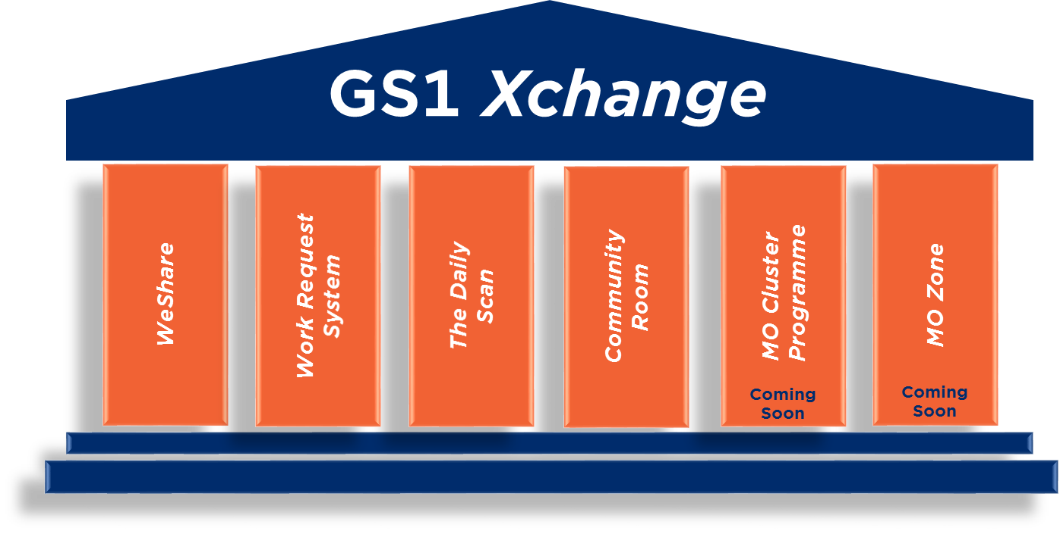
GS1 Xchange: Where collaboration meets community
GS1 Xchange is your new home for a variety of existing and future GS1 user communities.
This new meeting space includes established communities such as the
GS1 Community Room and GS1 WeShare portals, as well as new communities like the GS1 Daily Scan- your fresh source for up-to-date recent GS1 news and industry information.
User benefits include:
Single sign-on
Easy navigation between different communities
Improved experience
Join today!
Xchange.gs1.org

Slide 137
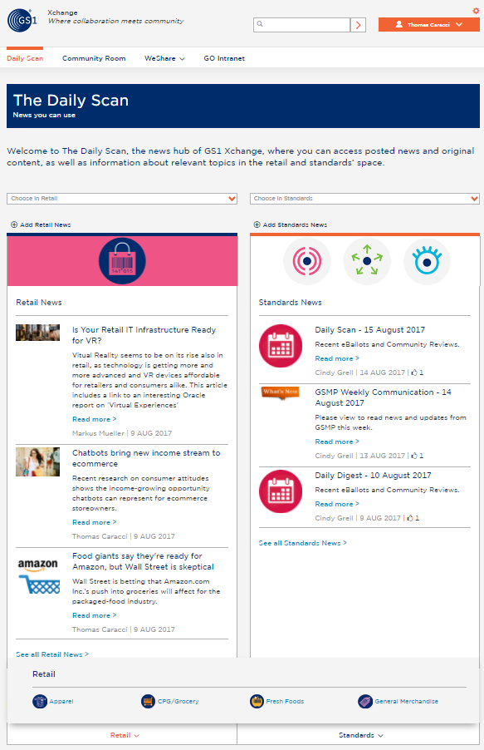


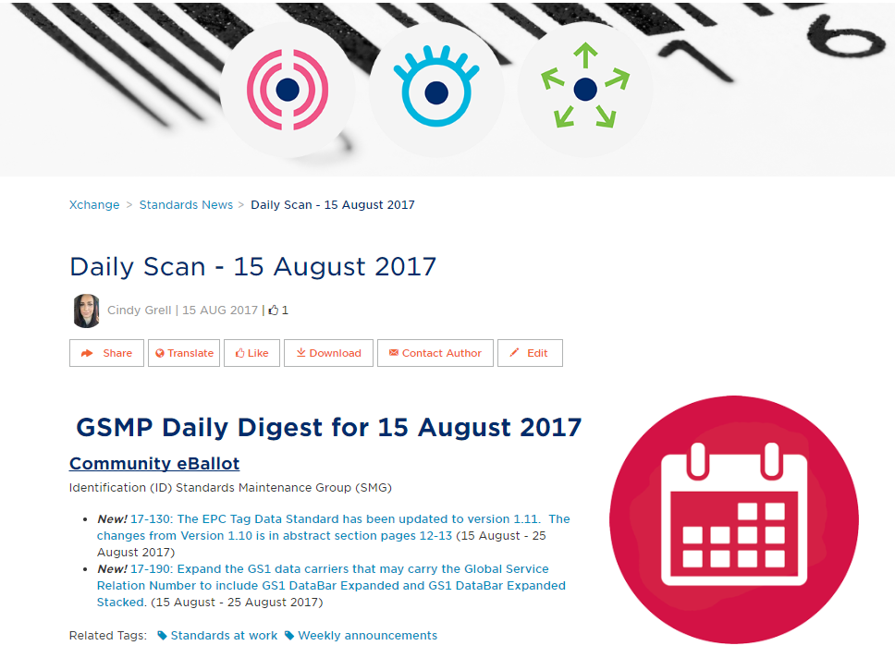

The Daily Scan: News you can use
Did you know? The Daily Scan is the new welcome page on the GS1 Xchange platform, providing you with up-to-date GS1 news and information.
Join us! Experience this modern approach to news, with cutting-edge features such as:
Timely retail & standards’ news for GS1 members
Quick access to your GS1 portals
News sorted & tagged by category
Shareable & downloadable content through social media
Translation function
Weekly digest…and more!
Xchange.gs1.org

Slide 138
Adjourn

