Slide 1
GS1 Industry & Standards Event 2017
09-13 October 2017 – Brussels, Belgium
Transforming business together
Session: GS1 GO Hosting Service
Time: 13:30 – 15:30
Who may attend: All
Speaker(s): Owen Strouse, Sean Lockhead & Mark Van Eeghem, GS1

Slide 2
Anti-trust caution
GS1 operates under the GS1 anti-trust caution. Strict compliance with anti-trust laws is and always has been the policy of GS1.
The best way to avoid problems is to remember that the purpose of the group is to enhance the ability of all industry members to compete more efficiently.
This means:
  There shall be no discussion of prices, allocation of customers, or products, boycotts, refusals to deal, or market share.
  If any participant believes the group is drifting toward impermissible discussion, the topic shall be tabled until the opinion of counsel can be obtained.
The full anti-trust caution is available via the link below, if you would like to read it in its entirety: http://www.gs1.org/gs1-anti-trust-caution.

Slide 3
Statement & reminder for seeking intellectual property information
Relevant to the features of the specification that are being developed in this work group, if anyone has knowledge or information about intellectual property rights, such as, patents or patent applications; please promptly convey this information to the work group facilitator.
The intellectual property rights can either be in development or owned by persons, companies or third parties within this work group or outside this work group.
We do this under the guidance of the GS1 Intellectual Property Policy, so that GS1 can seek to avoid the uncertainty regarding intellectual property claims against the Specification.

Slide 4
Meeting etiquette
Meetings will begin promptly as scheduled
Be present – avoid multi-tasking
Avoid distracting behaviour:
  Place mobile devices on silent mode
  Avoid sidebar conversations
Be considerate
  Avoid monologues
  Keep comments concise
Respect work group decisions
  Avoid re-opening decisions unless there is a significant quality impact
Collaborate in support of meeting objectives
  Ask questions
  Be open to alternatives
Be representative
  Avoid personal remarks
  Do not speak for your company or community if you do not clearly understand their needs
  Votes should reflect the needs of your company or community

Slide 5


GS1 Standards Event App – How to get it
Get the App by searching your App store for "GS1 Global Events" (If you already have the Global App due to attendance at the Global Forum or Standards Event, you do not need to do this)
Once you have the Global App on your mobile device, type GS1IS17 in the search box. Please click the orange (+) to activate the event within your application.
1
2
Login with the email address you used to register for the event:
Username: (your registered email)
Password: 2017
2017
3

Slide 6
WiFi internet access
Select “Crowne-Plaza-Free-Internet” and connect
Password: 2017

Slide 7
Agenda
GS1 Service Overview
  GEPIR
    Overview
    Demo
  GLN Service
    Overview
    Demo
  Escrow
    Overview
Single Sign-on
  Overview
  Vision & Benefits
Open Discussion / Community Requirements

Slide 8
GS1 Service Overview

Slide 9
GS1 Service – GEPIR

Slide 10
GS1 GEPIR Service
PRODUCT POSITIONING:
GEPIR is a global service that utilizes a distributed network, providing a single point of access to GS1 Global Company Prefixes (GCP) and GS1 Key Licensee’s
  Is ‘foundational’ for validation of GS1 Global Company Prefixes (GCP) and GS1 Key Licensee’s
  Resolves GS1 Keys to a GS1 GCP to provide information (contact) on the Licensing Organization [of the GCP]
  Indicates the organization with rights to create GS1 Keys from the associated GCP
  An open system with no requirement around user access & authentication
  By definition it is not a registry of GLNs; it can expose GLNs as information associated to the Licensing Organization
  GEPIR has an update planned called GEPIR: Modernized; it will add an SLA and diagnostic requirements to any self hosted nodes to ensure they all perform to the same level as GS1 Hosted nodes
ADOPTION:
Every GS1 Member Organization must participate in the GEPIR network by 2012 GA agreement
GOVERNANCE:
The GS1 GO LT reports to the Management Board who governs all GS1 Services & Solutions which are the B2B and B2C services and solution to include GEPIR

Slide 11
GS1 Hosted GEPIR – DEMO

Slide 12
GS1 Service – GLN Service

Slide 13
GS1 GLN Service
PRODUCT POSITIONING:
The GS1 GLN Service is a global service utilizing a central registry, providing a single point of access to GS1 GLN master data via an interconnected network of local registries
  Provides access to the global service via a Local GLN Registry including user authentication
  A global solution that connects all GLN registries to enable the look-up of GLN and basic party information from any other registry
  A closed system that requires user access & authentication only for GS1 Federation Members
  By definition it is a registry of GLN’s; to provide GLN master data

Slide 14
GS1 GLN Service
ADOPTION:
MO’s in Production (11):
    Canada, Germany, Lithuania, Ireland, Macedonia, Moldova, Latvia, Egypt, Nigeria, Bolivia, US
MO’s in Testing:
    GS1 Colombia
Recent MO Inquiries:
    GS1 Slovenia, GS1 Switzerland, GS1 UK
Service Usage a/o October 10, 2017:
    Total GLNs: 385,079
    Total Hosted GLNs: 11,200
    Added Last 30/60/90 days: 44 / 1,393 / 2,586

Slide 15
GS1 GLN Service
Challenges:
Only two required fields in Global Index
  Minimal benefit
  Should we require more to increase value of service?
Unknown peer-to-peer usage
How to gain additional adoption?
ROADMAP:
Service will be maintained if adoption increases

Slide 16
GS1 Hosted GLN Service – DEMO

Slide 17
GS1 GO Service – Escrow

Slide 18
GS1 GO Service – Escrow
Purpose:
Secure a backup of the key membership data to ensure continuity of the core services to user companies in the event of a MO’s expulsion, resignation or in the event of a force majeure.
Hosted GEPIR is an option to satisfy escrow requirements.
Challenges:
GEPIR has limited mandatory attributes
Escrow has greater number of mandatory attributes
Some MO’s don’t want all Escrow attribute exposed in GEPIR
Need: Opt attributes into/out of GEPIR if they are not mandatory for GEPIR

Slide 19
Single Sign-On

Slide 20
Single Sign-On - Overview

Slide 21
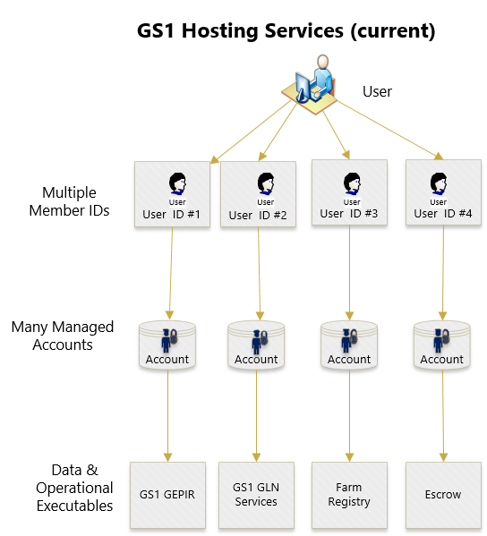
Hosted Services – Current State
GS1 currently maintains hosted applications (GEPIR, GLN Services, Escrow, Farm Registry)
Each service maintains its own set of:
  User IDs
  Data Sets
  Proprietary functionality
In a number of instances, the services share:
  Similar data sets
  Functionality

Slide 22
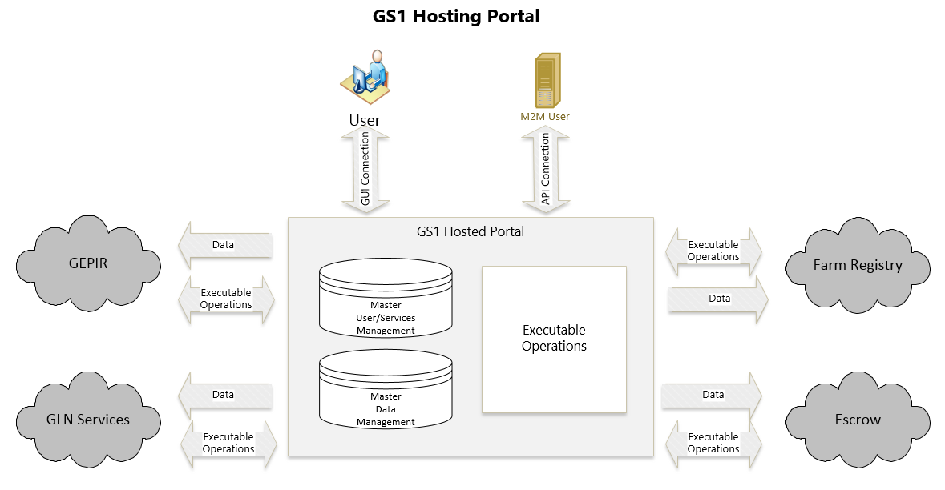
Hosted Services – Future State Proposal
Goal: Provide user with a single sign on while reducing redundant data entry and system functionality.

Slide 23
Vision

Slide 24
Data Services – Future State Proposal
Key Features:
Migrate from a Services-With-Data to a Data-with-Services approach
Single Login Hosting Portal
Single Data Set/Record – Multiple uses
  Ex. GLN record can be shared in GEPIR & GLN Service
Modular Design
Flexible access controls
No change to existing end user functionality

Slide 25
Benefits

Slide 26
Benefits
Users:
Single Sign On
Single Portal for all GO hosted services
Flexible Access Controls within Company/MO
Retain Existing Functionality
GS1:
Maintain Single Portal
Flexible (consistent) Access Controls
Quickly Add New Modules
Eliminate excess system environments (save $$)
Reduce number of TeamWork Sites (reduce staff workload)

Slide 27
Open Discussion / Community Requirements

