Slide 1
GS1 Industry & Standards Event 2017 09-13 October 2017 – Brussels, Belgium Transforming business together
Session: GS1 Cloud Lunch & Learn
Time: October, 10
Speaker(s): Mike Wehrs, Birgit Mahler

Slide 2
Anti-trust caution
GS1 operates under the GS1 anti-trust caution. Strict compliance with anti-trust laws is and always has been the policy of GS1.
The best way to avoid problems is to remember that the purpose of the group is to enhance the ability of all industry members to compete more efficiently.
This means:
There shall be no discussion of prices, allocation of customers, or products, boycotts, refusals to deal, or market share.
If any participant believes the group is drifting toward impermissible discussion, the topic shall be tabled until the opinion of counsel can be obtained.
The full anti-trust caution is available via the link below, if you would like to read it in its entirety: http://www.gs1.org/gs1-anti-trust-caution.

Slide 3
Introduction
Mike Wehrs
Head of Data
Products & Services, Solutions
Audrey Kremer
Director Industry Engagement, Cloud & Emerging Services
Birgit Mahler
Product Manager,
GS1 Cloud

Slide 4
Consumers
Retailers, e-tailers,
& marketplaces
App developers & solution providers
GS1 Cloud
The largest source of trusted product information in the world
Healthcare
Brand owners
Regulators
GS1 MOs

Slide 5
GS1 Cloud: Core attributes and features
Attributes | Check | View | Explore
1. GTIN
2. Brand
3. Label Description
4. Medium Resolution Image
5. Target Market
6. Company Name
7. Product Classification
Check
View
Explore
Required for service
Service enhanced as a result

Slide 6
GS1 Cloud
Check
Formerly known as GTIN Authentication
View
Formerly known as Product Validation
Explore
Formerly known as Search

Slide 7
GS1 Cloud
Benefits for consumers
Confidence in product information
Connected, seamless experiences

Slide 8
GS1 Cloud
Benefits for brand owners
Ease of data management
Activation of products globally
Global reach for their B2C data

Slide 9
GS1 Cloud
Benefits for retailers, e-tailers and marketplaces
Simplified data access
Easier data quality
Product exploration
Confident consumers

Slide 10
GS1 Cloud
Benefits for app developers and solution providers
One source of authoritative data
Great data
Global community

Slide 11
GS1 Cloud
Benefits for regulators
Easier data access and data quality
Easier compliance by brands and retailers
Easier security and border risk management

Slide 12
GS1 Activate and GS1 Cloud
Consumer product data collection
Data uploaded from various sources
Consumer product data storage
Data stored in a modern, scalable cloud database
Consumer product data access
Data distributed to various value-creating applications
Member Customer Systems
GS1 Activate
GTIN Issuance and Activation
Data Users
Check
GS1 Cloud
MO CRM/ERP Systems
View
Explore
Data Quality & Policy Validations
Other sources
GDSN Data Pools
Data aggregators
Local/other catalogues
Brand owner internal database
Global Company Prefix (GCP)
GTIN non-reuse
Consumer Product Variant (CPV)
Data Permanence
Rules
Data Validation Rules

Slide 13
GS1 Cloud: Data-loading and access timeline
2017
2018
Aug
Sept
Oct
Nov
Dec
Jan
Start initial
data load
GS1 MOs
(A trial of 10-12 MOs began in August. Others who are ready can begin testing in September*)
Start brand owner data refresh
Brand owners
GDSN Data Pools
Testing and app development phase
Data not yet accessible to the public
Data access
Check
View
Explore

Slide 14
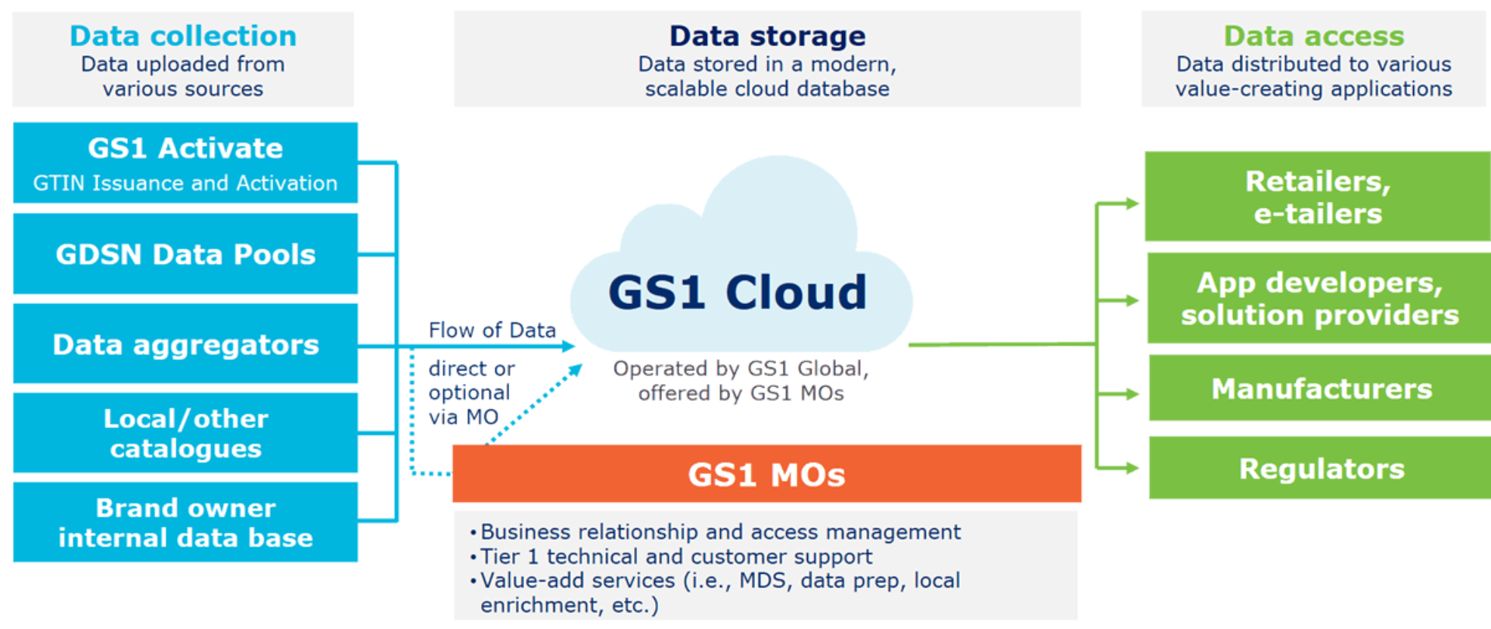
GS1 Cloud: How it works

Slide 15
Confidence starts with trusted data.
GS1 Cloud
www.gs1.org/gs1-cloud

