Slide 1
GS1 Master Data Services and Brand Owner Certification
GS1 Industry and Standards Event
9–13 October 2017 – Brussels
Transforming business together
08:30 – 10:00 CET, Thursday, 12th October
Presentor : Patrick Ponsaerts

Slide 2
Anti-trust Caution
GS1 operates under the GS1 anti-trust caution. Strict compliance with anti-trust laws is and always has been the policy of GS1.
The best way to avoid problems is to remember that the purpose of the group is to enhance the ability of all industry members to compete more efficiently.
This means:
      There shall be no discussion of prices, allocation of customers, or products, boycotts, refusals to deal, or market share.
      If any participant believes the group is drifting toward impermissible discussion, the topic shall be tabled until the opinion of counsel can be obtained.
The full anti-trust caution is available via the link below, if you would like to read it in its entirety: http://www.gs1.org/gs1-anti-trust-caution.

Slide 3


GS1 Standards Event App – How to get it
Get the App by searching your App store for "GS1 Global Events" (If you already have the Global App due to attendance at the Global Forum or Standards Event, you do not need to do this)
Once you have the Global App on your mobile device, type GS1IS17 in the search box. Please click the orange (+) to activate the event within your application.
1
2
Login with the email address you used to register for the event:
Username: (your registered email)
Password: 2017
2017
3

Slide 4
WiFi Internet Access
Select “Crowne-Plaza-Free-Internet” and connect
Password: 2017

Slide 5

GS1 Master Data Services and Brand Owner Certification
Learning Objectives:
Why was this Programme created?
What is the Master Data Services Certification and why it is important
What are the benefits for MOs and Brand Owners
How to prepare for the certification and Audit process
Insight in the Audit process
Notes:
Member Organizations who wish to become certified in Master Data Services, as well as those;
MOs who wish to have the MDS
MOs who already have a service and want to be globally certified
In the next 20 minutes, you’ll learn more about:
what the Master Data Services Certification is, and why it is important
What the benefits are for MOs and Brand Owners
How to prepare for the certification and Audit process

Slide 6
Background:
Why Did Global Office Develop This Programme?

Slide 7
Executive Committee of the GS1 Management Board
In effort to take action on the state of the world’s data quality, the Executive Committee of the GS1 Management Board, supported by the GS1 Data Excellence Board, instructed GS1 to develop a data quality certification program for Master Data Services and Brand Owners.
Steps taken on the Master Data Services & Brand Owner Certification Programme:
Drive usage of Data Quality Master Data Services: Member Organisations
Best Practice Guideline to develop and deploy DQ Master Data Services, completed December 2015
Develop a certification programme Master Data Services for MOs, completed June 2016
Strengthen Data Quality at the Source: Brand Owners
Best Practice Guideline for DQ at the Source, completed December 2015
Develop a certification programme for Brand Owners, completed June 2016
  To be delivered by Member Organisations to Brand Owners

Slide 8

Impact of a ½ pound difference on Transportation Costs (GS1 US example)
Scenario 1 (Existing data) | Scenario 2 (Measured data)
9.5 lbs | 9.0 lbs
1,900 lbs | 1,800 lbs
45,000 lbs | 45,000 lbs
23 pallets | 25 pallets
4,600 cases | 5,000 cases
109 | 100
$3,000 | $3,000
$327,000 | $300,000
Case Weight
Case weight is actually ½ pound less
Pallet Weight
Truck Weight Limit
Extra ½ pound per case allows 2 additional pallets per truck
Pallets per Truck
Cases per Truck
400 more cases per truck
# Trucks
9 less trucks
Cost per Truck
Total Costs
$27,000 in Savings
At 200 SKUs, and just 3% (=6 SKU) have the case weight overstated in a similar fashion:
That would be (27Kx6) $162,000 in potential savings!

Slide 9
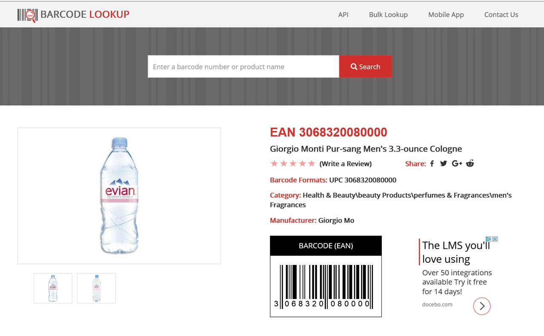
A GTIN gives the right picture but the wrong information
The quality of the data is a direct reflection on the quality of the product
Notes:
Consumers have become more demanding in their purchasing decision
s. From a consumer’s perspective, having access to the right product at the right time at the right price is paramount to their shopping experience – whether it is through traditional brick-and-mortar or online shopping
The ability to meet the consumer’s needs in the most cost-efficient manner is critical to traditional and online retailers alike.
The ability to service the customer in the manner they are demanding is dependent upon accurate and complete data.
The quality of the data is a direct reflection on the quality of the product. Therefore product data and images must be treated with the same regard for quality as the product itself

Slide 10
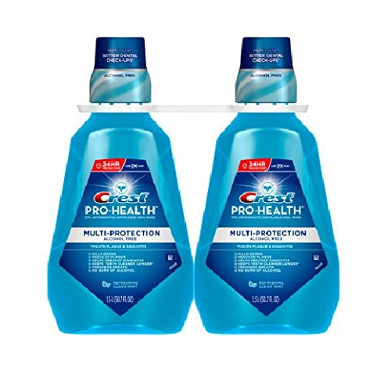




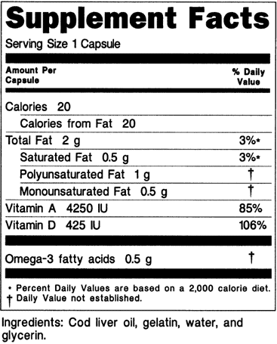
Data Reality Yesterday & today!
Storage and Handling Unit of Measure
Storage and Handling Unit of Measure
Over the Counter (OTC)
Package Status
Net Content 3 UOM
Primary UPC
Max Order Qty
Pack Value
Supplier Stock Number
UDEX
Product Type
Chemical Indicator
Storage and Handling High Value
Issuing Agency
Size Unit of Measure
Serial Number
Medium Product Description
Suppressed UPC
Primary Delivery Method
Production Start Date
Unit UOM
MFG GLN
Quantity per Package
Department
Device required to be labeled as containing natural rubber latex or dry natural rubber (21 CFR 801.437)
Ti
Spec Height
Merchandise Height
Brand
GMDN Preferred Term
Container Type
Signing Description
Package Discontinue Date
Primary DI Number
Device Description
Spec Width
Storage and Handling High Value
Flavor
Gross Weight
Spec Length
Storage and Handling Type
Shipping Start Date
Unit Size
Base Unit of Measure
Brand Name
Brand Group
Sub-Brand
Device Exempt from Premarket Submission
Material #
Spec Unit
Product Code
Net Content 5 UOM
Container Content
Merchandise Width
Item Description 1
Brand Owner
Storage and Handling Type
Platform
Hazmat Classification
Volume UOM
Storage and Handling Unit of Measure
Name
Is Security Tag Present
Nutritional
Product Category
UPC Description
Merchandise Length
MFG GLN 1
Style
Trade Item Recall Ind
MFG GLN 5
BarCode Type
Cancel Date
Merchandise Weight
Storage and Handling High Value
Company Physical Address
Package Name 2
Package Name 4
What MRI safety information does the labeling contain?
Definition
Conveyable
Product Percent Juice
Lead Time
Package DI Number
Package Name 3
Storage and Handling Unit of Measure
Item Type
Direct Consumer Delivery
Prod Hierarchy
Height
Discontinue Date
MFG GLN 4
Storage and Handling Low Value
Gross Weight UOM
Weight Unit
Device Subject to Direct Marking (DM), but Exempt
Return Goods Policy
Supplier Pack Cost
Depth
Special Storage Conditions
Target Market
FDA Listing Number
Human Cell, Tissue or Cellular or Tissue-Based Product (HCT/P)
Net Weight UOM
Language Code
Cluster
Merchandise Unit
Net Weight
Short Product Description
Order Qty Multiple
Register with GS1
Storage and Handling Unit of Measure"
Package Type
Sub-Department
Shipping Unit
Ordering Unit
Device Count
Model Number
Net Content 2 UOM
Catalog Number
Net Content 2
Storage and Handling Low Value
Customer Contact Phone
Product Size
Combination Product
Material Group
Packaging Material Code
Deposit UPC
Business Unit
Fineline
Hi
Device Count
Net Content 4 UOM
Storage and Handling Unit of Measure
Storage and Handling High Value"
Net Content
Size Value
Device labeled as "Not made with natural rubber latex"
Item Identifier
Virtual UPC Code
Primary DI Number
RFID Tagged
Height UOM
Storage and Handling Low Value
Multi-Pack Indicator
RPPC Indicator
Recyclable Package
Package Marked Returnable
Labeler DUNS Number
Commercial Distribution Status
Package Type
Net Content 5
Selling UOM
Min Order Qty
Graphics Specialty
Graphics Specialty Base
Storage and Handling Unit of Measure
Storage and Handling Unit of Measure"
Company Name
Composite Wood Level Code
Spec Weight
Supplier Number
Width
CPSC Regulated Indicator
Secondary DI Number
FDA Preferred Term Code
Expiration Date
Depth UOM
Unit of Use DI Number
Sub-Type
Cluster Material
Storage and Handling High Value
GTIN
GPC
Coupon Family Code
Storage and Handling Type
Base Unit
Large Product Description
Storage and Handling Unit of Measure
CAW
Product Classification
Environmental Identifier
Customer Contact Email
Storage and Handling Type
Net Content 3
MFG Code
Trademark Family
Cluster Marketing Wrap
Registration Status
Storage and Handling Unit of Measure
Base Unit UOM
Item Scannable
Storage and Handling Unit of Measure
Invoice Item
Information Provider
Tare Weight
Consumer Unit
Container Specialty
Manufacturing Date
Version or Model Number
Kit
Size Text
Vending
Device Packaged as Sterile
DM DI Different from Primary DI
Product Sub-Group
Valid From
Secondary Information Provider
Net Content 4
Deposit Text
Variable Weight
Item Contains Wood
Package Name 1
Ordering UOM
For Single-Use
Commercial Distribution End Date (mm/dd/yyyy)
Product Code Name
Volume
Storage and Handling Low Value
MFG GLN 2
Contains DI Package
Sterilization Method
Information Private
Private Label Indicator
Storage and Handling High Value
Third Information Providerv
Storage and Handling Low Value
FDA Premarket Submission Number
Register with DataPool
Country of Origin
Net Content 1 UOM
Deposit Amount
Deposit Code
Nationally Priced
Aerosol Indicator
SAP Description
Storage and Handling Type
DM DI Number
Segregation Code
Barcode Derivable
Material Code Agency
Packaging Type
Audit Date
Storage and Handling Unit of Measure
DI Record Publish Date (mm/dd/yyyy)
Size Type
Lot or Batch Number
Secondary DI Issuing Agency
Pesticide Indicator
National Account Package Code
Storage and Handling Type
Requires Sterilization Prior to Use
Donation Identification Number
Storage and Handling Low Value
Health Category
Width UOM
Special Order Available
Base Unit Retail
Deposit Currency
Subject to US Patent
Lowest Level
Fourth Information Provider
Deposit State
Pallet Stack Height
Several MOs and third party solution providers have developed local data quality programs!
Nothing is wrong but …….

Slide 11
What is the Programme Aiming to Do?
Provide a global benchmark for Master Data Services Data Quality processes and procedures for MOs and Brands
Audit to ensure everyone is complying to the same criteria
Align MOs that choose to certify and recognize the certification of other MOs knowing they comply to the same criteria in their region
Improve DQ, Image Capture, Measurement Accuracy, Label information

Slide 12


Potential for Regional Alignment
Ways of Working
    Align on best practises
    Align on generic data requirements across region
    Align on Image capture requirements across the region
MDS and Brand Owner Certification
    Compliant with GO MDS audit a recognised standard
  Regional recognition of the MDS certification
  Reducing complexity for suppliers, certified in one country and recognised by other MO countries who have completed MDS certification

Slide 13

Eligibility Criteria
In order for a MO to be eligible to participate in this program, they need to either already be operating a Master Data Services or Brand Owner Certification programme, or they are about to embark on developing such services
It is important that the MO who applies to be certified has the correct resources and the required skill sets to achieve certifications
Notes:
In order for a Member organization to be eligible to participate in this program, they need to either already be operating a a Master Data Services or Brand Owner Certification programme, or they are about to embark on developing such services
It is important that the MO who applies to be certified has the correct resources and the required skill sets to achieve certifications.

Slide 14

No Master Data Services yet?
Start Small and Grow Over Time
Talk to GO about your MDS strategy
Enlist help from local GS1 MOs, that have mature, successful Master Data Services and Brand Owner Certification Programmes in place.
Start small and build on success then, expand as needed.

Slide 15

What is the Master Data Services certification?
Why Should I Get Engaged

Slide 16


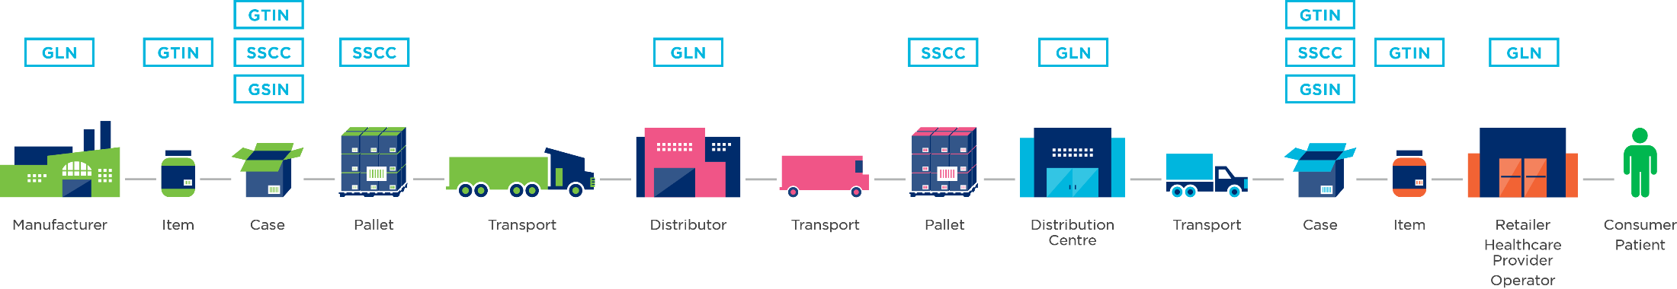
Objective of Programme
OBJECTIVE OF THE MASTER DATA SERVICES certification PROGRAMME
DATA QUALITY
IMAGE QUALITY
REDUCE COSTS, MAXIMIZE EFFICIENCY & IMPROVE DATA QUALITY AT SOURCE
Notes:
To meet these needs, the Global Office has developed the Master Data System Certification programme to help the users of GS1 standards achieve a great level of data and image quality and thereby reduce costs and maximizing efficiencies across the supply chain
The objective of the programme is to improve data quality at the source by establishing performance requirements for Master Data Services Certification and Brand Owner certification.

Slide 17


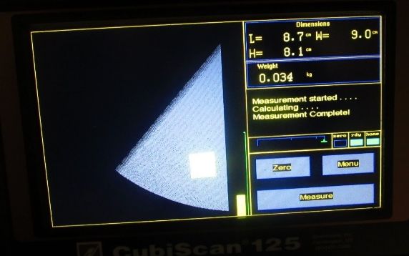
Example of one of our Pilot MOs structure-flow
Service Request
Scheduling and notification
(Done when all balances are in order and if <30 products/day)
Service Request: Manufacturer or retailer sends their products
Scheduling and notification: Planner ensures lab is notified and has the products recorded
Data Capture: All mandatory product information is recorded and validated starting with GTIN
Image: Only one image is mandatory to be captured. More is recorded as additional services
Data Quality: Several quality checks are made including bar code quality
Upload data to platform: Once the data quality report is generated the product info is uploaded
Delivery of results: Delivery efficiency is measured to client
Product Reception
Capture & homologation
Upload data to Data Quality
Platform
Delivery of results

Slide 18
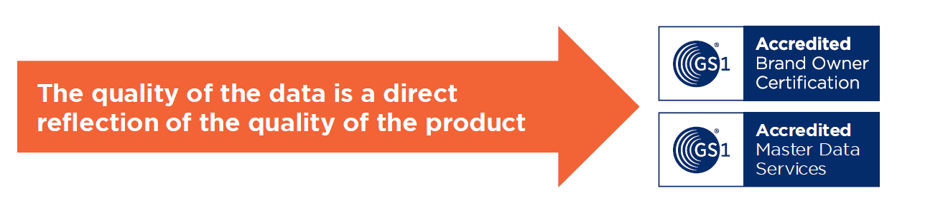
What is the MDS & Brand Owner Certification Programme?
A global programme designed to improve data quality at the source
Certification is valid for 2 years
Notes:
The objective of the programme is to improve data quality at the source by establishing performance requirements for Master Data Services Certification and Brand Owner certification.

Slide 19

Two Foundational Components
  MO Master Data Services Certification
    Provides Member Organisations with best practices for a well structured Master Data Services Certification programme, based on MOs who have achieved success
  Brand Owner Certification
    Provides Brand Owners with guidelines they can take at the creation of the data. Ensures images, weights and measurements are verified to meet retailer’s needs and are compliant with GS1 standards
All based on GS1 Standards and the DQ Framework
Notes:
There are two main services which comprise the MDS Certification Programme:
Master Data services certification & Brand Owner Certification
Master Data Services certification refers to a set of criteria listed in the Master Data Services Checklist.
Brand Owner Certification:
The Member Organisation (MO) is responsible for administering the certification of the Brand Owners in their country, ensuring consistency and correct implementation of the best practices.
Brand Owners need training and support through this process. Therefore, this programme recommends the Member Organisation implement a national programme to certify Brand Owners based on the criteria outlined in the Brand Owner Checklist.

Slide 20

Benefits for our Member Organisations
Strengthen Data Quality
  Maximize efficiency throughout the supply chain and decrease consumer and retailer risk
Offer New Services to Brand Owners & SMEs
  Position the MO to become the “trusted advisor” addressing Master Data business challenges and increase usage of MDS
Everybody Wins
  Reduce time spent re-capturing and re-validating data

Slide 21

Benefits for Brand Owners
Improves data quality at the source and across the supply
    Globally harmonised data quality certification programme
Better information for the consumer experience
    The quality of the data and image is a direct reflection on the quality of
    the product
Images are verified to meet the Brand, Retailer’s and Web Shop needs
    Online shoppers prefer selecting a product with an image
Verified weights, measurements, images
    Compliant with GS1 standards
    Supply Chain costs decrease when data is accurate
    Complete and accurate information for space planning (Planograms)
Sales increase when information is accurate and linked to an image
Core service linked to the GS1 Cloud & Trustmark

Slide 22
Master Data Services and Brand Owner
Pilot Status, Pipeline and Next Steps

Slide 23

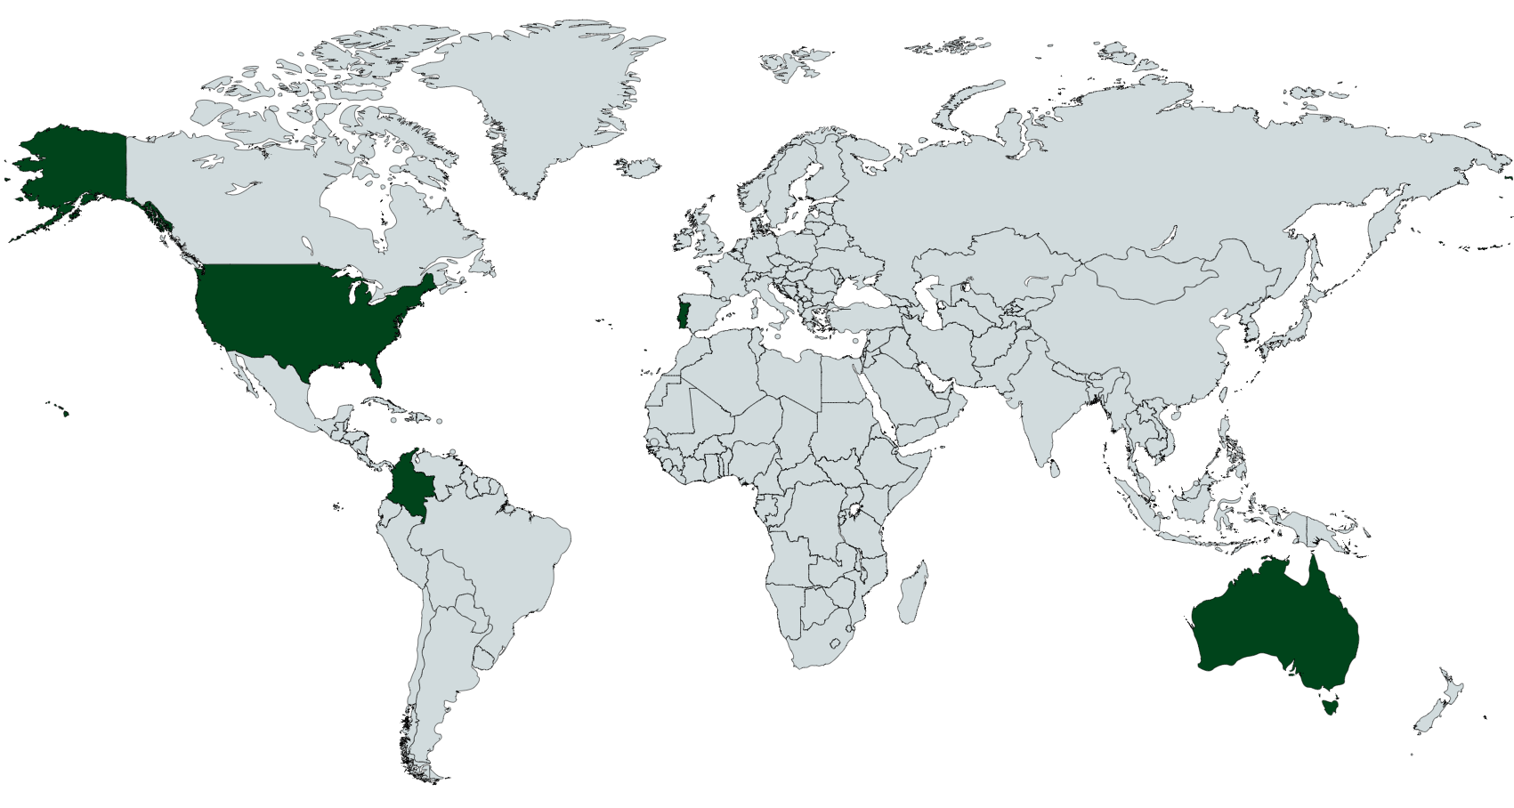

Master Data Services and
Brand Owner Certification - PILOT
Pilot Completed: January 2017-June 2017
                GS1 Australia
                GS1 Colombia
                GS1 Portugal
                GS1 United States
                GS1 Colombia
                GS1 United States
Congratulations
to the pilot Member Organisations who are now all
CERTIFIED
Notes:
The Programme Pilot Phase was launched with four Member Organisations, in January of 2017. The selection of the 4 Pilot MO was a balanced based on Different Regions / Different Structures & Different Sizes
The Pilot will completed 30 June 2017, with all four pilot Member Organisations certified in MDS and two also receiving Brand Owner certification. GS1 is currently enhancing the Programme based on the learnings from the pilot MOs.

Slide 24
Master Data Services and Brand Owner Certification
Phase 3 – (actual)
    Integrate learnings from pilots
    MO training and deployment
    Enrich the certification
    Support certified MOs efforts to certify brands in their region
Phase 4 – (future)
    Expand program to more MOs
    Develop inter-MO recognition of MDS certified products

Slide 25
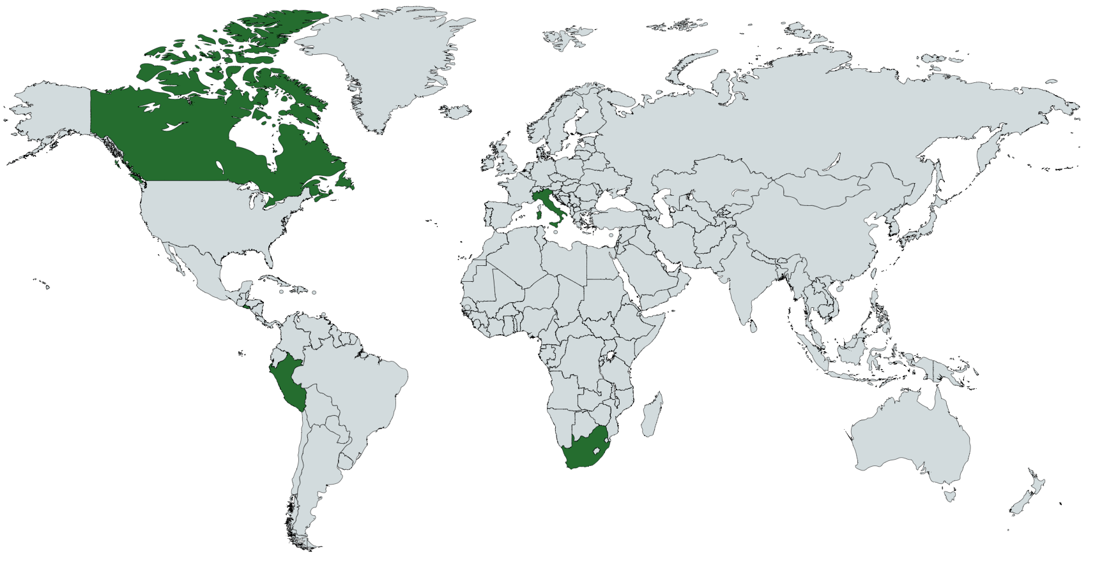
Certification Programme - Fiscal Year 17/18
5
                GS1 Canada (confirmed 02/18)
                GS1 El Salvador (Plan 03/18)
                GS1 Italy (Plan 01/18)
                GS1 Peru (confirmed 12/17)
                GS1 South Africa (confirmed 11/17)
CEO COMMITMENTS for FY 17/18

Slide 26
Support and Guidance
Training, Mentoring & Resources

Slide 27
Help you can Expect
TRAINING
FAQ
eLEARN Course
Operational Manual
Criteria Checklist
Clearly Defined Deployment Plan
Routine Team Calls
Milestone Review Checkpoints
One Point of Contact
DQ Strategy Development
Auditor Access
Translation Assistance
MO Connections
MENTORING & SUPPORT
PAY IT FORWARD
Post Certification Discussion:
  Programme Learnings
  Ease of Certification
  Suggest Programme Enhancements

Slide 28

Partners:
GS1 GO & GS1 MO Data Quality Teams
Evaluating Member Organisations with a defined process, allows the critical elements of the Programme’s criteria to be assessed commonly worldwide.
Partnering GO/MO teams together, allows for the uniqueness of each country’s maturity in MDS to be understood and adapted to ensure certification is fairly applied

Slide 29
eLEARN Training Modules 1-3
MODULE 1 - Intro to the GS1 Global Master Data Services Certification Programme
What is the Master Data Services Certification Programme?
Why is it important?
What are the benefits of the programme for MOs and Brand Owners?
MODULE 2 - How to Harmonize an existing MDS Certification Programme for Global Compliance
MOs that have an MDS and/or Brand Owner Programme in place
What is the process of certification?
How does the MO prepare for the Audit by Global Office?
What documentation is required from the MO to participate?
MODULE 3 - How to Prepare for the MDS Certification for Member Organisations and Brand Owners
MOs that do not have an MDS and/or Brand Owner Programme in place
What is the process of certification?
What is required of the MO?

Slide 30
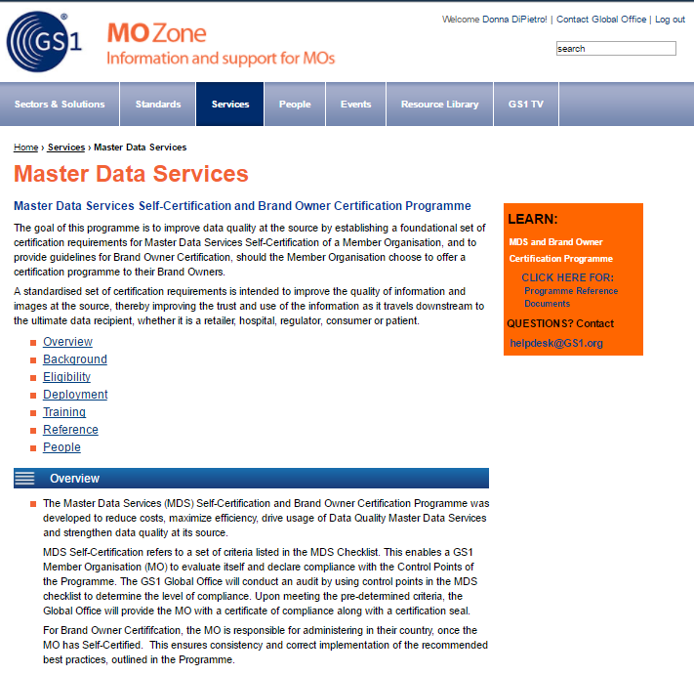
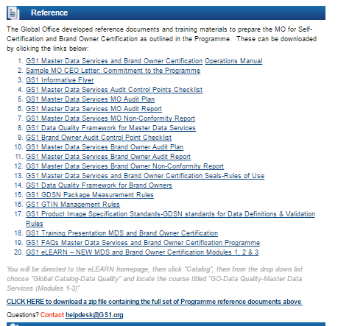
Available Resources
Programme Webpage-MO Zone: http://mozone.gs1.org/master-data-services/

Slide 31

Master Data Services & Brand Owner Steps for Certification

Slide 32
Steps for Certification (aligned to DQ Framework) Step 1
STEP 1: Strategy
MDQ STRATEGY
STEP 2: Conformance Framework
DATA QUALITY CONFORMANCE FRAMEWORK
SECTOR, TM, DATA UC,
ATTRIBUTE,
DQ CONFORMANCE RULES
DATA QUALITY MANAGEMENT SYSTEM
STEP 3: Use Cases, Data Model & References
BUSINESS PROCESS & MASTER DATA
USE CASES
DATA MODEL
GS1 REFERENCES, STANDARDS & GUIDELINES
STEP 4: DQ Management System
DATA QUALITY MANAGEMENT SYSTEM
GS1 REFERENCES, STANDARDS & GUIDELINES
STEP 5: Data Governance, Processes, Assessment, Creation & Maintenance of Data
DATA
GOVERNANCE PROCESS & ASSESSMENT
CREATION & MAINTENANCE
OF DATA
GS1 REFERENCES, STANDARDS & GUIDELINES
STEP 6: Detailed MDQ Processes & Procedures
PROCESS PROCEDURES
PRODUCT
DATA AUDIT
INSPECTION
PROCEDURES
INSPECTION
BODY
SELECTED
INSPECTION PREPARATION
SUSTAINABILITY
PROCESSES
GS1 REFERENCES, STANDARDS & GUIDELINES
Notes:
Prepare your MDS Strategy and Get CEO approval
It is recommended that the Member Organisation first read the best practice documentation for Master Data Services and Brand Owner Certification:
GS1 Data Quality Framework for Master Data Services Best Practices document, which includes:
Master Data Services – The Business Process Focus
How to capture data and images
Product Data Comparison Service
How to Quality Assure Data from the Data Source
Item Maintenance: Add, Change and Delete
Product Information Distribution
Master Data Services Education & Training Procedure
Case Studies: GS1 Mexico, GS1 Sweden, GS1 Netherlands, GS1 Canada
GS1 Data Quality Framework for Brand Owners, which includes
Best Practice guidance for Data Governance
Role of a Data Steward/Project Lead within the Organisation
Data owners within the organisation
Item Maintenance: Add, Change and Discontinued
Best Practice for Audit Inspection
Data Quality Metrics
Communicate Data on Finished Products
Data Sharing and Communications
Best Practice for Training and Education
Get commitment from the CEO
Develop and get commitment for MDQ strategy from CEO
Inform the Global Office your intent to do self-certification
Identify the resources for your Master Data Services team
Set up your data governance department and train your resources with the required skills
Create the necessary audit documentation
Operations Manual for MDS/Data Quality Management
Standard Operational Procedures
MDS Best Practices and related data quality documentation

Slide 33
Steps for Certification (aligned to DQ Framework) Step 2
STEP 1: Strategy
MDQ STRATEGY
STEP 2: Conformance Framework
DATA QUALITY CONFORMANCE FRAMEWORK
SECTOR, TM, DATA UC,
ATTRIBUTE,
DQ CONFORMANCE RULES
DATA QUALITY MANAGEMENT SYSTEM
STEP 3: Use Cases, Data Model & References
BUSINESS PROCESS & MASTER DATA
USE CASES
DATA MODEL
GS1 REFERENCES, STANDARDS & GUIDELINES
STEP 4: DQ Management System
DATA QUALITY MANAGEMENT SYSTEM
GS1 REFERENCES, STANDARDS & GUIDELINES
STEP 5: Data Governance, Processes, Assessment, Creation & Maintenance of Data
DATA
GOVERNANCE PROCESS & ASSESSMENT
CREATION & MAINTENANCE
OF DATA
GS1 REFERENCES, STANDARDS & GUIDELINES
STEP 6: Detailed MDQ Processes & Procedures
PROCESS PROCEDURES
PRODUCT
DATA AUDIT
INSPECTION
PROCEDURES
INSPECTION
BODY
SELECTED
INSPECTION PREPARATION
SUSTAINABILITY
PROCESSES
GS1 REFERENCES, STANDARDS & GUIDELINES
Notes:
Conformance Framework
Sectors
Review target market requirements
Review Data Use Cases
Agree attributes for each sector
Image standards for target market
Define Data Quality Conformance rules
Outline Data Quality Management system

Slide 34
Steps for Certification (aligned to DQ Framework) Step 3
STEP 1: Strategy
MDQ STRATEGY
STEP 2: Conformance Framework
DATA QUALITY CONFORMANCE FRAMEWORK
SECTOR, TM, DATA UC,
ATTRIBUTE,
DQ CONFORMANCE RULES
DATA QUALITY MANAGEMENT SYSTEM
STEP 3: Use Cases, Data Model & References
BUSINESS PROCESS & MASTER DATA
USE CASES
DATA MODEL
GS1 REFERENCES, STANDARDS & GUIDELINES
STEP 4: DQ Management System
DATA QUALITY MANAGEMENT SYSTEM
GS1 REFERENCES, STANDARDS & GUIDELINES
STEP 5: Data Governance, Processes, Assessment, Creation & Maintenance of Data
DATA
GOVERNANCE PROCESS & ASSESSMENT
CREATION & MAINTENANCE
OF DATA
GS1 REFERENCES, STANDARDS & GUIDELINES
STEP 6: Detailed MDQ Processes & Procedures
PROCESS PROCEDURES
PRODUCT
DATA AUDIT
INSPECTION
PROCEDURES
INSPECTION
BODY
SELECTED
INSPECTION PREPARATION
SUSTAINABILITY
PROCESSES
GS1 REFERENCES, STANDARDS & GUIDELINES
Notes:
Use Cases, Data Model & References
Develop use cases for MDS strategy
Develop and Deploy the data models aligned with MDS certification criteria
Ensure all parties involved in the MDS certification are familiar with the GS1 Standards required:
GS1 GDSN Package Measurement Rules
GS1 GTIN Allocation Rules
GS1 Product Image Specification Standard

Slide 35
Steps for Certification (aligned to DQ Framework) Step 4
STEP 1: Strategy
MDQ STRATEGY
STEP 2: Conformance Framework
DATA QUALITY CONFORMANCE FRAMEWORK
SECTOR, TM, DATA UC,
ATTRIBUTE,
DQ CONFORMANCE RULES
DATA QUALITY MANAGEMENT SYSTEM
STEP 3: Use Cases, Data Model & References
BUSINESS PROCESS & MASTER DATA
USE CASES
DATA MODEL
GS1 REFERENCES, STANDARDS & GUIDELINES
STEP 4: DQ Management System
DATA QUALITY MANAGEMENT SYSTEM
GS1 REFERENCES, STANDARDS & GUIDELINES
STEP 5: Data Governance, Processes, Assessment, Creation & Maintenance of Data
DATA
GOVERNANCE PROCESS & ASSESSMENT
CREATION & MAINTENANCE
OF DATA
GS1 REFERENCES, STANDARDS & GUIDELINES
STEP 6: Detailed MDQ Processes & Procedures
PROCESS PROCEDURES
PRODUCT
DATA AUDIT
INSPECTION
PROCEDURES
INSPECTION
BODY
SELECTED
INSPECTION PREPARATION
SUSTAINABILITY
PROCESSES
GS1 REFERENCES, STANDARDS & GUIDELINES
Notes:
Data Quality Management System (DQMS): procedures that are implemented within an organisation to ensure good quality data.
Prioritize focus areas required for the Master Data Services certification process:
Organisational capabilities
System Capabilities
Business Process
Continued Improvement
Data Governance
Policies and Standards
Planning and Risk Management
Internal Audit Programme Management
Due to the wide spectrum of activities encompassed by the DQMS, there are multiple starting points by which DQMS can be set up within companies.

Slide 36
Steps for Certification (aligned to DQ Framework) Step 5
STEP 1: Strategy
MDQ STRATEGY
STEP 2: Conformance Framework
DATA QUALITY CONFORMANCE FRAMEWORK
SECTOR, TM, DATA UC,
ATTRIBUTE,
DQ CONFORMANCE RULES
DATA QUALITY MANAGEMENT SYSTEM
STEP 3: Use Cases, Data Model & References
BUSINESS PROCESS & MASTER DATA
USE CASES
DATA MODEL
GS1 REFERENCES, STANDARDS & GUIDELINES
STEP 4: DQ Management System
DATA QUALITY MANAGEMENT SYSTEM
GS1 REFERENCES, STANDARDS & GUIDELINES
STEP 5: Data Governance, Processes, Assessment, Creation & Maintenance of Data
DATA
GOVERNANCE PROCESS & ASSESSMENT
CREATION & MAINTENANCE
OF DATA
GS1 REFERENCES, STANDARDS & GUIDELINES
STEP 6: Detailed MDQ Processes & Procedures
PROCESS PROCEDURES
PRODUCT
DATA AUDIT
INSPECTION
PROCEDURES
INSPECTION
BODY
SELECTED
INSPECTION PREPARATION
SUSTAINABILITY
PROCESSES
GS1 REFERENCES, STANDARDS & GUIDELINES
Notes:
Data Governance, Processes, Assessment, Creation and Maintenance of Data
Deploying a data governance process within an MO for any MDS service will not only improve the MO’s business operations, but also enable it to have auditing capabilities and deploy a Brand Owner certification program
When an MO deploys a ‘data capture service’, it will need to implement defined and measurable processes for data capture and maintenance. This involves ensuring data quality checks and assessments are in place throughout the data flow.
GS1 Standards foundational for all MDS processes

Slide 37
Steps for Certification (aligned to DQ Framework) Step 6
STEP 1: Strategy
MDQ STRATEGY
STEP 2: Conformance Framework
DATA QUALITY CONFORMANCE FRAMEWORK
SECTOR, TM, DATA UC,
ATTRIBUTE,
DQ CONFORMANCE RULES
DATA QUALITY MANAGEMENT SYSTEM
STEP 3: Use Cases, Data Model & References
BUSINESS PROCESS & MASTER DATA
USE CASES
DATA MODEL
GS1 REFERENCES, STANDARDS & GUIDELINES
STEP 4: DQ Management System
DATA QUALITY MANAGEMENT SYSTEM
GS1 REFERENCES, STANDARDS & GUIDELINES
STEP 5: Data Governance, Processes, Assessment, Creation & Maintenance of Data
DATA
GOVERNANCE PROCESS & ASSESSMENT
CREATION & MAINTENANCE
OF DATA
GS1 REFERENCES, STANDARDS & GUIDELINES
STEP 6: Detailed MDQ Processes & Procedures
PROCESS PROCEDURES
PRODUCT
DATA AUDIT
INSPECTION
PROCEDURES
INSPECTION
BODY
SELECTED
INSPECTION PREPARATION
SUSTAINABILITY
PROCESSES
GS1 REFERENCES, STANDARDS & GUIDELINES
Notes:
The Data Governance Process has by now defined:
Process Procedures
Product Data Audit Process
Inspection Process, including who will conduct the inspections
Sustainable Process for Data Maintenance
GS1 Standards need to be at the foundation of all MDS processes

Slide 38
8 Steps to Deployment

Slide 39
Master Data Services and Brand Owner Certification
8 Steps to Deployment
1
MO CEO signs Commitment Letter and sends to GO
If Document Review is positive, MO will be informed and the date of the official on-site Audit will be confirmed
2
GO ensures the MO has all the Programme reference and training materials
3
GO & MO call/meet to discuss deployment and to plan and agree on proposed dates
MO takes the eLearn Course and reads the reference and training materials for the Programme
If Document Review is negative a Gap Analysis will be provided to the MO and GO will call to discuss what steps are suggested to remedy the gaps
4
5
GO & MO agree that the training is complete, they discuss the Audit Pre-check documents and customized checklist
MO conducts audit by gathering the Audit pre-check documents
MO remedies the gaps in time for the official on-site Audit.
6
Notes:
Double check wording

Slide 40
Master Data Services and Brand Owner Certification
8 Steps to Deployment
7
GO conducts official Audit on-site at the MO (MO will provide documents as requested)
If the Audit Report is positive (pass), Deployment is Complete and the MO will be provided with a Certificate of Compliance and a Seal
8
GO provides an Audit Report to the MO with a pass/fail.
If the Audit Report is negative (fail) a Non-conformity Report will be provided to the MO describing the non-conformities and the timeline to remedy.
MO remedies the non-conformities and submits to GO to determine if they meet the criteria and issue a final pass/fail to the MO
There is visibility throughout this process. Should an MO disagree with the Auditor’s assessment they have the option to appeal the results through the Appeals Committee
Notes:
Look at wording

Slide 41
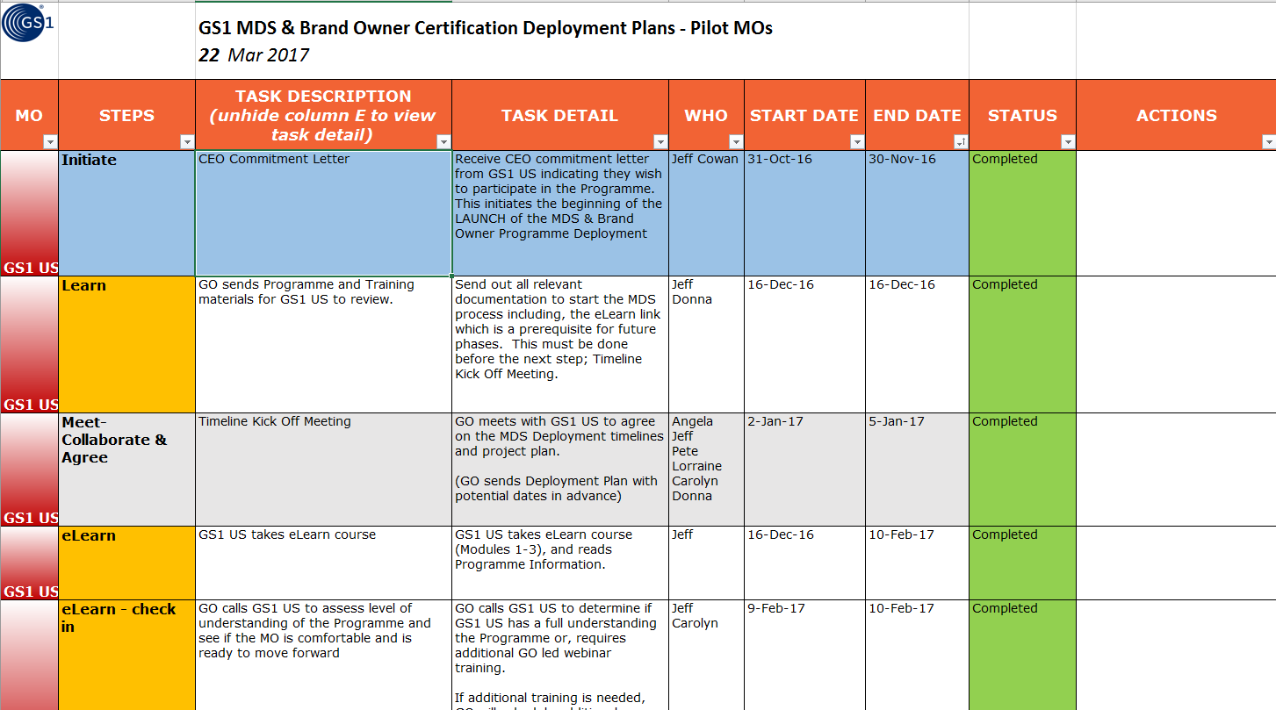
Deployment Plan Example
Notes:
Routine GO/MO Team Calls to prepare and all the way through certification
Training and Reference Materials
Milestones
Continuous MO support as needed
Audit Pre-check Built into Plan

Slide 42
MDS Certification and the Audit Process
Control Points and Compliance Criteria

Slide 43




Control Points and Compliance Criteria
Global Office will use the Control Points to diagnose:
Please refer to the Master Data Services and Brand Owner Checklist for all Certification Compliance Criteria
Operations
  How data quality is managed, used and stored
Procedures
  How business processes are declared, recorded and documented
Risk and quality management
  How risks and parameters are measured

Slide 44
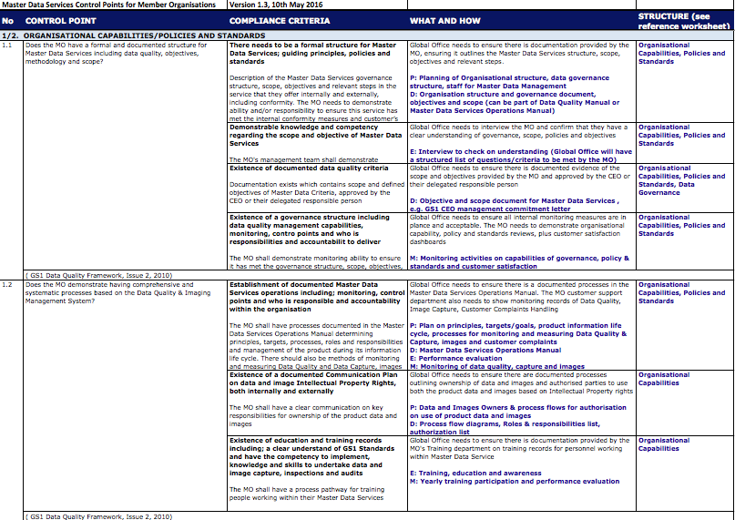
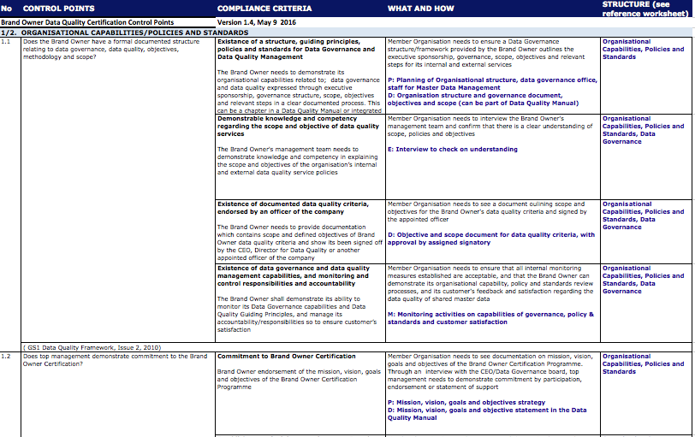
Compliance criteria for the On-site Audit
Key documentation:
GS1 Master Data Services Control Points, Version 2.2, June 2016
GS1 Brand Owner Data Quality Certification Control Points, Version 2.2, June 2016
Notes:
Check placement and for dup

Slide 45
Before the Audit

Slide 46
Initiating the Audit
INITIAL MEETING
Define essential elements to prepare the On-Site audit and
prepare the Audit Programme
CONDUCTING DOCUMENT REVIEW
Reviewing relevant management system documents, including records, and determining their adequacy with respect to audit criteria
Notes:
MEETING – WHO SHOULD BE THERE

Slide 47
Before the Audit:
Pre-Check Document Review
MO audit – needed certification criteria documentation:
Operations Manual for Master Data Services/Data Quality Management
Standard Operational Procedures e.g. Inspections, audits, training, risk management, non-conformance, customer management
Master Data Services and/or Brand Owner Best Practices and related data quality documentation
Brief information about Master Data Service/Brand Owner
Please refer to the MDS and Brand Owner Checklist for all Certification Criteria

Slide 48
Summary of the Audit Plan
MANDATORY INFORMATION
Audit objectives
Audit criteria and any reference documents
Audit scope, incl. identification of organisational & functional units and processes to be audited
Agree dates & places for on-site audit activities
Expected time & duration of on-site audit activities, (incl. meetings with auditee’s management & audit team meetings)
Roles and responsibilities of audit team members & accompanying persons
Allocation of appropriate resources to critical areas of audit
Working, reporting & documentation must all be in English
Notes:
It would be good to know: logistic arrangements and audit follow-up actions

Slide 49
During the Audit

Slide 50
The On-Site Audit
The Audit Objective is to gain a full understanding and verify the competency levels of the MO Team
On-Site Audit according to the agreed Audit Plan:
  Conducting opening meeting
  Collecting and verifying information
  Generating audit findings
  Completing the GS1 Master Data Services/Brand Owner Checklist
  Preparing audit conclusions
  Conducting closing meeting
Where:
Company facilities
Duration:
1.5 Days
Template to fill:
GS1 Master Data Services/Brand Owner Checklist
Notes:
When? At the beginning of the On-Site Audit
Who? Auditee’s management or, where appropriate, those responsible for functions or processes to be audited
Purpose? To confirm the audit plan,
To provide short summary of how audit activities will be undertaken,
To confirm communication channels,
To provide opportunity for GO auditee to ask questions

Slide 51
Collecting & Verifying Information
- Against the Audit Criteria Process
Only information that is verifiable may be considered audit evidence
Audit evidence will be recorded

Slide 52
GS1 Master Data Services Control Points, Version 2.2, June 2016 - Audit Criteria
Can be referred as the GS1 Master Data Services Checklist and sets out the audit criteria for Master Data Services Certification
Defines essential elements for development of a service based on the Data Quality Management System framework which has 7 key functional areas:
        Organisational structure
        Policies and standards
        Business processes
        System capabilities
        Data Governance
        Planning & Risk Management
        Continued Improvement

Slide 53
After the Audit

Slide 54
After the Audit:
Preparing the Audit Report
Audit Plan
  The current plan and it’s been recorded and documented
Non-conformity Report for every Non-conformity found
  Gaps identified during the Audit
  Observation Report
GS1 Master Data Services/Brand Owner Checklist with all Non-conformities and Observations detected during the Audit
  Used by the Auditor during the audit observing/notations
The Audit Report
  Findings of the Audit – summary of the 7 key areas
The Conformance Report
  High level summary of the audit – one pager

Slide 55
Corrective Action Information Section
Cause of Non-Conformity
Action declared by the MO which once implemented, will solve the Non-Conformity
Date committed by the MO to
implement the Corrective Action
Name & signature of the responsible person for implementing the Corrective Action

Slide 56
The Final Audit Report
Document to record the audit conclusions
4 Sections:
Organisation Information – Company
Audit Team Information – Roles and Responsibilities
Audit Information – Refers back to the Audit Plan
Audit Results – Conformance levels achieved
The document is to be completed by the Audit Team Leader (GO)

Slide 57
Summary of the Audit Findings (MDS)
Key Functional Areas | No. of compliant control points obtained | Total control points/section | Description of % (0-100%, Red is <25%, Green >75%)
Organizational Capabilities & policies and standards | 12 | 12 | Green (100%)
2. Business processes and system capabilities | 4 | 4 | Green (100%)
3. Planning & risk management | 1 | 1 | Green (100%)
4. Continuous improvement | 2 | 2 | Green (100%)
Nomenclature:
N/A: Number of Non Applicable Control Points detected
Obtained: Number of Control Points with Conformity
%: Percentage of Approval
Notes:
GREEN 75%-100%
AMBER 25% - 74%
RED 0 – 24%

Slide 58
Summary of the Audit Findings (BO)
Key Functional Areas | No. of compliant control points obtained | Total control points/section | Description of % (0-100%, Red is <25%, Green >75%)
Organizational Capabilities & policies and standards | 8 | 8 | Green (100%)
2. Business processes and data governance | 4 | 4 | Green (100%)
3. System capabilities | 2 | 2 | Green (100%)
4. Planning & risk management | 1 | 1 | Green (100%)
5. Continuous improvement | 1 | 1 | Green (100%)
6. Additional criteria for MO administering BO Certification | 2 | 2 | Green (100%)
Nomenclature:
N/A: Number of Non Applicable Control Points detected
Obtained: Number of Control Points with Conformity
%: Percentage of Approval

Slide 59
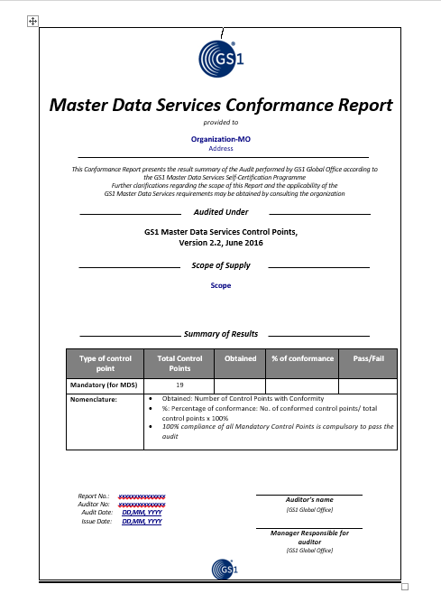
Conformance Report
Describes the summary of Audit results
Must be signed by the Auditor Team Leader (GO)
It contains the following:
  Audited Company Name and Address
  Audit Criteria
  Audit Scope
  Summary of Results (Summary Table from the Audit Report)
  Report Number with Auditor Reg. Number, name and signature
  Audit Date (first day of the on-site audit)
  Report Issue Date
Notes:
Non Compliance (if time)
The GS1 Master Data Services Auditor shall assess on the basis of the evidence provided by the MO within the 30 days.
If the GS1 Master Data Services Auditor is satisfied that all compliance criteria have been met as a result of the remediation, then it shall issue a confirmation of the certification
The GS1 Master Data Services Auditor shall issue a report of the Second Audit (the “Second Audit Report”).
If, upon completion of the Second Audit, the MO is still found in the Second Audit Report to be affected by a Non-Conformity, then its certification shall be deemed invalid.
It shall only be authorised to re-apply the certification after a term of 6 Months after the date of the Second Audit Report

Slide 60
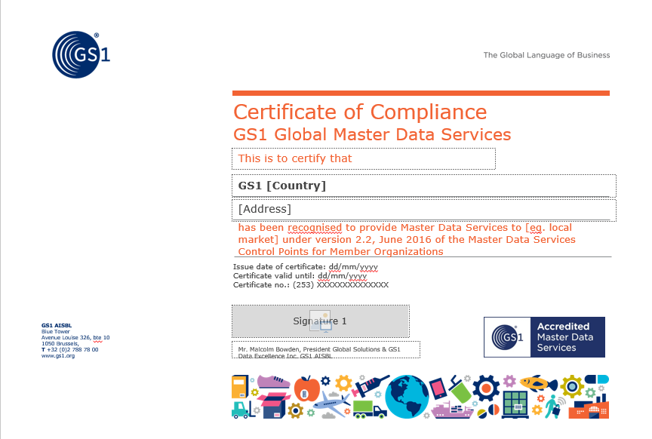
Successful MOs will be awarded the Certificate of Compliance

Slide 61






Meet the GS1 Data Quality Team
Malcolm Bowden
President, Global Solutions & GS1 Data Excellence Inc.
malcom.bowden@gs1.org
+32 2 788 78 52
Mike Wehrs
Head of Data Products and Services
Email: mike.wehrs@gs1.org
Telephone: +1 425 829-3227
Mobile: +1 425 829-3227
DATA QUALITY & MDS CERTIFICATION
Patrick Ponsaerts
Director, Master Data Services and Data Quality
patrick.ponsaerts@gs1.org
Office: +32 278 87 886
Mobile: +32 (0)495 58 38 14
Carolyn Lee
Traceability & Master Data Management Manager
GS1 MDS Auditor
carolyn.lee@gs1.org
Office: +32 2 788 78 45
Mobile: +32 476 94 55 38
Donna DiPietro
MDS and Brand Owner Certification Programme Manager
donna.dipietro@gs1.org
Office: +1 609 557 4550
Mobile: +1 609 575 2043

Slide 62


Slide 63


Slide 64
Take a moment to rate this session

