Slide 1
Global Product Classification (GPC)
Implementation Success Stories
GS1 Standards Event March 19, 2018
Speakers: Mike Mowad, GS1 Global Office
Tina Schaefer, Washington State Department of Ecology

Slide 2


GS1 Standards Event App – How to get it
Get the App by searching your App store for "GS1 Global Events" (If you already have the Global App due to attendance at the Global Forum or Standards Event, you do not need to do this)
Once you have the Global App on your mobile device, type GS1NJ18 in the search box. Please click the orange (+) to activate the event within your application.
1
2
3
Login with the email address you used to register for the event:
Username: (your registered email)
Password: GS1events
2017
ar
2018

Slide 3
Agenda
GPC Overview
GPC usage in the Children's Safe Product Act
Q&A

Slide 4
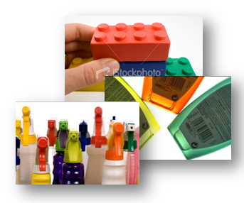
What is GPC?
A system that gives buyers and sellers a common language for grouping (or categorising) products in the same way, everywhere in the world
Improves the GDSN data accuracy and integrity, speeds up the supply chain's ability to react to consumer needs, and contributes to breaking down language barriers.
Since 2007, GPC adoption has grown in coverage and in implementation (in parallel with the use of GTINs)
in GDS

Slide 5

How does GPC Work?
GPC is a rules-based, four-tier classification system for grouping products
The four tiers are Segment, Family, Class, and Brick (with attributes and attribute values).
A Brick identifies a category incorporating products (Global Trade
Item Numbers - GTINs) that serve a common purpose, are of a
similar form and material, and share the same set of category
attributes.

Slide 6



GPC – Part of the GS1 System of Standards
GS1 Identification Numbers
Identify Companies, Products, Locations,
Logistics, Assets and Services
Capture
GS1 Data Carriers
Barcodes and EPC-enabled RFID
GS1 Data Exchange
Share Classification, Master Data,
Transactional Data and Physical Event Data

Slide 7
GPC Brick Example: Milk
Brick Attributes
Brick Attribute Values
Segment
Brick
If Organic
NO
UNIDENTIFIED
YES
Food/Beverage/
Tobacco
FULL FAT
HALF FAT
LOW FAT
NON FAT
REDUCED FAT
UNCLASSIFIED
UNIDENTIFIED
Level of Fat Claim
Family
Milk/Butter/Cream/
Yogurts/Cheese/
Eggs/Substitutes
Milk
(Perishable)
If With Probiotic Claim
NO
UNIDENTIFIED
YES
Class
Milk and Milk Substitutes
BUFFALO
CAMEL
ALMOND NUTS
COMBINATION
COW
SHEEP
UNCLASSIFIED
UNIDENTIFIED
YACK
Source

Slide 8
GPC Releases
GPC uses a “Consolidated Release” strategy to publish twice per year, (every June and December)
5 months after a GPC publication is released, it is integrated into the GDSN
Website: http://www.gs1.org/gpc

Slide 9
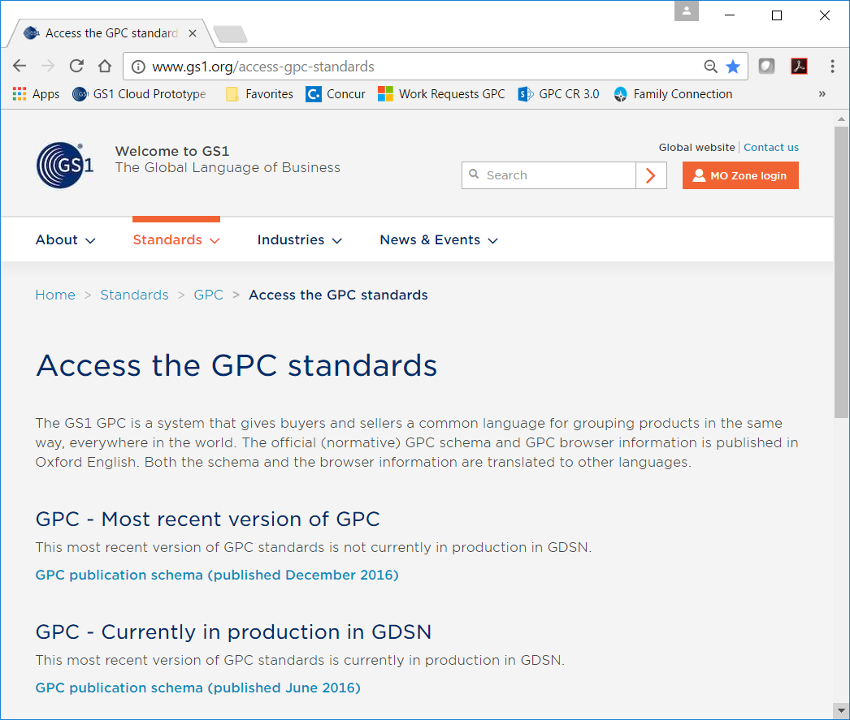
GPC Standards Website

Slide 10























GPC Translations
GPC is officially published in Oxford English and is translated to 22 other languages
 | Arabic |  |  | French |  |  | Korean |  |  | Russian
 | Chinese |  |  | German |  |  | Latvian |  |  | Serbian
 | Czech |  |  | Greek |  |  | Macedonian |  |  | Spanish
 | Danish |  |  | Hungarian |  |  | Norwegian |  |  | Swedish
 | Dutch |  |  | Italian |  |  | Persian
 | Finnish |  |  | Japanese |  |  | Portuguese
* Languages in Orange are coming soon

Slide 11



Core Attribute in the GS1 Cloud
Attributes | Check | View | Explore
1. GTIN
2. Brand
3. Label Description
4. Medium Resolution Image
5. Target Market
6. Company Name
7. Product Classification
GPC
Required for service
Service enhanced as a result

Slide 12
Children's Safe Product Act
Tina Schaefer, Washington State Department of Ecology

Slide 13
GS1 and Ecology data
Children’s Safe Products Act
Companies
Chemicals
Product Testing
Ecology
Chemicals
BRICKS
BRICKS
Notes:
CSPA
2012 – 2017 - 9,236 total reports
270 companies
257 bricks

Slide 14


Children’s Safe Products Act
Chapter 70.240 RCW - the law
2008
“Children’s product”
Requires manufacturer reporting
Limits on lead, cadmium, six phthalates and five flame retardants
Residential upholstered furniture

Slide 15
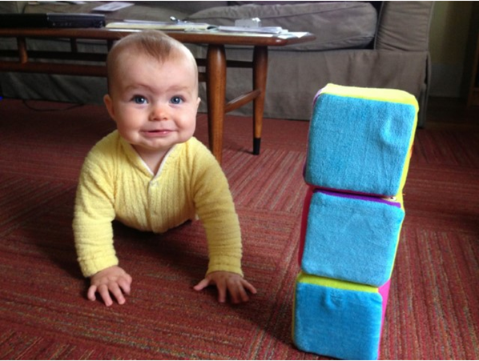
Children’s Safe Products Rule
Chapter 173-334 WAC - the rule
2011
Chemicals of High Concern to Children (CHCC)
2017 - added 22 and remove 3 CHCCs
Clarify reporting requirements and enforcement process
Product category defined as the “brick” level of GS1 GPC standard
Companies
Chemicals
BRICKS
Notes:
John Williams – talked with industry they said they use “negotiated agreement” we wanted product data (too much data, unmanageable) but industry said they could give it by brick. Already familiar with, using
356 children’s “product” bricks include toys, kitchen items for feeding…./257 reported

Slide 16
10 Most Reported CSPA Bricks
Notes:
TOTAL records FOR ALL 5 YEARS
From 2012-2017:
2012 – 3633
2013 - 9233
2014 – 11,223
2015 – 10,396
2016 – 10,250
2017 – 10,682 (9/15/2017)
55,254 total as of 9/15/2017 Avg about 10,000
From 263 manufacturers
Covering 358 product categories (bricks)
Top chemicals
Cobalt
Ethylene glycol
Antimony
Styrene
Methyl ethyl ketone

Slide 17
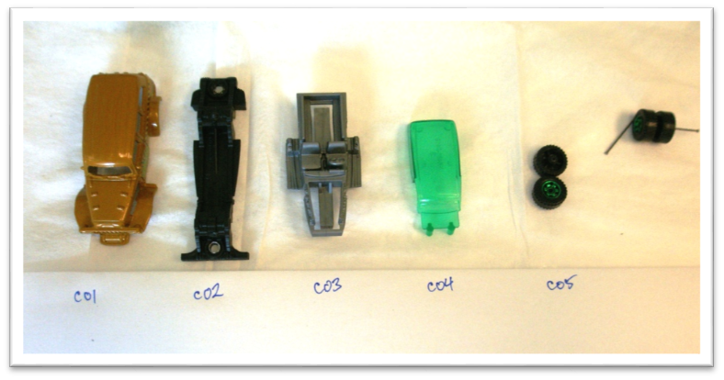
Product Testing Process
Quality Assurance Project Plan
  Defines chemicals, methods,
  & product selection
Sample Collection
  Purchase products
Enter Data
Isolate Components
Components of a Toy Car
Ecology
Chemicals
BRICKS
Notes:
All product regulation testing, brakes, product packaging, state purchase PCBs, PFAs – still track by brick

Slide 18
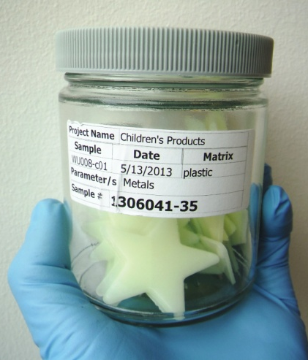
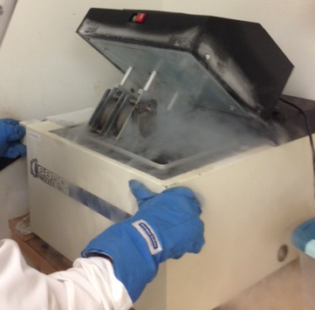
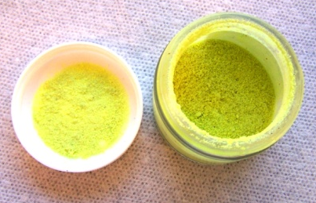
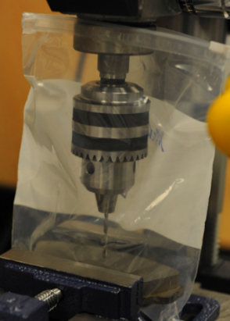
Lab Preparation, Analysis, and Reporting
Samples to Lab
Lab Preparation & Analysis
Evaluate Data & Write Report
  Results to Compliance Lead
Notes:
Product testing
Completed > 20 product studies
Screened > 11,000 product components
Tested > 3,000 products
270 analytes (209 of these PCBs)
Enforcement actions > 150 products

Slide 19
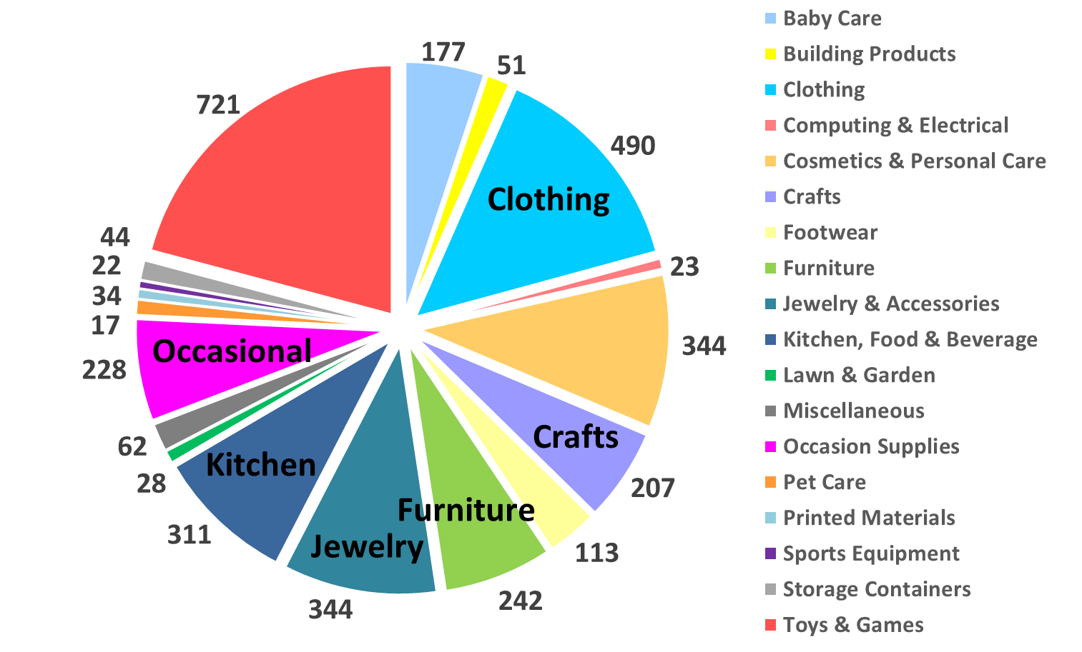
Products Tested to Date
Baby Care
Toys
Cosmetics
Notes:
20 studies….

Slide 20
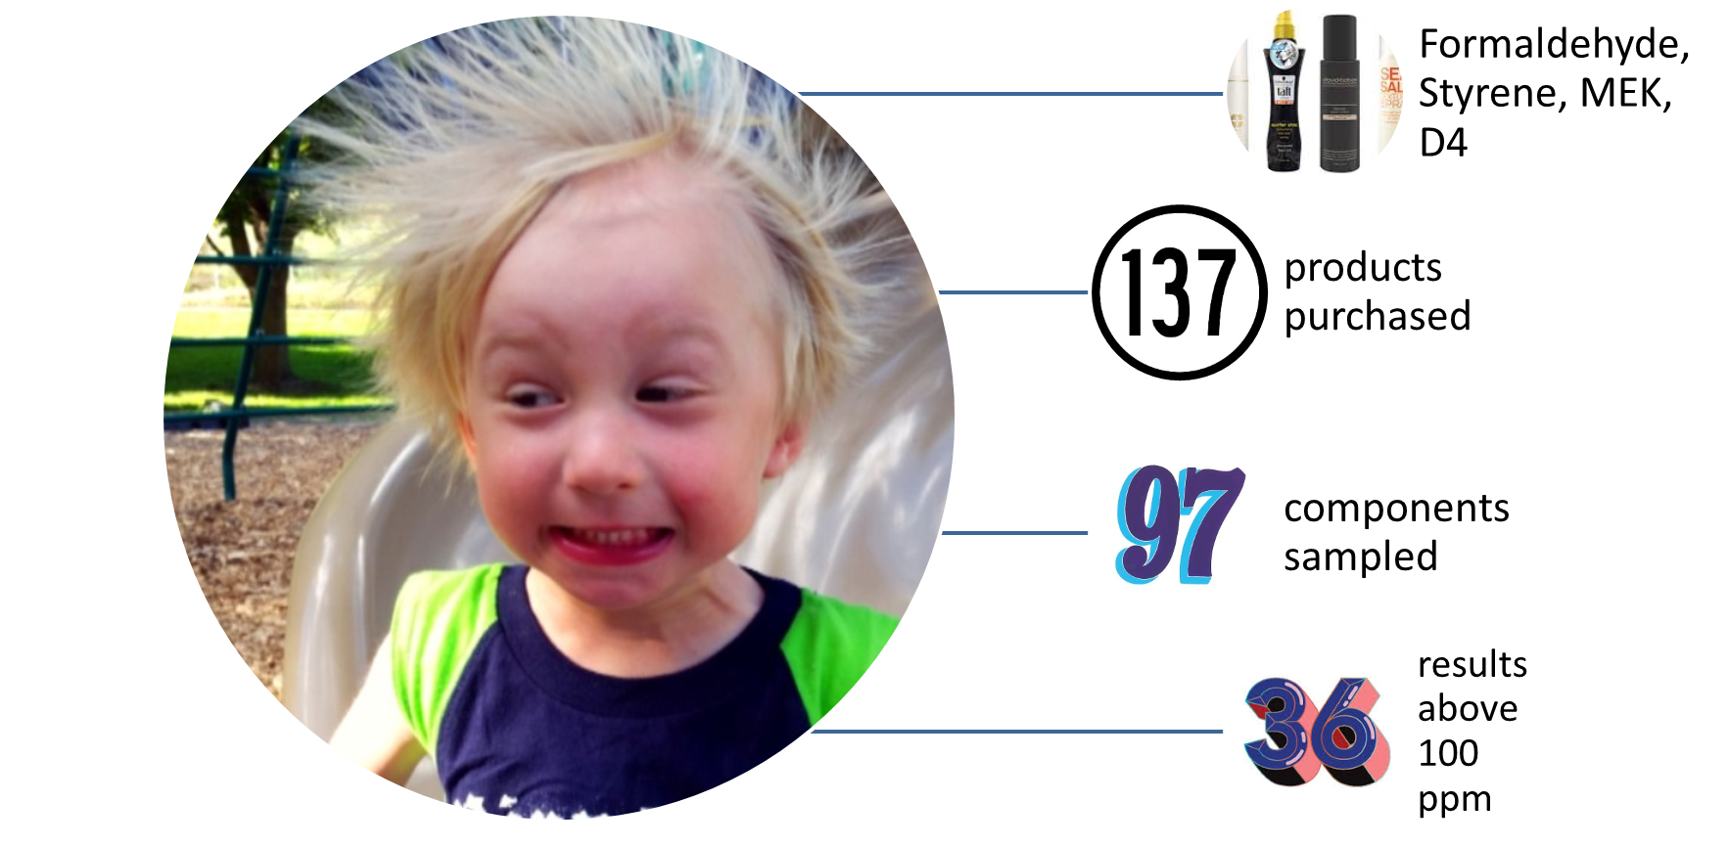
2017 CSPA Study
https://fortress.wa.gov/ecy/publications/SummaryPages/1703020.html
Notes:
137 products we had to figure out brick

Slide 21
CSPA Enforcement
Results above 100ppm
Matching brick
Different bricks
Compliance letters
Notes:
Using info in databases searched by brick – 4 matched reports.
6 other reports from companies but either didn’t have matching CHCC or matching brick.
Why don’t they add up to 36?? 18 companies, some for several products, some products preempted by federal law (sunblock)

Slide 22







Partners
Notes:
In addition to collection manufacturer reported data – we regularly work with folks outside Ecology.
Two other states have similar children’s laws (copied mostly from CSPA) – we share information, experience, and lessons with both Oregon and Vermont. They are in the beginning stages of implementing their CSPA-like laws. In fact, we are working under an EPA grant with Oregon and IC2 to develop the database for the OR Toxic Free Kids Act. The development of that database will allow for one-stop reporting for manufacturers for all three state’s laws (or so they hope). Additionally, we participate in other IC2 efforts and collaborate regularly with other states – including Minnesota and California.
OR and VT used our CHCC list as their own, they also have manufacturers report using bricks.
California Department of Toxic Substances Control
Just recently we shared results from our CSPA database with EPA and California.
Test SAW login - https://test-secureaccess.wa.gov/ecy/cspa/
trus461
C$PAlogin123

Slide 23





Contact Information
Mike Mowad
GS1 Global Office
1009 Lenox Dr., Suite 202, Lawrenceville NJ, 08648, USA
T +1 609.557.4568 | E michael.mowad@gs1.org
Tina Schaefer
Washington State Department of Ecology
300 Desmond Drive SE, Lacey, WA 98503
T 360-407-6786 | E tina.schaefer@ecy.wa.gov
www.gs1.org

Slide 24
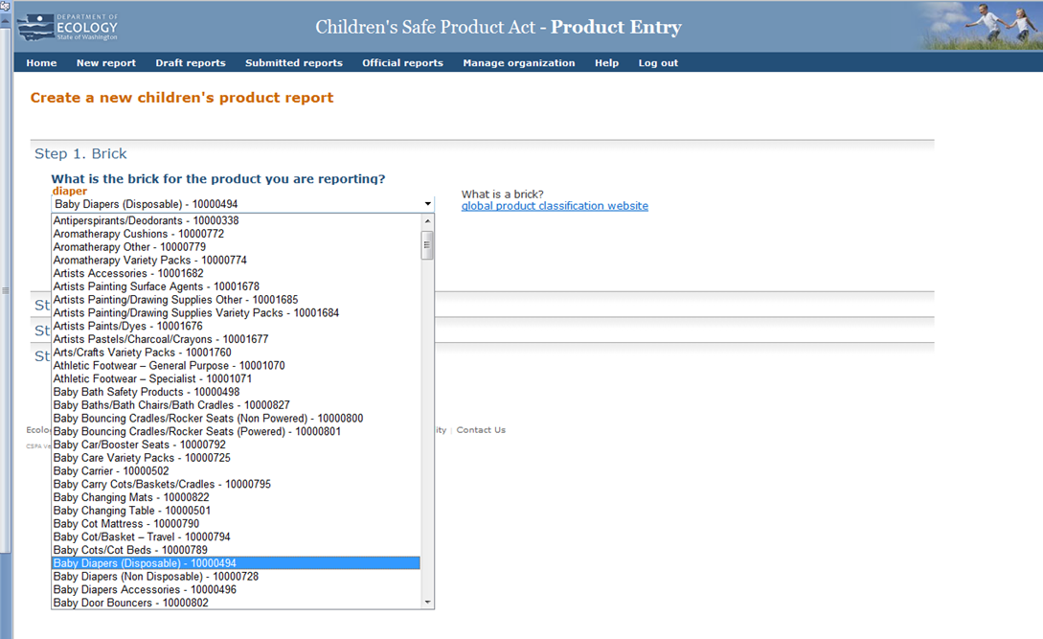
CSPA Data Entry Demonstration

