Slide 1
Mobile Ready Hero Images
First Thoughts
Phil Archer
October 2017

Slide 3
Tesco online presentation

Slide 4
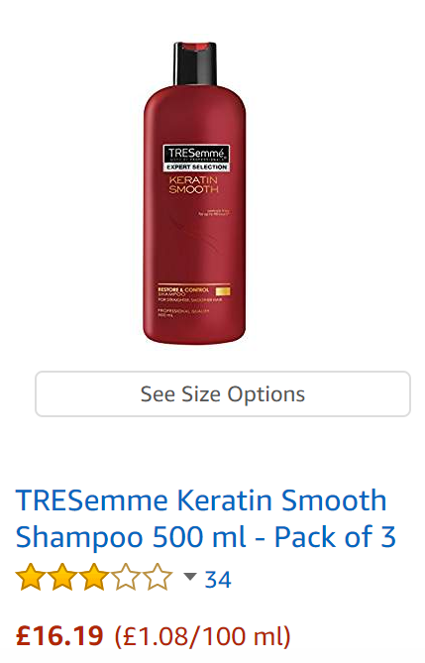
Amazon

Slide 5

Unilever’s Mobile Ready Hero Image

Slide 6
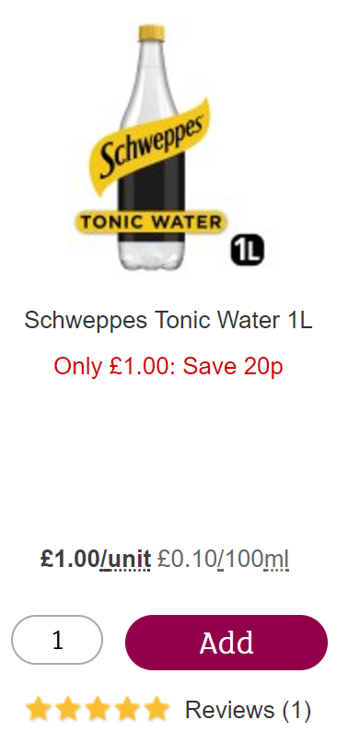
Coca-Cola Europe’s version (on Amazon)

Slide 7
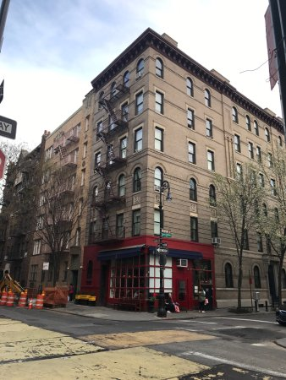

Slide 8
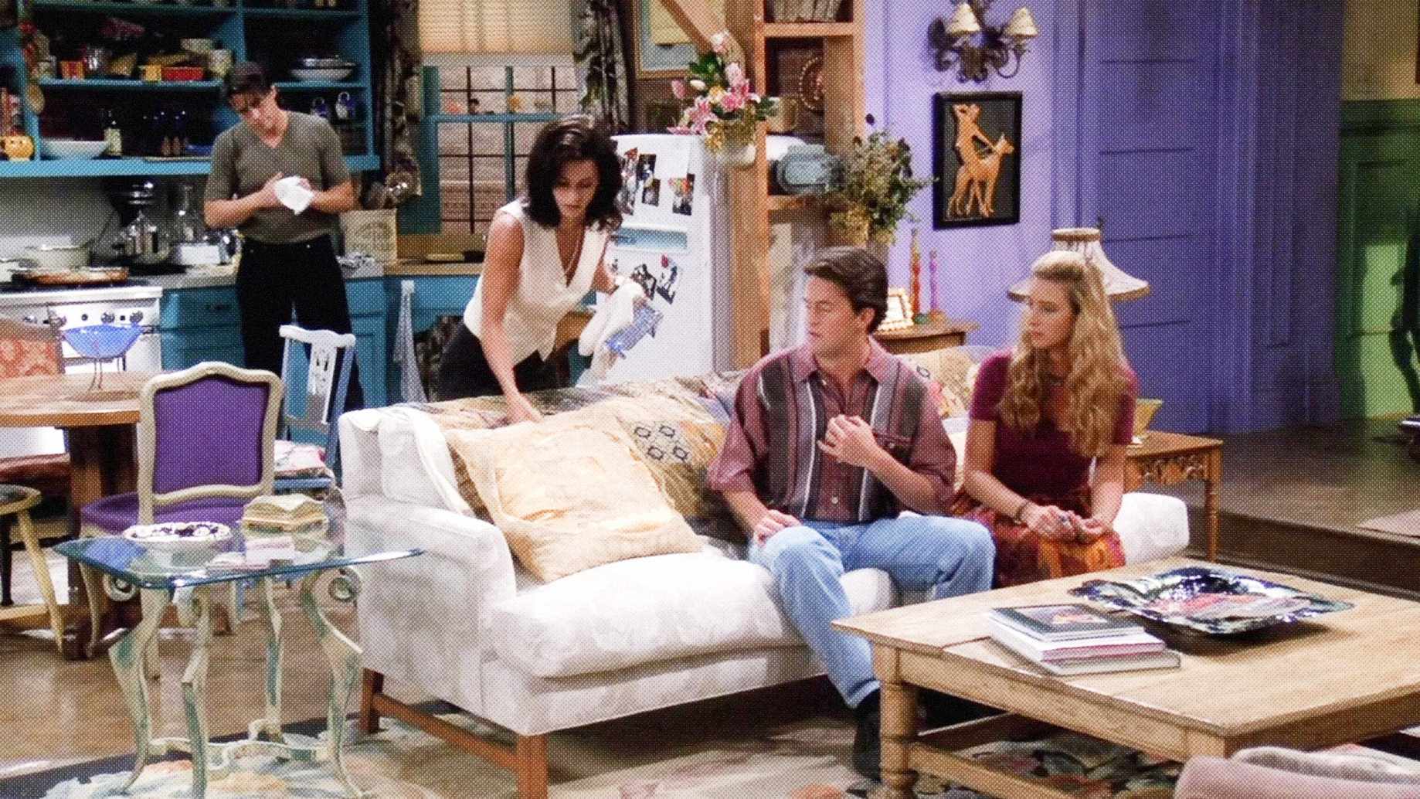

Slide 9
Why
Aid instant understanding by consumers through regular semiotics

Slide 10
What Constitutes A Guideline?
Intended Outcome
Explanation
Possible implementation methods
Testable

Slide 11
Example of an intended outcome
Consumers must be able to see size/quantity easily

Slide 12

Possible implementation?

Slide 13
Example of an intended outcome
Consumers must be able to see size/quantity easily
When shown on the pack, text indicating size/quantity should be at least x% of the height of the image.

Slide 14
Boundaries
When shown on the pack, text indicating size/quantity must be bottom left

Slide 15



Possible implementations?

Slide 16
Boundaries
?
When shown on the pack, text indicating size/quantity must be bottom left

Slide 17
Questions
?

Slide 18

Mobile Ready Hero Images Mission Specific Working Group (MSWG)
Update as of:
01 October 2017
WR # | 17-000234
Due Date | May 2018 (TBC by the group)
Step # | 3
OGSM | No
Chairs | TBD
Project description
Develop a GS1 guideline for product images presented in online retail environments on small screens, typically alongside ‘add to basket’ functions, that all brands can follow to achieve consistency in conveying brand, variant, format and size information concerning CPGs. Presentation on larger screens and in, for example, advertising, are out of scope.
Deliverable /Objective | Define the minimum set of guidelines for product images to achieve consistency in conveying brand, variant, format and size information concerning CPGs, and develop tooling and more detailed implementation advice to facilitate adoption across multiple brands by multiple retailers in different contexts.
Stakeholders
Company participation
LT Sponsor | Marianne Timmons | SDL | Jean-Luc Champion
SME | Dan Clark | IE Liaison | Phil Archer
AG liaison | TBD | Project approved | 08-14-2017
 | Data Recipients | Data Senders | MOs | SP | Other
Actual roster | 4 | 13 | 21 | 5
Roster participation required | 4 | 4 | 4 | 2
Minimum votes required | 2 | 2 | 2 |  | 12
Milestone deliverables
MILESTONE | DATE | Cur | Prev
MRHI Guideline Drafting | Dec-17 | N
MRHI Guideline Finalisation | Jan-17 | N
MRHI Guideline Community Review | Feb-17 | N
MRHI Guideline eBallot | Mar-18 | N
MRHI Guideline IP Review | Mar-18 | N
MRHI Guideline Ratification & Publication | Apr-18 | N
Highlights
The group kick-off meeting and co-Chair election will be hosted during Brussels GSMP Event on October 10th, 2017.
Risks & issues
There is a lack of participation from retailers/eTailers. Working on it.
Legend
N | Not started | G | On schedule | Y | Minor risk/~10% behind schedule | R | Significant risk/10%+ behind schedule | C | Complete

Slide 19
Working practices & methods
Weekly meetings?
Bi-weekly?
Please complete the Doodle poll (e-mail to follow)
Use the mailing list (not individual e-mails)
Google Docs
Slack

Slide 20
Face to face meeting
Early December (provisional)
Multiple centres with video link

