Slide 1
Global Standards Management Process (GSMP) new member orientation
An overview of participation tools & resources
Cindy Grell
Manager, Community Engagement, Communications and Events

Slide 2

GSMP Overview
  Standards Development Resources
    Standards Development process (also known as GSMP) video
    GSMP Manual
    Work groups & how to join them
  Governance
    Standards Development Certification Programme
  Tools
    Standards Development Certification Programme
    Community Room
    Training video
    Work request system
News & Events
    Communications
    Reporting
    Events
Meet the Team

Slide 3
Resources

Slide 4
GSMP Principles
1
Openness & Transparency
5
Standards Protection
  A clear process, open to all.
  Protected by the GS1 Intellectual Property Policy.
2
User Driven Standards
6
GOVERNANCE
  In response to business needs.
  The GSMP is accountable.
3
CONSISTENCY
7
Consensus and Voting
  Drives interoperability between the stakeholders who adopt them.
  Strives for consensus of all stakeholders.
4
Stakeholder Participation
8
Global Applicability
  Includes the entire supply chain (from manufacturer to providers).
  Strive for global applicability across multiple industries, wherever possible.
Notes:
The GSMP follows the GS1 Guiding Principles as shown here.
GSMP’s scope is the management of global standard development to meet industry needs, both at the international and local level.

Slide 5
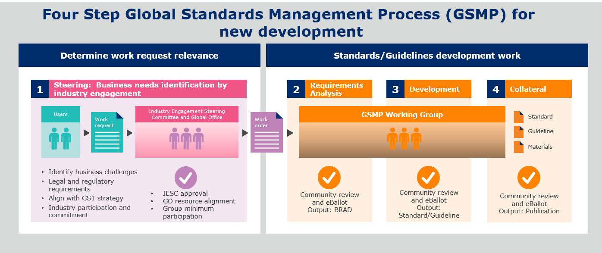
Standards Development Process
Introduction to the Global Standards Management Process (GSMP) video – this video is a high level overview of the process of standards development

Slide 6
Standards Development Process Resources
Standards Development Website
GSMP Manual – this manual provides all the guidelines we must follow to properly develop standards
GS1 IP Policy – the GS1 IP Policy helps to ensure that those who develop the standard are not improperly influencing the standards development process.

Slide 7
Work Group information
Why join a GS1 work group? Click here to find out.
There are two types of GSMP work groups:
Standards Maintenance Group (SMG) – improve existing standards
  Electronic Data Interchange (EDI) – led by Jean Luc Champion, GS1 & Tasha Wiehe, GS1
  Global Master Data (GMD) – led by Justin Childs, GS1
    Image Specification – led by Tasha Wiehe, GS1
    GDS Trade Item Implementation Guideline – led by Tasha Wiehe, GS1
    GDS Validation Rules – led by Tasha Wiehe, GS1
  Global Product Classification (GPC) – led by Jeanette McVeigh, GS1
  Identification (ID) – led by John Ryu, GS1
  Traceability & Event Sharing (TES) – led by John Ryu, GS1

Slide 8
Work Group information, continued
Mission Specific Work Groups (MSWG) – develop new standards
  Attribute Definitions for Business – led by Tasha Weihe, GS1
  EPCIS & CBV 2.0– led by John Ryu, GS1
  Messaging for Verification of Pharmaceutical Saleable Returns – led by Greg Rowe, GS1
  Fighting Illicit Trade (FIT) – led by John Ryu, GS1
  Digital Link – led by Greg Rowe, GS1
  Healthcare GTIN Allocation Rules – led by Greg Rowe, GS1
  Mobile Ready Hero Images – led by David Buckley, GS1
  Pharmaceutical Clinical Trials Processes– led by Greg Rowe, GS1
  Scan4Transport – led by John Ryu, GS1

Slide 9

Industry Groups
Industry groups exist to bring clear business needs to the standards development process and to ensure implementation of GS1 standards
Consumer Product Variant Discussion Group
Fresh Foods Industry User Group
GDSN User Group
Healthcare
Transport & Logistics Industry User Group

Slide 10
Governance

Slide 11
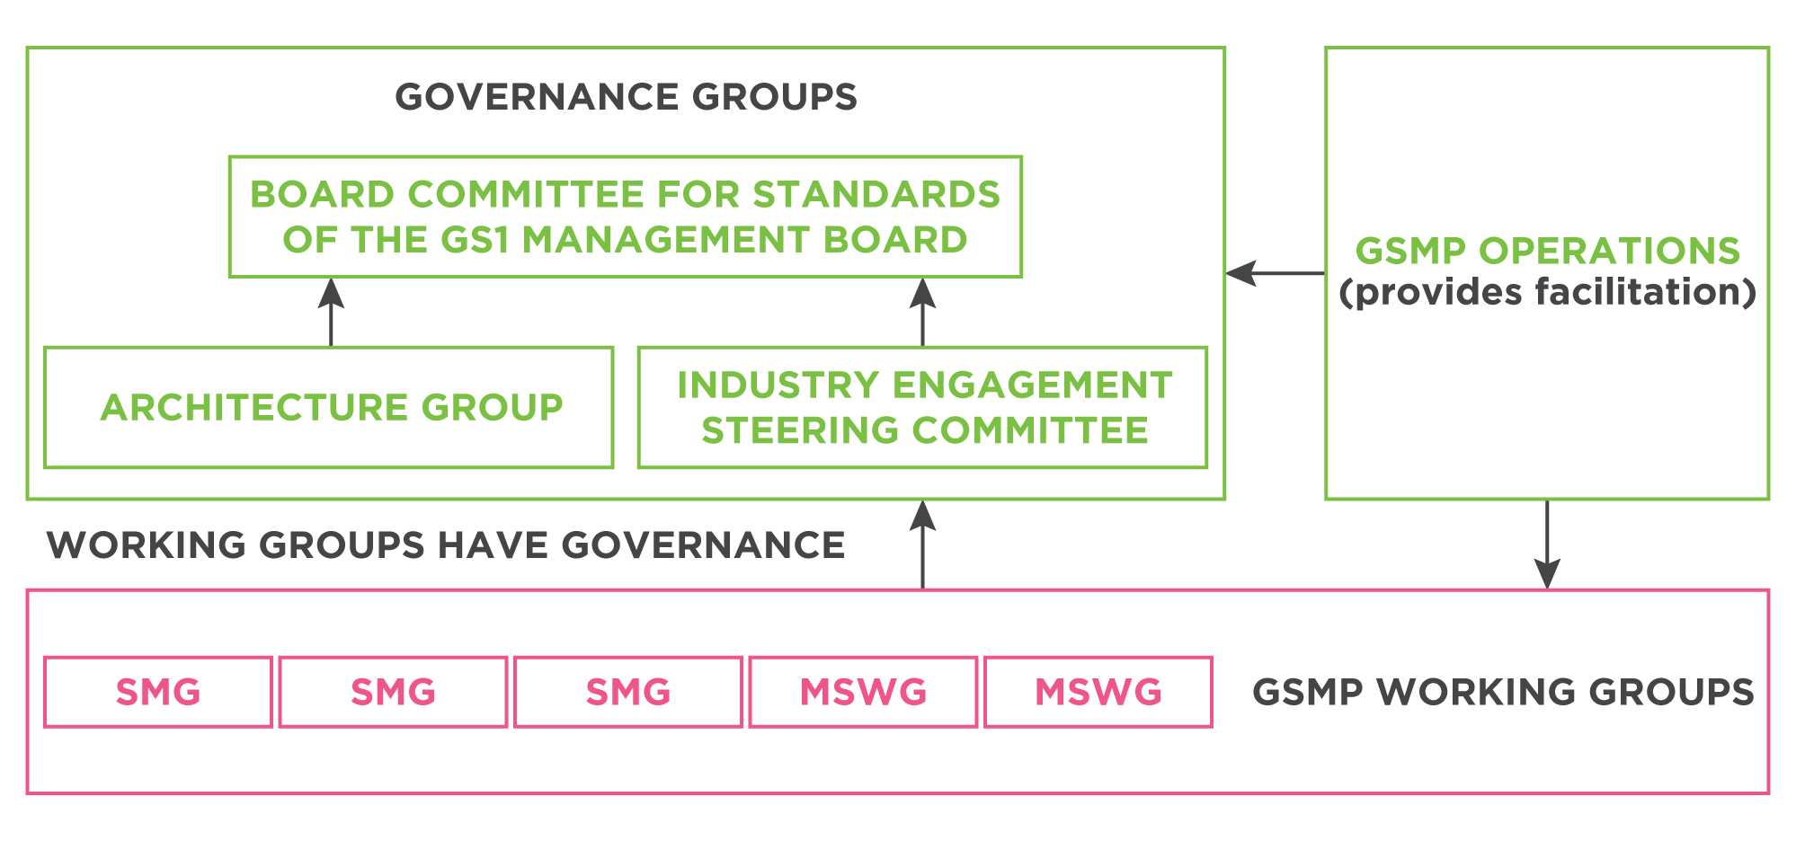
GSMP Governance
Notes:
The GS1 Architecture Group is a formal part of the GS1 Governance Structure.
Like all other GSMP groups its full roles, responsibilities and membership criteria are listed in the GSMP Manual.
The Architecture Group aims to leverage the best of the community, not to sit in opposition to or judgement of it and is given direction by the Board Committee for Standards.

Slide 12
Role of the Board Committee for Standards (BCS)
Assess that “due process” has occurred in the GSMP.
Provide operational and strategic policy and guidance in support of the GSMP.
Oversee the smooth operation of the governance sub-teams of the BCS, namely the Industry Engagement Steering Committee and the Architecture Group and advisory groups to the BCS.
Assess the progress of standards programmes and provide direction on major issues and opportunities.
Ensure consistent and effective application of the GS1 Intellectual Property policy.
Review and adapt the ongoing role of GSMP within the changing GS1 strategic landscape.
Ensure that there is a consistently applied GS1 System Architecture and that all GS1 standards created align with it.
Make recommendations to the GS1 Management Board (MB) for the ratification of all GS1 standards including EPCglobal and GDSN.
Oversee all standards created under the GS1 umbrella to ensure that they conform to the principles of the GS1 System and the GS1 Architecture.

Slide 13
Role of the BCS, continued
Ensure that GS1 has a standards strategy to deliver world class leading standards within the landscape of new and evolving technologies.
Authorise the structures and process that GS1 will use to operate GSMP.
Regularly monitor GSMP performance to ensure:
  that it is delivering results in line with the GS1 Business Plan
  escalations are resolved
  correct trade-offs are made between speed and quality of standards
  balance occurs between global user priorities and needs of SME and local requirements
Ensure that the broad community is aware of and committed to the role of GSMP, its scope, performance and plans.
Report to the GS1 Management Board (MB).

Slide 14

Role of the Industry Engagement Steering Committee
Approve and prioritise work undertaken in GSMP based on established entrance criteria (especially, commitment of industry to adopt the deliverables).
Act as an advisory body to the Board Committee for Standards (relative to GSMP projects).

Slide 15
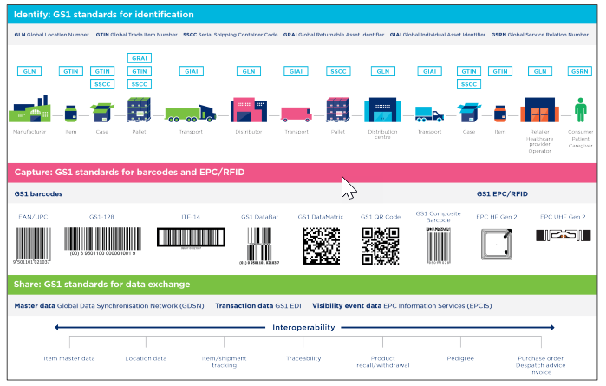
Role of the GS1 Architecture Group (AG)
Ensure the technical integrity of the GS1 system, and the consistent and efficient inter-operation of all the various GS1 standards.
The GS1 Architecture publications are one of the main tools to help achieve this.
https://www.gs1.org/standards/gs1-architecture

Slide 16

The GS1 System Architecture
An overall architecture, showing how the different components fit together to form a cohesive whole.
GS1 system is described in a single, easily readable and comprehensive paper
Maintained and re-publish annually
The target audience is large, including:
  End Users and Solution Providers
  External parties who want to understand the GS1 System
  GS1 Member Organisations
Notes:
The GS1 System Architecture was published following a full Global Standards Management Process community review. Although the principles and ideas behind the GS1 System Architecture have existed for many years, this is the first time the entire GS1 System has been described in a single, comprehensive and complete manner.
The document is aimed at End Users and Solutions Providers, external parties who want to understand the GS1 System, and of course, GS1 Member Organisations.
The document was first published in March 2012 and will be regularly maintained and updated.

Slide 17

GS1 Architecture Publications
GS1 System Architecture – the “what” + the “why”
  Showing how the standards fit together
  Articulating underlying technical principles
  Helping to guide the development of future standards
GS1 Architecture Principles
  Overview provided later in this presentation
Each publication has been reviewed by GSMP community
Notes:
The GS1 Architecture is defined via three important publications:
The GS1 System Architecture shows how the standards fit together and helps to guide the development of future standards.
The GS1 Architecture Principles are a set of 22 principles guiding the development of the GS1 System.

Slide 18
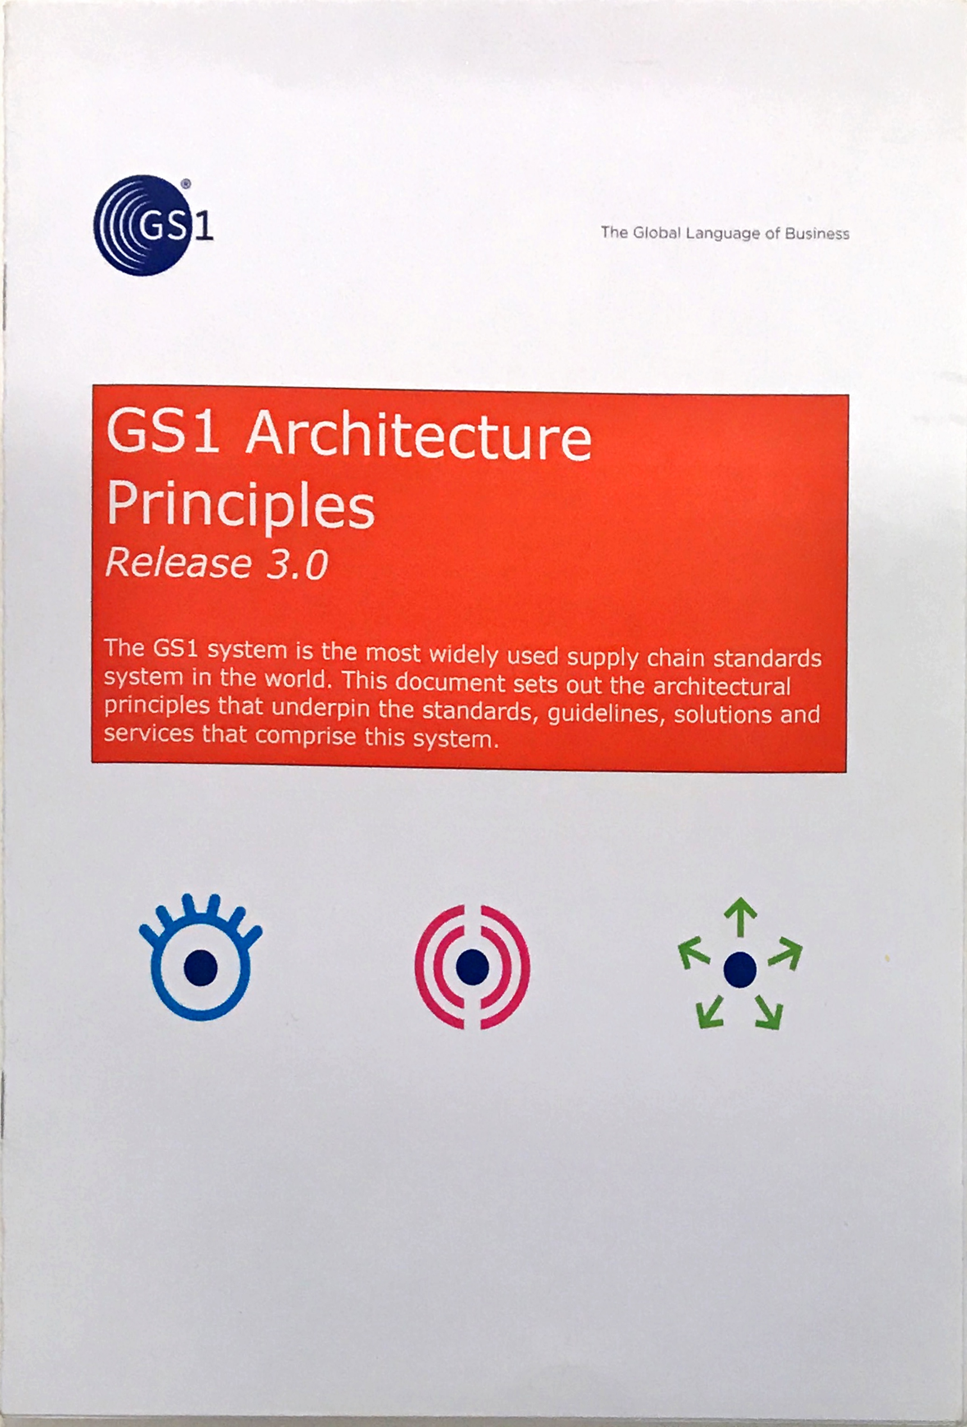
The new Architecture Principles
Revised with the objectives:
  To add principles that were missing, to remove principles that are not adding value and to correct any principles that need correcting.
  To improve the clarity of the principles, in the light of experience of applying them, if and where necessary
  Approved by the Board Committee for Standards.
Notes:
The principles were reviewed and enhanced under the auspices of the GS1 Architecture Group and were put into GSMP community review.
The collaborative and open approach to development does not always produce crystalline prose, but does improved clarity and understanding.
You are urged to read the principles in full and, if you are part of the standards development community, to have them in mind when you participate in GSMP groups.

Slide 19
The GS1 Architecture Principles
Conformance
Non-significance
Consistency
Open Supply Chains
Demonstrable Business Value
Overall Value / Overall Cost
Depreciation
Re-Use of Components
Elimination of non-conformance
Royalty Free
Extensibility
Scalability
Forward Looking
Security
Global Multi-Sector Standards
Simplicity
GS1 Identification Keys
Technology Independence
Interoperability
Third Party Standards
Non-Duplication
Vision and Mission
Notes:
The GS1 Architecture Group does not categorise the principles. Each is self-contained and equally important.
However, for the purposes of illustration in this rapid eLearn we will focus on two examples:
GS1 Identification Keys
Global Multi-Sector Standards
Using these examples does not imply they are the most important principles or indeed representative, they are simply chosen to show an example of a principle in detail.

Slide 20

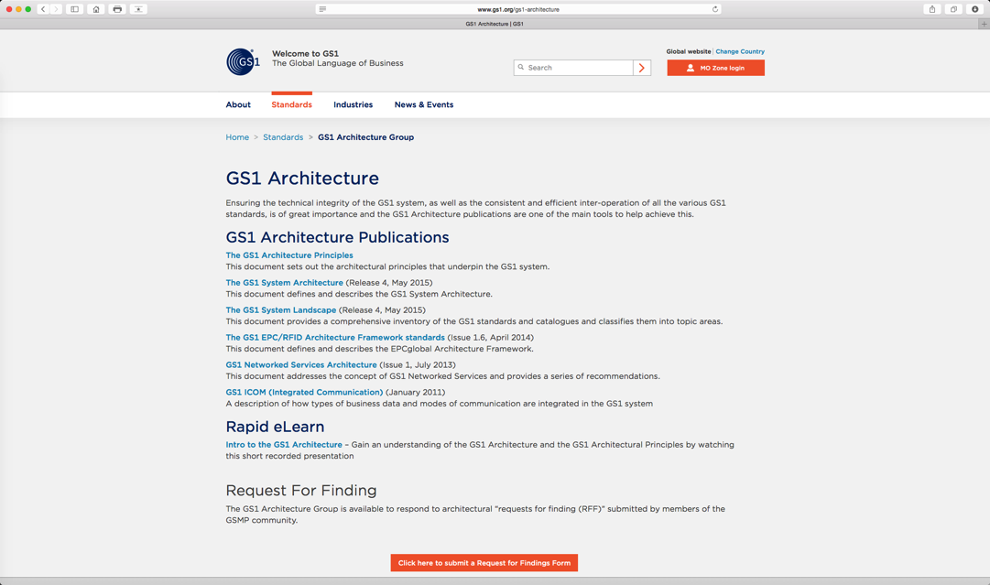
Where to learn more
All Architecture material via
www.gs1.org/architecture
Notes:
Thank you for taking the time to review this rapid eLearn. We hope it has provided an insight to the GS1 System Architecture and GS1 System Principles.
These publications, and further information about the GS1 Architecture, can be found via the web-page shown.

Slide 21
Tools

Slide 22
Standards Development Certification Programme
This unique programme is the only place where users can acquire the knowledge and skills needed to become an internal specialist in GS1 standards and the GSMP process, while also discovering how to run highly-effective and collaborative meetings. Click here to access the programme.
Level 2
GSMP Master
Presentation Skills & Cultural Diversity awareness
Building compelling value propositions
Effective Facilitation Skills
GS1 Project Management Skills
Classroom
+
eLearn
Level 1
Coming soon!
GSMP Professional
Competency
GS1 System Certificate
GS1 Intellectual Property Policy GS1 Code of Conduct Principles
GS1 Anti-Trust Clause
GS1 System Architecture Principles
Intro to Global Standards Management Process (GSMP)
How to create a quality Work Request
GSMP Professional
eLearn
Proficiency Level
22

Slide 23
Community Room
The Community Room is a central location for collaboration and sharing for all GSMP and Industry groups. It is located inside the GS1 Xchange portal.
For information on how to access and log into Xchange, click here.
For a training video on how to navigate through Community Room, click here.

Slide 24
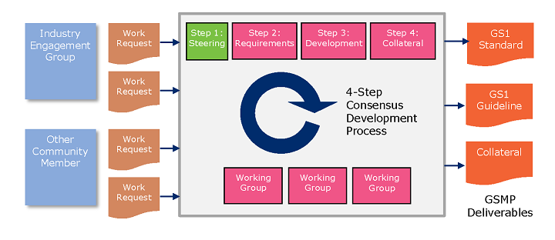
Work Request System
The GS1 Work Request System (WRS) is the entry point into the Global Standards Management Process (GSMP). Work Requests (WR) are submitted by the community to identify business needs that require standard-based solutions to improve efficiency, safety, security and or sustainability throughout the supply chain.

Slide 25
News & Events

Slide 26
Weekly GSMP Communication
Weekly communications is where we communicate the weeks activity of all groups and standards developed. Summary of all open ballots and community reviews are included for community consideration.
Once you are registered in the Xchange portal, you will automatically begin receiving GSMP Communications.

Slide 27
Reporting
Monthly
Mission Specific Work Group Scorecards
Quarterly
Standards Maintenance Group Scorecards
Management Report - activities, risks, project forecasting and metrics
Executive Summary - a summary of GSMP activities for the current quarter
All reporting can be found within the GSMP website, and will also be included in the weekly communications.

Slide 28
Events
There are two events per year, one in the US and one in Europe.
US event – GS1 Standards Event
  This event is primarily for work groups to meet face to face in order to work on standards development with a few industry sessions on important hot topics. This event is primarily held in the Spring.
European event – GS1 Industry & Standards Event
  This event is much larger as it incorporates work group development and industry topics facing our community around the world. This event is primarily held in the Fall.
  Why attend a GS1 Standards Event? Click here to find out.

Slide 29

Save the date!
Notes:
29

Slide 30
Team

Slide 31











Your GS1 Standards Development Team
Andrew Hearn
Head of
Standards
Development
Eileen Harpell
Operations Manager, GSMP
Cindy Grell
Manager,
Community Engagement, Communications & Events
Eddy Merrill
Operations Analyst, GSMP
Jean-Luc Champion
Manager, Standards Development
John Ryu
Director,
Standards Development
Greg Rowe
Director, Standards Development
David Buckley
Senior Manager, Technical Publications and Standards Development
Gena Morgan
Consultant,
EPCIS
Justin Childs
Director,
Standards Development
Tasha Wiehe
Director,
Standards Development

Slide 32


Your GS1 Standards Development Leaders
David Buckley
Senior Manager, Technical Publications & Standards Development
Justin Childs
Director Standards Development
Jean-Luc Champion
Manager, Standards Development
John Ryu
Director Standards Development
Jeanette McVeigh
Director, Global Classification and Standards
Gena Morgan
Consultant
Greg Rowe
Director, Standards Development
Tasha Wiehe
Director, Standards Development

Slide 33
Contact us
Contact us: GSMP@gs1.org

