Slide 1
GS1 Industry and Standards Event 2017 Transforming business together
Plenary
Brussels, Belgium
Tuesday, 10 October 2017

Slide 2
Welcome to Brussels!
Bienvenue à Bruxelles
Welkom in Brussel

Slide 3
But where will Brussels take you?

Slide 4
Did you know that…

Slide 5
FOOD
Brussels has 138 restaurants per square mile!
The Brussels’ International Airport is the largest chocolate selling point in the world!
There are more than 800 brands of beer on sale in Brussels!
#bonapp
#guiltypleasure
#cheers

Slide 6
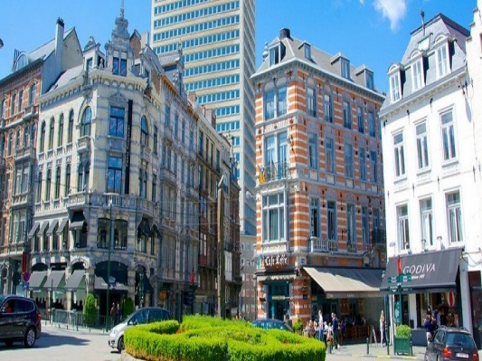
Best places to enjoy this…
PLACE SAINTE-CATHERINE /
SINT-KATELIJNEPLEIN
Location: Dansaert district
GROTE ZAVEL /
GRAND SABLON
Location: near Royal Palace
SINT-GORIKSHALLEN /
PLACE SAINT GÉRY
Location: Dansaert district
#food
#chocolate
#beer

Slide 7
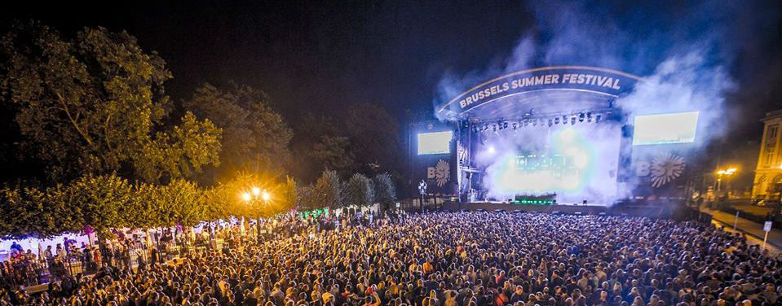
CULTURE
Opened in 1847, the Galeries Royales Saint-Hubert in Brussels are the oldest shopping arcades in Europe!
Victor Hugo lived in Brussels for 6 years during which he completed Les Misérables!
Brussels gave us Jacques Brel, Toots Tielemans, Lara Fabian, Stromae and many many more musicians!
#shinebright
#classic
#shakeitoff

Slide 8
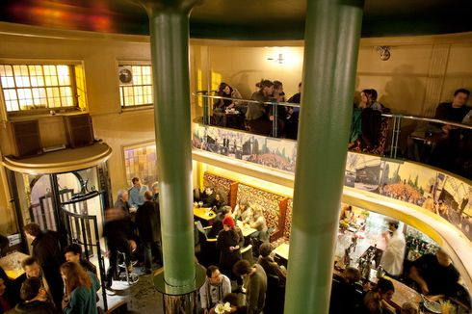
Best places to enjoy this…
GROTE MARKT /
GRAND PLACE
Location: the heart of Brussels
THEATRE NATIONAL
Location: Brouckère district
ARCHIDUC
Location: Dansaert district
#brusselsglory
#showtime
#allthatjazz

Slide 9
NATURE
In the Top 20 of Greenest European Capital Cities, Brussels is ranked #9, beating London and Paris!
Every Spring, thousands of people flock to the Hallerbos to witness it’s transformation from a sea of green into a sea of blue!
In the city centre of Brussels, you can find 15 parcs to enjoy!
#winner
#mothernature
#eveningwalk

Slide 10
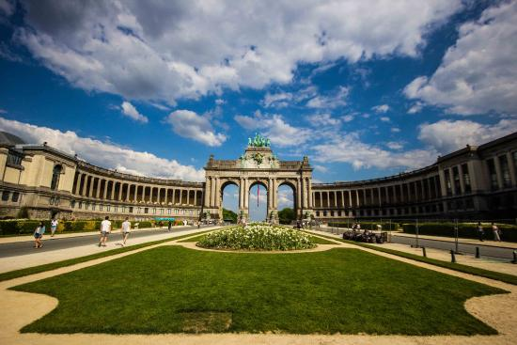
Best places to enjoy this…
PARC DU CINQUANTENAIRE /
JUBELPARK
Location: European district
TERKAMERENABDIJ /
ABBAYE DE LA CAMBRE
Location: Elsene / Ixelles
PARC ROYAL /
WARANDEPARK
Location: next to Royal Palace
#relaxing
#discovery
#impressive

Slide 11
And last but not least…Belgian Comic Strip Center!

Slide 12
Enjoy the hell hole!

Slide 14
Plenary agenda
The week ahead
Global Standards Management Process (GSMP) update
GS1 “state of the business”
Keynote Speaker – David Rowan, WIRED UK
GS1 Standards Awards
Closing remarks

Slide 15
The week ahead

Slide 16
Record attendance!
Amazing number
of countries!
374
32
27%
New attendees!
Notes:
16
Add pop up % new attendees on third click

Slide 17
Transforming business together
Thank you for joining us!
This week we will:
Inform, learn and share best practices
Network and strengthen our working relationships
Help define the future of global business standards
60 sessions
4 Lunch & Learns
2 evening networking events!
Notes:
Welcome Reception & Posterboard Contest, held last night.
Winners will be announced at the Networking Dinner tonight. We have a great night planned with plenty of time for networking

Slide 18
Transforming business together
Key topics we are talking about:
Green Transport & Logistics
Fresh Foods – achieving faster, fresher supply chains
Technical Industries
Apparel & General Merchandise
Omni-Channel: Mobile Ready Hero Images
Barcode Identification Futures
GS1 Standards in CPG
Enabling greater traceability
Omni-channel last mile opportunities
Global Standards in Maritime & Ports
Maintenance, Repair & Overhaul in Rail MSWG
Innovation
…and many more!

Slide 19
GSMP Update
Mark Holmes, GS1
Vice President Global Standards Management Process (GSMP)

Slide 20
Our three pillars of excellence are working…
Participation
Relevance
Efficiency
Notes:
More efficient use of your time will increase participation and ultimately build a more relevant standard and we have proven we can move faster without compromising quality

Slide 21
We are moving at the speed of business…
443 average days to deliver new GS1 standards in our Mission Specific Work Group (MSWG) before operational improvements
Note: Time to deliver a new standard is calculated from the date the group is seated to the end state (published, etc.)
Notes:
Take left margin numbers away…

Slide 22
More is happening… execution is key!
Ratified
GTIN Reuse Cessation
Consumer Product Variant Identifier
Consumer Product Variant into GDD
Left Shoe/Right Shoe
EDI Cash Handling
GDSN Major Release 3.1.3
EANCOM Standard Edition 2016
EDI Harmonised Model
In Process
Consumer Product Variant into GDSN
Seafood & Aquaculture Traceability
Update to GS1 Foundation for Fish
MRO Rail Phase II
Temperature Sensor Monitoring
New version of GPC Standard
Mobile Ready Hero Images
GDS Maintenance Release 3.1.4
… and more!
Notes:
Phase I was for identifying parts and phase II for the ability to exchange or share parts data amongst trading partners?

Slide 23
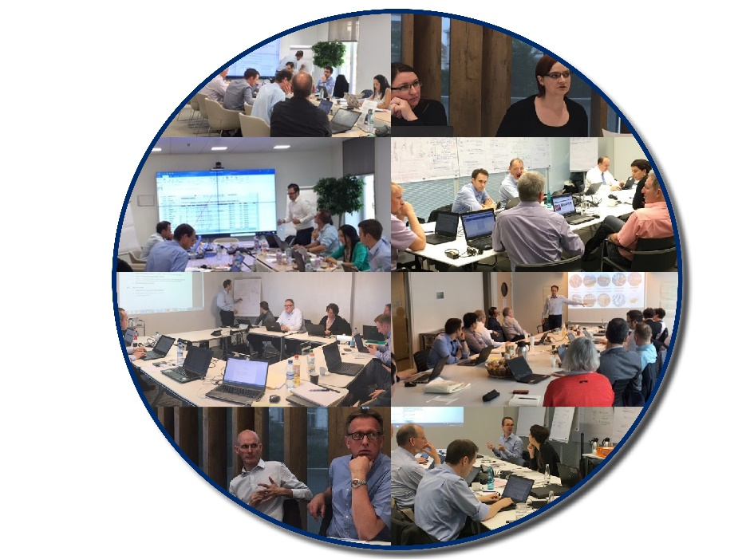
Face to face (f2f) meetings are working…
MRO in Rail Phase II, Berlin
March 2017
MRO in Rail, Phase II, Paris
June 2017
Global Model Number (Basic UDI-DI) f2f
US & Brussels
June 2017

Slide 24
Improvements in our Standard Maintenance Groups (SMG)
Improved
Needs Improvement
Presented at Jersey City Standards Event 2017
Standard development for Identification SMG by 50%
Time to market for new attributes into Global Data Synchronisation Network
Notes:
Using best-in-class techniques we have learned
We currently have a cycle time of x for new maintenance attributes
Industry is telling us this is unacceptable
We will be addressing. We have already identified areas to improve.
More to come and please let me know the issues you are having
Improved upfront work for new work requests and consolidating requirements and solutions group discussions

Slide 25
Time to market for new attributes into GDSN
The Global Master Data Standards Maintenance Group working in coordination with Global Data Synchronisation Network (GDSN) and the community has improved the release of “new” attributes into the network
We have been able to meet the needs of both retail and healthcare with our new release schedule
Notes:
Never done…

Slide 26
What’s next…
GS1 Standards Development Certification Programme
Global Services Development Process (GSDP)
Global standards adoption metrics
Notes:
You will be hearing more and more about the following three bullet points…
I would like to hear from 10 companies to come forward to get involved any of the 3

Slide 27
Thank you for your input!
Notes:
All the things we have done are moving us in the right direction based on your feedback; mission accomplished
Glad you feel things are getting better too…
I promised you that we needed improvements

Slide 28
GS1 “State of the business”
Marianne Timmons, Malcolm Bowden, Robert Beideman, Mike Wehrs

Slide 29
GS1 Key Priorities 2017-2018
CORE SECTORS
Retail/Omni-channel
Healthcare
Technical Industries
Transport & Logistics
STANDARDS
GS1 UniqueID
Traceability
Global Model Number (BUDI-DI)
SERVICES
GS1 Global Data Services (GS1 Cloud)
GS1 Key Issuance/Activation
GLEIF – Global LOU
GDSN Simplification
INNOVATION
Consumer Internet of Things (C-IoT)
Blockchain
ORGANISATION
Big Picture Implementation

Slide 30
A Word From Our Global Management Board

Slide 31
GS1 Big Picture
The “Big Picture” is a long term project for GS1 to introduce global services for all Member Organisations (MOs)
Two types of services – Core Services (to be provided by all MOs and addressing general membership needs) and Value Added (optional for MOs, services addressing individual needs).
Managed globally and deployed locally (by GS1 MOs)
Service portfolio centrally developed and go-to-market strategy defined to avoid user confusion, multiplication of efforts and conflicts among MOs
New organisational capabilities will be developed (globally and locally) to deliver the vision
The Big Picture project will position all of us to offer our customers a seamless experience when working with GS1 -> Acting as One Organisation
Offering truly Global Services will help companies of all sizes grow their business and become more efficient.
The first global services will be based on the GS1 Cloud

Slide 32
Building our Future Together

Slide 33
The Value of GS1 Membership

Slide 34
We need to:
Leverage the federation
Build the infrastructure
Embrace the value of membership

Slide 35
Consumers
Retailers, e-tailers,
& marketplaces
App developers & solution providers
GS1 Cloud
The largest source of trusted product information in the world
Healthcare
Brand owners
Regulators
GS1 MOs

Slide 36
GS1 Cloud
Check
Formerly known as GTIN Authentication
View
Formerly known as Product Validation
Explore
Formerly known as Search

Slide 37
Share your products with the world.
Global data visibility starts with GS1 Activate.

Slide 38
GS1 Cloud: Value of features to stakeholders
Service / Features | Brand owners | Retailers, e-tailers, marketplaces | App developers, solution providers | Regulators | GS1 MOs
GS1 Cloud: Check
GS1 Cloud: View
GS1 Cloud: Explore
GS1 Activate | *
*Retailer that offer white-label products can also use GS1 Activate

Slide 39
GS1 Cloud: How it works
Data collection
Data uploaded from various sources
Data storage
Data stored in a modern, scalable cloud database
Data access
Data distributed to various value-creating applications
GS1 Activate
GTIN Issuance and Activation
Retailers, e-tailers
GDSN Data Pools
GS1 Cloud
App developers, solution providers
Data aggregators
Flow of Data
direct or optional via MO
Operated by GS1 Global,
offered by GS1 MOs
Manufacturers
Local/other catalogues
GS1 MOs
Regulators
Brand owner internal data base
Business relationship and access management
Tier 1 technical and customer support
Value-add services (i.e., MDS, data prep, local enrichment, etc.)
Notes:
The GS1 Cloud has three primary functions: data collection, data storage and data exchange.
Data collection will take place through the sharing of data from existing databases plus a new global key issuance and management service — GS1 Activate — offered by every MO.
Data storage will ultimately include more than 100 million products, along with seven core product attributes that will deliver the trusted product information that consumers demand.
Data exchange will take place through MOs to retailers, e-tailers, manufacturers, app developers, etc. — opening up a door to entirely new categories of potential member customers.

Slide 40
GS1 Activate and GS1 Cloud
Consumer product data collection
Data uploaded from various sources
Consumer product data storage
Data stored in a modern, scalable cloud database
Consumer product data access
Data distributed to various value-creating applications
Member Customer Systems
GS1 Activate
GTIN Issuance and Activation
Data Users
Check
GS1 Cloud
MO CRM/ERP Systems
View
Explore
Data Quality & Policy Validations
Other sources
GDSN Data Pools
Data aggregators
Local/other catalogues
Brand owner internal database
Global Company Prefix (GCP)
GTIN non-reuse
Consumer Product Variant (CPV)
Data Permanence
Rules
Global Data Dictionary Validation Rules

Slide 41
GS1 Cloud Phase 1 – Core attributes & features
Attributes | Check | View | Explore
1. GTIN
2. Brand
3. Label Description
4. Medium Resolution Image
5. Target Market
6. Company Name
7. Product Classification
Check
View
Explore
Required for service
Service enhanced as a result
Notes:
To enable the first three data-exchange features of the GS1 Cloud, all MOs will be asked to provide 7 attributes:
GTIN
Brand
Label description
Medium resolution image URL
Target market
Company name
Product classification
The required data is geared towards consumer-facing applications so only consumer units are needed, along with the attributes that have been deemed essential for consumers.
If you have questions about why these attributes are important, how they are used, what the best practices are if you don’t have them in your system or how to address data quality, please see the GS1 Cloud FAQ document that is currently available.
And let’s review the three features that will be using these attributes:
For companies that want to ensure proper identification of products within their system, GS1 Check confirms that the Global Trade Item Number (GTIN) uses a GS1-assigned Company Prefix.
For mobile apps and e-commerce sites that want to provide accurate product information, GS1 View provides all available attributes for a product identified by a GTIN.
For companies looking for new products to carry in their physical or online store, GS1 Explore gives them the ability to discover new products by Global Product Classification (GPC) and target market.

Slide 42
Closing
The objective of the GS1 Cloud is to have the largest source of Brand authorised product information IN THE WORLD by January 2018
The GS1 Cloud will provide enormous benefits for all constituents: brand owners, eTailers, retailers, marketplaces, app developers, regulators and consumers
Phase 1 of the GS1 Cloud is deployed and products are being uploaded NOW
We have the technology platform, we have the marketing plan, we have the deployment plan ........
IT IS NOW UP TO EVERYONE TO PARTICIPATE AND EXECUTE AGAINST THESE PLANS!

Slide 43
Don’t forget!
How to get started in the GS1 Cloud Lunch & Learn: 12:30 in Le Palace 1, Ground floor
GS1 Cloud for GDSN Users: 13:30 in Klimt, Ground floor
GS1 Cloud Training for Member Organisations: 13:30 in Vision, 8th floor

Slide 44
Keynote speech
David Rowan, WIRED UK

Slide 45
Notes:
Play ken video

Slide 46
Ken Traub – In memoriam
The world has lost a thought leader, a mentor, a friend, a husband and father…and an amazing mind.
Ken was, perhaps, the most influential single contributor to GS1 over the last three decades.
He was incredibly dedicated to GS1—a torchbearer of the GS1 System of Standards.
GS1 has lost one of our family.
Notes:
Ken was, perhaps, the most influential single contributor to GS1 in the last decades. Ken was a sentinel of knowledge and of the truth…and a torchbearer of the GS1 System of Standards.
Ken was a groundbreaking thinker on the design and development of EPC Gen 2, GDSN, EPCIS, GLEIF, Traceability and the GS1 Architecture. He was also the designer of the GS1 Standards Management process. As a member of the GS1 Architecture Group, he worked to ensure the standards are well written and could be implemented across industries and technologies.
And, in addition to all of that, he donated his time as lead editor of:
- the GS1 System Architecture
- EPC Tag Data Standard
- EPC Information Services (EPCIS) standard
- Core Business Vocabulary standard
Barcode / RFID Interoperability guideline
His support of GS1 was demonstrated by his leadership, passion, and tireless efforts to make GS1 a better system…and to make each of us better people. GS1 has lost one of our family… Our hearts go out to Ken’s wife and his son…and to all those that knew and loved him.

Slide 47
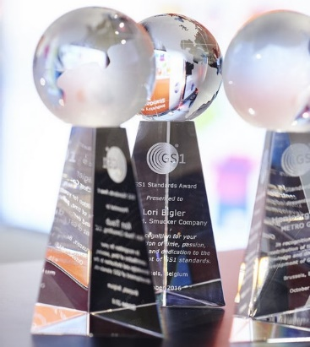
GS1 Ken Traub Standards Award
Award Criteria
A GS1 community member who:
has made a significant impact in the development and/or adoption of GS1 standards
is a generous source of knowledge and leadership to GS1
has promoted the benefits of GS1 Standards
has participated in multiple GS1 groups
Note: GS1 GO staff are not eligible.
We are announcing two winners:
1 person from industry
1 Member Organisation (MO) representative

Slide 48
GS1 Ken Traub Standards Award Winner
A dedicated contributor to GS1 and the GSMP process since 2009
Passionate about supporting GS1 Standards
Willing to spend time outside of GSMP evangelizing the standards to various industry groups
Works with others in industry to help them through questions and implementation challenges
John Terwilliger
Abbott Laboratories

Slide 50
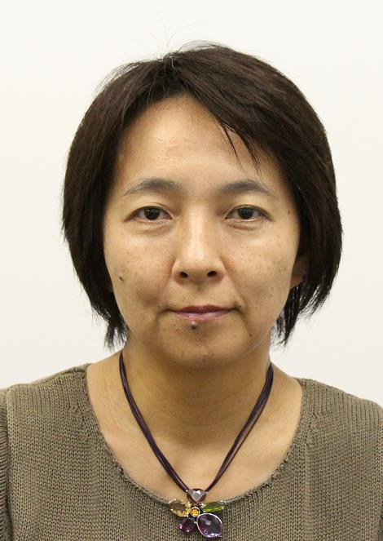
GS1 Ken Traub Standards Award Winner
A decade of participation and dedication to the development of GS1 standards.
Advocate for alignment of standards globally
Works closely with solution providers at the ISO level providing synergy between standards and technical components of standards
Participates in many work groups providing both input and expertise.
Naoko Mori
GS1 Japan

Slide 51
Tonight! Networking Dinner at Event Brewery
Meet in the Crowne Plaza lobby no later than 18:00 for bus departure
Enjoy great networking, delicious cuisine, beer and chocolate tasting, and music!

Slide 52
Enjoy the week!
Ask questions
Share experiences
Seek new ideas
Have fun!
Notes:
Enjoy being with friends and colleagues!
Enjoy being a member of the most unique organisation in the world!

Slide 53
Save the date!
GS1 Standards Event 2018
18-22 March
Jersey City, NJ USA
Building standards to deliver business value
Notes:
53

