Slide 1
Project Hero: Our Optimised Imagery Journey
Monday 9th October 2017

Slide 2
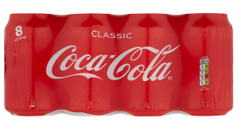
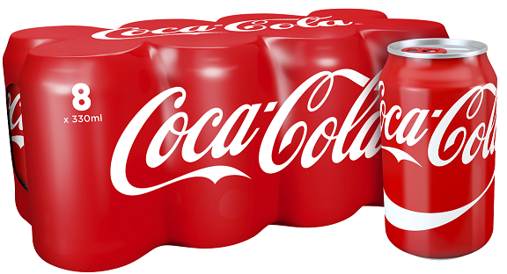
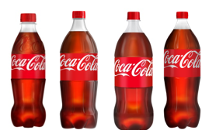
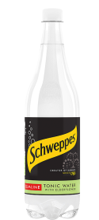
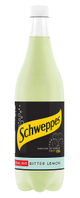
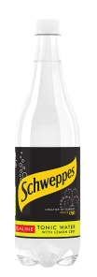
In January 2016 we set out on a journey to future-proof our imagery
2012
1
What information does the shopper need to make decisions?
2
What are the benefits of breaking off pack vs medium zoom?
Unclear Pack Size
Unclear Variant
3
How can we ensure our solution does not negatively impact Google Shopping results?
4
How can we develop a consistent shopping experience in the soft drinks category?

Slide 3
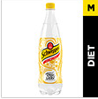
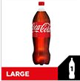
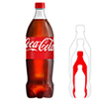
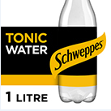
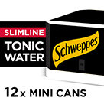
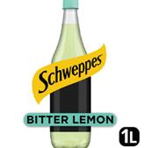
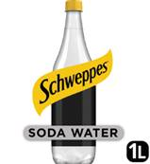
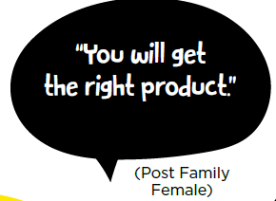
15 Months on, we have a potential solution
January 2016
Project Hero launched to optimise imagery for the mobile environment
March 2016
Eyetracking research commissioned and conducted (total 40 hours)
Quant Testing
Qual Testing
June 2016
Creative approach redeveloped and a/b tested
Current image in mobile scale
September 2016
AB test and retailer feedback led to final redesign of creative
Qual Testing
January - March 2017
Launched solution with first grocers and wholesaler
December 2017
New approach tested in focus groups and online testing (total 530)
Quant Testing

Slide 4
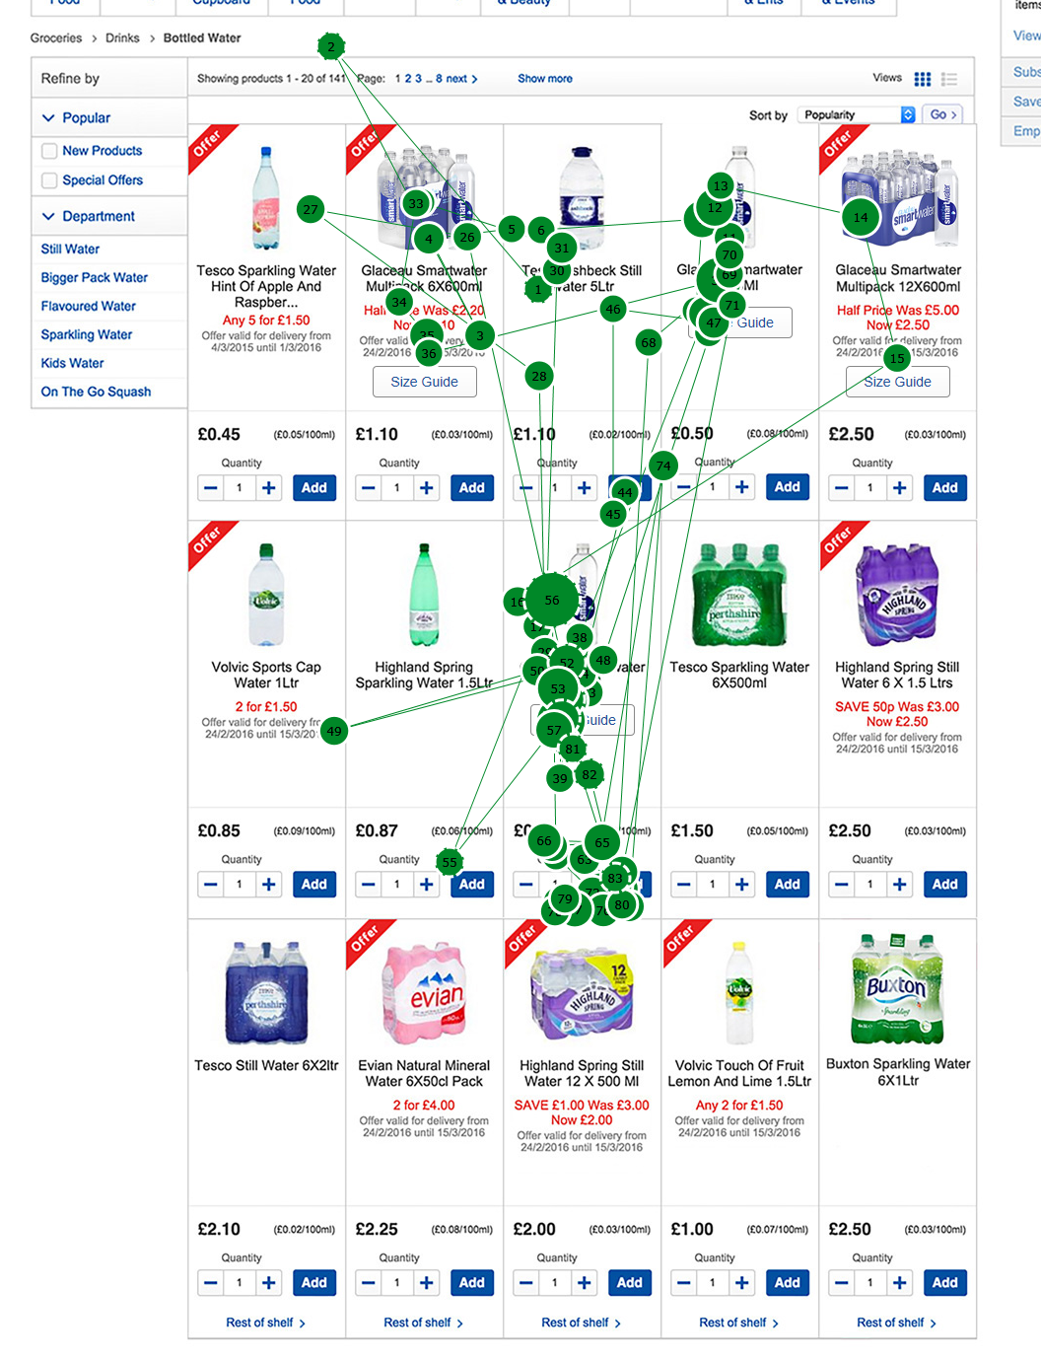
In March 2016, we qualitatively tested four contrasting solutions
25 Hours
8 Hours
7 Hours
Mixed Demographics - Frequent & First Time Online Shoppers
Cola & Water Category
Coca-Cola & Own label
Task Based Interviews
Via Simulated Popular Grocery Site
Size Labelling
Icon Led Solution
Occasion Labelling
Click Through

Slide 6
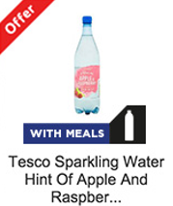
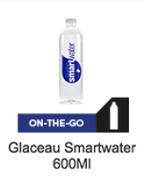
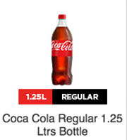
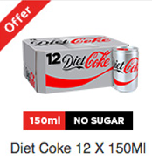
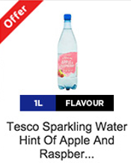
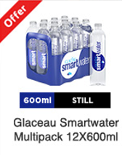
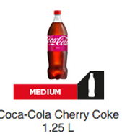
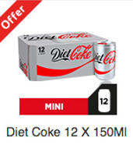
Our solutions tested a variety of approaches
Occasion Led
Variant Led
Relative Size Description

Slide 7
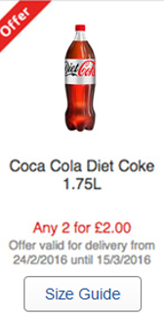
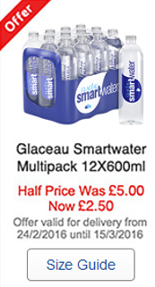
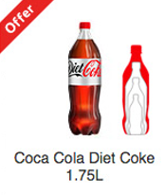
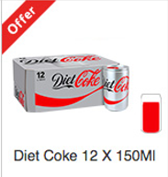
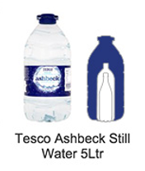
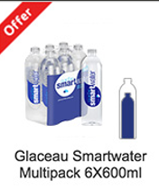
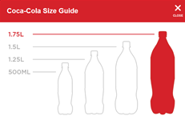
Two of our solutions used imagery to show size
1
Click to View Size Guide
Image Led Size Guide

Slide 8
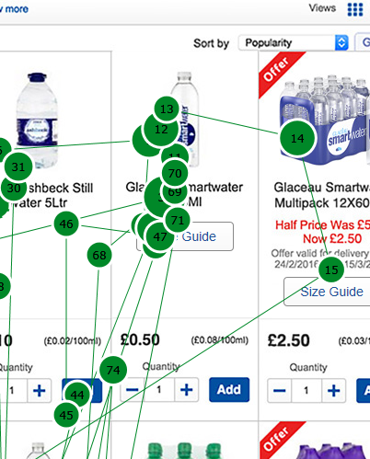
We identified three essential elements shoppers require
1
Shoppers look at imagery then copy
ml/L not always understood
3 - 5 seconds fixation duration on copy
 | Comparative size | Usage occasions | Quantity of contents
Example | “Small, medium, large “ | “family size”, “party size”, “individual size”, “mixer size”, “lunchbox fun size”, “handbag size”. | “ml and litres”
How many? (out of 40) | 23 | 9 | 8
3 - 5 seconds fixation duration on images
Three essential elements are required
Pack Size
Brand
Pack Variant

Slide 9
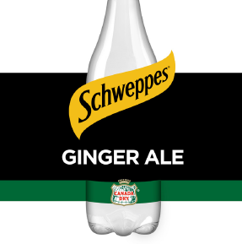
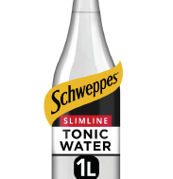
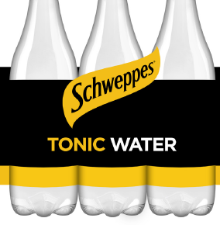
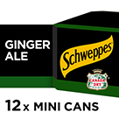
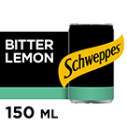
Phase two redesign focused on medium zoom
Source: Epoch design

Slide 10
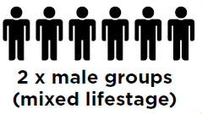
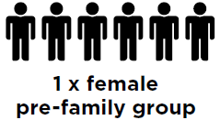
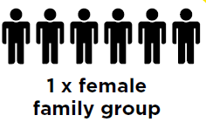
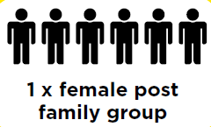
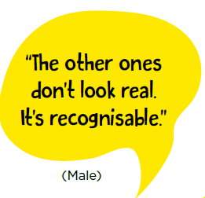
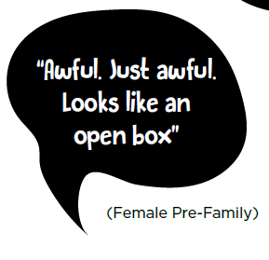
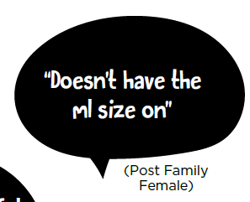
However, medium zoom did not perform well in qualitative testing
2
Current
Medium Zoom

Slide 11
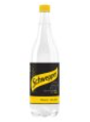
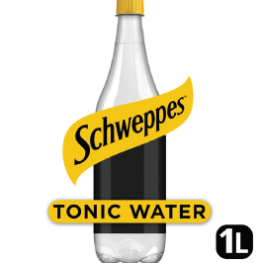
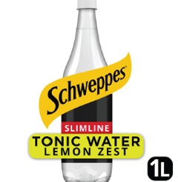
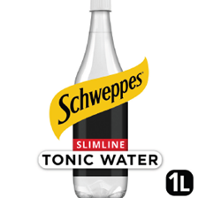
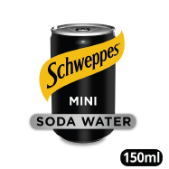
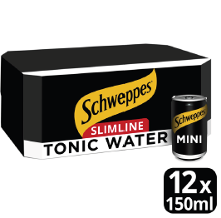
Phase three took all research into consideration on redesign
3
Breaking off pack is necessary for:
Thin products
Size labels
Current Out of Pack shots do not meet guidelines
Working with the team to redesign algorithm
GS more than happy to adapt to meet industry needs
Price points have been considered
A consistent area for size labelling is essential

Slide 12
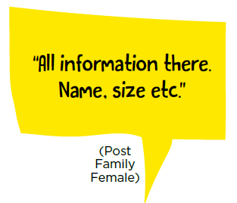
Research and sales results on current Solution are positive
Qualitative Testing
Interviews 30 Shoppers
Quantitative Testing
Survey 504 Shoppers
New Image
New Image
Old Image
Old Image
Previous vs Post Launch
+32% Volume
+45% YOY
+33% Value
+55% Household Penetration
+74% Basket Incidence

Slide 13
Now we want to work together to agree industry principles
4
1
Pack Size, Pack Variant & Brand
What information does the shopper need to make decisions?
2
Breaking off pack on thin products shows key information whilst maintaining the integrity of the product
What are the benefits of breaking off pack vs medium zoom?
3
Work with GS to update algorithm in line with industry principles
How can we ensure our solution does not negatively impact Google Shopping results?
4
Agree set principles on off pack/medium zoom and pack size location
How can we develop a consistent shopping experience in the soft drinks category?

Slide 14
Questions?

