Slide 1

How to use this Pilot Toolkit slide deck
1. Executive Summary (jump to slide 2)
Start here for a brief introduction to the sections in the Pilot Toolkit.
2. Full Pilot Toolkit (jump to slide 11)
Start at the beginning if you are new to 2D and want a complete overview of each element to start your 2D journey. This guides you through the Why, What, Who, How and Reporting and Learning sections.
3. Ready to Plan Your Pilot (jump to the HOW Section at slide 50)
If you already have a good understanding of 2D basics and would like to start thinking about how to organise and plan a pilot, start with the How section. You can always open and close the Why, What and Who sections for additional background and information.
In Slide Show mode, the navigation buttons below allow you to jump around the toolkit sections
HOW
REPORT & LEARN
GENERAL
WHY
WHAT
WHO
HOW

Slide 2

GS1 2D Pilot Toolkit
Updated March 2023
Notes:
To better enable the digital consumer, the retail industry is embarking on one of the biggest changes since the original introduction of the barcode: the adoption of 2D barcodes. To support you in your engagement with industry partners, we are pleased to share with you a new 2D Pilot Toolkit.

Slide 3
WHAT IS THE 2D PILOT TOOLKIT?
  A set of practical and relevant building blocks to enable both manufacturers or brand owners and retailers to jump start their 2D pilots
Tools
Lessons learned
THE 2D TOOLKIT
CONTAINS
Easy to navigate
Best practices
GENERAL
WHY
WHAT
WHO
HOW
REPORT & LEARN
Notes:
The goal of the Pilot Toolkit is to provide you with a set of practical and relevant building blocks to start pilots, including useful tools, checklists and templates, as well as case studies and best practices from existing 2D pilots and implementations around the world. So, let’s look more in-depth at the kit.

Slide 4
  WHY
  WHAT
  WHO
  HOW
    REPORTING & LEARNINGS
  What business use cases can be unlocked using 2D barcodes
  What is the scope of the pilot and what variables to consider when setting up a pilot
  Which supply chain partners and solution providers will you engage to create success
  How to set up and implement a 2D pilot; looking at different pilot building blocks, learnings and pitfalls
    How to track your pilot, capture learnings and report back to the GS1 community
GENERAL
WHY
WHAT
WHO
HOW
REPORT & LEARN
Notes:
The toolkit is divided into 5 sections that aspire to provide guidance on 2D pilot planning and execution
The Why section highlights business use cases that can be unlocked
The What section provides thoughtful considerations for defining the pilot scope
The Who section will help you identify internal and external stakeholders to engage for support and expertise
The How section provides resources you can leverage and will guide you in preparing for a successful pilot
The last section, Reporting and Learnings, provides tools to capture your learnings and share your results.
Now let’s take a quick look at key elements within each section.

Slide 5
Piloting 2D barcodes
WHY
KEY DRIVERS
Consumer Engagement
Safety
Sustainability
Inventory Management
Traceability
Improved Packaging
GENERAL
WHY
WHAT
WHO
HOW
REPORT & LEARN
Notes:
Why: There are many different business use cases that can be enabled by 2D barcodes and the power of more data. Within the toolkit are more than 2 dozen identified along with real world examples. There are also multiple support tools for determining the benefit and cost logics so you can build KPIs and set priorities for your pilot.

Slide 6




Decide the scope
for your 2D pilot
WHAT
SCOPE
Geography & Product
Barcode & Data
Value Chain
Pilot Implementation
GENERAL
WHY
WHAT
WHO
HOW
REPORT & LEARN
Notes:
What: The next step that the pilot toolkit provides is guidance for identifying scope elements. These elements include: geography and product selection, barcode and data scope, value chain impacts, and other broad pilot implementation decisions, such as duration and processes. Also included are examples and key learnings from previous pilots to help you set your pilots up for success!

Slide 7
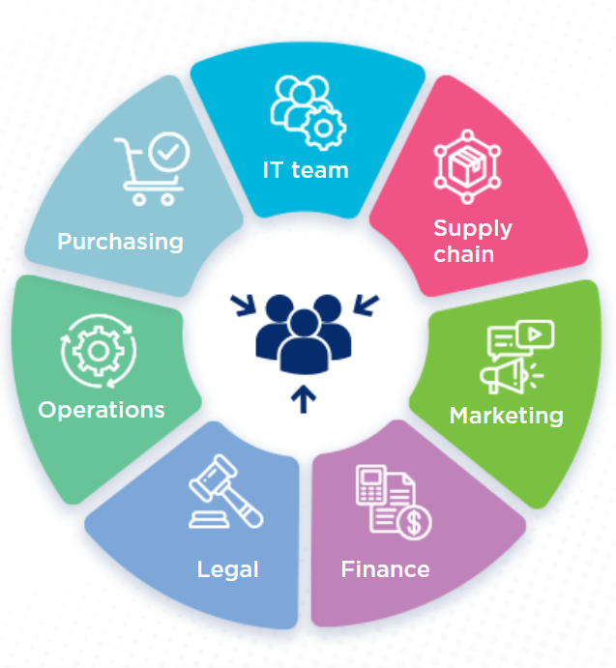

Identify Stakeholders for Pilot
WHO
STAKEHOLDERS
Manufacturers/ Brand Owners
Internal
Retailers
Solution Providers
Local GS1 Office
Finance
GENERAL
WHY
WHAT
WHO
HOW
REPORT & LEARN
7
Notes:
Who: It is important to identify and align cross-functional internal and external stakeholders. Depending on your use cases and scope, subject matter experts and supporting executives internally could be from a variety of disciplines, and each of those stakeholders will need to be aligned and engaged with their appropriate counterparts at your external partners participating in the pilot. Within the toolkit, you will find some key learnings on stakeholder management from previous pilots that can enrich your pilot planning.

Slide 8

Set Up Pilot
HOW
Pilot Steps
1
Discovery
2
Prepare & Mobilize
3
  Execute
4
  Report & Learn
HOW
REPORT & LEARN
GENERAL
WHY
WHAT
WHO
HOW
8
Notes:
How: Projects usually include four phases: Discovery, Prepare & Mobilize, Execute, and Report & Learn. The sections of the pilot toolkit map nicely to these phases…
Discovery is achieved in the Why section
Prepare & Mobilize are addressed in the What and Who sections
Execute is addressed by acting on your plan created through the How section
And of course, Report & Learn to share pilot progress and learnings
The How section of this toolkit identifies actionable elements for each of these phases as well as comprehensive, robust tools to use, such as, checklists, templates, reference resources and case studies specific to the tasks at hand.

Slide 9
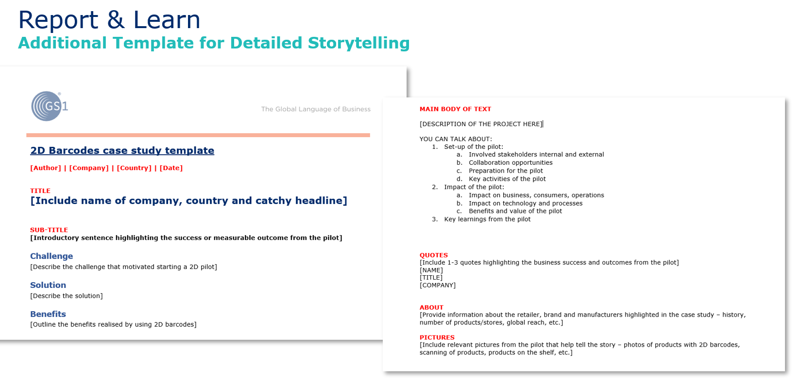
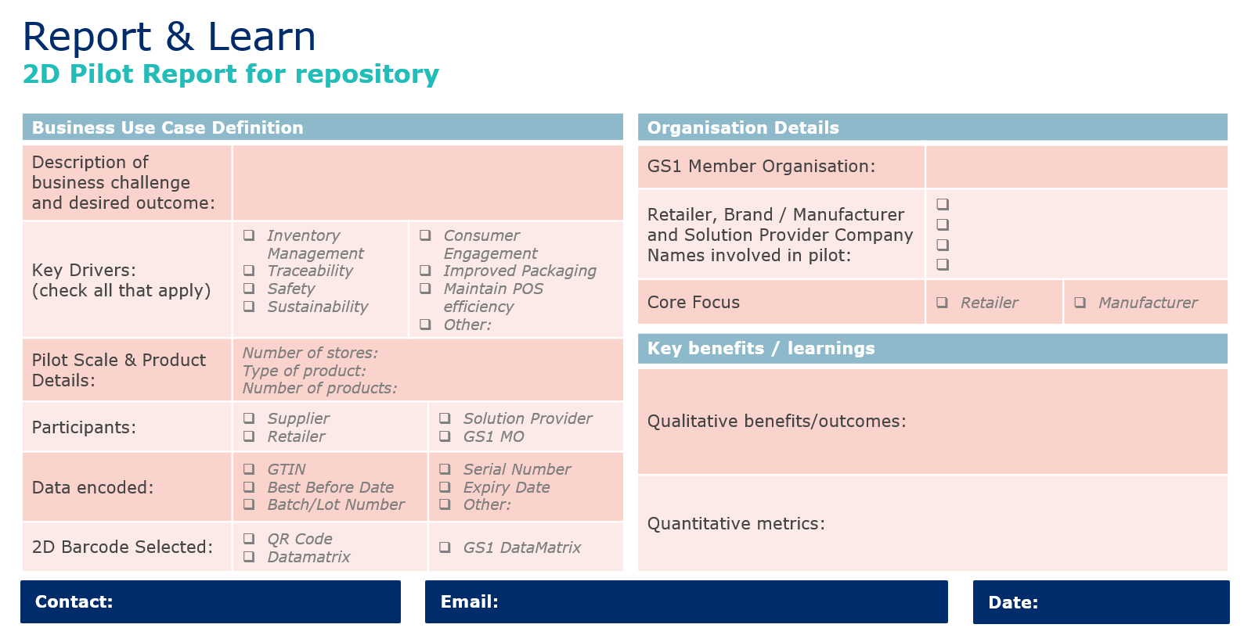
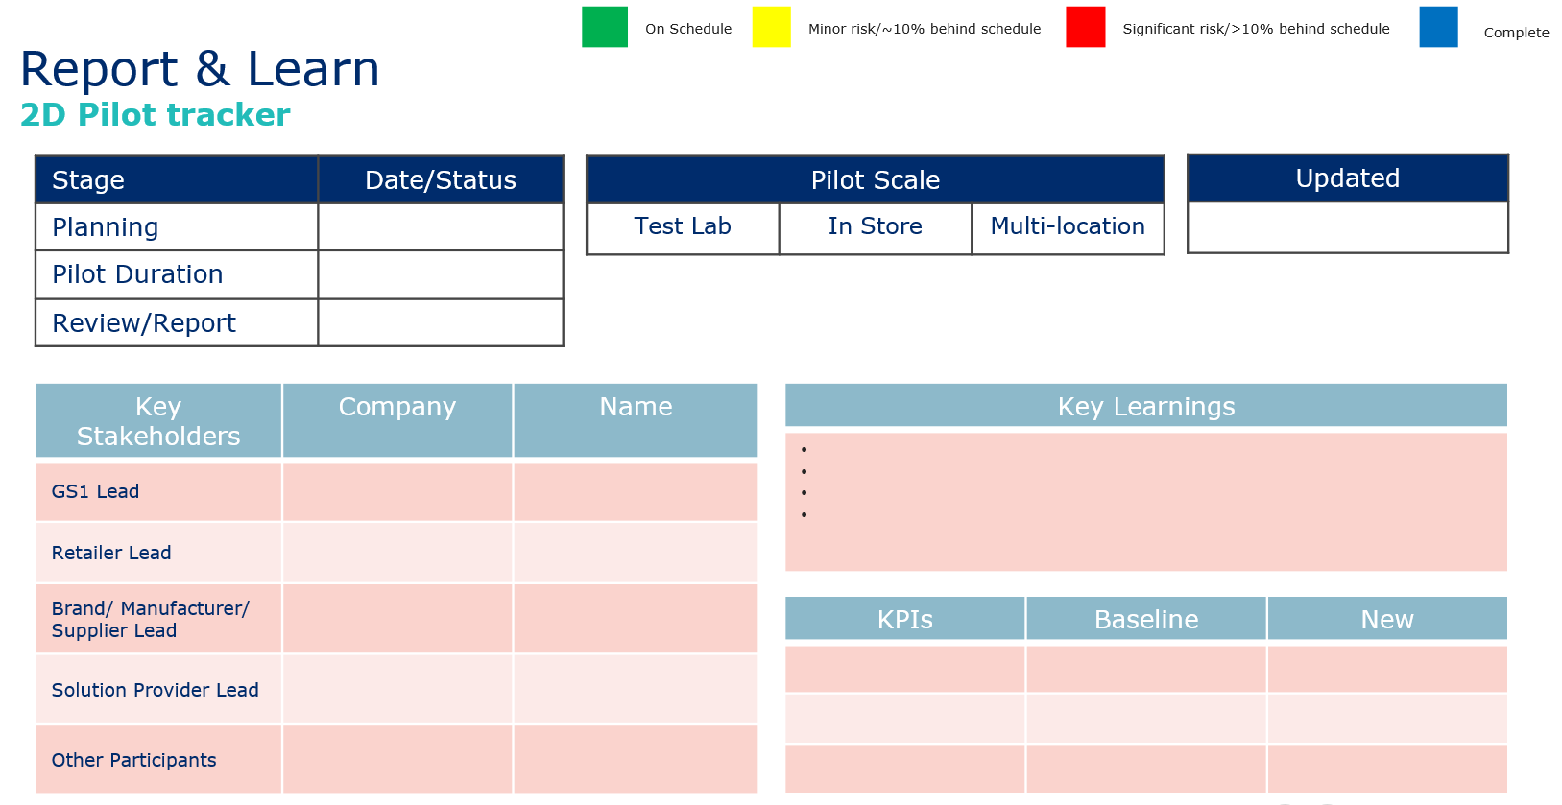
Reporting & Learning
REPORTING
SHARE
  Tools available for sharing your 2D pilot with the GS1 community:
HOW
GENERAL
WHY
WHAT
WHO
HOW
REPORT & LEARN
9
Notes:
Reporting & Learning: This 2D pilot toolkit is a living document, expanding as we learn more. So, it is essential for pilot learnings to be shared to help other industry companies jump start their 2D piloting and accelerate adoption. To that end, the toolkit contains different templates available to capture and share your 2D pilot facts, learnings, and benefits.

Slide 10

Summary
2D Use cases
Scope
Stakeholders
Checklist
Reporting Pilot
KPIs
Process Impact
Lessons learned
Benefits
IT & Data Impact
Storytelling
Costs
GENERAL
WHY
WHAT
WHO
HOW
REPORT & LEARN
10
Notes:
As you can see at-a-glance, the 2D pilot toolkit is a comprehensive resource with the structure, resources, tools, and best practices for you to engage with partners and develop a successful pilot.

Slide 11
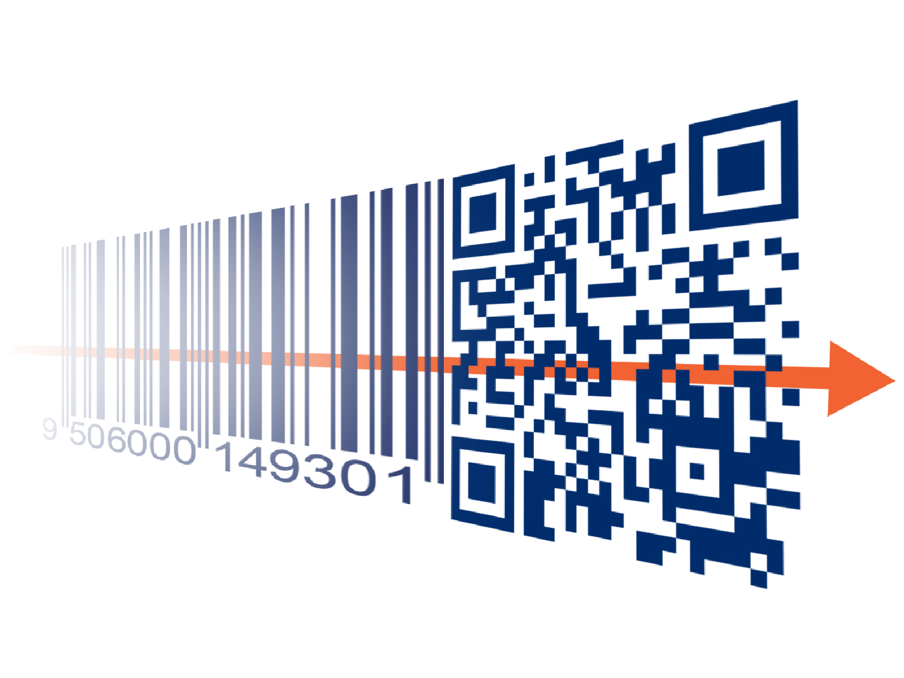
2D PILOT TOOLKIT
GENERAL
WHY
WHAT
WHO
HOW
REPORT & LEARN

Slide 12

2D PILOT TOOLKIT INTRODUCTION
Migration to 2D barcodes
  2D barcodes are becoming a key enabler to create both enhanced consumer experiences and unlock advanced business use cases...all while still going “beep” at checkout.
  GS1 is supporting industry along this “Global Migration to 2D” which has the ambition to enable 2D barcodes to be read at POS around the world by the end of 2027.
Industry pilots
  Along this journey, industry pilots are key so that brands and retailers (in collaboration with their Solution Partners) can explore the benefits of 2D, capture learnings and identify opportunities for scale-up implementation.
GS1 Toolkit
  To aid in this journey and enable industry use cases in a globally interoperable way, the GS1 2D Programme has developed this pilot toolkit framework to assist in planning pilots and capturing learnings for global knowledge sharing.
GENERAL
WHY
WHAT
WHO
HOW
REPORT & LEARN
Notes:
An introductory text on the 2D migration and why the 2D pilot toolkit came about.

Slide 13
WHAT IS THE 2D PILOT TOOLKIT?
  A set of practical and relevant building blocks to enable both manufacturers or brand owners and retailers to jump start their 2D pilots
A set of practical and relevant building blocks and tools for engaging in 2D pilots
An overview of lessons learned from 2D pilots that have already taken place worldwide
THE 2D TOOLKIT
CONTAINS
An easy to navigate toolkit designed for people both new to or experienced with 2D pilots
An overview of best practice examples to demonstrate pilots
GENERAL
WHY
WHAT
WHO
HOW
REPORT & LEARN
Notes:
A summary slide of the different elements explaining what the 2D toolkit sets out to do.

Slide 14
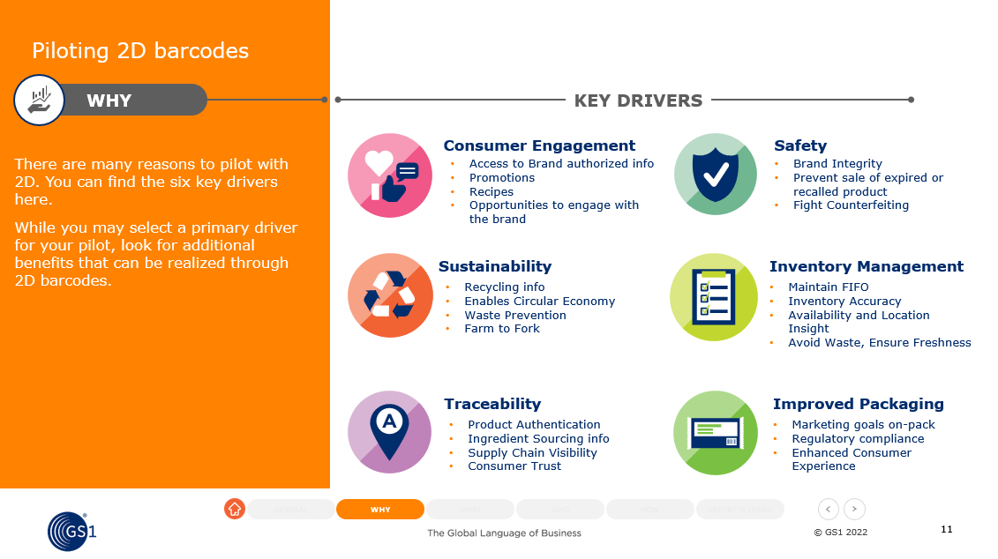
Manual
How does the toolkit work?
  To use the toolkit: first enter presentation mode and then use the buttons in the tool to navigate to the desired modules.
  If you are thinking about starting a 2D pilot or have made first steps, then this toolkit will help YOU.
Back to last slide viewed
Home button
Module navigation
Previous / next slide
GENERAL
WHY
WHAT
WHO
HOW
REPORT & LEARN
14
Notes:
A visual overview of how the toolkit works in powerpoint. Key is to put the powerpoint in presentation mode to make the interactive buttons and links work.

Slide 15
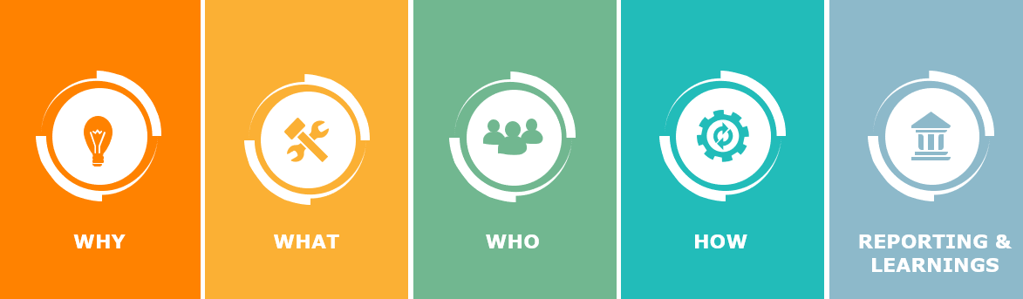
MANUAL
Where to start?
TOOLKIT CHAPTERS
  On the next page you will find the outlay of the toolkit, with interactive links to the different chapters.
  While you can move to any chapter at any time, we recommend going through this toolkit sequentially on first use.
GENERAL
WHY
WHAT
WHO
HOW
REPORT & LEARN
15
Notes:
This slide explains the different point of entries into the document

Slide 16
  WHY
  WHAT
  WHO
  HOW
    REPORTING & LEARNINGS
  What business use cases can be unlocked using 2D barcodes
  What is the scope of the pilot and what variables to consider when setting up a pilot
  Which supply chain partners and solution providers will you engage to create success
  How to set up and implement a 2D pilot; looking at different pilot building blocks, learnings and pitfalls
    How to track your pilot, capture learnings and report back to the GS1 community
GENERAL
WHY
WHAT
WHO
HOW
REPORT & LEARN
16
Notes:
An overview of the five different content chapters and what questions will be answered in the 2D pilot toolkit.

Slide 17


Collaborative model
Where to start?
Where GS1 can support
  Retailer
  Collaboration with all key internal and external stakeholders is foundational to pilot success. GS1 can support your pilot from the start.
  Neutral partner in the process
  Help with guidance on data and 2D barcode choices
  Provide guidance on the use of globally-interoperable GS1 Standards
  Leverage standards and solutions that are already implemented
  Connect to other companies that are piloting or have piloted
  Assistance in connecting to scanner or POS providers
  Manufacturer or
  Brand owner
  Scanner or POS provider
GENERAL
WHY
WHAT
WHO
HOW
REPORT & LEARN
17
Notes:
Key here is to ensure that both retailer, manufacturer and the solution provider work together on the pilot from the start. Furthermore the role of local GS1 MO’s is explained and where they can add value during the process.

Slide 18
Understanding the WHY
  What business use cases can be unlocked using 2D barcodes
GENERAL
WHY
WHAT
WHO
HOW
REPORT & LEARN
Notes:
This chapter lays out what business use cases can be unlocked using 2D barcodes.

Slide 19
Start by identifying the Key Drivers
WHY
KEY DRIVERS
Consumer Engagement
Safety
  There are many reasons to pilot with 2D. You can find the six key drivers here.
  While you may select a primary driver for your pilot, look for additional benefits that can be realized through 2D barcodes.
  Key learning:
  Start with a brainstorming exercise on potential use cases to define the most beneficial value drivers to begin your 2D journey
Access to Brand authorized information
Price and promotions
Nutritional information and recipes
Opportunities to engage with the brand
Brand Integrity
Prevent sale of expired or recalled product
Fight counterfeiting
Sustainability
Inventory Management
Recycling information
Enables Circular Economy
Waste Prevention
Farm to Fork
Repair information
Maintain FIFO (first in, first out)
Inventory accuracy
Availability and location insight
Avoid waste, ensure freshness
Efficient store processes
Improved analytics & insights
Traceability
Improved Packaging
Product authentication
Ingredient sourcing info
Supply chain visibility
Consumer trust
Food safety
Marketing goals on-pack
Regulatory compliance
Enhanced consumer experience
GENERAL
WHY
WHAT
WHO
HOW
REPORT & LEARN
Notes:
An overview slide of the six key drivers for piloting 2D barcodes with different use cases to get companies to start thinking about their business challenges and opportunities and how 2D can help them in these. Furthermore, it is important to note that usually more than one use cases can be served at the same time and hence unexpected benefits can be gained.

Slide 20

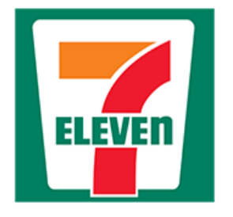
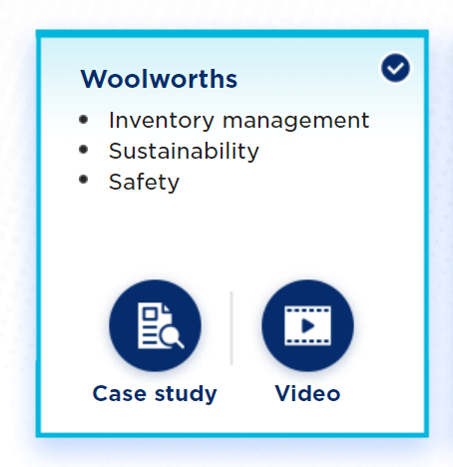
Align on your Prioritised Use Cases and review other Examples
WHY
2D PILOT EXAMPLES
  One code, many use cases
  Click on a best practice example to find out more details and get inspired.
Inventory management
Sustainability
Safety
Consumer engagement
Sustainability
Safety
Inventory management
Improved packaging
Inventory management
Sustainability
Safety
GENERAL
WHY
WHAT
WHO
HOW
REPORT & LEARN
Notes:
This is confirmed through best practice examples of use cases of 2D barcode pilots. Every pilot has had more benefits than just the chosen primary driver. Please click on these pilots to learn more and get inspired.

Slide 21

Consider Consumer Engagement Goals
WHY
CONSUMER ENGAGEMENT EXAMPLES
  If your primary use cases for 2D are operational, consider how you can improve consumer KPIs by also using that same 2D barcode to engage directly with consumers.
  Do you already have a QR code fon your product?
  Adding the GTIN inside of your existing QR code can unlock additional use cases AND enable that same code to go “beep” at POS.
  Check out key learnings here
Consumer engagement use case examples:
Product as a channel
In-store navigation
In-store conversion
Use at home
Share product experience
2. Marketing campaigns
Promotions
Social media activation
Customize products
Storytelling
3. Contextualized content and services
  Product info
  Agility to incorporate multiple messaging into one 2D code
  AR: virtual try-on
  Loyalty services
4. Operational excellence
1st party data collection
Traceability for recalls
Brand protection
Quick payments
GENERAL
WHY
WHAT
WHO
HOW
REPORT & LEARN
Notes:
There are many inspiring and diverse consumer engagement examples of using 2D barcodes available. For companies that are using 2D for operational use cases, talking to their marketing department can open up a lot of opportunities to engage directly with their consumers and these examples can be used for inspiration. However, many of these examples come from companies that are only using 2D for consumer engagement and not operations. Talking to their supply chain and adding GTIN (and other data attributes) to the barcode, operational use cases and benefits can also be unlocked.

Slide 22
Consider and define your KPI Framework
WHY
OPERATIONS KPIs
  Your prioritised use cases and drivers can influence several KPIs. Here are examples that can be impacted by implementing 2D barcodes:
  Operations KPIs
  Consumer facing KPIs
Operational Efficiency
Inventory Management
Resource Utilization
Traceability &
Safety
Sustainability
Sell-through rate
Perfect order rate
Throughput
Shipment cost reduction
Inventory accuracy
Number of scanning errors
Days Sales in Inventory (DSI)
Accuracy of forecast
Time to receive
Lead time
Safety stock levels
Utilisation rate
Cost of waste
Lost sales ratio
Dead stock/ spoilage
FTE productivity
Line utilisation
Percentage of products end-to-end tracked
Number of suppliers that implement sustainability management systems
Number of reported recall incidents
Number of expired products prevented from being sold
Time to recall
Percentage of circular inflow/ outflow
Supply chain waste
Recycling rates
GENERAL
WHY
WHAT
WHO
HOW
REPORT & LEARN
22
Notes:
Key for managers from different departments is to understand what KPIs can be positively impacted by using 2D. Through the benefit logic that retrackts from the goal back to the solution, a non exhaustive list of KPIs has been created. Starting with operational KPIs in the areas of operational efficiency, inventory management, resource utilisation, traceability & safety and sustainability.

Slide 23
Consider and define your KPI Framework
WHY
CONSUMER FACING KPIs
  Your prioritised use cases and drivers can influence several KPIs. Here are examples that can be impacted by implementing 2D barcodes:
  Operations KPIs
  Consumer facing KPIs
Consumer
Engagement
Revenue
Marketing
Campaigns
Transparency
Conversion rate
Net Promoter Score
Engagement rate
Brand perception
Number of impressions
Number of people who scan QR code
Improved insights and analytics
Sales growth
Sales by new consumers
Customer retention rate
Average sales volume per consumers
Consumer Return Rate
Return on Marketing Investment
Click-through-rate
Website traffic growth
Sales margin
Discount as a percentage of price
Number of actions
Revenue and cost per scan
Decrease in unauthorized product sales
Ratio of transparent products
Ratio of validated authentic products
GENERAL
WHY
WHAT
WHO
HOW
REPORT & LEARN
23
Notes:
2D barcodes can also positively influence different consumer facing KPIs in the areas of revenue growth, consumer engagement, marketing campaigns and transprency.

Slide 24
Establish your Benefit Logic
ABOUT
WHY BENEFIT LOGIC
  The benefit logic establishes logical links between business goals, KPIs, value drivers and components of the solution.
    The benefit logic defines the benefit areas to reach the ambition and KPIs set by the stakeholders.
    It also provides a framework for linking defined solutions to the benefit areas. By doing this, it automatically creates priorities of activities and states which activities to focus.
    Different stakeholders might have different priorities and the benefit logic is helpful in identifying those differences.
    Note that for every category the benefits can differ in size and set priorities in implementation accordingly.
STEPS
EXAMPLE
  How? What is needed?
  How? What is needed?
  Listing and mapping
  Solutions
  Value drivers
  Results
  Connecting elements if they are in dependency
2D solution
  enables
Value Drivers
  lever
KPI / Business goal
GENERAL
WHY
WHAT
WHO
HOW
REPORT & LEARN
Notes:
Benefit logic is a way to establish logical linkes between business goals, KPI’s, value drivers and solutions, in this case 2D barcodes. It details out the different areas where value is created through the enablement of drivers. There are different levels to a benefit logic, each deepening the level of detail.

Slide 25
Benefit Logic Level 1
SOLUTION
VALUE DRIVERS
KPIs
BUSINESS GOALS
Customer Engagement
Revenue increase
Profitability
2D BARCODE
Sustainability
Sustainability goals rate
Sustainability
Traceability
Cost decrease
Consumer NPS
Safety
Regulatory compliance rate
Regulatory
compliance
Inventory Management
Working capital decrease
Improved Packaging
Engagement rate
GENERAL
WHY
WHAT
WHO
HOW
REPORT & LEARN
25
Notes:
Level 1 of the benefit logic for 2D pilots is a high-level overview of how the goals, KPIs, value drivers and 2D solution are connected. Level 2 of the benefit logic can be asked for at your local GS1 office, who can also help you understand where value for your business may lie.

Slide 26
Benefits
A number of possible consumer benefits leading to increased revenue
For manufacturers
or brand owners
SOLUTION
VALUE DRIVERS
GOALS
KPIS
Consumer Engagement & Transparency
Average sales volume per consumers
Consumer Return Rate
Conversion rate
Net Promoter Score
Engagement rate
Brand perception
Number of people who scan QR code
Click-through-rate
Website traffic growth
Sales margin
Discount as a percentage of price
Decrease in unauthorized product sales
Ratio of transparent products
Ratio of validated authentic products
GENERAL
WHY
WHAT
WHO
HOW
REPORT & LEARN
Notes:
How to read the benefit logic level 2 (please note the logic is non exhaustive):
The solution [2D barcode] enables the increase of data a company can put on a barcode beyond GTIN.
This enables the availability of ingredient sourcing information on the product (adding e.g. Best Before Date or a batch number), which leads to increased traceability.
This enables all kinds of variables and activities like an increase in targeted recalls as well as product authentication.
This can lead to increased consumer engagement, which can lead to an increased number of products sold.
This finally leads to the overall business goal of increasing revenue.
KPI example: this can furthermore lead to ‘sub’ KPIs like improved brand perception and a decrease in consumer return rate.
----------------------------------------------------------------------
The 2D barcode enables readibilty of the barcode by smartphones.
This increases the opportunities for online marketing like competitions or promotions.
This can lead to increased consumer engagement, leading to an increase in the number of products sold.
This finally leads to the overall business goal of increasing revenue.
KPI example: this can furthermore lead to ‘sub’ KPIs like improved no of people scanning QR codes, website/app traffic increase and the like.

Slide 27
Benefits
Possible operational benefits leading to a reduction in cost and working capital
For manufacturers
or brand owners
SOLUTION
VALUE DRIVERS
GOALS
KPIS
Inventory Management, Sustainability & Transparency
Inventory accuracy
Number of scanning errors
Accuracy of forecast
Lead time
Safety stock levels
Utilization rate
Cost of waste
Lost sales ratio
FTE productivity
Time to recall
Recycling rates
Sell-through rate
Perfect order rate
Throughput
GENERAL
WHY
WHAT
WHO
HOW
REPORT & LEARN
Notes:
How to read the benefit logic level 2 (please note the logic is non exhaustive):
The solution [2D barcode] enables the increase of data a company can put on a barcode beyond GTIN.
This enables the availability of product information on the package (adding e.g. Best Before Date or a batch number).
This enables variables like an increase in use of FIFO and product freshness, which leads to an improvement of inventory management.
This can lead decreased working capital.
This finally leads to the business goal of increasing profitability.
----------------------------------------------------------------------
The 2D barcode enables the availability of ingredient sourcing info leading to increased traceability.
This can optimise the planning and scheduling leading to increased operational efficency.
This can lead to a reduction in costs.
This finally leads to the business goal of increasing profitability

Slide 28
Benefits
A number of possible consumer benefits leading to increased revenue
For retailers
SOLUTION
VALUE DRIVERS
GOALS
KPIS
Consumer Engagement & Transparency
Average sales volume per consumers
Consumer Return Rate
Conversion rate
Net Promoter Score
Engagement rate
Brand perception
Number of people who scan QR code
Click-through-rate
Website traffic growth
Sales margin
Discount as a percentage of price
Decrease in unauthorized product sales
Ratio of transparent products
Ratio of validated authentic products
GENERAL
WHY
WHAT
WHO
HOW
REPORT & LEARN
Notes:
How to read the benefit logic level 2 (please note the logic is non exhaustive):
The solution [2D barcode] enables the increase of data a company can put on a barcode beyond GTIN.
This enables the availability of ingredient sourcing information on the product (adding e.g. Best Before Date or a batch number), which leads to increased traceability.
This enables all kinds of variables and activities like an increase in transparency and ingredient information.
This can lead to increased consumer engagement, which can lead to an increased number of products sold.
This finally leads to the business goal of increasing revenue.
----------------------------------------------------------------------
The 2D barcode enables readibilty of the barcode by smartphones.
This increases the opportunities for online marketing like competitions or promotions.
This can lead to increased consumer engagement, leading to an increase in the number of products sold.
This finally leads to the business goal of increasing revenue.

Slide 29
Benefits
Possible operational benefits leading to a reduction in cost and working capital
For retailers
SOLUTION
VALUE DRIVERS
GOALS
KPIS
Inventory Management, Sustainability & Transparency
Inventory accuracy
Number of scanning errors
Accuracy of forecast
Lead time
Safety stock levels
Utilization rate
Cost of waste
Lost sales ratio
FTE productivity
Time to recall
Recycling rates
Sell-through rate
Perfect order rate
Throughput
GENERAL
WHY
WHAT
WHO
HOW
REPORT & LEARN
Notes:
How to read the benefit logic level 2 (please note the logic is non exhaustive):
The solution [2D barcode] enables the increase of data a company can put on a barcode beyond GTIN.
This enables the availability of product information on the package (adding e.g. Best Before Date or a batch number).
This enables variables like an increase in use of dynamic pricing, which leads to an improvement of inventory management and product freshness.
This can lead to a reduction in waste leads to a reduction in costs.
This finally leads to the business goal of increasing profitability and an increase in achievement of sustainability goals.
----------------------------------------------------------------------
The 2D barcode enables the availability of ingredient sourcing infro leading to increased traceability.
This can optimise the planning and scheduling leading to increased operational efficency.
This can lead to a reduction in costs..
This finally leads to the business goal of increasing profitability.

Slide 30
Evaluate your Cost Logic
ABOUT
WHY COST LOGIC
  The Cost Logic method (also called Cost Breakdown) identifies and divides costs into meaningful components.
    The cost logic defines the cost areas to reach the ambition set by the stakeholders and calculate the Business Case.
    It also provides a framework for linking defined solutions to the cost areas. By doing this, it automatically creates insights into the cost of priorities activities.
    2D introduction requires investments in technology, processes and people.
    Note that investments can differ depending on the category and brand label. Take this into account when setting priorities for implementation.
STEPS
EXAMPLE
  How? What is needed?
  How? What is needed?
  Listing and mapping
  Solutions
  Cost drivers
  Results
  Connecting elements if they are in dependency
2D solution
  enables
Cost Drivers
  lever
KPI / Business goal
GENERAL
WHY
WHAT
WHO
HOW
REPORT & LEARN
Notes:
Cost logic is a way to establish a breakdown of cost components linked to solutions, in this case 2D barcodes. It details out the different cost drivers. There are different levels to a benefit logic, each deepening the level of detail.

Slide 31
Cost Logic Level 1
SOLUTION
COST DRIVERS
COSTS
One-time costs:
Materials
IT hardware
2D BARCODE
One-time costs:
Labor
IT infrastructure
Recurring costs:
Materials
IT software & architecture
Recurring costs:
Labor
Own employees
External employees
GENERAL
WHY
WHAT
WHO
HOW
REPORT & LEARN
31
Notes:
Level 1 of the cost logic for 2D pilots is a high-level overview of how the cost, cost drivers and 2D solution are connected. Level 2 of the cost logic can be asked for at your local GS1 office, who can also help you understand where the costs for your business may lie and can be used as a basis for your business case.

Slide 32
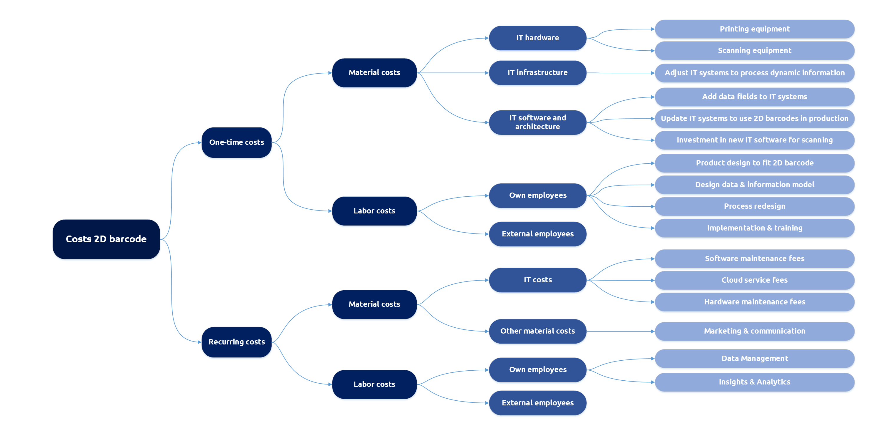
Cost Logic
Introducing 2D can require investment in different areas
For manufacturers
or brand owners
SOLUTION
COST DRIVERS
COSTS
GENERAL
WHY
WHAT
WHO
HOW
REPORT & LEARN
Notes:
How to read cost logic (note that it is non exhaustive):
To introduce the 2D barcode companies will need to think about one-off costs as well as recurring costs.
Both types of costs can be divided into material and labor costs.
Material costs can be divided into IT hardware, infrastructure, software and architecture.
Labor costs can be divided into costs for own employees as well as external employees.

Slide 33
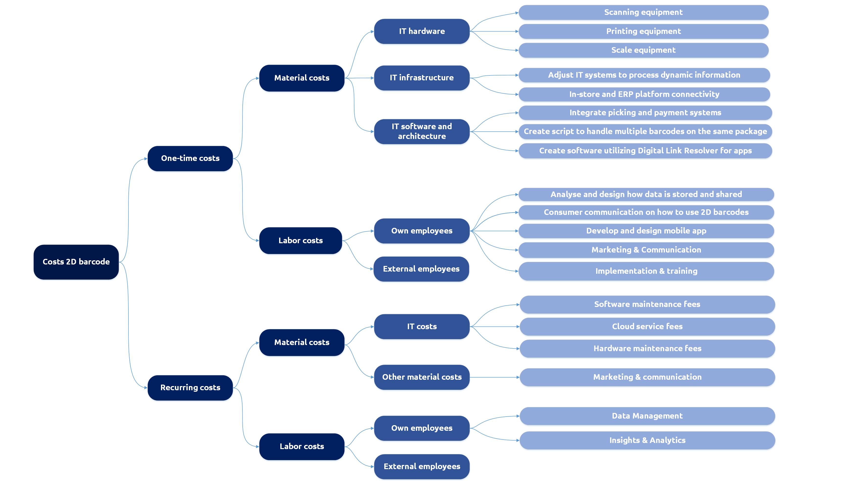
Cost Logic
Introducing 2D can require investment in different areas
For retailers
SOLUTION
COST DRIVERS
COSTS
GENERAL
WHY
WHAT
WHO
HOW
REPORT & LEARN
Notes:
How to read cost logic (note that it is non exhaustive):
To introduce the 2D barcode companies will need to think about one-off costs as well as recurring costs.
Both types of costs can be divided into material and labor costs.
Material costs can be divided into IT hardware, infrastructure, software and architecture.
Labor costs can be divided into costs for own employees as well as external employees.

Slide 34
Key learnings
WHY
Key learnings
  Review the key learnings and pitfalls from previous global 2D pilots to jump start your 2D pilot. You will find the learnings throughout the 2D pilot toolkit.
CONSUMER ENGAGEMENT (WHY)
    The content behind 2D barcodes is dynamic and can be changed instantly
    The biggest value for Consumer Products manufacturers lies in the direct contact with the end consumer
    For operational departments, engage with your brand marketing teams to align on goals and opportunities for 2D barcodes
    Using 2D barcodes can provide a competitive advantage for brand owners
    Enable real estate, not the package
    2D barcode is interoperable and cross-platform
    Consider a call-to-action on pack to ensure your consumers are aware of 2D codes and what to use them for (e.g., at self check-out, to access product information)
    Measure the numbers of 2D scans by consumers to track consumer engagement
    Ensure consumers land on destination pages with one click (no menu)
    Ensure to start piloting with consumers before making any large changes to processes or system to ensure you get the desired results
GENERAL
WHY
WHAT
WHO
HOW
REPORT & LEARN
34
Notes:
This slide contains learnings on consumer engagement from 2D pilots conducted.

Slide 35
Deciding on the WHAT
  What is the scope of the pilot and what variables to consider when setting up a pilot
GENERAL
WHY
WHAT
WHO
HOW
REPORT & LEARN
Notes:
This chapter lays out what scope questions to answer and what variables to consider when setting up a 2D barcode pilot.

Slide 36
Decide the scope
for your 2D pilot
WHAT
SCOPE
  Once you know why you want to conduct a pilot, what benefits can be realised and have selected use cases, it is time to set the scope for your pilot.
Geography & product scope
Barcode & data scope
  Country/geographical area
  Number of stores for retail
  Product category
  Type of product (fixed/variable weight or fixed number)
  Brand of the product (private label or branded)
  Products (number of products impacted)
  Selection of 2D code
      QR code with GS1 Digital Link
      Data Matrix with GS1 Digital Link
      GS1 DataMatrix with GS1 element strings
  The GTIN should be included in every 2D barcode
  Selection of additional data to include in 2D barcodes is based on use case(s)
Value chain scope
Pilot scope
  Identify the end-to-end value chain stakeholders involved
  Outline business processes impacted
  Map the Data & IT systems impacted
  Type of ecosystem (closed or open)
  Type of project (research, proof of concept, pilot, implementation)
  Type of implementation (virtual, full, or hybrid)
  Time (start and duration of pilot)
GENERAL
WHY
WHAT
WHO
HOW
REPORT & LEARN
Notes:
Once you have decided on the use case(s), it is time to set the scope. First of all in what country and/or geographical area to conduct the pilot. For retail the number of stores to pilot in. Next is the product scope. What category, line or SKUis going to be tested with? Next, the barcode type needs to be chosen, followed by the data attributes. Next an important step is thinking through all steps of the value chain and how the use case can effect the processes, data and systems. This is a high-level inventarisation. Deciding how to approach this impact comes at a later stage. Lastly the outlines of the pilot need to be set; whether open (with external partners) or closed, whether a research, POC or pilot, whether it will be a virtual, full or hybrid set-up and lastly the anticipated duration of the pilot needed to get results. In the next slides these steps are further detailed.

Slide 37
Geography &
Product Scope
WHAT
ABOUT
  First in scope is deciding in what country or geographical area to pilot. If you are in retail decide on how many stores to pilot in.
  Next in scope is deciding what type of product to pilot with and how many different products to include in the pilot.
  A. Type of product
    Starting with one country or region and a small number of stores will make the project more feasible and time-boxed.
    Choosing the type of product will have impact on the whole pilot set-up.
    It will have impact on the benefits and the barcode and data attributes that need to be chosen.
APPENDIX
  Food
  Non-Food
  Fixed number
  Variable weight
  Fixed weight
  Private label
  Brand
  See sections 7 and 8 of the 2D Barcodes at Retail POS Getting Started Guide for guidance for brand owners and retailers
  See the Fresh Foods implementation guide
  B. Number of different products
GENERAL
WHY
WHAT
WHO
HOW
REPORT & LEARN
Notes:
First in scope is deciding in what country or geographical area to pilot. If you ar in retail decide on how many stores to pilot in. Easiest to test is a small set-up.
Next is thoroughly looking at the end-to-end value chain to inventarise which steps are impacted by the pilot and what adjustments need to be made in process, data and IT.

Slide 38
Barcode & Data Scope
WHAT
ABOUT
  Second in the scope is deciding which barcode to use and what data attributes to use for your pilot purpose.
  A. Type of 2D barcodes
    Barcode and data selection is dependent on three key factors: who needs to scan the barcode, how will they scan the barcode and what data is needed for the desired use case.
    In some cases, you may want to start small by just using the GTIN in a 2D barcode and then scaling up to add other data as needed. In other cases, incorporating additional data will be needed.
    Your local GS1 office can help with barcode and data selection.
  QR Code with GS1 Digital Link syntax
  DataMatrix with GS1 Digital Link syntax
  GS1 DataMatrix with element string syntax
APPENDIX
  B. Data Attributes
  See sections 5 and 6 for details on barcode types and how to use GS1 Application Identifiers in the 2D Barcodes at Retail POS Getting Started Guide
  Visit the 2D in Retail webpage
  Use the 2D Barcode Explorer to learn more about barcode types
  See more on Best practices for creating QR Codes powered by GS1
  See also other tools and templates
  GTIN
  Use By Date
  Best Before Date
  Batch/lot number
  Serial Number
  Weight per kilo
  Price to Pay
  Price/kg
GENERAL
WHY
WHAT
WHO
HOW
REPORT & LEARN
Notes:
Once the use case is chosen as well as the product scope it is time to decide on the type of barcode and data attributes. Local GS1 offices can help with the selection of these and on the GS1 website there are tools and further information to guide the choice. The next slides give a high-level overview.

Slide 39
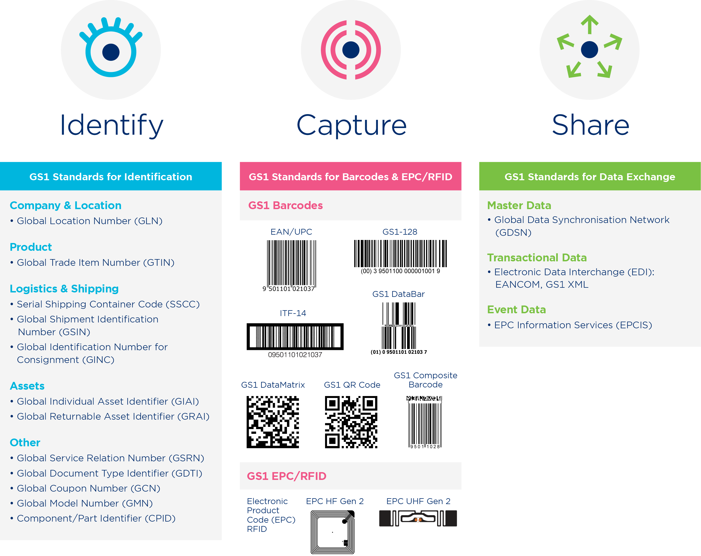
Barcode & Data Scope
WHAT
IDENTIFY, CAPTURE & SHARE
  GS1 standards create a common language to identify, capture and share product data, ensuring important information is accessible, accurate and easy to understand.
  Choose the appropriate data carrier and implement across the end-to-end Value Chain
  Manufacturer
  Wholesaler
  Distributor
  Customs authorities
  Online store
  Retailer
  E-fulfilment center
  Logistic service provider
  Distribution center
  Pick-up point
  Consumer
GENERAL
WHY
WHAT
WHO
HOW
REPORT & LEARN
Notes:
GS1 creates a common langauage to identify, capture and share product data in through different standards. Hereby an overview of these standards.

Slide 40
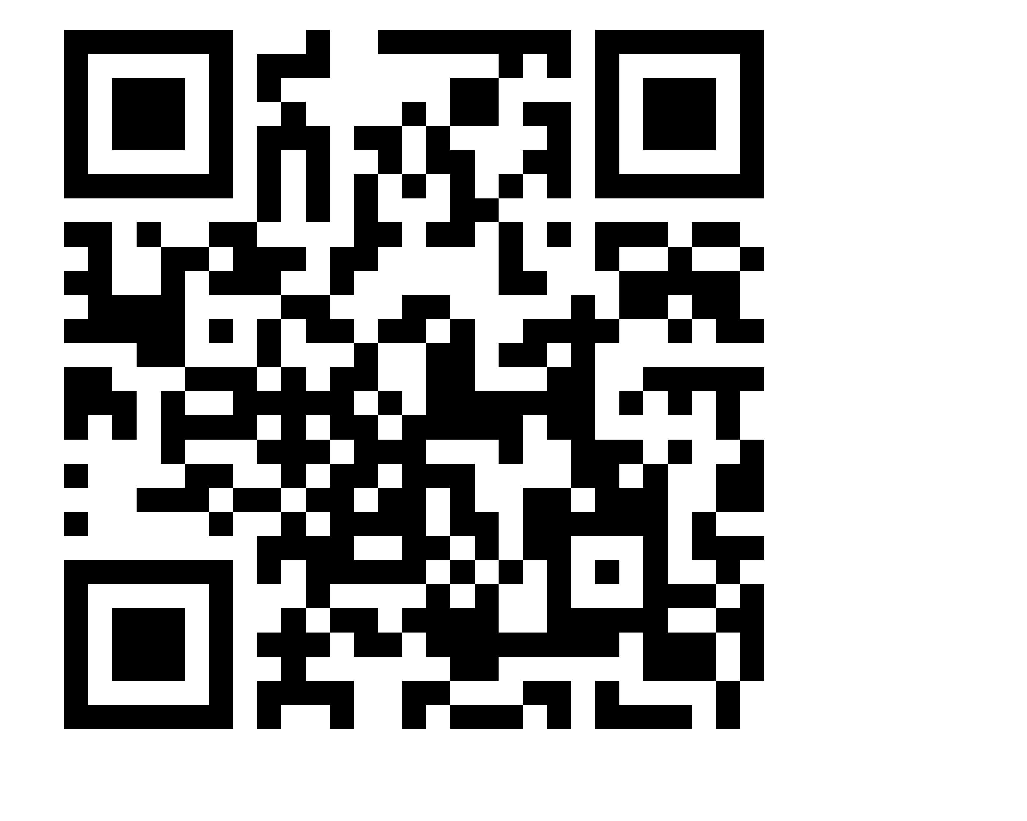


Barcode & Data Scope
WHAT
2D BARCODE TYPES
  There are three types of 2D barcodes that enable a wide range of use cases:
  QR Code with GS1 Digital Link syntax
  Data Matrix with GS1 Digital Link syntax
  GS1 DataMatrix with element string syntax
QR Code
Data Matrix
GS1 DataMatrix
The only 2D barcode that is consumer scannable with all smartphone cameras.
Connects to the web.
Can connect to the web but requires an app to scan with a smartphone.
Can be printed a little smaller than a QR Code with the same data.
Useful in supply chain applications where consumer engagement is not a requirement today, such as variable-measure products at POS.
Requires an app to scan with a smartphone
GS1 Digital Link
syntax
GS1 element
string syntax
GENERAL
WHY
WHAT
WHO
HOW
REPORT & LEARN
40
Notes:
For 2D there are three types of barcodes to choose from with different uses and elements. Please contact local GS1 to assist with the right choice.

Slide 41
Barcode & Data Scope
Use cases including supporting data attributes
Example data that could unlock the use cases
 | GTIN | Digital Link URL/URI | Consumer Product Variant (CPV) | Net Weight + Price + Best Before Date (Variable Measure) | Batch/Lot Number | Expiration Date/ Best Before Date | Serial Number | Country of Origin
Consumer Engagement | x | X | X
Sustainability | X | X | X |  |  | X
Traceability | X | X | X |  | X |  | X | X
Safety | X | X | X |  | X | X
Inventory Management | X | X | X | X | X |  | X
Improved Packaging | X | X | X
CRAWL
(2D + GTIN • in store printing)
WALK
(Preprinted labels w/more data)
RUN
(In-line printing)
GENERAL
WHY
WHAT
WHO
HOW
REPORT & LEARN
Notes:
This is a (non-exhaustive) overview of what data attributes can help with what use cases. The data attributes will have a different impact on the processes and systems that may need to be adjusted (from crawl to walk to run). Again local GS1 can help you with deciding on the right data attributes.

Slide 42
Value Chain Scope
WHAT
ABOUT
  Third in scope is thoroughly looking at the end-to-end value chain to see who is impacted by the pilot and what adjustments need to be made in process, data and IT.
    Analyzing the end-to-end value chain will ensure you will not overlook any players nor steps that may be impacted.
    It will give you an insight into the impact for the different stakeholders whether technically, operationally or organizationally.
    During the project planning decide what changes are necessary for the pilot and which are not (resolve through workarounds, e.g. virtual stock counting).
APPENDIX
  End-to End Value Chain
  High-level Value Chain process impact
  High-level Value Chain data & IT impact
GENERAL
WHY
WHAT
WHO
HOW
REPORT & LEARN
Notes:
First in scope is deciding in what country or geographical area to pilot. If you ar in retail decide on how many stores to pilot in. Easiest to test is a small set-up.
Next is thoroughly looking at the end-to-end value chain to inventarise which steps are impacted by the pilot and what adjustments need to be made in process, data and IT.

Slide 43
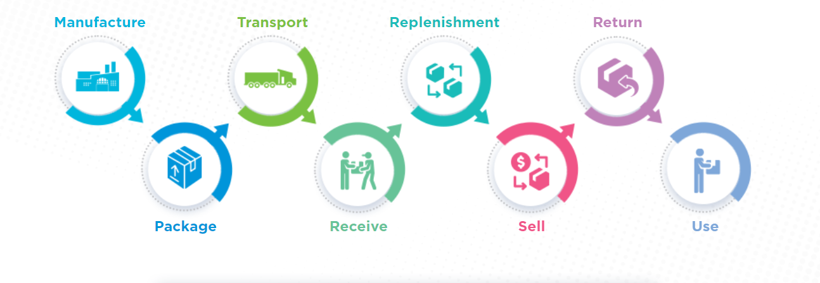
Value chain
Think about the E2E impact in the whole value chain and all process, data and IT touchpoints
GENERAL
WHY
WHAT
WHO
HOW
REPORT & LEARN
Notes:
An overview of the value chain from grower (in case of food) to manufacturer, transport and logistics to the wholesales and distributor to the retail distribution center to the retail store and finally to the end consumer (and sometimes back).

Slide 44
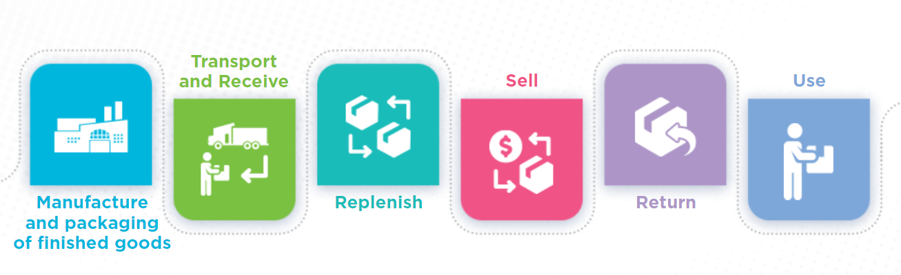
Value Chain
Possible process impact
Process impact
Printing
Packaging
Labelling
Adjustments
Redesign packaging and labels
Adjust production lines (packaging & printing)
On-demand 2D print solutions for item/case/pallet labelling
Process impact
Scanning
Weighing
Consumer communication
Processing payment
Adjustments
Adjust in-store printing
Adjust scales systems
Adjust in-store processes
Educate consumers
Train in-store staff
Manufacture and packaging of finished goods
Sell
Process impact
Scanning
Adjustments
Scanning/reading hardware and software
Process impact
Tracking returned goods
Revalorisation
Adjustments
Develop consumer communications
Develop digital touchpoints (web/apps)
Utilise GS1 Digital Link for apps
Transport and receive
Return
Process impact
Replenishment
Inventory checking
Adjustments
Adjust replenishment models
Adjust replenishment processes (including picking)
Process impact
Engaging consumers
Process post-purchase data
Adjustments
Educate consumers
Replenish
Use
GENERAL
WHY
WHAT
WHO
HOW
REPORT & LEARN
Notes:
An overview of key value chain steps. From manufacturing to packaging to transport to receiving to replenishment to sales to return to use. Different operational processes can be impacted during these steps and may need to be adjusted. These can be smaller or larger changes. It needs to be decided whether to change these processes (and often IT and data) completely for the pilot or whether to use things like test versions, materials or virtual workarounds (eg for replenishment models) to proof the business case before making full adjustement for implementation and scale-up.

Slide 45
Value Chain
Possible data and IT system impact
Data impact
Product packaging
Load carrier labels
Product data
Production data
IT system impact
Factory ERP
Manufacturing Execution systems
Printing & scanning systems
Quality Management Systems
Material Sourcing systems
Product Information Management systems
Data impact
Production data
Dynamic pricing
Product info
Product photos
IT system impact
Point of sales system (POS)
Weight systems
Mobile consumer apps
PIM/DAM systems
Manufacture and packaging of finished goods
Sell
Data impact
Load carrier labels
Advanced Ship Notice messages
Warehouse instructions
IT system impact
Scanning systems
Global IoT tracking systems
Mobile apps, including scanning
Warehouse management systems
BI-systems
Data impact
Returns and recycling instructions
Returns data
Repairs/refurb data
Recalls
IT system impact
Store Fulfilment Management system
Recycling systems
Transport and receive
Return
Data impact
Inventory management data
Warehouse instructions
IT system impact
Mobile apps, including scanning
Warehouse management systems
Store Fulfillment Management systems
BI-systems
Data impact
Web links
Consumer opt-in
IT system impact
Consumer mobile platforms and apps
Web shops
Replenish
Use
GENERAL
WHY
WHAT
WHO
HOW
REPORT & LEARN
Notes:
Again the overview of key value chain steps. From manufacturing to packaging to transport to receiving to replenishment to sales to return to use. Next to processed the impact of adding product data during the different steps and its impact on different systems need to be inventarised. The impact depends the use case(s), on choices made for data attributes, wether in a closed environment without external partners or an open environment, whether workarounds and shortcuts will be used for the pilot or not (e.g. in case of a legal obligation). This should be further worked out during the project preparation.

Slide 46
Key learnings
WHAT
Key learnings
  Review the key learnings and pitfalls from previous global 2D pilots to jump start your 2D pilot. You will find the learnings throughout the 2D pilot toolkit.
SCOPE (WHAT)
    Map the entire process
    Understand the entire IT changes needed, not just how back-end systems connect to POS
    Think through a roadmap of use cases & how to combine them to simplify codes on-pack
    Evaluate opportunities for your private label products
    Keep in mind that a logistical unit is not the same as a consumer unit during set-up
    Check if your back-end systems can accept a 14-digit GTIN, next to 12 or 13 digits
    Think carefully before choosing your data carrier
    Validate on-pack data with data available elsewhere
    Consider opportunities to connect 2D to more information at different stages
    Check the format of dates and other structures that are fully defined within GS1 standards
    Even if you are not starting a pilot yet, when making changes to your data environment, start preparing for more product data.
    Please note that 2D implementation (and sometimes even piloting) is often not easy with e.g. in grocery with over 30k SKUs and many suppliers. It is therefore key to start with the right scope and set-up to then use the results to decide on further roll-out.
    Understanding obstacles and thinking about them up front will increase your chances of success. Key obstacles can be limited upside for a category/SKUs, large print and system investments, complex value chains, limited consumer response, number of SKUs, difficult cooperation in the value chain.
GENERAL
WHY
WHAT
WHO
HOW
REPORT & LEARN
Notes:
This slide contains learnings on the scope.

Slide 47
Involving the WHO
  Which supply chain partners, solution providers and internal stakeholders will you engage to create success
GENERAL
WHY
WHAT
WHO
HOW
REPORT & LEARN
Notes:
This chapter lays out which supply chain partners, solution providers and internal stakeholders could be involved when setting up a 2D barcode pilot.

Slide 48
Identify Stakeholders for Pilot
WHO
STAKEHOLDERS
  Select your subject matter experts and other champions based on your pilot scope and use cases.
  Each internal stakeholder should be aligned with their counterparts at external partners.
  GS1 helps to provide:
    Guidance on the use of GS1 standards and solutions
    Expertise in 2D barcode and data selection
    Key learnings and other best practices for pilot implementation
  Internal
  IT
    ERP systems
    Point of sales systems
    Web and app infrastructure
    Reporting & analytics systems
    Other systems
  Supply chain (incl. logistics)
  Marketing
  Finance
  Legal
  Operations (incl. in store employees)
  Purchasing department
  External
  Manufacturers / Brand owners
  Retailers
  Solution Providers
    Scanning hardware & software
    On demand barcode printing
    Printing
    Scales
    POS software
    Other
  Local GS1 office
GENERAL
WHY
WHAT
WHO
HOW
REPORT & LEARN
Notes:
Starting internally, a 2D pilot is usually started from one angle from one department (IT/ Legal/Marketing, Supply Chain). Just approaching this from this one department leaves many possible further benefits aside. Please ensure to have an initial meeting internally to see what opportunities the different departments see and then decide who to include in the project. Furthermore, involving external stakeholders from the start enhances the chances of success and sets companies up better for scale-up when the pilot shows successful KPIs.

Slide 49
Key learnings
WHO
Key learnings
    STAKEHOLDERS (WHO)
    Ensure top-management commitment
    Identify updates needed to data governance models
    Identify adjustments needs to product lifecycle management processes
    Ensure cross-functional teams are involved from IT, Supply Chain and marketing
    Consider partnering with a trading partner that has similar timelines and goals
    Involve applicable equipment system and IT solution providers
    Ensure retailers and manufacturers collaborate on the desired barcode and data attributes and outline the benefits for each stakeholder
    Set up a matrix to clarify roles and responsibilities within your organisation and between external partner organisations
    Partner with internal and regulatory compliance resources if regulatory requirements need to be met
  Before selecting stakeholders for your 2D pilot, it is important to consider and achieve the following:
GENERAL
WHY
WHAT
WHO
HOW
REPORT & LEARN
Notes:
Starting internally, a 2D pilot is usually started from one angle from one department (IT/ Legal/Marketing, Supply Chain). Just approaching this from this one department leaves many possible further benefits aside. Please ensure to have an initial meeting internally to see what opportunities the different departments see and then decide who to include in the project. Furthermore, involving external stakeholders from the start enhances the chances of success and sets companies better up for scale-up when the pilot shows successful KPIs.

Slide 50
Set up the project, the HOW
  How to set up and implement a 2D pilot; looking at different pilot building blocks, learnings and pitfalls
HOW
REPORT & LEARN
GENERAL
WHY
WHAT
WHO
HOW
Notes:
This chapter lays out how to set up a 2D barcode pilot. It outlines the four different phases of a project without going into details on project methodology. Every company uses its own methodology. It does include a check list with basic checks as well as checks from learnings for companies to print out and use as reference. Lastly an overview of key learnings are included in this chapter, which may be the most meaningful insights to take in. These will be continuously updated with every pilot shared with the GS1 community.

Slide 51
Set Up Pilot
HOW
Pilot Steps
  Now that you’ve explored the use cases, identified the scope and partners, it is time to set up and run your pilot. This section breaks down the key steps to not only prepare for a successful pilot but guides you in reporting on the results and capturing learnings.
1
Discovery
2
Prepare & Mobilize
3
  Execute
4
  Report & Learn
HOW
REPORT & LEARN
GENERAL
WHY
WHAT
WHO
HOW
Notes:
Projects usually include four phases, discovery (WHY), prepare and mobilize, execute (WHAT, WHO and HOW) and report & learn (REPORT & LEARNINGS). The second column describes the different elements during this phase. The third contains a description of the element as well as links to modules, tools and templates where specific to 2D barcode pilots. The first step is the discovery phase in which to gather information and enable a data driven decision on the pilot.

Slide 52
Discovery
Project Phase Overview
1
KEY
OBJECTIVE
The key objective of the Discovery phase is to gather information and to enable a data-driven decision on the pilot
OVERVIEW
ELEMENT
ELEMENT DESCRIPTION*
1
2D use cases
Approach and processes on how to develop a business case
Discovery
Determine use cases from based on business priorities
2
KPIs
Determine objective/goal (KPIs)
Prepare & Mobilize
Benefits
Determine expected benefits for business cases
3
Costs
Define possible costs for business cases
  Execute
4
Impact/effort matrix
Create impact/effort matrix
  Report & Learn
* Click links to access additional information
HOW
REPORT & LEARN
GENERAL
WHY
WHAT
WHO
HOW
52
Notes:
Projects usually include four phases, discovery (WHY), prepare and mobilize, execute (WHAT, WHO and HOW) and report & learn (REPORT & LEARNINGS). The second column describes the different elements during this phase. The third contains a description of the element as well as links to modules, tools and templates where specific to 2D barcode pilots. The first step is the discovery phase in which to gather information and enable a data driven decision on the pilot.

Slide 53
Prepare & Mobilize
Project Phase Overview
2
KEY
OBJECTIVE
The key objective of the Preparation & Mobilize phase is to set-up the pilot project and mobilize people
OVERVIEW
ELEMENT
ELEMENT DESCRIPTION*
1
Stakeholders
Approach and processes on how to develop a business case
Discovery
Involve end-to-end stakeholders along value chain
2
Collaboration model
Define collaboration model
Prepare & Mobilize
Checklist
Validate checklists for Brands/Manufacturers, Retailers ​and Solution Providers
3
Scope
Define scope​
  Execute
4
Governance
Set up a governance model
Report & Learn
Project team
Set up (pilot) project team ​
Project planning
Develop pilot/project planning​
Communication plan
Make communication plan for end-to-end stakeholders
Kick-off
Kick-off pilot ​
* Click links to access additional information
GENERAL
WHY
WHAT
WHO
HOW
REPORT & LEARN
53
Notes:
The second phase is report and mobilize in which the what, who and how is set-up and resources are mobilized. This phase finishes with a kick-off.

Slide 54
Execute
Project Phase Overview
3
KEY
OBJECTIVE
The key objective of the Execute phase is to put the plan into action
OVERVIEW
ELEMENT
ELEMENT DESCRIPTION*
1
Discovery
Process analysis & design
Define process impact along end-to-end value chain
2
Data impact
Define data impact along end-to-end value chain
Prepare & Mobilize
3
IT
Define IT Architecture, hardware, infrastructure & software impact
  Execute
Development cycle
4
Develop/Build/Test/Run/Run model support (e.g. consumer service)
Report & Learn
Change management
People training or change management ​
Documentation
Documentation
Budget tracking
Coordinate with finance
Stakeholder management & communication
Coordinate frequent communication across all internal and external stakeholders
* Click links to access additional information
HOW
REPORT & LEARN
GENERAL
WHY
WHAT
WHO
HOW
54
Notes:
The third phase is the execution phase in which the detailed elements are worked out and the pilot project is executed. Furthermore, project management and communication is key during this phase.

Slide 55
Report & Learn
Project Phase Overview
4
KEY
OBJECTIVE
The key objective of the Report & Learn phase is to share your learnings with the wider GS1 community
OVERVIEW
ELEMENT
ELEMENT DESCRIPTION*
1
Discovery
2D Pilot tracker
A tool to document status during your 2D pilot (incl. KPIs)
2
2D Pilot report
Template to document pilot details and facts
Prepare & Mobilize
3
Storytelling template
Further build out via 2D pilot template storytelling
  Execute
Scale-up
4
Consider next steps and process adjustments for scale-up to a full implementation
Report & Learn
* Click links to access additional information
HOW
REPORT & LEARN
GENERAL
WHY
WHAT
WHO
HOW
55
Notes:
The last phase the report and learn phase in which the progress of the pilot project is tracked as well as after the end of the pilot lessons learned can be shared with the wider GS1 community and inspiring stories are told for more companies to start piloting. Lastly, if the pilot has been successful, a plan for scaling-up should be made (note: in the set-up of the pilot companies should already think about what decisions need to be made to make scaling-up after successful pilots easier).

Slide 56
Checklist Brand Owners
For manufacturers
or brand owners
HOW
Scope checklist
Technical checklist
  While the pilot toolkit includes a lot of information for discovery and planning for a pilot, this checklist can be valuable for Manufacturers/Brands to confirm all business, technical and partnership steps have been met.
  Download a PDF checklist:
  https://www.gs1.org/docs/retail/Brand_and_Manufacturer_2D_barcodes_checklist.pdf
Evaluate business use case opportunities.
Pick a pilot product, line or category.
Evaluate existing barcodes on-pack.
Select 2D barcodes based on use cases and requirements.
Identify additional data needs that need to be encoded with the GTIN.
Understand data and GS1 standards before making decisions.
Ensure technical capabilities for encoding dynamic data (where applicable).
Assess print capabilities and print quality.
Check for scanning compatibility with the new barcode.
Ensure software, hardware and databases are up-to-date.
Stakeholder checklist
Align internal stakeholders, such as Supply Chain, IT dept, Marketing.
Engage with your Solution providers.
Collaborate with a retailer to test POS checkout feasibility for the new 2D code.
Identify common goals and measures with collaboration partners.
Involve authorities if required in your region.
HOW
REPORT & LEARN
GENERAL
WHY
WHAT
WHO
HOW

Slide 57
Checklist Retailers
For retailers
HOW
Technical checklist
  While the pilot toolkit includes a lot of information for discovery and planning for a pilot, this checklist can be valuable for Retailers to confirm all technical and partnership steps have been met.
  Download a PDF checklist:
  https://www.gs1.org/docs/retail/Retailer_2D_barcodes_checklist.pdf
Partner with your scanner and POS solution providers for guidance on system readiness for 2D.
Evaluate backend system upgrades required to leverage additional data.
Ensure systems can ingest additional data to support new business use cases.
Ensure your scanners are ready to read all 2D in Retail standard barcodes.
Stakeholder checklist
Collaborate with trading partners to align on business use case opportunities and additional data that you would like to capture.
Evaluate opportunities for your private label products (see checklist for manufacturers).
Collaborate closely with solution providers; make sure POS checkout is updated and configured for your business use cases.
Identify common goals and measures with collaboration partners.
Educate in-store associates.
Educate consumers: self checkout, omni-channel and consumer engagement.
HOW
REPORT & LEARN
GENERAL
WHY
WHAT
WHO
HOW

Slide 58
Checklist Solution Providers
For Solution Providers
HOW
Scope checklist
Technical checklist
Review products that will be used in the pilot, including evaluating the product substrate.
Understand which static and dynamic data needs to be encoded in 2D barcodes, which are determined by the desired use case.
Understand the GS1 data structure and quality standards.
Evaluate the printing and scanning environment including print surface.
Ensure technical capabilities for encoding dynamic data (where applicable).
Assess print capabilities and print quality and adjust based on the print environment.
Check for scanning compatibility with 2D barcodes.
Ensure software, hardware and databases are up-to-date.
Optimise how data is encoded in the 2D barcode.
  While the pilot toolkit includes a lot of information for discovery and planning for a pilot, this checklist can be valuable for solution providers to determine the right technical solution.
  Download a PDF checklist:
  https://www.gs1.org/docs/retail/Solution_Provider_2D_barcodes_checklist.pdf
Stakeholder checklist
Internal stakeholders to take on board include brand marketing/manufacturing, information technology, shop floor operations and maintenance departments.
Engage with up and downstream solution providers (label software, printing, scanning, enterprise, etc.).
Collaborate with brand and retailer to ensure POS checkout feasibility for the new code.
Identify common goals and measures with collaboration partners to avoid conflicts later.
Involve authorities if required in your region.
HOW
REPORT & LEARN
GENERAL
WHY
WHAT
WHO
HOW

Slide 59
Key learnings
HOW
Key learnings
  Review the key learnings and pitfalls from previous global 2D pilots to jump start your 2D pilot. You will find the learnings throughout the 2D pilot toolkit.
    PRINTING (HOW)
    Evaluate your current printing systems and explore how it can be adapted for various use cases
    Migrating to 2D barcodes is easiest for products that you are already labeling individually (such as deli or fresh meat, where an expiry date could be added)
    For pre-printed products, adding the GTIN to a QR Code may be most appropriate for consumer engagement
    Static printing is much cheaper to start with than dynamic printing (evaluate production process, print capabilities and investment needed)
    Evaluate all printers also in store; e.g. for in-house deli system
    Test 2D barcode printing on labels until barcode quality is good
    Beware that bright sunlight, and background colors might cause issues for efficient scanning
    Clean printers regularly to ensure the printed barcodes can be scanned
    Prepare to include 2D in your natural packaging (re)design cycle
    Prepare to changeover to 2D in your regular printing systems investment cycle
GENERAL
WHY
WHAT
WHO
HOW
REPORT & LEARN
Notes:
This slide contains learnings on printing specifically.

Slide 60
Learnings
HOW
Key learnings
  Review the key learnings and pitfalls from previous global 2D pilots to jump start your 2D pilot. You will find the learnings throughout the 2D pilot toolkit.
IMPLEMENTATION (HOW)
    Evaluate all scanners and update hardware or software where needed: POS, flatbed scanners, fixed scanners, handheld scanners, in-store apps-including APIs, and warehouse scanners
    Understand the capabilities of 2D image scanners in collaboration with your solution providers (For example, can your scanners accommodate two barcodes with the same GTIN on the product? You may need a software upgrade to achieve this)
    Ensure mobile devices from consumers can interact with the 2D barcodes
    Train in-store employees and gain buy-in as part of the pilot planning
    Translate the improved (future) system capabilities into associate training (what to do when I see multiple barcodes?)
    Educate consumers: self checkout, omni-channel and consumer engagement
    Check the latest GS1 Standards guidelines for the human readable text under the 2D barcodes and review GS1’s scanner testing outcomes
GENERAL
WHY
WHAT
WHO
HOW
REPORT & LEARN
Notes:
The last learning slide goes deeper into learnings from the implementation phase.

Slide 61

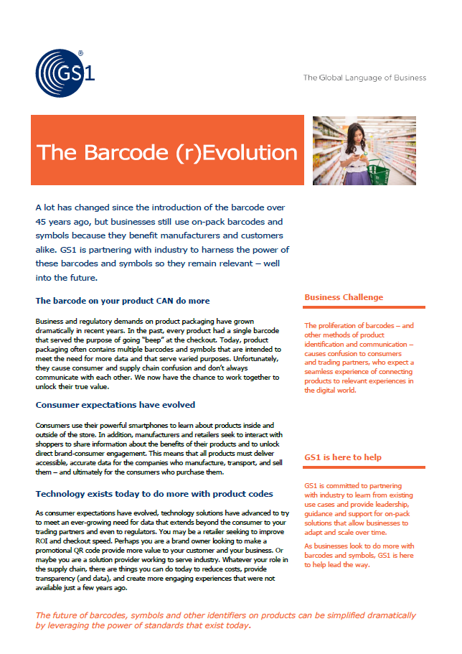

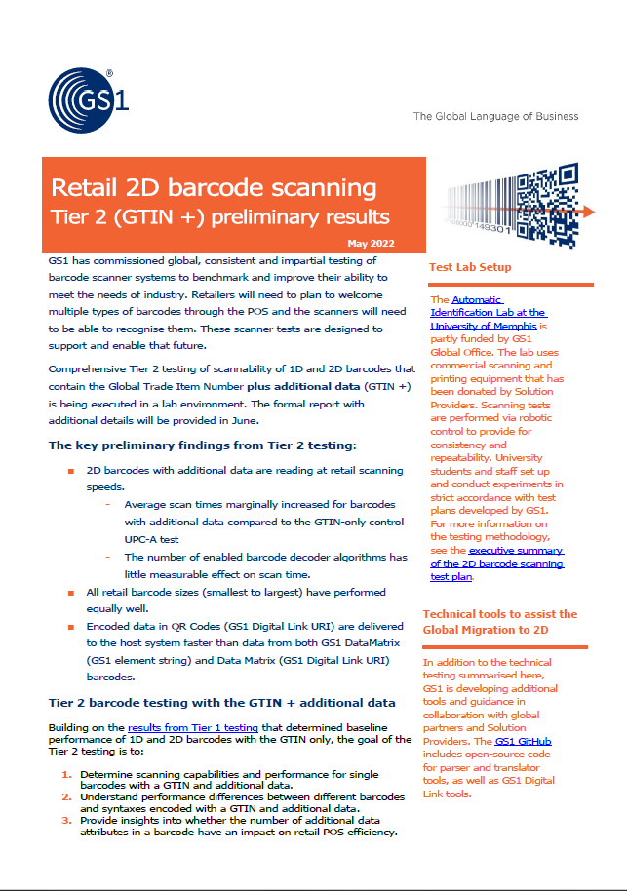

Additional Resources
TOOLS
REFERENCE DOCUMENTS
  Reference documents are available such as guidelines, use cases, media and other links that provide information for 2D pilots.
LINKS
2D in Retail: main webpage resource
GS1 Digital Link
Global 2D Programme - Foundational FAQs
GS1 DataMatrix Guideline
2D Barcode Explorer
GS1 GitHub
Best practices for creating QR Codes powered by GS1
GS1 General Specifications
HOW
REPORT & LEARN
GENERAL
WHY
WHAT
WHO
HOW
Notes:
Tools & templates contain an overview of available reference documents like guidelines, use cases, media and useful links that serves as a mini library for 2D piloting.

Slide 62
Additional Resources
TOOLS
CASE STUDIES
  Case Studies document specific industry success stories from implementing 2D barcodes
Inventory management
Sustainability
Safety
Consumer engagement
Sustainability
Safety
Inventory management
Improved packaging
Inventory management
Sustainability
Safety
HOW
REPORT & LEARN
GENERAL
WHY
WHAT
WHO
HOW

Slide 63






Additional Resources
TOOLS
VIDEO LINKS
  Case Study videos document specific industry success stories from implementing 2D barcodes
GS1 DataMatrix for variable weight products
GS1 Belgium-Luxembourg
Woolworths implements 2D barcodes
GS1 Australia
First scan of a 2D QR Code with GS1 Digital Link
GS1 Brasil
2D barcodes gain momentum in China
GS1 China
Expiry date management across 12,432 convenience stores
GS1 Thailand
GS1 DataMatrix implementation for fresh products
GS1 Switzerland
HOW
REPORT & LEARN
GENERAL
WHY
WHAT
WHO
HOW

Slide 64
Reporting & learnings
    How to capture learnings and report back to the GS1 community
HOW
GENERAL
WHY
WHAT
WHO
HOW
REPORT & LEARN
Notes:
This chapter lays out how to track a 2D barcode pilot, but moreover how to capture learning and report back to the GS1 community.

Slide 65
Reporting & Learning
REPORTING
ABOUT
  Reporting 2D pilots
    Storytelling
    Facts
  Share learnings
  Reporting 2D pilots and sharing learnings will enable other Consumer Products and Retail organizations to recognize benefits as well as jump start their own 2D pilots; the power of the GS1 community!
TOOLS
TEMPLATES
  Using templates provided by GS1 enables the set-up of a repository in the future, where other companies can look up similar pilots
  2D pilot tracker
  2D pilot report for repository
  2D pilot template storytelling
HOW
GENERAL
WHY
WHAT
WHO
HOW
REPORT & LEARN
Notes:
Reporting and sharing learnings within the GS1 community is the most powerful way to help and accelerate companies and innovations to become more widespread. This chapter contains links to different reporting templates that serve that purpose and will be used to continue to improve this toolkit.

Slide 66
Report & Learn
2D Pilot tracker
 | On Schedule |  | Minor risk/~10% behind schedule |  | Significant risk/>10% behind schedule |  | Complete
Stage | Date/Status
Planning
Pilot Duration
Review/Report
Pilot Scale
Test Lab | In Store | Multi-location
Updated
Key Stakeholders | Company | Name
GS1 Lead
Retailer Lead
Brand/ Manufacturer/ Supplier Lead
Solution Provider Lead
Other Participants
Key Learnings
KPIs | Baseline | New
HOW
GENERAL
WHY
WHAT
WHO
HOW
REPORT & LEARN
Notes:
The 2D pilot tracker provides a high-level overview of the pilot by sharing key contacts and key elements of the pilot. Together with the next template (pilot report), this will help GS1 in bringing companies together that are on a similar path but also ease finding similar 2D pilots, key contacts and key learnings.

Slide 67
Report & Learn
2D Pilot Report for repository
Business Use Case Definition
Description of business challenge and desired outcome:
Key Drivers: (check all that apply) | Inventory Management Traceability Safety Sustainability | Consumer Engagement Improved Packaging Maintain POS efficiency Other: | Consumer Engagement Improved Packaging Maintain POS efficiency Other:
Pilot Scale & Product Details: | Number of stores: Type of product: Number of products:
Participants: | Supplier Retailer |  | Solution Provider GS1 MO
Data encoded: | GTIN Best Before Date Batch/Lot Number |  | Serial Number Expiry Date Other:
2D Barcode Selected: | QR Code Data Matrix |  | GS1 DataMatrix
Organisation Details
GS1 Member Organisation:
Retailer, Brand / Manufacturer and Solution Provider Company Names involved in pilot:
Core Focus | Retailer | Manufacturer
Key benefits / learnings
Qualitative benefits/outcomes:
Quantitative metrics:
Contact:
Email:
Date:
HOW
GENERAL
WHY
WHAT
WHO
HOW
REPORT & LEARN
Notes:
The 2D pilot report for repository, summarizes the key characteristics of 2D pilots, which will enable a future repository and easy filtering options for finding similar 2D pilots for chosen use cases.

Slide 68
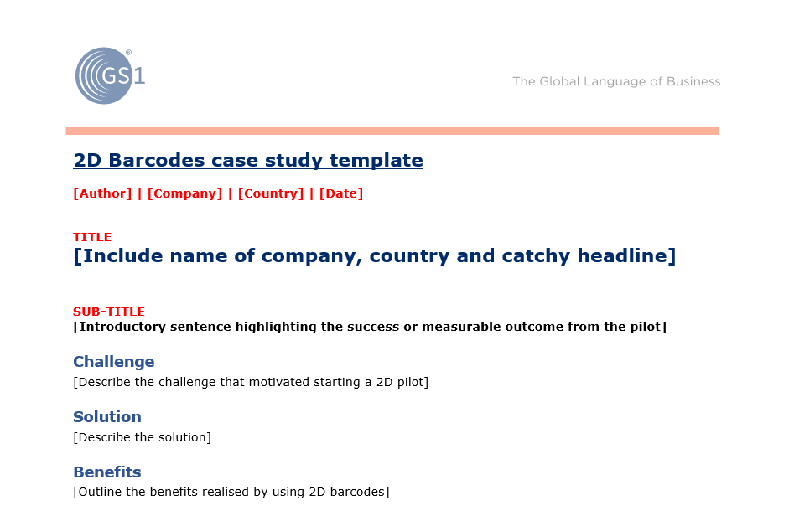
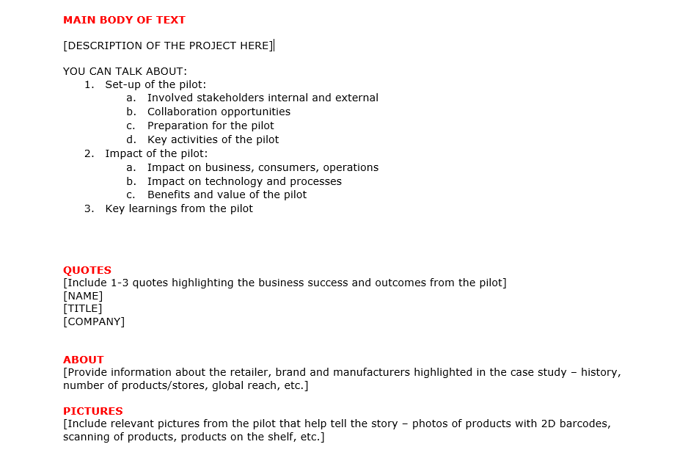
Report & Learn
Additional Template for Detailed Storytelling
Download online: https://www.gs1.org/docs/retail/2D_pilot_storytelling_template.docx
HOW
GENERAL
WHY
WHAT
WHO
HOW
REPORT & LEARN
Notes:
The 2D pilot report for repository, summarizes the key characteristics of 2D pilots, which will enable a future repository and easy filtering options for finding similar 2D pilots for chosen use cases.

Slide 69
Have questions?
CONTACT GS1
https://www.gs1.org/contact
HOW
REPORT & LEARN
GENERAL
WHY
WHAT
WHO
HOW
Notes:
Do you have any questions, please contact the global GS1 office or your local GS1 Member Office.

